Slide 1
Navigating Banner 9
Thor Johnsen
Banner Student Consultant
Thor.Johnsen@ellucian.com

Slide 2
Application Navigator and the Main Menu

Slide 3






Application Navigator
The Welcome Screen: 4 ways to navigate
  Search Box:
    Searches page names and descriptions
    Also search menus and jobs/processes
  Menu Icon:
    Essentially the Main Menu
  Search Icon:
    Like the “Go To box”
    Like a Search Box that’s accessible on any page
  Recently Opened Icon:
    Previously found under ‘File’
    Now includes all objects previously opened

Slide 4
Banner 9 Terminology

Slide 5
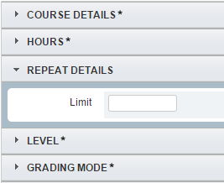



Terminology
  Forms = Pages
  From Key Block; Next Block (Section) = ‘Go’
  Rollback = ‘Start Over’
  ‘Blocks’ are now ‘Sections’
    Query = Filter
      Execute = Go

Slide 6
Parts of a Page, Notification Center, and Filters

Slide 7

Parts of a Page – Page Header
  Page Close
  Page Title (Controlled on GUAUPRF)
  BDM Add/Retrieve
  Related Menu
    Like the Options Menu in INB for pages
  Tools Menu
    Like the Options Menu in INB for actions

Slide 8



Parts of a Page – Page Footer
  Previous/Next Section
  Save (Or Cancel/Select)
  Record Count
  Table/Field Name

Slide 9
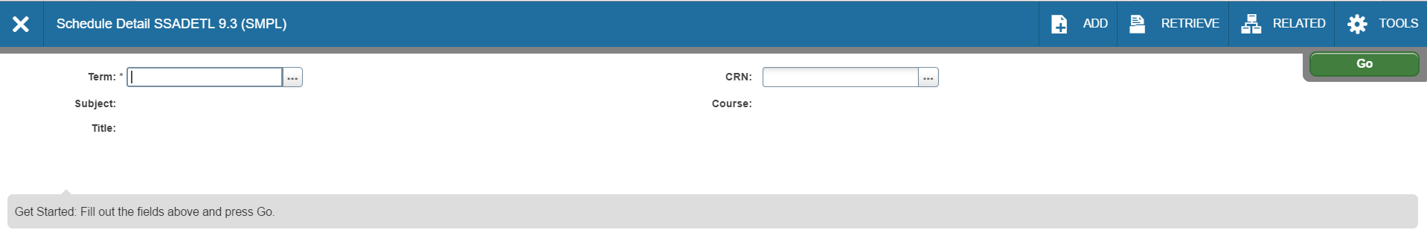



Parts of a Page
  Key Block
    Enterable only when in Key Block
  Sections
    Multiple/Single Record*
    Can be collapsed/expanded
  Online Help
    Can be your best friend!
  ‘Look Up’ Button
    Displays List of Values from corresponding Validation table

Slide 10




Notification Center
  Different Information is displayed with these
  Compare it to traffic signals
    Green: Saved Successfully
    Yellow: Warning
    Red: Error
      Multiple errors are displayed together
    Blue: Informational

Slide 11
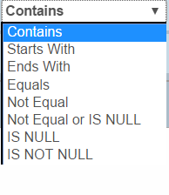
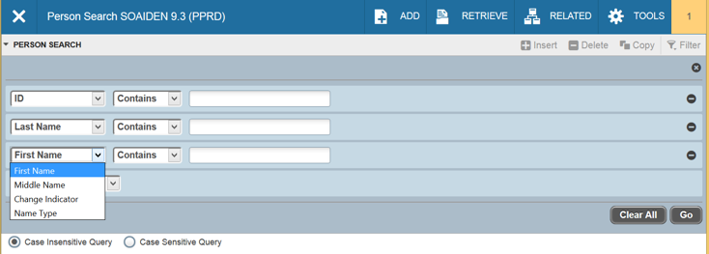
Filters
  % and _ (underscore) are wildcards
  % represents any amount of characters
    Ex.: %G% = any page/record with a ‘G’ in it
    _ only represents one wildcard character
  New filter options

Slide 12
Keyboard Shortcuts

Slide 13
#1 Best Feature
How to make Banner BIGGER
  Ctrl = increase zoom (essentially ctrl with +)
  Ctrl – decrease zoom
  Ctrl 0 reset zoom to 100%
These are all web shortcuts (not new Banner shortcuts) but because XE is not on Oracle forms, these shortcuts actually work now.

Slide 14
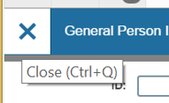
Keyboard Shortcuts
Buttons display shortcut with mouse-over
Command Banner 8 Banner 9
Save F10 F10
Rollback/Start Over Shift+F7 F5
Quit/Close Ctrl+Q Ctrl+Q
List of Values/Lookup F9 F9
Log Out of Banner Ctrl+Q Ctrl+Shift+F
Next Block/Next Section; Go Ctrl+PgDwn Alt+PgDwn
Previous Block/Section Ctrl+PgUp Alt+PgUp
Clear Block/Section Shift+F5 Shift+F5
Next Field Tab Tab
Previous Field Shift+Tab Shift+Tab
Checkbox toggle Spacebar Spacebar
Radio Group toggle Left/Right Arrow Left/Right Arrow
Go To: Search F5 Ctrl+Shift+Y
Go To: Recently Opened F5+Up/Down Ctrl+Y+Up/Down
Forms with Tabs direct to Tab F2 Ctrl+Shift+1, 2, 3, 4

Slide 15
Keyboard Shortcuts
Command Banner 8 Banner 9
Enter Query/Filter F7 F7
Execute Query/Go (on Filter) F8 F8
Quit/Exit/Cancel Query Ctrl+Q Ctrl+Q
Insert Record F6 F6
Delete Record Shift+F6 Shift+F6
Copy Record/Section F4 F4
Clear Record Shift+F4 Shift+F4
Next Record Down Arrow Down Arrow
Previous Record Up Arrow Up Arrow
Cut Ctrl+X Ctrl+X
Copy Ctrl+C Ctrl+C
Paste Ctrl+V Ctrl+V
Open Related Menu Alt+O Alt+Shift+R
Open Tools Menu Alt+O Alt+Shift+T
Help Alt+H+H Ctrl+Shift+L

Slide 16
Keyboard Shortcuts
Command Banner 8 Banner 9
SDE: Ctrl+D Ctrl+Shift+U
Print: Shift+F8 Ctrl+P
Data Extract/Export Alt+H+X Shift+F1
Change MEP Context Alt+Shift+C
BDM: Add Document Alt+A
BDM: Retrieve Document Alt+R
Workflow: Submit Alt+W
Workflow: Release Alt+Q

Slide 17
Supplemental Documentation
  Banner Transformed: Getting Started With Your Administrative Applications
    Also includes Banner keyboard shortcuts
    Also available on Client Documentation Library

Slide 18

Demonstration
Thor Johnsen
Email: Thor.Johnsen@ellucian.com
Phone: 407-670-4529

