Slide 1
The Triploid Grass Carp Risk Assessment Tool
Use to inform your decision making process.
Are you a good candidate for Grass Carp
Containment is one issue
Others include destruction of plant biodiversity, loss of fish habitat, and survival/establishment of grass carp population.
No guarantee for the CT DEEP to issue a permit, but
can inform your communities on the importance of protecting biodiversity and fish habitat
can inform the communities on the health and characteristics of your lake
Important information to lead to possible other types of mediation.

Slide 2
Finding the Data

Slide 3
Limnological Data
This includes measurements of:
Total Phosphorus
Total Nitrogen
Chlorophyll-A
Secchi Disk Transparency
Bathymetry
Littoral zone
Bathymetry
Why is this data important?
Used to determine lake health and determine trophic level (production of energy)
Important in considering if the lake will support a population of grass carp.
Where to find this data:
Primary literature:
Connecticut Lakes: A Study of the Chemical and Physical Properties of 56 Connecticut Lakes
https://www.isbns.co.tt/isbn/9781878899040/
Connecticut College Arboretum; Dr. Pete Silver.
Chemical and Physical Properties of Connecticut Lakes, With Emphasis on Regional Geology
Bathymetry data:
https://portal.ct.gov/-/media/DEEP/fishing/general_information/LakeBathymetryMaps.pdf

Slide 4
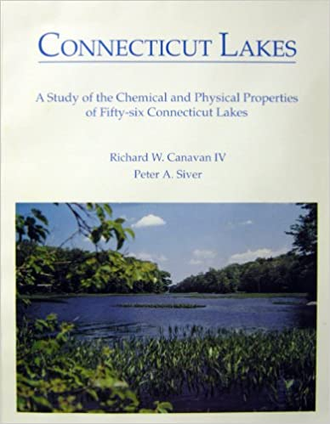

Slide 5
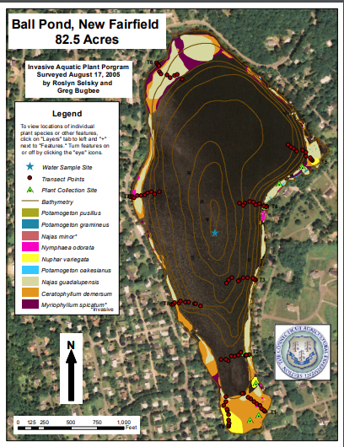
Plant species maps
Understanding the plant communities that exists in your system is key to protecting the asthetic, recreational, and economic value of a lake or river.
If your system has been mapped the survey information can be found at:
https://portal.ct.gov/CAES/Invasive-Aquatic-Plant-Program/Survey-Results/Survey-Results
Provided by the CT Agricultural Experiment Station.
They also provide some water quality data.

Slide 6
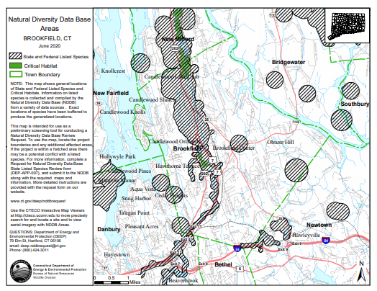
Are there state listed species?
State listed plant species present in lakes and rivers can be affected by the introduction of grass carp.
CT DEEP Natural Diversity Database (NDDB) has maps sorted by town showing if a state listed species is present in an area.
https://portal.ct.gov/DEEP/Endangered-Species/Endangered-Species-ReviewData-Requests
If a state listed species is present a follow up request can be made to review the exact species present.

Slide 7
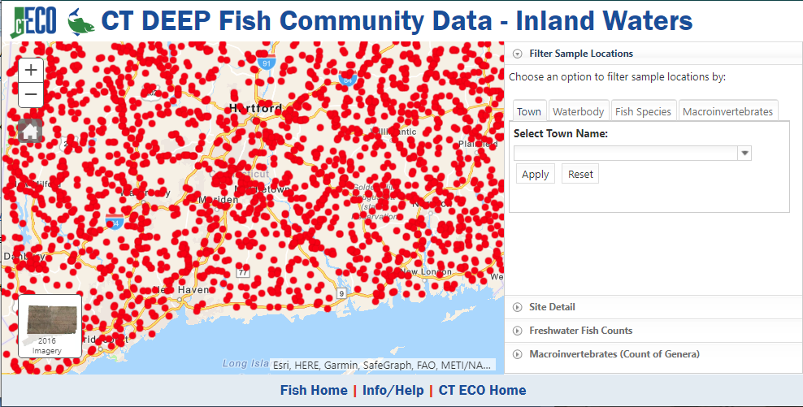
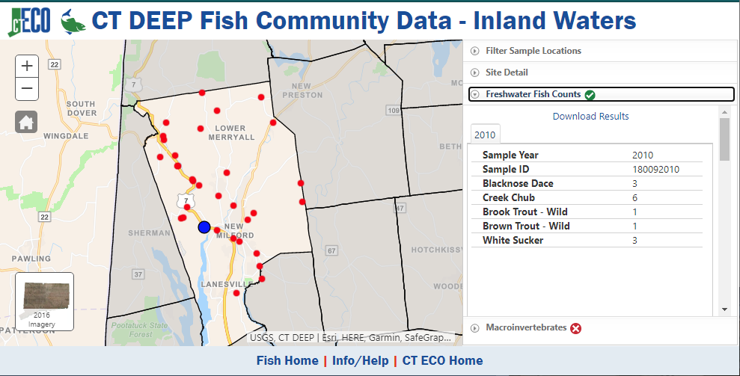
Fish species
Grass carp could potentially have effects on fish communities in systems they are introduced to, so having data before hand will be important for deciding and monitoring effects.
This data is provided by Connecticut Environmental Conditions Online and can be accessed at:
http://www.cteco.uconn.edu/projects/fish/viewer/index.html

Slide 8
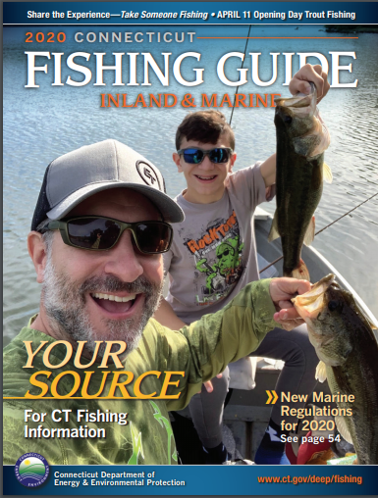
Special fisheries management
Certain lakes will have special regulations beyond statewide mandates including special fishery management. A system that is hosting one of the plans could adversely affected by introduction of grass carp.
To find this data consult the fishing guide, starting at page 31 is a list of Lakes and Ponds that have site specific regulations.
https://portal.ct.gov/DEEP/Fishing/General-Information/Fishing-Guide

Slide 9
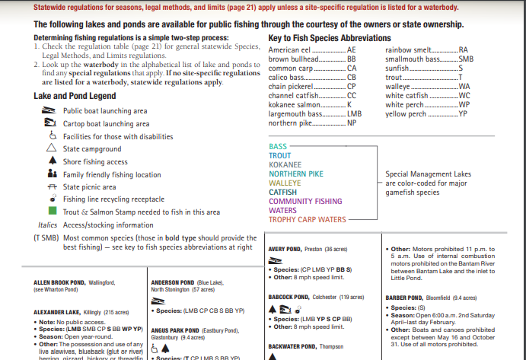

Slide 10
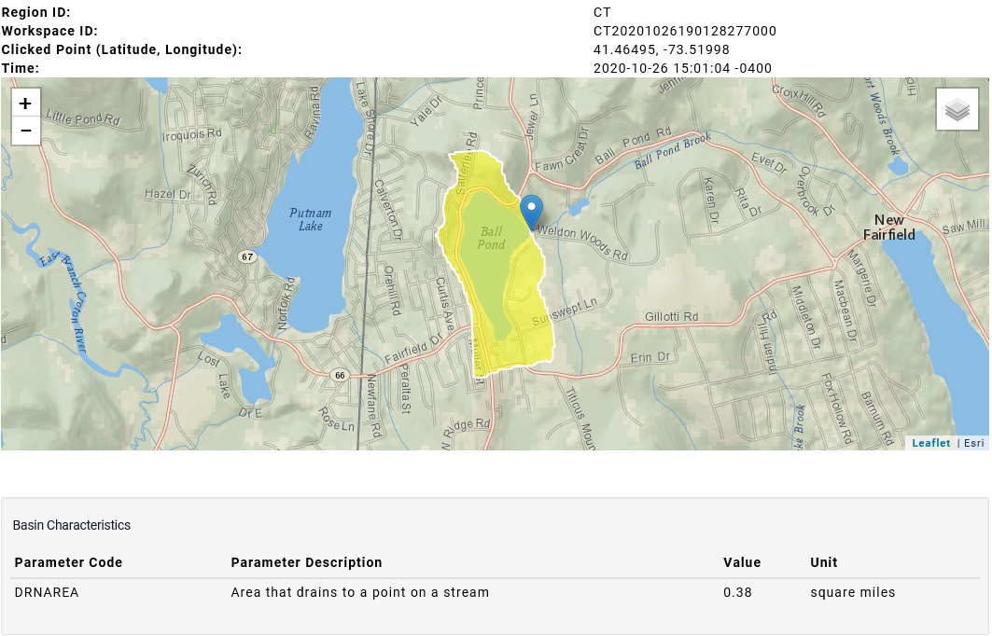
Watershed and Ecological Isolation
Watershed and ecological isolation will be important in determining if containment is possible.
USGS StreamStats provides a useful application for determining watershed size
https://streamstats.usgs.gov/ss/

