Slide 1
Western’s 6th Alcohol and Drug Survey 2017
Core survey administered spring 2017
Prepared by: Sharon Guck , M.P.H.
Coordinator, Substance Abuse Prevention Office
August 2017

Slide 2
Why Collect These Data?
Look at the current population before leaping into action!
  Any problems unique to WCSU?
  Any problems especially urgent?
Measure progress in the future, and over time.
Check “reality.”
  There is a common perception that drugs and alcohol are a normal part of campus life
  And are a choice that only affects the user, but in reality may have a wide range of effects on the entire campus community.
Justification for and accountability of programming and intervention strategies.
Grant/ Strategic planning/visioning.
Annual reporting.

Slide 3
Core Alcohol and Drug Survey
Developed in response to Congressional Anti-Drug Abuse Act of 1986.
Designed to be
  inexpensive
  easy to administer
  reliable and valid
  allows campuses to compare their problems to a national sample.
Addresses drug and alcohol use as well as campus culture issues, perception,
Notes:
The data reported here will by definition be different (and probably worse) than data obtained through more routine methods.
People are more likely to say they’ve experienced a problem when asked to answer an anonymous survey than if they have to go to a police station or counseling center to give the same information in person.

Slide 4
Method
IRB approval December 2016 protocol no. 1617-91
  Representative sample obtained by Institutional Research – collectively these 80 classes will yield the most representative sample of our student population.
Administered March – May 2017
  1250 surveys mailed out/530 returned 42% RR
  31 surveys discarded because of high “lie index’ score
  2017 sample size 499

Slide 5
2017 Sample
Number of surveys=499 is a nice large sample
Freshman = 19%
Sophomores = 20.4%
Juniors = 32.5%
Seniors = 26.4 %
1.6% = graduates or other
46.3% females (compared to 56% in 2012)
53.7 % males (compared to 43 % in 2012)
30 % live on campus
70% live off campus
90% are full time students
80% work part-time or full time

Slide 6
Average Number of Drinks Consumed a Week (q.15)
Notes:
On campus students do NOT drink more than commuter students.
This was not true in past surveys (so housing has done a good job in this area.)
In 2010 and 2012, resident students drank more than commuters.

Slide 7
WCSU avg. = 3.5 drinks
Nat’l. Reference Group = 4.3 (based on 123,430 reference group)
Notes:
National reference group =125,371 students from 288 institutions between 2012-2014
I want to know ___ who are these people in the 10-21 heavy dkg category?
What part of the population are they from?
Are they different in terms of gender, age, ethnicity, race,
And what interventions are best for this target pop….
And how do we continue to support those non or moderate users???

Slide 8
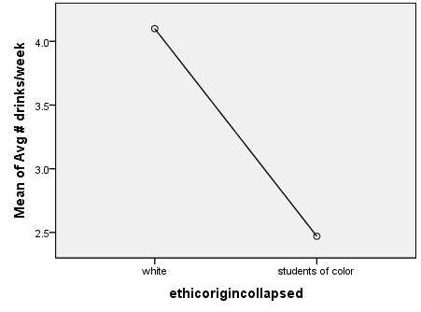
Average Number of Drinks per Week Was Associated With
Ethnic Origin with white students drinking more than students of color
Independent t-test
White students (M=4.10, SD=5.959) drink significantly more than students of color (M=2.47, SD= 7.089) p<.05
4.10
2.47
Notes:
Anova used with a continuous DV (# of Drinks) and an independent variable (categorical or nominal)

Slide 9
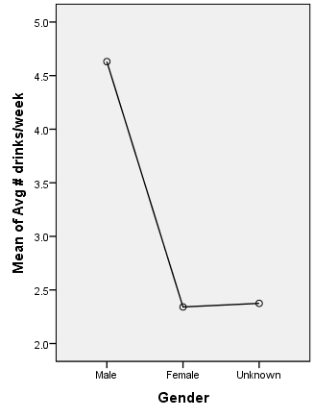
Average Number of Drinks per Week Was Associated With……
Gender with males drinking more that females

Slide 10
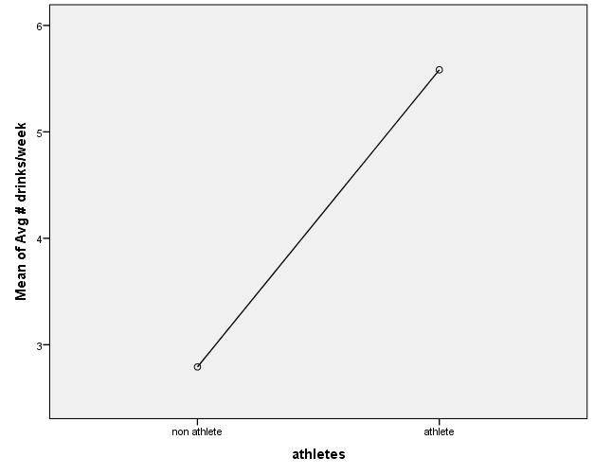
Average Number of Drinks per Week Was Associated With….
Intercollegiate Sports with Athletes drinking more than non-athletes
Analysis of Variance (ANOVA)
F(df 1,482)=17.483, p<.05 [.000], η²=.035
Notes:
White athletes drink more than athletes of color

Slide 11
Percentage of Students Reporting Heavy Episodic Drinking (q.14)
WCSU 41.8% binged
Nat’l ref. group = 43.6%
Notes:
National reference group =125, 371 students from 288 institutions between 2012-2014
WCSU

Slide 12
Percentage of Students Claiming to Have Binged/Consumed 5+ Drinks in Last Two Weeks

Slide 13
Heavy Episodic Drinking was associated with…
Male students (p<.05)
White students (p<.05)
Athletes (G=0.34)
Tobacco users
Driving under the influence (G=0.43)
Missing classes (G=0.42)
Being taken advantage of sexually (G=0.33)
Being hurt or injured (G=0.46)
Notes:
Pearsons Chi square shows if there is a sign. Relationship between variables (p,.05 = 5% chance of being wrong in rejecting the null hypothesis
Phi & Cramer’s V = tells us the strength of the association

Slide 14
Notes:
Increased M. smoking is associated with lowered GPA(0.28)
No significant difference in past 30 day Marijuana use by residence type (commuter or resident)
Students who began smoking marijuana at a young age also reported more current use of marijuana in the past 30 days. So the younger you began smoking, the more you currently smoke.
A one-way ANOVA indicated that the average number of drinks that students consume in a week varied by the amount of weed that students have consumed in the past prior 30 days to taking the survey, F (4,450) = 7.50, p <.05. Tukey’s B post hoc procedure indicated that those who have not smoked marijuana in the past 30 days prior to taking the survey (M = 2.36) drink significantly less on average in a week than those that have smoked marijuana 3 to 5 days (M = 7.05) in the past 30 days. No other significant differences were found

Slide 15
Notes:
The last two categories are worrisome – could be stoned every 3rd day to daily.
And we know marijuana use is negatively correlated w GPA – so implications for SAP, retention and dropping out of school

Slide 16
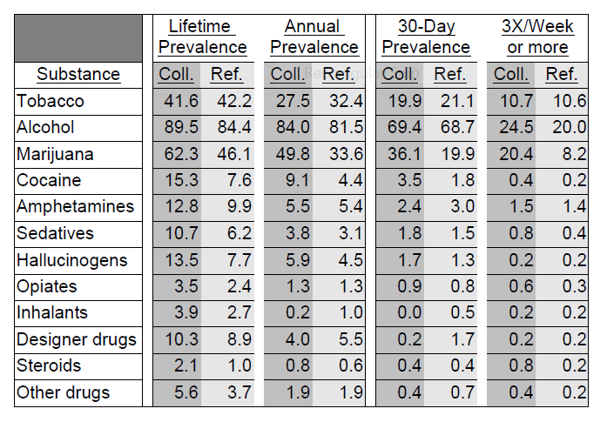
WCSU Compared to National Reference Group
Notes:
Most outstanding in this data is:
We are in line with alcohol (a bit high on binge 3X or more/wk
Marijuana we are way above annual/30 day prevalence & 3X or more/week
Cocaine – we are above ref. group on lifetime, annual & 30 day prevalence

Slide 17
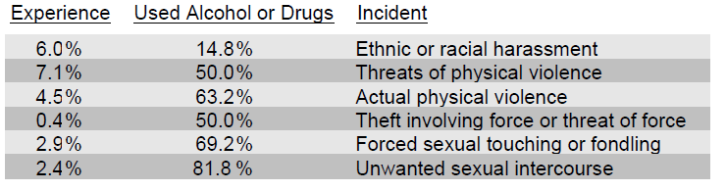
Experiences in Harassment or Violence and Alcohol’s Involvement
Notes:
A chi square test of independence was indicated that whether or not a student experienced ethnic or racial harassment depended on if the student was white or a student of color

Slide 18
Perception of Normal Alcohol Use vs. Actual Alcohol Use (per year) from 2004-2017
Notes:
Past 5 years illustrate decrease in students perception of drinking on campus…more accurately reflects the true norm….
Takes time to change norms but it is doable.
Look at smoking cigarettes (30 years in the making)

Slide 19
The good news is…
Substance Abuse is a
preventable behavior
and
Substance Addiction is
a treatable disease
Notes:
Slide 11: A message to remember.
We discussed many important points today. Two points, in particular. I hope you remember. One is that drug abuse and addiction affect every segment of society. That’s all of us. Everyone. Not one person is immune from the disease of addiction.
These slides today demonstrate that there are observable changes in brain function that take place when drugs are used. We saw that the brains of addicts are different from the brains of people who are not addicted. And it is difficult, in some cases impossible, to return the brain to normal. Scientists, like those who work at the National Institute on Drug Abuse, are working to develop treatments to help people who are addicted to drugs. But treatment, like addiction, is a complex issue.
Courtesy of Partnership for a Drug Free America.

Slide 20
Prevention needs to address:
INITIAL USE
ESCALATION OF USE

Slide 21
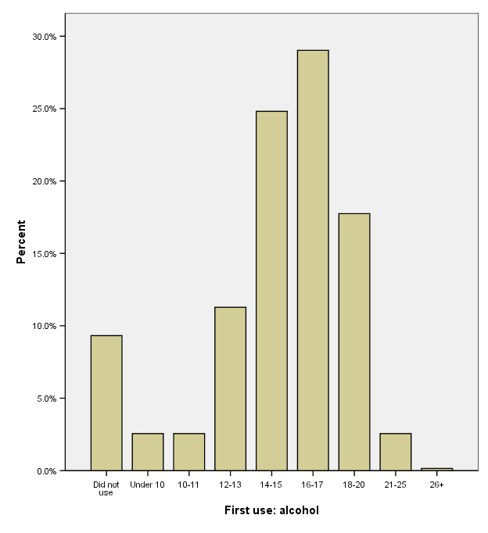
Age at First Use
18% College
53% in High School
14 % Middle School
9% never
3%
3%
Notes:
Three years of collected data on our referred population reveal that freshmen are over-represented in the number of alcohol policy violations. While comprising roughly 25% of the student body, they account for 67.3% of total alcohol policy violations. Further, freshmen comprise 89% of total alcohol transports. Of those students referred to the CHOICES Office for the BASICS (Brief Alcohol Screening Instrument for College Students), freshman, again, are over represented with 39% of referrals being freshman (e-Chug Administrative Reports, 2003-08)
The “Age of First Use” remains well below freshman year of college (see table 1 in appendix). Core data illustrates that 89% of our 2008 sample first used alcohol well below the legal age of 21 and certainly before entering college. So students are coming to college requiring early intervention services as well as general prevention. Almost 16% first used alcohol between ages 10-13; 53% first used between ages 14-17; and 18% first used between ages 18-20 (Core Survey, 2008). This underscores the need to reach students immediately (freshman year) and through multiple methods including prevention efforts, early identification and intervention.

Slide 22
Study Finds Increased Stress
and Depression for College First-Years
The emotional health of first-year college students has hit an all-time low.
In a survey of more than 200,000 freshmen at 279 colleges and universities only 52 percent of students rated their emotional health as high or above average
Fewer female students reported high levels of mental health than men (46 percent compared to 59 percent).
Notes:
The federal Drug Enforcement Administration (DEA) has temporarily banned five chemicals whose effects mimic marijuana, following through on an announcement it made last November, NPR reported March 1.
NPR said over 3,000 calls were made to poison control centers "since last year" related to "fake pot." Side effects of using the products, as reported by emergency rooms, include "anxiety attacks, elevated heart rates, vomiting, even convulsions."
The DEA said it was outlawing the chemicals to protect public health and safety.
UCLA's Higher Education Research Institute reports

Slide 23
Alcohol Use Continuum
Alcohol Use Continuum
behaviors
Physical Addiction
Event
Alcohol
3X
Chronic
Abuser
Non Drinker
Experimental
Drinker
Social
Drinker
Situational Drinker
Dependent
1 time
Alcohol
Event
Primary
Progressive
Chronic
Fatal
Consequences
Behavior
Judgment
Physical &
Emotional

Slide 24
.40
0
Death possible
-No perception
-Anesthetized
-Depressed CNS
Safety Zone
- Mild Euphoria
-Experience safe effects
-Feelings of Well-being
-Rarely any negative effects
-No impaired brain function
.30
Vitals affected
-Involuntary functions impaired
- comprehension
-semi-conscious
- coma
.20
.05
Dysphoria /Disinhibition
- Depressant effects begin
- Stronger emotions - mood swings
- Decreased driving abilities
- Desire to drink more
- Slower reaction time
- Judgment impair
- Inflated sense of self
- inhibitions decrease
- Confusion, dazed
- Needs assistance w/ walking
- Severe intoxication
.19
.18
Intoxicated
-Unsteady
-Boisterous
Impairment of all functions
-Poor Judgment
.17
.16
.15
.10

Slide 25
Drivers of Excessive Drinking: Underlying Assumptions
Environmental factors may influence why and when students start AODA use,
genetic factors and family history plays a role in determining who will develop abuse or addiction problems.
Parental, campus and community expectations also influence individuals’ attitudes and use patterns.
Drug use expectations, whether used to relax, reduce stress, or forget problems can reinforce adolescents and young adults AODA patterns.

Slide 26
Drivers of Excessive Drinking: Underlying Assumption
Availability and easy access,
Cultures accepting of drunkenness,
Target marketing, and lack of consequences also drive excessive drinking on college campuses.
Brain development greatly affects young adults’ decision making and risk taking behaviors and is negatively impacted by alcohol. (NIAAA)

Slide 27
Beliefs and Social Perceptions on Consumption of Alcohol
Students who feel that alcohol enhances social activity drink significantly more on average than those who believe that alcohol does not enhance social activity
Students who feel that consuming alcohol makes its easier to deal with stress drink significantly more than students that disagree with this belief
Students who believe that alcohol facilitates a connection with peers drink significantly more than those that don’t hold this belief
Students who believe that alcohol facilitates male bonding drink significantly more than those that that disagree with this belief

Slide 28
Beliefs and Social Perceptions on Consumption of Alcohol
Students that believe that drinking makes women sexier drink significantly more than those that do not hold this belief; however, this is not significant in regards to the perception that drinking makes men sexier
Students that believe that drinking makes themselves sexier drink significantly more than those that believe that it does not make themselves sexier
Notes:
Students that believe that drinking makes women sexier drink significantly more than those that do not hold this belief; however, this is not significant in regards to the perception that drinking makes men sexier

Slide 29
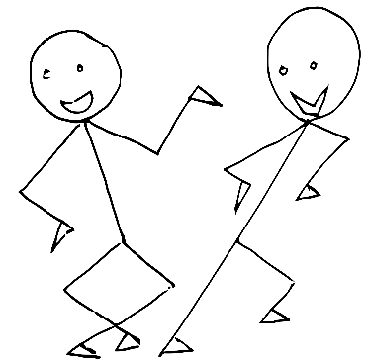
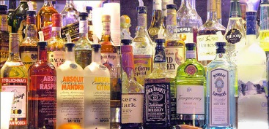

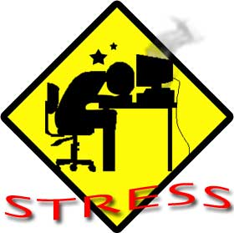

Students who Believe…….
Alcohol enhances social activity
Alcohol facilitates connections
Alcohol helps with stress
Alcohol makes me sexy
Drink More Alcohol

Slide 30
Beliefs and Social Perceptions on Consumption of Alcohol
Drink Significantly more
Feel that alcohol enhances social activity
Believe alcohol helps with stress
Believe alcohol facilitates connections
Students who………

Slide 31
Beliefs and Social Perceptions on Consumption of Alcohol
Drink Significantly more
Believe alcohol facilitates male bonding
*Believe alcohol makes women sexier
Believe alcohol makes them sexier
Students who………

Slide 34
Students’ engagement is significantly correlated with several measures of student satisfaction and align positively with the mission of Student Affairs.
Students who are engaged in Student Affairs programs on campus felt significantly more;
Valued as a person on this campus (p<.05)
Felt a responsibility to contribute to the wellbeing of other students (p<05)
Felt their campus encourages them to help others in need. (p<.05)
Does Your campus have AODA Prevention programs (<.05)
Than their counterparts who were not involved in any activity on campus
* including: a club, intercollegiate sports, cultural or religious activities, music and performing arts, intramural sports and Greek life
Notes:
Student engagement is not correlated with any measure of drinking or marijuana use
But is associated with other campus climate questions as noted above

Slide 37
Campus Climate Questions

Slide 38
Opiate Use from 2004-2016

