Slide 1

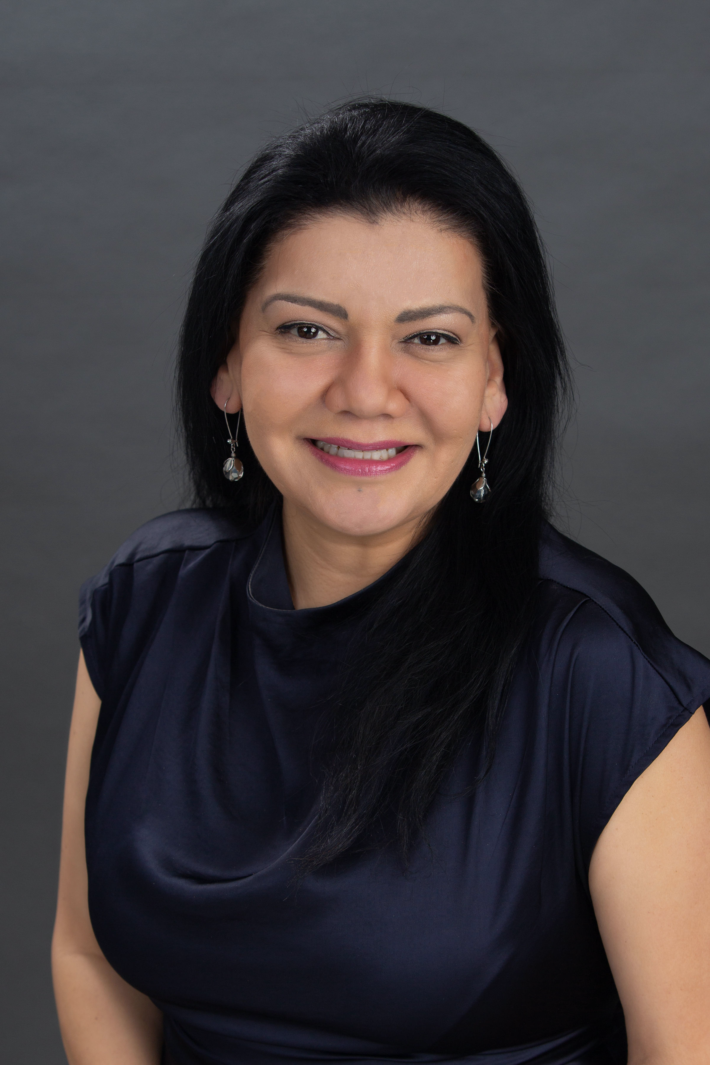

EMPOWERING, CREATING, AND INNOVATING IN GLOBAL EDUCATION
What happens when students own their learning.
Presented by Sandra Peña

Slide 2
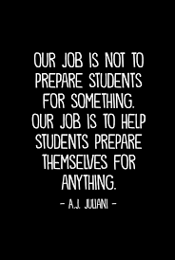

Slide 3
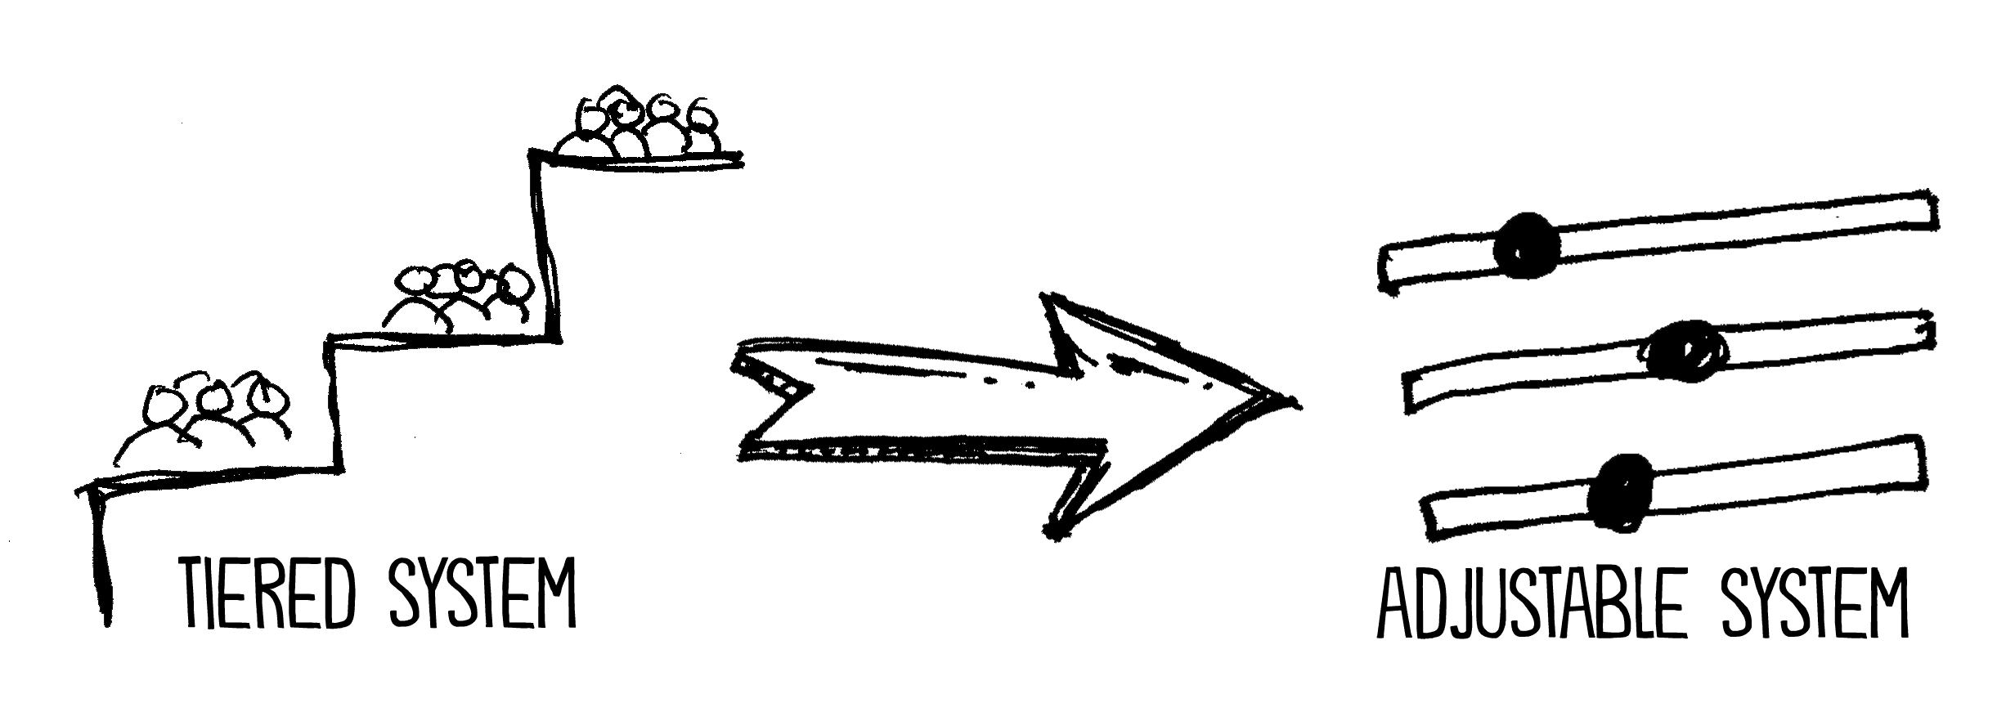
STAGGERING NUMBERS

Slide 4
TRUTHS
Truth #1 Every child deserves to own their learning. Teachers can empower student ownership of lifelong learning.
Truth #2 Every child in your class is someone else’s whole world. Empowering students transforms our social/human connections.
Truth # 3 Stories will always shape us. They will always help us learn. Empower students to create and share their learning stories.
Truth #4 The only thing you can prepare students for is an unpredictable world.
Truth #5 Literacy is about learning, and learning is about unlearning and relearning.
Truth #6 As teachers, we have a huge impact on our students’ lives. Empowering our students amplifies that impact.

Slide 5
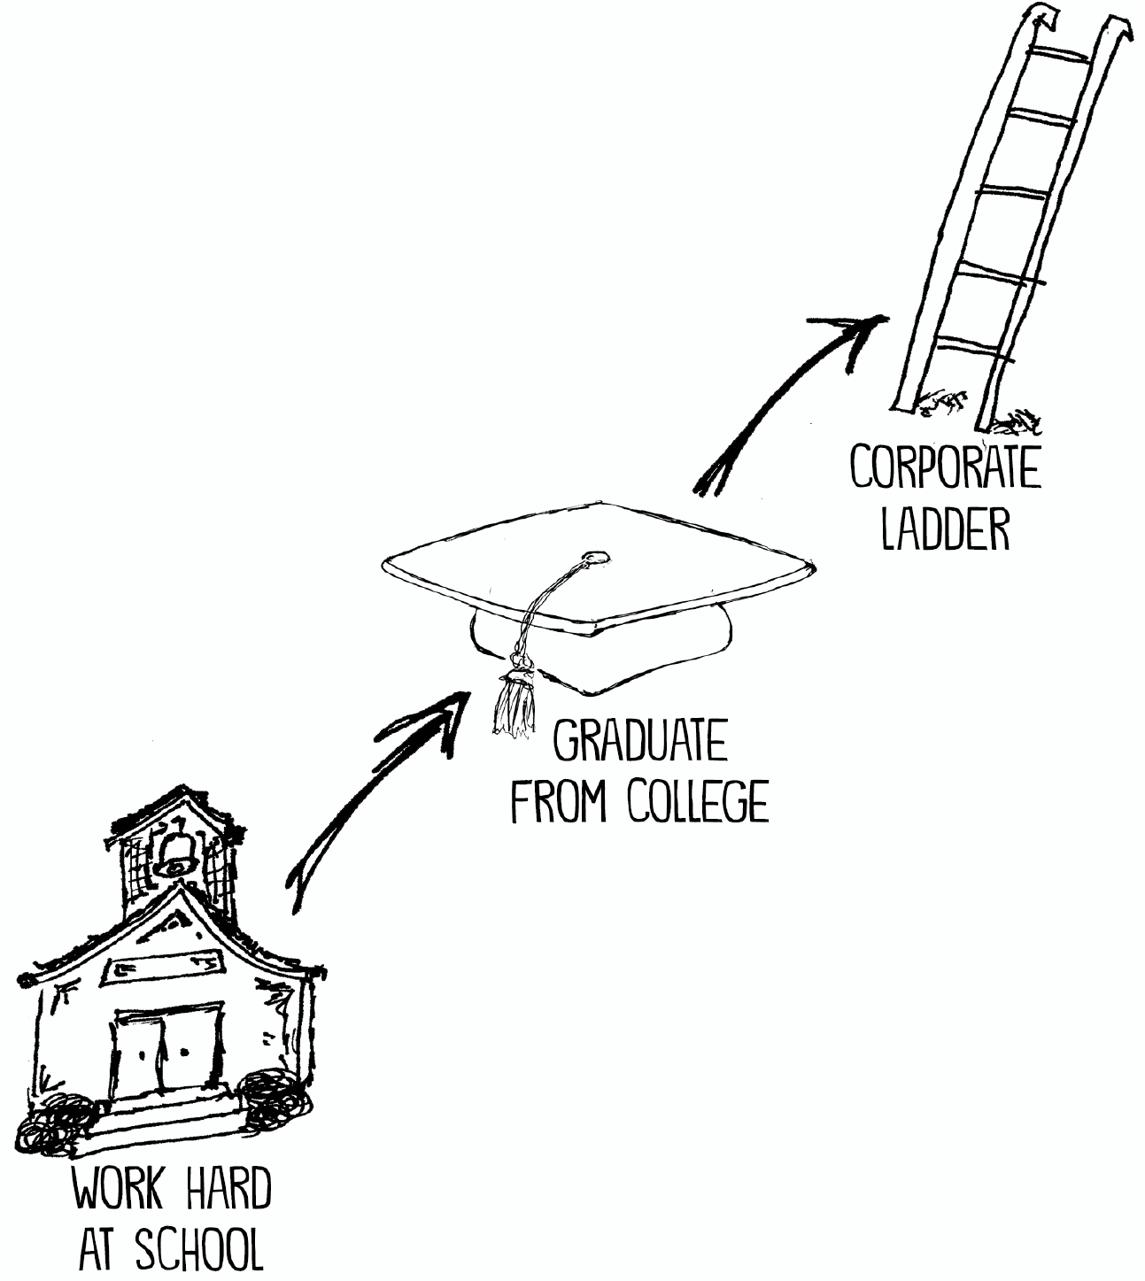
THE DEPENDABLE FORMULA

Slide 6
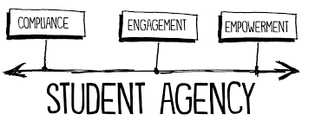
THE SHIFT

Slide 7
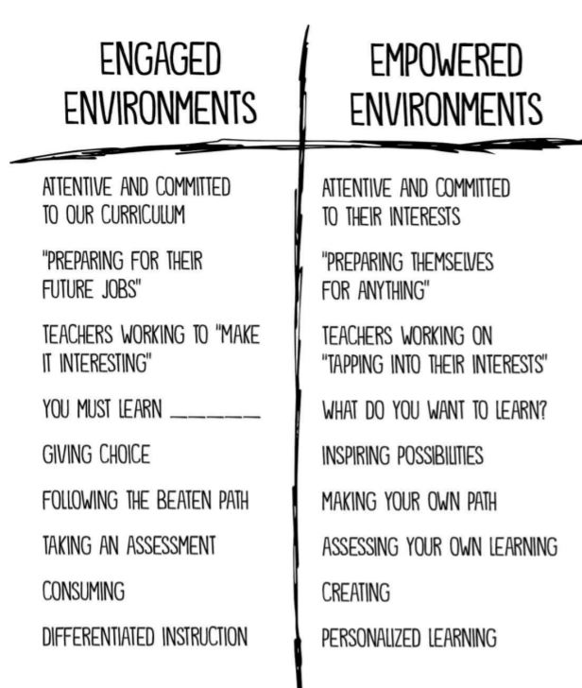
HOW DO WE MAKE THE SHIFT AS TEACHERS AND LEADERS?

Slide 8

ENGAGEMENT
”Empowering students means giving kids knowledge and skills to pursue their passions, interests, and future”
Bill Ferriter

Slide 9
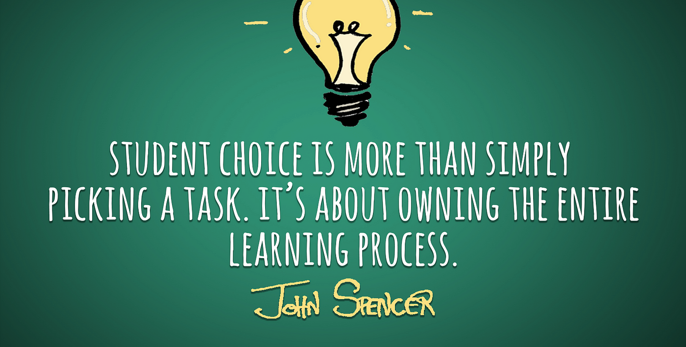
THE CHOICE OF A CHOICE

Slide 10
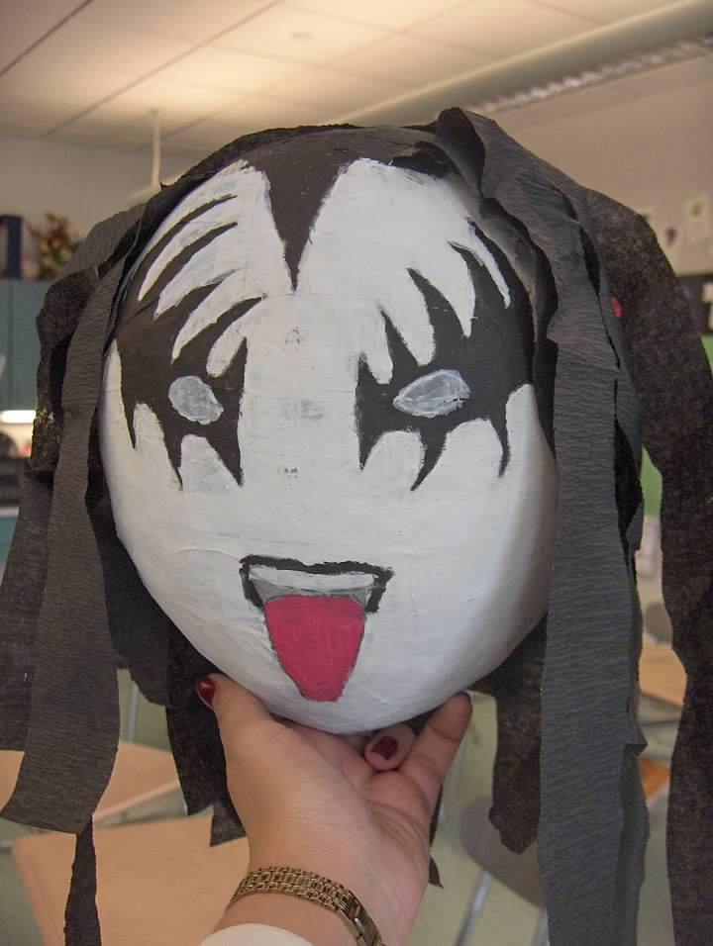
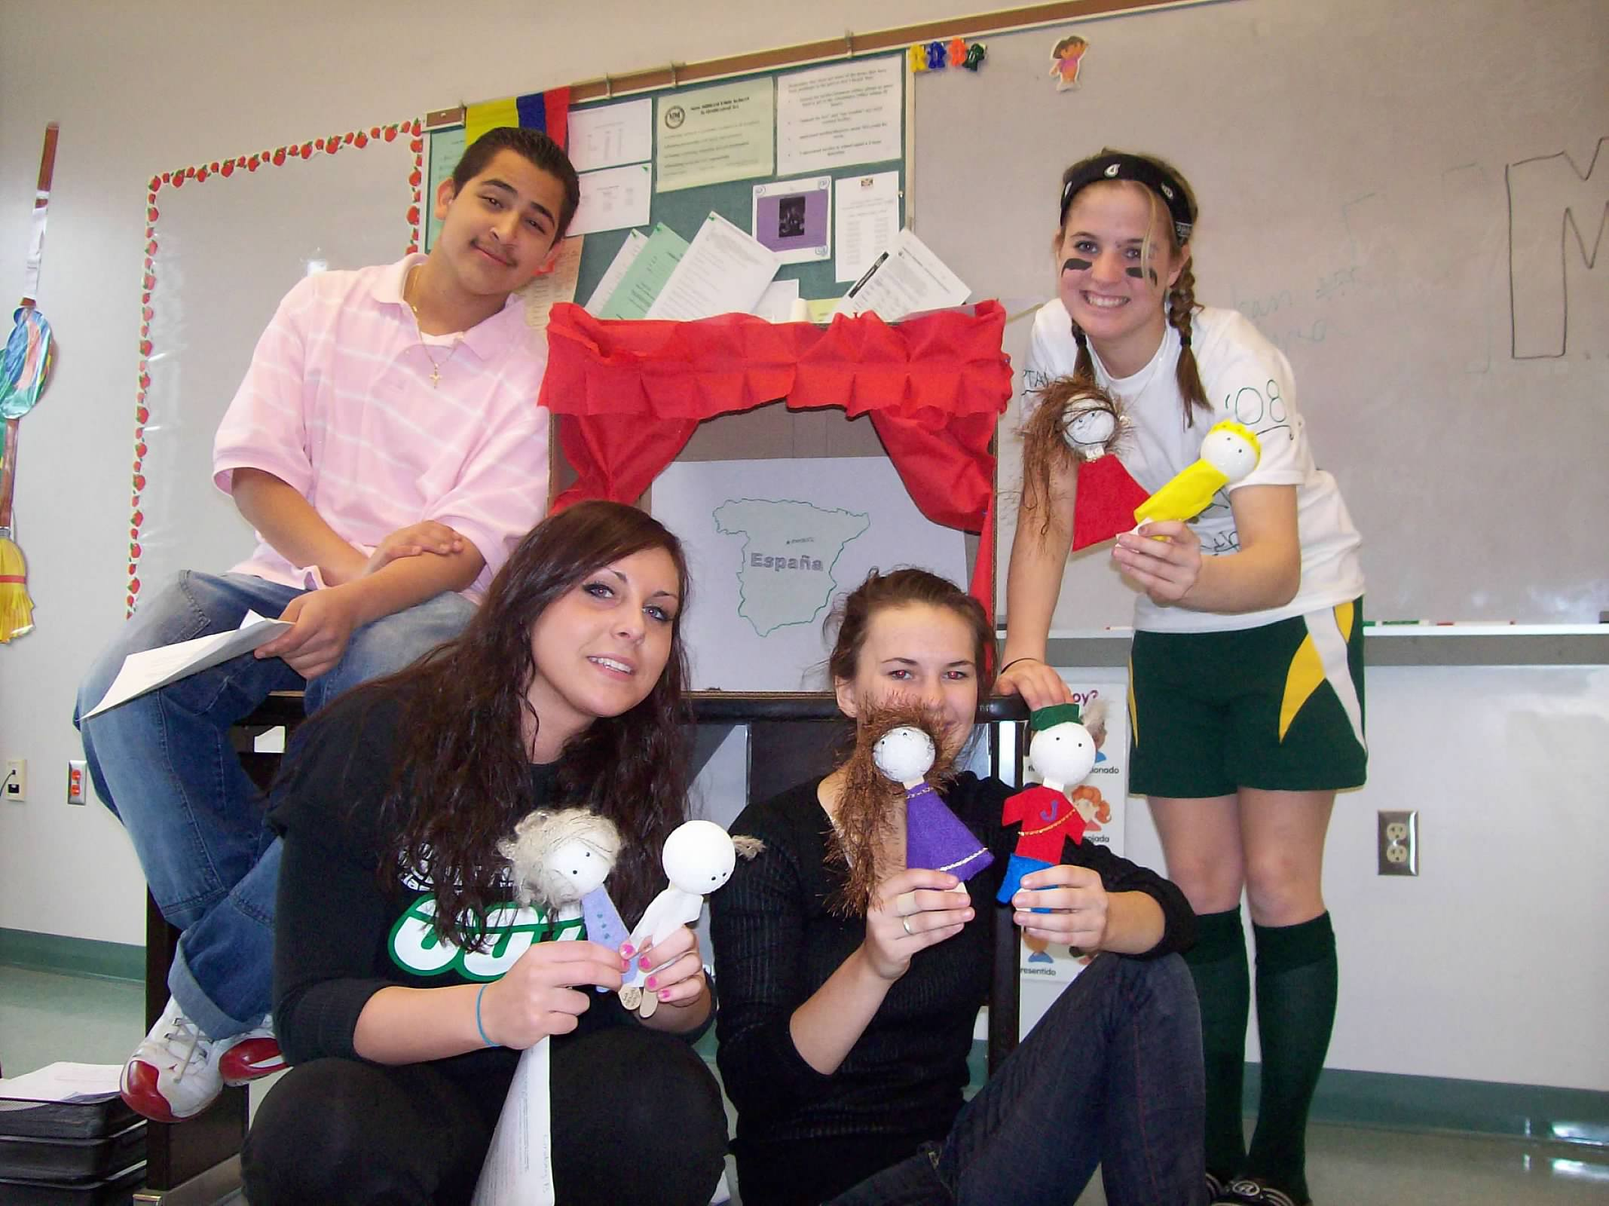
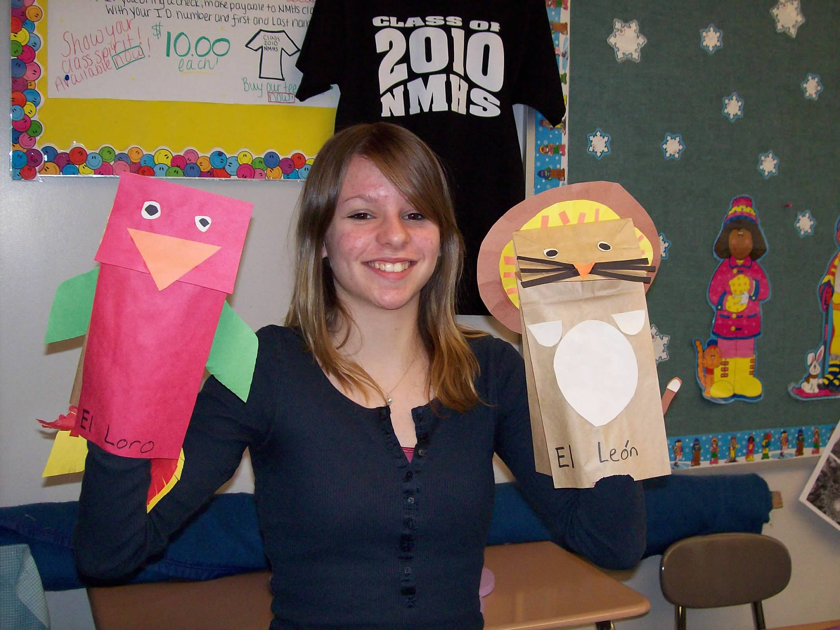
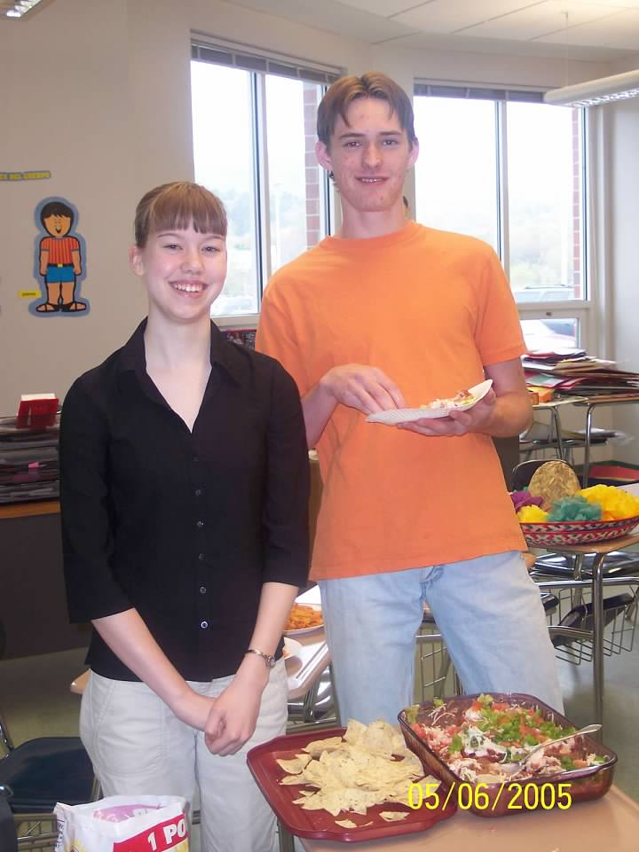
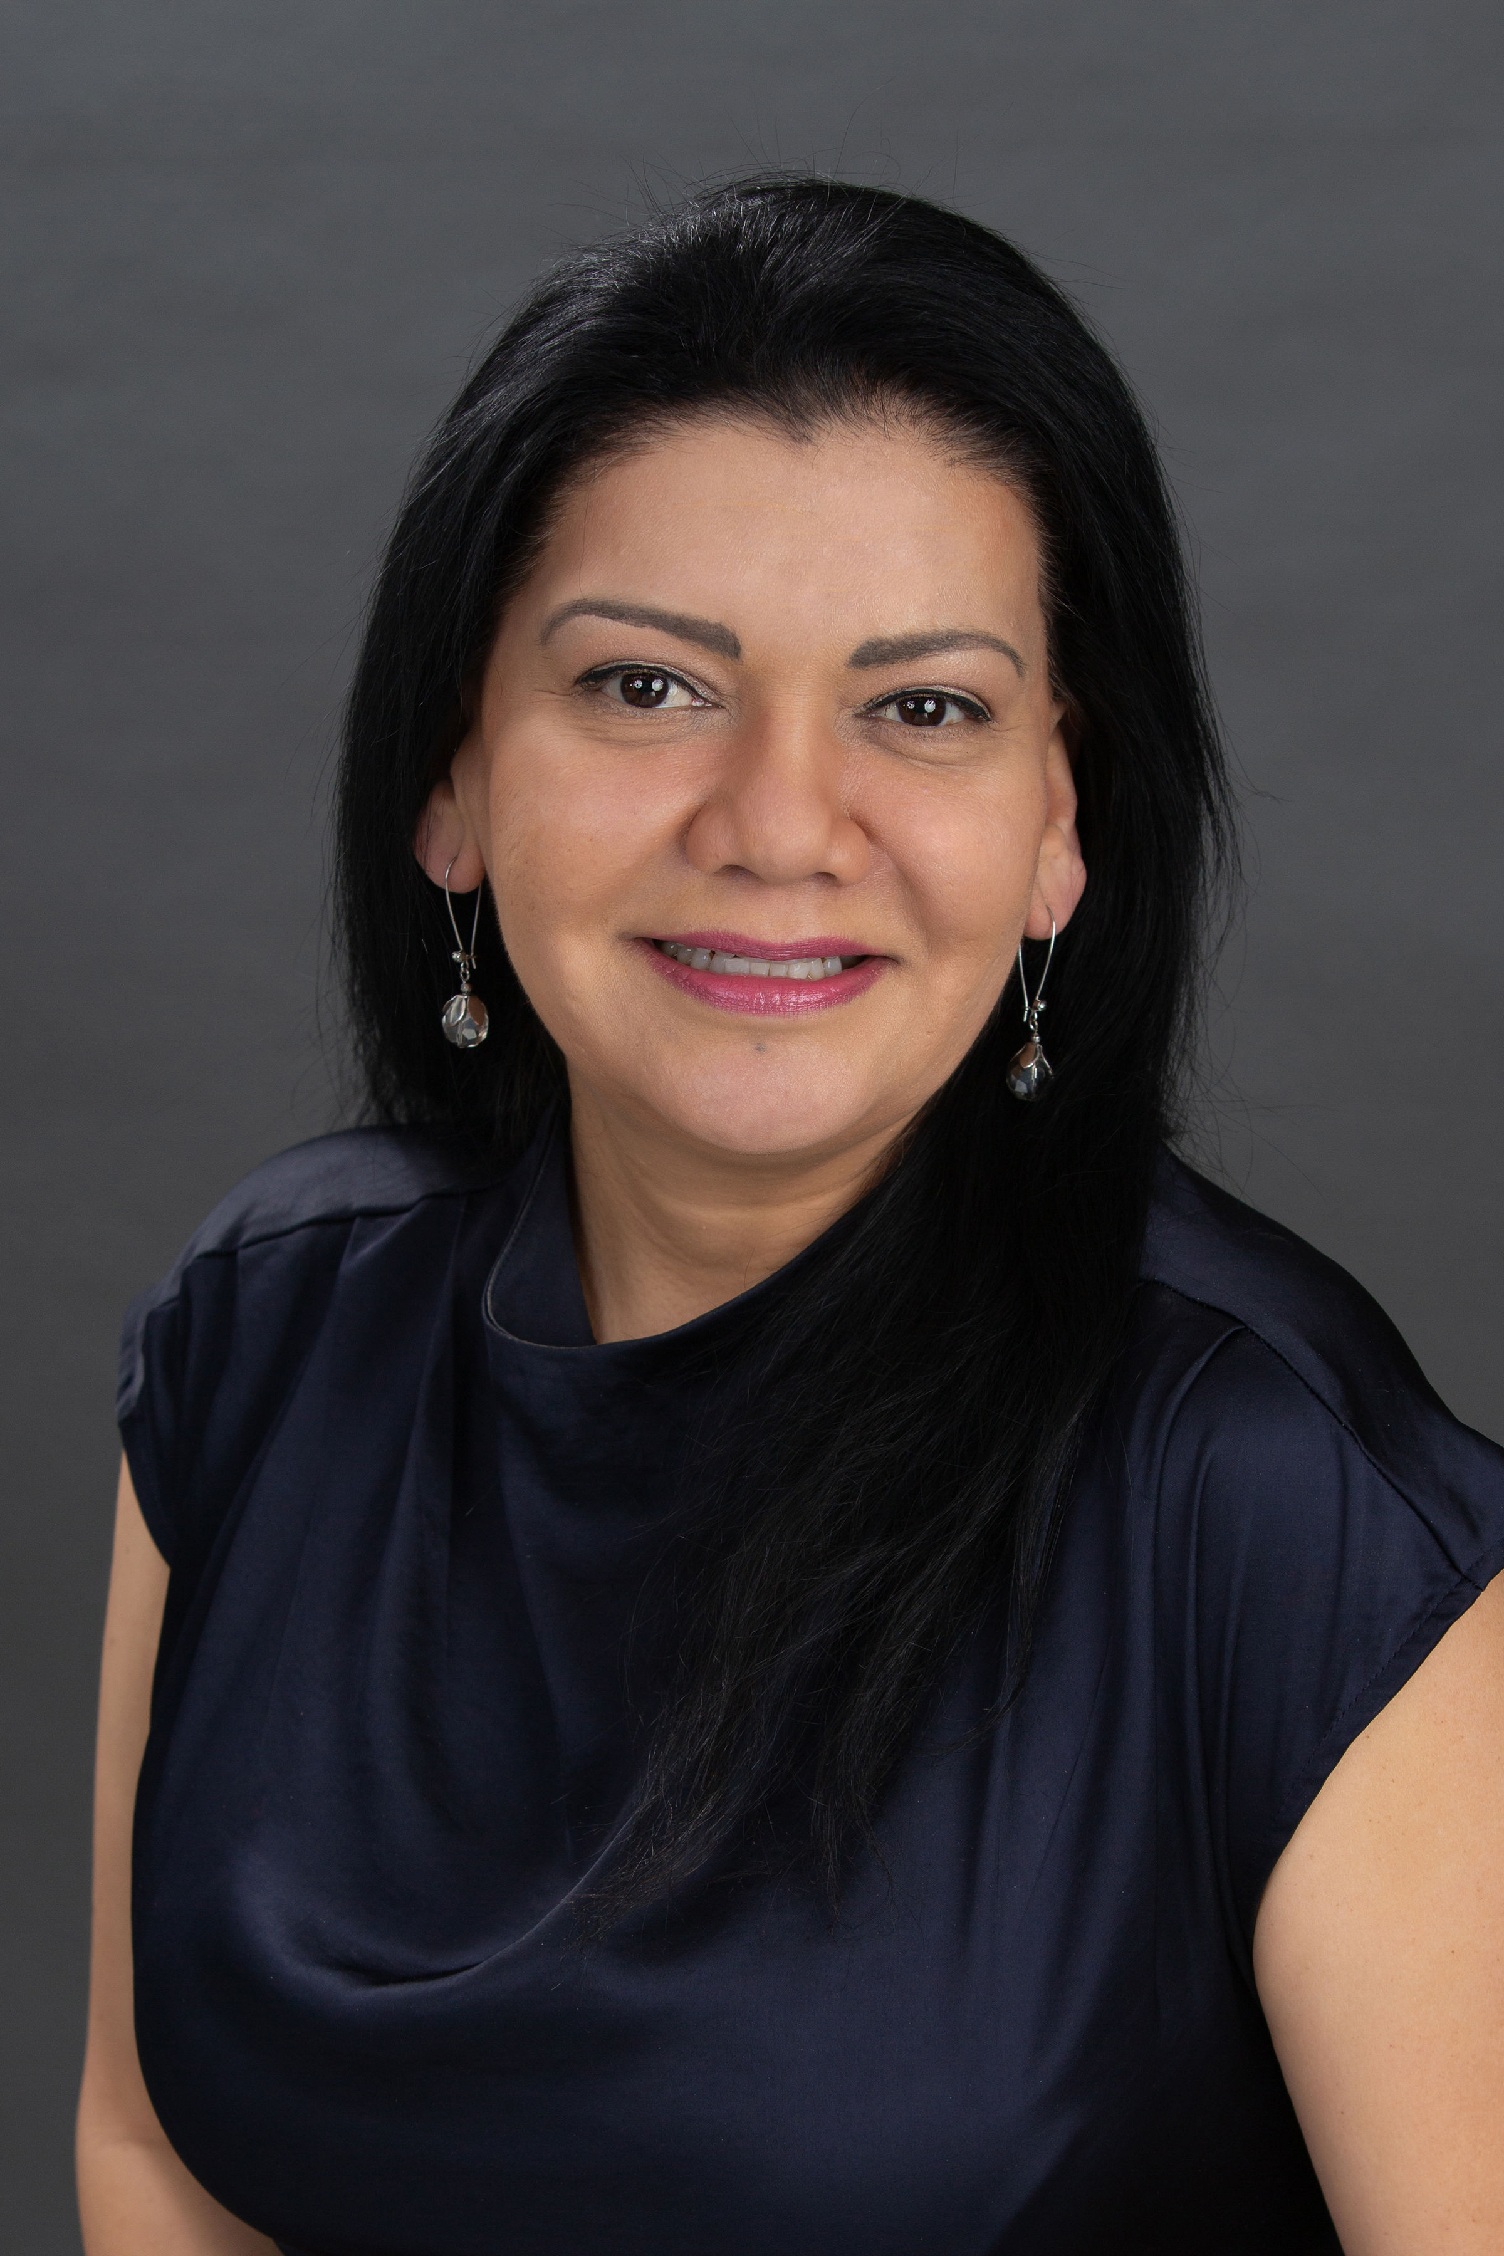
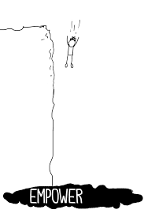
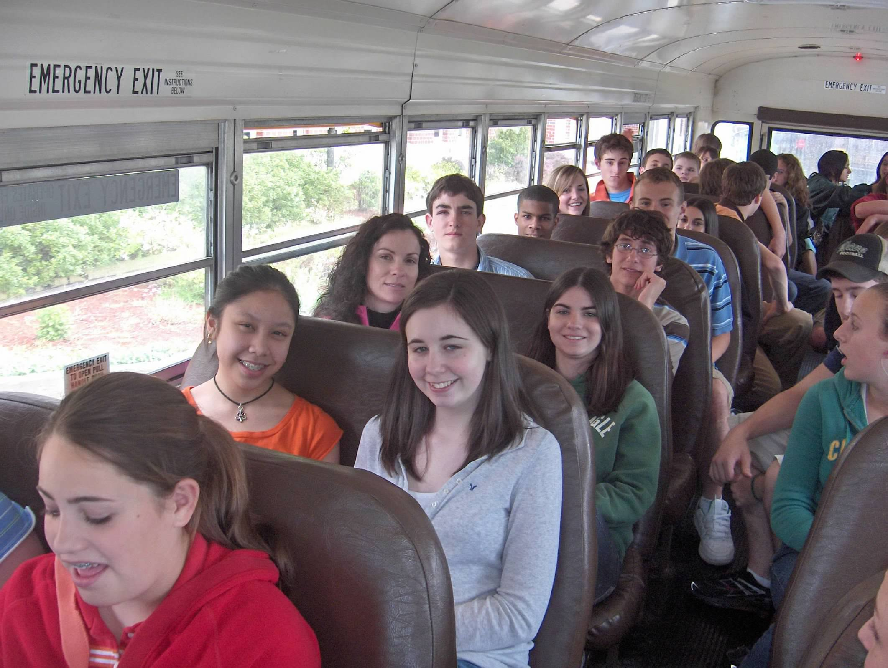
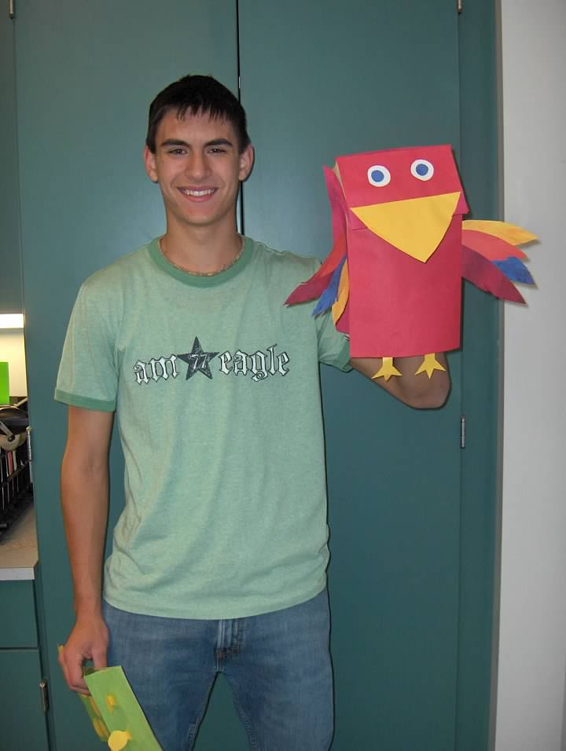
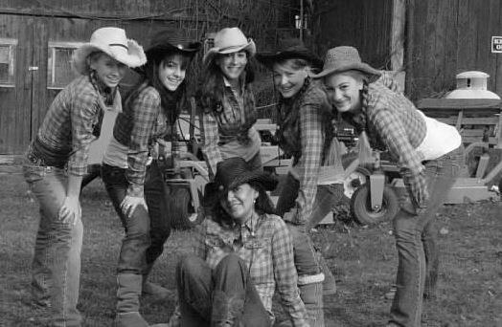
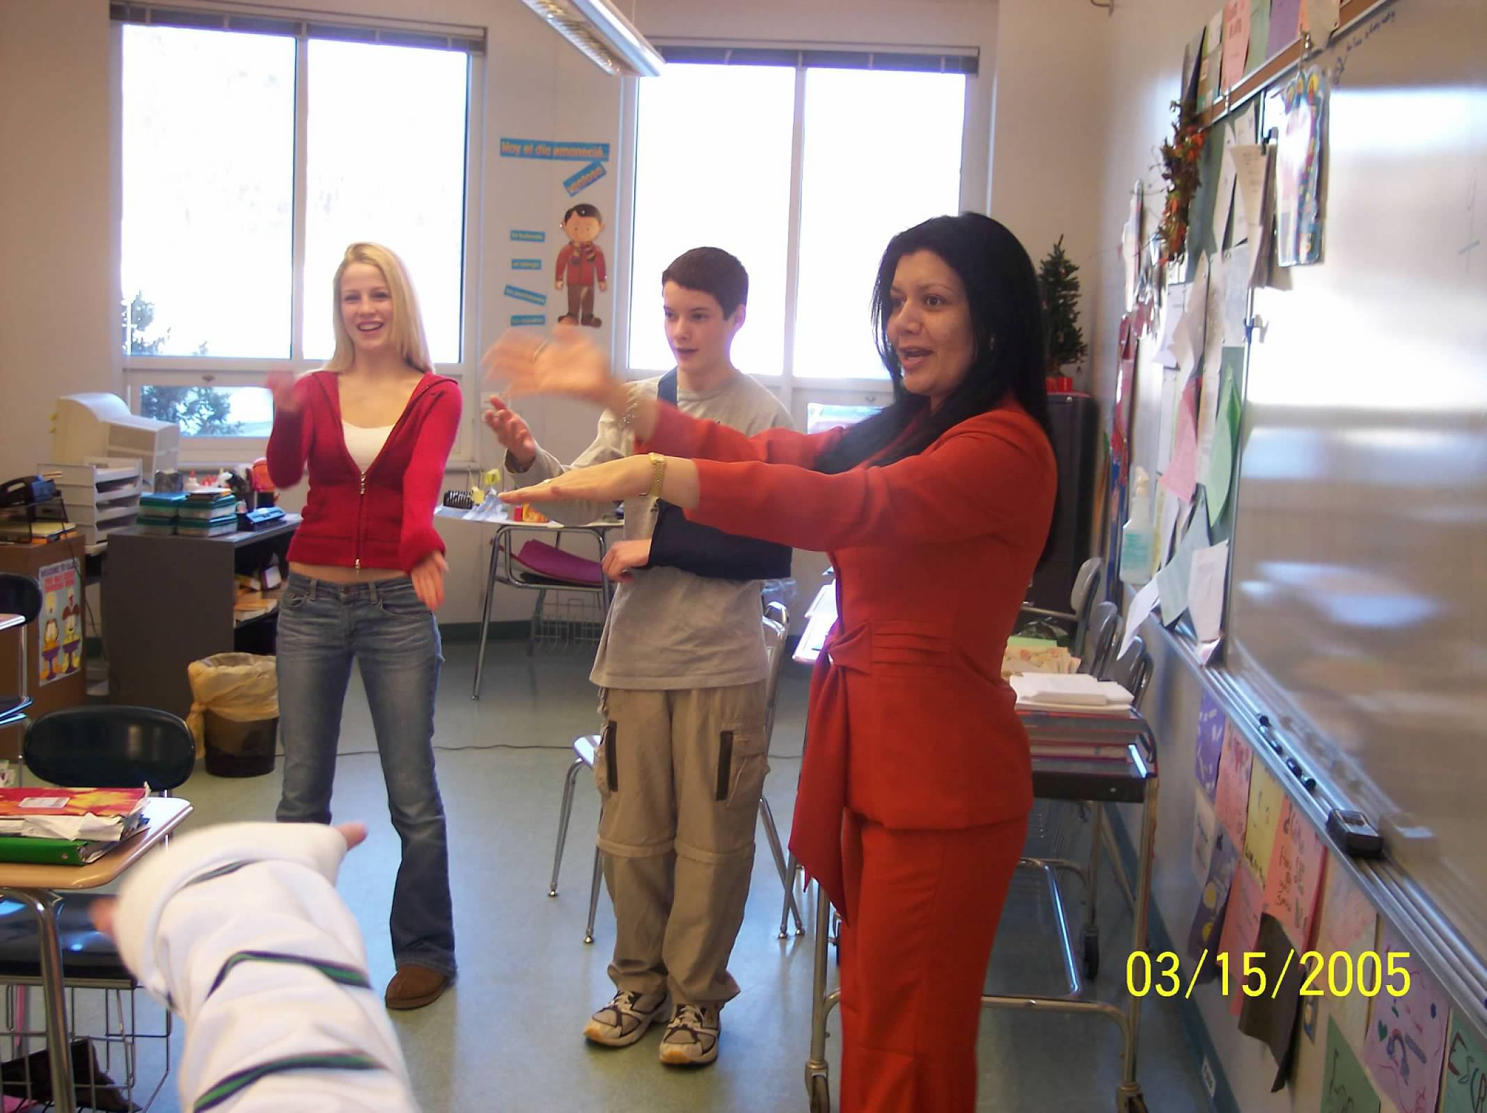
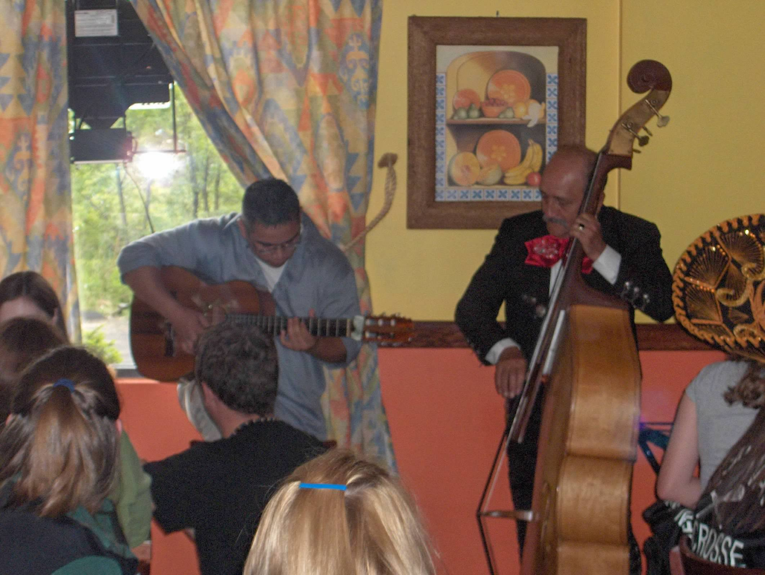
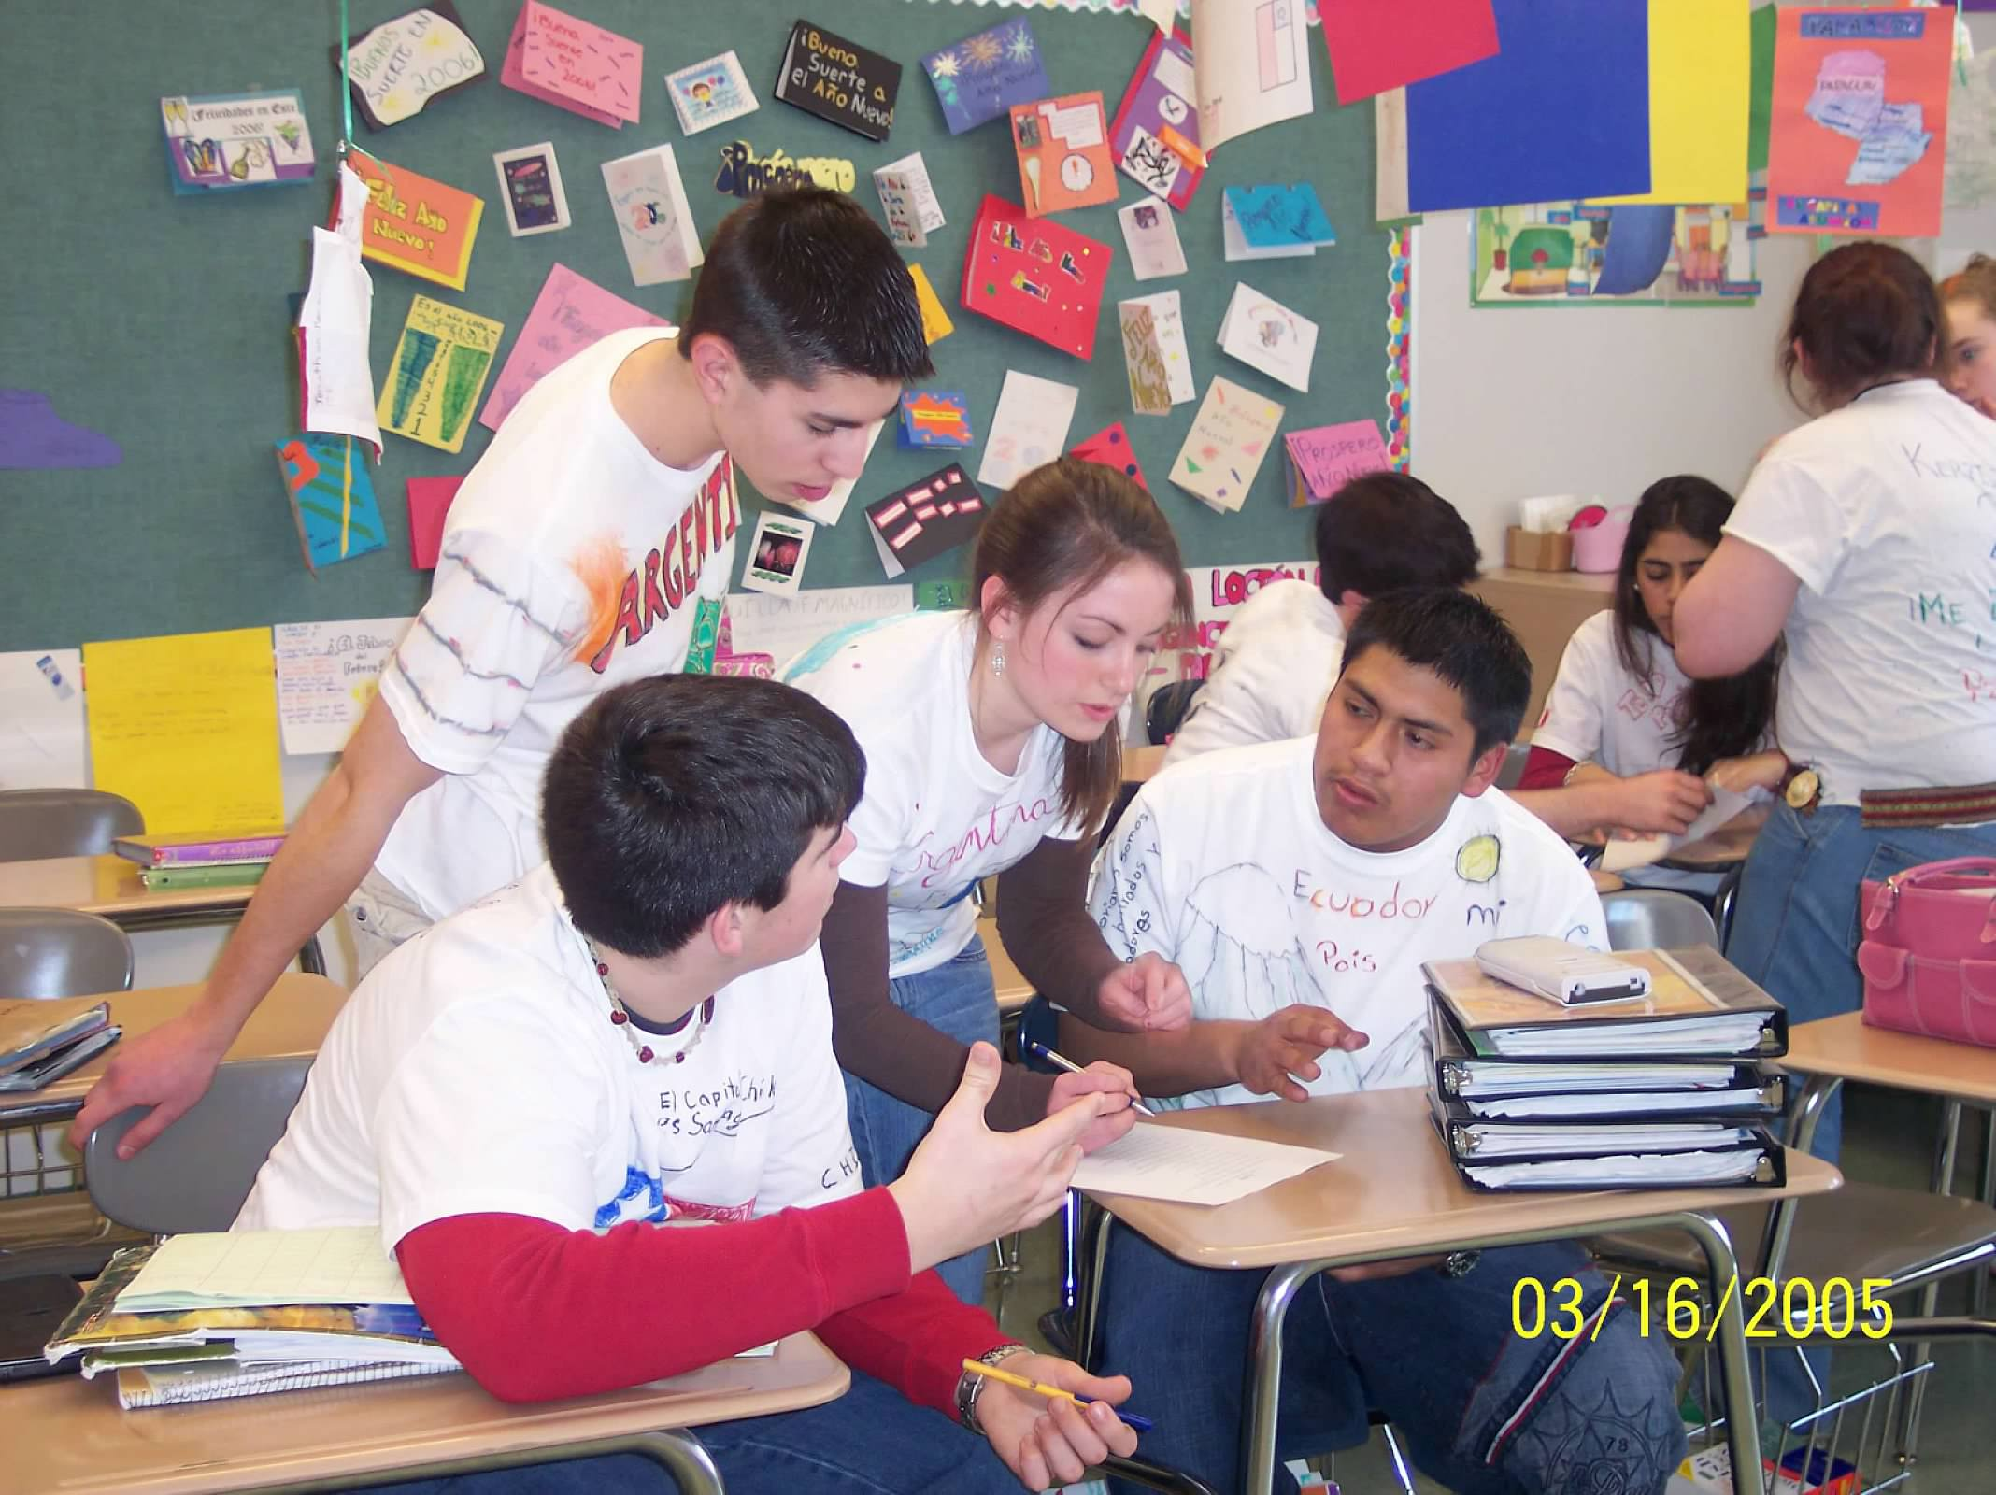
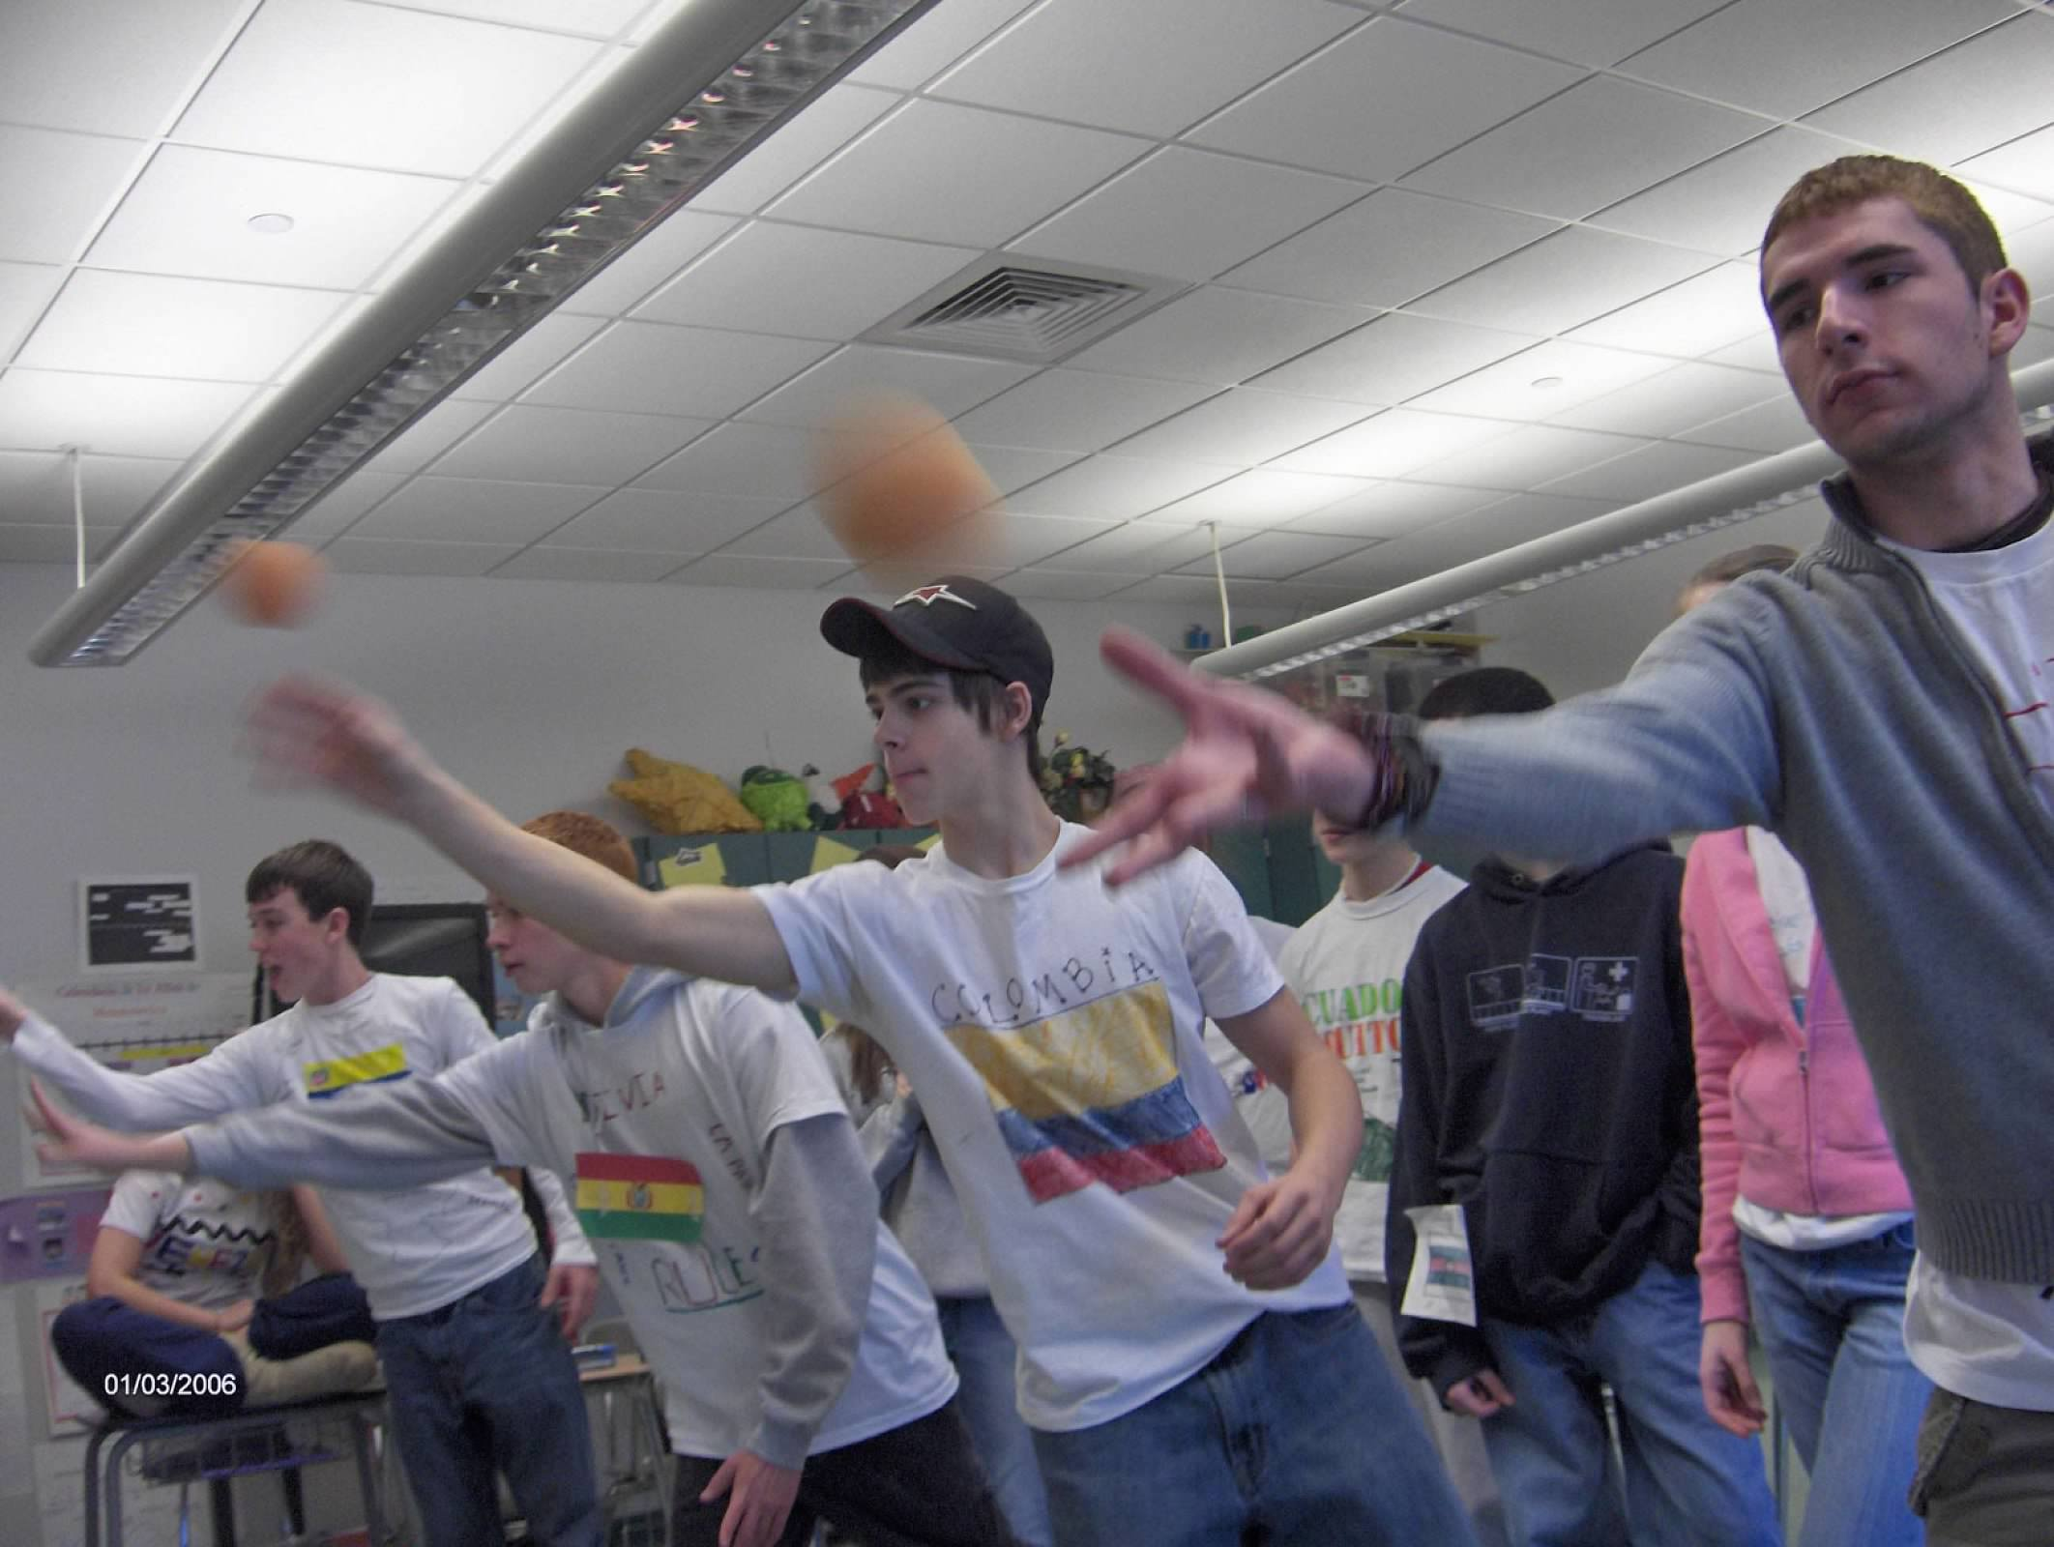
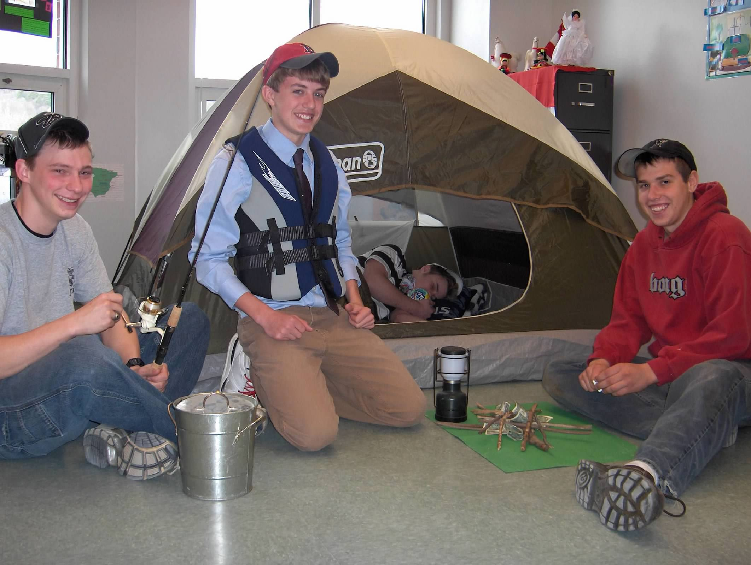
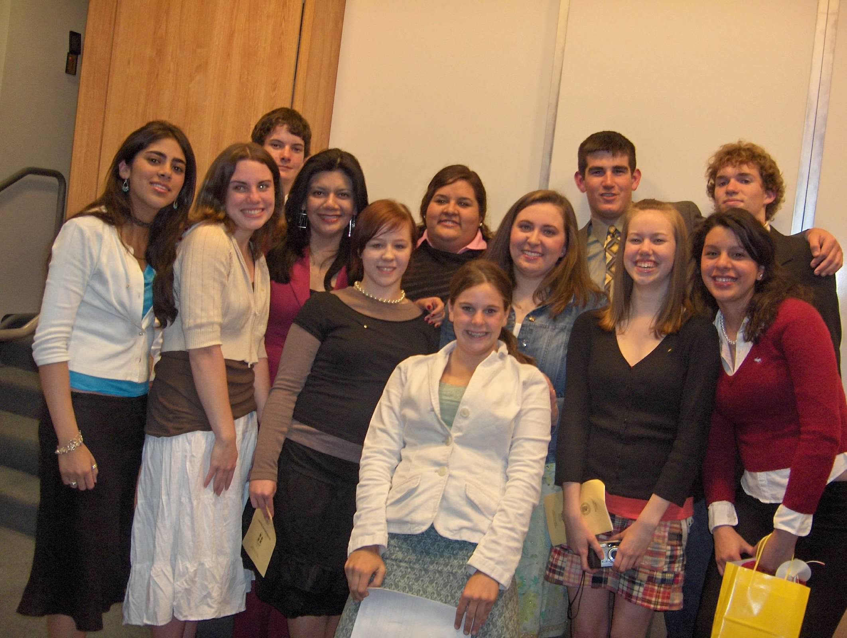

Slide 11

SPENCER’S SUMMARY

Slide 12


Slide 13
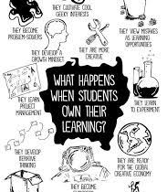
ARE YOU READY?
LET’S MAKE A DIFFERENCE…
TODAY AND EVERY DAY

Slide 14
JOHN SPENCER

Slide 15
REFERENCES
Blog. (n.d.). John Spencer. https://spencerauthor.com/blog/
Bringing blogging into the classroom with student blog projects. (2022, March 2). EdTech Classroom. https://edtech-class.com/2022/03/02/bringing-blogging-into-the-classroom-with-student-blog-projects/
(2021, November 3). John Spencer. https://spencerauthor.com/
Spencer, J. (2017, June 17). 7 Things That Happen When Students Own Their Learning. YouTube. https://youtu.be/N7S9kyk-odA
The HOW of empowering students & educators: A conversation with Dr. John Spencer. (n.d.). PersonalizeSC:: Personalized and Digital Learning. https://personalizesc.ed.sc.gov/personalizesc/blog/the-how-of-empowering-students-educators-a-conversation-with-dr-john-spencer/
Turn & talk / John Spencer on the shift to student empowerment. (2020, January 16). ASCD. https://www.ascd.org/el/articles/john-spencer-on-the-shift-to-student-empowerment
Unleashing creativity in the classroom | Dr. John Spencer | Teach away. (2022, June 8). Teach Away. https://www.teachaway.com/blog/unleashing-creativity-classroom-dr-john-spencer
‎The creative classroom with John Spencer on Apple podcasts. (n.d.). Apple Podcasts. https://podcasts.apple.com/us/podcast/the-creative-classroom-with-john-spencer/id1141442116
Why we need creative classrooms (A manifesto) — A.J. Juliani. (2021, August 30). A.J. Juliani. https://www.ajjuliani.com/blog/ka8eye5pf5bhwp3-lc7ch-nd29c-ddt7y-5gf79-2bcyt-67hl2-xtpcb-5b8a5-3se4f-9h2mp-ml247-9wb4n-8b6jk-lkcha-aydfe-ra44k-awyx8-tkpxx-pklrj-kkw58

