Slide 1
Division of Finance & Administration-Western Connecticut State University
Training for Budget/Financial Managers
September 2022

Slide 2
Finance & Administration Training Agenda

Slide 3
Administrative Services
Agenda: Contracts, Procurement &
P-Card Program

Slide 4
Contracts Do’s and Don’ts
Do…
Don’t…
Engage Subject Matter Expert, CFO and Contract Developer when negotiating financial business matters and terms and conditions.
Submit a Pre-Authorization Form (online form) to initiate Contract Development to assist in keeping an inventory and accounting for WCSU contracts.
Ensure State contract terms and conditions are included in any agreement to protect the interests of WCSU and the State of Connecticut.
Unlawfully sign an agreement if unauthorized by the WCSU Delegation of Authority.
Agree to terms and conditions which may make WCSU and State vulnerable to lawsuits, litigation, etc.
Agree to terms and conditions that do not favor WCSU and State; i.e. Sovereign Immunity, Termination and Confidentiality.
Circumvent the contract process.

Slide 5
Main Components of a Contract
Vendor Name and Information: Legal Business Name must appear on the contract i.e. (LLC, LLP, Inc.)
Term: Start and End Date of an Agreement (No open-ended terms.)
Scope of Work: Must be detailed enough to answer: Who, What, When, Where, Why, and How?
Cost: A maximum contract amount is required. (No open-ended costs.) Total contract amount must be included.
Invoices – Contact information including Requesting Department contact person, address, phone number and email must be included to identify as to who will be responsible for the receipt and handling of invoices.

Slide 6
When Contracts are Required…
Contracts are required for purchased services greater than $10,000.
OAG approval is required for non-templated contracts $25,000 or greater.
MOA vs. MOU: Note - WCSU can only enter into an MOA/MOU with a State Agency or other constituent unit of the State. (Municipalities and other organizations are excluded as they have different governing laws.)
MOA =
Memorandum of “Agreement” between binding parties with monetary value.
MOU =
Memorandum of “Understanding” between binding parties with no monetary value.

Slide 7
Procurement Process
Procurement Process >$10,000 requires a competitive solicitation to ensure the best, guaranteed price achieved.
Goods and Services $10,000 - $50,000 = Minimum of 3 quotes must be obtained.
> $50,000:
RFP: (Services) competitive process issued to solicit proposals where award is made based on a rating and ranking system used to evaluate proposal responses and determine successful respondent(s)
Request for Quotation: (Goods only) competitive process issued to solicit proposals where award is made based on results of a pricing sheet.
Purchase Orders (PO): Upon receipt of requisitions, PO’s are used to deliver goods or services
For goods, a PO serves as the contractual agreement
For services, <$10,000 a PO may serve as the contractual agreement but purchases >$10,000 will require a written contract to be issued to the vendor for signature unless a PSA, Honorarium or Food Service request. These types of requests have online forms for completion and submission.
Exceptions to the procurement process:
Sole-Source: A product or service that is extraordinary or unique in that no other vendor can provide the same product or service. (If a patent or trademark exists then additional information may be requested to further justify the procurement type.)
Previously Vetted Solicitations/Contracts with partnering State agencies and organizations: DAS State Contracts, CSCU Agreements and other Consortium Agreements.

Slide 8
P-Card Program
Purchasing Card or P-card Program: The program is managed by the State Department of Administrative Services. The program offers designated personnel a credit card used as a procurement tool which is a more efficient and effective method of purchasing and paying for goods and services with a value of less than $2,500.
Benefits of the P-card:
Goods and services can be more quickly and easily obtained
Work related to the purchase of and payment for goods and services is significantly reduced
More efficient use of time will enable employees to focus on the value-added aspects of their jobs
Reduces the number of requisitions, purchase orders, invoices and checks
Enables Purchasing and Accounts Payable to focus on higher yield value-added activities
Examples of Ineligible P-card expenses:
Computer related hardware such as computer desktops, laptops and printers. IT related requests should be reviewed and approved by IT&I in advance
Electrical, plumbing, carpentry, painting or structural work requires advance approval by Facilities Management
Travel Related Food Purchases (defer to Travel Office on processes) and Food Truck Vendors
Note: Please defer to the P-Card Manual for the full list of ineligible purchases.

Slide 9
General Housekeeping Matters
A Pre-Authorization request must be submitted through the new Administrative Pre-Authorization Approval app when requesting a contract, agreement or competitive solicitation; regardless if the Vendor is proposing their own agreement. This assists in prioritizing requests and obtaining executive level approvals needed to proceed.
Fillable Requisition Form: There appear to be numerous formats of the Requisition Form. For consistency, please use the form provided in the weblink to avoid from have multiple versions of the form in circulation. Note: Alternate versions of the requisition will be returned back to sender and no longer approved.
PSA/Honorarium Form: This form has been updated per the CSCU Manual to allow for purchases $5,000 or less.
Food Service Request Form: Must be submitted 2 weeks in advance of the event per Sodexo’s policy. Note: WCSU appreciates compliance with this policy to avoid potential audit findings.
Rule of Thumb: When in doubt, please call Purchasing for guidance.

Slide 10
Amy Lopez Karen Muffatti
Director of Administrative Services Purchasing Assistant
203-837-8657 203-837-8660
lopeza@wcsu.edu muffattik@wcsu.edu
This Photo by Unknown Author is licensed under CC BY

Slide 11
Financial Planning & Budgets

Slide 12
Financial Planning & Budgets Training Agenda:
“Line-Item” vs. “Lump-Sum” Budget Approach
Actions to Align the Spending with Line-item Budget
Our Commitment and What We Have Been Working On
Budget Transfer Form

Slide 13
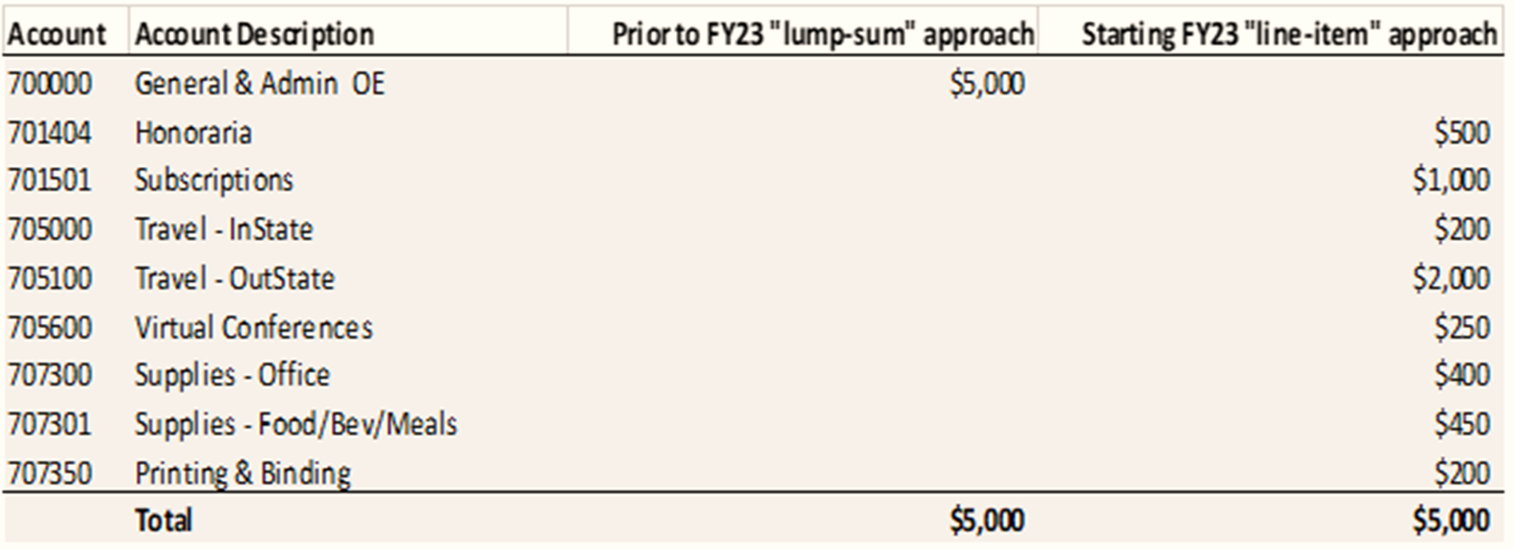
“Line-Item” vs. “Lump-Sum” Budget Approach

Slide 14
Actions to Align the Spending with Line-item Budget:
Check available line-item budget prior placing order/s or reconciling P-card charges
Request a budget transfer if line-item budget is insufficient
Monitor budget and spending by reviewing webFOCUS reports
Communicate any unexpected initiatives that require budget re-allocation or additional funding

Slide 15
Our Commitment:
Further strengthen communications between Finance & Administration and all other WCSU Divisions
Continued transparency
Prevent “surprises” from negatively impacting our bottom line
Advance and solidify data-driven culture
What We Have Been Working On:
A plan for Monthly or Quarterly budget review meetings with Divisional Budget Managers
WCSU Budget Policies & Procedures Manual
Budget Transfer Form
Re-designing Budget website, Budgets – Finance & Administration (wcsu.edu)
Common email account for general budget related inquires/requests – budget@wcsu.edu
Provide support and training when needed

Slide 16
Budget Transfer Form
Required Fields to be filled:
Requestor info
Details regarding the Fund, Org, Expense Account and Amount
Justification for Budget Transfer/s
Notes:
Important Reminder:
Transfers between Personal and OE are not allowed unless approved by CFO!

Slide 17
Mufu Weng Inita Mix
Director of Financial Planning Budget Analyst
& Budgets
203-837-8248 203-837-8516
wengm@wcsu.edu mixi@wcsu.edu
This Photo by Unknown Author is licensed under CC BY

Slide 18
Accounts Payable
Agenda: Invoices and Distribution Form

Slide 19
Accounts Payable
Located in University Hall room 205
Hours are Monday-Friday 8:00-4:30
Our office is responsible for a variety of functions associated with the making of non-payroll payments to students, employees, and our vendors
This Photo by Unknown Author is licensed under CC BY-SA

Slide 20
Invoices
Invoices from the vendor must include:
Vendor information
Invoice date and amount
Ship to, sold to and delivered to must be Western Connecticut State University
Itemized detail of expenses
No sales tax
All invoices are mailed directly to the Accounts Payable office or emailed to apinvoices@wcsu.edu They will then be emailed to the appropriate department for approval
Once the invoice is approved by the financial manager it should be sent to AP either inter-office or electronically to Battistat@wcsu.edu
Checks are issued on Fridays & mailed the next business day or direct deposited

Slide 21
Approval of Invoices
Needed in the body of email from the financial manager
Vendor Name
Invoice #
Invoice amount to pay
PO# or attached requisition with proper coding
Date goods/services received
Or the invoice may be digitally signed with the received date
If you are submitting with a reg, it must be sent to purchasing first

Slide 22
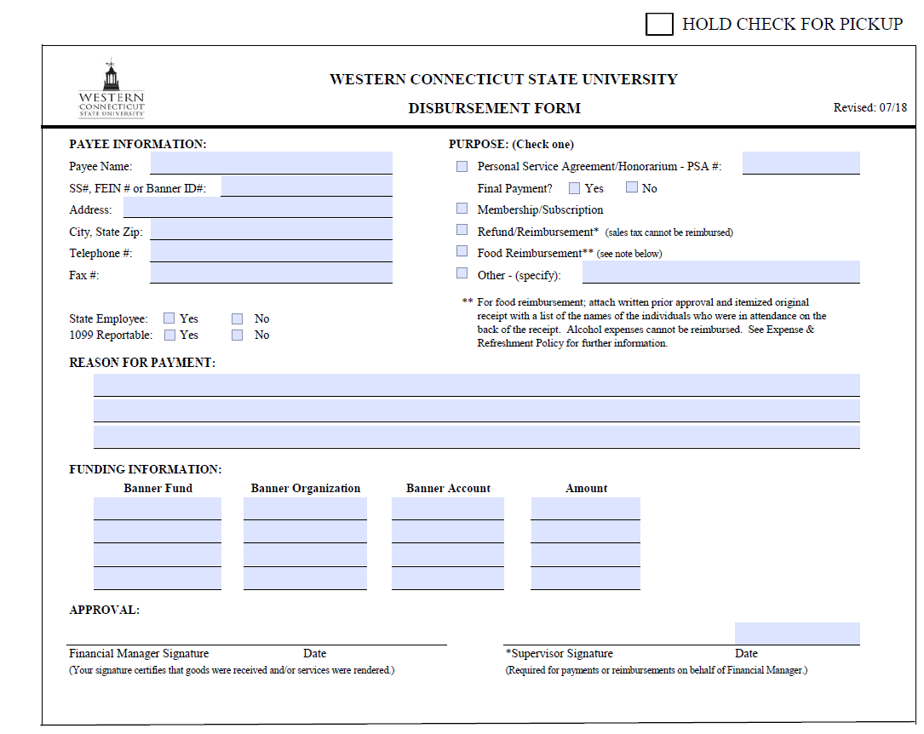

Slide 23
Disbursement Form
Uses:
-Personal Service Agreement
-Honorarium
-Refund
-Reimbursement
-Membership
-Subscription
-Other

Slide 24
Tammie Battista Kathleen Morey
Assoc Director Fiscal Affairs-AP Clerk Typist-AP
203-837-8378 203-837-8363
Battistat@wcsu.edu Moreyk@wcsu.edu
This Photo by Unknown Author is licensed under CC BY

Slide 25
Fiscal Affairs
Agenda: WebFOCUS

Slide 26
WebFOCUS
What is WebFOCUS?
How to access WebFOCUS?
How to sign into WebFOCUS?

Slide 27
What is WebFOCUS?
WebFOCUS is a report writing software which exports financial information from Banner9.
The financial data is continuously updated and reflected in real time.
There are 11 custom reports available in the Financial Manager’s portal.
WebFOCUS Training Manual is available on Finance & Administration website under Budgets
https://www.wcsu.edu/financeadmin/services/budgets/
Notes:
Top 3 frequently used reports:
Transaction Summary Report – OE and Self-Supporting Orgs – shows summary total of budget, YTD expense, encumbrances, and available balance.
Transaction Detail Report by an Org – shows details by account for each Org.
OE and Salary Budget vs Actual by Org Report – shows summary totals budget vs actual with variance amounts and percentages.

Slide 28
How to access WebFOCUS?
If you currently don’t have access, send an e-mail to Mary Mazza or Inita Mix.
Provide Org number(s) and Org name(s) that you oversee and confirm if you have Banner9 access.
Fiscal Affairs office will setup an ITI ticket for the access needed.
Once ITI tickets are completed you will be notified, and a training session will be scheduled.

Slide 29
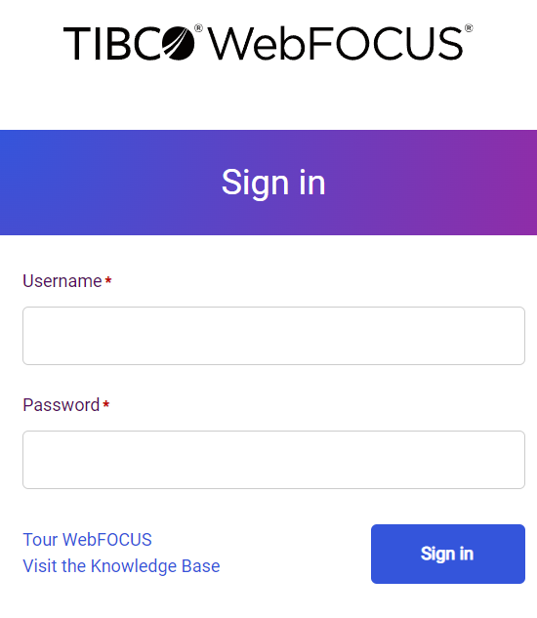
How to sign into WebFOCUS?
To find the WebFOCUS link, visit the Finance and Administration website and select Budgets.
https://reports.bi.ct.edu/ibi_apps/bip/portal/FinancialManagers
To sign in username is wcsu\Window’s name (example: wcsu\mazzam)
Password is the same as your WCSU Window’s password.

Slide 30
Mary Mazza Inita Mix
Associate Controller Budget Analyst
203-837-8372 203-837-8516
mazzam@wcsu.edu mixi@wcsu.edu
This Photo by Unknown Author is licensed under CC BY

Slide 31
This Photo by Unknown Author is licensed under CC BY-SA

