Slide 1
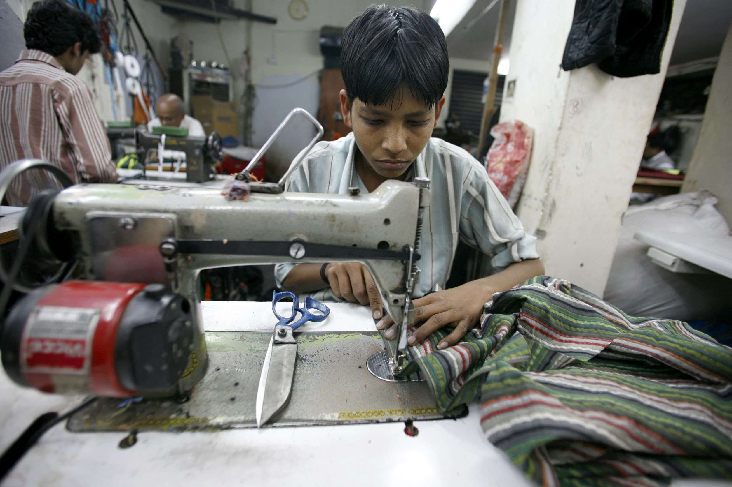


Fashion’s Hidden Victims
By: Nicoletta Smith

Slide 2
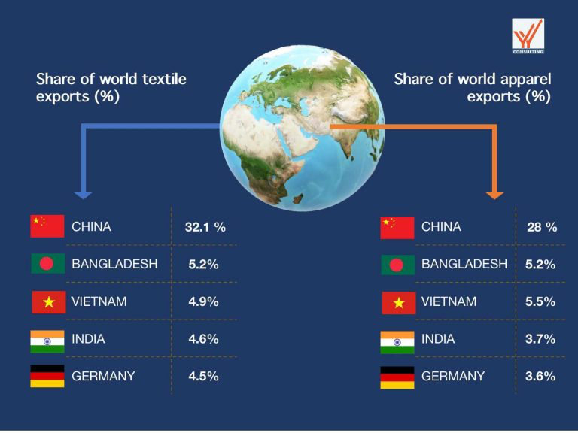
The Hidden Cost of Fashion
Millions of children are employed in textile mils, garment factories, and cotton fields around the world.
ILO estimates that over 160 million children are in child labor.
Fashion is one of the top industries to fuel demand.
Fast fashion produces inexpensive clothing at a fast pace, but at what cost?

Slide 3
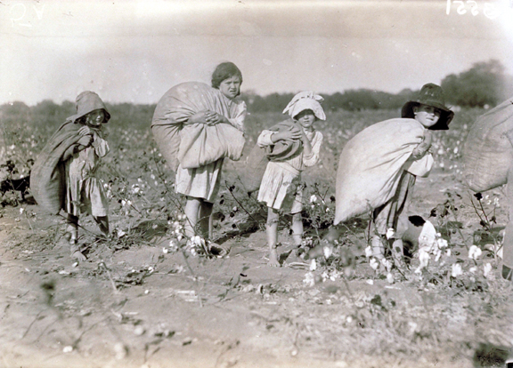
What Is Child Labor?
Work that deprives children of their childhood, potential, or dignity, and harms physical or mental development.
Common in cotton harvesting, garment sewing, and dyeing.
A key distinction is helping families vs. exploitative labor.

Slide 4
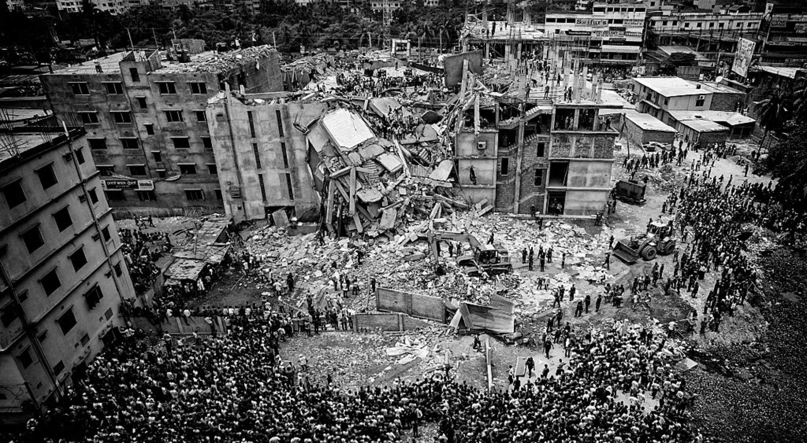
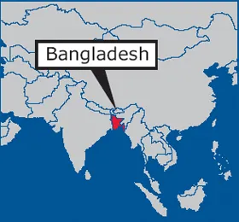
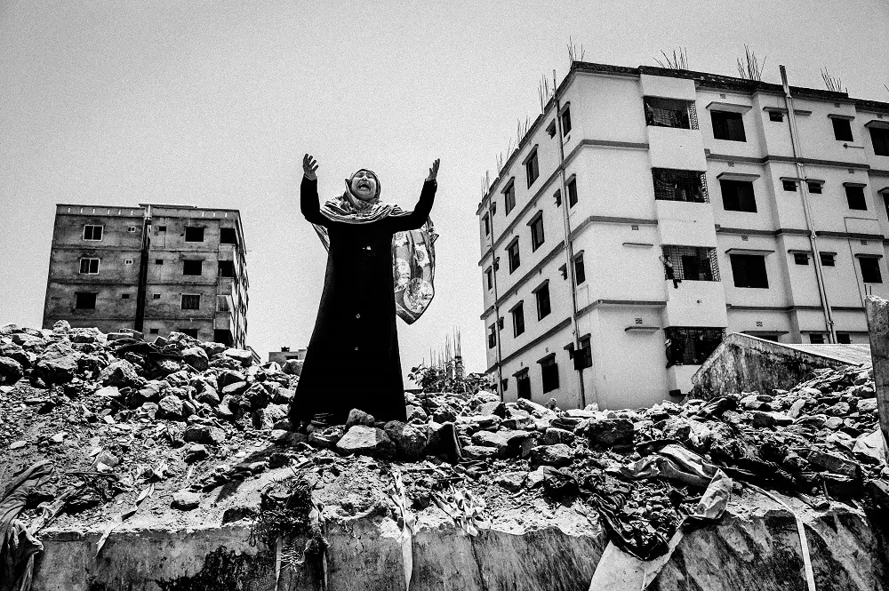
Case Study -
Bangladesh Garment Factories
Following China, Bangladesh is the second largest exporter of apparel in the world.
Children, as young as 10, do work for more than 12 hours a day at a pay of less than $1.50 a day.
Workers may not have safe working conditions and may be exposed to toxic dyes as well as machinery injuries.
In 2013, the Rana Plaza factory collapsed which killed 1,134 workers, many of whom were underage.

Slide 5
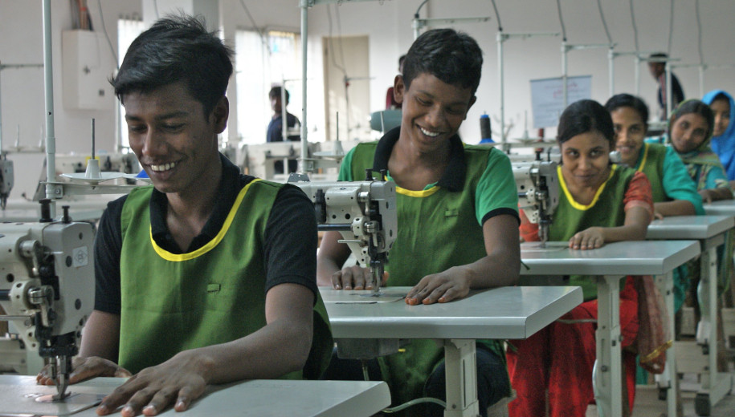
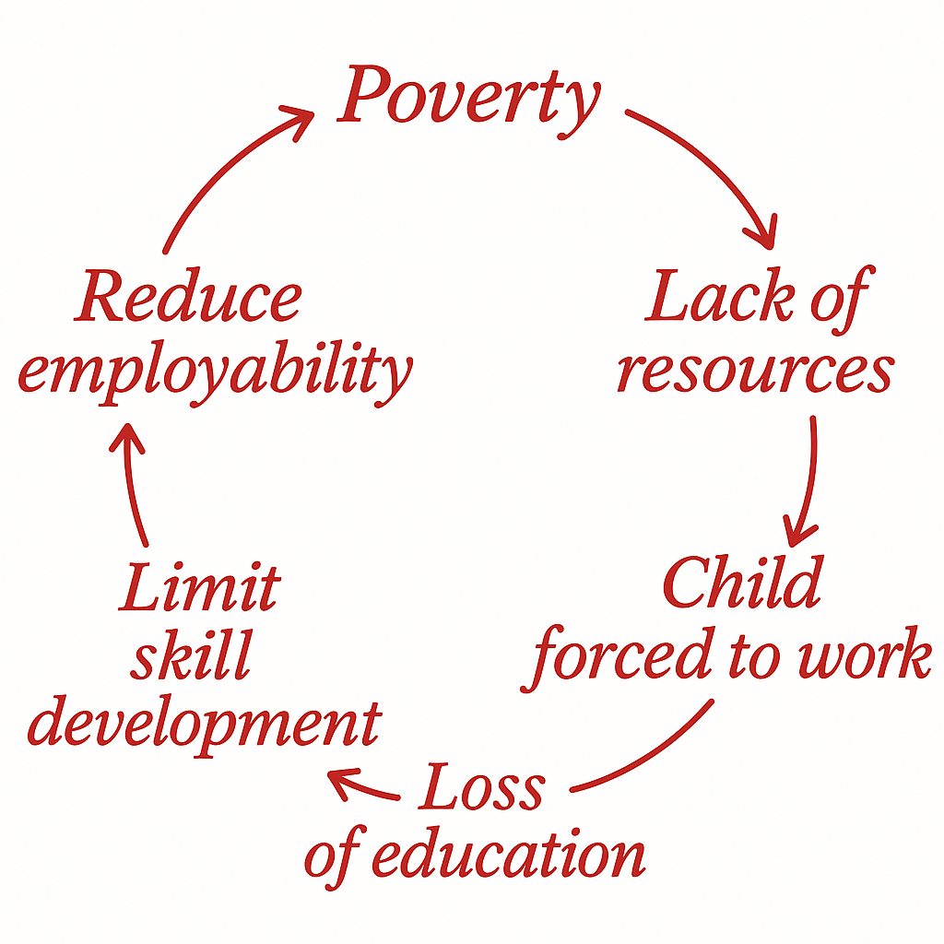
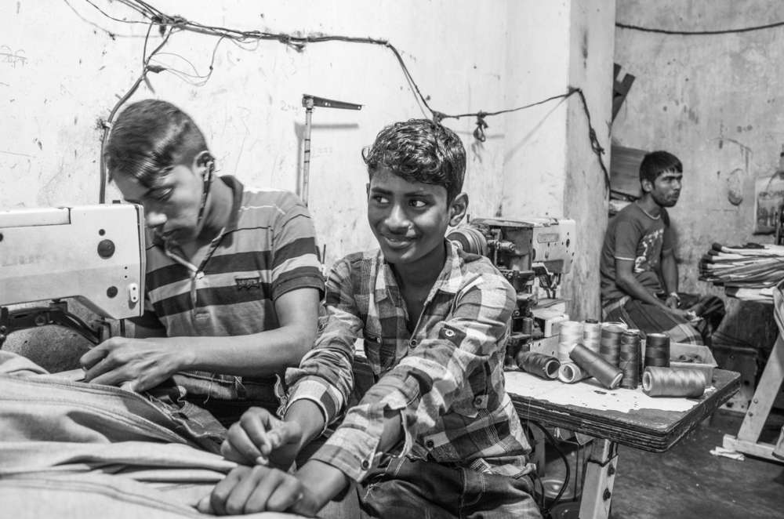
Why Child Labor Happens?
Poverty and lack of education, families depend on their children’s income.
Cheap labor demand, companies subcontract to minimize costs.
Weak enforcement, corruption and lack of monitoring.
Fast fashion brands compel mass production due to low prices.

Slide 6
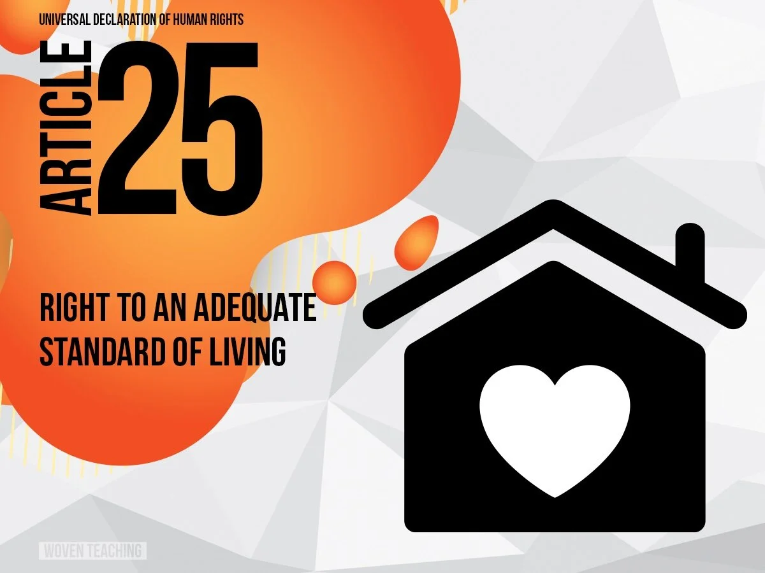

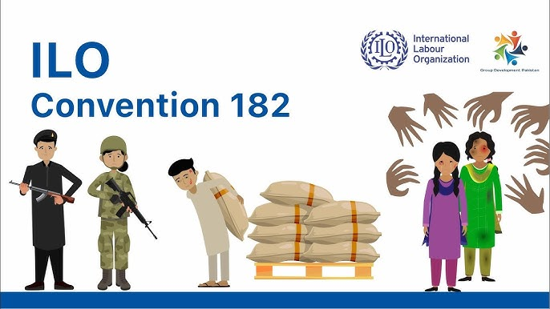

Human Rights Violations
Breaking multiple international protections:
  UDHR Article 25: Right to sufficient standards of living and child protection.
  ILO Conventions No. 138 & 182: Minimum age and worst forms of child labor.
  UNCRC Article 32: Protection from economic exploitation.

Slide 7
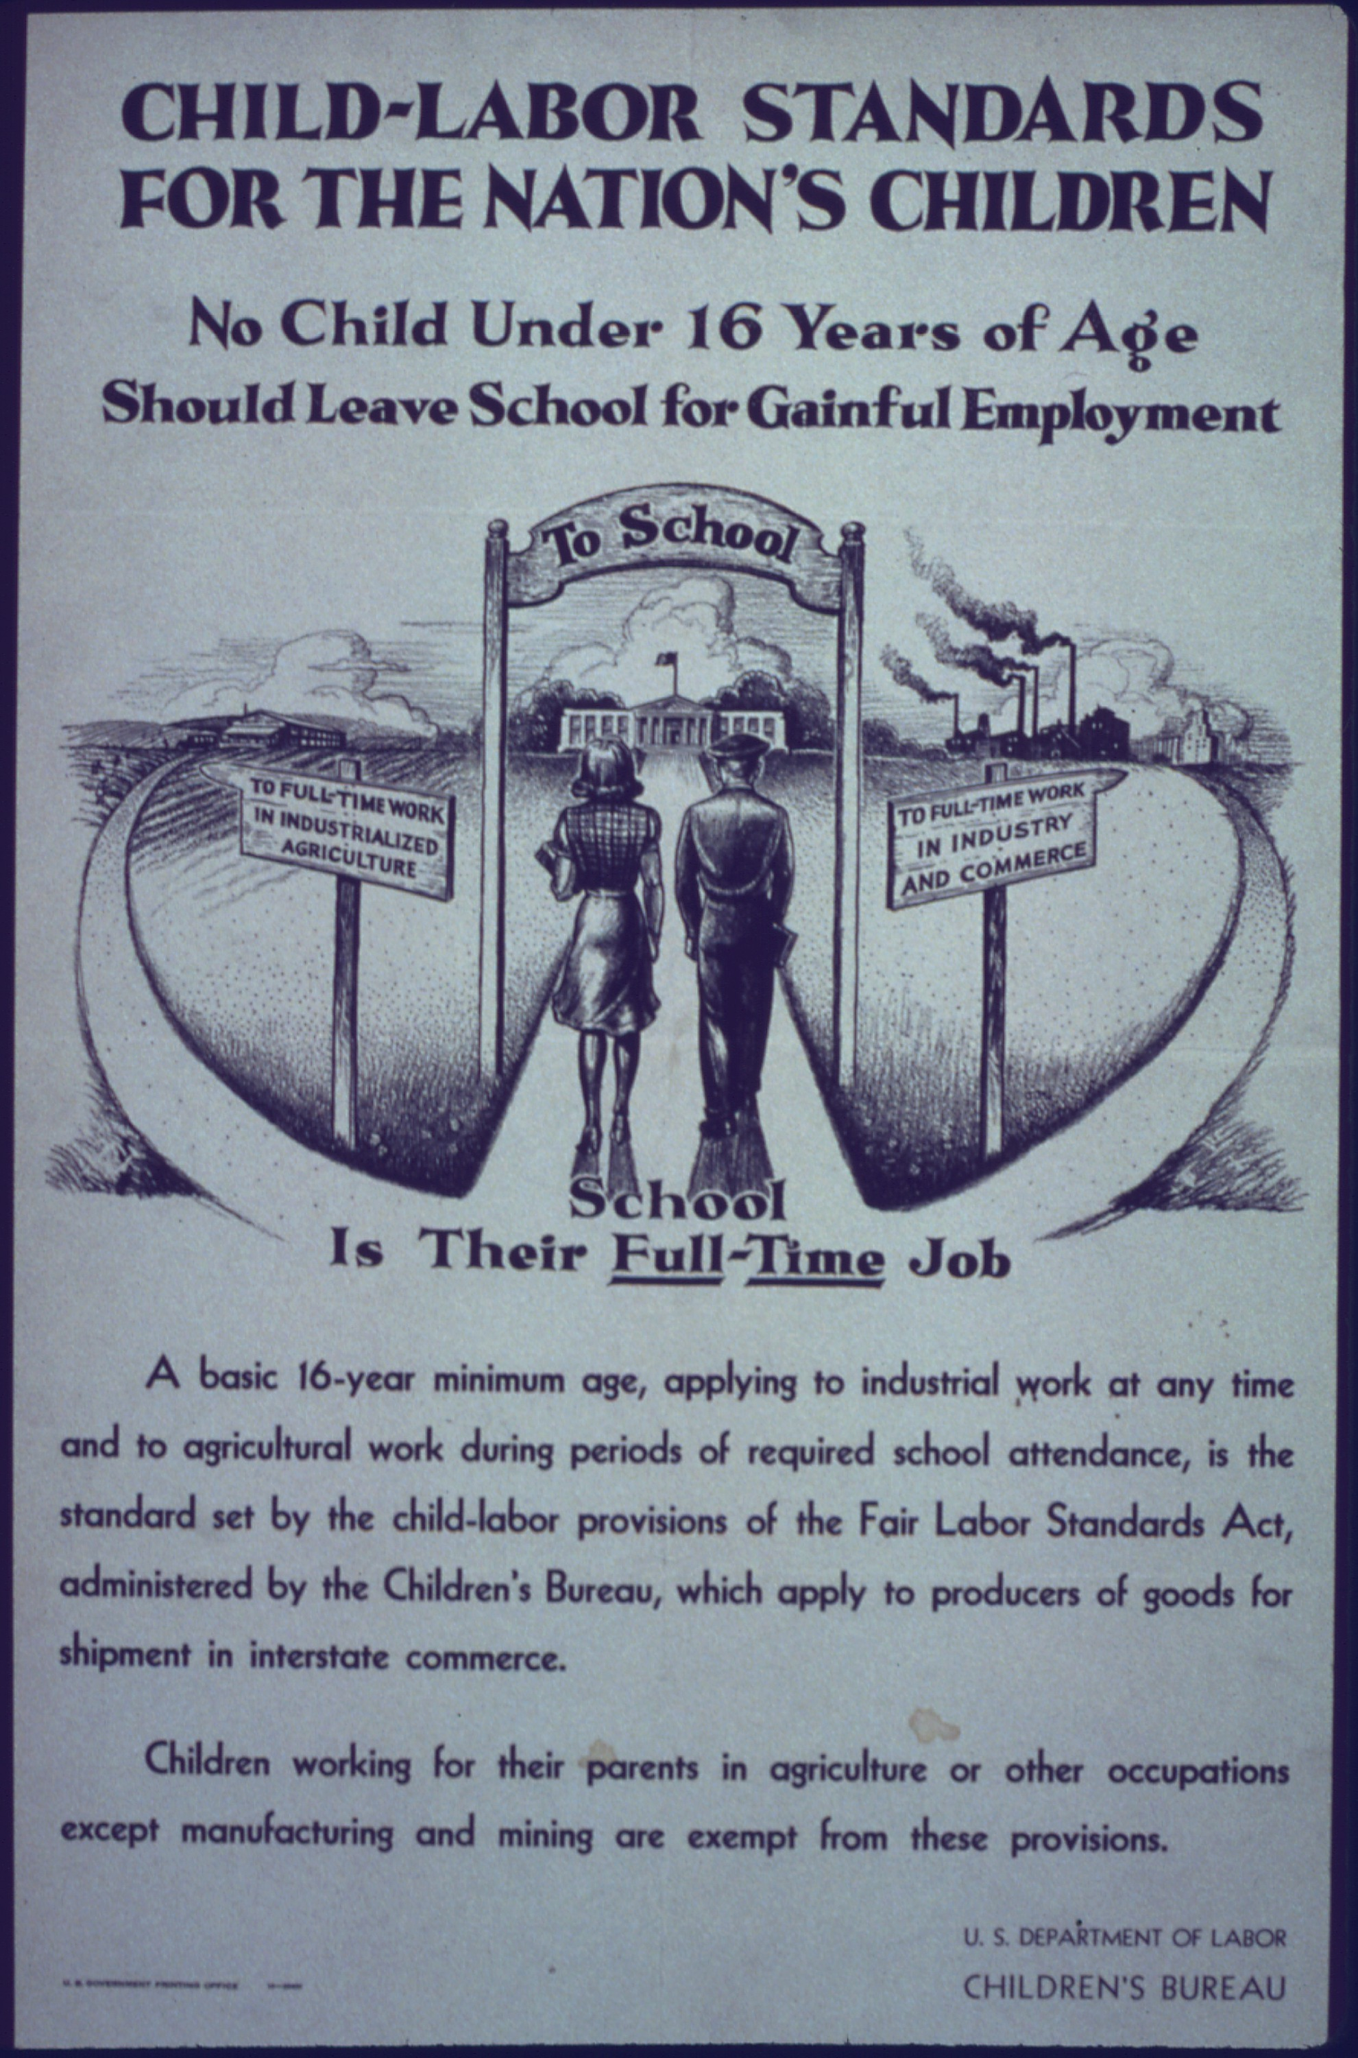
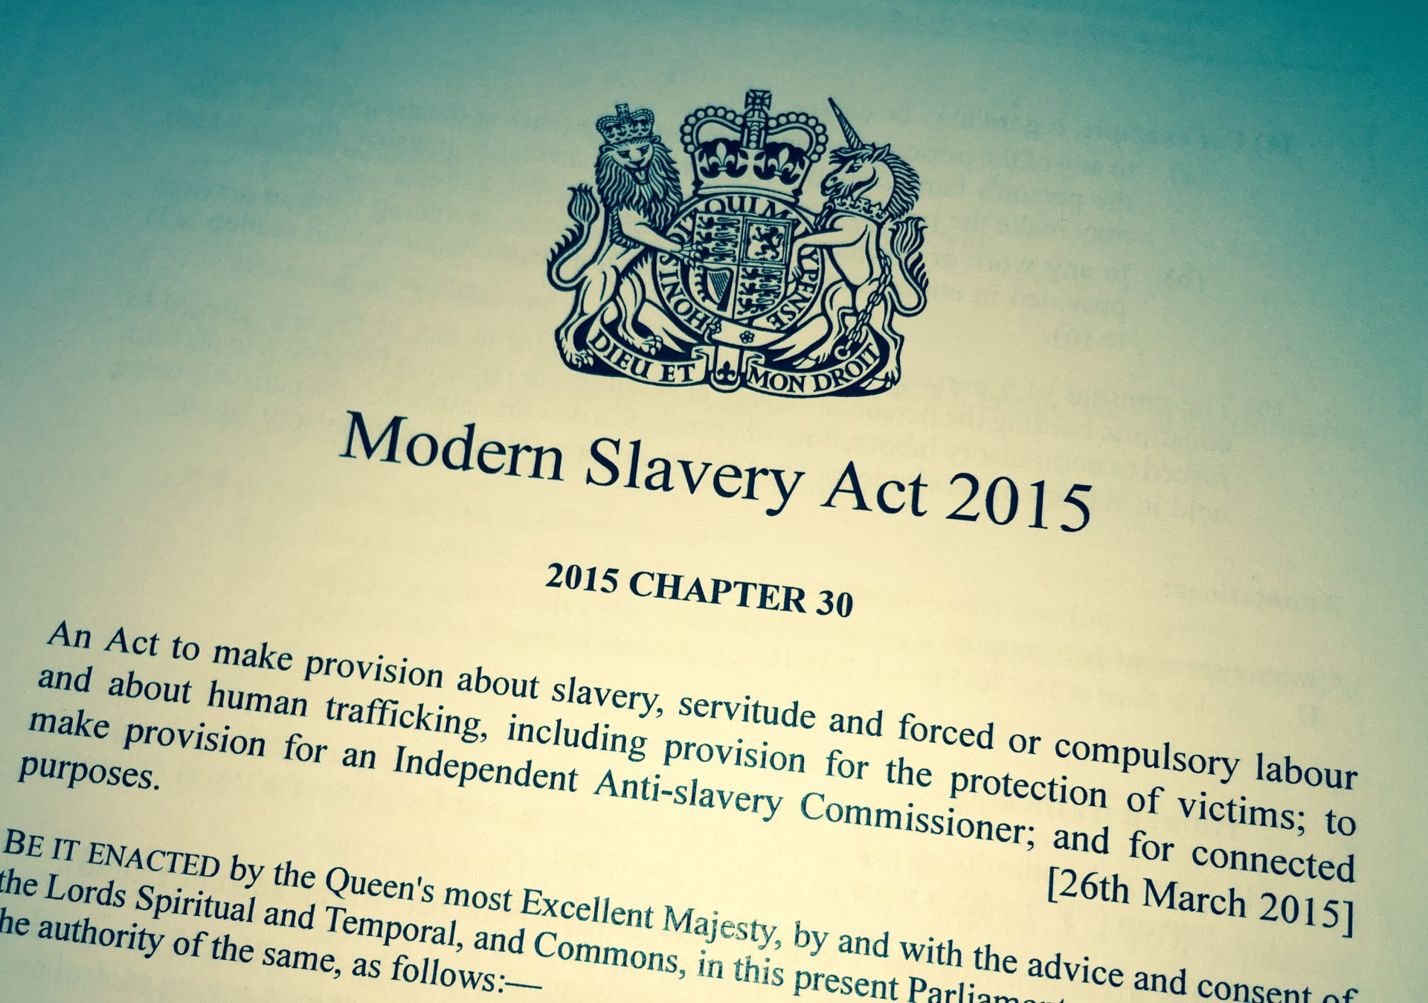
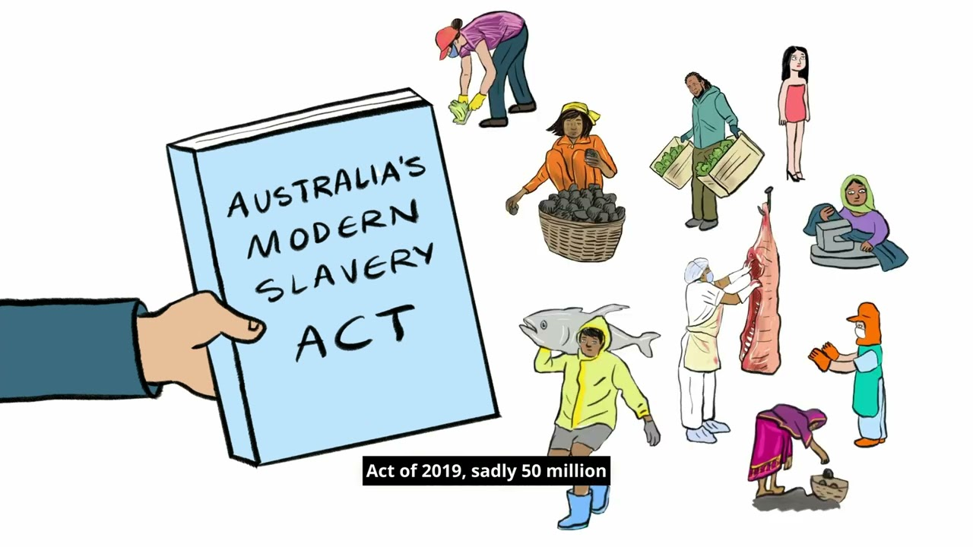
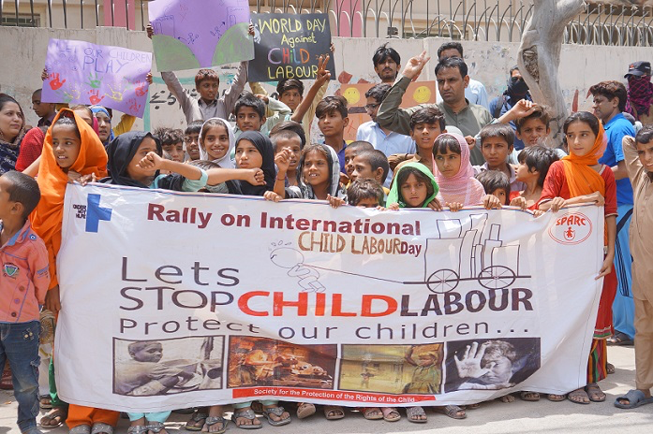
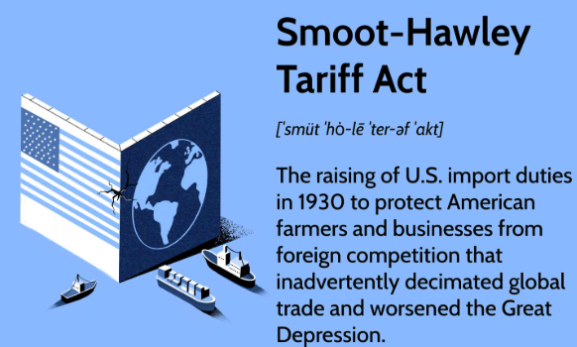
Legal Accountability
& Corporate Responsibility
U.S. Tariff Act (1930): Prevents imports from forced or child labor.
Modern Slavery Acts (UK 2015, Australia 2018): Require transparency in supply chains.
Many brands issue Ethical Sourcing Reports, but enforceability is limited.
NGOs, including Fashion Revolution and Clean Clothes Campaign expose violations.

Slide 8
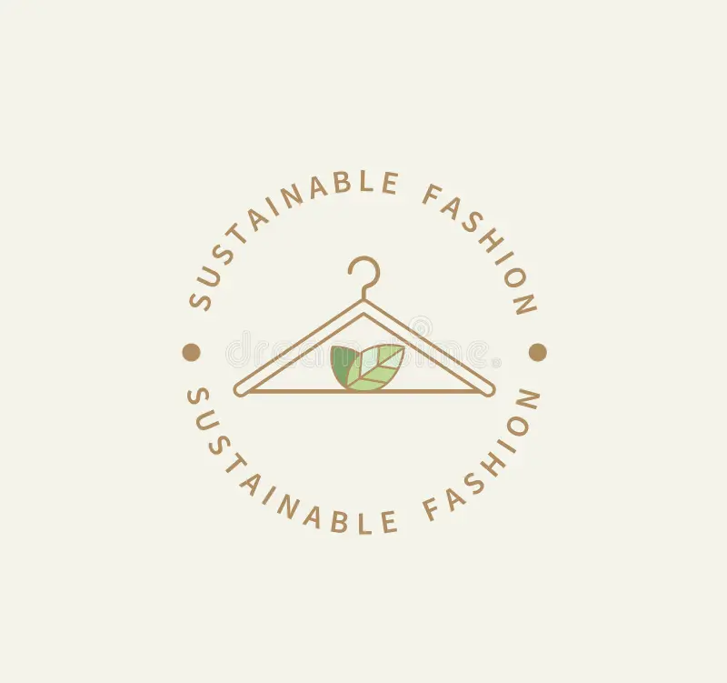
The Path Forward
Consumer Awareness: Purchase less; select sustainable brands.
Corporate Action: Invest in ethical supply chains and auditing.
Education Access: Programs that keep children connected to school rather than to factories.

Slide 9
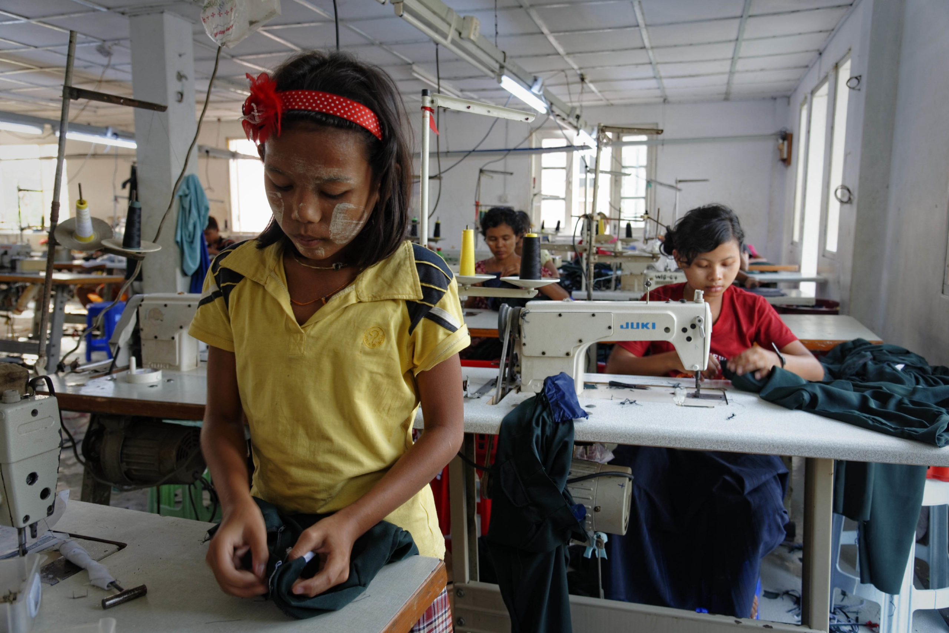
Conclusion
Support ethical companies and fair trade.
Invest in free and quality education.
Strengthen inspections and laws.
Raise awareness and encourage youth activism.

Slide 10
References
https://www.ilo.org/global/publications/books/WCMS_797515/lang--en/index.htm
https://www.unicef.org/supply/stories/children-fashion-supply-chain
https://cleanclothes.org/
https://www.dol.gov/agencies/ilab/reports/child-labor/list-of-goods
https://ranaplaza-fund.org/
https://www.fashionrevolution.org/transparency

