Slide 1

Global Organ Trafficking and the Murder of Victims in China Prisons
By: Faith Reilly

Slide 2
What is organ trafficking?
Illegal removal and trade of human organs for profit
Often taken without consent from vulnerable people- prisoners, the poor, or kidnaped victims
Driven by high demand for transplants and limited donors
Involves thousands of victims and over $1 billion yearly
Violates the right to life, autonomy and human dignity
Notes:
Organ trafficking is the illegal removal and sale of human organs- usually for transplants or profit
In many cases, the organs are taken without consent from vulnerable groups like prisoners, the poor or even people who have been kidnapped
This happens because there is a huge global demand for organ transplants but not enough legal donors
It’s a billion dollar black market that affects thousands of victims each year
Beyond the money, it’s a serious violation of basic human rights- the right to life, autonomy and dignity

Slide 3
History of Organ Harvesting and Trafficking in China
late 1980s
Began in the late 1980s with organs taken from executed prisoners
1990s-2000s
There was a rapid increase in transplants despite very few voluntary donors
1999
Chinese Communist Party launches persecution campaign against Falun Gong, labeling it as a “threat”
2006
First international reports expose large-scale organ harvesting of Falun Gong prisoners, promoting UN and U.S. investigations
Notes:
"Organ harvesting in China developed gradually over several decades.
It began in the 1980s with the use of organs from executed prisoners, but by the 1990s, transplant operations had grown dramatically without a reliable donor system.
After 1999, the detention of Falun Gong practitioners provided a new, hidden source for organs, and by the early 2000s, evidence pointed to organized medical screening inside detention centers.
In 2006, international reports exposed these practices, prompting human rights investigations that continue to this day."

Slide 4
Data and Evidence of Organ Harvesting in China
Hospitals in China report performing an estimated 60,000-100,000 organ transplants per year- far higher than the government’s official claim of only 10,000
Given the overwhelming gap in these statistics, where did China source tens of thousands of organs?
Wait times as short as 2-4 weeks- much faster than other countries
Global illegal organ trade worth $800 million- $1.7 billion annually
Notes:
“Investigations estimate China does up to 100,000 transplants a year — far more than it reports. People often get organs within weeks, not months, which points to a hidden donor source. The UN and WHO say there’s credible evidence of forced organ harvesting, and the global organ trade is worth 800 million to 1.7 billion annually”

Slide 5

China’s Organ Harvesting and International Law
Illegal organ harvesting violates the Universal Declaration of Human Rights: Article 3- right to life and security and Article 5- freedom from torture or cruel treatment
UN and WHO rules ban organ removal through coercion
Detainees are blood-tested, executed, and harvested for organs- a clear breach of international human rights and medical ethics
Notes:
In China, many reports show that organs are taken from prisoners of conscience and political dissidents, often without their consent.
These actions violate international human rights laws- including the Universal Declaration of Human Rights. Article 3 protects the right to life and security, and Article 5 bans torture or cruel treatment
The UN and World Health Organization also prohibit organ removal through coercion
Despite these laws, detainees continue to be harvested for organs, showing a serious violation of both human rights and medical ethics.

Slide 6
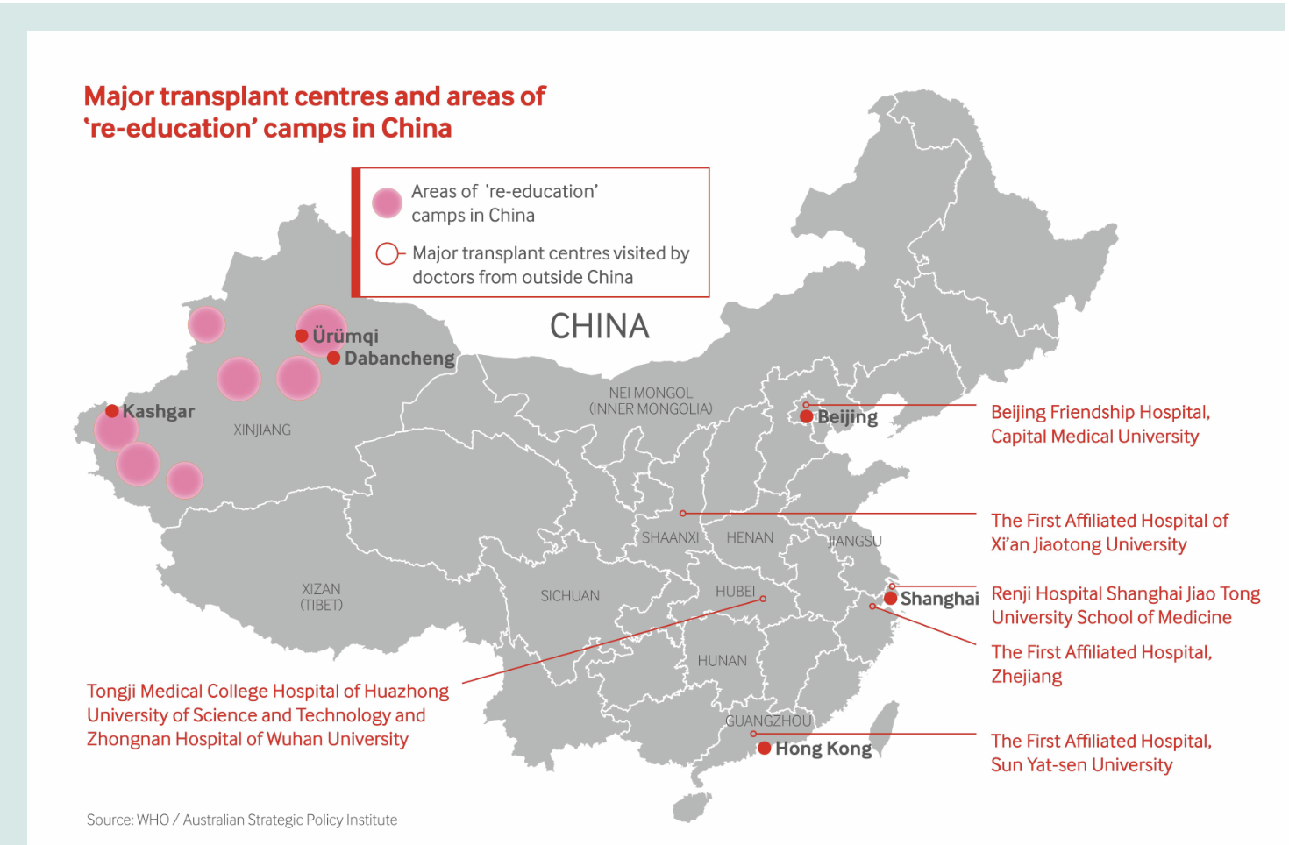
Inside China’s Prison System and “Re-Education Camps”
Thousands are detained for political or religious beliefs- including Falun Gong practitioners
Prisoners undergo blood tests, DNA sampling, and organ scans with no medical reason given
Many detainees disappear or are reported “transferred”, and are never seen again
State-run hospital and prisons are often connected- creating a pipeline from prisons to operating tables
Evidence shows organs are removed while victims are alive or immediately after execution, then bodies are cremated to hide proof
This process is systemic and industrialized- not isolated abuse
Notes:
“This map shows how many of China’s major transplant hospitals are located near large prison and ‘re-education’ camp areas. Thousands of people are detained for their religious or political beliefs, including Falun Gong practitioners. Inside these camps, detainees are forced to undergo blood tests and organ scans without any medical reason. Many of them are later listed as ‘transferred’ and never seen again. Evidence shows that some hospitals and prisons are directly connected, creating a pipeline from prisoners to transplant operating rooms. Reports indicate organs are often taken while victims are still alive or right after execution, and their bodies are cremated to destroy proof. This is a coordinated, state-run system—not a few isolated cases.”

Slide 7
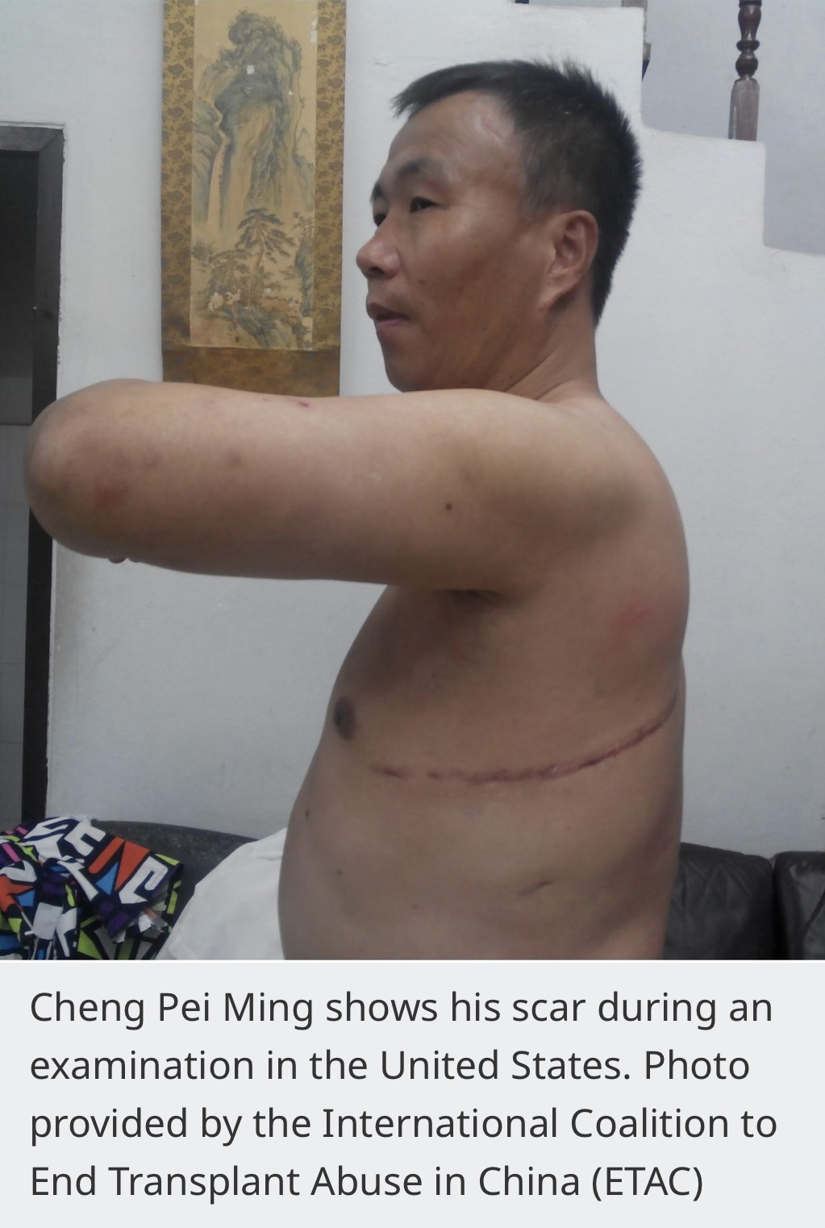
A Survivor's Story
Cheng Pei Ming, a Falun Gong practitioner from Shandong, was imprisoned and tortured (1999-2004) for his beliefs
While imprisoned, he was subjected to repeated blood tests and medical scans without explanation
In 2004, Cheng was forcibly taken for a "surgery." When he awoke, he was shackled to a hospital bed with a large incision on his side.
After escaping China years later, U.S. medical scans confirmed parts of his liver and left lung had been surgically removed.
He is believed to be the first known survivor of China's forced organ harvesting campaign.
Today, Cheng speaks publicly to raise awareness and honor those who were killed for their beliefs and organs.
Notes:
“Cheng Pei Ming is a person who survived forced organ harvesting. He was imprisoned simply for practicing Falun Gong — a peaceful meditation practice banned by the Chinese Communist Party. While in prison, he was tested repeatedly, not for health reasons, but to check organ compatibility.
In 2004, he was suddenly taken for what guards called an ‘operation.’ When he regained consciousness, he found himself in severe pain with a surgical incision across his chest. He had never consented to any procedure.
Years later, after escaping to the U.S., medical tests confirmed that sections of his liver and lung had been removed. Cheng is believed to be the first person to survive China’s forced organ harvesting — a process that kills most victims.
His survival provides rare physical proof of these crimes. Cheng now uses his voice to speak for the countless others who did not make it out alive.”

Slide 8

Ending forced Organ Harvesting
Call for accountability- International pressure needs to stay strong- countries, hospitals, and corporations should refuse to work with China's transplant programs until transparency is proven
Student & community action- Raising awareness is one of the most powerful tools we have. Schools and universities can host events, screening, and discussions to inform others
Personal responsibility- People can take the ETAC Pledge- a commitment not to receive organs from unethical transplant systems like China’s
Legislative Action- The Stop Forced Organ Harvesting Act of 2025 has already passed the U.S. House of Representatives and is now under review by the Senate Foreign Relations Committee. The bill seeks to sanction individuals and entities involved in forced organ harvesting and hold governments accountable
Notes:
To end the presentation, I want to focus on what can actually be done to end forced organ harvesting.
First, accountability: International pressure needs to stay strong. Other countries, hospitals, and even private companies should refuse to work with China’s transplant system until there’s real transparency and proof that organs are ethically sourced.
Second, community action: Raising awareness is one of the most powerful tools we have. Schools and universities—like ours—can host events, film screenings, or discussions to help more people understand what’s happening and how serious it is.
Third, personal responsibility: There’s even something individuals can do. People can take the ETAC Pledge, which is basically a promise not to accept an organ from an unethical transplant system like China’s.
And finally, government action: In the U.S., the Stop Forced Organ Harvesting Act of 2025 was passed by the House and is now in the Senate Foreign Relations Committee. This bill would sanction individuals and organizations involved in organ harvesting and make the U.S. take a stronger stand against these human-rights violations.
So overall, real change depends on both awareness and accountability—at every level.”

Slide 9
References
https://pubmed.ncbi.nlm.nih.gov/27805507/
https://thediplomat.com/2024/08/first-known-survivor-of-chinas-forced-organ-harvesting-speaks-out/
https://www.scu.edu/ethics/healthcare-ethics-blog/forced-organ-harvesting-a-decades-long-injustice-in-need-of-international-accountability-and-action/
https://www.bma.org.uk/news-and-opinion/at-what-price
https://endtransplantabuse.org/pledge/
https://www.congress.gov/bill/119th-congress/house-bill/1503/text/ih

