Slide 1
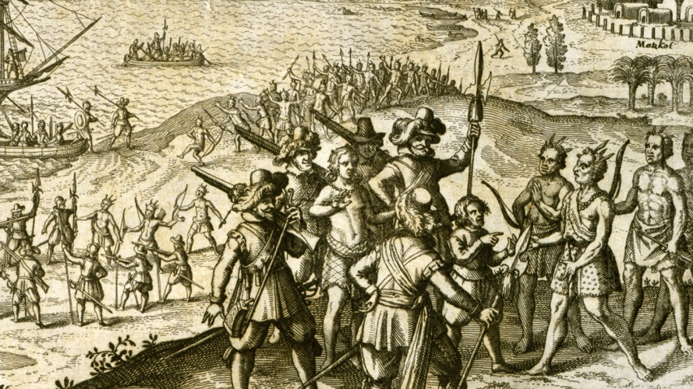

Legacy of Oppression In Dominican Republic
By: Yaritza Santana Jimenez
This Photo by Unknown Author is licensed under CC BY-SA

Slide 2
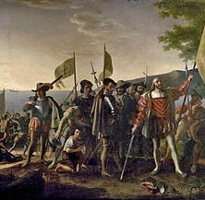
Colonizers Arriving to Hispaniola
Christopher Columbus arrived in Hispaniola in December of 1492. Which is what we now call Dominican Republic. During that time the island was home to many tribes such as the Arawak, Orinoco and Ciguayo, which overall are considered the Taino people. Much of this history has been captured in many films and journal entries that Columbus and Bartolome de las Casa wrote. In which they captured the kindness and hospitality of the Taino people. However, they also captured the injustices they committed against the Taino people which include mass rape, beatings and unjust killings.
This Photo by Unknown Author is licensed under CC BY-SA

Slide 3
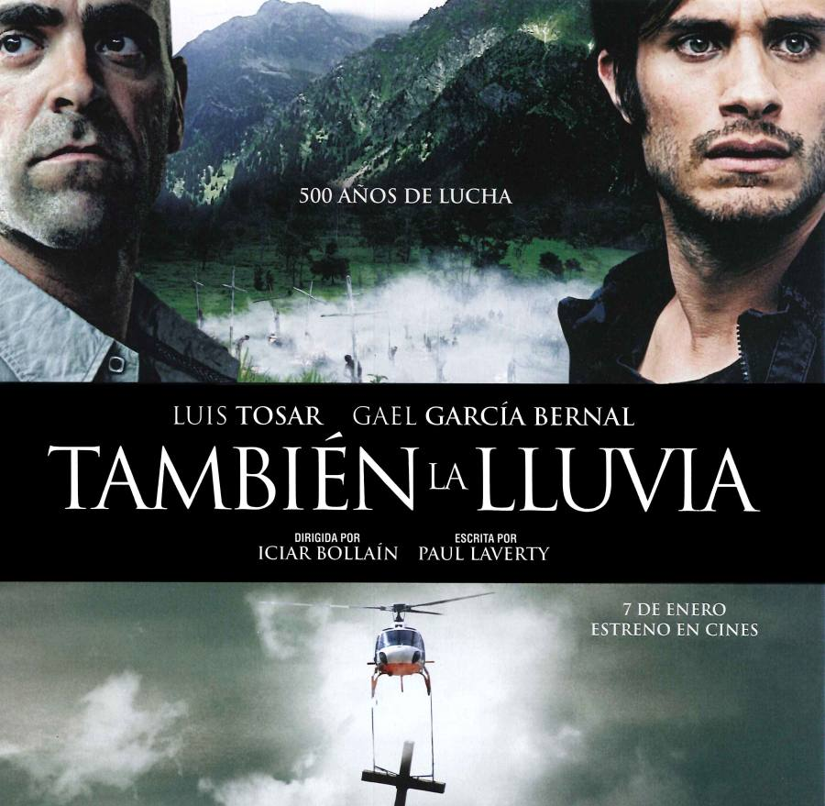
Even The Rain
Most of my inspiration stems from personal encounters and the film Even the Rain directed by Iciar Bollain. This film depicts many of the injustices committed by Cristopher Columbus. In the film we can see violations of Articles 1, 2, 3, 9, 20, 23, 25,21 and 19 from UDHR. These very much represent the oppressive environment Taino people were forced to live under. Additionally, the film also depicts the Cochabamba Water War in Bolivia that was caused due to a privatization of the water and a shortage of resources for the residents and further depict violations of Human Rights during colonialism and modern-day Bolivia.
This Photo by Unknown Author is licensed under CC BY-SA-NC

Slide 4
Forced into Religion
In the film, there are representations of brutality from the Spanish conquistadors in which they forced the Taino people into Christianity. The Taino that resisted were brutally beaten, killed and tortured. Accordingly, entire villages were burned and massacred if they refused to obey religious orders. They were also forced to be baptized and forced to rid themselves of meaningful objects. The Spanish conquistadors also forbade them from engaging in rituals that were ceremonial to them and punished them if they did not obey. Once the Taino people were baptized, they were considered objects of Spain and started being sold and enslaved which constitute of violation of Articles 18 and 4 from the UDHR.

Slide 5
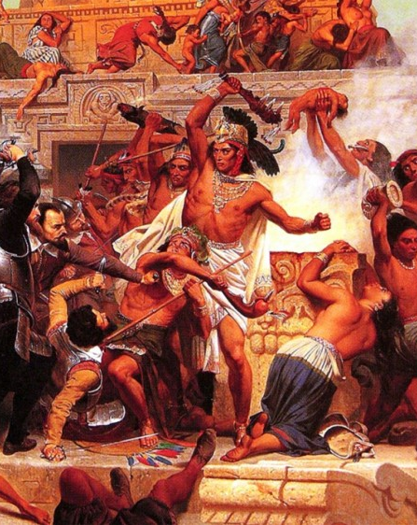
Other Injustices During Colonization
As previously mentioned, the Taino people suffered immensely at the hands of the conquistadors. Not only were they stripped of their identity in terms of religion. They were also forced to produce gold for the Spanish and if they did not comply, they were killed. I consider these violations of Articles 4, 6, 7 and 5 of the UDHR which consider all humans to be equal and free from slavery. Additionally, many of these slaves were renamed and their identities were erased forever.
This Photo by Unknown Author is licensed under CC BY-SA

Slide 6
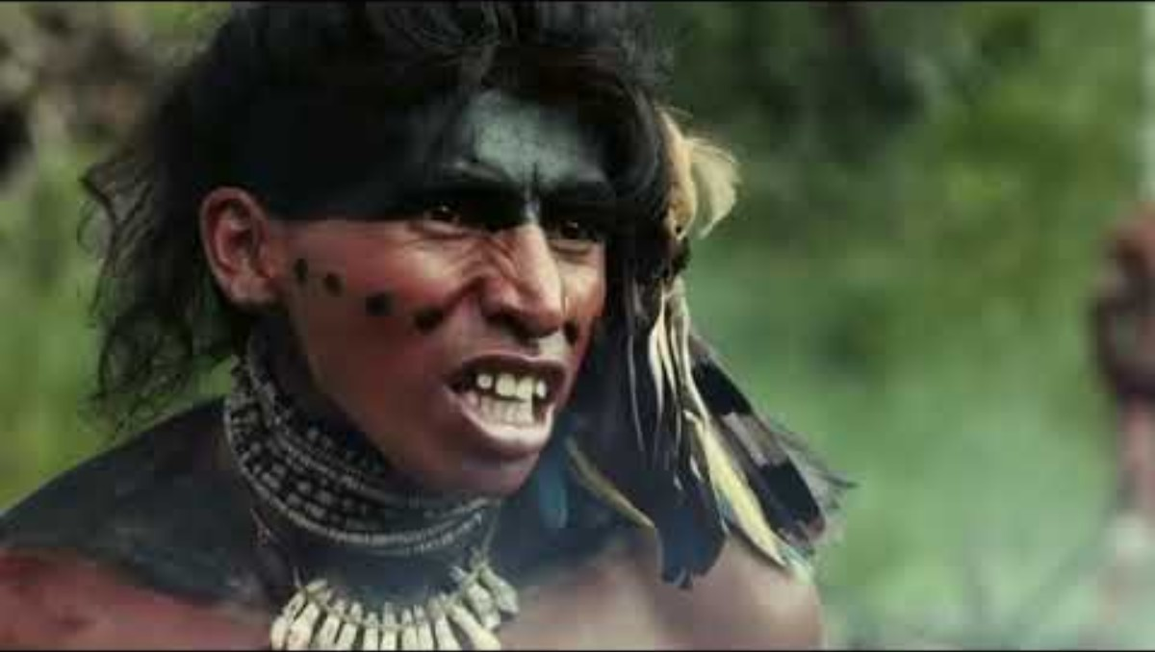
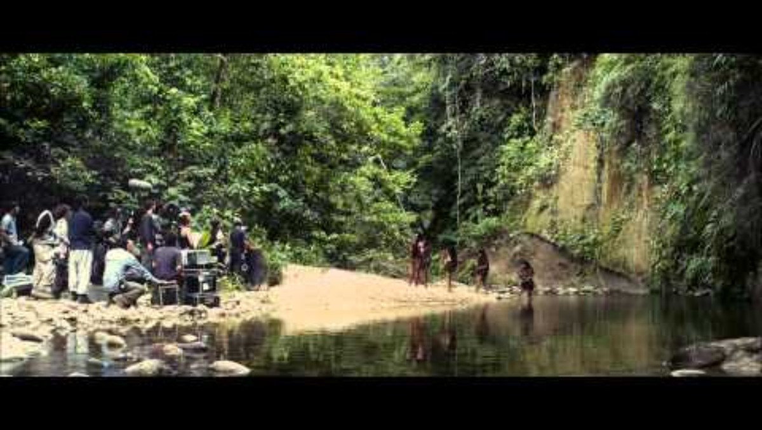
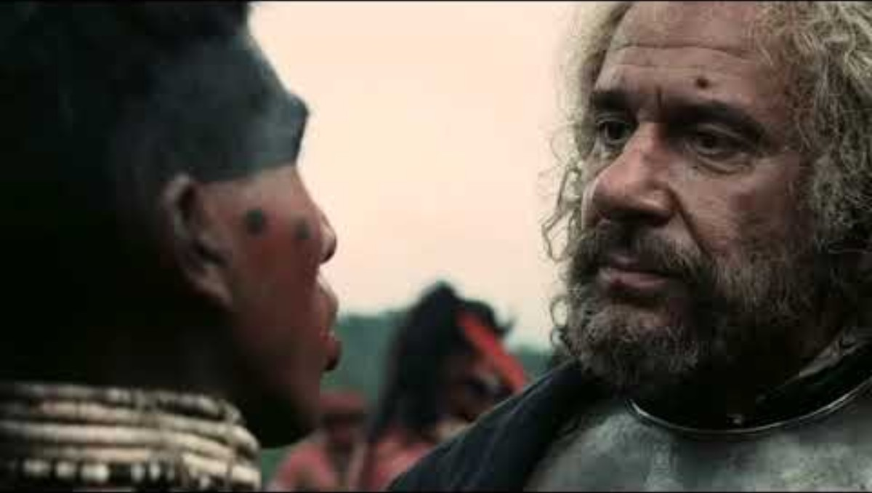
Clips from the Movie
Execution of Hatuey, first hero of Cuba
Scene from Even the Rain, initial Colombus colonization effort
EVEN THE RAIN - Trailer [ENG SUB]

Slide 7
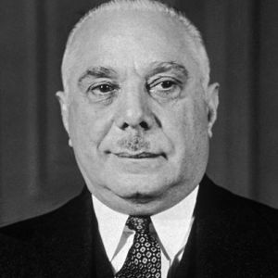
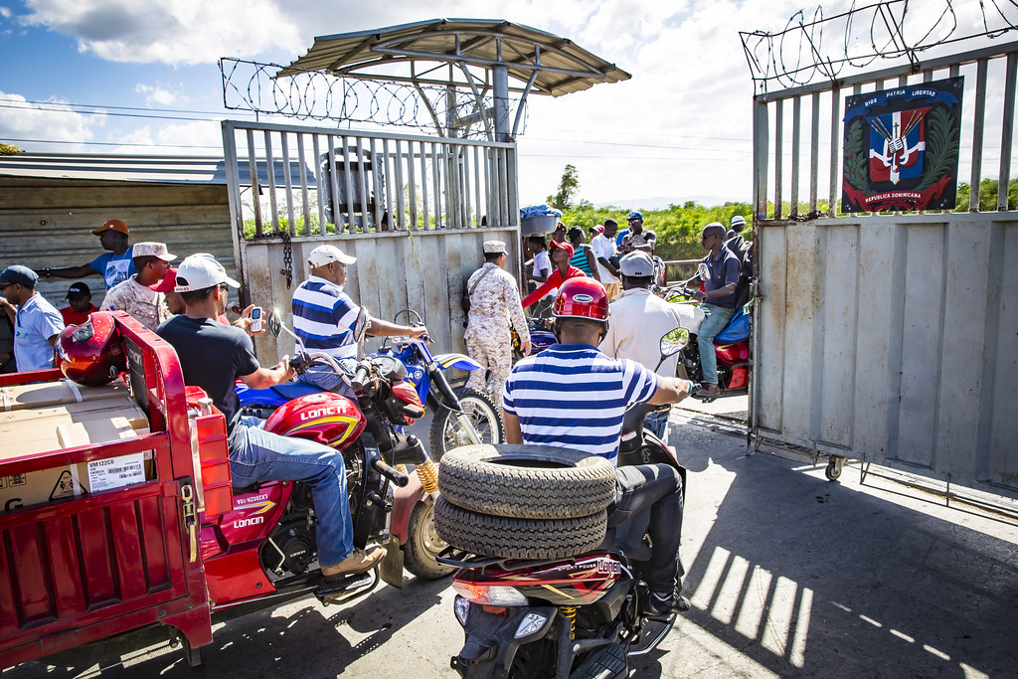
Modern Day Oppression and Discrimination
Although, Dominican Republic was renamed, many of the racist and oppressive ideologies from the Spanish are still present. There are mass deportation of Haitians, mass killings and racial discrimination among Dominicans. Additionally, poverty is also an issue, and all because of the Spanish and their influence that is still seen nowadays.
This Photo by Unknown Author is licensed under CC BY-NC-ND
This Photo by Unknown Author is licensed under CC BY-SA-NC

Slide 8
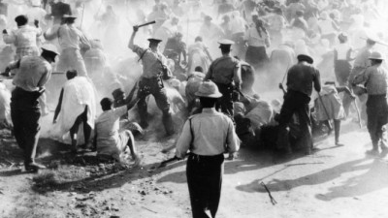
Parsley Massacre
The Parsley Massacre was a state sponsored genocide ordered by Rafael Trujillo during the 1930s. He was a Dominican dictator that wanted to “whiten” the Dominican population, and he decided that soldiers must use the word “peregil” or parsley as a test. During this time soldiers would question people of darker skin complexion and whoever said this word in a Haitian Creole accent was immediately identified as Haitian and they were killed. About 30,000 people were killed and buried in mass graves that were never found. This massacre lasted about 8 days, and many Haitians were said to hide in the caves in an attempt to escape their fate.
This Photo by Unknown Author is licensed under CC BY-ND

Slide 9
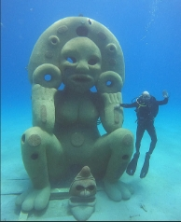
Atabey Statue
This is a statute of Atabey. A Taino goddess of Earth and Water. She is believed to represent water and soil and the presence of life in the ocean. However, this statute was located in Sosua and recently has been ordered to be removed by legislators and religious groups in Sosua. They suggested the removal of this statute because they considered it evil and demonic and not representative of the Taino culture.

Slide 10
My Taino Descent
As a woman of Taino and African descent, the opportunities offered to me in the Dominican Republic were not great. Education is a main part of this because only wealthy families can afford a college education. Additionally, I would not be able to find employment because these opportunities only are found when wealthy families offer. A prime example would be my mother and her sister, who for the past two years have struggled to find a stable form of employment.

Slide 11
References
The Decline of the Tainos, 1492-1542: A Re-Vision
Dominican Republic's Taino Legacy: Unearthing Indigenous Roots - Island Hopper Guides
Christopher Columbus's Legacy: Exploring the Contentious History of the Colonial Zone - Island Hopper Guides
Who Were the Taíno, the Original Inhabitants of Columbus’ Island Colonies?
80 Years On, Dominicans And Haitians Revisit Painful Memories Of Parsley Massacre : Parallels : NPR
Atabey: The First Mother of Borikén - by Luna Divina
¿Cuáles son las características que tiene la escultura de Atabey en Sosúa?

Slide 12
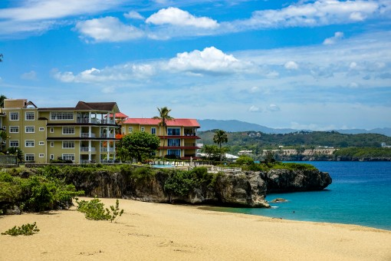
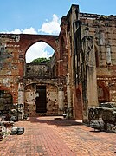
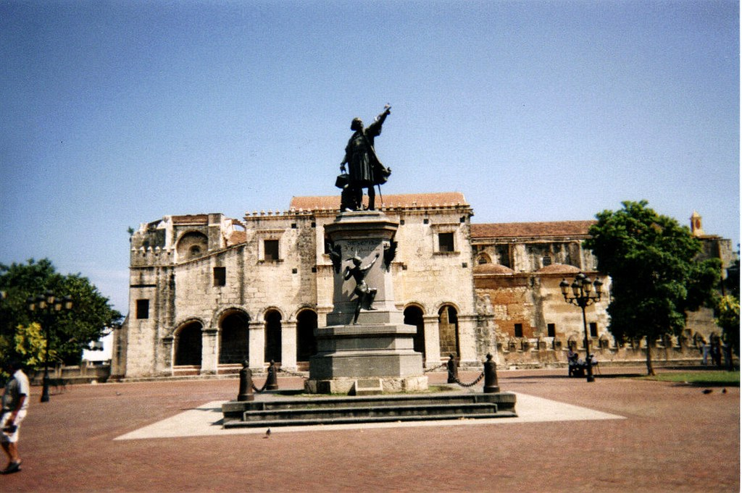
THANK YOU
Yaritza Santana Jimenez
This Photo by Unknown Author is licensed under CC BY
This Photo by Unknown Author is licensed under CC BY-SA

