Slide 1


The Right to Seek Asylum & Refugee Protection
My Personal Journey from Iraq to the United States

Slide 2
My Story
I was born in Iraq and grew up during a time of war and instability. Because of ongoing conflict and the serious struggles my family faced due to the war, we were forced to leave our home in September 2016 to find a safe place to live. We moved to the United States not just for protection, but for a chance at stability, education, and opportunity, something we could no longer safely access in our own country. This right to seek safety is not just personal to me; it is protected under international law.

Slide 3
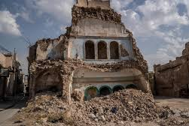
This picture is showing how homes are destroyed because of the war

Slide 4
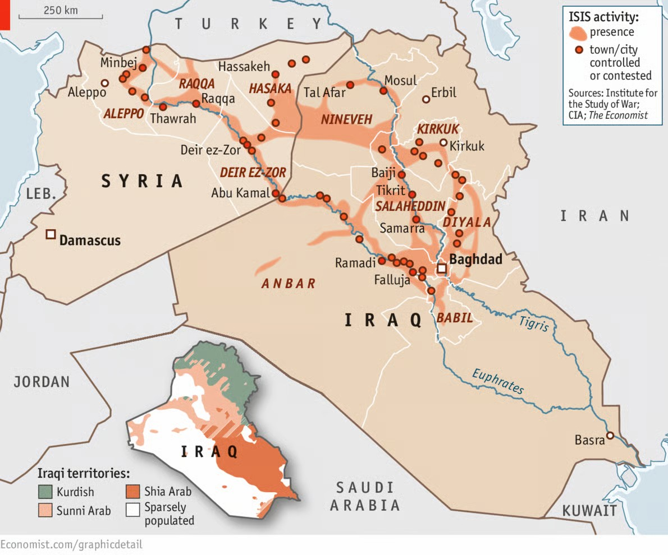
In this picture it is showing how ISIS controlled places extending from Syria to Iraq during the war

Slide 5

This information shows the number of people who moved to the United States from Iraq during the conflict.
The data show that between 2012 and 2022, nearly 83,000 Iraqi refugees were resettled in the United States. Estimates from historical reporting also suggest that about 164,000 Iraqi refugees have found their homes in the U.S. from 2003 to 2023, emphasizing continuous movement over many years.

Slide 6
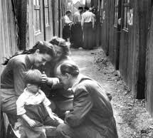
International Legal Basis
The Universal Declaration of Human Rights recognizes that individuals have the right to seek asylum from persecution and danger. The 1951 Convention Relating to the Status of Refugees defines who is legally considered a refugee and ensures protection for those fleeing war. The UNHCR enforces and supports refugee rights globally.

Slide 7
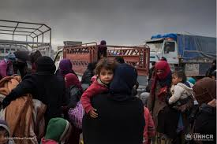
How This Matters
The right to seek asylum exists to save my family's lives and from displacement caused by bombs and missiles. For my family, leaving Iraq was not a choice; it was a necessity driven by survival. Asylum and refugee protections are not favors or privileges. They are legal rights meant to shield families like mine when war erodes all sense of safety and security.

Slide 8
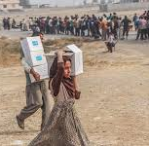
Impact of War in Iraq
Food & medicine shortages
Lack of protection & safety
Denial of civil rights & freedoms
Daily bombings & violence
Loss of relatives & loved ones
Forced displacement due to war

Slide 9
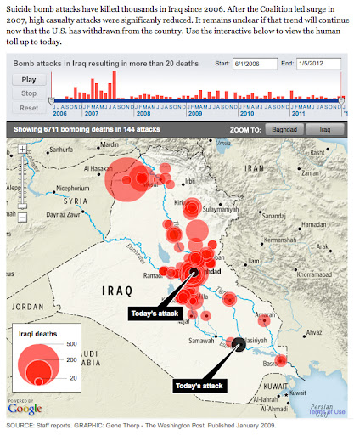
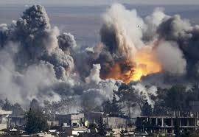
These Pictures shows the most bombed areas in Iraq

Slide 10
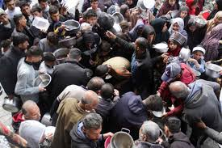
This picture shows how people struggle to find food

Slide 11
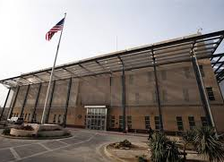
American Embassy - Baghdad (2010)
Embassy staff were welcoming
Professional and respectful support
Clear guidance on asylum documents
Efficient service and communication
The environment was safe and supportive

Slide 12

Opportunities Found in the U.S.
Since we have arrived in the United States, my family has finally found a stable home, and I have found opportunities that have helped me shape my future. I was able to pursue education, meet supportive mentors, work toward a career focused on criminal justice and helping others, and make positive changes in the great country and culture. The U.S. gave my family a safer place. And, we have found an organization that welcomes the refugees and helps them with resettlement.

Slide 13
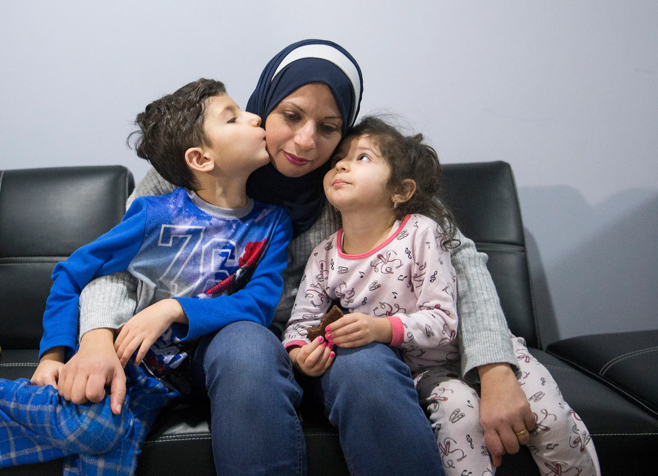
My Message
My family’s journey from Iraq to the United States is proof of why asylum protections matter. They help families escape war, rebuild their lives, and give individuals the chance to turn struggle into strength, survival into success, and opportunity into purpose. This right gave me safety, and now it gives me direction.

Slide 14
Conclusion
Immigration and asylum were necessary due to war
Embassy staff made the experience positive
The process was smooth and successful
Asylum provided the path to a safe and stable life

Slide 15

Works cited
United Nations. Universal Declaration of Human Rights, 1948, Article 14.
Migration Policy Institute. Refugees and Asylees in the United States: 2023. Between FY 2012 and FY 2022, approximately 83,000 refugees from Iraq were resettled in the United States.
Santana, Rebecca. “20 Years Later: Iraqis Still Emigrate to U.S. After Invasion.” Associated Press News, Jun. 18, 2023. An estimated 164,000 Iraqis have already found homes in America since the 2003 invasion.
Convention Relating to the Status of Refugees, 1951.
UNHCR. “Refugee Protection and Asylum.”

