Slide 1
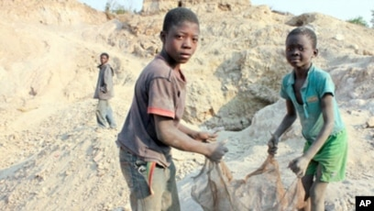
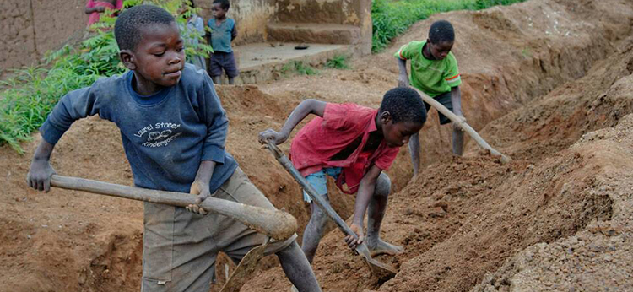

Child Labor within African countries
RYLE LITWIN
Legal Studies track
Fall 2025
Justice and Law Administration Division

Slide 2
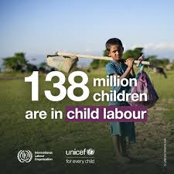

What is child labor?
Child labor according to UNICEF is, "work that children are too young to perform or that – by its nature or circumstances – can be hazardous." It is work that does not contribute to the necessary growth of the child, it is work that is potentially harmful to their safety, health and wellbeing.
In some instances, children are forced into labor which is a form of slavery. Children in these circumstances may be subjected to drug trafficking, prostitution or even war.
This kind of treatment towards children occurs worldwide with 138 million working daily. Most of the child labor occurs in Africa with 87 million children forced into employment between the ages of 5 and 11 years old.

Slide 3
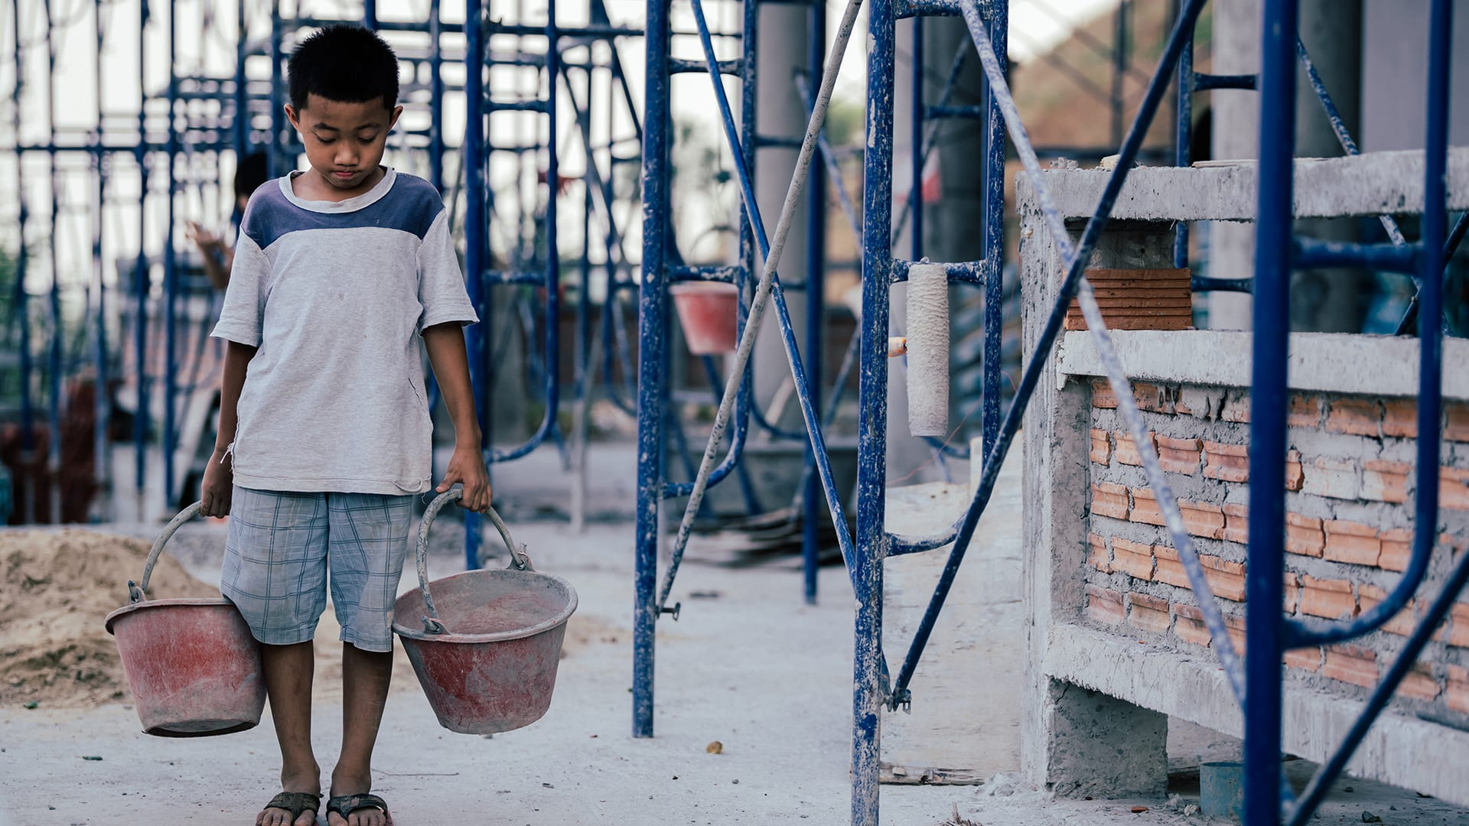
Statistics & Data
Specific to African Countries
Nearly one out of five children were subjected to child labor as of 2016, a higher rate than any other region globally
Agriculture remains the largest sector making up 61% of child labor following services such as selling good and domestic work being 27% and 13% being factory manufacturing and mining (ILO, 2024).
Boys are more likely to be involved in child labor for much longer than girls with boys making up 70.6% of child labor works following girls making up 29.4%
The age group making up more child labor is between 12 and 17
63.3% of child labor workers are paid, causal employee; 36.2% are unpaid

Slide 4
Causes behind African child labor
The causes behind African child labor stem from all areas, poverty being one of the main reasons. Families depending on their child’s income to survive, parent income in not enough to feed, clothe and house their families.
In some unfortunate cases, children are used for labor purposes due to their vulnerability, children are more inclined to work harder positions because they do not know the risks and possible injury in includes.
Children in third world countries also lack education due to minimal educational resources making them more susceptible to labor jobs at a young age.
Young girls are sent to work doing house chores with the preconceived notion that women are unable to participate in labor work like young boys this results on some occasions, young girls being sent into employment work away from their families or sex slavery.
Sometimes, child labor is deeply ingrained in a countries custom that a child working within the workforce is a a normal part of growing up for a young child.

Slide 5

Child labor compared to gender roles
Traditional gender roles consist of women being placed within the household to clean, take care of the home and raise any children she had. Men are told to run the household, work to support his family, and protect his loved one.
Related to child labor, young girls are told to work close with their mothers to gain knowledge on how to run a household. Young boys are put into the work force to be mechanics, factory workers, miners, or farmers.
The fairness within child labor is overall negative, children should not be working, they should be receiving an education. Related to gender roles, forcing young boys and girls into labor of any kind is cruel and inhumane.

Slide 6
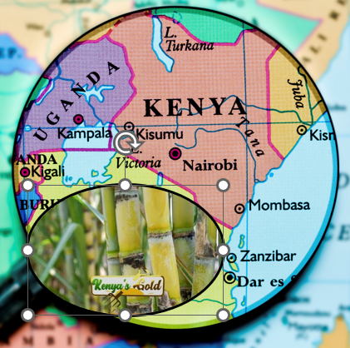
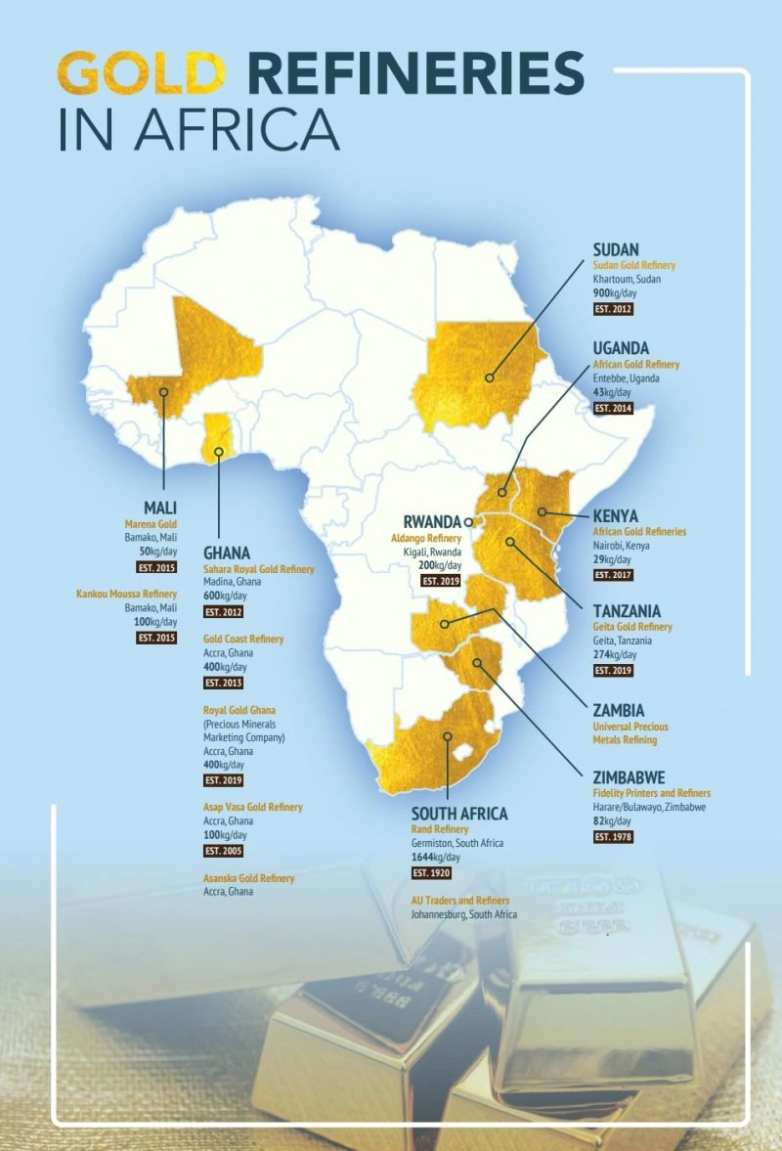
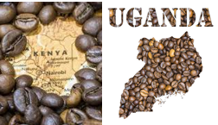
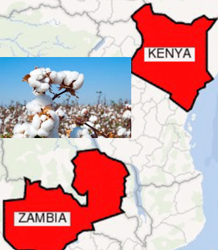
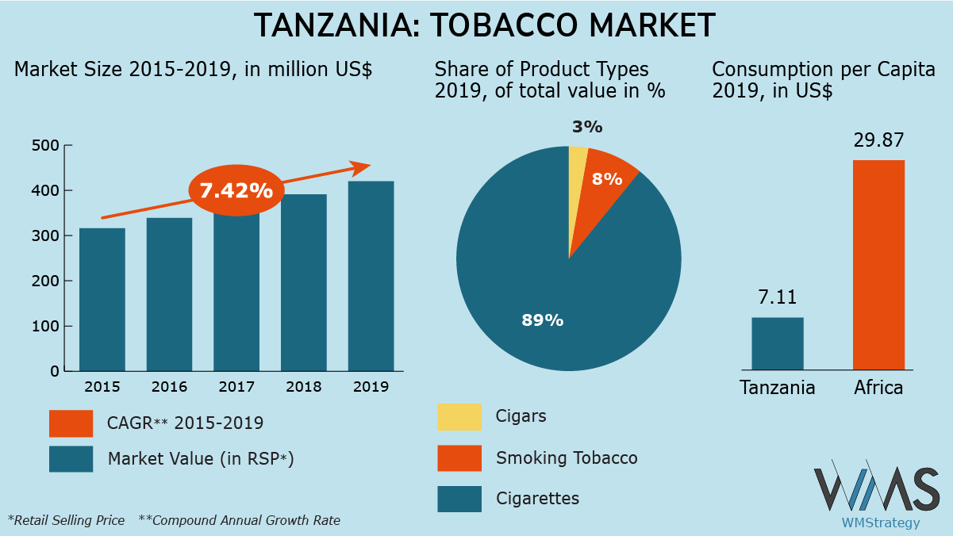
Child Labor Industries by Country

Slide 7
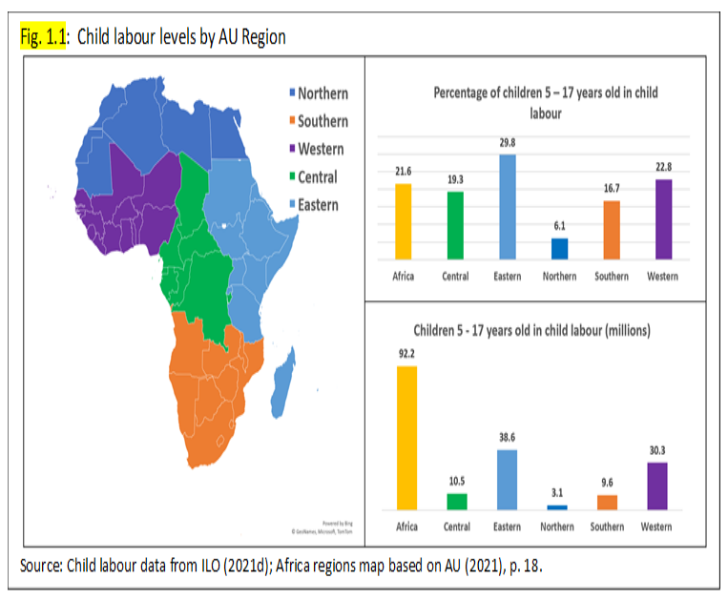
Regulations
The South African Department of Employment and Labor (DOEL) enhanced workplace inspections, report violations to the South African Police Service, and refer victims to safety services.
The South African Police Service (SAPS) specifically investigate cases involving child labor. Issues such as child labor, trafficking, and exploitation are closely monitored and prioritized to reduce crimes against children.
“In 2024, 2,180 labor inspectors carried out 308,799 worksite inspections, identifying 3 child labor violations. The government conducted at least 1 investigation into suspected severe forms of child labor and initiated 1 prosecution” (Bureau of International Labor Affairs, 2024).

Slide 8
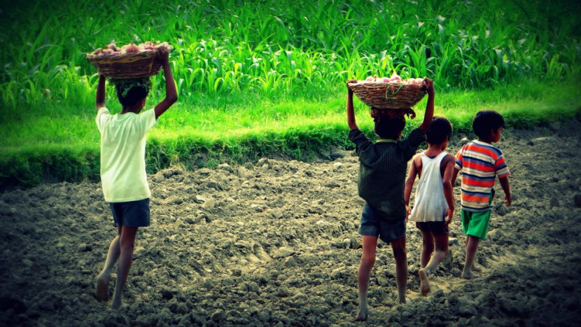

Effects of Child Labor
The National Library of Medicine did a study on child labor effects, and their findings were “Child labor was found to be associated with a number of adverse health outcomes, including but not limited to poor growth, malnutrition, higher incidence of infectious and system-specific diseases, behavioral and emotional disorders, and decreased coping efficacy” (NLOD, 2018). Overall, poor health and emotional damage are the main outcomes but children in African experience harder, more severe work loads. Mining in the coal mines can cause respiratory infections, exposure to deadly chemicals, explosions resulting in death, and chronic long-term illnesses. Much of Tanzania uses child labor to help with Tabacco farming being exposed to harsh chemicals and being outside in the extensive heat causing heat stroke or even death. Child labor in general stunts educational growth, causes physical and emotional harm and can result in life changes that alter their lives forever.

Slide 9

How can we lower child labor rates?
Lowering child labor rates starts at the source of the industrial businesses that allow child labor and use it as a “inexpensive” way out of paying adult workers.
Stronger labor laws in African countries and creating stricter authority to enforce these regulations.
Supplying more resources to families to support their children instead of forcing them to work.
Worldwide knowledge of the ongoing issue to encourage support from other countries.
Overall monitoring businesses, encouraging education and supplying resources for child and families and more important, implementing stricter labor laws to save more children every year form falling victim to child labor.

Slide 10
“Child Slave to Star Student: Mabel’s Story”
Mabel, a child labor survivor speaks on her experiences as a young worker and how she escaped.
When Mabel was a young girl, her mother got sick and died. She was sent to live with relatives. “My grandfather said he can’t send us to school because he spent his money to bury our mother,” Mabel recalls, “so we have to work to pay the money.” Mabel was forced into child labor slavery on Lake Volta, the biggest man-made reservoir in the world. In this huge expanse of water, storms can easily capsize small fishing boats and kill those aboard. “I feel scared because the lake is very big,” Mabel says. “When the wind is blowing, you can just go down, and you will die.” Mabel was forced to fold the fishing nets. “They would tell me I must hold the net,” she says. “They are going to throw the net, so if they throw the net and then they are coming [back], I should be folding it. If they came and I am not folding it, they will cane me. They will use the paddle to cane me.” (Free the Slaves)
To read more about Mabel’s story click here: Mabel's story

Slide 11
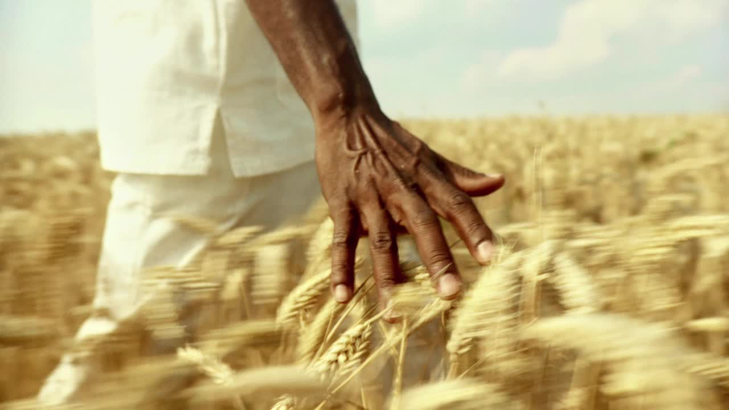
Final thoughts
Child labor has been an ongoing issue for decades, forcing young children into factories or farms so young they can barely read or write is sickening. African countries are less fortunate than America or Europe, making their children much more likely to be involved in the horrible epidemic. African families need to support themselves and their parent's income is not enough making the children employees as young as 5 years old. Child labor effects are so awful that even a grown adult shouldn’t have to endure. Lowering child labor is difficult but possible if laws were stricter and industries enforced age restrictions on who is hirable to work. Spreading the statistics and data about child labor to every part of the world to inform the population is necessary for change as well. Helping children become child again is the main goal here, creating a bright future not a future filled with health issues and a fleeting life of hopeless work.

Slide 12
Work Cited
https://www.unicef.org/protection/child-labour
https://www.ilo.org/projects-and-partnerships/projects/child-labour
https://www.dw.com/en/industries-that-rely-on-child-labor/g-41431614
https://www.ilo.org/resource/child-labour africa#:~:text=Worldwide%2C%20the%20agriculture%20sector%20accounts,in%20hazardous%20work%20in%20Africa.
https://www.dol.gov/agencies/ilab/resources/reports/child-labor/south-africa
https://pmc.ncbi.nlm.nih.gov/articles/PMC6459361/

