Slide 1
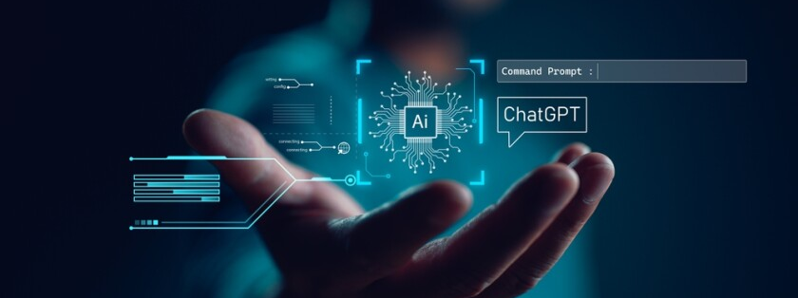
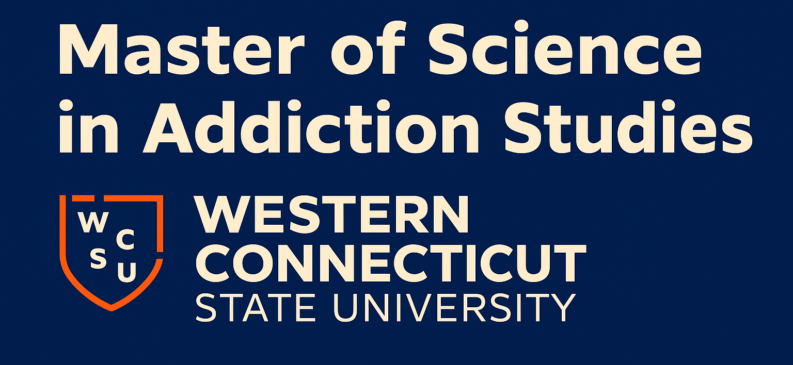
AI Use Cases in the M.S. in Addiction Studies Program
Mary Murphy, Ph.D.
Assistant Professor
Dept of Psychology
Notes:
Image source: Microsoft 365 content library
Artificial intelligence supports the M.S. in Addiction Studies program by enabling predictive analytics for early intervention, personalizing treatment plans based on student and patient data, and enhancing research through rapid data analysis. These applications help improve educational outcomes and advance addiction science through innovative, data-driven approaches.

Slide 2

Agenda:
AI-Powered Learning Tools
AI for Brainstorming and Topic Development
  AI tools support brainstorming and initiating tasks, enabling easier topic development and creative exploration.
AI to Improve Search Strategies
  AI-powered search tools streamline journal article searches, making it faster and more effective to gather relevant information.
AI for Visual Data Enhancement
  AI applications enhance data visualization and mindmap creation, helping students organize information visually.
AI-Driven Soft Skills Training
  Immersive AI technology provides performance feedback, strengthening interpersonal and counseling skills for student clinicians in training.
1
2
3
4
Notes:
Image source: Microsoft 365 content library
Explore Topic Development with ChatGPT for brainstorming and task initiation. Discover Search Strategies using SciSpace and Consensus AI to improve research efficiency. Enhance Visual Imagery with Napkin AI for data visualization and Canva for creating mindmaps. Strengthen Soft Skills Training through Skillsetter and 360 immersive tech utilizing AI-generated performance feedback.

Slide 3
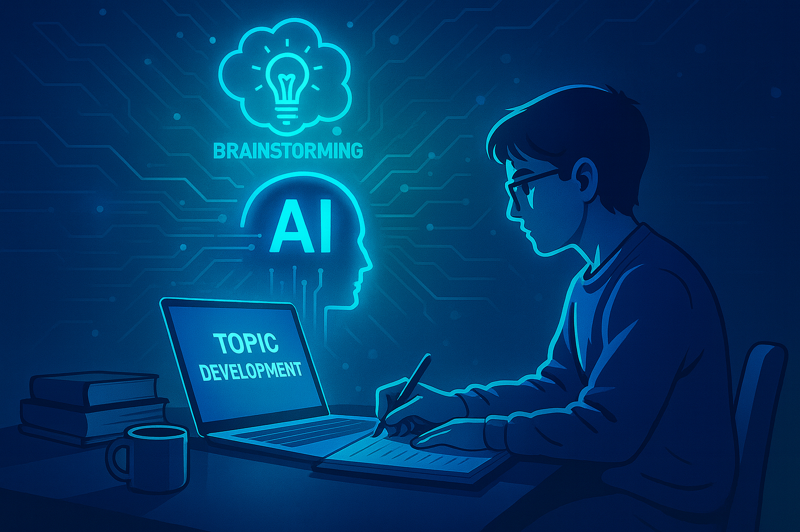
AI Use Case #1 -Topic Development
Where: Master’s Project (PSY 590)
The Problem: Each year students struggle to find and develop a topic that has enough recent research (past 5 years of journal articles) focused on intervention-based studies for addiction related topics.
The Solution: Students are taught to use ChatGPT (Free version) to brainstorm the topic they are interested in (without needing much prior knowledge). This helps them with task initiation (‘getting started’ issues) so they can get straight to figuring out if their ideas are viable for a topic they will focus on for a semester-long culminating experience project.

Slide 4
AI Use Case # 2 Search Strategies
Where: In all courses (most especially PSY 590)
The Problem: Students have a very hard time finding journal articles using traditional Boolean-based (AND, NOT, OR) searches. Then when they get their articles they struggle to understand the content.
The Solution(s):
  1. Students are taught to use SciSpace to search for articles, chat with the paper to ask it clarifying questions, help them quickly screen whether the article fits the criteria for their project (generates a table with custom columns to capture the elements you want to pull from the article), ask it to explain the data tables / figures in the Results section to understand the data like never before, highlight any portion of the text to summarize the meaning at any grade level, and can transform articles into audio summary podcasts to turn flat pdfs into engaging media.

Slide 5
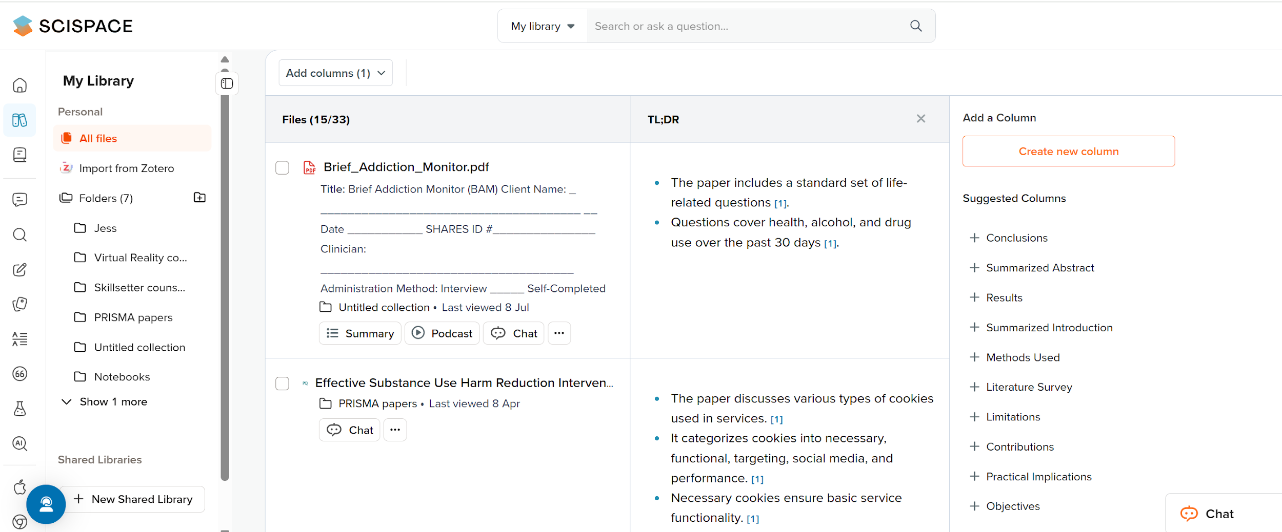
https://scispace.com/

Slide 6
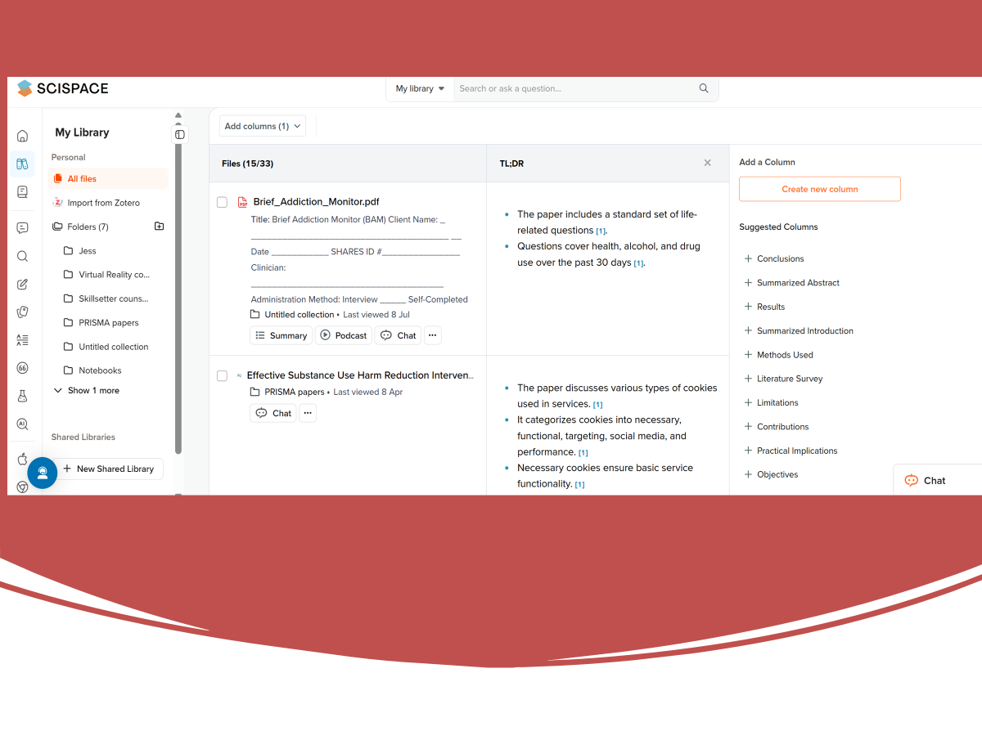
2️⃣ View TL;DR summary of your research paper
3️⃣ Add or customize columns for your summaries
1️⃣ Click here to upload your PDF
4️⃣ Click the Podcast icon to listen to your paper as audio
5️⃣ Use the Chat button to ask your pdf clarifying questions

Slide 7
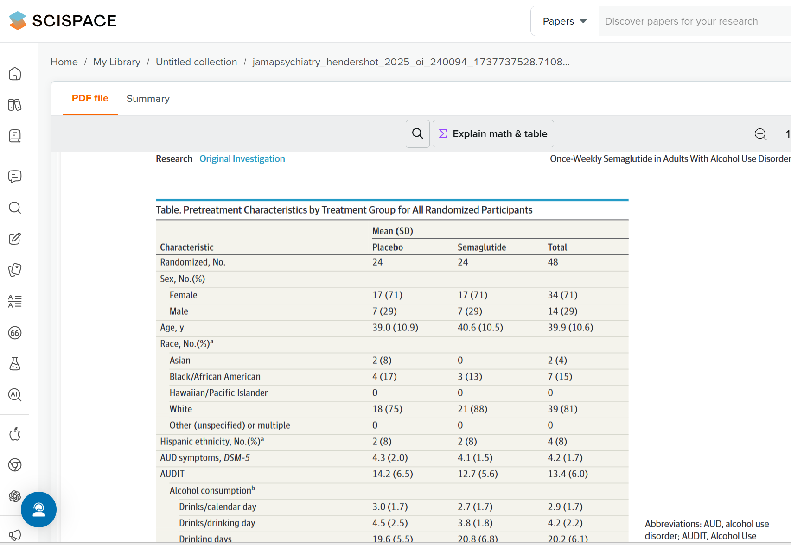

Slide 8


Slide 9
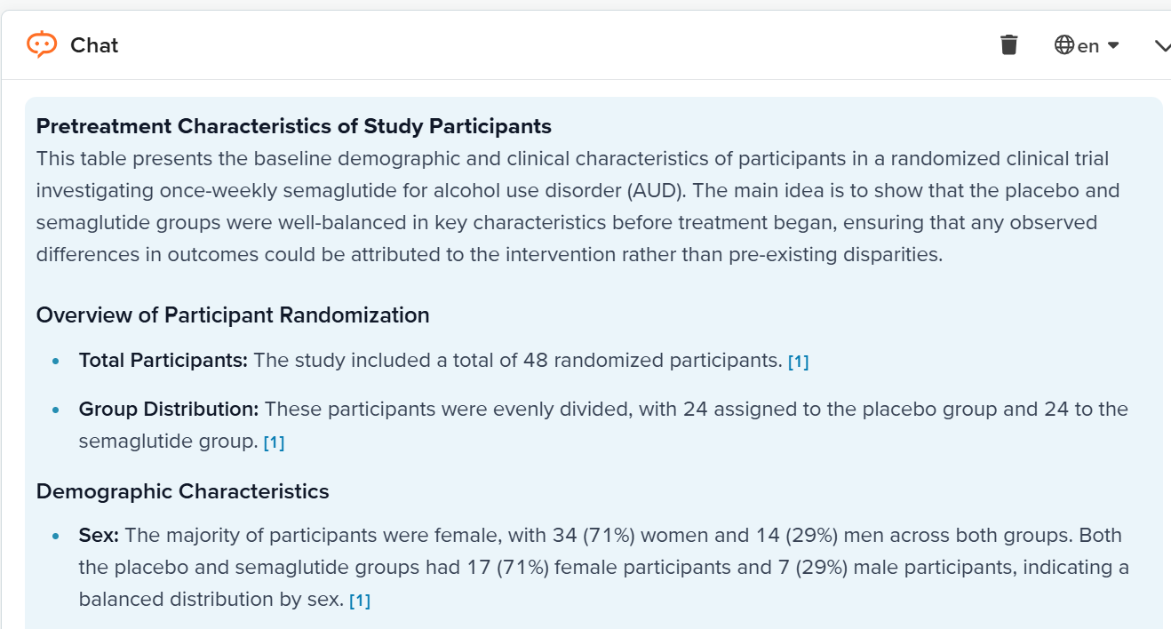

Slide 10
AI Use Case # 2 Search Strategies, continued
The Solution(s):
  2. Students are taught to use Consensus AI (Free) to improve critical thinking skills, learn how to discern what information is considered evidence-based, check assumptions about what they think they may know based on what they have heard.
  Especially in the addiction counseling field, since drug trends emerge quickly and new drugs come on the scene that they are unfamiliar with they can evaluate if information they are hearing from clients is credible, & educate themselves about the emerging substances.

Slide 11
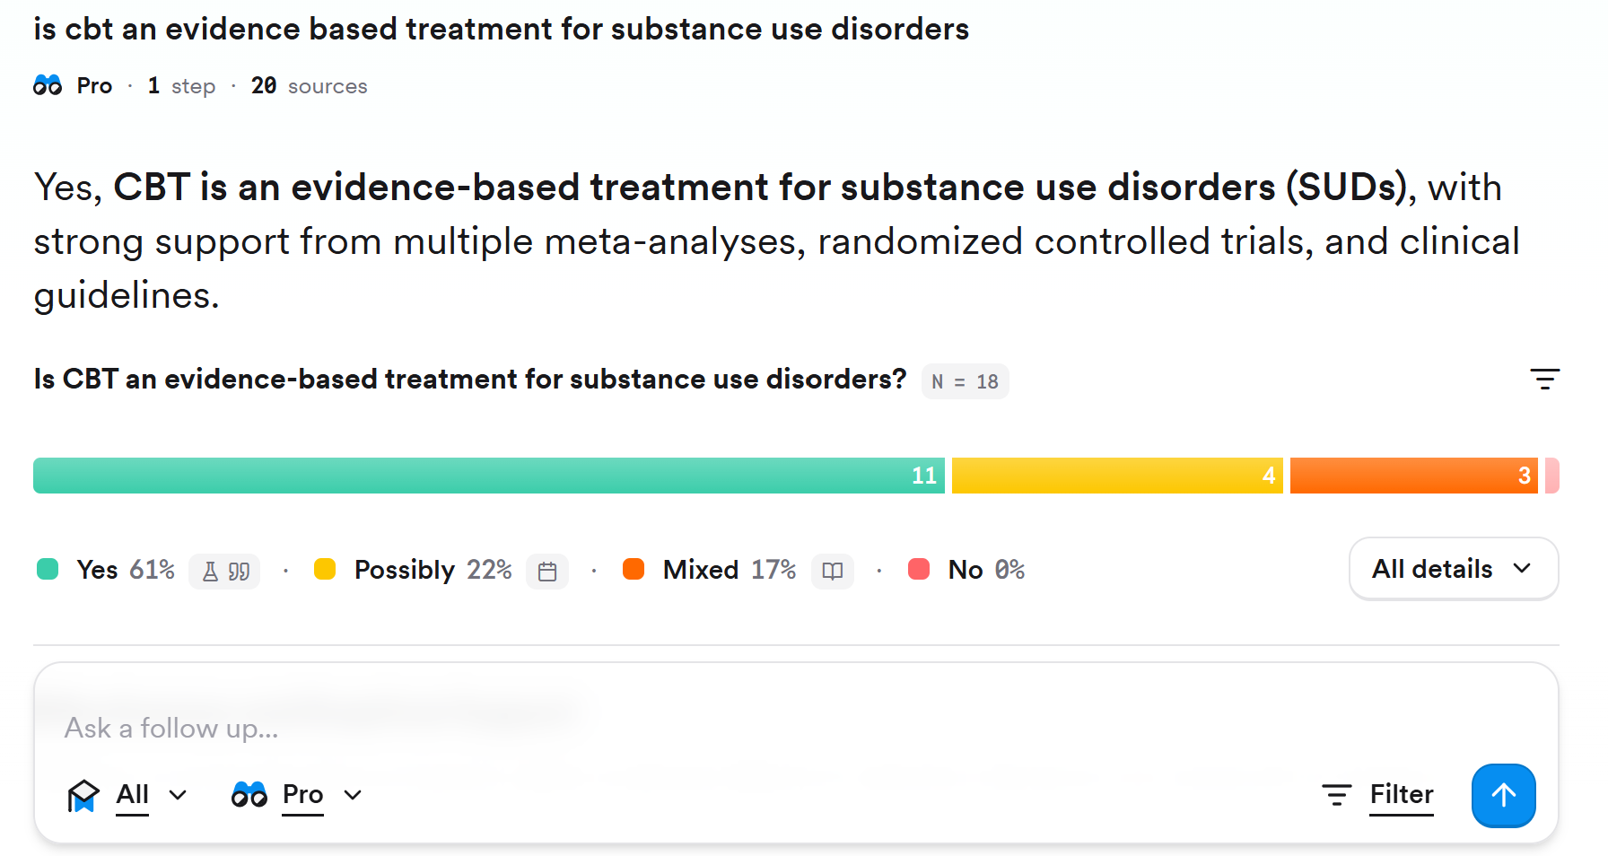
My question (yes/ no format needed)
Answer based on a review of the peer reviewed literature
Consensus meter
https://consensus.app/

Slide 12
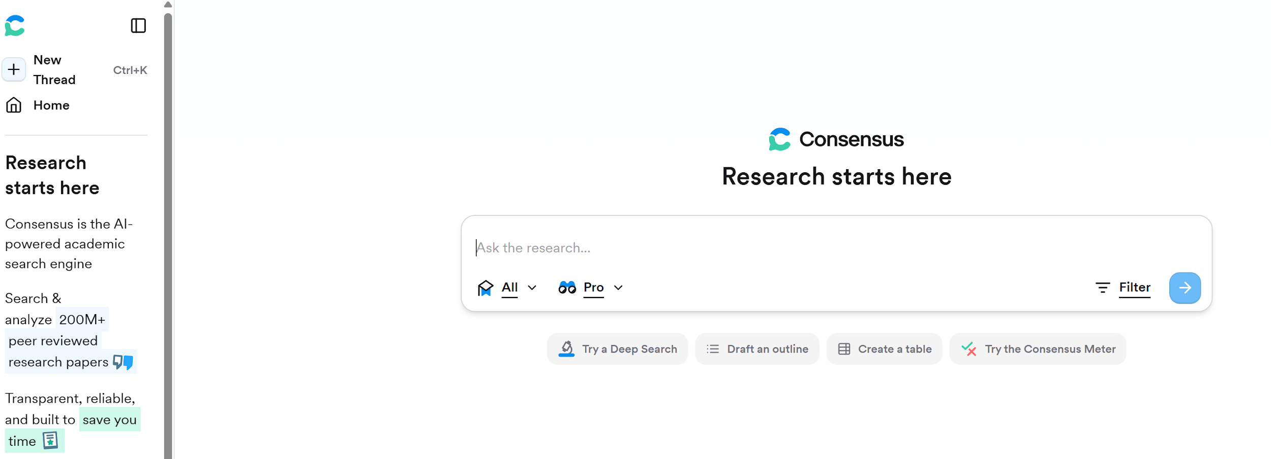
https://consensus.app/

Slide 13
AI Use Case #3 -Visual Imagery:
Where: In all courses (most especially PSY 590)
The Problem: Students often struggle with visualizing projects from start to finish and combining relevant information into an effective presentation for class papers and long-term projects.
The Solution(s):
  Teach students to use Napkin AI to generate data and content visualizations for their master’s project. Helps them transform lengthy text into high impact visuals which improve their communication and presentation skills.
  Show students how to use Mindmaps (in Canva) as a preliminary tool to develop preliminary sketch of the scope of their master’s project and honors thesis. Helps support their executive functioning.
  Show students how to use ChatGPT to generate (and refine) images to add to projects and papers to improve their overall presentation skills.

Slide 14
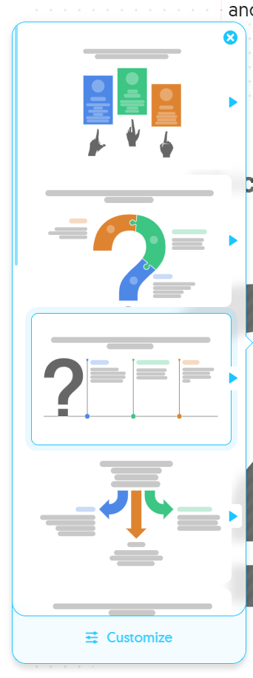
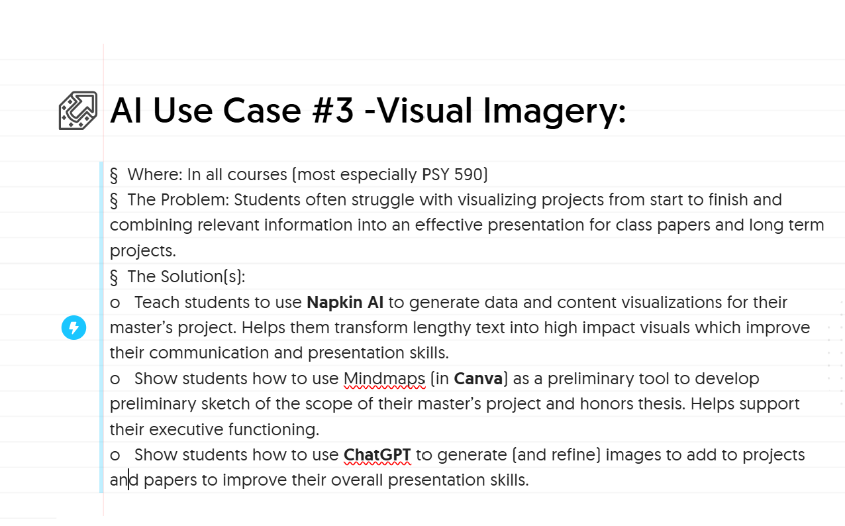
AI generates visualization options
https://www.napkin.ai/

Slide 15
Which AI tool should I use to enhance my project visualization
and presentation skills?
Canva Mindmaps
Develops preliminary sketches
of project scope, supports
executive functioning.
Napkin AI
Generates data and
content visualizations to
transform text into
impactful visuals,
improves communication
and presentation skills.
ChatGPT
Generates and refines
images to enhance
project presentations.
Created with napkin AI

Slide 16
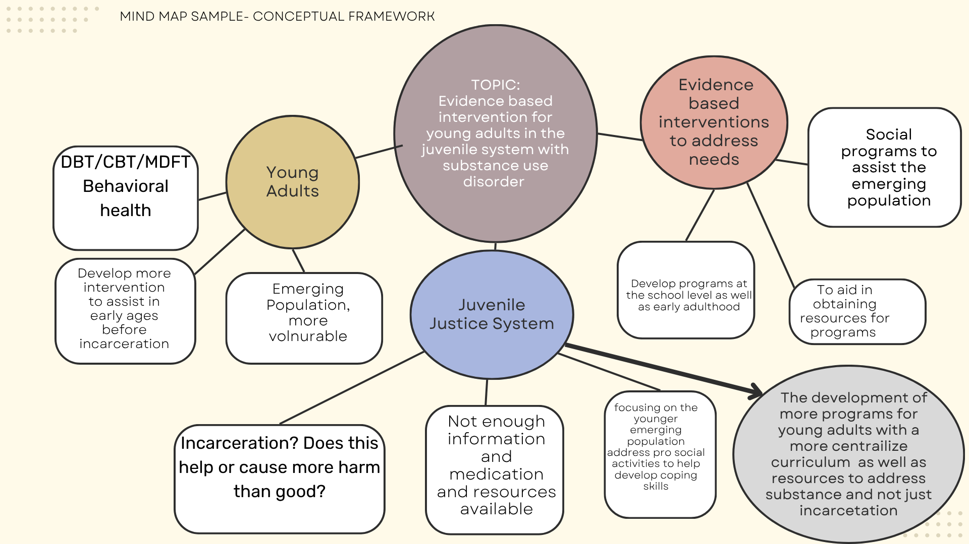
Mind map created with CANVA generated template
Made with Canva with Magic Write (Free version) www.canva.com

Slide 17
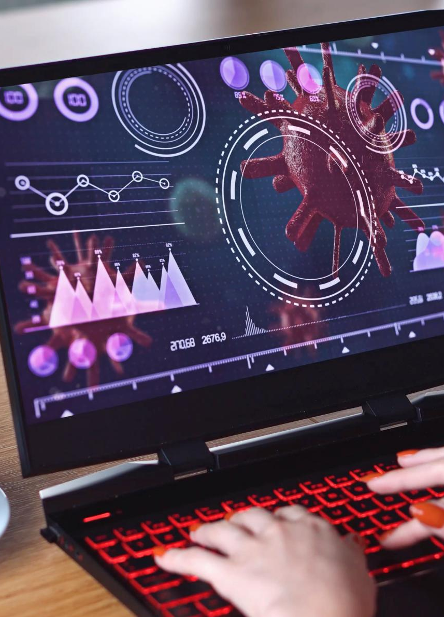
Enhancing Presentations with ChatGPT
Generating Visual Ideas
  ChatGPT provides detailed descriptions for visuals, helping users brainstorm custom images to fit their presentation needs.
Creating Tailored Graphics
  Use AI image tools with ChatGPT’s prompts to make unique graphics that match your content perfectly.
Boosting Audience Engagement
  Custom images produced with ChatGPT enhance audience interest and make presentations visually memorable.
Notes:
Image source: Microsoft 365 content library
ChatGPT can help generate ideas for custom images by describing visuals you need. Use AI image tools, guided by ChatGPT's prompts, to create tailored graphics for your slides. Incorporating these bespoke images enhances audience engagement and ensures your presentations are memorable and visually appealing.

Slide 18
Enhancing Presentations with ChatGPT
I ADMIT I DIDN’T ACTUALLY CREATE THIS SLIDE MYSELF AT ALL (ChatGPT DID IT FOR ME)
Generating Visual Ideas
  ChatGPT provides detailed descriptions for visuals, helping users brainstorm custom images to fit their presentation needs.
Creating Tailored Graphics
  Use AI image tools with ChatGPT’s prompts to make unique graphics that match your content perfectly.
Boosting Audience Engagement
  Custom images produced with ChatGPT enhance audience interest and make presentations visually memorable.
Notes:
Image source: Microsoft 365 content library
ChatGPT can help generate ideas for custom images by describing visuals you need. Use AI image tools, guided by ChatGPT's prompts, to create tailored graphics for your slides. Incorporating these bespoke images enhances audience engagement and ensures your presentations are memorable and visually appealing.

Slide 19
AI Use Case #4 -Soft Skills Training
Where: Substance Use Counseling: Applied Individual and Group Counseling (PSY 595)
Problem: Students in the program are clinicians in training but have very few opportunities to be observed while they practice implementing newly developing counseling skills. Anxiety about working with clients is significant and professors have ethical concerns about not being able to directly observe students on internship or with any clients.
Solution: Counseling simulation technology allows students to practice counseling skills within safe and ethical confines of homework recordings with guided models practice
  Homework recordings to practice at www.skillsetter.com
  CreaTechnology Grant to create mock therapy space and purchase 360° high definition recorded roleplay to provide unprecedented level of feedback regarding soft skills (body language, eye contact, warmth, empathy)

Slide 20
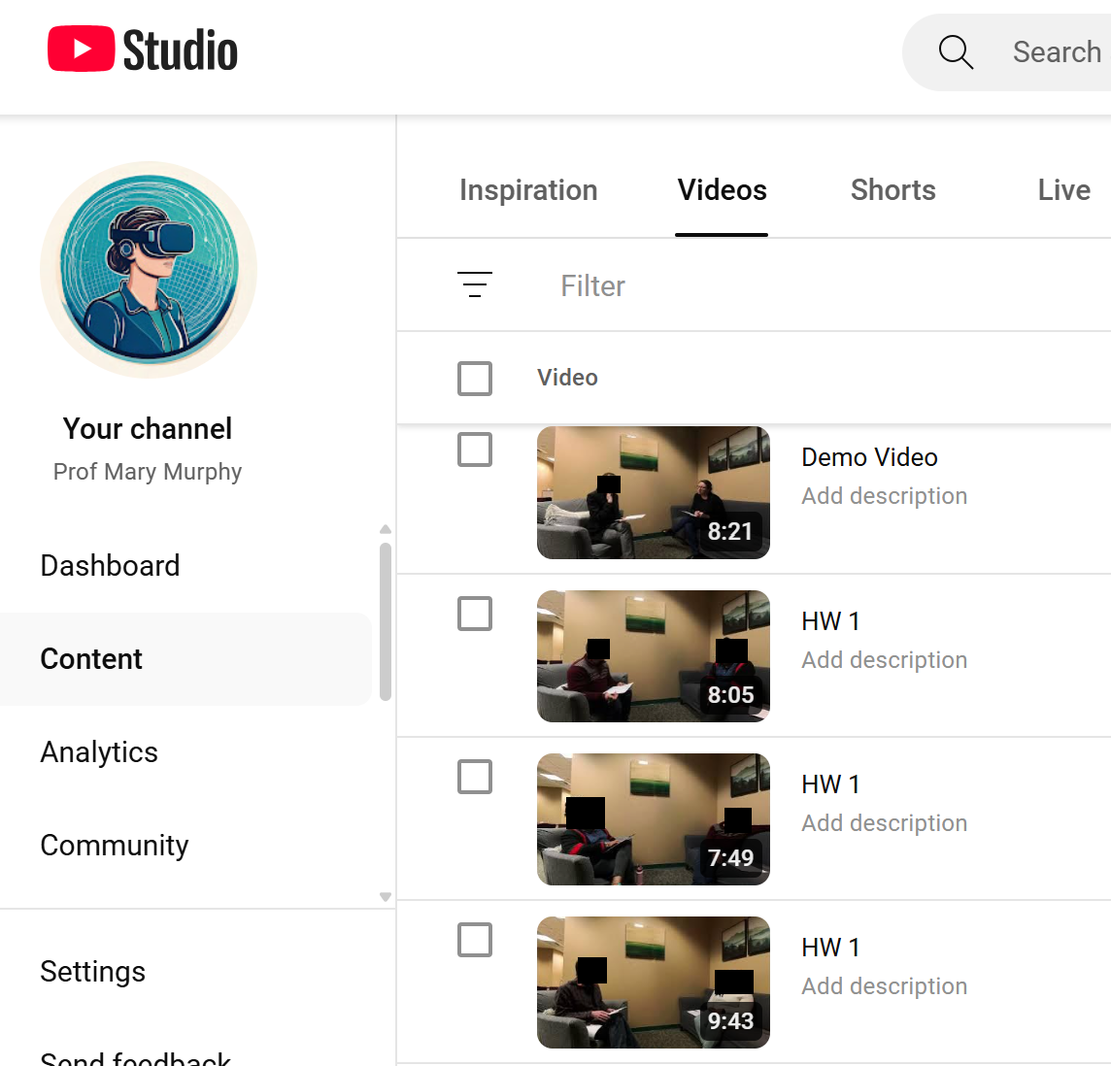
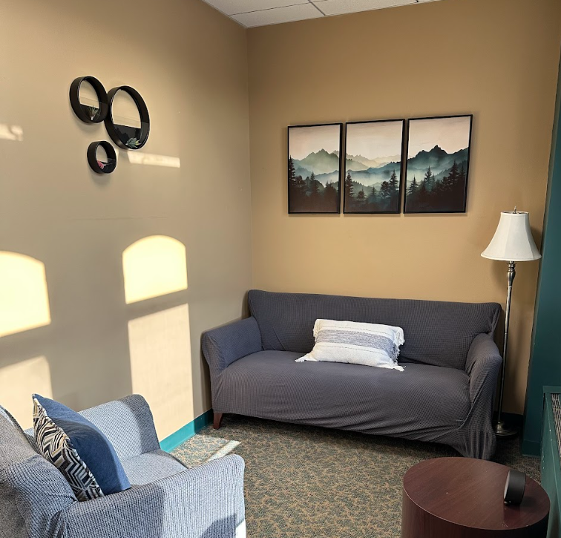
Mock Therapy Office, YouTube Video Homework

Slide 21
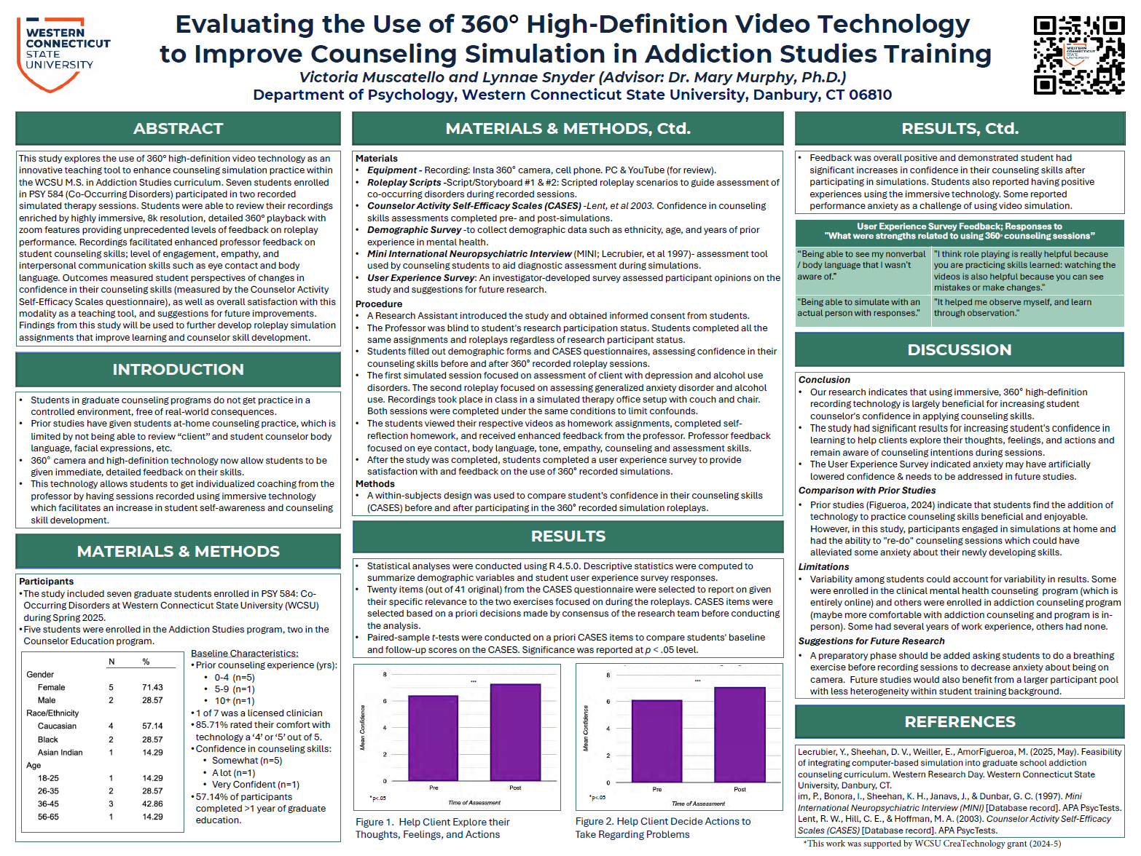
AI lead to a grant and conference presentation so far

Slide 22
THANK YOU
Mary Murphy, LADC, Ph.D.
Department of Psychology
Assistant Professor,
Masters in Addiction Studies Program
Graduate Program Coordinator
Warner Hall Suite 300B
murphym@wcsu.edu
203-300-2316
http://www.youtube.com/@ProfMaryMurphy
https://www.wcsu.edu/psychology/m-s-in-addiction-studies/
https://www.linkedin.com/in/mary-murphy-phd-ct
https://www.researchgate.net/profile/Mary_Murphy

Slide 23
Sources
Who I follow
(Andy Stapleton)
Consensus AI:
https://youtu.be/fZgLKYcEp0M?si=5o_L1jHFcCGN268A
Napkin AI:
https://youtu.be/LvObyJFnM8U?si=ek-PPuqJkAVa1GII
SciSpace:
https://youtu.be/cZjaHI8RnWY?si=OKkTwVpMuPtvEr_7
Comparison of AI research tools:
https://youtu.be/xIj366I-om8?si=webJUe66JKS5kMos

