Slide 1
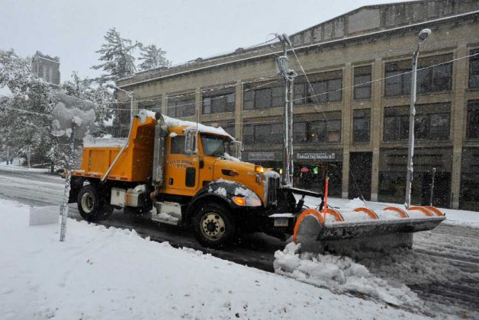
Snow in October…..
How Could This Happen ??
Jeffrey Tongue
Meteorologist

Slide 2
Disclaimer
National Weather Service Staff from the New York, NY Weather Forecast Office at Today’s Conference and NOT here on Official Government Times.
Views and Opinions Presented Today May NOT necessarily represent those of the National Weather Service…..

Slide 3
Snow in October…..
How Could This Happen ??
Jeffrey Tongue
Meteorologist

Slide 4

"We can add it to the list of things I never thought I'd see in my lifetime, which has been growing for the last year and a half,“
A lot of the town looks like a war zone.
"We have the fury of (Tropical Storm) Irene mixed with cold and ice,"
"an unprecedented amount of damage" that will required “a long-term cleanup.”
Notes:
Bill Jacquemin
New Milford Mayor Pat Murphy
Police Chief Douglas Fuchs
Danbury Mayor Mark Boughton

Slide 5
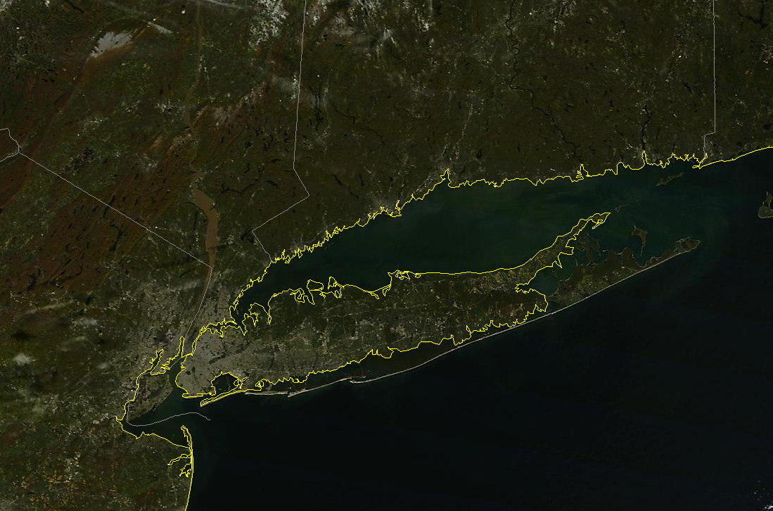
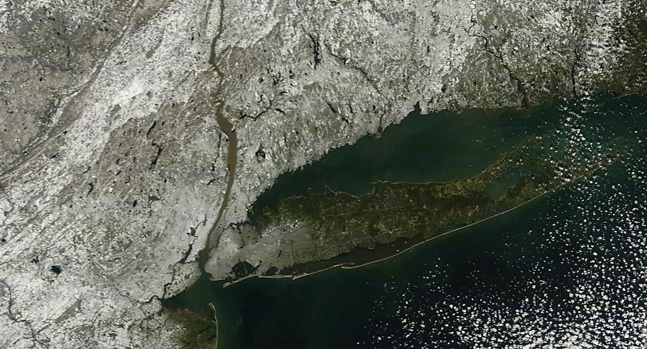
October’s Snow

Slide 6
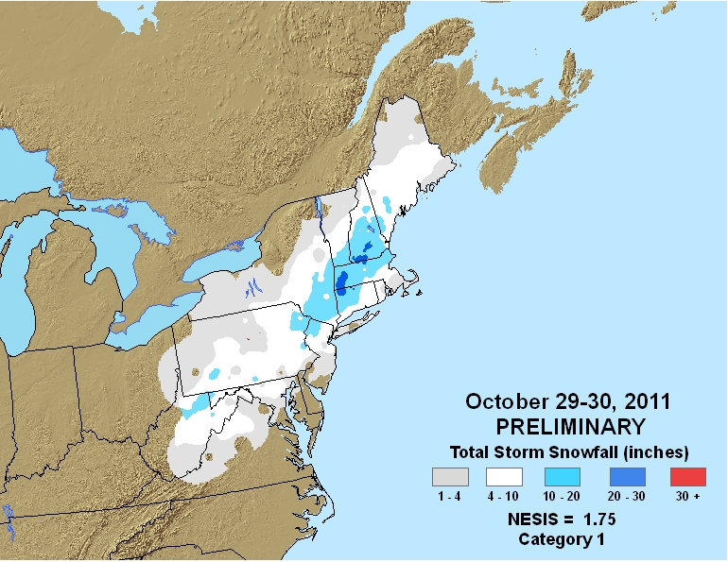
The Northeast Snowfall Impact Scale (NESIS) - Kocin and Uccellini, 2004
Notes:
41st on the list since 1950.

Slide 7
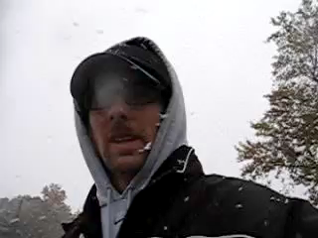

Slide 8
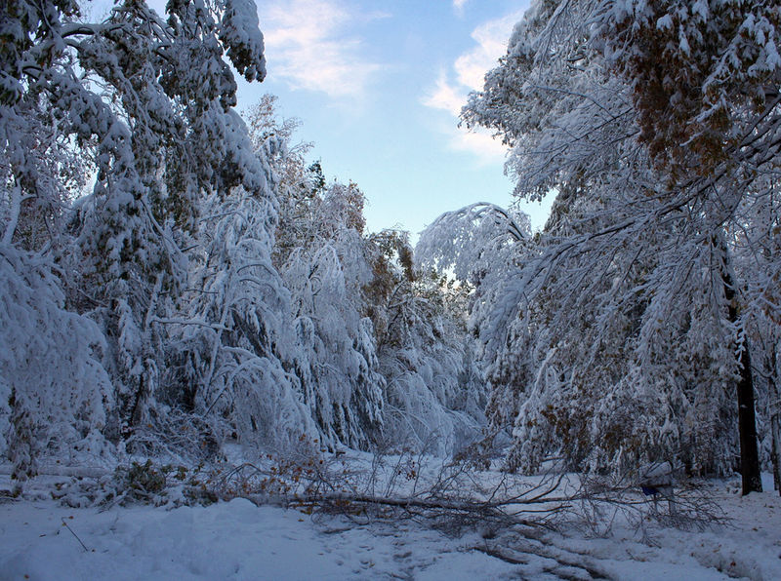

Slide 9
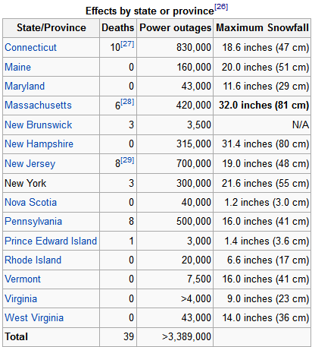
Some Numbers…

Slide 10
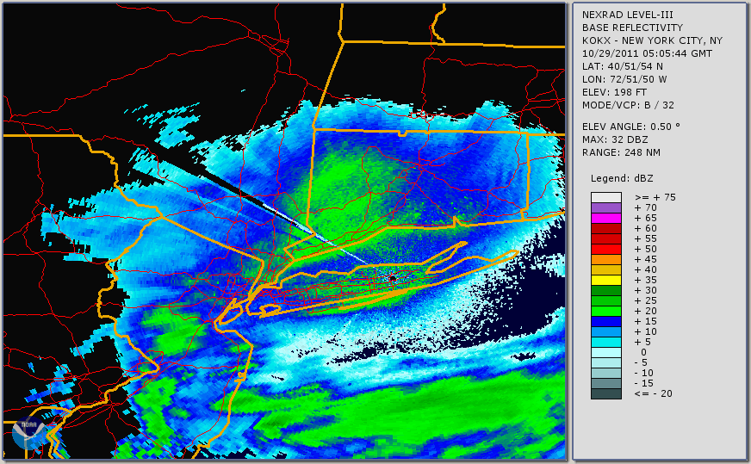


Slide 11
NWS Forecast Discussions
SOME SNOW SHOWERS WILL BE POSSIBLE...ESPECIALLY AS THE STORM EXITS...HOWEVER NO ACCUMULATION IS EXPECTED. (Wed Afternoon)
FAR INLAND MAY SEE A FLAKE OR TWO (Thu Morning)

Slide 12
Thursday Afternoon
HERE'S MY THINKING...
1. THIS IS A HIGHLY ANOMALOUS EVENT WHERE SIGNIFICANT LATE OCTOBER SNOW HAS NEVER BEEN
OBSERVED ON THE COASTAL PLAIN PER THE 1ST ORDER CLIMATE STATIONS.
EVEN INLAND...SCANS OF THE COOP DATA SHOWS THAT ACCUMULATING SNOW IS ALMOST UNHEARD OF.
2. MOST PCPN IS IN THE AFTN AND SOLAR RADIATION WILL LIKELY KEEP TEMPS ABOVE FREEZING AS CHANGE TO SNOW OCCURS.
3. LASTLY...I COULD NOT FIND SUPPORT OF SFC TEMPS BEING BELOW FREEZING IN ANY OF THE PROFILES I EXAMINED.
THUS...IN COLLABORATION WITH HPC WINTER WEATHER DESK AND SURROUNDING WFO'S...WE HAVE LIMITED SNOW
ACCUMULATION TO HIGHER INLAND ELEVATION AND ONLY ALLOWED FOR SLUSHY TRACE AMOUNTS ON THE COAST - MOST OF WHICH WOULD OCCUR BETWEEN 5 AND 8 PM.
A DEVELOPING COASTAL STORM WILL BRING THE FIRST SNOWFALL OF THE SEASON TO THE REGION ON SATURDAY. SEVERAL INCHES OF SNOW ARE POSSIBLE FOR THE HIGHER ELEVATIONS IN THE AFTERNOON INTO THE EVENING. WHILE ACCUMULATION IS EXPECTED MAINLY ON THE GRASSY SURFACES...SOME ACCUMULATION OF SNOW IS LIKELY FOR AREA ROADWAYS AFTER SUNSET. THERE REMAINS A CHANCE THAT SOME AREAS COULD SEEN AS MUCH AS 6 INCREASES OF SNOWFALL...BUT THE MORE LIKELY SCENARIO IS FOR 1 TO 3 INCHES OF WET SNOW.

Slide 13
Meteorologists Struggle
THE DEVIL IS IN THE DETAILS OF THE BOUNDARY LAYER
SST AROUND 60 F !
A RELATIVELY WARM GROUND WILL HELP MELT SNOWFALL
A FAIRLY CLASSIC WINTER WEATHER EVENT FOR OUR REGION IF IT WERE NOT OCTOBER.

Slide 14
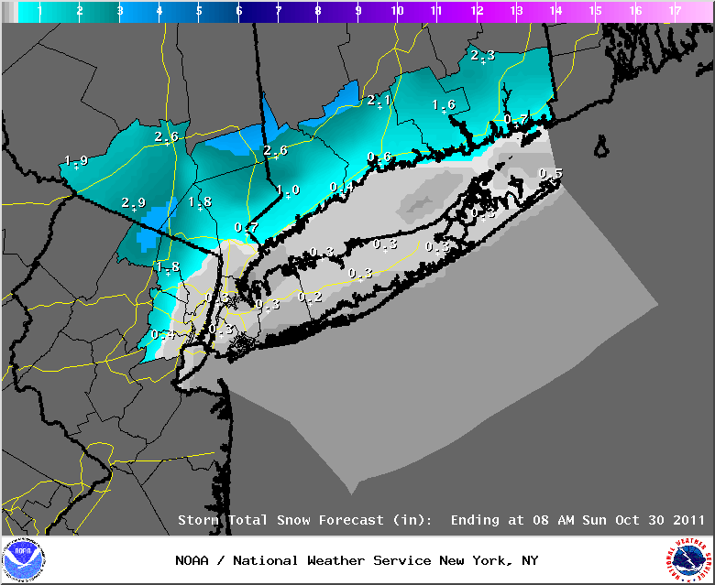
Thursday, Oct 27 - 4 PM

Slide 15
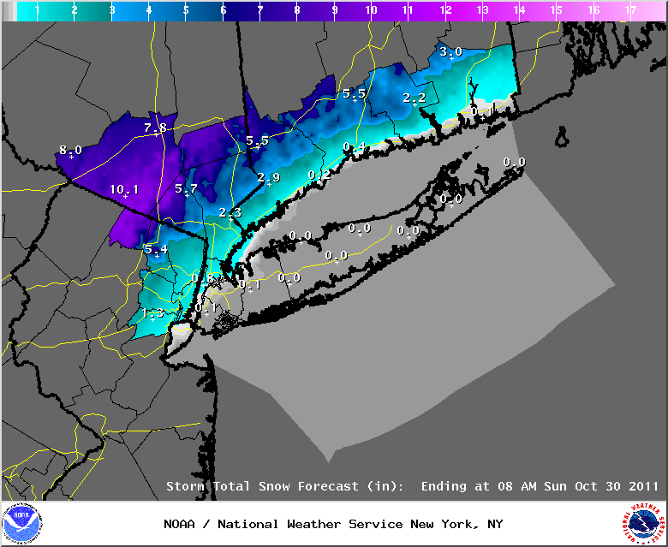
Friday, Oct 28 4 AM

Slide 16
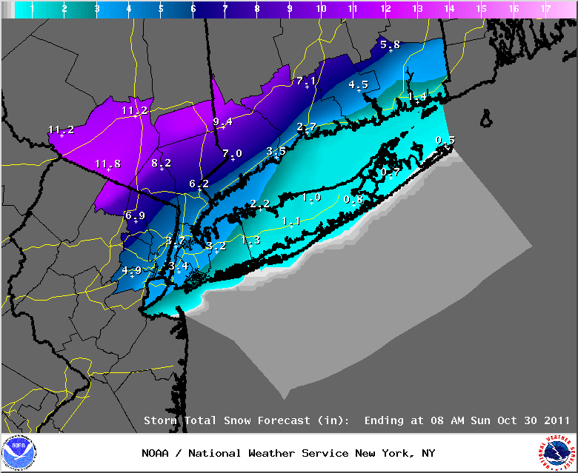
Friday, Oct 28 4 PM

Slide 17
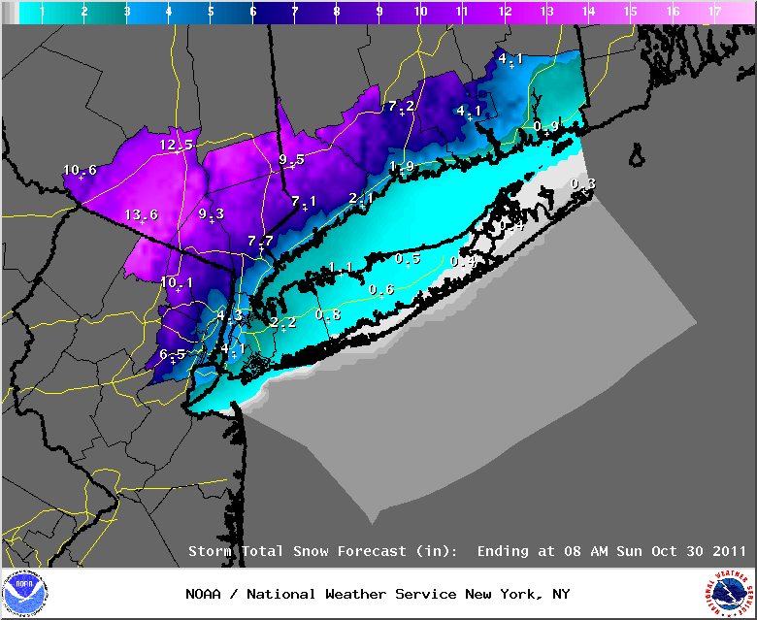
Saturday, Oct 29 4 AM

Slide 18
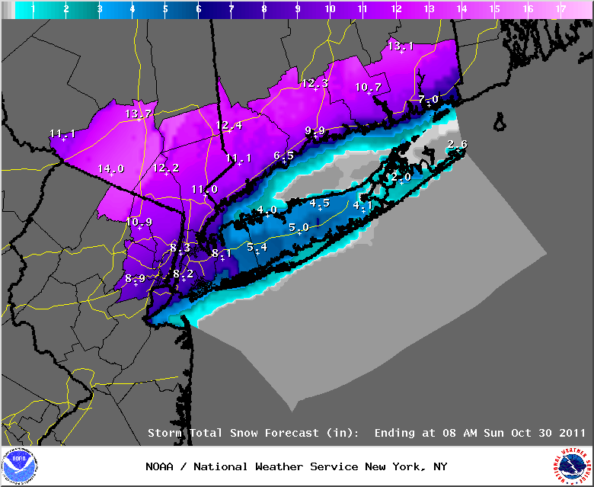
Saturday, Oct 29 230 PM

Slide 19

Saturday, Oct 29th 900 PM

Slide 20
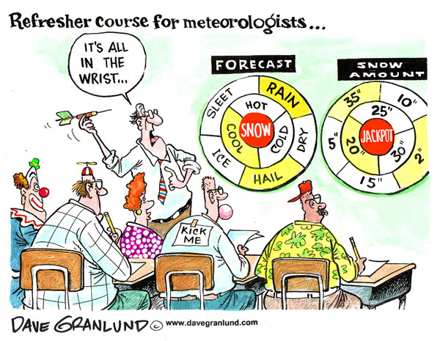

Slide 21
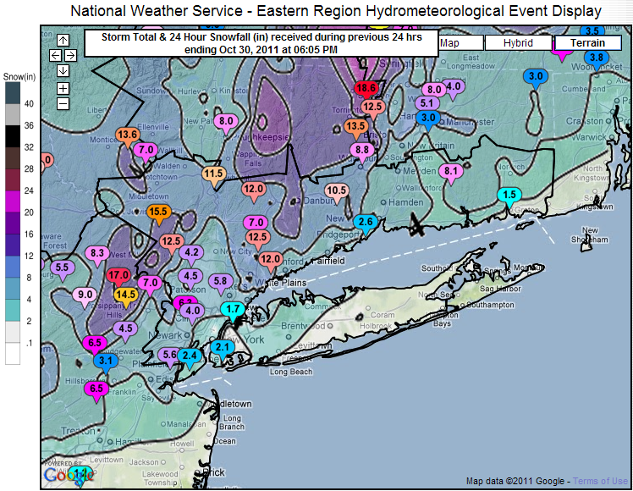
What Occurred

Slide 22
Oct 29 4 AM – Forecast – very good

Slide 23
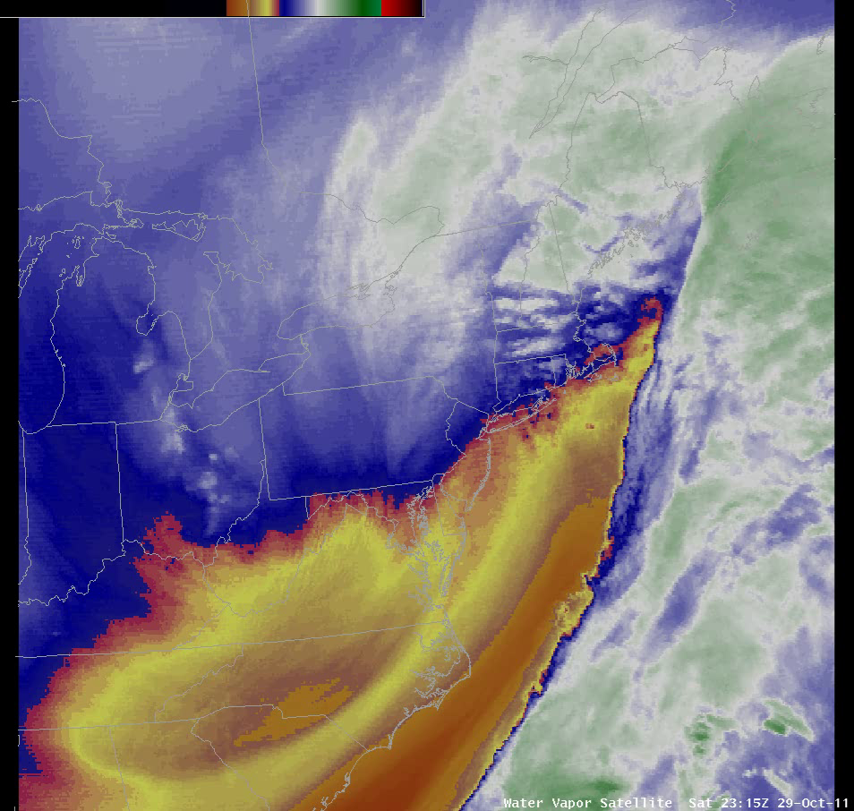

Slide 24
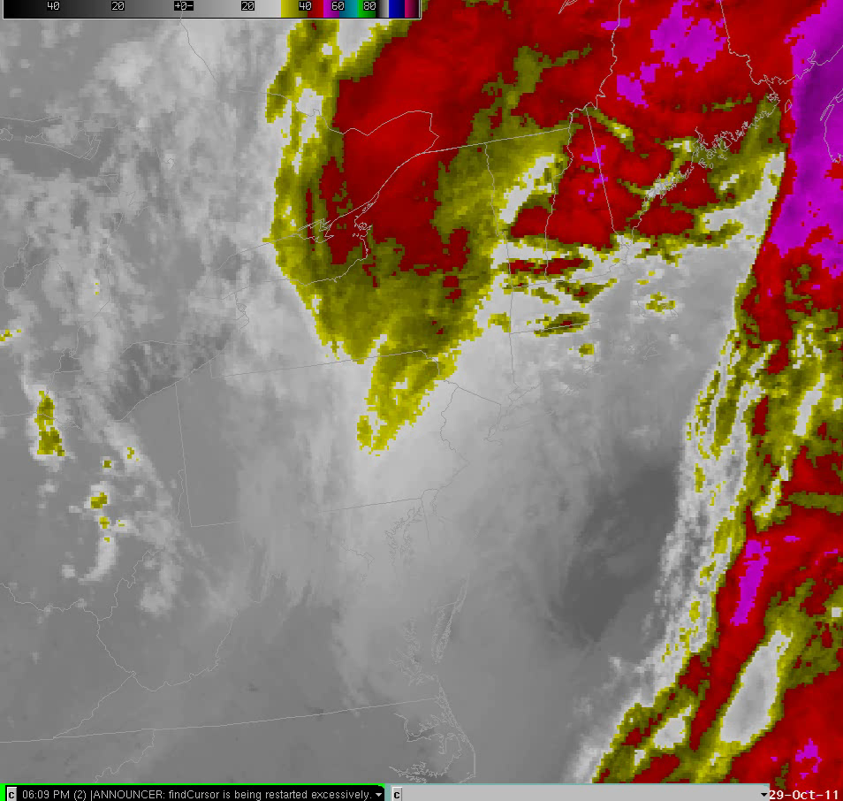

Slide 25
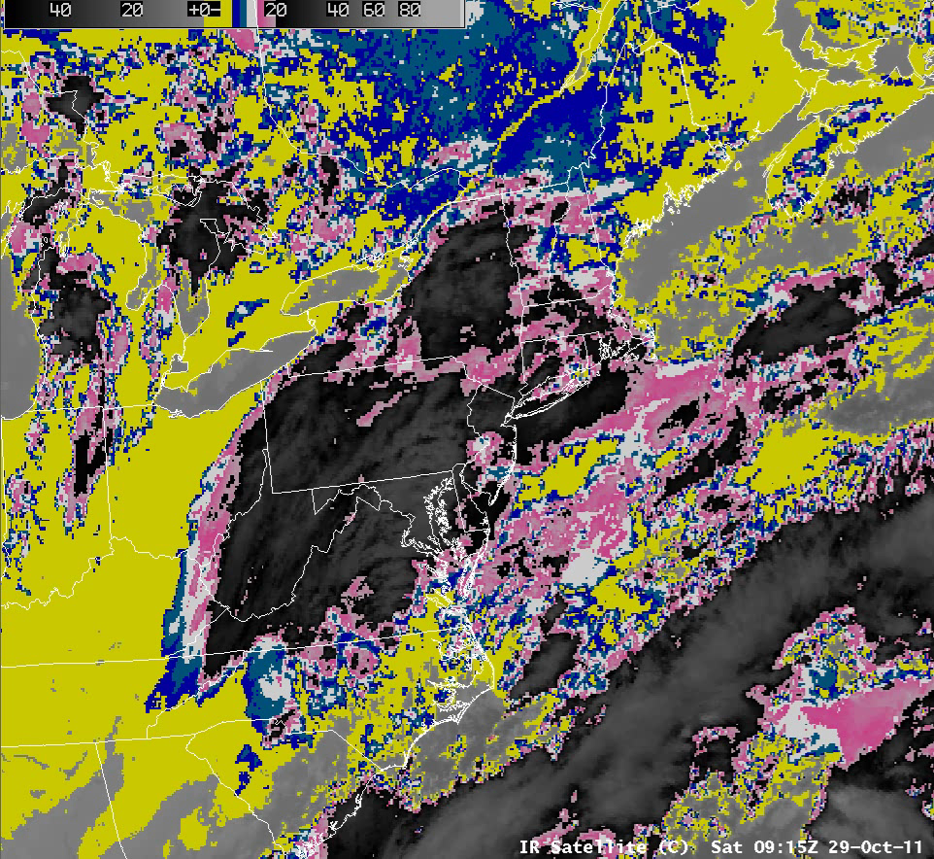

Slide 26
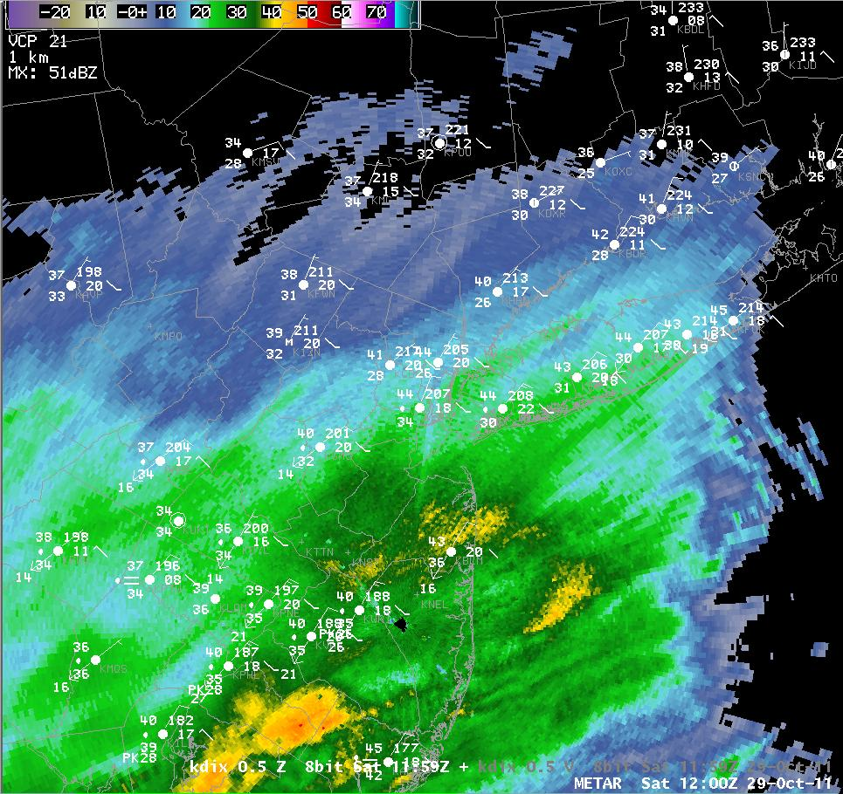
12Z

Slide 27
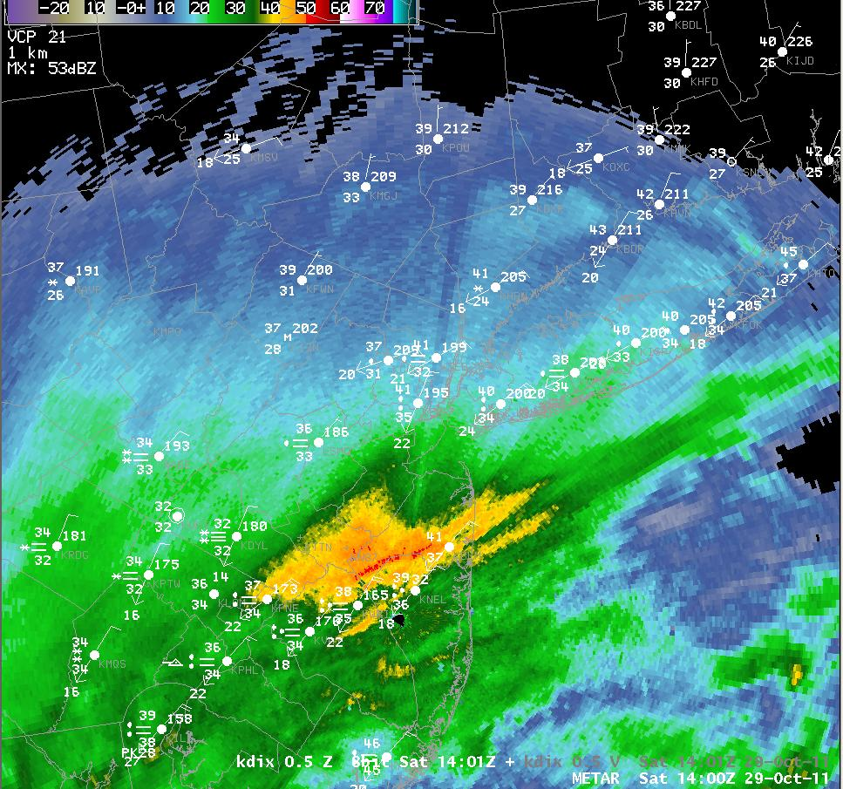
14Z

Slide 28
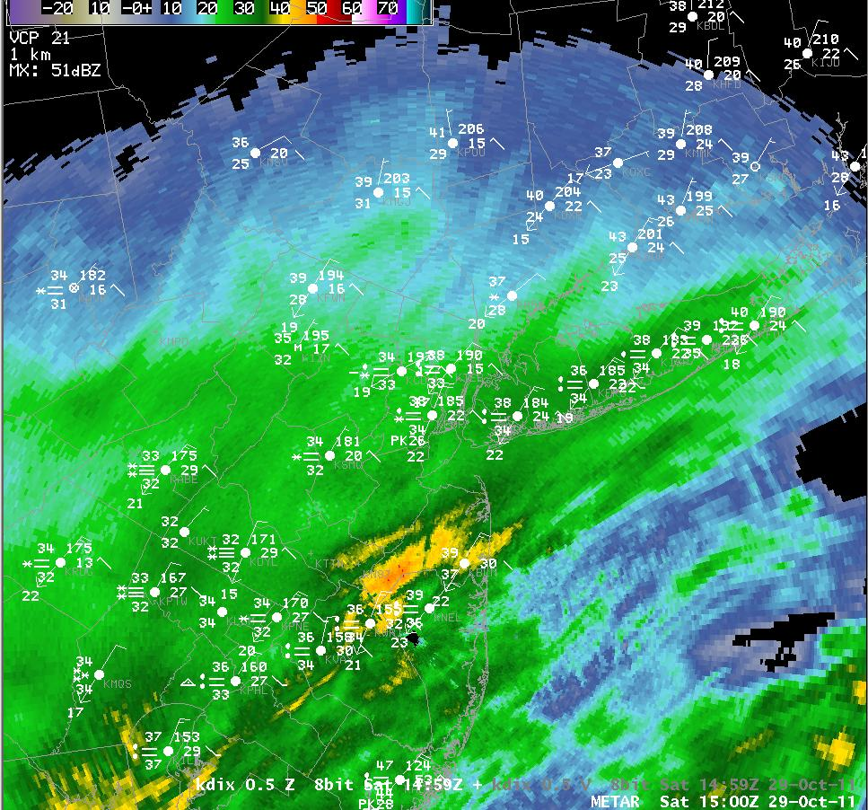
15Z

Slide 29
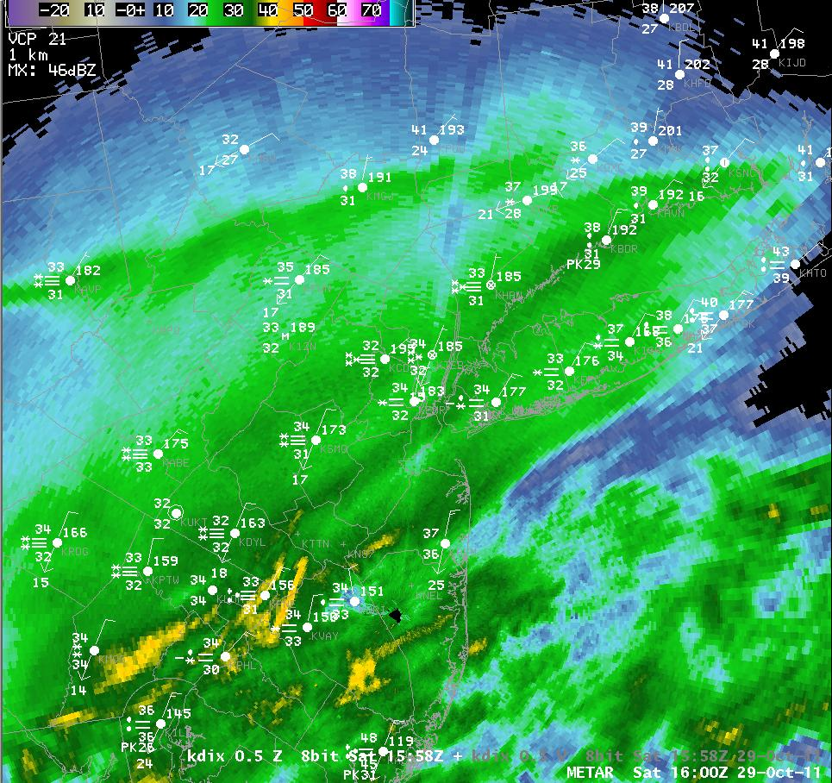
16Z

Slide 30
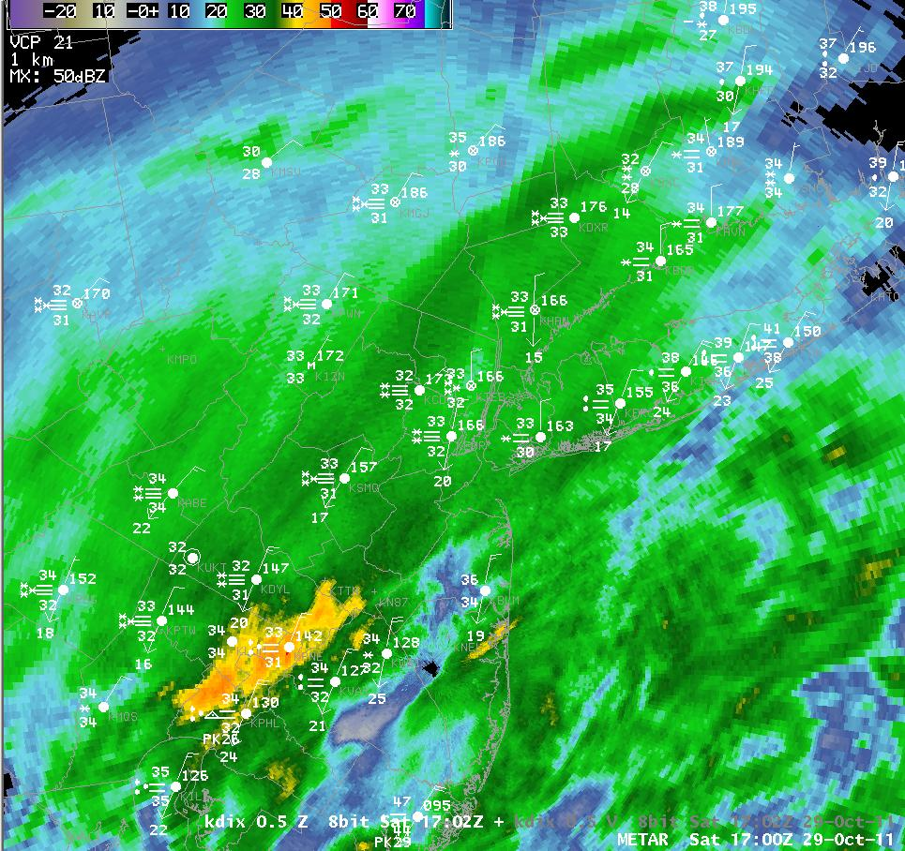
17Z

Slide 31
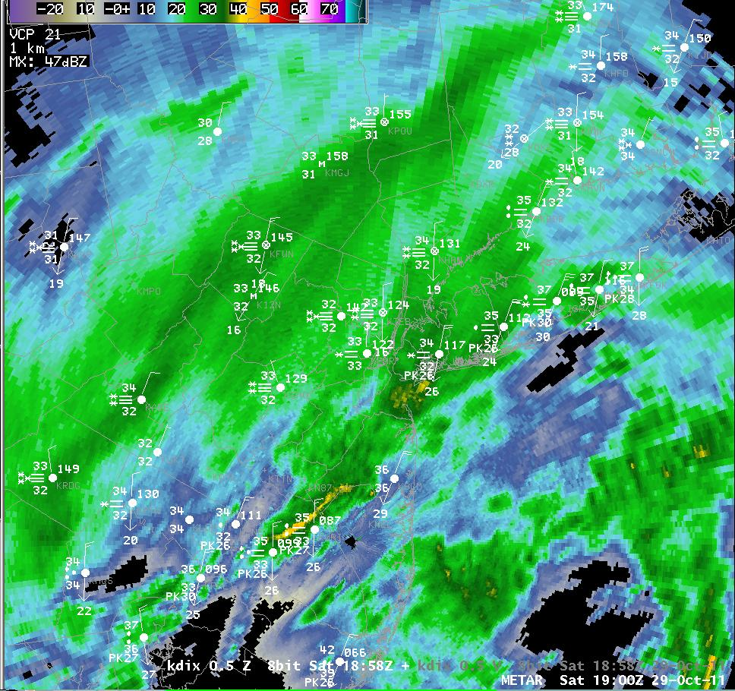
19Z

Slide 32
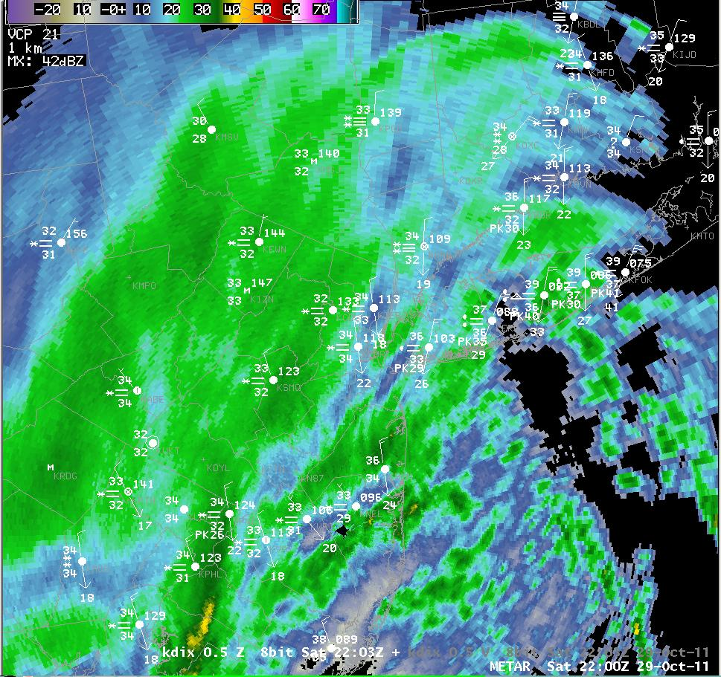
22Z

Slide 33
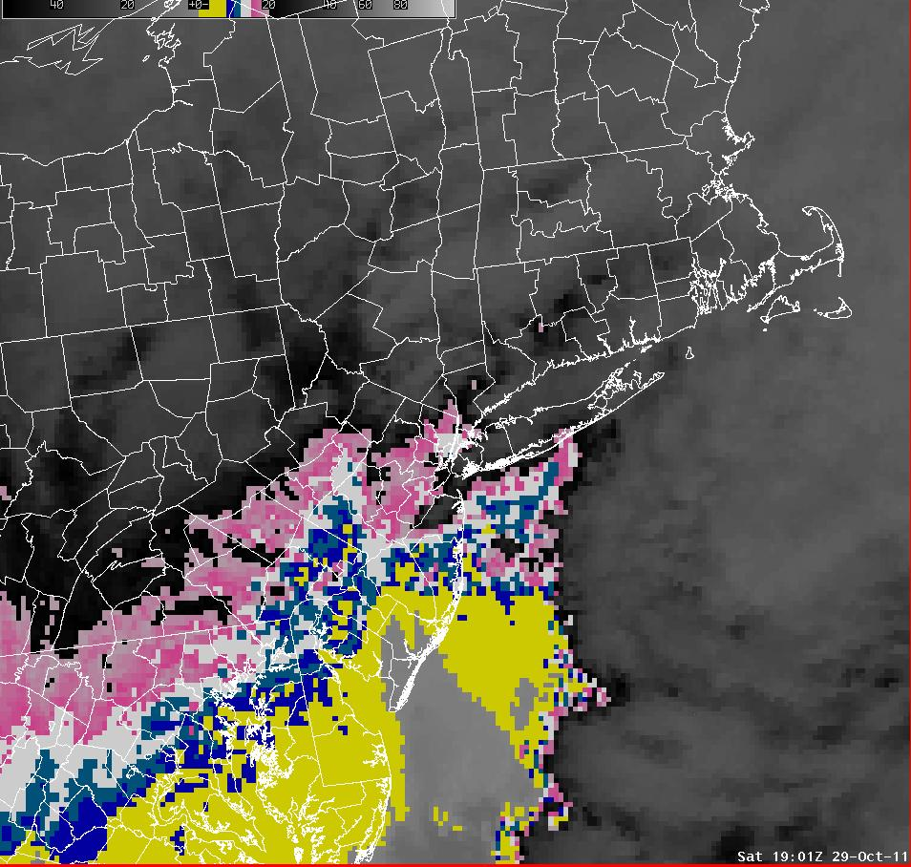
19Z

Slide 34
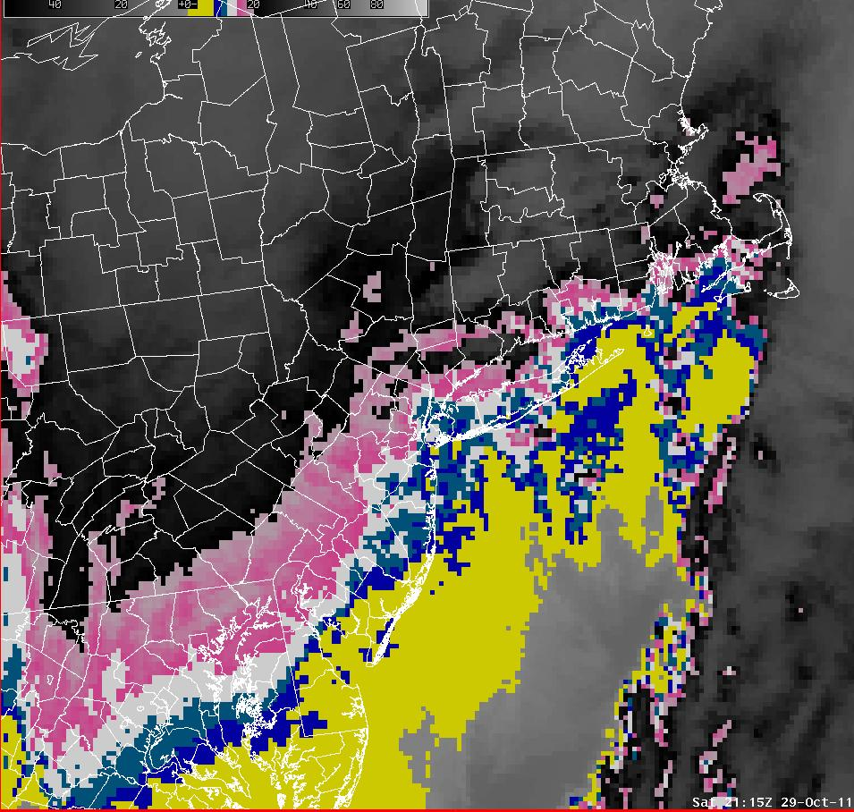
21Z

Slide 35
Key Forecast Issue
Timing – Change to Snow was sooner than Forecast in NY Metro.
7 AM Saturday:
TIMING...RAIN WILL DEVELOP EARLY THIS MORNING AND COULD BE HEAVY AT TIMES. THE RAIN WILL MIX WITH AND THEN CHANGE TO SNOW LATE THIS AFTERNOON INTO EARLY THIS EVENING..

Slide 36
Aviation Was Greatly Impacted
Passengers were held without water or bathrooms for 7 hours on JetBlue flight 504 at Bradley International outside Hartford, Conn., when their Fort Lauderdale, Fla., flight to Newark was diverted.

Slide 37
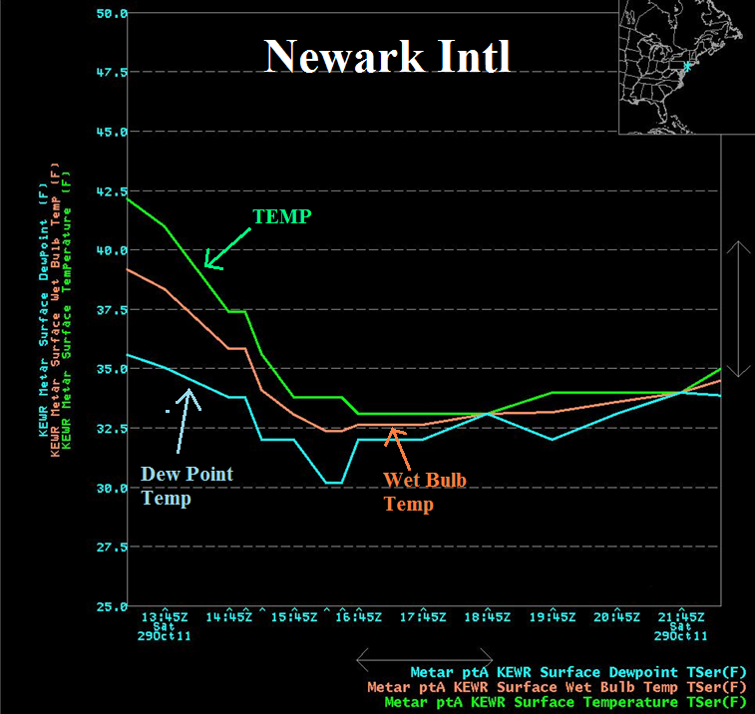

Slide 38
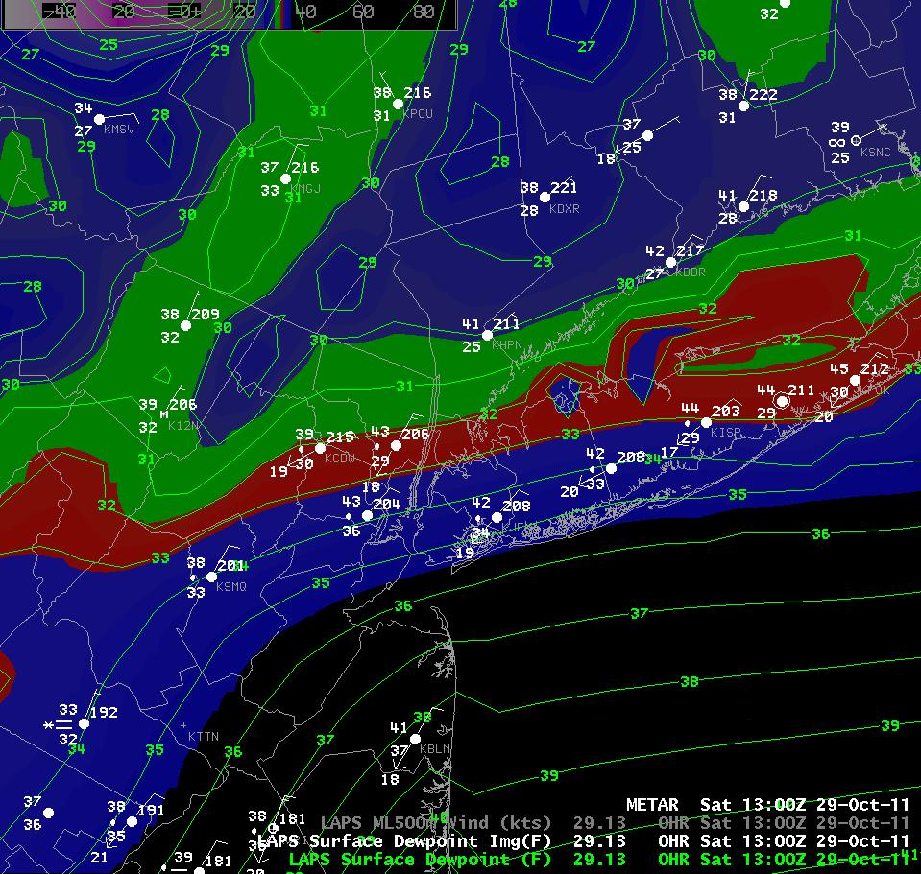
13Z
Dew Pt

Slide 39
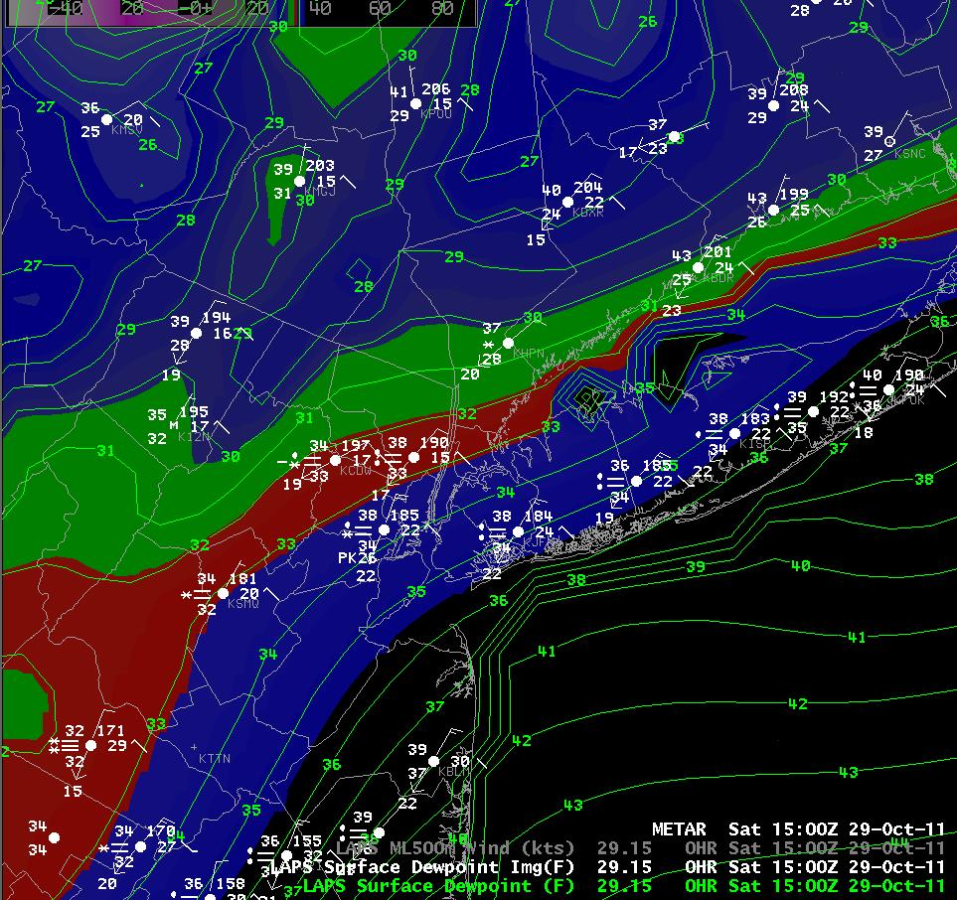
15Z
Dew Pt

Slide 40
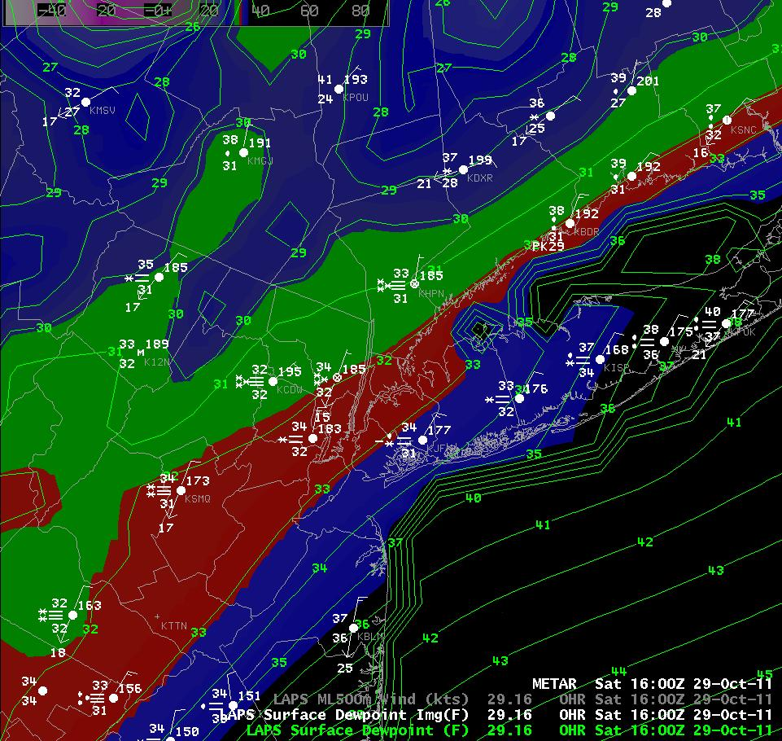
16Z
Dew Pt

Slide 41
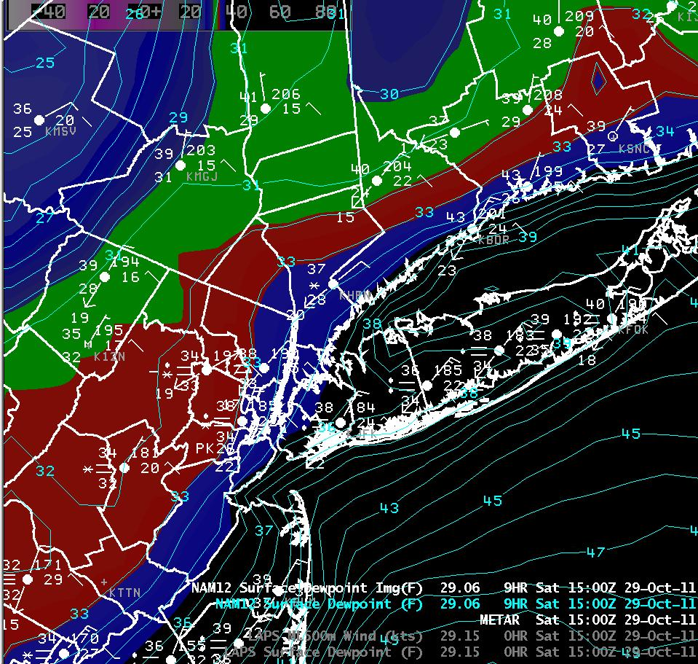
NAM
9 HR Fcst

Slide 42
What About the 6-8” Forecast For NYC and Long Island ???
...QUEENS COUNTY...
  ASTORIA 2.0 1100 PM 10/29 PUBLIC
  NYC/LA GUARDIA 1.7 200 AM 10/30 FAA CONTRACT OBSERVER
  NYC/JFK AIRPORT 1.5 200 AM 10/30 FAA CONTRACT OBSERVER
  HOWARD BEACH 0.5 700 PM 10/29 SKYWARN SPOTTER
...NASSAU COUNTY...
  MINEOLA 4.0 503 PM 10/29 SKYWARN SPOTTER
  WOODMERE 2.3 200 AM 10/30 PUBLIC
  NORTH MASSAPEQUA 2.1 1230 AM 10/30 PUBLIC
  MUTTONTOWN 1.0 100 AM 10/30 SKYWARN SPOTTER
  PLAINVIEW 0.7 600 AM 10/30 SKYWARN SPOTTER
...SUFFOLK COUNTY...
  NORTH BABYLON 0.4 700 AM 10/30 PUBLIC
  ISLIP AIRPORT 0.3 200 AM 10/30 FAA CONTRACT OBSERVER
  UPTON 0.2 200 AM 10/30 NWS OFFICE

Slide 43
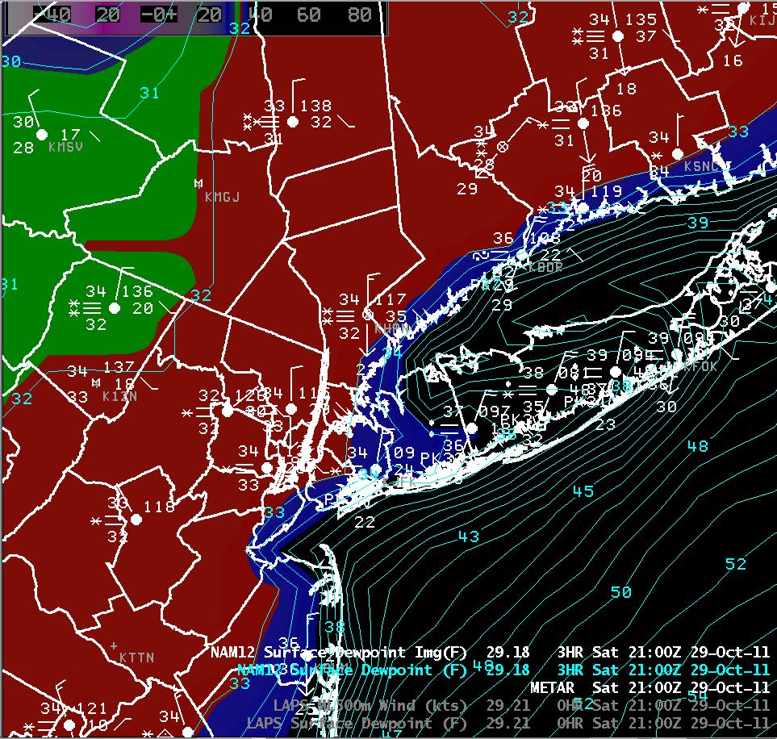
21Z
Dew Pts

Slide 44
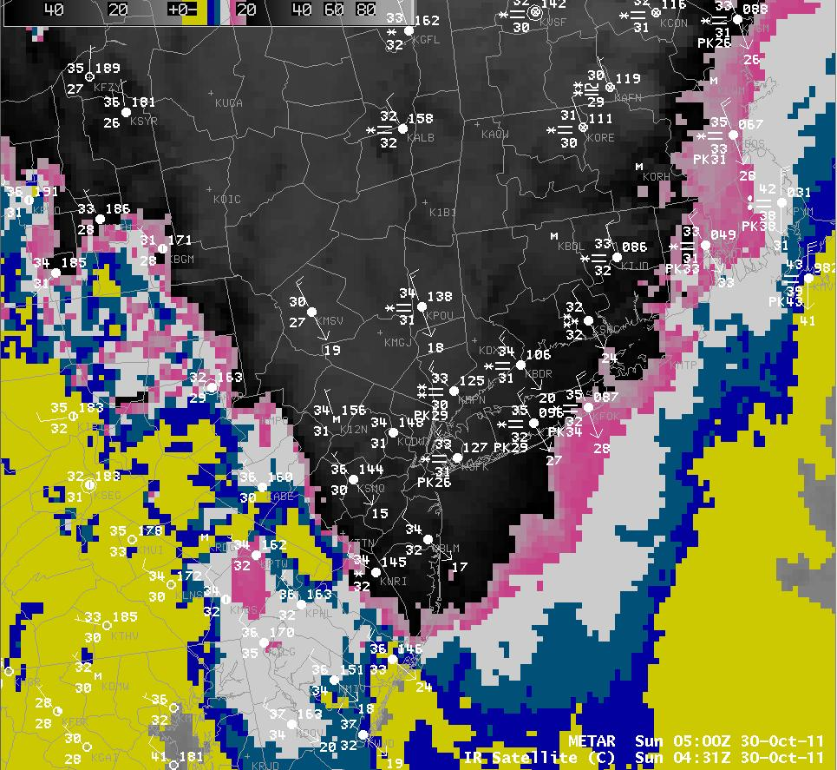
05Z

Slide 45
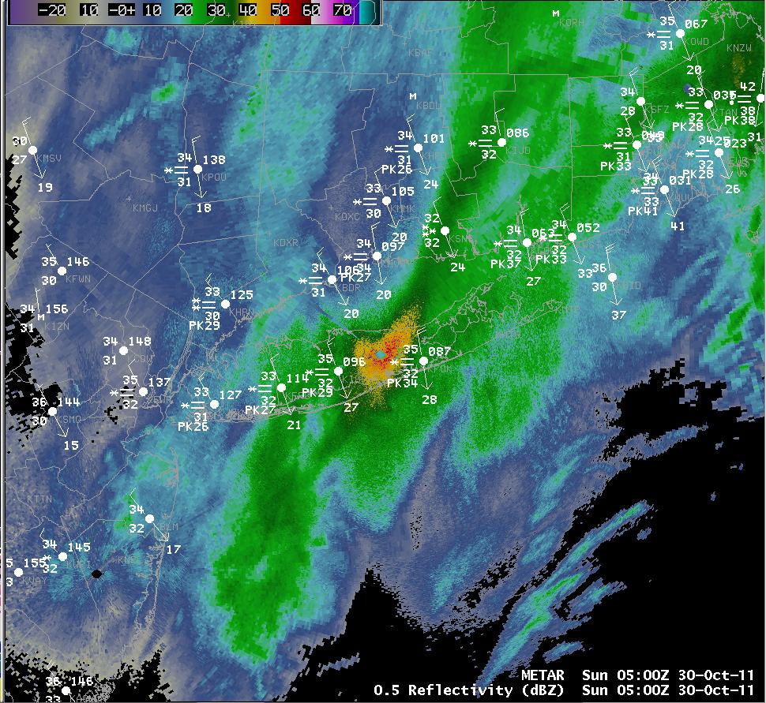
05Z

Slide 46
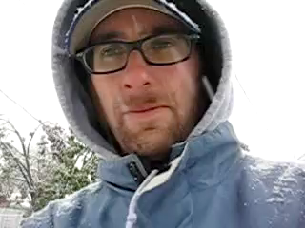
Some Conclusions….

Slide 47
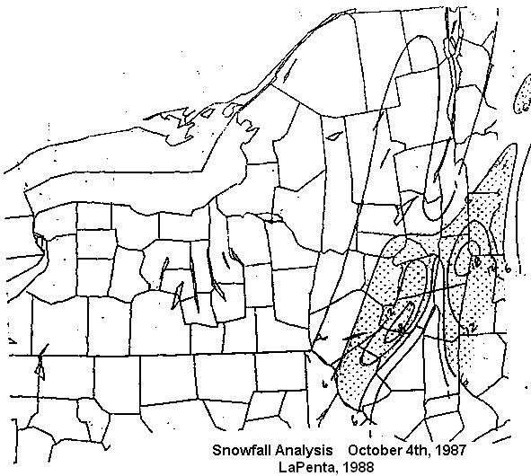
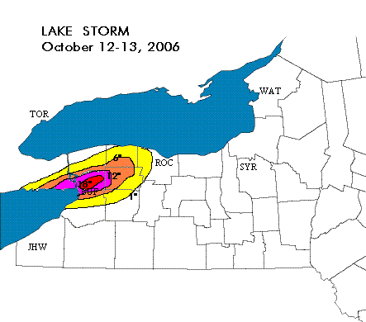
Unprecedented Event ?

Slide 48
Lessons Learned
Watch for “Rare” Events
  As the climate changes ???
  They may not be unprecedented
The Ground is too Warm… NOT !
Observations…Observations…Observations
Meteorology is a Stochastic Science

Slide 49

Deterministic Forecasts Fail

Slide 50
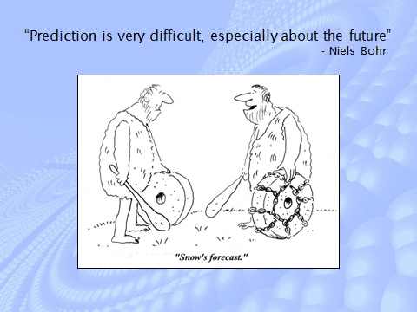
The Challenge – Educate and Communicate Probabilistically

Slide 51
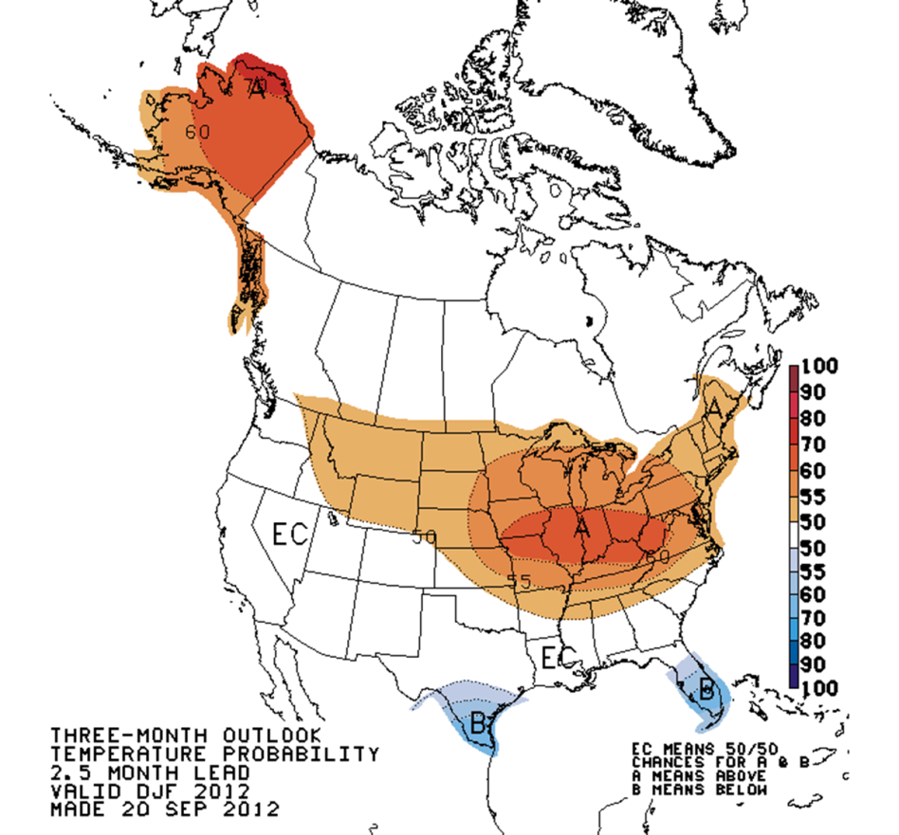
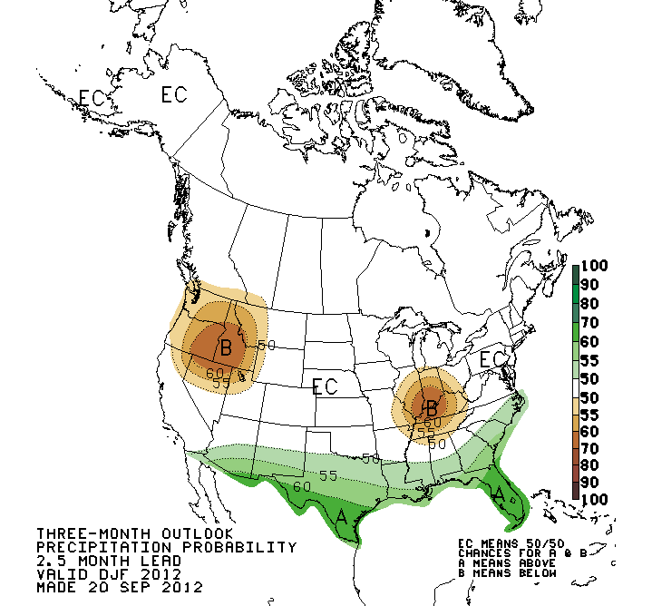
This Winter?

Slide 52
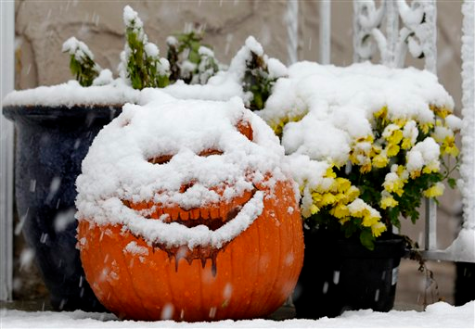
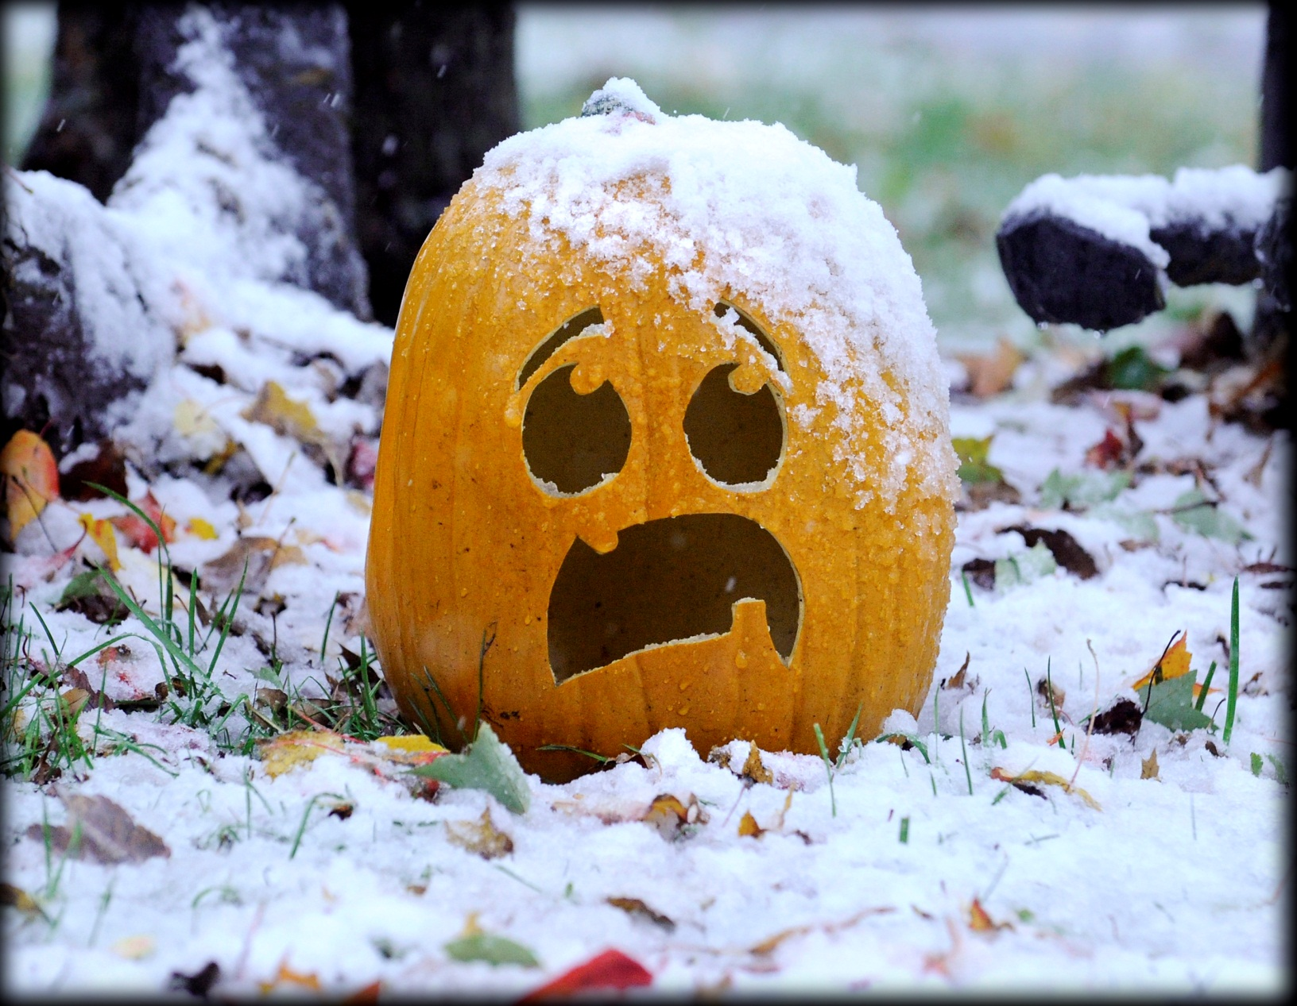
Thank You

