Slide 1
The 1938 New England Hurricane as a Unique Case of Extratropical Transition and Comparison of its Predictability to Analog Northeast U.S. Events
Robert Hart rhart@fsu.edu
http://moe.met.fsu.edu
Dept. of Earth, Ocean, and Atmos. Science
Florida State University
http://coolwx.com
4th Tri-State Weather Conference, WCSU
13 October 2012

Slide 2
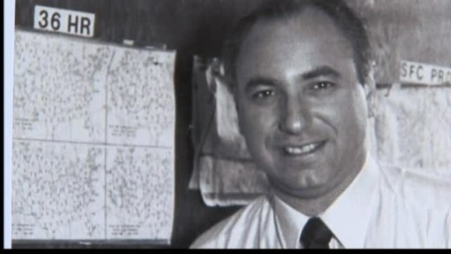



Before I begin…

Slide 3
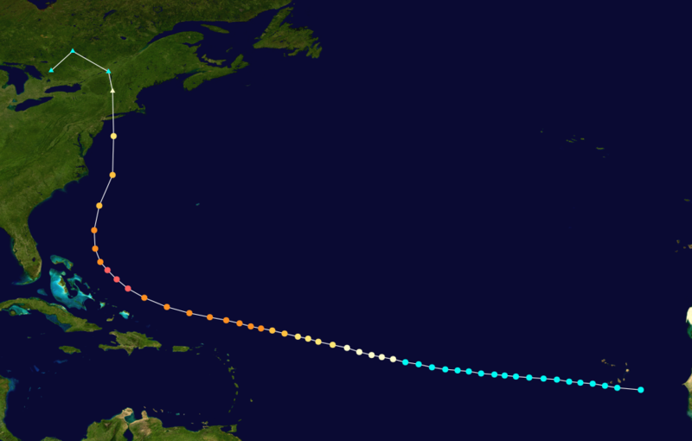
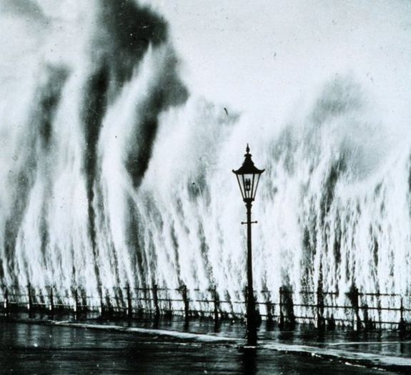
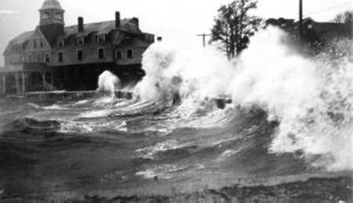
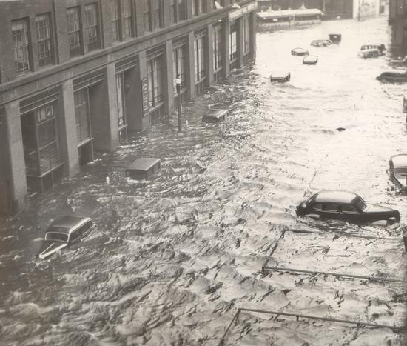
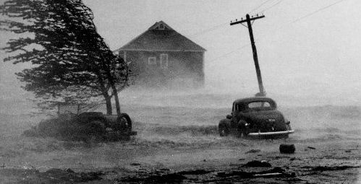
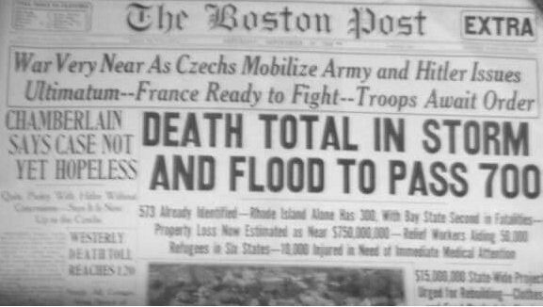
1938 New England Hurricane
Image references available upon request.

Slide 4
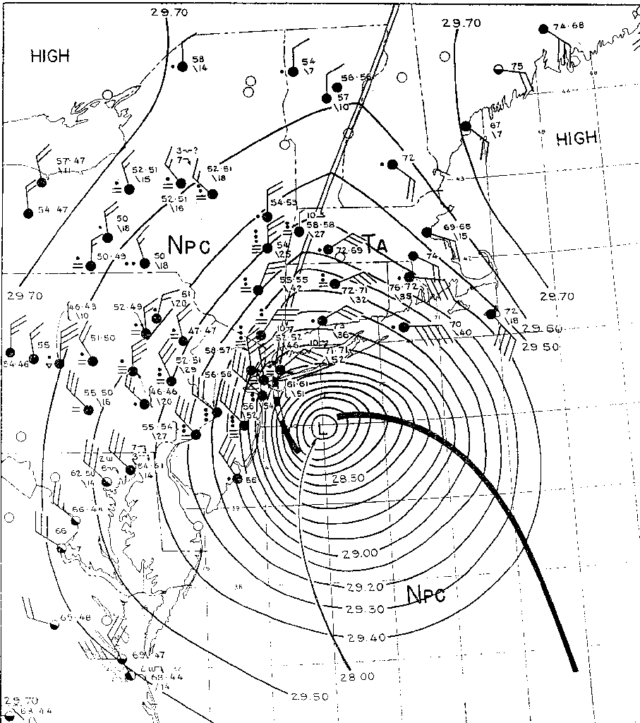
1938 New England “Hurricane”
Tannehill (1938) and Pierce (1939) and followup studies identified the interaction of the TC with an unusually strong, perhaps negatively tilted trough for the time of year (last day of summer)
This interaction provided for:
Rapid movement poleward minimizing time over cold water
Another energy source
A NNW track into New England that placed an unusual percentage of the area on the right side of the storm
Surface analysis 21 September 1938
NY
MA
PA
?
VA
940hPa
(C. Pierce, Mon. Wea. Rev. 1939)
MSLP

Slide 5
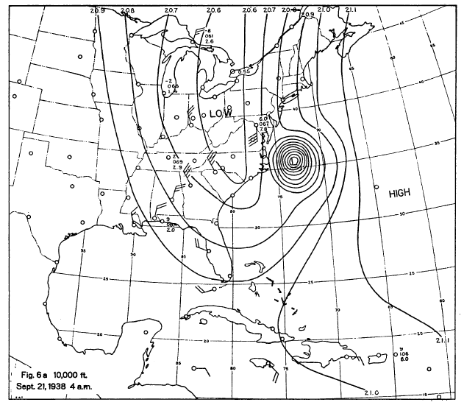
1938: Approx. 700mb Analysis
Source: Pierce 1939 Monthly Weather Review.

Slide 6
Questions
How often does a steering pattern set up for such a landfall? How often is a TC there at the same time?
What was it actually at landfall?
Where in the range of extratropical transition (ET) lifecycles was this case?
What would forecasts be like today if the 1938 TC were to happen again?
Given the availability of new ensemble reanalysis datasets for the period, can we quantify the predictability?

Slide 7
Rarity of large scale pattern
Let’s first ask ourselves how often has the pattern across the region been similar to that of the 1938 Hurricane.
First, perform trajectory analysis of parcels starting at the TC location for every 5 day period back to 1957
Next, isolate those that cross the Long Island/ Connecticut region of New England
Finally, further subset those regimes by time of year to determine the TC feasibility

Slide 8
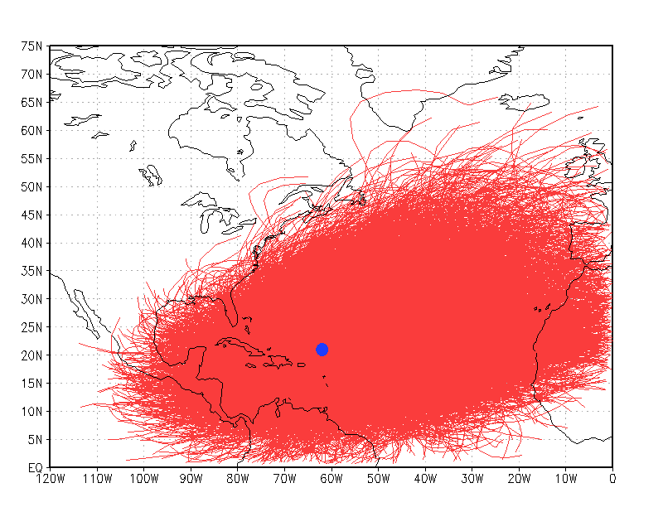
Sampling of five-day forward trajectories at 500 hPa (1957-2002 ERA40)

Slide 9
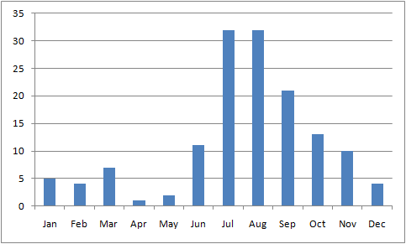
Analog trajectory distribution
Over 45 Years: 196 days during which trajectories passed through the landfall region after starting at 21°N/62°W (4 days a year)
Events:
155 individual “events”
114 one-day
32 two-day
7 three-day
2 four-day+
Monthly distribution (to the right)

Slide 10
Analog-TC Synchronicity
Of the 155 periods supporting landfall traj., 109 fell during JJASO.
This results in an estimated two short periods (1-2 day) per TC season on average
But how often is a TC near 21°N/62°W during the TC season?
33 storms (1957-2002) within 1° radius of 21°N/62°W
57 storm days over 45 years = 0.84% of the Jan-Oct. period
Illustrates the rare synchronicity required for a NE type landfall
However, this may underestimate the return period given that there can be other trajectory starting points that lead to New England

Slide 11
Deficiencies of this estimate
The prior analysis is unsatisfying in two ways:
First, if a TC HAD formed and moved into the analog region, the large scale pattern would have changed from what we observed and thus the storm likely would not have reached New England in the first place.
Second, the prior analysis gives no information on the underlying dynamical features driving the storm structure evolution into NE.
Thus, we move onto ensemble numerical modeling to address this latter deficiency

Slide 12
36, 12, 4km Model Domains

Slide 13
Model Setup
WRF Model Configuration:
36, 12, 4km resolution grids (shown previously)
Two-way nesting ; Physics choices available upon request
IC and BCs are 20th Century Reanalysis (Compo et al. 2011)
What is a reanalysis?
A long-term simulation started in the past that constantly assimilates observations
Observations keep the simulations in check
The simulation approach permits analysis estimates where observations are temporarily missing
20th Century Reanalysis is unique in that it goes back to 1871
Note: These are simulations, not forecasts.

Slide 14
Simulations started every 6hr
Color is date of initialization
Color is intensity (MSLP)

Slide 15
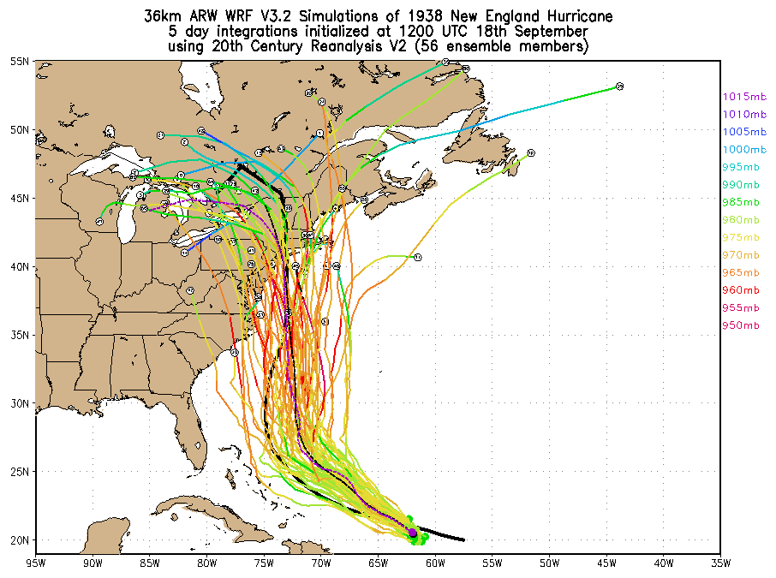
56 Member Ensemble Starting from same Initial Time/Date

Slide 16
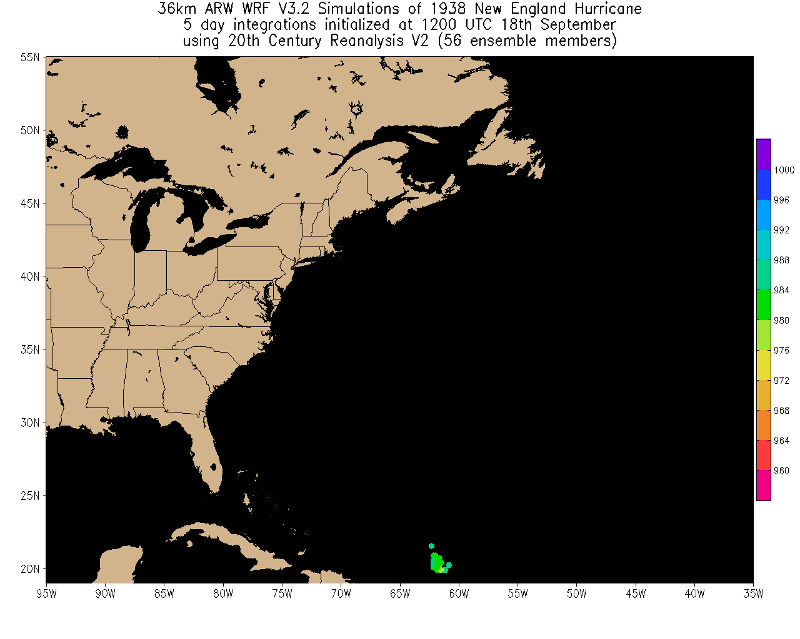
Initial Condition Sensitivity: Track and Intensity

Slide 17
Three clusters of track
Left curving
Right curving
Slow moving

Slide 18
Is 1938 a typical case of ET in terms of structural variability/predictability?
The distribution of 56 track and intensity combinations suggests that it is not – but can we refine that?
View the case in the perspective of an Atlantic climatology of ET
Use cyclone phase space (Hart 2003; Hart et al. 2007) as a means to quantify and normalize ET lifecycle. What is it?

Slide 19
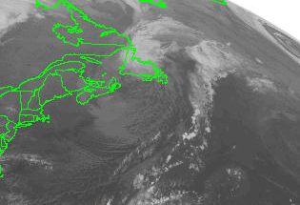
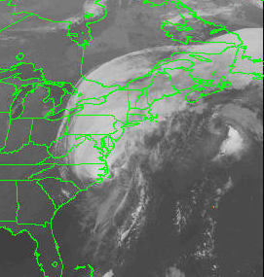
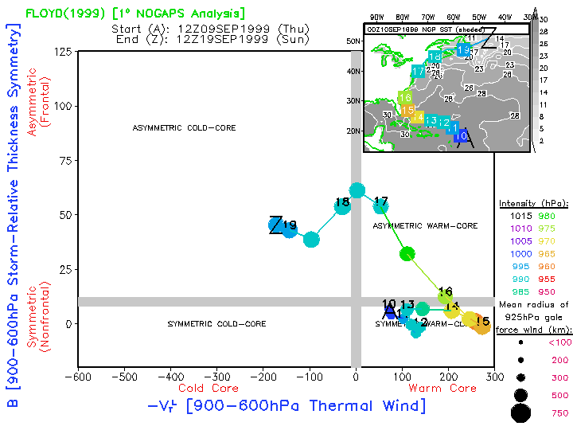
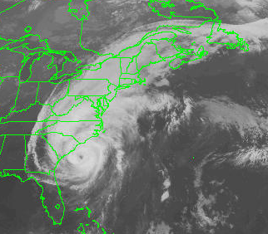
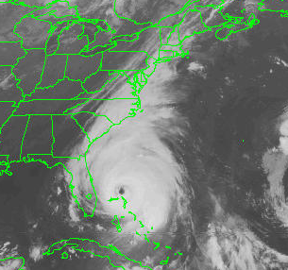
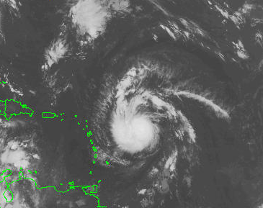
Warm-to-cold core transition: Extratropical Transition of Hurricane Floyd (1999): B Vs. -V_{T}^{L}
5
4
3
Asymmetric cold-core
5
Asymmetric warm-core (hybrid)
B
2
4
3
Symmetric cold-core
1
2
1
-V_{T}^{L}
Symmetric warm-core (tropical)

Slide 20
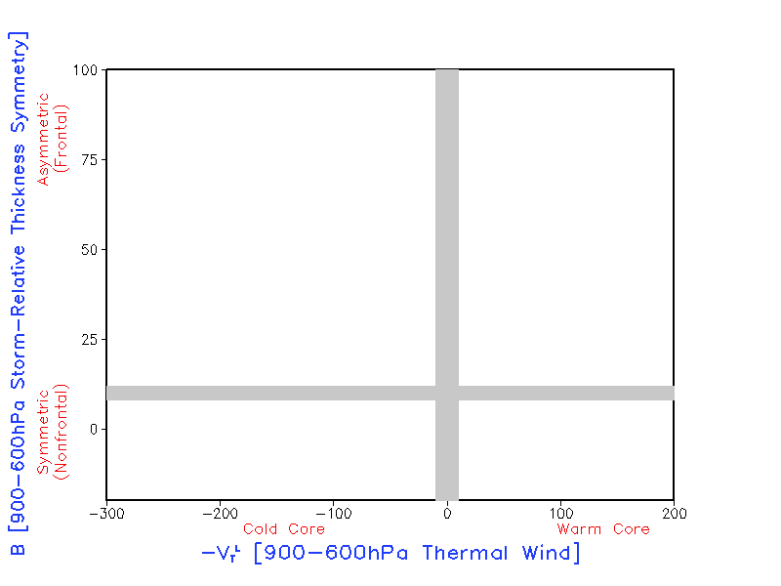
34-Cyclone Composite Mean Phase NOGAPS-analysis based Trajectory with key milestones labeled
Composite Mean ET Structural Evolution Summary
T_{E}+24h
T_{E}
T_{E}+48h
T_{MID}
T_{B}
T_{E}+72h
T_{B}-24h
T_{B}-72h
T_{B}-48h
Hart et al. 2007

Slide 21
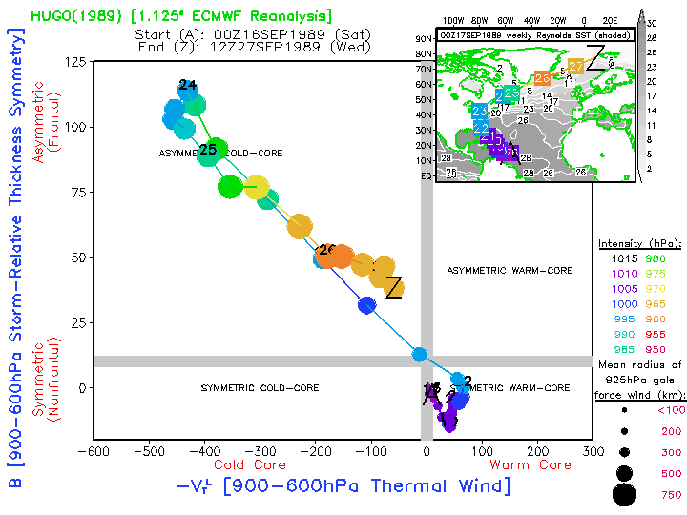
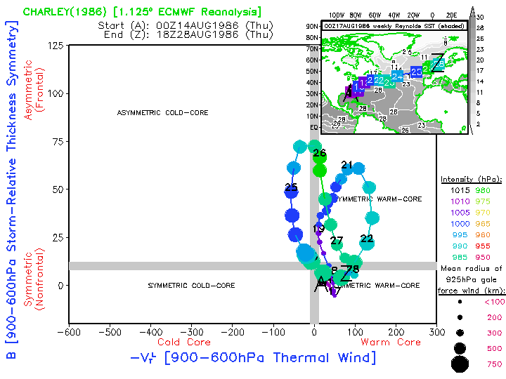
Floyd (1999): Non-intensifying cold-core development
Hugo (1989): Explosive cold-core development
Charley (1986): Schizophrenia
Hart et al. 2007

Slide 22
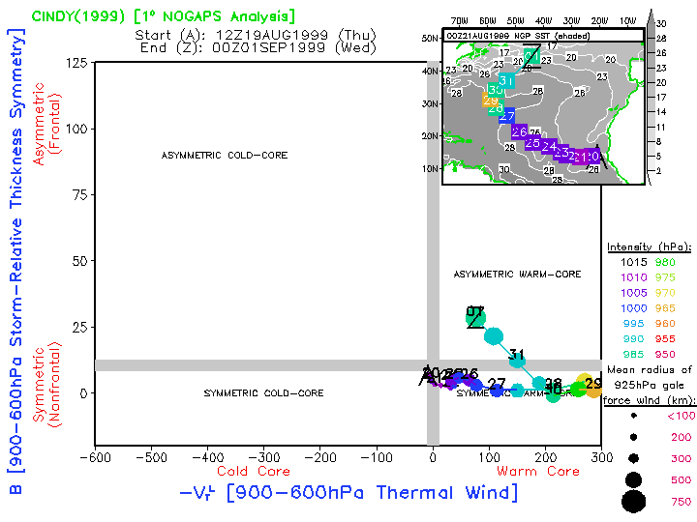
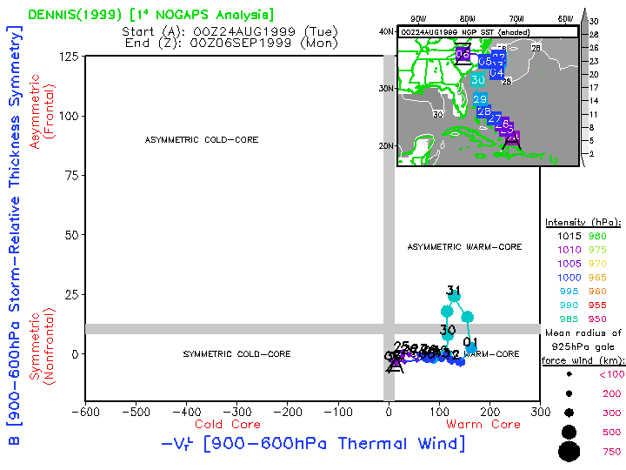
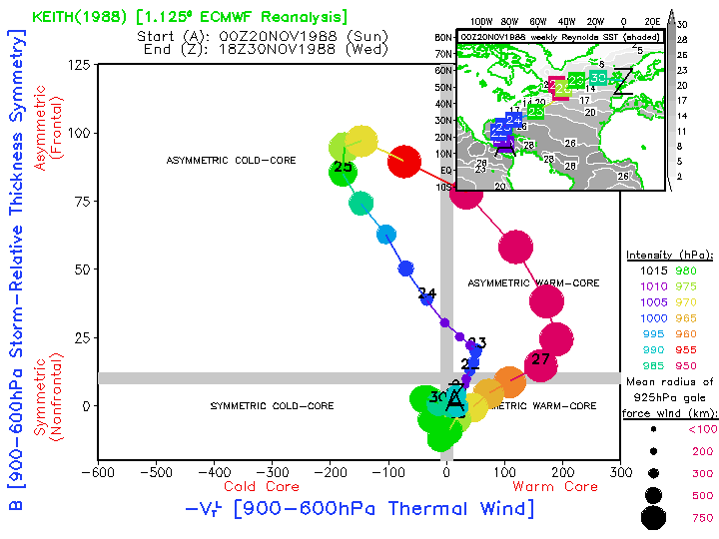
Cindy (1999): Absorption.
Dennis (1999): “ET-Interruptus”.
Keith (1988): Explosive warm-seclusion development
Hart et al. 2007

Slide 23
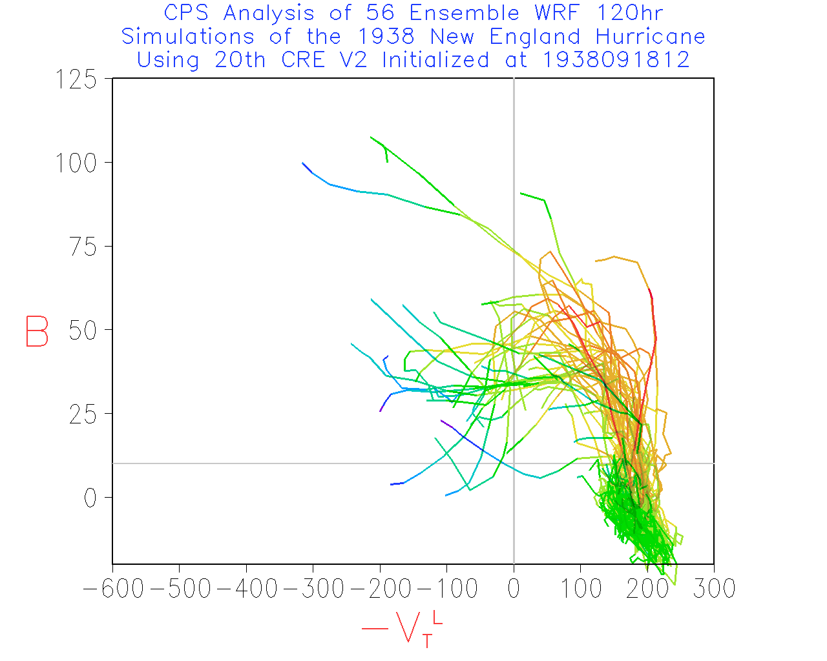
Structural uncertainty of 1938 New England Hurricane from WRF Ensemble
Nonfrontal Frontal
Cold Core Warm-core
Cyclone phase space described in Hart (2003; MWR)

Slide 24
Structural uncertainty of 1938 New England Hurricane from WRF Ensemble
Midlatitude/Winter Cyclone Structure
Hybrid Structure
Nonfrontal Frontal
Occluded/ decaying winter cyclone
Tropical Structure
Cold Core Warm-core

Slide 25
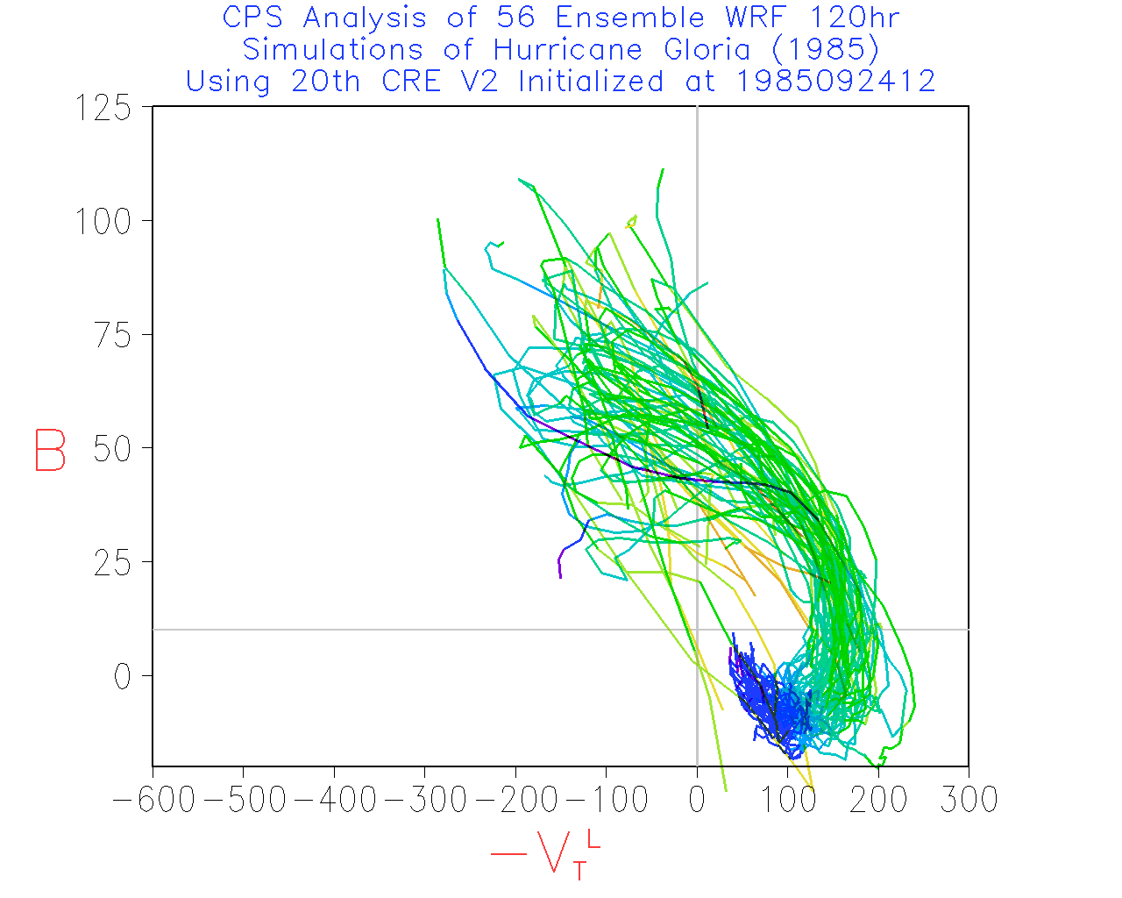
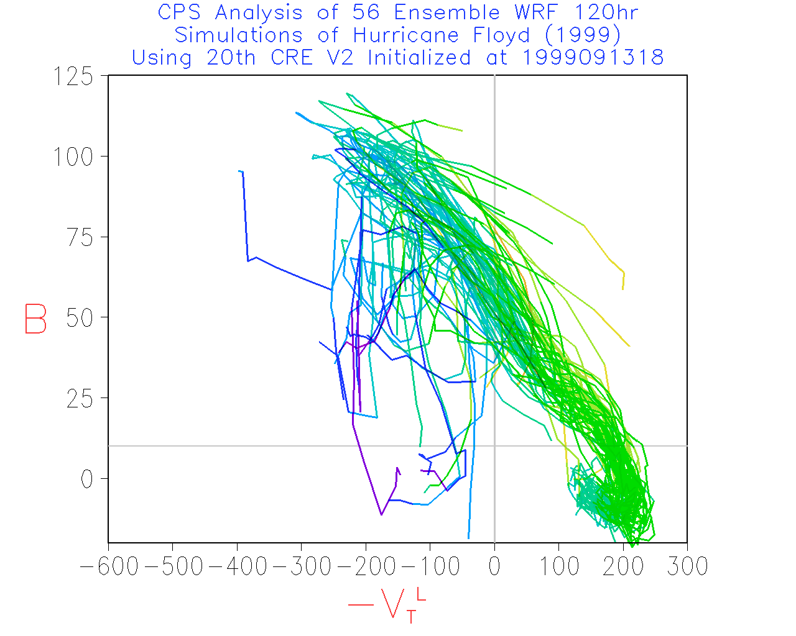

Hurricane Gloria (1985)
Hurricane Floyd (1999)
New England (1938)
All three storms had generally similar paths
All three storms occurred within two weeks of each other
The structural uncertainty of Gloria, Floyd are more typical of extratropically transitioning TCs in the region based on prior studies
Yet, the structural uncertainty of the 1938 storm was very different from the other two and had an unusual dominance of dangerous (and rare) warm-seclusion evolutions.

Slide 26
Is 1938 Worst-Case Predictability?
1938 is a nightmare forecast from a structure and impact perspective.
However, is the track uncertainty shown equally nightmarish?
Could it be worse?
Answer is yes: Fujiwhara interaction.

Slide 27
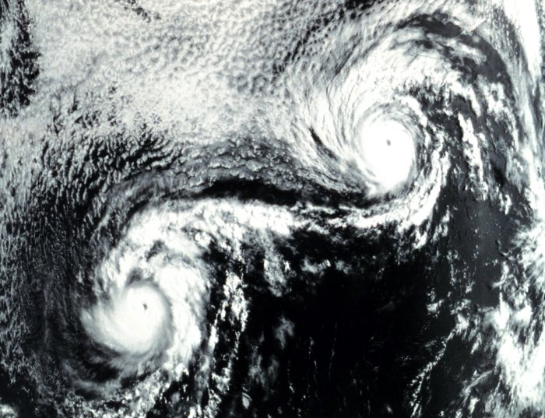
WPAC Example: 1974

Slide 28

WPAC Example: 2009

Slide 29
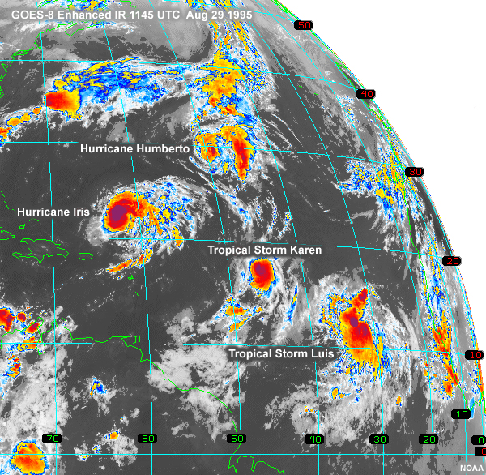
Occurrences in Atlantic (1995)

Slide 30
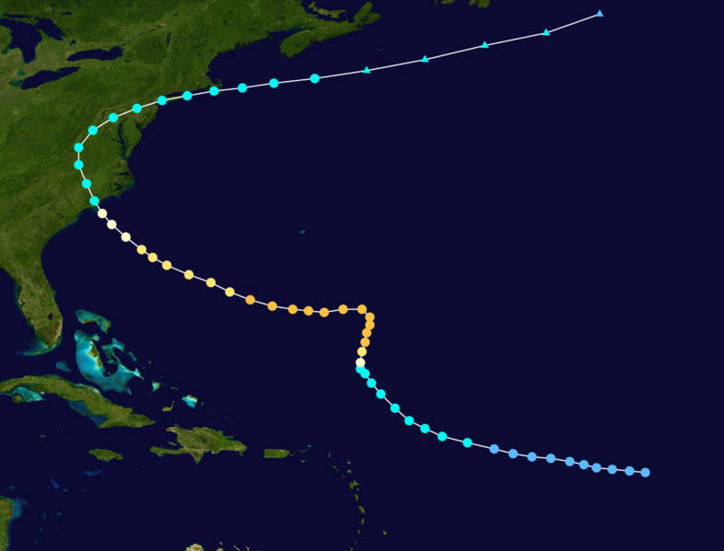
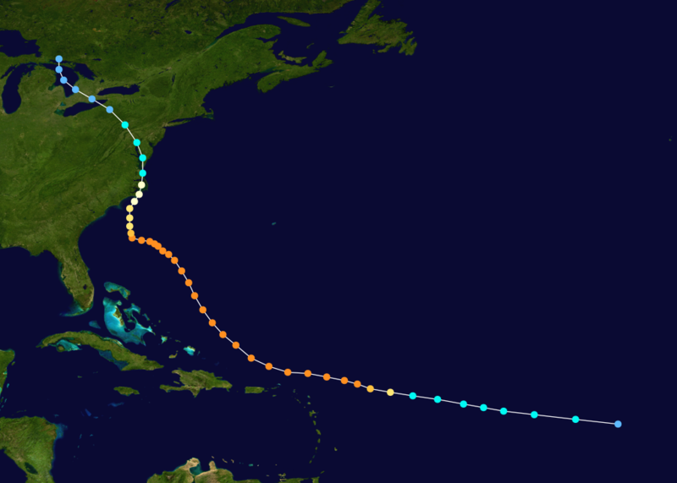
Occurrences in Atlantic (1955)
Example: Diane (left) and Connie (right)
Note the jog west of Connie that may have made landfall further NW than otherwise
Often the interaction is easier to see when analyzed centroid-relative
Source: NHC Best-track

Slide 31
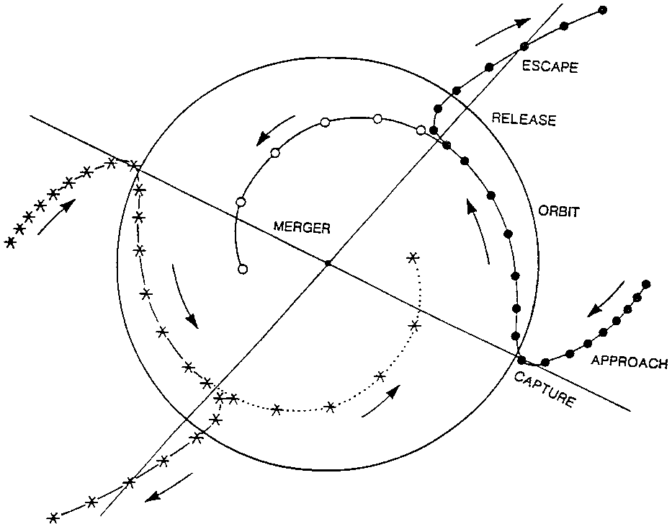
Schematic of TC-TC Interaction
Source: Lander and Holland (1993): QJRMS

Slide 32
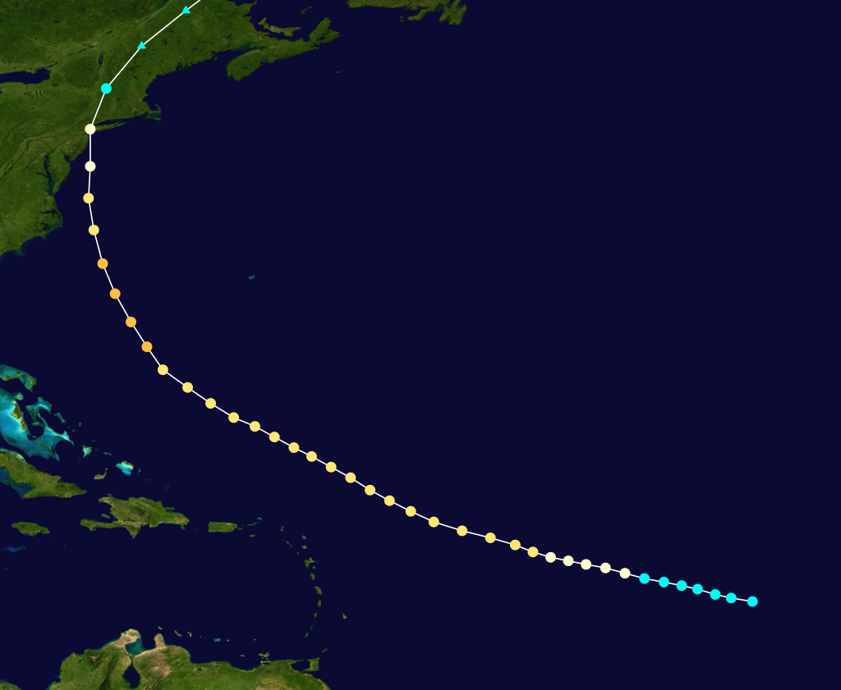
1893 New York City Hurricane
Landfall from SSE to SE rather than more typical S or SSW approach
Peaked at marginal category 3 offshore SC
30 foot storm surge into NYC, LI
Source: NHC Best-track

Slide 33
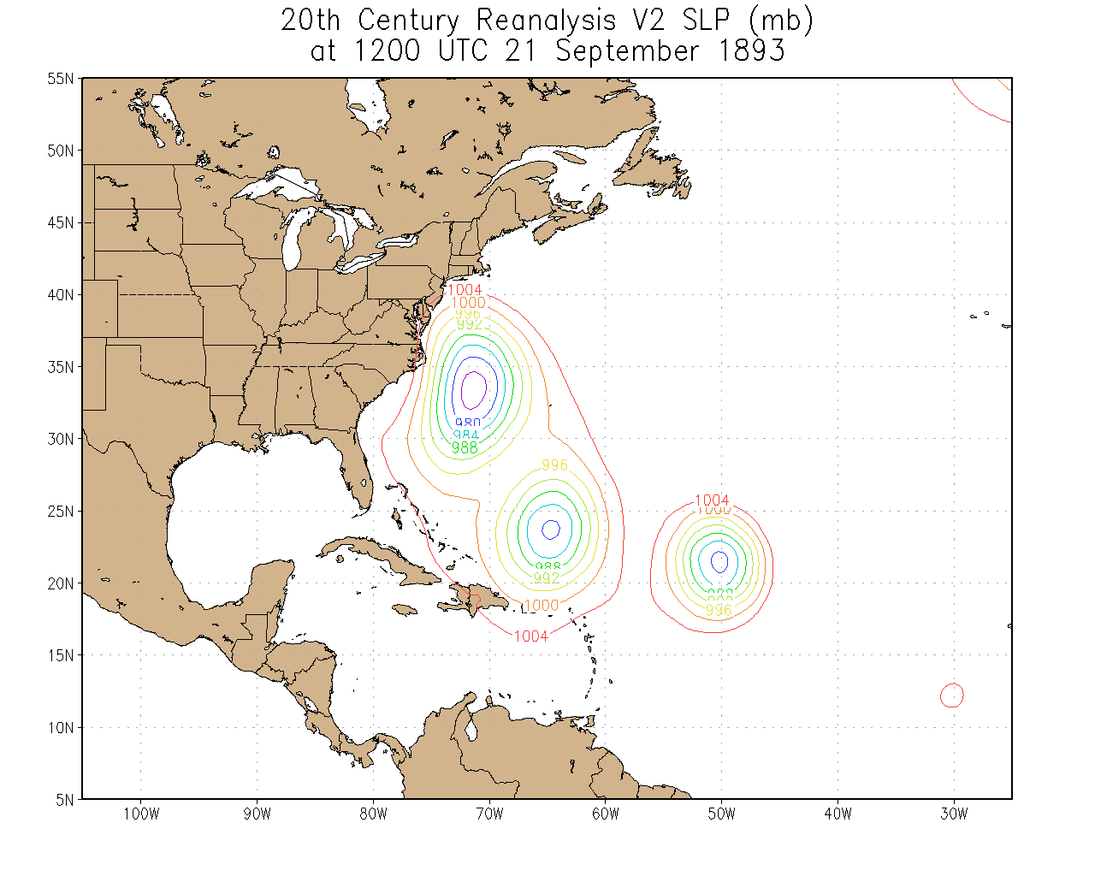
Reanalysis: 1893 NYC Hurricane
Nightmare scenario – with three hurricanes interacting with one another.
Fujiwhara interaction is a nightmare to forecast when there are just two storms…

Slide 34
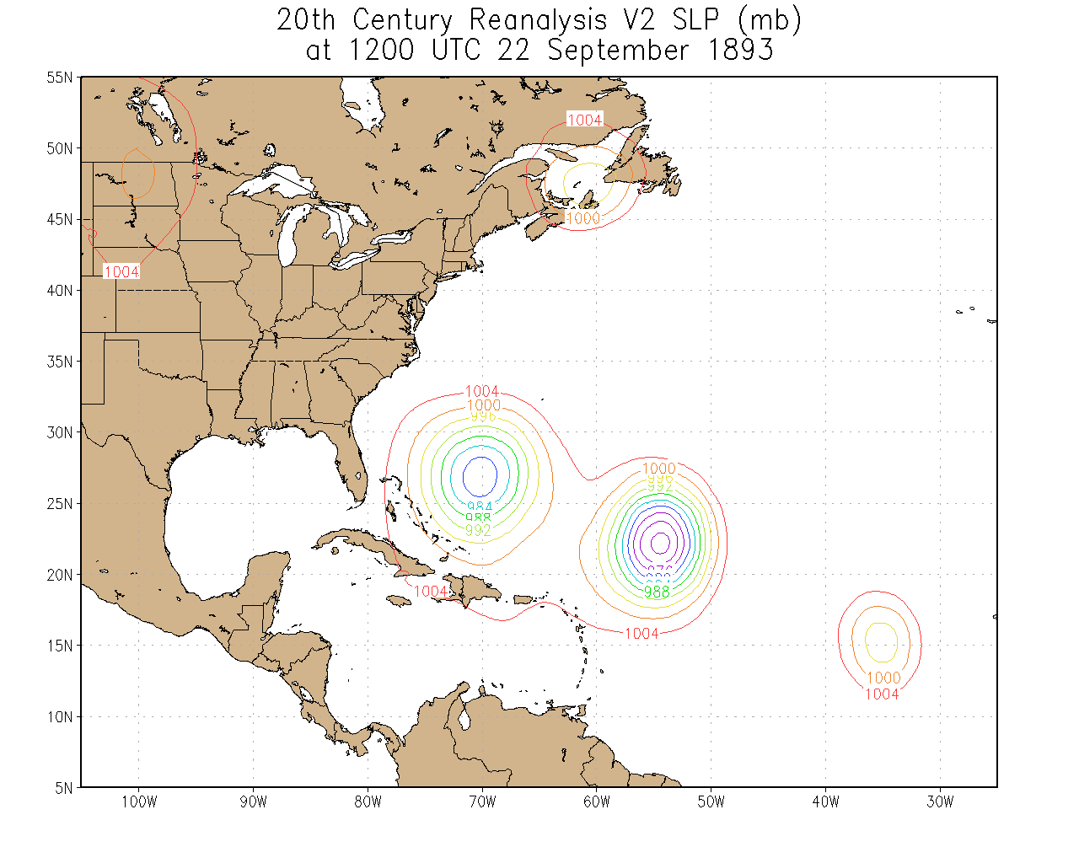
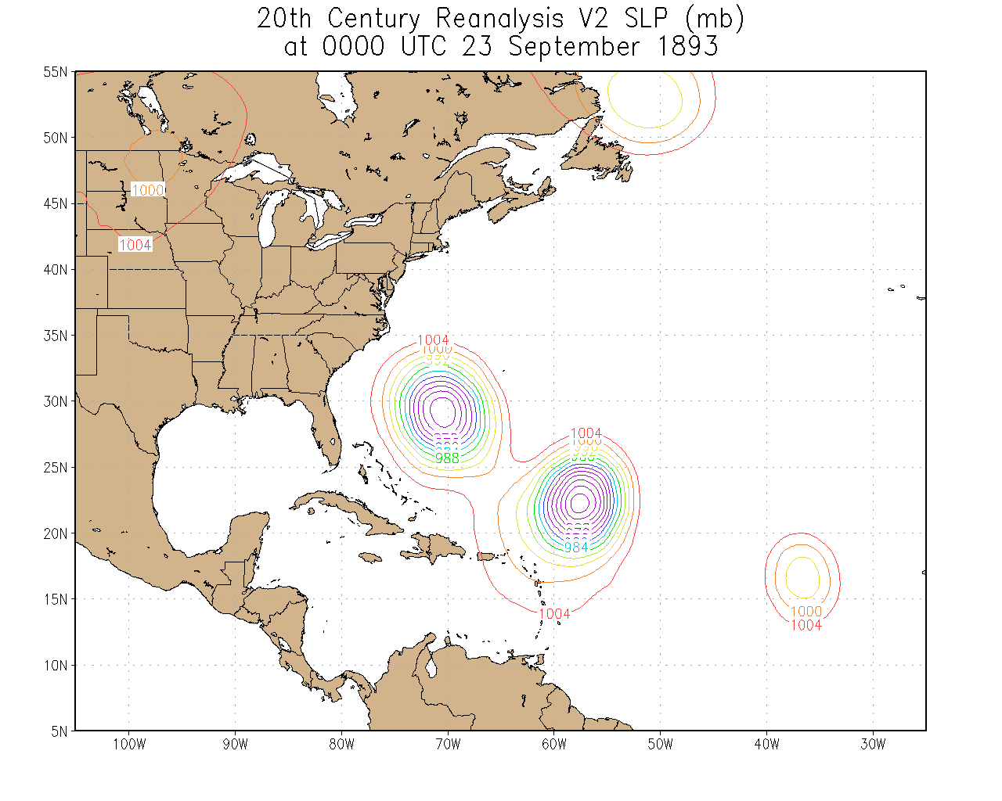
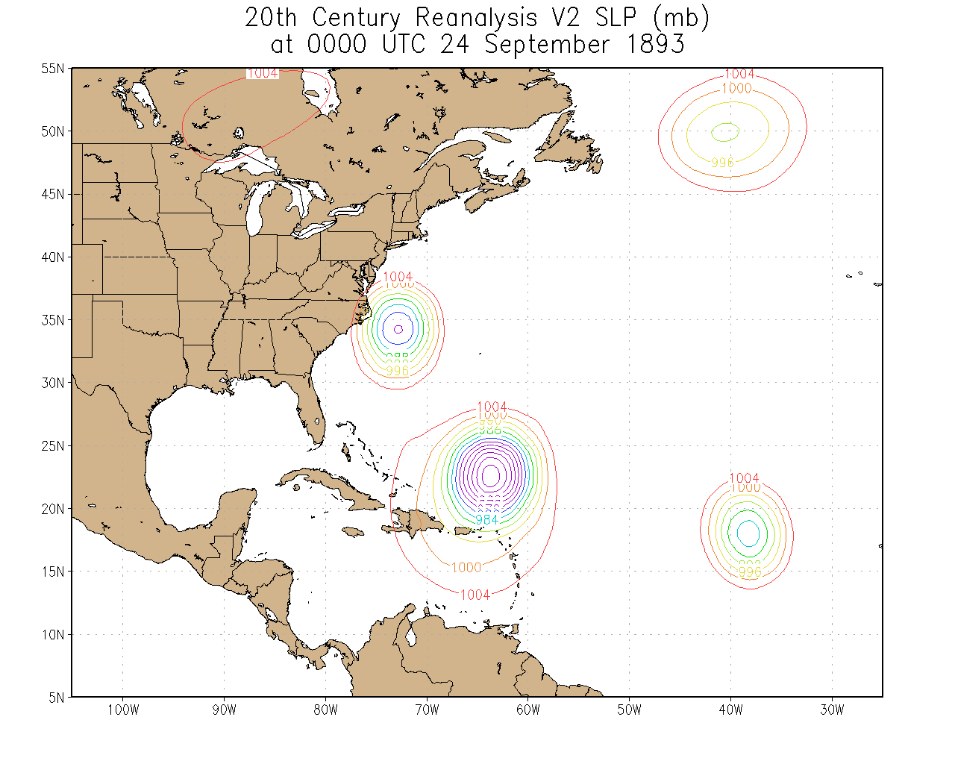
Reanalysis: 1893 NYC Hurricane

Slide 35
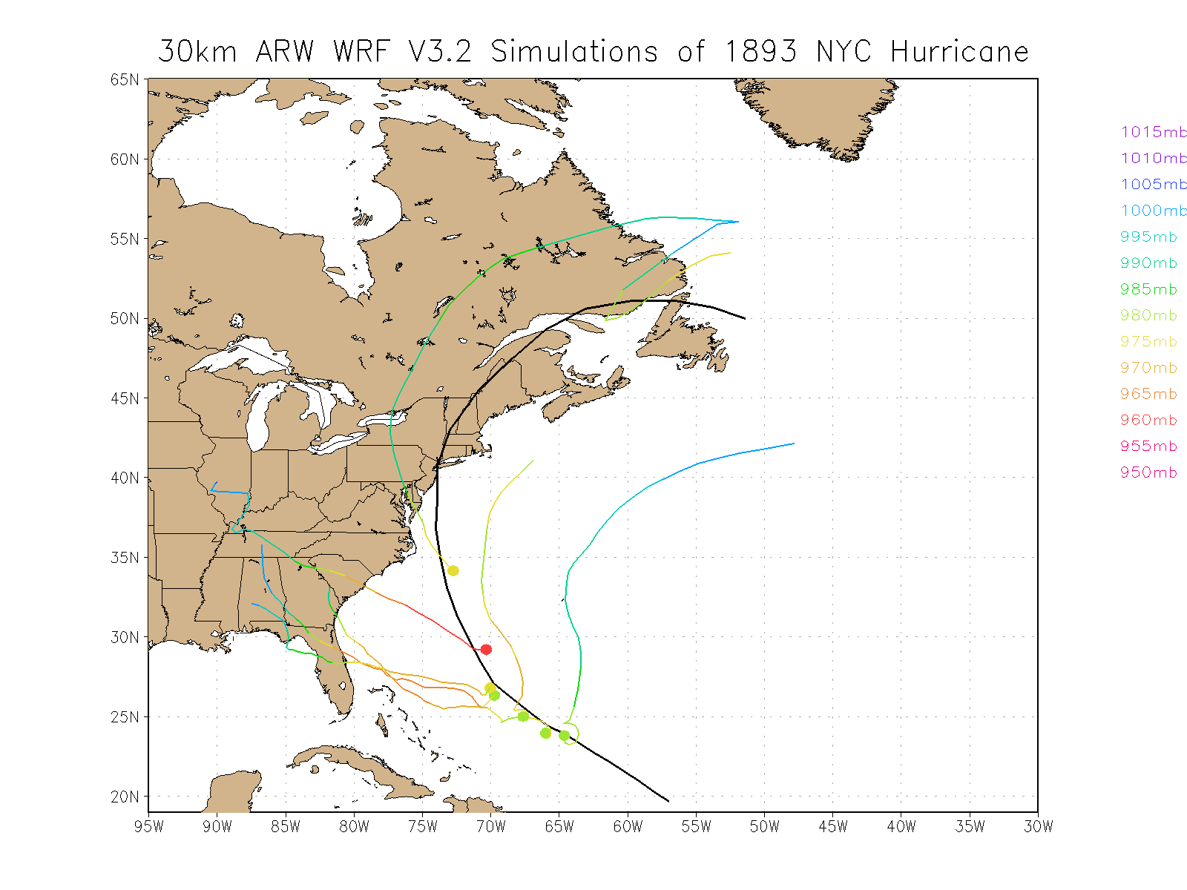
WRF Simulations: 1893 NYC Hurricane

Slide 36
Take-home points
Analogs:
A pattern supporting flow into Connecticut from where the 1938 storm was most intense occurs at most a few days a year
Of course, getting a hurricane to be in that area at the same time is more rare. So, we resort to modeling to better understand the predictability of such rare events.
Modeling:
Landfall timing errors of about 6-12hr (too late in the model)
Nearly every type of ET, with strong emphasis on destructive warm-seclusion lifecycle
Dominance of left-curving tracks, remarkable given the rarity in the historical record
Role of Fujiwhara:
1938’s track was made possible by the interaction with an unusually strong for September (baroclinic) winter type storm to the west.
There are events where such interaction occurs with other hurricanes, with the 1893 New York City hurricane an extreme example of three interacting tropical systems leading to almost chaotic forecasts if performed today

Slide 37
Questions
Question: What is sensitivity to ocean temperatures, ocean coupling, model atmospheric physics? Oceans have warmed since 1938. Impact?
Question: How does the TC survive the rapid change in environ. & balance?
Question: How would today’s data change the predictability?
Good aspects of today’s forecast setting: Better ICs and SST, coupling
Bad: The lateral BCs would be forecast not (re)analyses as here.
Is what is shown here the best-case scenario for a repeat, or will a real-time setting forecast be even less predictable than what is shown here?
Question: Given the surprises a well-forecast Irene produced in New England, what surprises might a near-repeat of 1938 produce that we are not ready for?

