Slide 1
WSR - 88D Characteristics of Significant Tornadoes in
New York and New England
Lance Franck
University of Massachusetts Lowell
Hayden Frank
NOAA/NWS/Weather Forecast Office, Taunton Massachusetts

Slide 2
This study utilized WSR-88D Level II Data to examine the characteristics of significant tornadoes over the New York– New England area, dating back to 1995.
Some of the radar features studied included:
The Mesocyclone
Gate to Gate Shear
Storm Mode
The authors also examined:
Climatology
Three cases in-depth
The Long Island & Block Island (non-significant) tornadoes
of Aug 10th, 2012

Slide 3
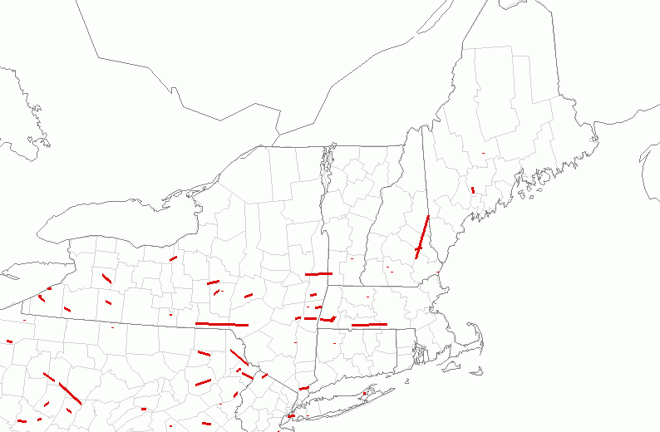
Climatology
A significant tornado is defined as having a rating on the Fujita Scale or Enhanced Fujita Scale (Feb 2007) of F2/>.
In the seventeen year period between 1995 and 2011, thirty-eight significant tornadoes occurred over this area, resulting in 7 fatalities and 421 injuries.
Significant tornado tracks between 1995 and 2011 (SPC)

Slide 4
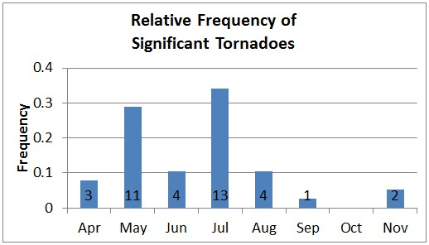
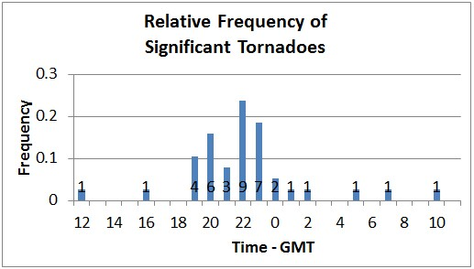
The majority of tornadoes occurred during the months of May & July, between 19Z and 23Z (3 to 8 PM E.D.T.)

Slide 5
The Mesocyclone
A storm-scale vertical column of rotating air that
develops in the updraft of a severe thunderstorm.
It covers a much larger area than the tornado that
may develop within it. It is the hallmark of a supercell.
Does it meet Mesocyclone criteria?
  At least ten-thousand feet (KFT) in depth.
  Persisting for at least two concurrent volume scans
  (about 10 minutes).
  Diameter of 5 miles or less.
  Rotational Velocity of at least 25 knots.

Slide 6
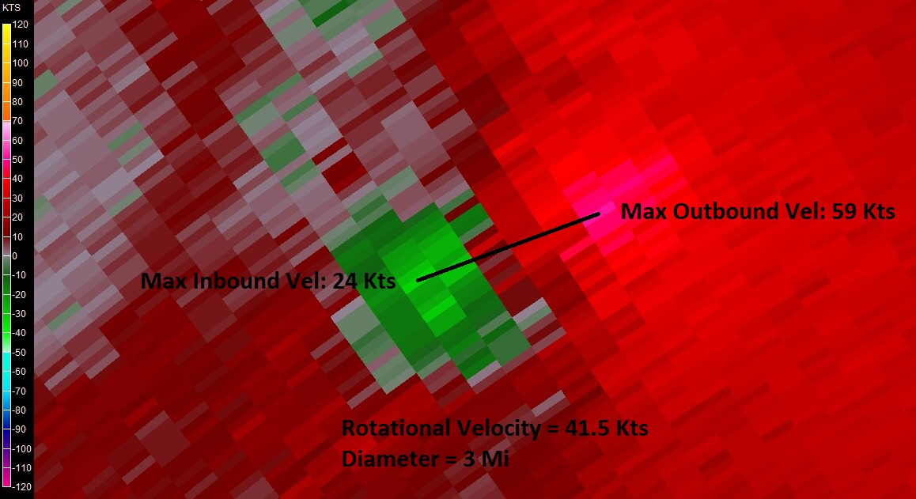
Example of a Mesocyclone.

Slide 7
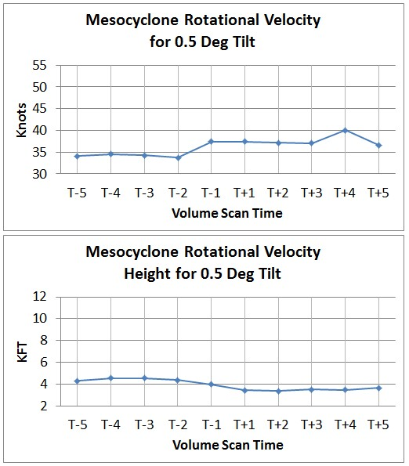
Velocity increases from T – 2 to T – 1; Height decreases.
Velocity – Height Correlation Coefficient = -0.84

Slide 8
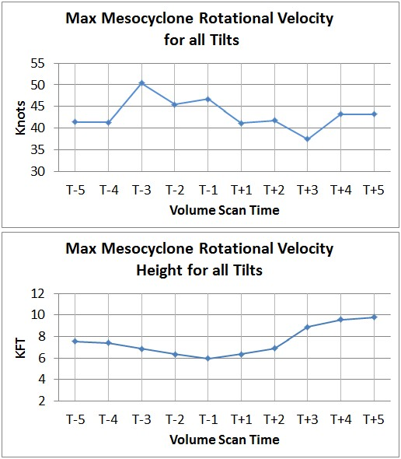
At least three elevation angles were used up to 20 KFT.
Maximum Velocity at T – 3; Minimum Height at T – 1.

Slide 9
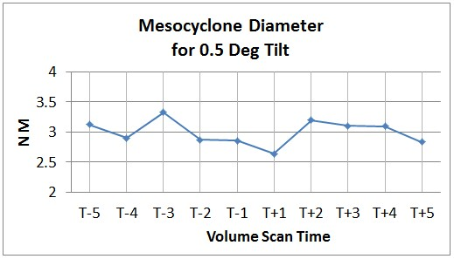
Diameter ranged from 2.5 to 3.5 miles.
Diameter consistently decreased from T – 3 to T + 1
(about 0.7 miles).
Similar (but much smaller) pattern from T + 2 to T + 5.

Slide 10
Gate to Gate Shear
A velocity measurement taken at the point where the
greatest inbound and outbound velocities exist adjacent
to each other (pixel to pixel).
It is used to determine whether or not a Tornado Vortex Signature (TVS) is present.
Does it meet TVS criteria?
  At least several thousand feet deep.
  Persists for at least two concurrent volume scans.
  Gate to Gate Shear dependent on range from radar:
  ≥ 90 knots for range < 30 miles.
  ≥ 70 knots for 30 ≤ range ≤ 50 miles.

Slide 11
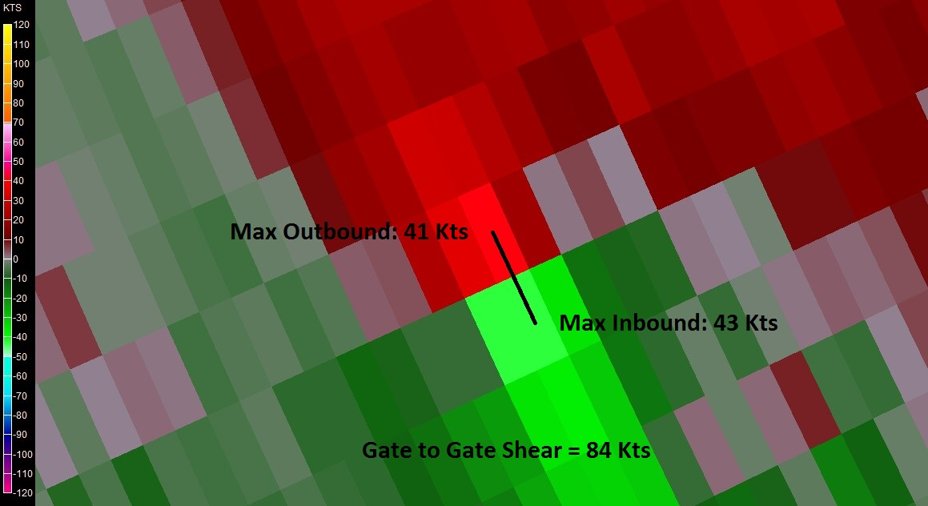
Example of Gate to Gate Shear.

Slide 12
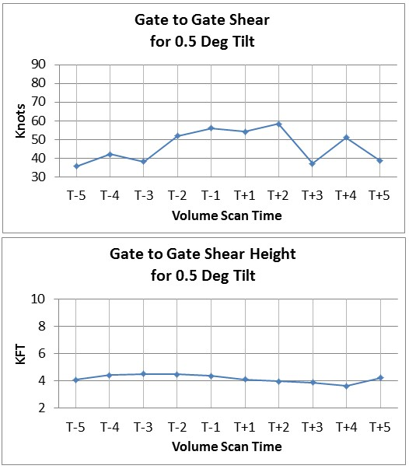
Gate to Gate Shear increased from T – 3 to T – 1.
Unlike the Mesocyclone, Velocity – Height correlation absent.

Slide 13
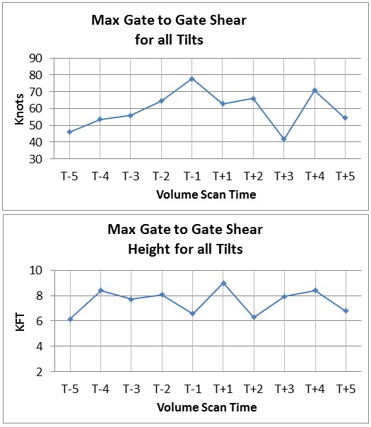
Velocity increased 30 knots from T – 5 to T – 1.
Maximum Velocity = 78 knots (T – 1).

Slide 14
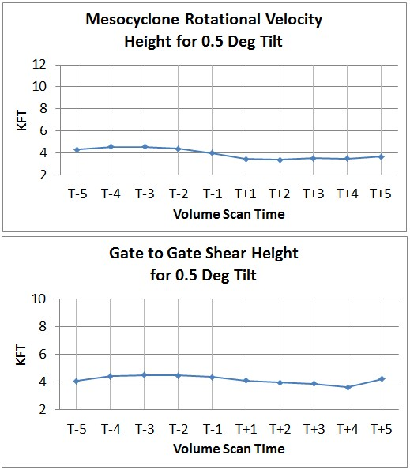
Strong correlation between Mesocyclone Height and
Gate to Gate Shear Height at lowest elevation angle:
  Correlation Coefficient = 0.78

Slide 15
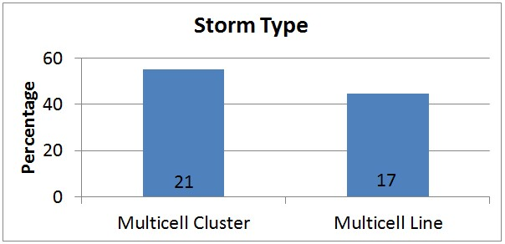
Storm Mode
Multicell Clusters were slightly more prevalent.

Slide 16
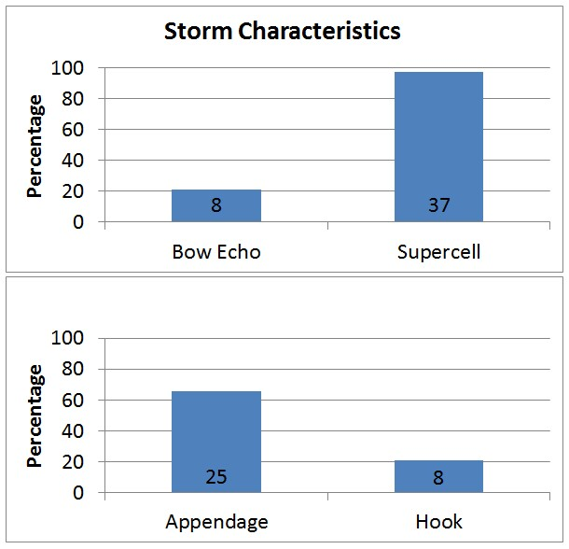
Low-Topped Supercells were observed in only 2 Cases.

Slide 17
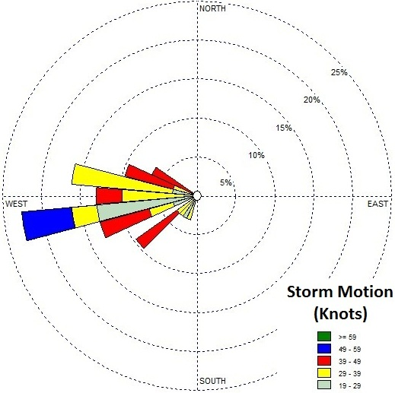
(WRPlot View)
Storm Motion plotted on a compass rose.
  Range: 250 - 290 degrees / 25 - 45 knots.

Slide 18
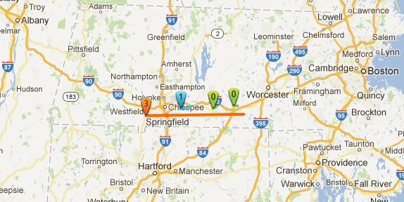
The Cases
The June 1st, 2011 Westfield to Charlton MA EF3 Tornado
(Google)
  EF Rating: 3
  Path Length: 38 Miles
  Path Width: ½ Mile
  Deaths: 3
  Injuries: 200

Slide 19
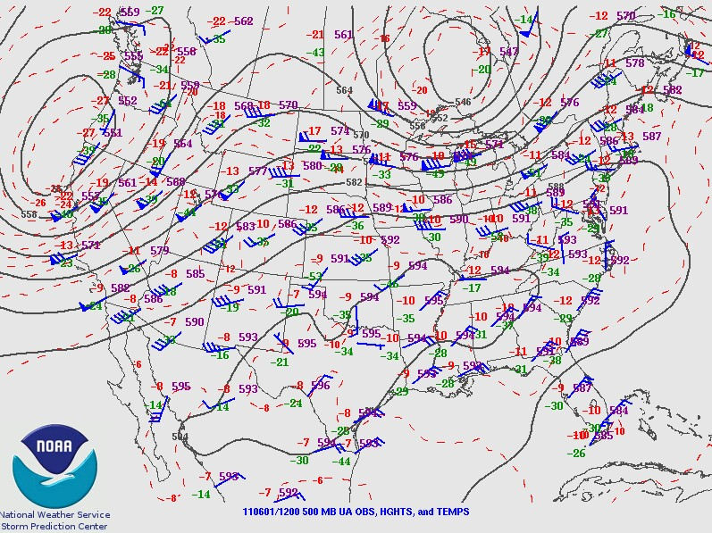
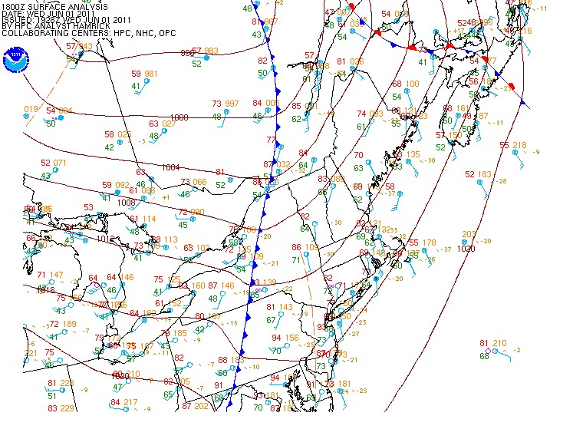
12Z 500 hPa Analysis 18Z Surface Analysis
  Closed 500 hPa low in Southern Canada; Westerly flow.
  Surface cold front and attendant pre-frontal trough in NY.
  Warm & moist southerly flow at the surface.

Slide 20
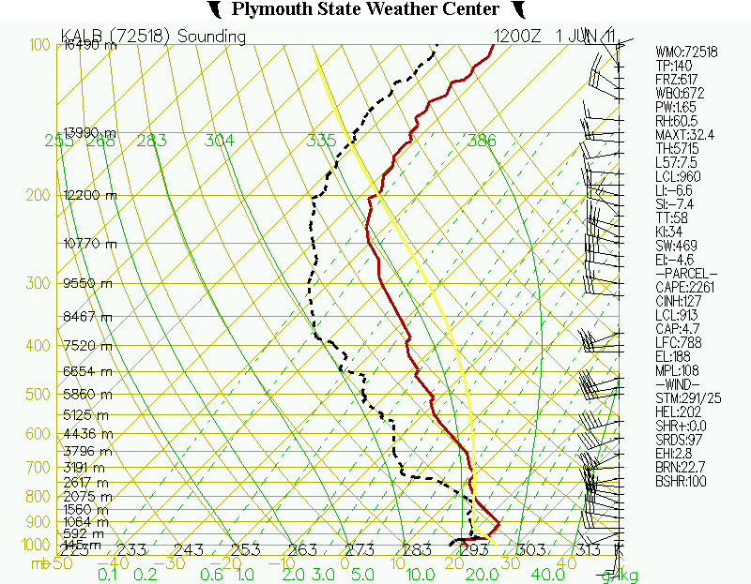
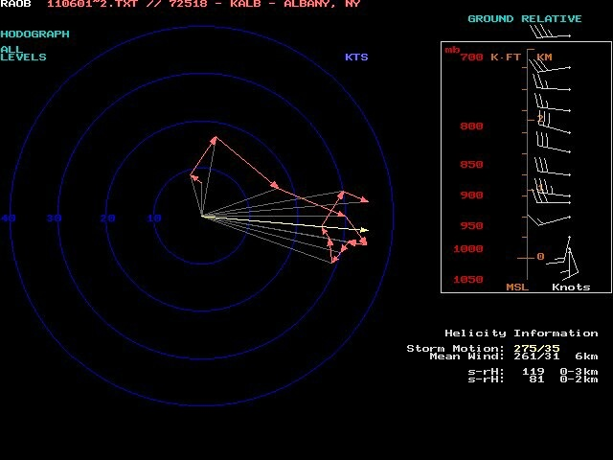
12Z Albany Sounding 12Z Albany Hodograph ( lower 1 KM )
  Both speed & directional shear in the lowest 1 KM.
  Elevated Mixed Layer (EML).
X

Slide 21
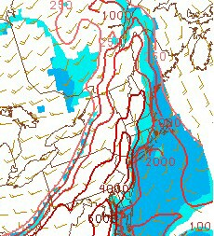
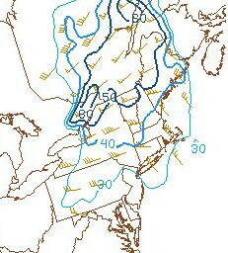
18Z ML Cape & CIN (SPC) 18Z Effective Bulk Shear (SPC)
  High CAPE – High Shear environment.

Slide 22
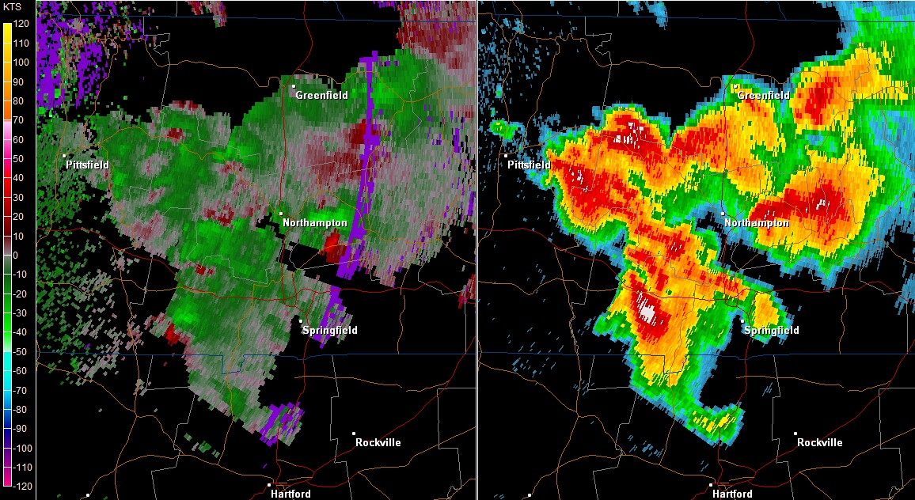
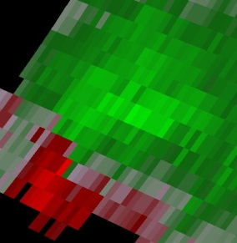
ENX Storm Relative Velocity & Base Reflectivity (0.5 Deg. Tilt) - 2002Z
Strengthening Mesocyclone (left panel - inset)
Rotational Velocity = 35 knots.

Slide 23
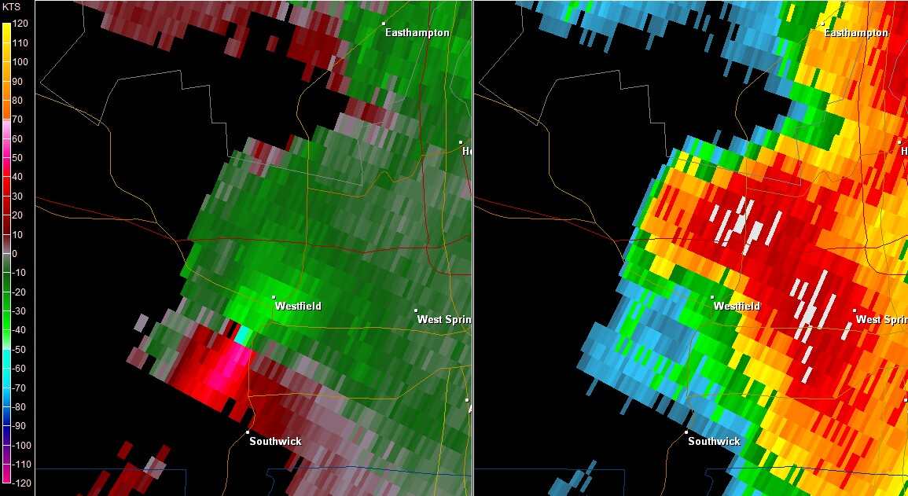
ENX Storm Relative Velocity & Base Reflectivity (0.5 Deg. Tilt) - 2016Z
Note appendage over Westfield, MA.
Gate to Gate Shear = 103 knots; Tornado began at 2017Z.

Slide 24
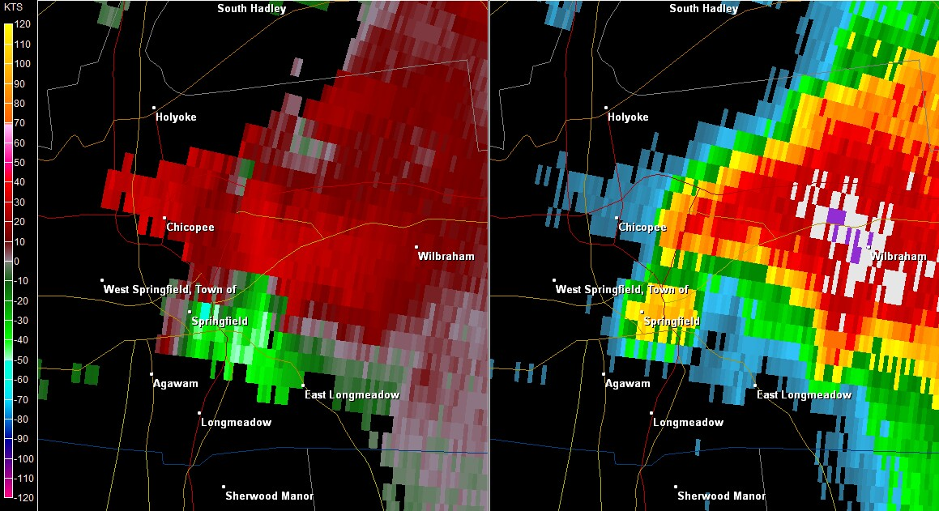
BOX Storm Relative Velocity & Base Reflectivity (0.5 Deg. Tilt) - 2036Z
Hook Echo; Tornado over Springfield, MA.
Hail Spike evident.

Slide 25
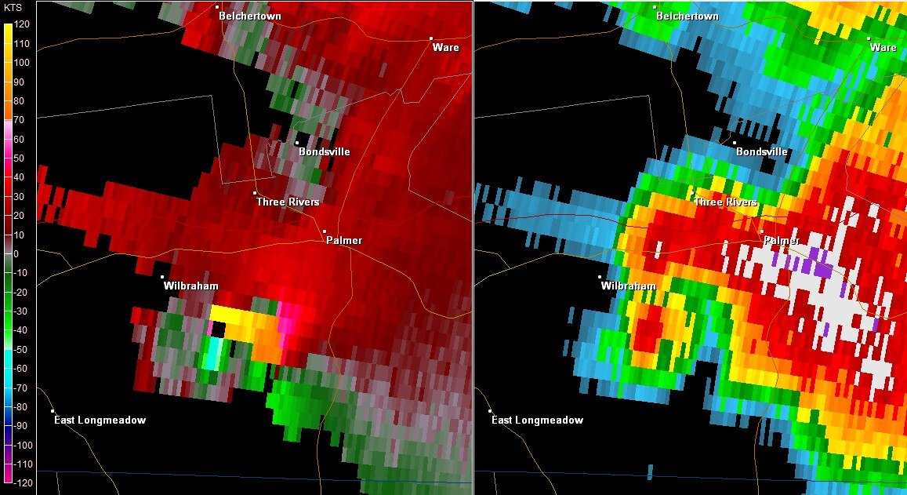
BOX Storm Relative Velocity & Base Reflectivity (0.5 Deg. Tilt) - 2051Z
Hook Echo better defined; Tornado entering Monson, MA.

Slide 26
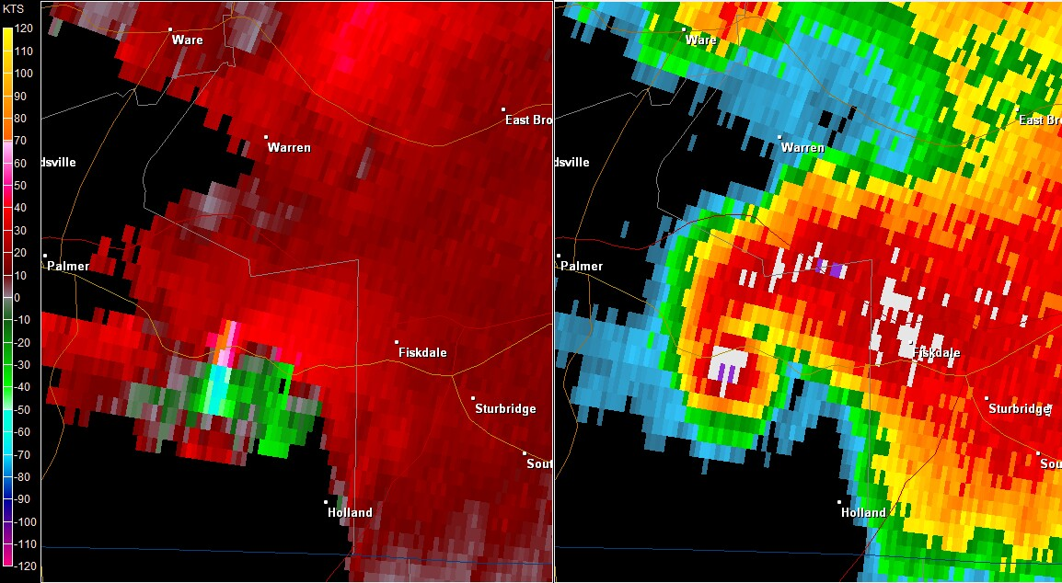
BOX Storm Relative Velocity & Base Reflectivity (0.5 Deg. Tilt) - 2104Z
Tornadic Debris Signature Spike.
Gate to Gate Shear = 123 knots; Tornado over Brimfield, MA.

Slide 27
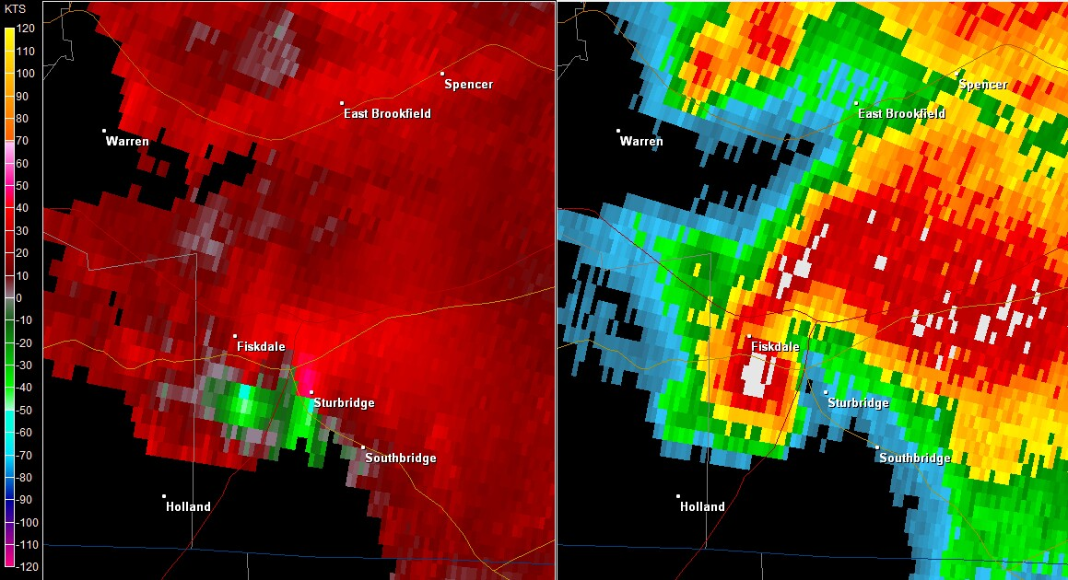
BOX Storm Relative Velocity & Base Reflectivity (0.5 Deg. Tilt) - 2113Z
Tornado in the vicinity of I-90 / I-84 Interchange.
Multiple Vortex evident in velocity data.

Slide 28
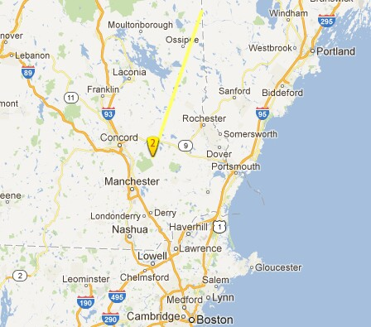
The July 24, 2008 NH Tornado
(Google)
  EF Rating: 2
  Path Length: 50 Miles
  Path Width: ½ Mile
  Deaths: 1
  Injuries: 2

Slide 29
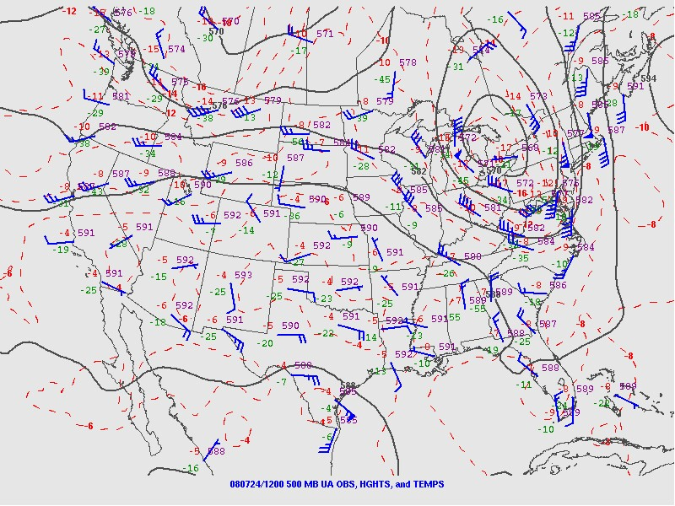
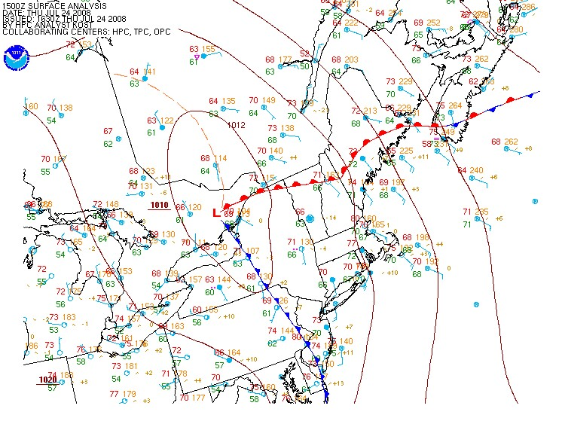
12Z 500 hPa Analysis (SPC) 15Z Surface Analysis
  Anomalous 500 hPa closed low; 50+ knot southerly flow.
  Surface warm front moving northward.
  South-Southeast flow with 70F+ Dewpoints.

Slide 30
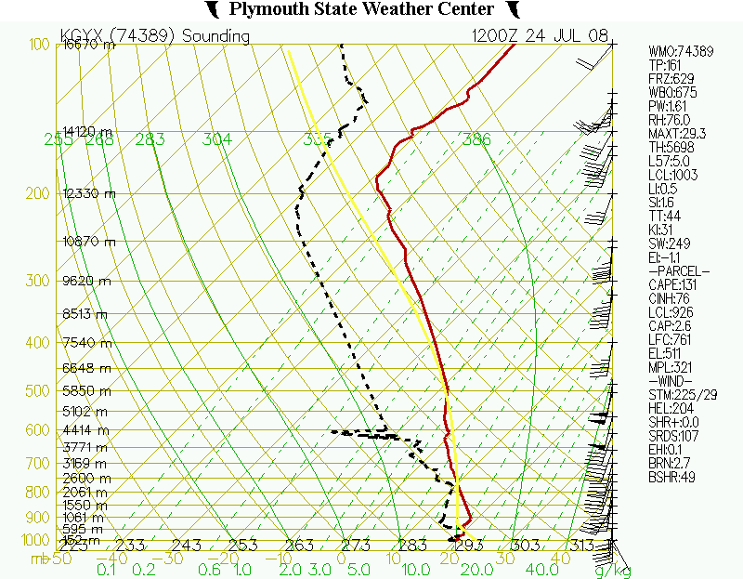
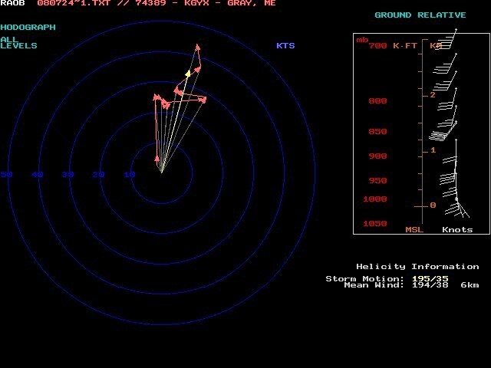
12Z GYX Sounding 12Z GYX Hodograph ( Lower 1 KM )
  Deep South-Southwest flow through the column.
  Modest directional and speed shear (lowest 1 KM).

Slide 31
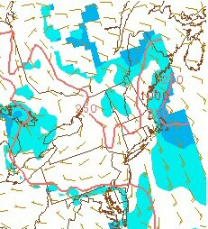
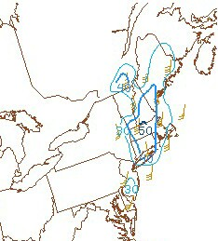
15Z ML Cape & CIN (SPC) 15Z Effective Bulk Shear (SPC)
  Low Cape – High Shear environment.

Slide 32
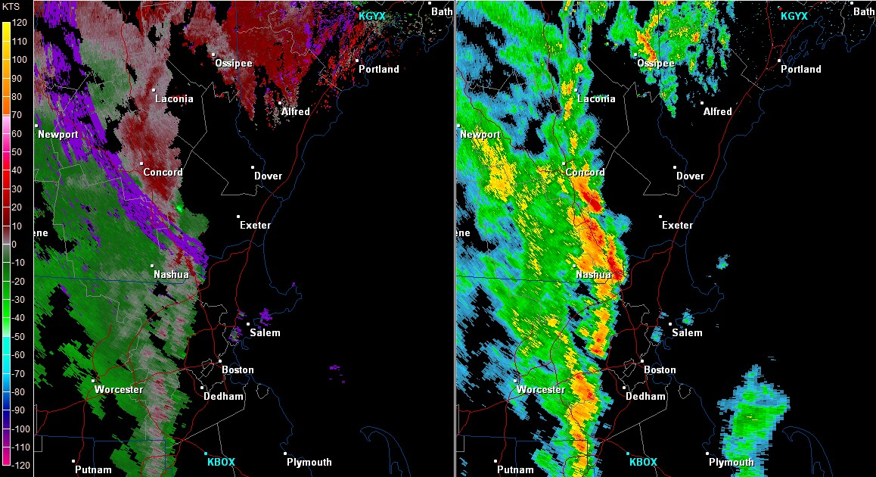
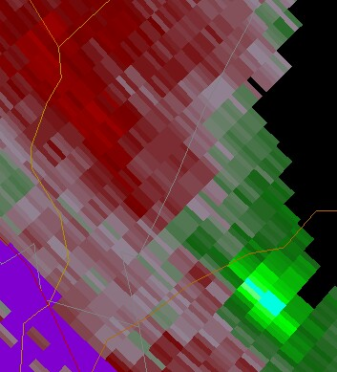
GYX Storm Relative Velocity & Base Reflectivity (0.5 Deg. Tilt) - 1520Z
GYX Radar indicated a broad circulation (left panel - inset)
Rotational Velocity = 37 knots.

Slide 33
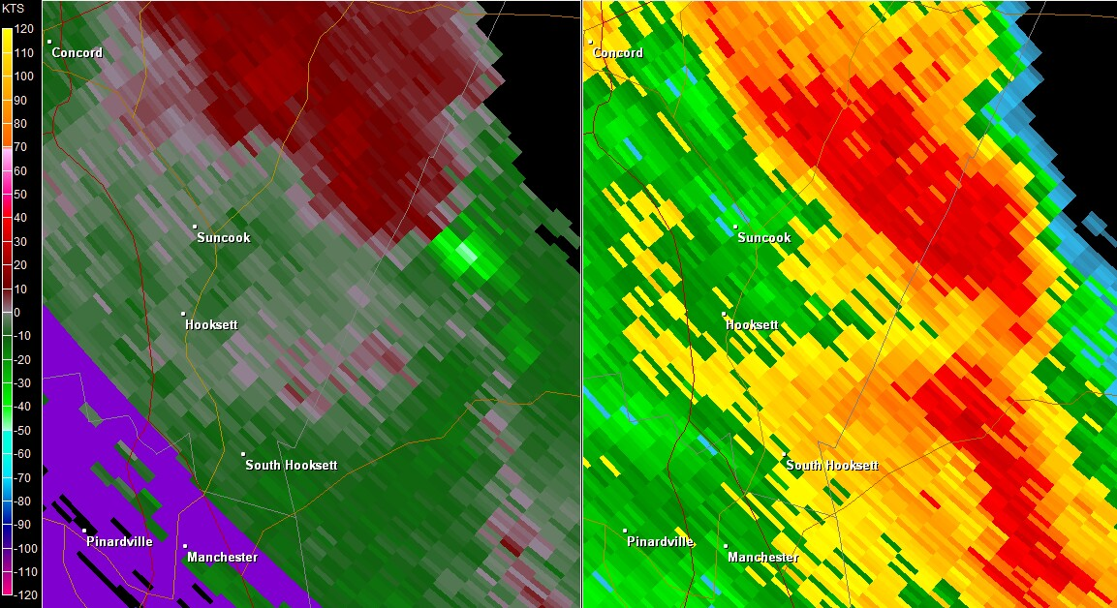
GYX Storm Relative Velocity & Base Reflectivity (0.5 Deg. Tilt) - 1529Z
Gate to Gate Shear = 54 knots; Tornado began at 1530Z.

Slide 34
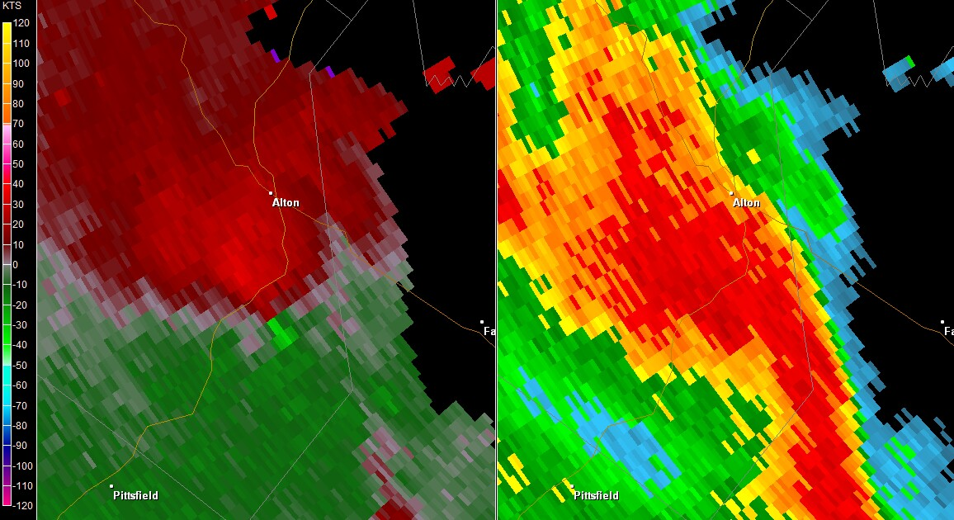
GYX Storm Relative Velocity & Base Reflectivity (0.5 Deg. Tilt) - 1557Z
Note “comma-like” appendage of higher reflectivity.

Slide 35
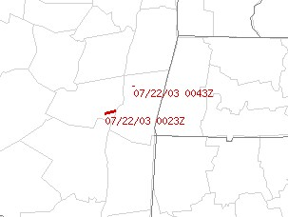
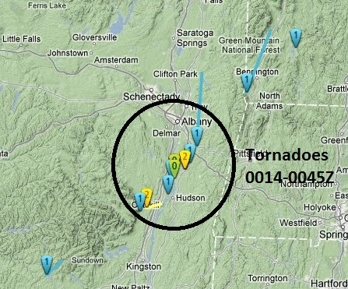
The July 21, 2003 NY Tornadoes
  EF Rating: 2
  Path Length: 1.5 Miles
  Path Width: 150 Yards
  Deaths: 0
  Injuries: 7
Map of F2 / > Tornadoes (SPC) Map of all Tornadoes (Google)
Tornado 1: 0023Z Tornado 2: 0043Z
EF Rating: 2
Path Length: 1.3 Miles
Path Width: 50 Yards
Deaths: 0
Injuries: 1

Slide 36
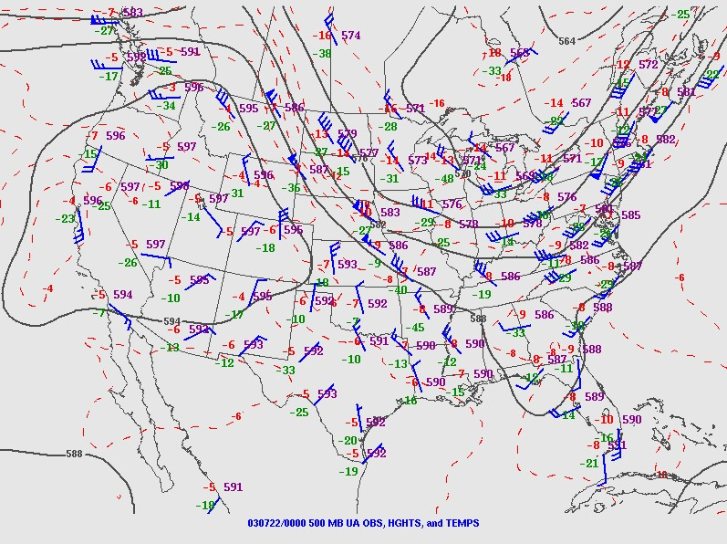
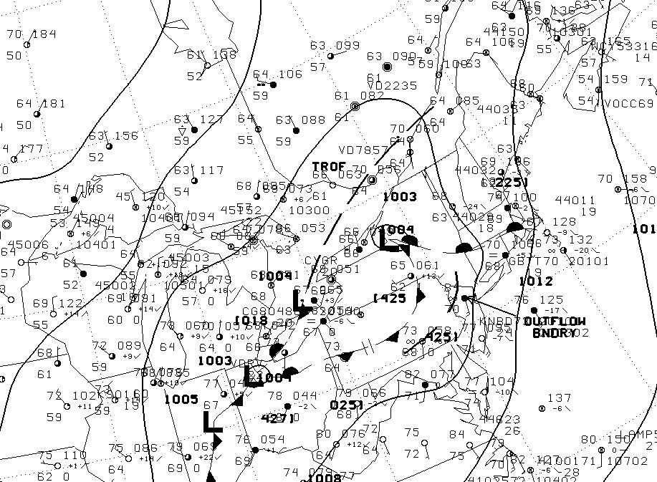
00Z 500 hPa Analysis 00Z Surface Analysis
  500 hPa Jet Maxima of 50+ knots moving through NY/PA.
  Warm front moving northward through the Hudson Valley,
  leading to southerly flow and 60F+ Dewpoints.

Slide 37
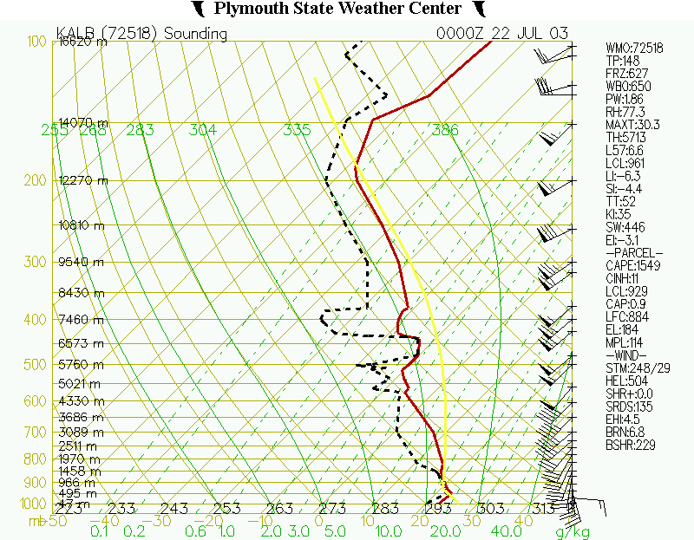
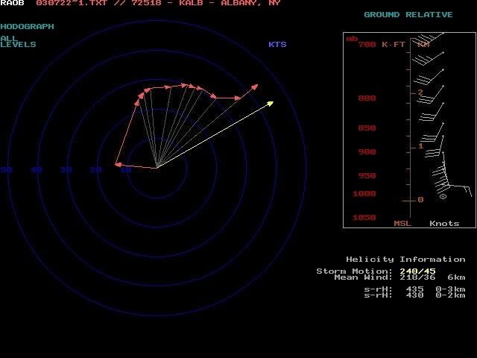
00Z Albany Sounding 00Z Albany Hodograph ( Lower 1 KM )
  Strong directional and speed shear.
  Long and clockwise Hodograph in the lowest 1 KM;
  large values of Storm-Relative Helicity.

Slide 38
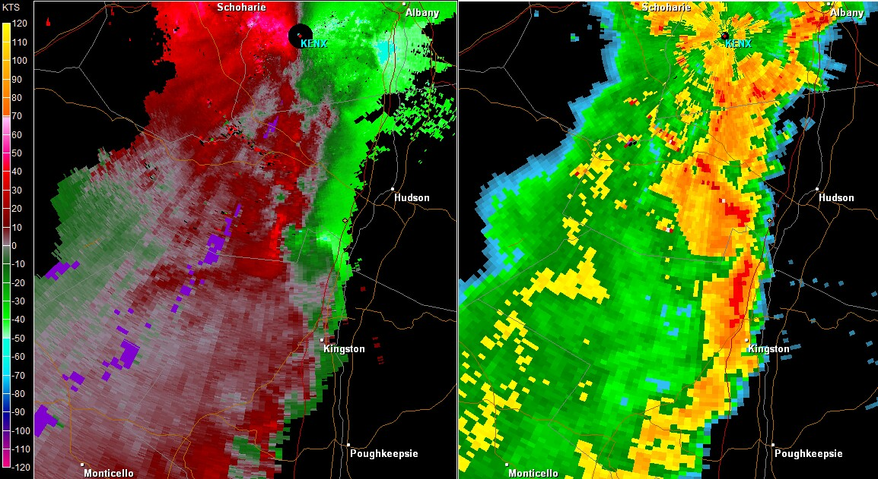
ENX Storm Relative Velocity & Base Reflectivity (0.5 Deg. Tilt) - 0009Z
Broad Mesocyclone; Rotational Velocity = 51 knots
Produced F1 Tornado in Sullivan County NY at 2320Z.

Slide 39
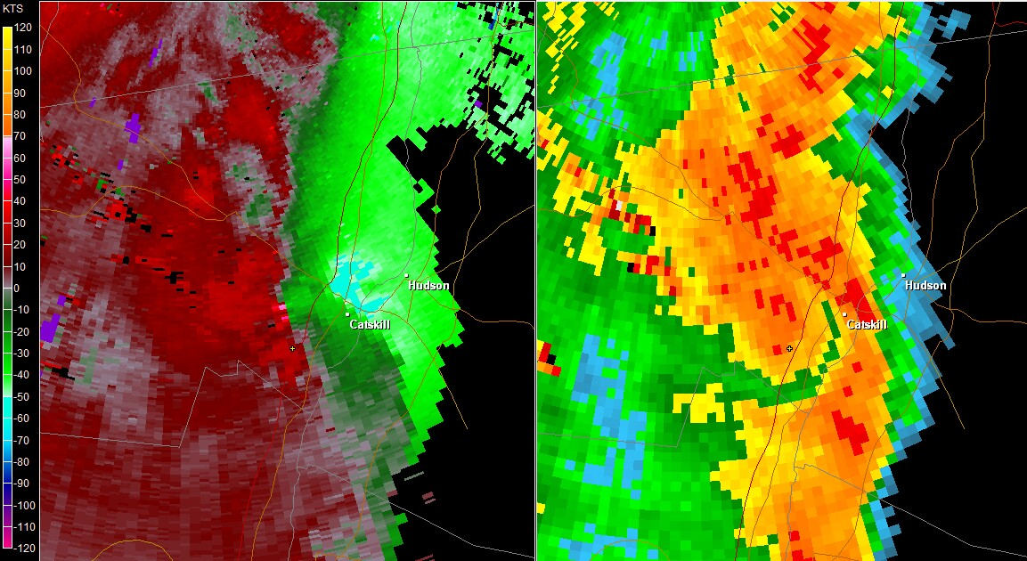
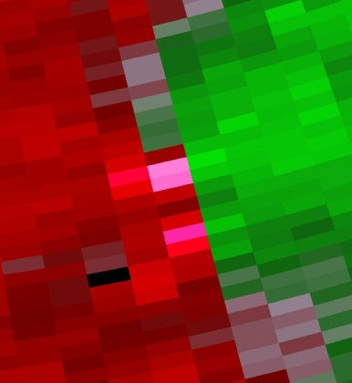
ENX Storm Relative Velocity & Base Reflectivity - 0020Z
Gate to Gate Shear = 96 knots; First F2 Tornado began at 0023Z.

Slide 40
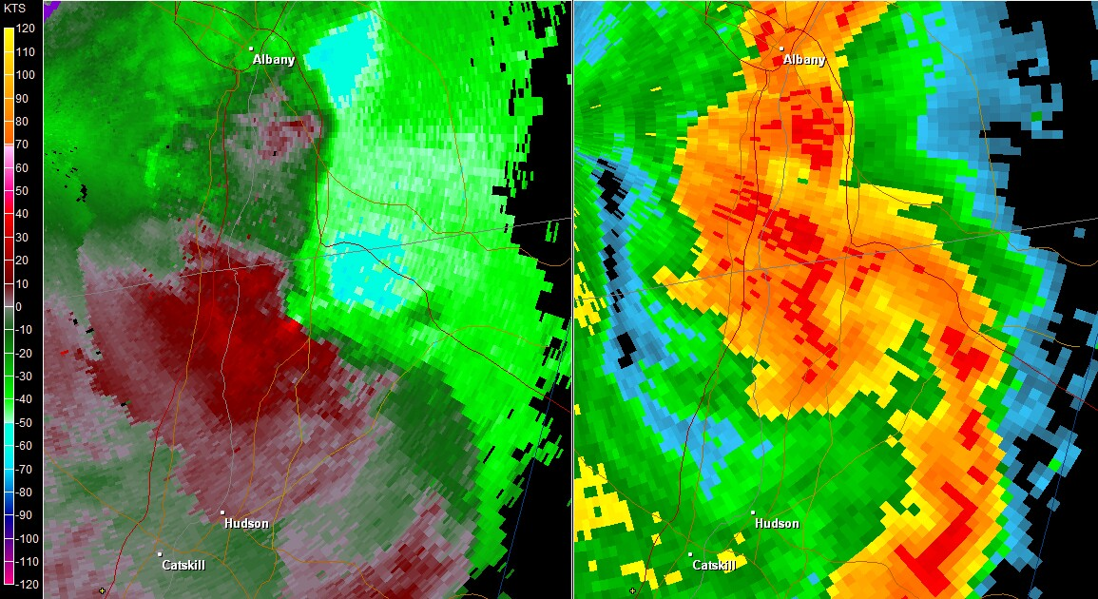
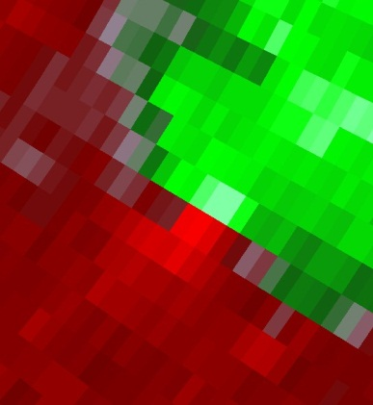
ENX Storm Relative Velocity & Base Reflectivity - 0040Z
Gate to Gate Shear = 87 knots; 2nd F2 Tornado began at 0043Z.
Produced 3 additional F1 tornadoes in the following 70 minutes.

Slide 41

The August 10, 2012 EF-0 Tornadoes
  EF Rating: 0
  Path Length: 4.5 Miles
  Path Width: 150 Yards
  Deaths: 0
  Injuries: 0
(Google)
Tornado 1: 1806Z Tornado 2: 1957Z
EF Rating: 0
Path Length: 4 Miles
Path Width: 20 Yards
Deaths: 0
Injuries: 0

Slide 42
These tornadoes were associated with a Mesoscale Convective System (MCS) and an attendant Mesoscale Convective Vortex (MCV). There was also a microburst in Glastonbury, CT.
What is an MCV?
  A cyclone within an MCS.
  Ranges from 30 to 180 Miles in Diameter.
  May persist even after the MCS itself has dissipated.
Essentially, the MCS develops the characteristics of a warm-core system, similar to that of a tropical cyclone. But the strongest circulation is in the mid-levels of the atmosphere. It may also
be reflected at the surface as a small area of low pressure.

Slide 43


The Long Island Tornado
OKX Storm Relative Velocity & Base Reflectivity (0.5 Deg. Tilt) - 1800Z
Tornado began at 1806Z.

Slide 44


The Block Island Tornado
OKX Storm Relative Velocity & Base Reflectivity (0.5 Deg. Tilt) - 1957Z
Gate to Gate Shear = 60 knots; Tornado began at 1957Z.

Slide 45


The Mesoscale Convective Vortex (MCV)
OKX Storm Relative Velocity & Base Reflectivity (0.5 Deg. Tilt) - 2027Z
The MCV circulation intensified over CT; note eye-like feature.
The Glastonbury, CT microburst occurred at 2030Z ~ 100 mph.

Slide 46
WSR - 88D Characteristics of Significant Tornadoes in
New York and New England
Lance Franck
University of Massachusetts Lowell
Hayden Frank
NOAA/NWS/Weather Forecast Office, Taunton Massachusetts

