Slide 1
July 26, 2018
EF1 Tornado Strikes Central MA Between 230 and 245 AM
NOAA/National Weather Service
Boston/Norton, MA
Tri-State Weather Conference
September 29th, 2018

Slide 2
Overview: July 26, 2018 EF1 Tornado
A tropical environment was in place with Pwats over 2 inches.
A shortwave/cold front was approaching the region with an impressive southerly low level jet of 30-40 knots.
Greatest concern was localized flash flooding as impressive low level jet/high Pwat axis combined with strong forcing.
Forecasters were aware about the low probability for isolated severe weather including a tornado. Some guidance indicated a meso low, but struggled with how quickly it would develop and where it would track.
An initially rotating storm south of Long Island, spawned special marine warnings around midnight before weakening.
Shortly before 230 am, the couplet began to regenerate and quickly resulted in an EF1 tornado that touched down in Douglas. The tornado tracked northeast about 4.5 miles before a brief second touchdown in Upton. No injuries were reported, but some trees fell on houses and damaged roofs.

Slide 3
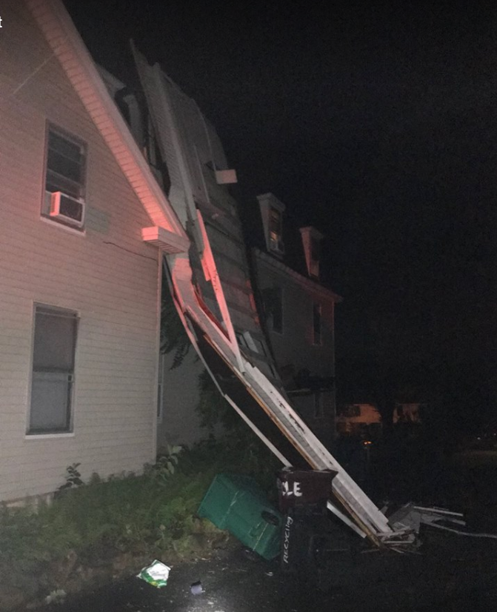
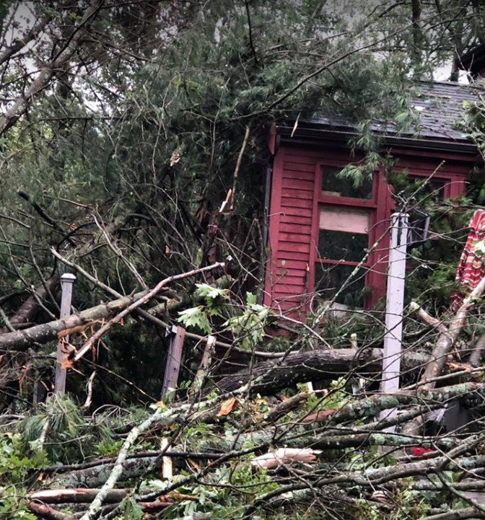
EF-1 Tornado Damage From Douglas/Upton MA
Images Courtesy of Boston/Norton Amateur Radio Group

Slide 4
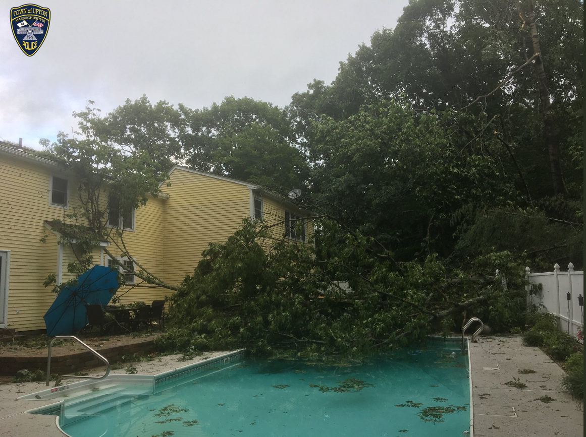
Upton, MA EF1 Tornado Damage
Image Courtesy of the Upton Police Department

Slide 5
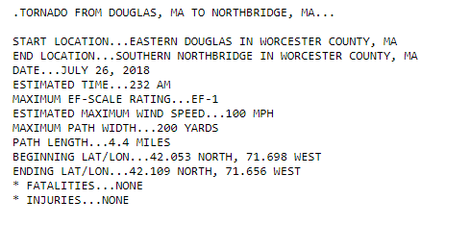
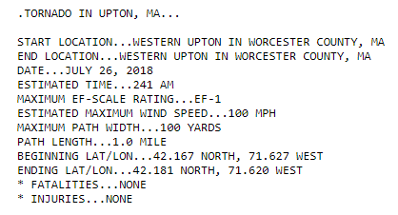

Slide 6
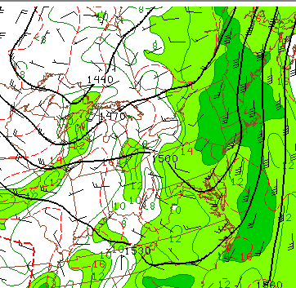
SPC: Meso- Analysis: Valid 6Z July 26th
850 MB Low Level Jet
Impressive 850 mb low level jet of 30 to 40 knots ahead of an approaching shortwave and cold front.
Approximately 30 minutes before the tornado touches down in East Douglas, MA.

Slide 7
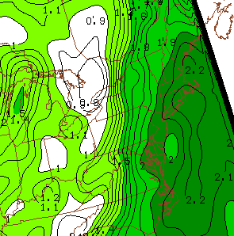
SPC: Meso- Analysis: Valid 6Z July 26th
Pwat Axis: Valid 6z
Pwats over 2 inches along with the strong low level jet + approaching shortwave.
Greatest concern was the potential for localized flash flooding, with the lower risk for isolated severe weather.

Slide 8
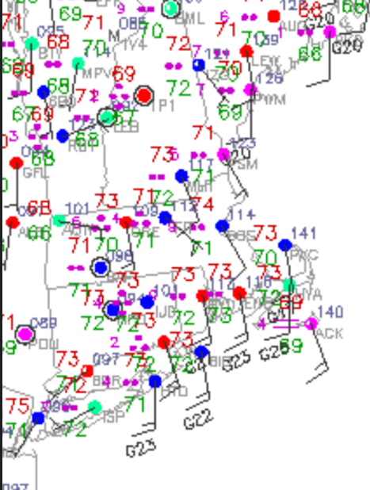
Surface Analysis: Valid 6Z July 26th
Station Plots
Station observations indicated a weak meso low in the vicinty of central MA.
Classic tropical tornado with 70+ dewpoints and extremely low LCL/s.
Backed surface winds in this region was probably a big factor in spinning up the tornado 30 minutes later.

Slide 9
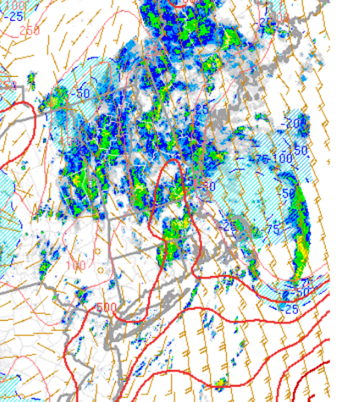
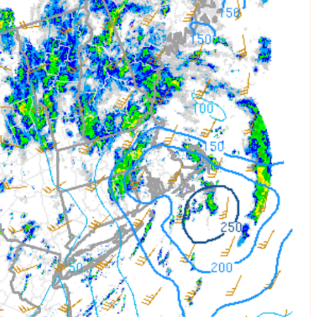
SPC: Meso- Analysis: Valid 6z July 26th
Surface Cape: Valid 6z
0 to 1 KM Helicity
500+ J/KG of Cape coupled with 0-1 KM helicity around 200 units. Favorable.
0-1 KM helicity may have been higher in vicinity of meso-low

Slide 10
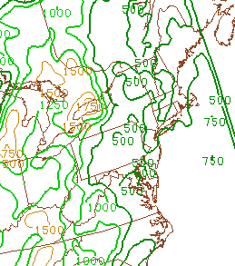
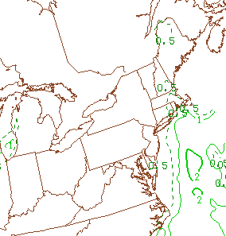
SPC: Meso- Analysis: Valid 6z July 26
LCL Heights
0 to 1 KM EHI
Extremely low LCL/s around 500 meters.
Low level EHI exceeding 0.5 may also have been a helpful clue.

Slide 11
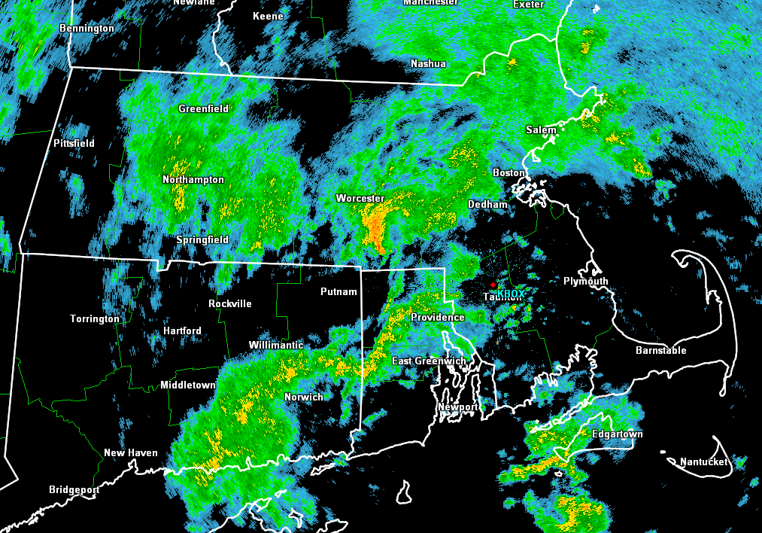
0.5 Reflectivity at 630Z
Despite harmless looking showers with no lightning, a tornado was touching down in Douglas, MA.
A closer look may reveal the meso-low spinning in central MA.

Slide 12
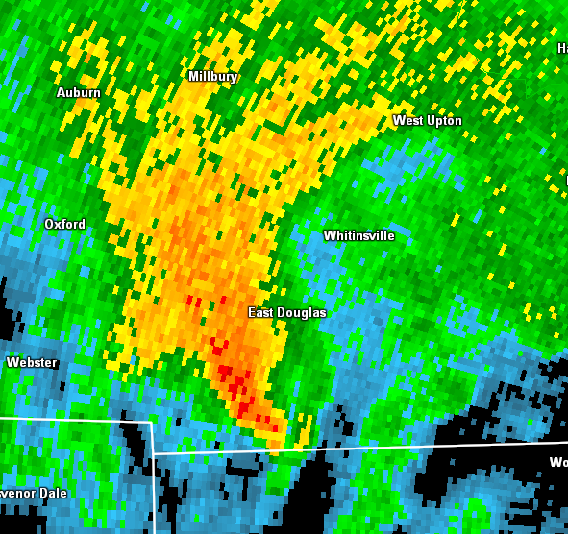
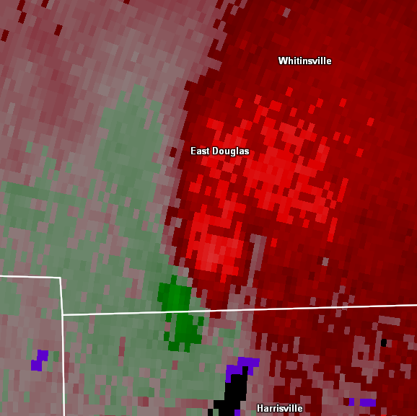
0.5 REF: 624Z
0.5 SRM: 624Z
Broad but somewhat symmetrical rotation about 5 minutes before tor.
Rotational velocity of around 22 knots.

Slide 13
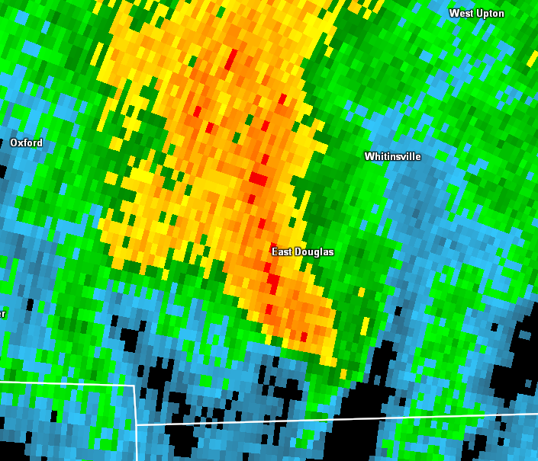
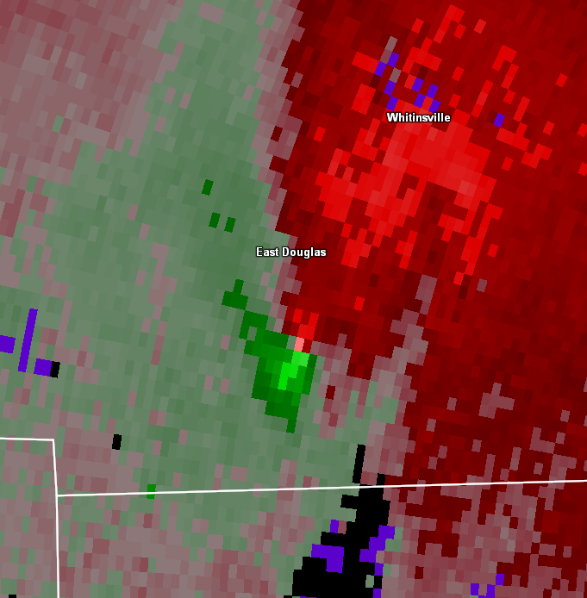
0.5 REF: 627Z
0.5 SRM: 627Z
Gate to gate shear of 65 knots only 1600 feet from the radar. Given very low LCL/s not too hard to get that circulation on the ground.
Environment very favorable for tropical tornado touchdowns.

Slide 14
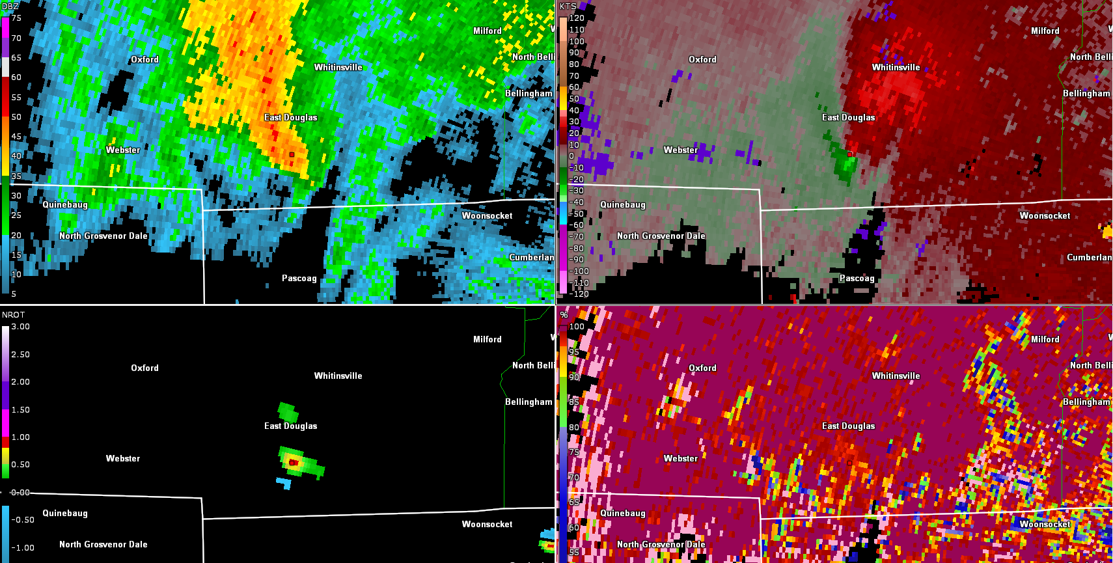
0.5 Reflectivity: 627z
0.5 SRM: 627z
0.5 NROT: 627z
0.5 CC: 627z
The 65 knots of gate to gate shear had an NROT of 0.85.
CC over the circulation is 0.98, so no confirmed radar touchdown yet.

Slide 15
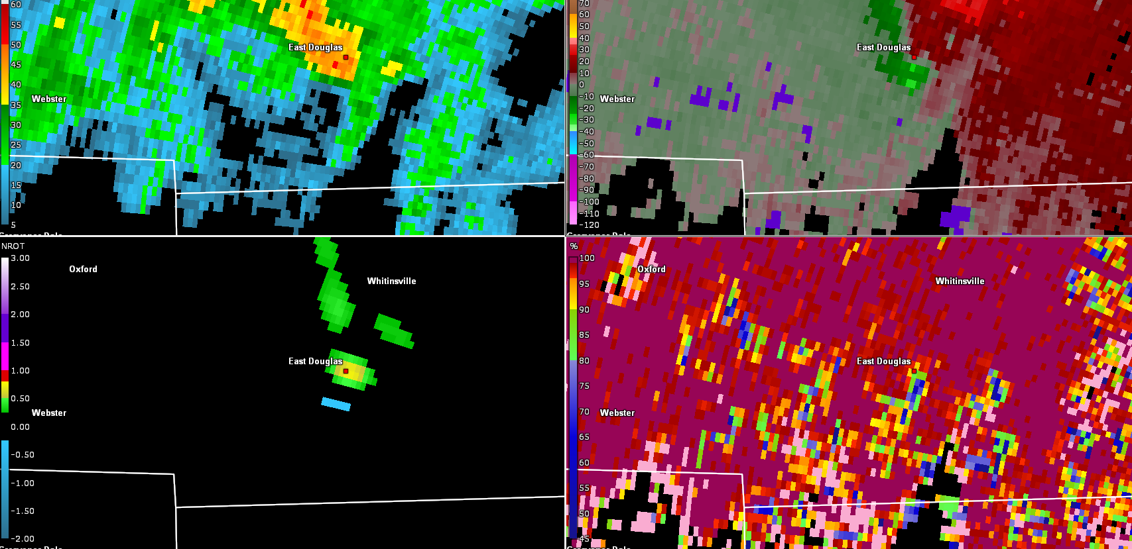
0.5 Reflectivity: 630z
0.5 SRM: 630z
0.5 NROT: 630z
0.5 CC: 630z
Although couplet weakened, radar indicates at least a brief touchdown.
Look for the three criteria to confirm touchdown.
SRM couplet, CC<0.90, and reflectivity>30 dbz.
Possible tornado lifted, but debris may remain lofted.

Slide 16
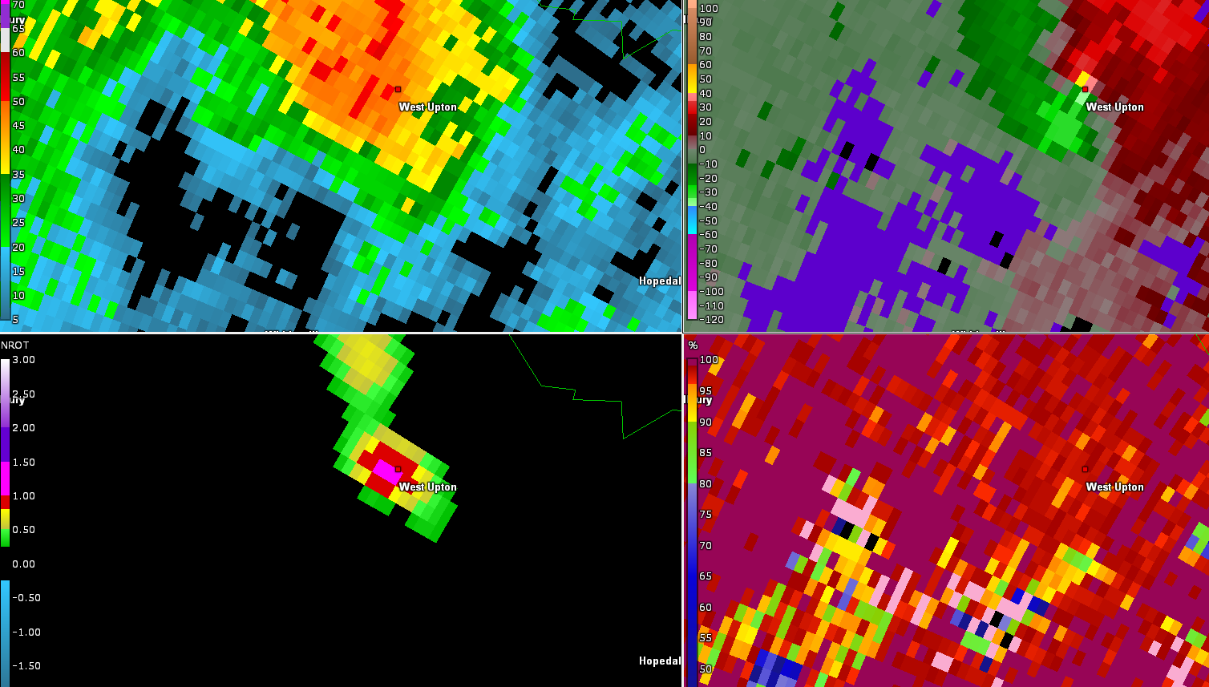
0.5 Reflectivity: 641z
0.5 SRM: 641z
0.5 NROT: 641z
0.5 CC: 641z
Tornado had lifted earlier, but couplet tightens dramatically at 641z.
Gate to gate shear of 80 knots/NROT over 1.
Despite the very impressive signature, we do not have a radar confirmed touchdown. CC well above 0.90.

Slide 17
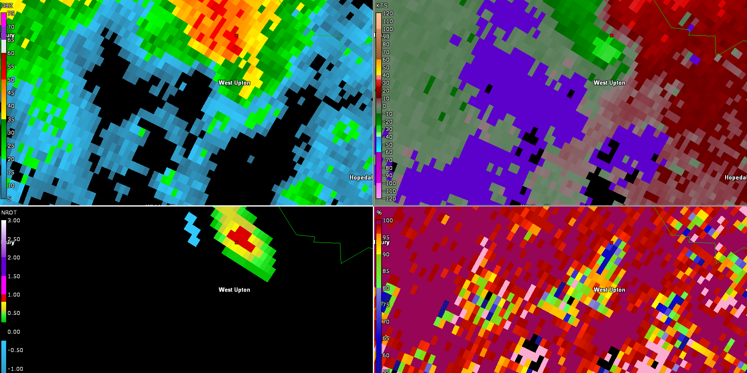
0.5 Reflectivity: 644z
0.5 SRM: 644z
0.5 NROT: 644z
0.5 CC: 644z
Couplet weakens, but we know that a tor has at least touched down.
SRM couplet, reflectivity > 30 DBZ, and CC<0.90.
Debris can remain lofted in the air behind the storm/couplet even after tornado has lifted.

Slide 18
Lessons Learned From This Event
Situational awareness is extremely important. Sometimes what appears to be the lower threat ends up becoming the main impact.
If there is any concern about tornadoes definitely utilize Sails 3.
Tornado warning thresholds may be lower in tropical environments given low LCL/S. This storm was being sampled from about 1500 feet, not too hard to get the rotation to the ground.
Gate to gate shear of 50+ knots with NROT near 1 should be considered for tornado warnings. We will have false alarms, but there is no other way to be able to give much lead time.
The CC in this case was messy and tough to discern in real time. If this is the case, defer that to another person if possible.

