Slide 1
A New View of Our Skies: The GOES-R Satellite Series in Action
Eleanor Vallier-Talbot
NOAA/National Weather Service
Boston/Norton, MA

Slide 2
GOES 16/17 Instruments
Advanced Baseline Imager (ABI)
Primary instrument for processing imagery
Multichannel imaging radiometer
Cloud, Moisture, Particulate & Temperature
data for wide variety of products
Geostationary Lightning Mapper (GLM)
Data captured in Events, Groups & Flashes

Slide 3
GOES 16/17 Instruments
Space Weather Instruments
Solar Ultraviolet Imager (SUVI)
Extreme Ultraviolet & X-Ray Irradiance sensors (EXIS)
SUVI & EXIS measure UV light & X-rays
Space Environment In-Situ Suite (SEISS)
Measures emission of Magnetosphere particles
Magnetometer (MAG)
Monitors sun’s geomagnetic field

Slide 4
GOES 16/17 Products
16 Main Channels
2 Visible
4 Near Infrared (NIR)
10 Infrared
Two Channel Differences Imagery
Multispectral Red-Green-Blue Composites
Simple and Advanced

Slide 5
GOES 16/17 Imagery
Visible
Red/Blue channels
Near IR
High clouds (Cirrus)
Vegetation (“Veggie”)
Snow/Ice
IR
Low, mid and upper tropospheric levels
Ozone
Cloud Top Phase
CO2

Slide 6
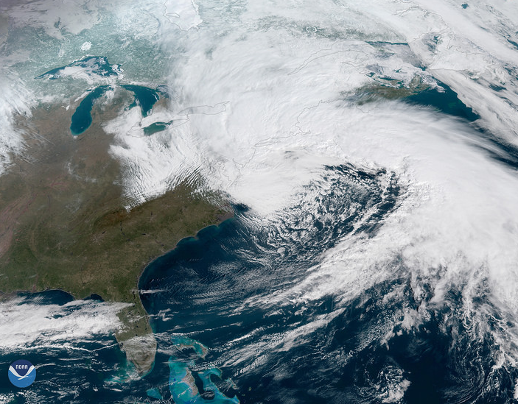
Nor’easter – March 1-3, 2018
GOES-East Visible Satellite imagery
Highest Wind Gusts –
97 mph – Wellfleet, MA
95 mph – Chatham, MA
93 mph – Barnstable, MA

Slide 7
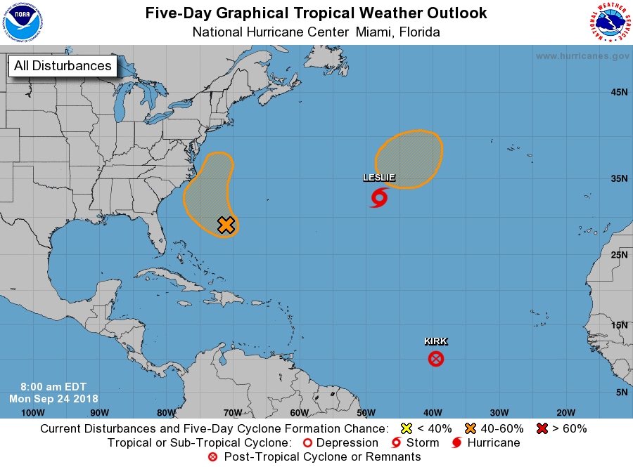
GOES-16 Infrared “Clean”

Slide 8
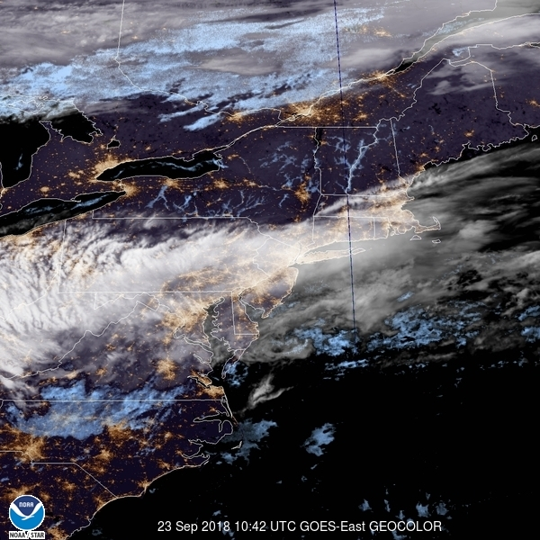
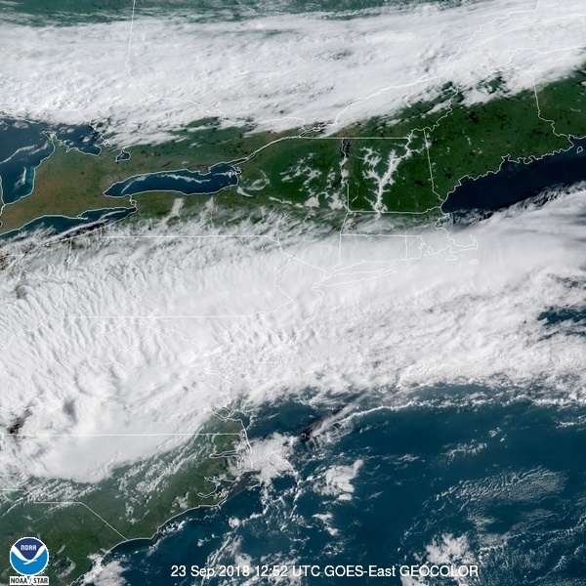
GOES 16 GeoColor Day/Night Imagery
Multispectral IR
True Color
“Visible at Night”
Credit: GOES East Image Viewer
https://www.star.nesdis.noaa.gov/GOES/

Slide 9
Natural Color Images
Credit:
Scott Bachmeier
@CIMSS_Satellite on Twitter
GOES-East Red/Veggie Pseudo (Green/Blue Color) – 21Sep2018 – 1732UTC

Slide 10
GOES Two Channel Difference Products
Based on Brightness Temperature Differences (BTD)
Products
Split Window Difference (SWD) – 10.3 µm - 12.3 µm
Difference in Water Vapor absorption
Key absorption differences in airborne dust
10.7 µm - 3.9 µm
Detects water based clouds at night, including fog/low stratus
8.6 µm – 10.7 µm
Absorption differences in ice clouds

Slide 11
Channel Difference Product
Credit:
NOAA/NESDIS,
VISIT, SHyMET,
CIRA, RAMMB
Split Window Difference
Used in Convective Initiation even before clouds develop (picks up boundary/convergence zone)
Identifies new convection that will eventually develop into mature thunderstorms
Convective case in Texas Panhandle 15May2018
http://rammb.cira.colostate.edu/templates/loop_directory.asp?data_folder=training/visit/loops/29may18/swd/swd_4panel&loop_speed_ms=60
Credit: Lindsay, Daniel, et al, BAMS – August 2018
Using the GOES-16 Split Window Difference to Detect a Boundary prior to Cloud Formation

Slide 12
Split Window Difference Product
Use Difference to see Increasing or Decreasing Atmospheric Moisture
April 7, 2017 – South Central U.S.
High pressure shifts east to Mississippi Valley while weak trough moves across WY/CO into central Plains
NON severe weather day, shows increasing humidity
http://cimss.ssec.wisc.edu/goes/blog/wp-content/uploads/2017/04/SWD_1430UTC_07Apr2017_with850Dewpoints_Defaults_toggle.gif

Slide 13
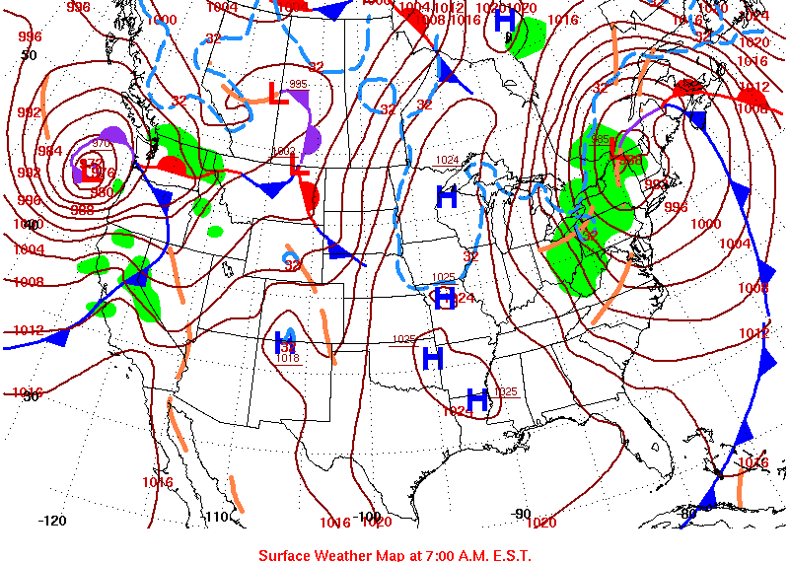
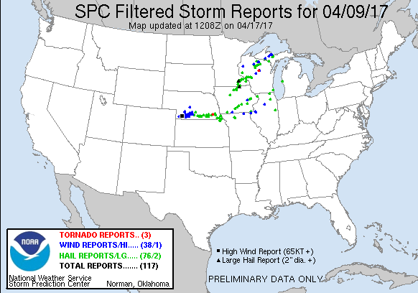
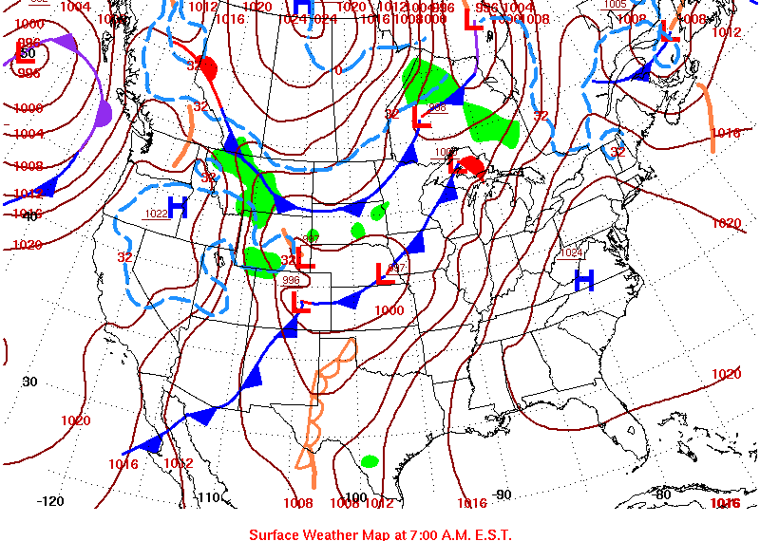
“Priming the Atmosphere”
April 7, 2017
Credit:
NWS/Storm Prediction Center
and CIMSS Satellite Blog
April 9, 2017

Slide 14
RBG Composites
MeteoSat developed sets of “recipes” (second generation) in the early 2000s
Creates image data with specific wavelength ranges within electromagnetic spectrum
Blend of brightness temperatures and/or temperature differences
Qualitative false color images designed to enhance specific features:
Low Clouds/Fog -- Fires/Hot Spots
Atmospheric Dust -- Smoke Plumes
Convection -- Snow/Ice
Air Mass Characteristics – Volcanic Ash

Slide 15
RBG Composites
Applications
Cloud phase & height analysis
Distinguishing fog vs. low clouds
Identifying & tracking airborne objects such as volcanic ash, blowing dust, fire hot spots
Determine strong convection, jet streaks, ice content, moisture areas, etc.

Slide 16
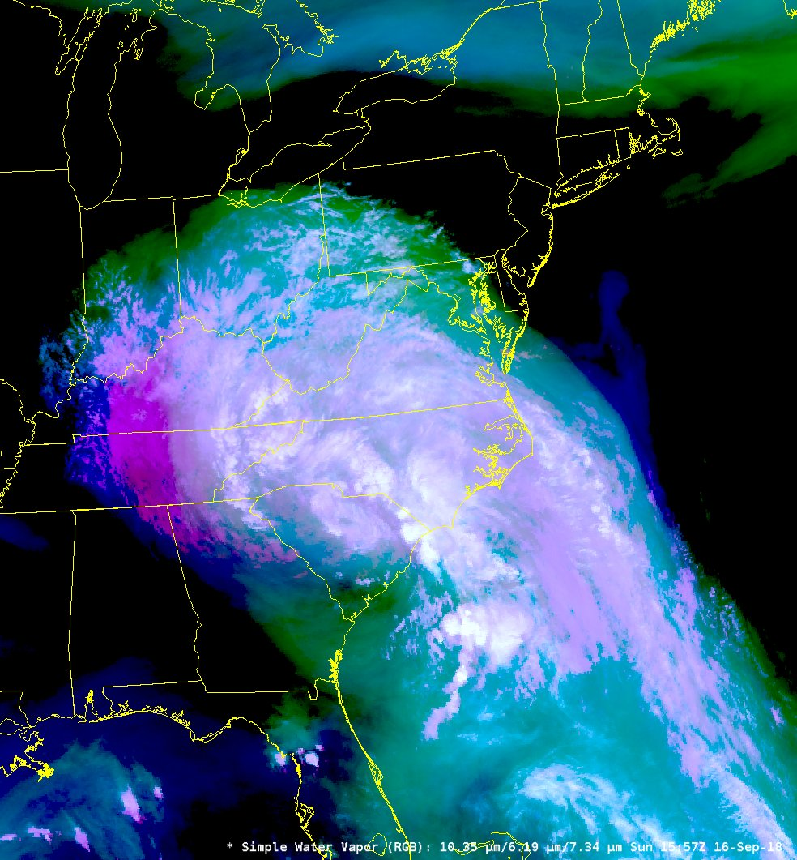
“Simple” RBG Composite
Simple Water Vapor
Hurricane Florence
16-Sep-2018
1557 UTC
Credit:
NASA SPoRT

Slide 17
Air Mass RGB
Inference of cyclogenesis
Used to diagnose environment around synoptic weather systems
Enhanced air mass temperature/moisture characteristics
Validate location(s) of potential vorticity anomalies in model data
Difficult to delineate difference in high heat situations (desert)

Slide 18
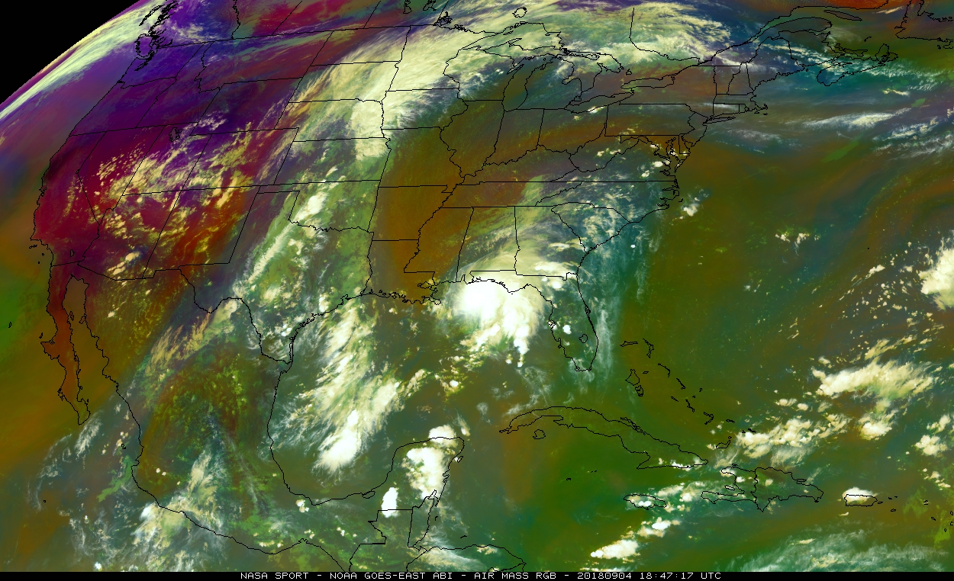
Tropical Storm
Gordon
Credit:
NASA SPoRT
Air Mass RGB Composite
September 4, 2018 – 1847 UTC

Slide 19
Dust RGB
Difficult to see in Visible and Infrared Satellite imagery
Similar to other cloud types
Uses band differencing and IR thermal channel to contrast airborne dust
Also uses particle phase, optical depth and cloud thickness especially in the Red color band to determine dust areas vs. clouds

Slide 20
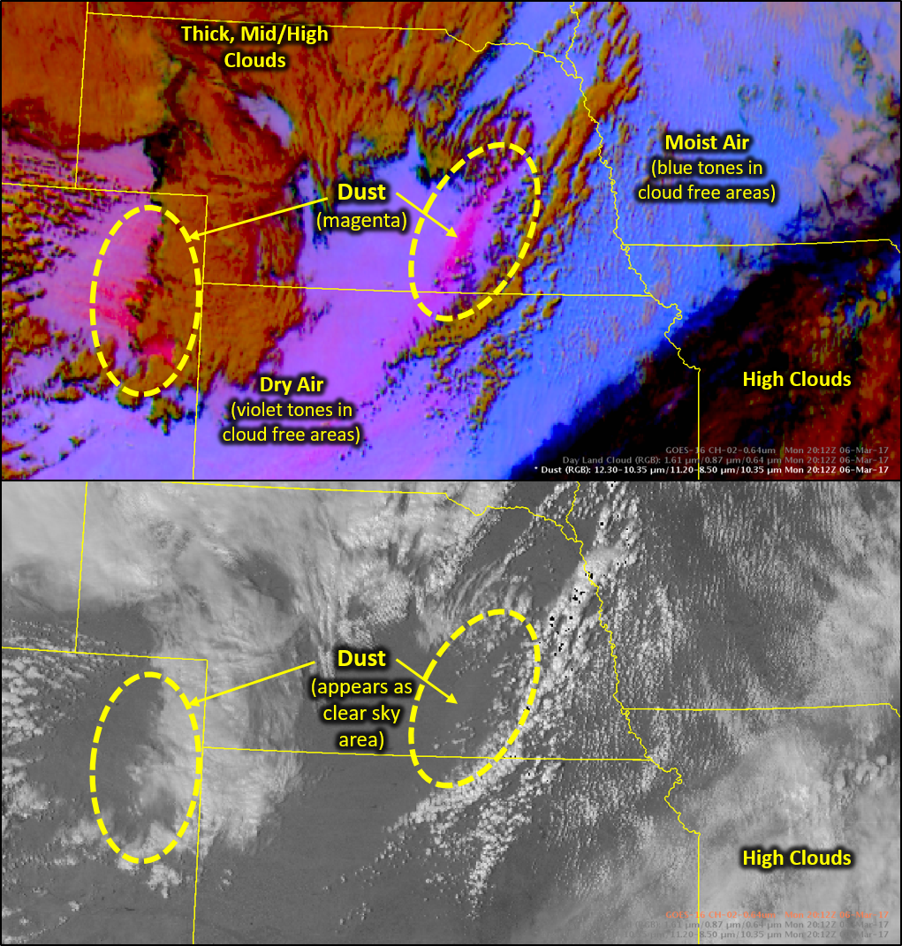
March 6, 2017
Credit:
Kevin Fuell
NASA SPoRT

Slide 21
Day Convection RGB
Identifies intense updrafts indicative of strong convection
Look for the YELLOW! Using the 3.9 µm identifies small ice particles
Particles don’t grow with intense updrafts
Differentiates between new and mature convection
Orange/Red = Dissipating convection
Yellow = Strengthening convection

Slide 22
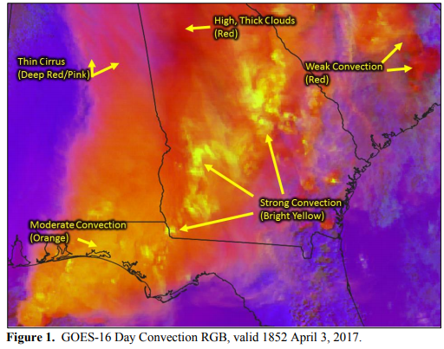
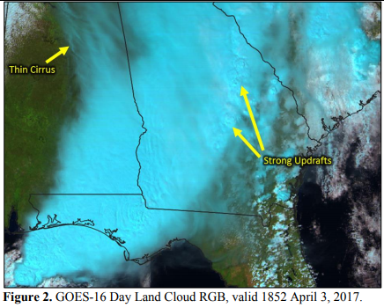
Credit:
Kris White/NWS Huntsville, AL
Contribution to NASA/SPoRT
Application Library
https://weather.msfc.nasa.gov/sport/training/AppLib/1min/Applib_1min_SPoRT_20170403_DtConvRGB_CONUSESE_SvrStrmGA.pdf

Slide 23
Nighttime Microphysics RGB
Distinction between low clouds/fog
Two channel differences used
10.4 µm - 3.9 µm and 12.4 µm - 10.4 µm
Excellent delineation between cloud heights
Overnight cloud/fog show from New England on September 24
Credit:
NASA SPoRT
https://twitter.com/NWSBoston/status/1044133171510554624

Slide 24
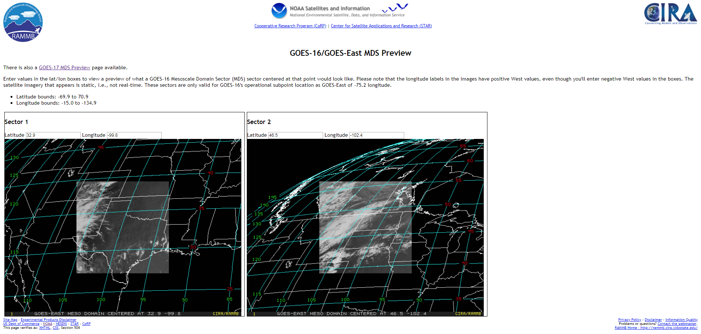
GOES-16/East Mesoscale Domain Sector (MDS) Preview
One minute, movable 1000 km²
satellite sectors
Two sectors available from GOES 16 & 17 by local NWS WFOs
Also available from
GOES-17
(Change 16 to 17
in URL)
http://rammb.cira.colostate.edu/products/goes-16_mds_preview/

Slide 25
Hurricane Ophelia – October 16, 2017
Category 3 hurricane on October 14 across the eastern Atlantic before rapid extratropical transition
Development of a “sting jet” during transition as the storm moved across the United Kingdom and Ireland
Gust up to 103 knots reported (SW Ireland)
http://cimss.ssec.wisc.edu/goes/blog/page/3?s=sting+jet

Slide 26
Credits
NASA/NOAA GOES-R website
www.goes-r.gov
Cooperative Institute for Meteorological Satellite Studies (CIMSS)
NASA Short Term Prediction Research & Transition (SPoRT) Center
CIMMS Satellite Blog
College of DuPage NEXLAB Experimental Satellite
https://weather.cod.edu/satrad/exper/

