Slide 1
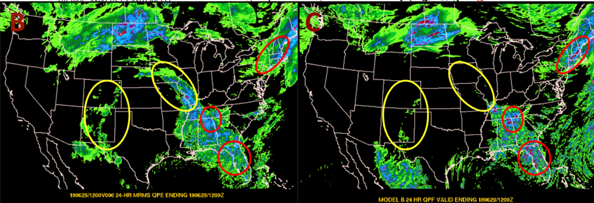
Novel Ways To Access and Visualize Model Biases at the Weather Prediction Center
Michael Erickson¹² and James A. Nelson¹
WCSU Tri-State Weather Conference
Danbury, CT
29 September 2018
¹National Oceanographic and Atmospheric Administration, Weather Prediction Center, College Park, MD
²CIRES, University of Colorado Boulder, Boulder, CO
Images provided by Ben Albright; WPC

Slide 2
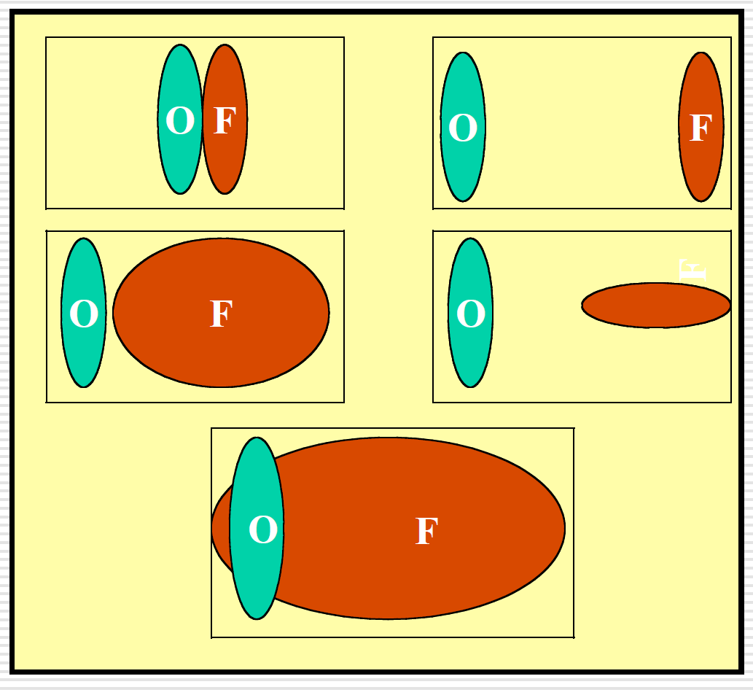
Why Track Objects?
Output from Quantitative Precipitation Forecasts (QPF) look like coherent objects.
Humans automatically evaluate QPF “goodness” by eye.
Standard verification doubly penalizes models for a displaced forecast. A model that forecasted no object would score better.
Object-oriented verification of QPF objects allows for a more intuitive type of verification that assesses:
Object displacement
Object area
Object intensity
Object orientation
Object initiation/dissipation
Forecast Vs Observations
Davis et al. (2006) and Gilleland et al. (2007)

Slide 3
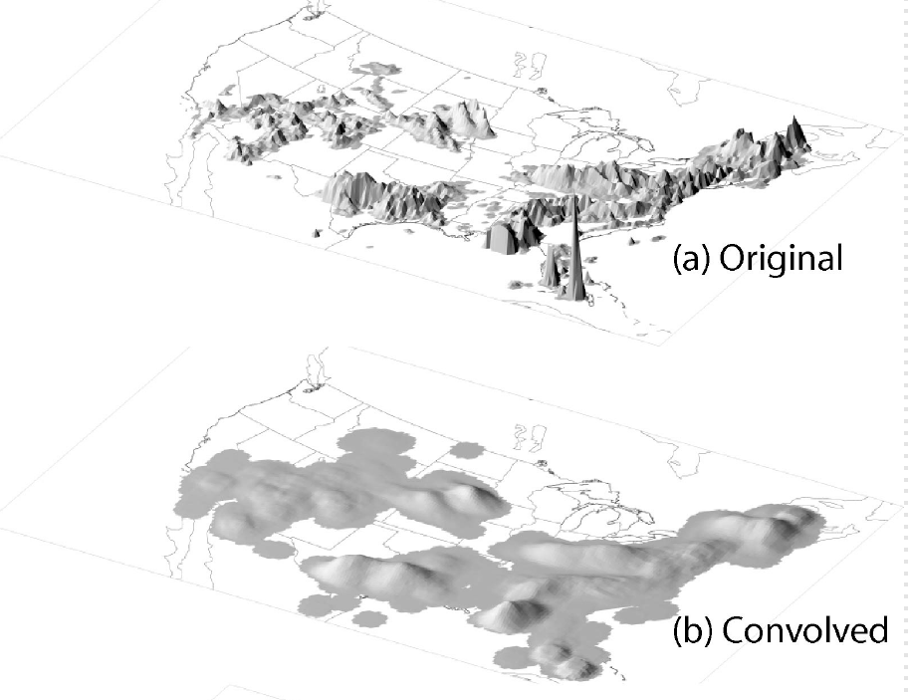
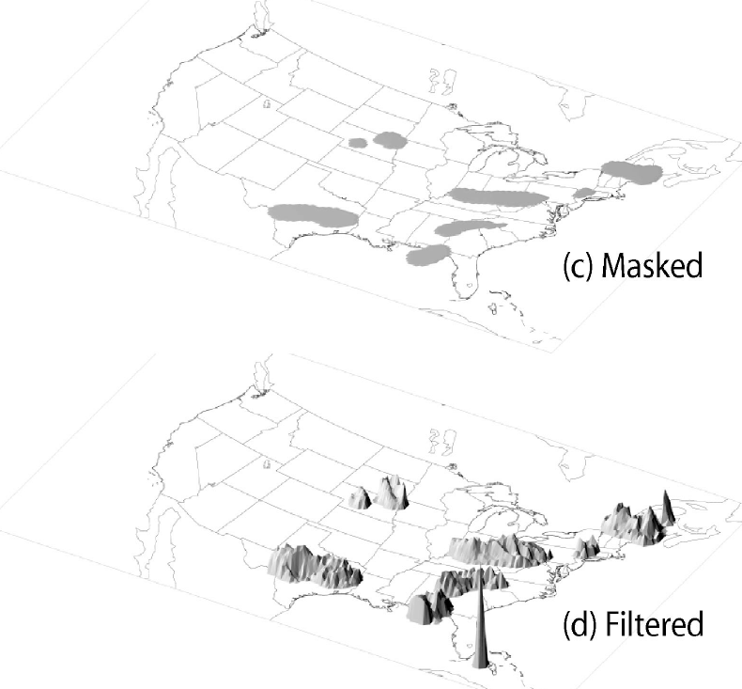
Tracking QPF Objects – Identification
The Model Evaluation Tools (METv6.0) Method for Object-based Diagnostic Evaluation Time-Domain (MTD) is used to track precipitation objects.
The identification of precipitation objects involves 3 steps:
Convolution (smoothing) of the raw precipitation field to remove noise and identify cohesive objects.
Masking the precipitation data below a specified threshold to identify objects of sufficient intensity.
Filtering (retaining) the raw precipitation data inside the objects identified and removing all other data.
Steps Toward Object ID
Davis et al. (2006)

Slide 4
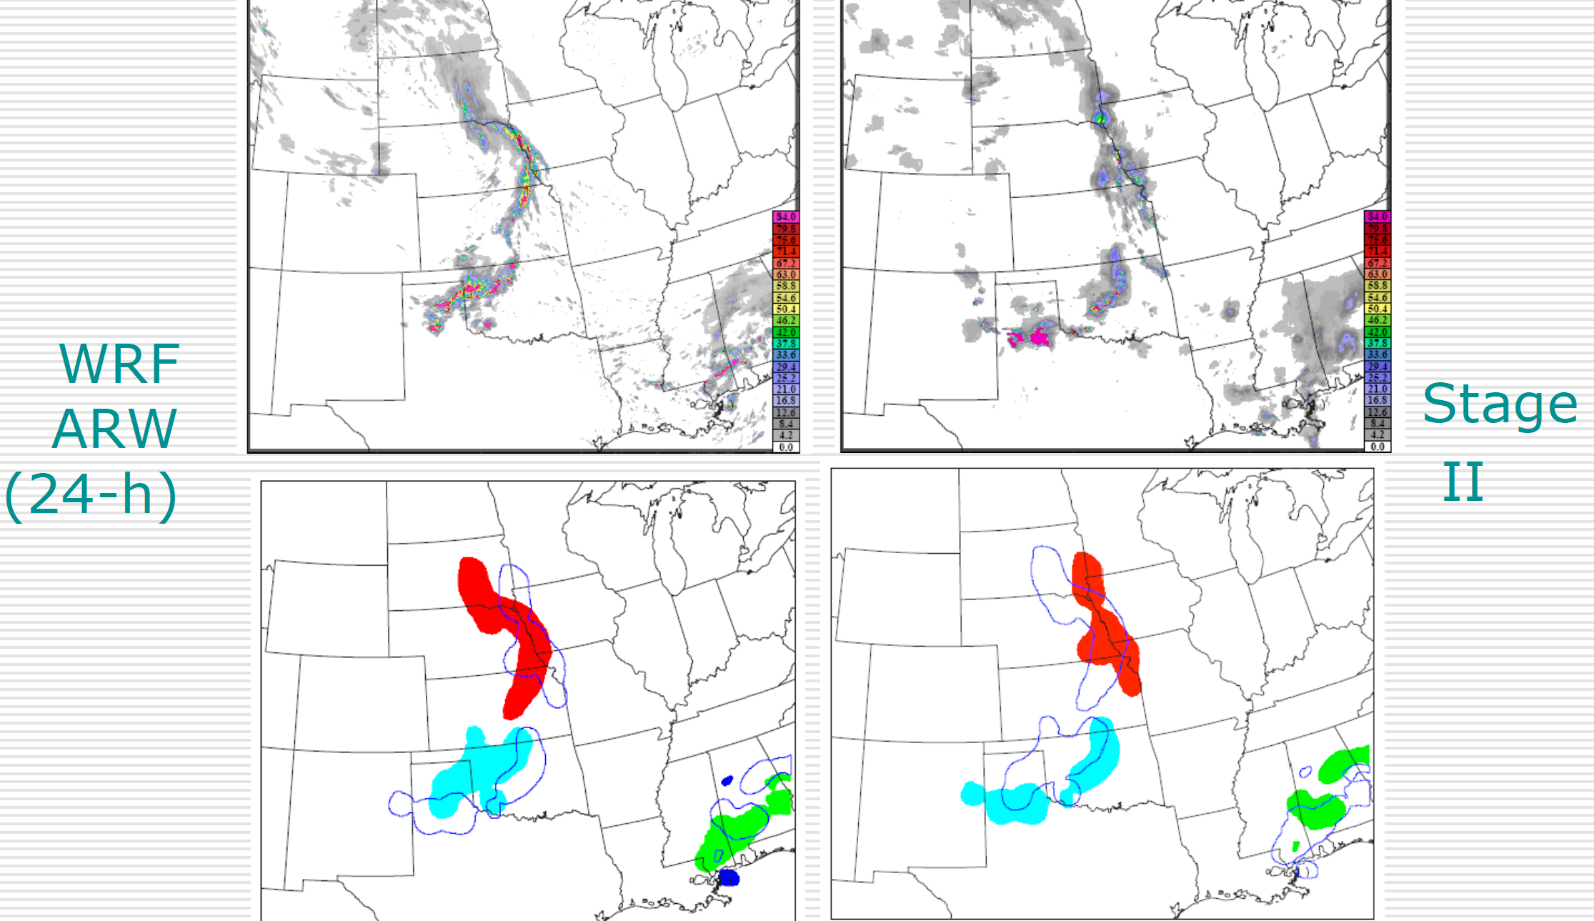
Tracking QPF Objects – Matching/Merging
Object Matching and Merging
MTD compares objects within the same field and between model and observation by:
Merging Objects: If two objects in a forecast or observation field are close together, they are combined into one.
Matching (Pairing) Objects: If a forecast and observation object are similar enough, they are considered the same object. This is how difference statistics in object attributes are computed.
MTD should not simply be run “out of the box.” There are several tuning parameters to ensure the desired objects are identified and tracked.
Gilleland et al. (2007)

Slide 5
Sensitivity Studies: Methodology
15 sensitivity studies are performed by tuning parameters controlling:
Convolution radius: Smoothing the field.
Space centroid distance: Importance of spatial separation for matching and merging.
Time centroid distance: Importance of temporal separation for matching and merging.
Four active cases are selected:
12 UTC on 21 July 2017
12 UTC on 26 July 2017
12 UTC on 05 Aug 2017
12 UTC on 12 Aug 2017
Tracker performance is evaluated subjectively by-eye and objectively using common error metrics.
Remember: Here we are optimizing the tracker, not evaluating the forecast.
Sensitivity Studies
Sensitivity Study Name | Convolution Radius (km) | Space Centroid Weight | Time Centroid Weight
Test 1 | 16 | 13 | 40
Test 2 | 24 | 13 | 40
Test 3 | 32 | 13 | 40
Test 4 | 16 | 32 | 32
Test 5 | 24 | 32 | 32
Test 6 | 32 | 32 | 32
Test 7 | 16 | 44 | 23
Test 8 | 24 | 44 | 23
Test 9 | 32 | 44 | 23
Test 10 | 16 | 40 | 13
Test 11 | 24 | 40 | 13
Test 12 | 32 | 40 | 13
Test 13 | 16 | 23 | 44
Test 14 | 24 | 23 | 44
Test 15 | 32 | 23 | 44

Slide 6
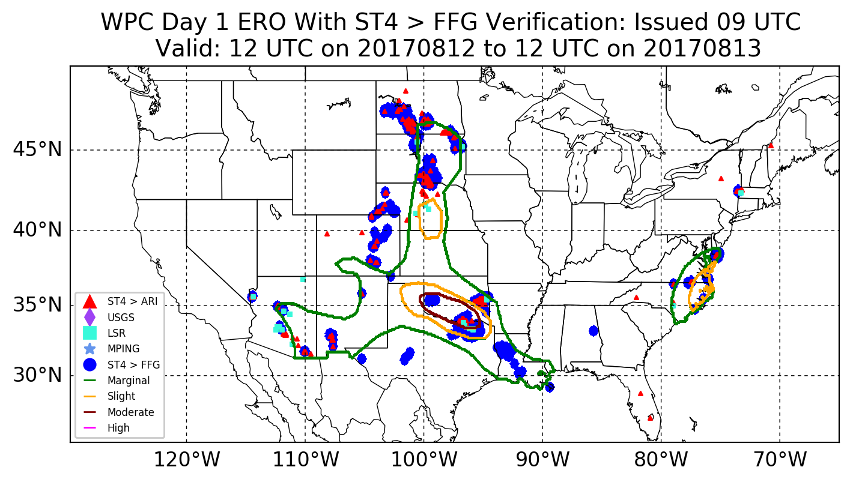
Sensitivity Studies
Example: 12 to 13 August 2017
This case featured a moderate risk in WPC’s Excessive Rainfall Outlook (ERO) over southern Oklahoma.
The ERO is a probabilistic forecast of precipitation exceeding Flash Flood Guidance within 40 km of a point.
The forecast verified slightly further southeast with another region of flooding underpredicted over the Dakotas southward to Eastern Colorado.
WPC Excessive Rainfall Outlook
Valid: 12 UTC 12 – 13 Aug 2017

Slide 7
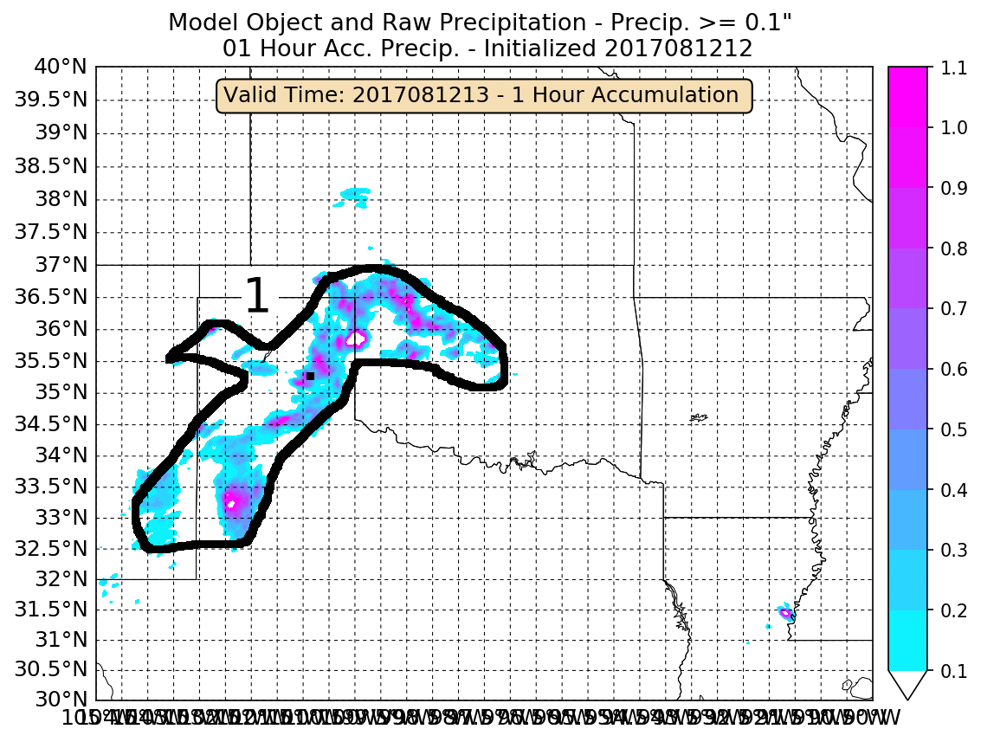
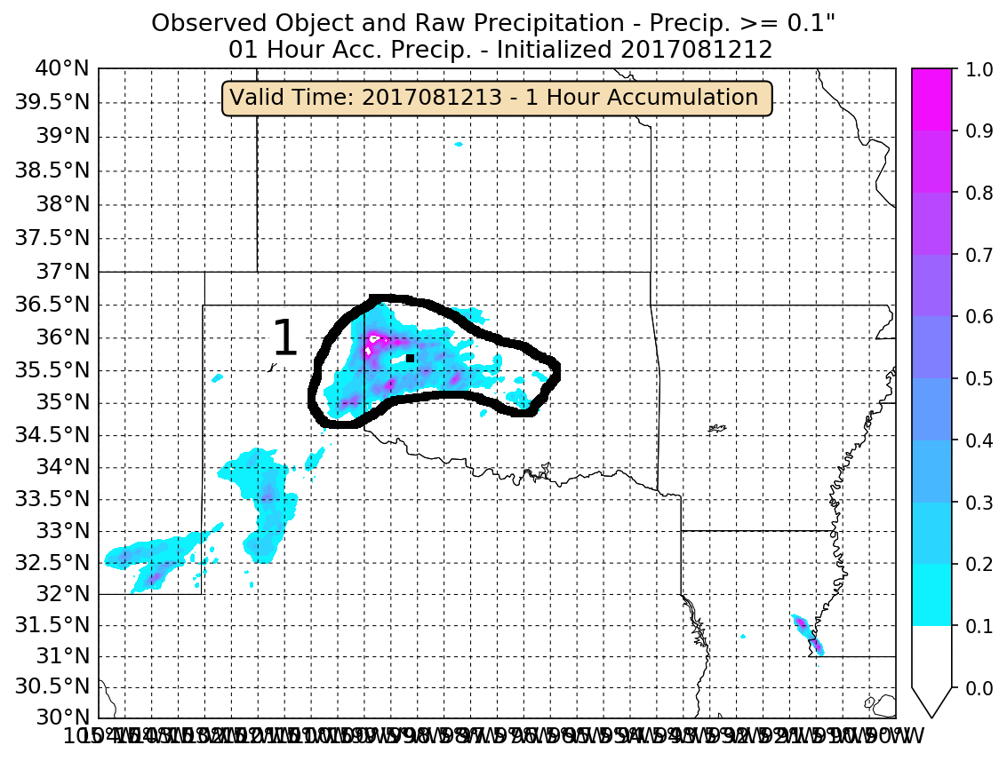
Sensitivity Studies: Creating the “Observed” Objects By-eye
Hand Drawn - Model
Hand Drawn - Observation
To verify these cases, the object convex hull and centroid location were identified by-eye for the High Resolution Rapid Refresh (HRRR) model and Stage IV (rainfall analysis).
Objective verification includes latitude/longitude displacement for False Alarm Ratio (FAR), Hit Rate (HIT), Critical Success Index (CSI), Contingency Bias, Mean Error (ME), and Mean Absolute Error (MAE).

Slide 8
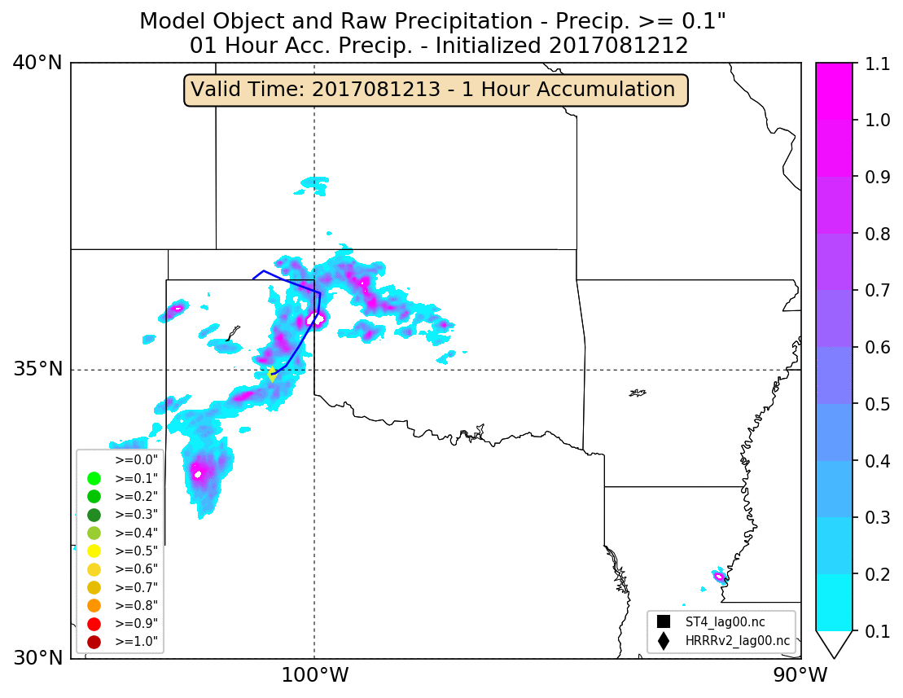
Sensitivity Studies: HRRR Tracker Performance
12 to 13 August 2017
Test 2
Test 5
Test 8
Test 11
Test 14
Test 2 and 14 perform poorly due to merging of far away objects (off the map) in later forecast hours.
Tests 5, 8, and 11 perform well by-eye.

Slide 9
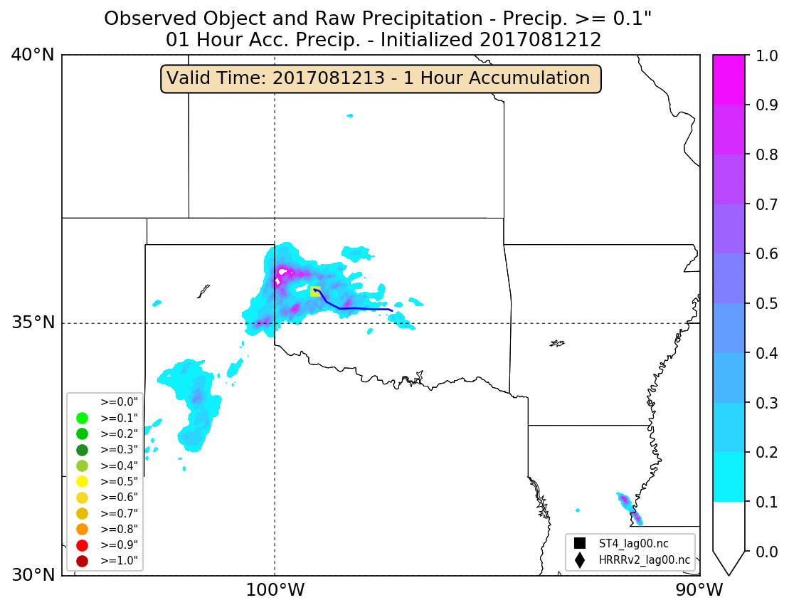
Sensitivity Studies: Stage IV Tracker Performance
12 to 13 August 2017
Test 2
Test 5
Test 8
Test 11
Test 14
Similar results are found for the tests with the Stage IV observations.
Tests 5, 8 , and 11 perform the best for this case.

Slide 10
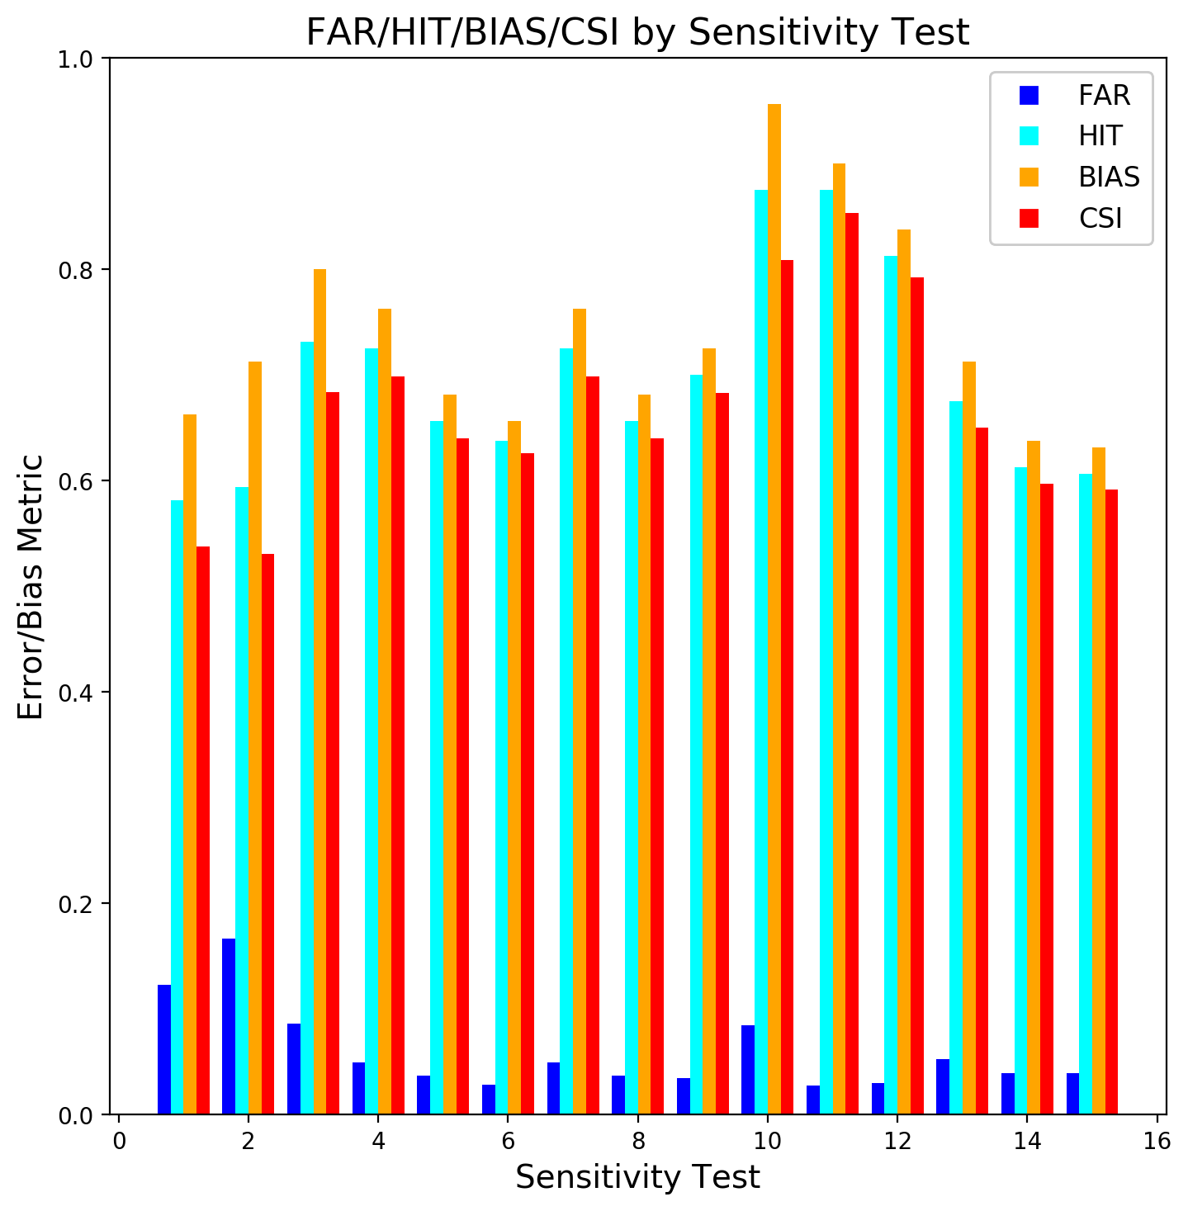
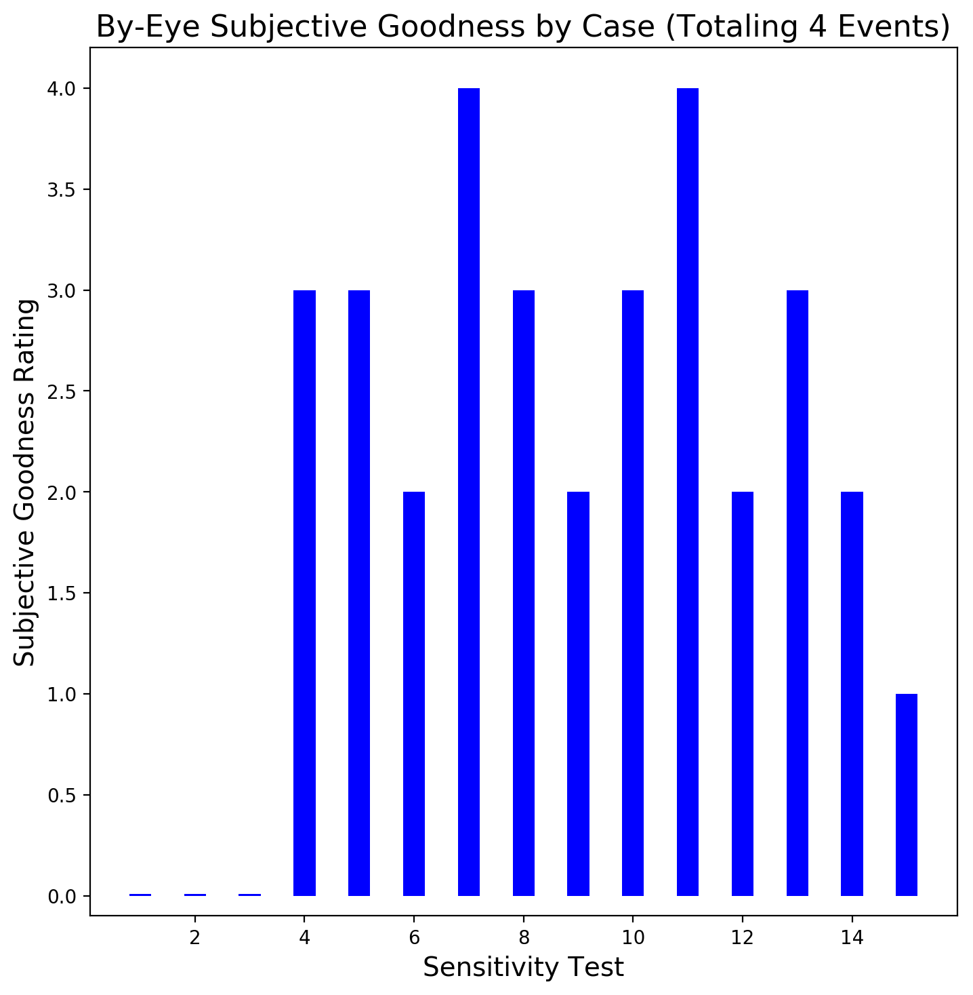
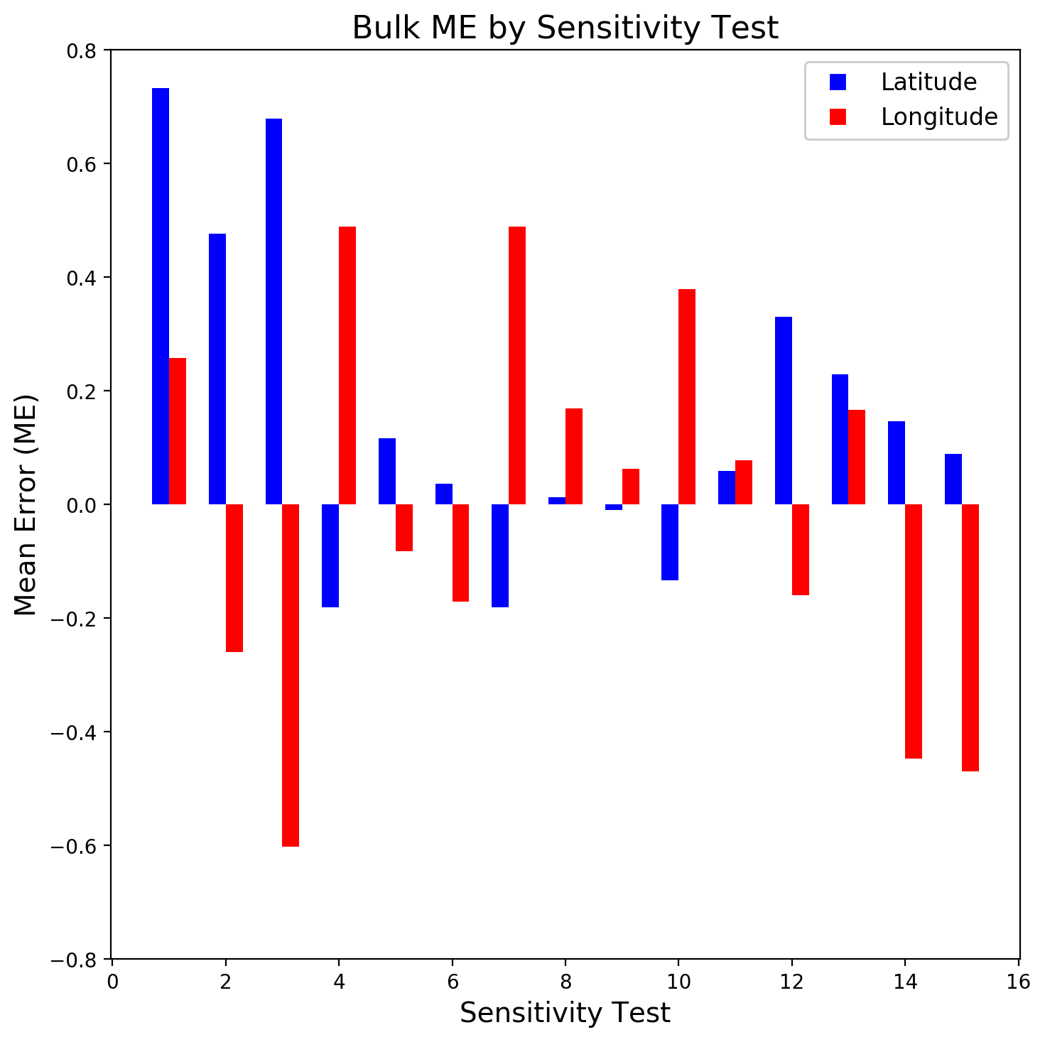
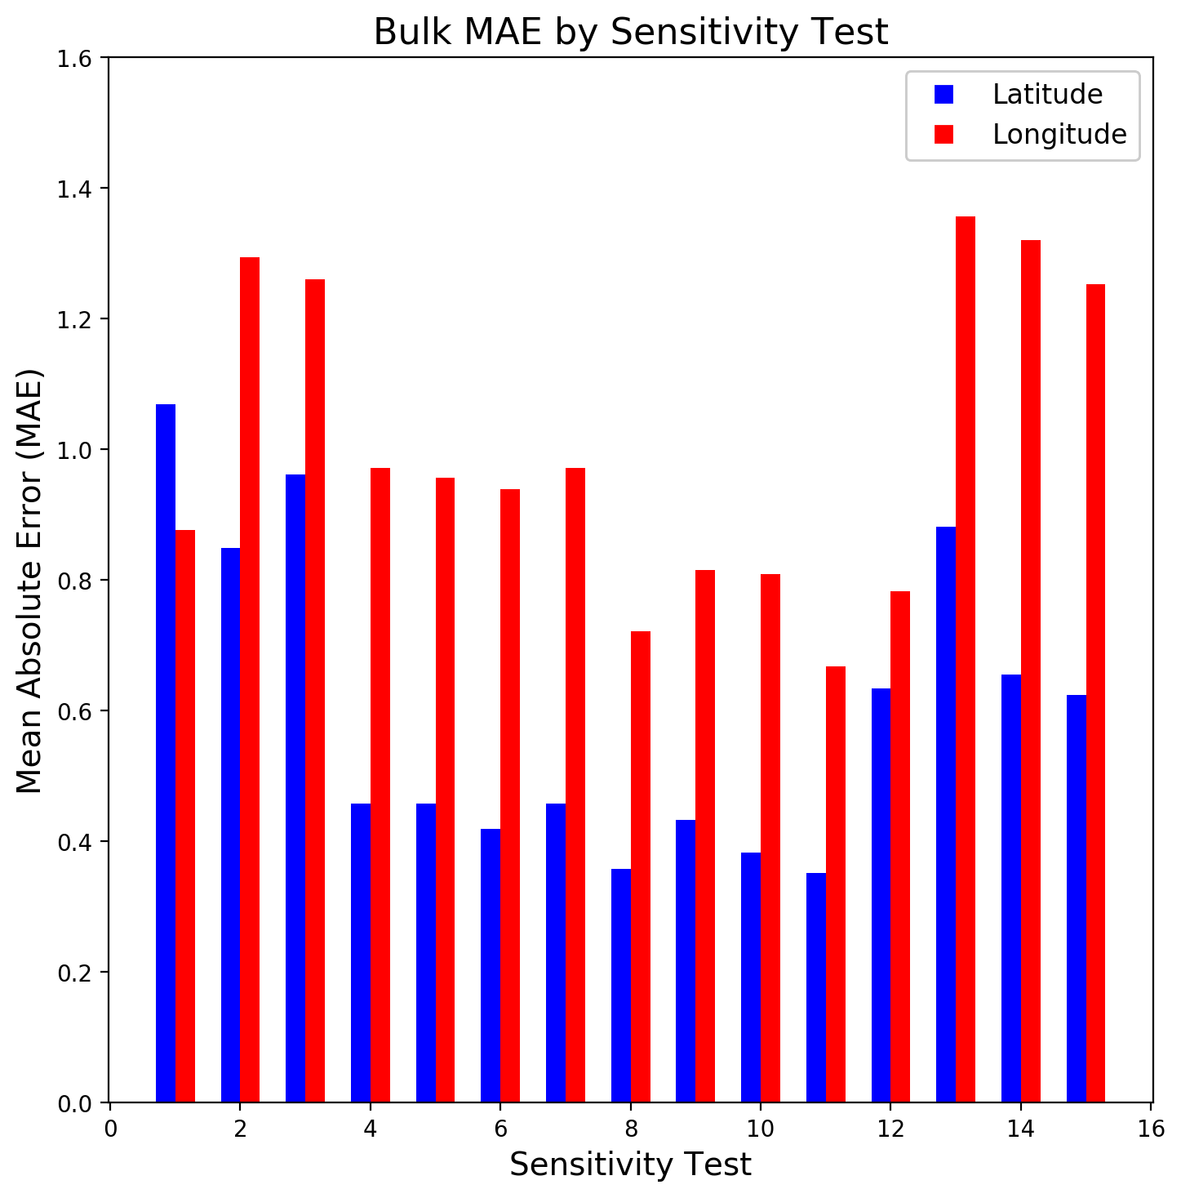
Sensitivity Tests: Bulk Verification Results
Objective Vs Subjective
Objective Results: FAR, HIT, Bias, and CSI
Subjective Results: By-eye Measure of “Goodness”
Tests 7 and 11 perform best subjectively.
Test 11 is selected for the retrospective runs because it performs well with all objective metrics.
Objective Results: ME
Objective Results: MAE

Slide 11
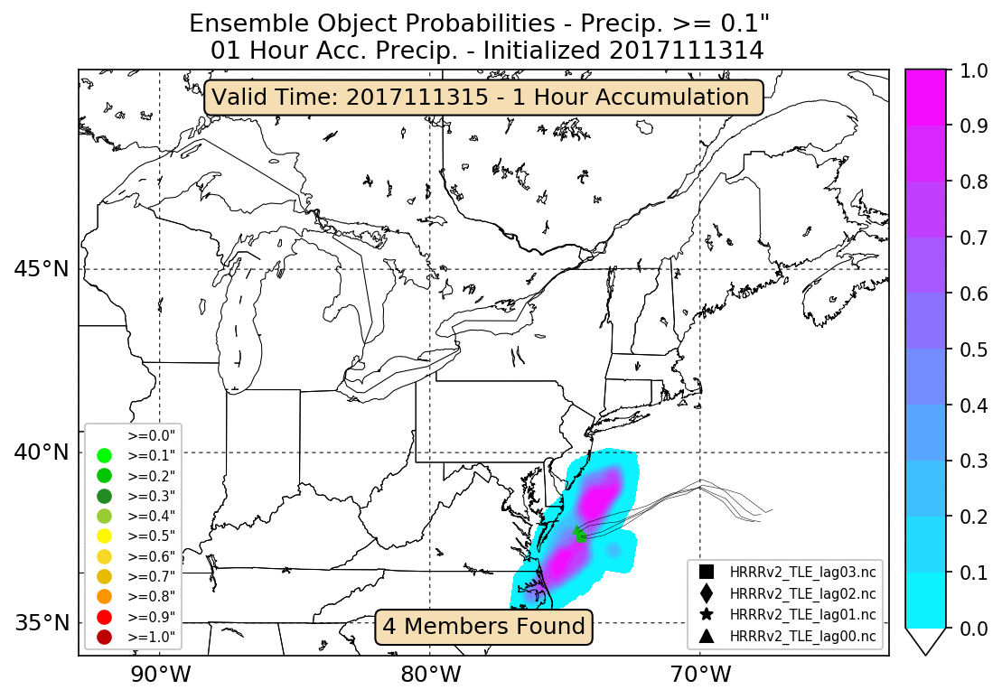
Identifying QPF Objects at WPC - Overview
The Weather Prediction Center (WPC) is transitioning towards object-based evaluation of QPF through:
Testbed Evaluations: Using object-based verification with participant feedback in the Flash Flood and Intense Rainfall Experiment (FFaIR).
Experimental Graphics: Displaying quasi-operational MTD graphics on internal websites for WPC forecasters.
Retrospective runs: Over a period of time, track/compare QPF and observation to gather biases in object attributes related to displacement, orientation, and intensity (primary focus of talk).
QPF Tracking Example 20171113
List of Trackable Ensembles
Ensemble | Resolution | Runs per day | Members | Run Length
HRRR TLE | ~ 4 km | 24 | 4 (3 time-lagged members) | 15
HRRRv3 TLE | ~ 4 km | 6 | 3 (2 time-lagged members) | 30
HREFv2 | ~ 4 km | 2 | 8 (4 time-lagged members) | 36
NSSL (while it existed) | ~ 4 km | 1 | 9 | 36

Slide 12
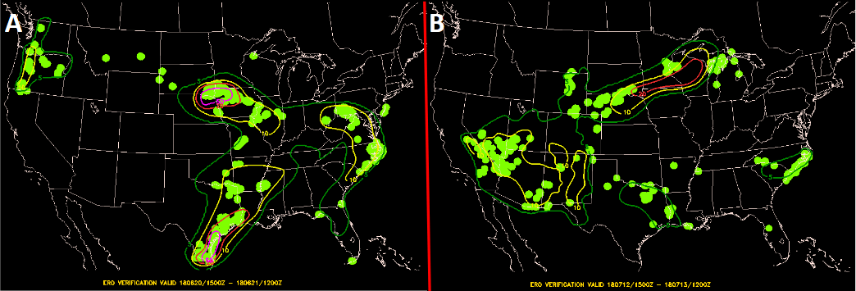
A) Testbed Evaluations - FFaIR
FFaIR is a real-time pseudo-operational environment where participants work together to explore the utility of emerging model guidance and tools for improving flash flood forecasts.
The experiment is conducted annually at WPC over four weeks from mid-June to mid-July.
Users are asked to look at experimental guidance to create experimental forecasts and subjectively evaluate all products.
FFaIR Experimental ERO with Verification for Two Events
Images provided by Ben Albright; WPC

Slide 13
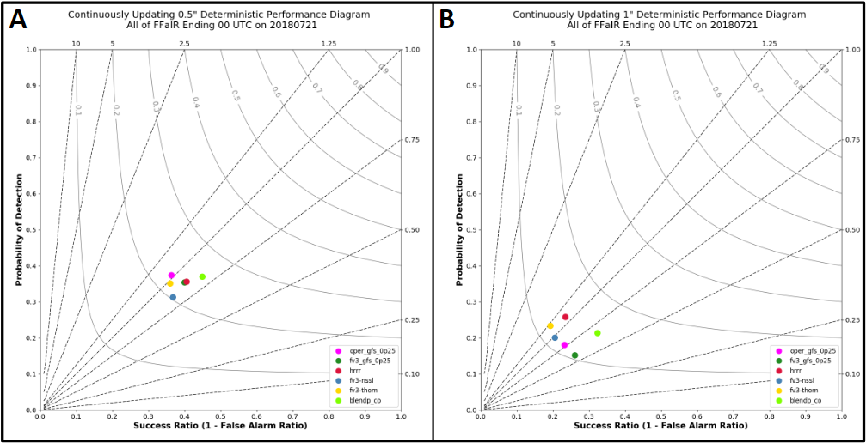
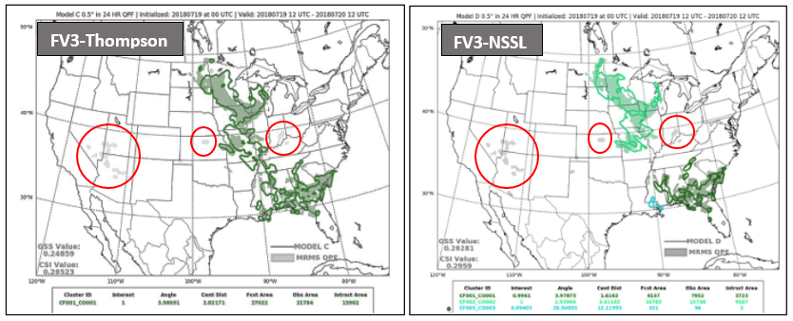
A) Testbed Evaluations - FFaIR
Performance Diagrams
Within FFaIR, participants are asked to subjectively rate models, other guidance, and their own forecasts.
Thereafter, participants are shown objective evaluation through performance diagrams and object-oriented results.
Participants then discuss similarities and differences between objective and subjective guidance.
Object-oriented Verification

Slide 14
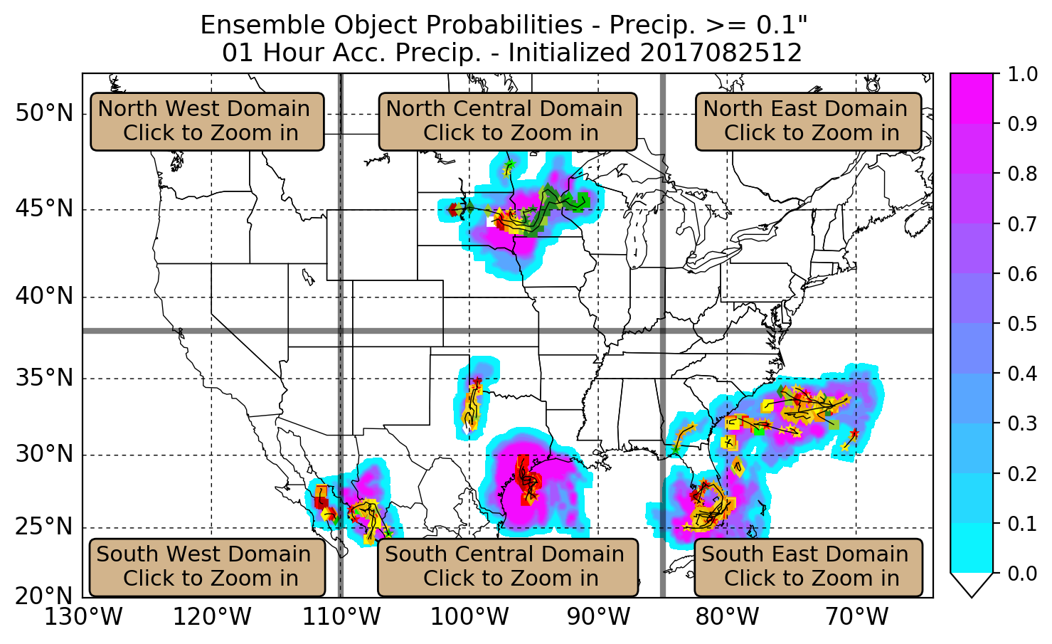
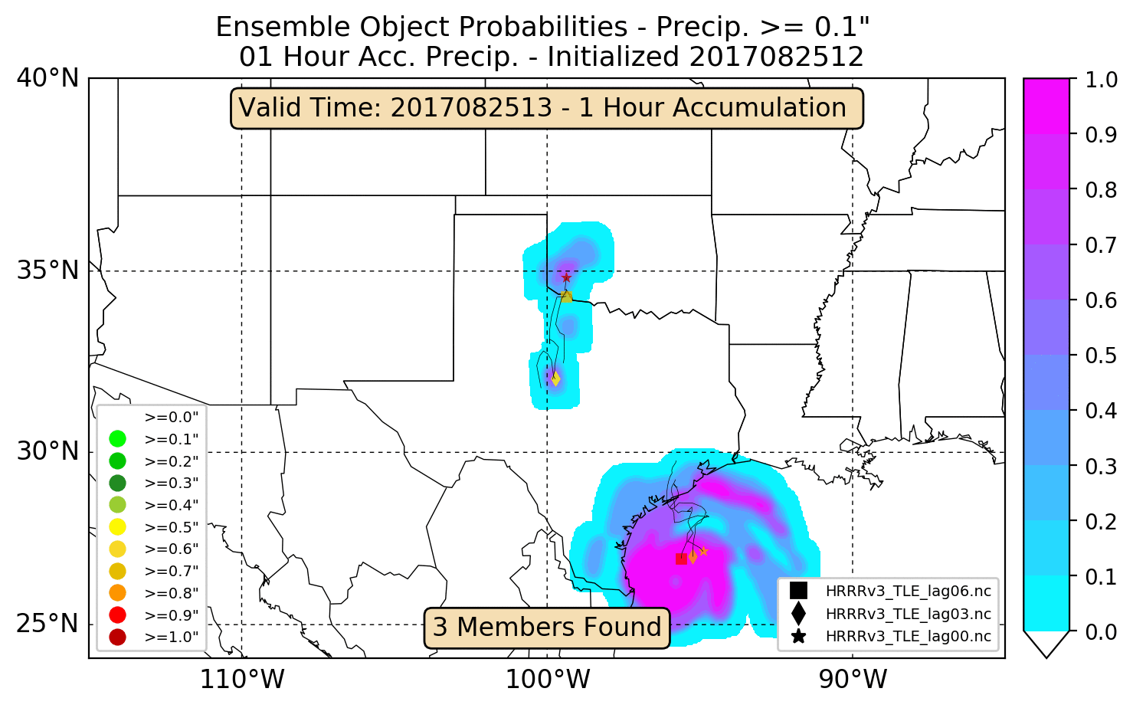
B) Experimental Graphics - Warm Season QPF
Internal Website
An internal WPC Google Site has been created to display current object attributes for several ensembles.
Users initially view a static CONUS image, with the option to zoom in on a more detailed and animated regional subplot.
Shading denotes probability of being in an object, marker type denotes model type, and marker color denotes the 90th percentile of object intensity.
Regional Zoom from CONUS View

Slide 15
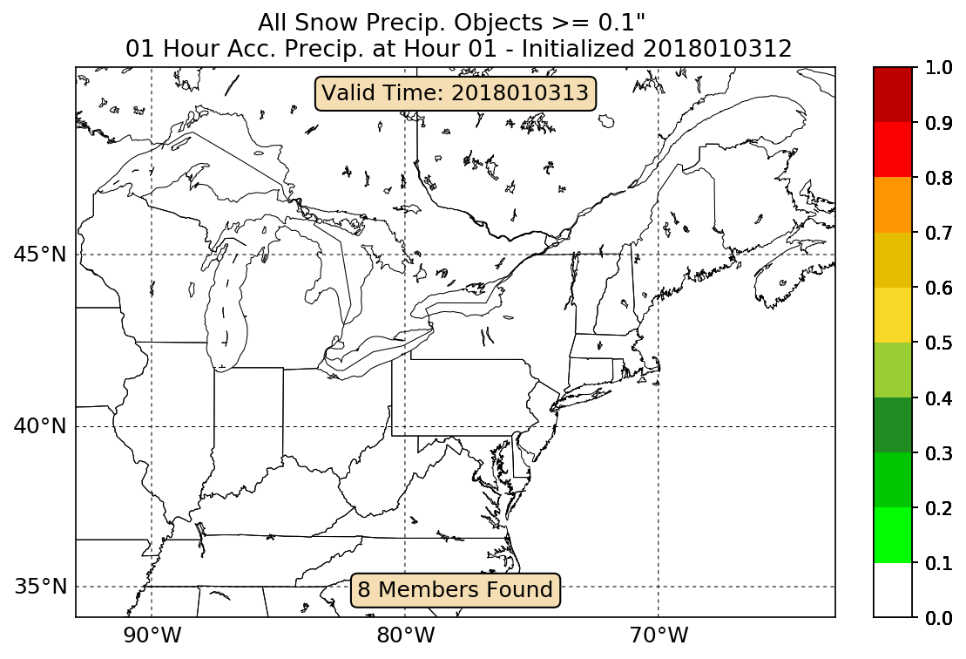
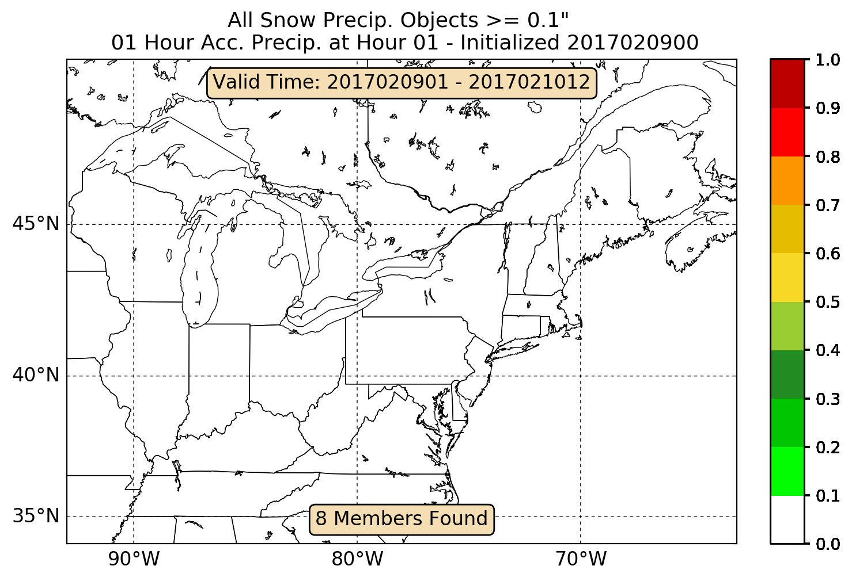
B) Experimental Graphics - Snowband Website
Example from Website
HREF on 12 UTC 03 Jan 2018
QPF is masked with the categorical snow field and tracked to generate snow band images.
Snow band objects from the 03 - 04 Jan 2018 Blizzard are shown for the HREFv2.
The shape of the snow band object is displayed, with the border color representing 90th percentile of object intensity.
Website interface allows for the user to specify ensemble, domain, model initialization, and model trends.
Website Work Performed by Sara Ganetis
WPC/IMSG

Slide 16
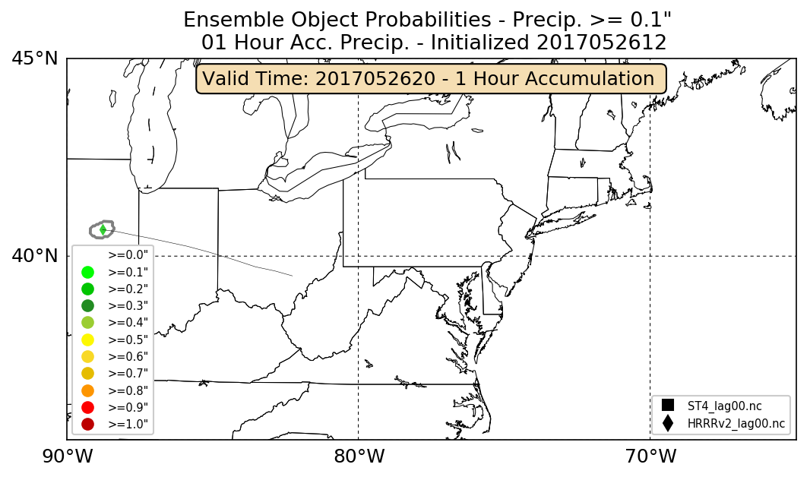
C) Retrospective Tracking – Methodology
The HRRRv2 and HRRRv3 QPF objects exceeding 0.1” 0.25” and 0.5" per hour are tracked and compared to the Stage IV analysis between 01 May – 31 Aug 2017.
Using paired model and observation object attributes, differences are computed in object centroid latitude, centroid longitude, intensity, orientation, and size.
Using start/end time of paired objects, differences in object initiation and dissipation are calculated between model and observation.
Tracking Example - 26 May 2017
The HRRRv2 and HRRRv3 QPF objects exceeding 0.1” 0.25” and 0.5” per hour are tracked and compared to the Stage IV analysis between 01 May – 31 Aug 2017.
Using paired model and observation object attributes, differences are computed in object centroid latitude, centroid longitude, intensity, orientation, and size.
Using start/end time of paired objects, differences in object initiation and dissipation are calculated between model and observation.
Model Initiates
Object First
All difference statistics are aggregated on a 2º latitude/longitude grid.
Only results that are statistically significant at 99% using a Student’s T-test are retained.

Slide 17
C) Retrospective Tracking – Methodology
The HRRRv2 and HRRRv3 QPF objects exceeding 0.1” 0.25” and 0.5” per hour are tracked and compared to the Stage IV analysis between 01 May – 31 Aug 2017.
Using paired model and observation object attributes, differences are computed in object centroid latitude, centroid longitude, intensity, orientation, and size.
Using start/end time of paired objects, differences in object initiation and dissipation are calculated between model and observation.
Tracking Example - 26 May 2017
The HRRRv2 and HRRRv3 QPF objects exceeding 0.1” 0.25” and 0.5" per hour are tracked and compared to the Stage IV analysis between 01 May – 31 Aug 2017.
Using paired model and observation object attributes, differences are computed in object centroid latitude, centroid longitude, intensity, orientation, and size.
Using start/end time of paired objects, differences in object initiation and dissipation are calculated between model and observation.
All difference statistics are aggregated on a 2º latitude/longitude grid.
Only results that are statistically significant at 99% using a Student’s T-test are retained.
All difference statistics are aggregated on a 2º latitude/longitude grid.
Only results that are statistically significant at 99% using a Student’s T-test are retained.

Slide 18
C) Retrospective Tracking – Methodology
The HRRRv2 and HRRRv3 QPF objects exceeding 0.1” 0.25” and 0.5” per hour are tracked and compared to the Stage IV analysis between 01 May – 31 Aug 2017.
Using paired model and observation object attributes, differences are computed in object centroid latitude, centroid longitude, intensity, orientation, and size.
Using start/end time of paired objects, differences in object initiation and dissipation are calculated between model and observation.
Tracking Example - 26 May 2017
The HRRRv2 and HRRRv3 QPF objects exceeding 0.1” 0.25” and 0.5" per hour are tracked and compared to the Stage IV analysis between 01 May – 31 Aug 2017.
Using paired model and observation object attributes, differences are computed in object centroid latitude, centroid longitude, intensity, orientation, and size.
Using start/end time of paired objects, differences in object initiation and dissipation are calculated between model and observation.
All difference statistics are aggregated on a 2º latitude/longitude grid.
Only results that are statistically significant at 99% using a Student’s T-test are retained.
All difference statistics are aggregated on a 2º latitude/longitude grid.
Only results that are statistically significant at 99% using a Student’s T-test are retained.

Slide 19
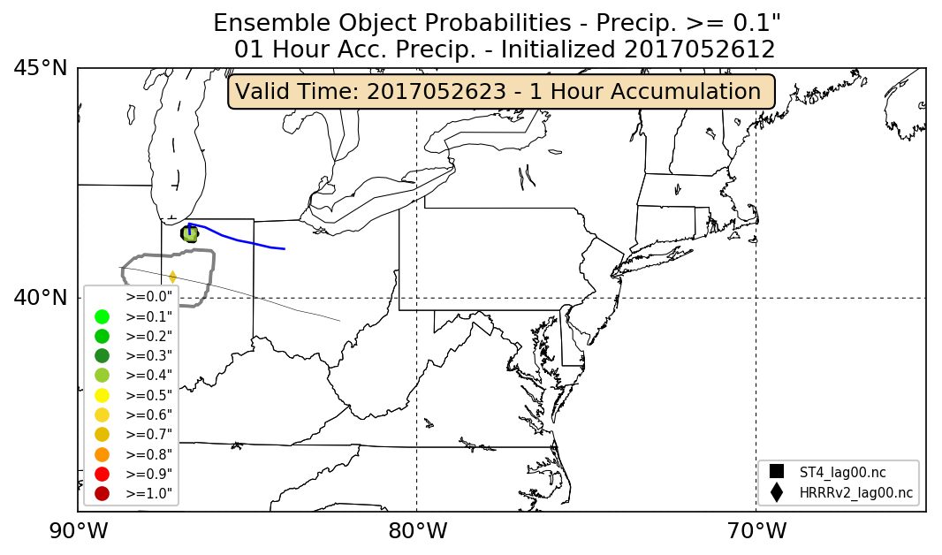
C) Retrospective Tracking – Methodology
The HRRRv2 and HRRRv3 QPF objects exceeding 0.1” 0.25” and 0.5" per hour are tracked and compared to the Stage IV analysis between 01 May – 31 Aug 2017.
Using paired model and observation object attributes, differences are computed in object centroid latitude, centroid longitude, intensity, orientation, and size.
Using start/end time of paired objects, differences in object initiation and dissipation are calculated between model and observation.
Tracking Example - 26 May 2017
Displacement in Initiation
Analysis Initiates
Object 3 Hours
Later
Displacement at Current Hour
All difference statistics are aggregated on a 2º latitude/longitude grid.
Only results that are statistically significant at 99% using a Student’s T-test are retained.

Slide 20
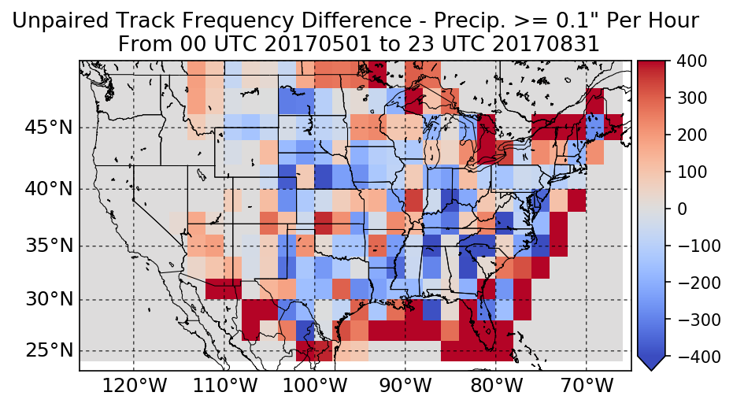
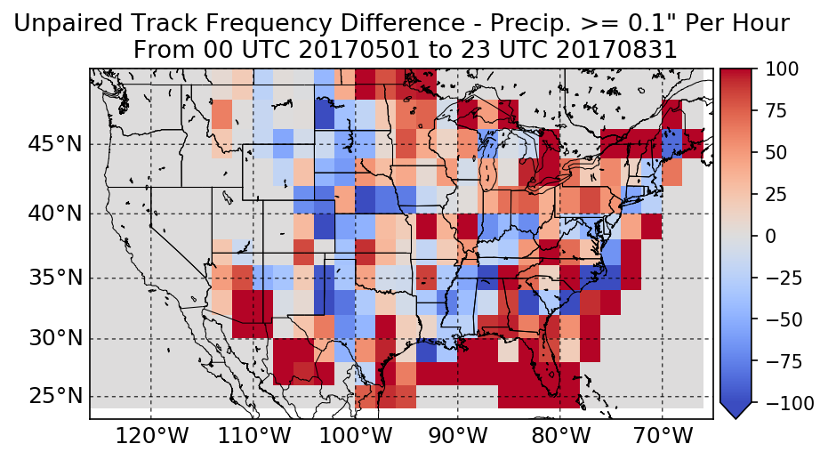
C) Unpaired Track Count Difference HRRRv2 and HRRRv3 at > 0.1”
Track count difference is a bit noisy, but the HRRRv2/HRRRv3 produce too few tracks over CONUS.
One exception is along the CONUS boundaries, were there are too many tracks.
Note: Statistics over poor radar coverage regions should be used with caution, since this will affect the quality of the Stage IV data.
HRRRv2 – Track Count Difference
HRRRv3 – Track Count Difference

Slide 21
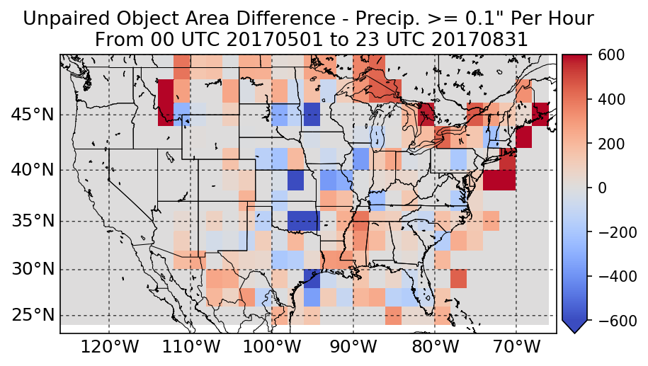
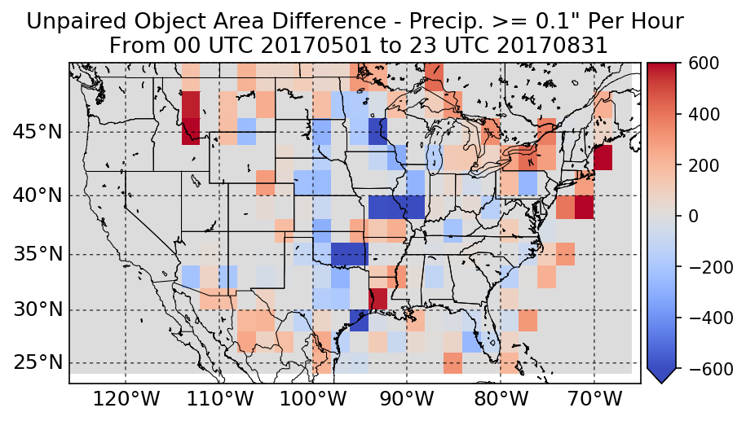
C) Unpaired Object Area Difference HRRRv2 and HRRRv3 at > 0.1”
HRRRv2 – Object Area Difference
The HRRR produces heavy precipitation objects that are too small over the Plains and Mid-west.
For the remainder of CONUS, the HRRR generally produces objects that are the correct size or slightly too big.
HRRRv3 – Object Area Difference

Slide 22
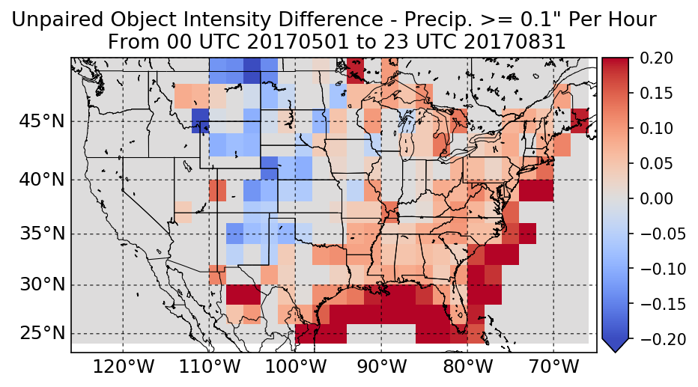
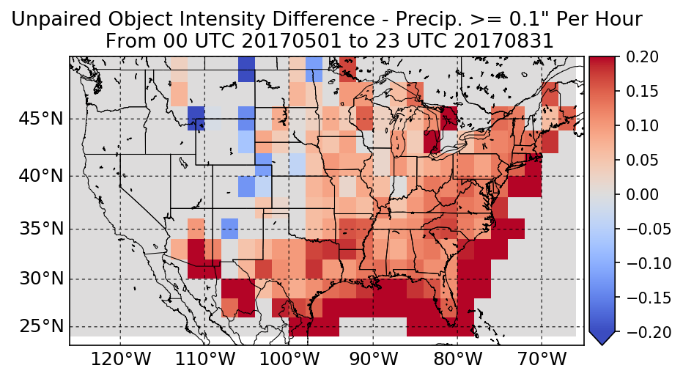
C) Unpaired Object Intensity Difference HRRRv2 and HRRRv3 at > 0.1”
Over the eastern half of CONUS, the HRRR produces objects that are too intense. This wet bias is slightly greater for the HRRRv3.
HRRRv2 – Object Intensity Difference
HRRRv3 – Object Intensity Difference
Over portions of the eastern Rockies and High Plains, the HRRR does not produce intense enough objects. This dry bias is slightly greater in the HRRRv2.

Slide 23
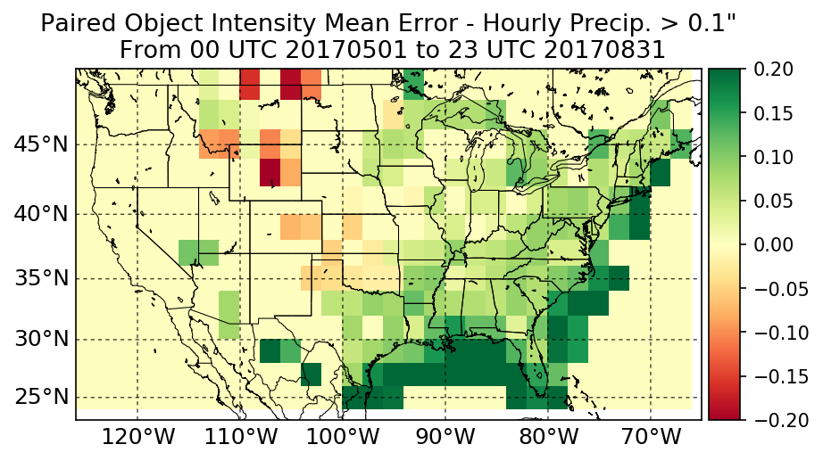
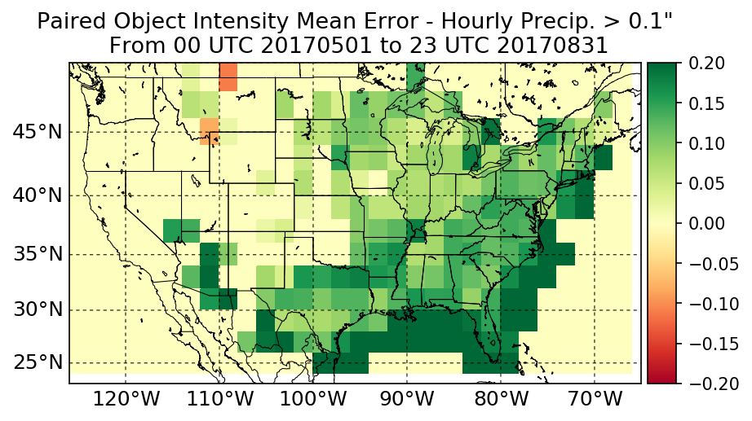
C) Paired Object Intensity Difference HRRRv2 and HRRRv3 at > 0.1”
Paired intensity bias is similar to unpaired intensity bias, with the HRRR overdoing precipitation in the eastern half of CONUS.
HRRRv2 – Object Intensity Difference
The dry bias over the Rockies/Plains is reduced slightly compared to the unpaired statistics. This may be caused by the inability to properly match model/observation pairs.
HRRRv3 – Object Intensity Difference

Slide 24
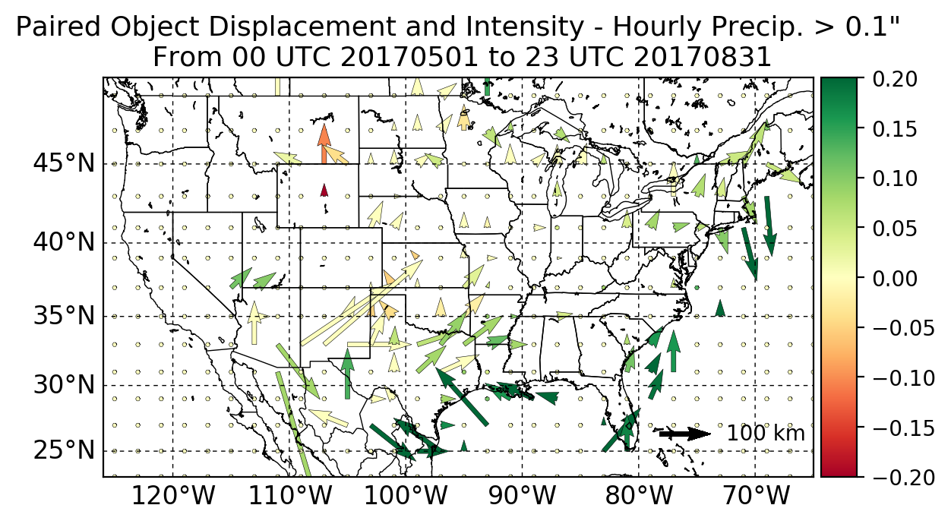
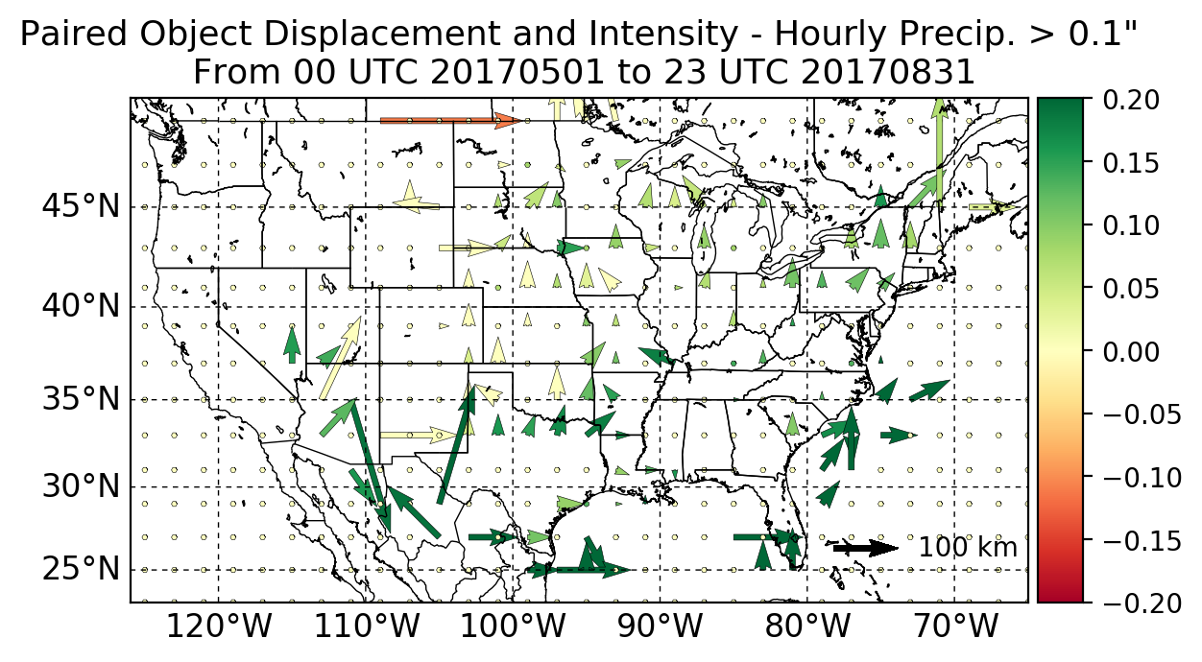
C) Paired Displacement and Intensity HRRRv2 and HRRRv3 at > 0.1”
Warm season displacement biases for the HRRRv2 and HRRRv3 are generally shifted to the North across most of CONUS, particularly in the Southern Plains.
HRRRv2 - Intensity/Displacement
HRRRv3 - Intensity/Displacement
There are also slight northward displacement biases over portions of the Southeast and Mid-Atlantic coasts.

Slide 25
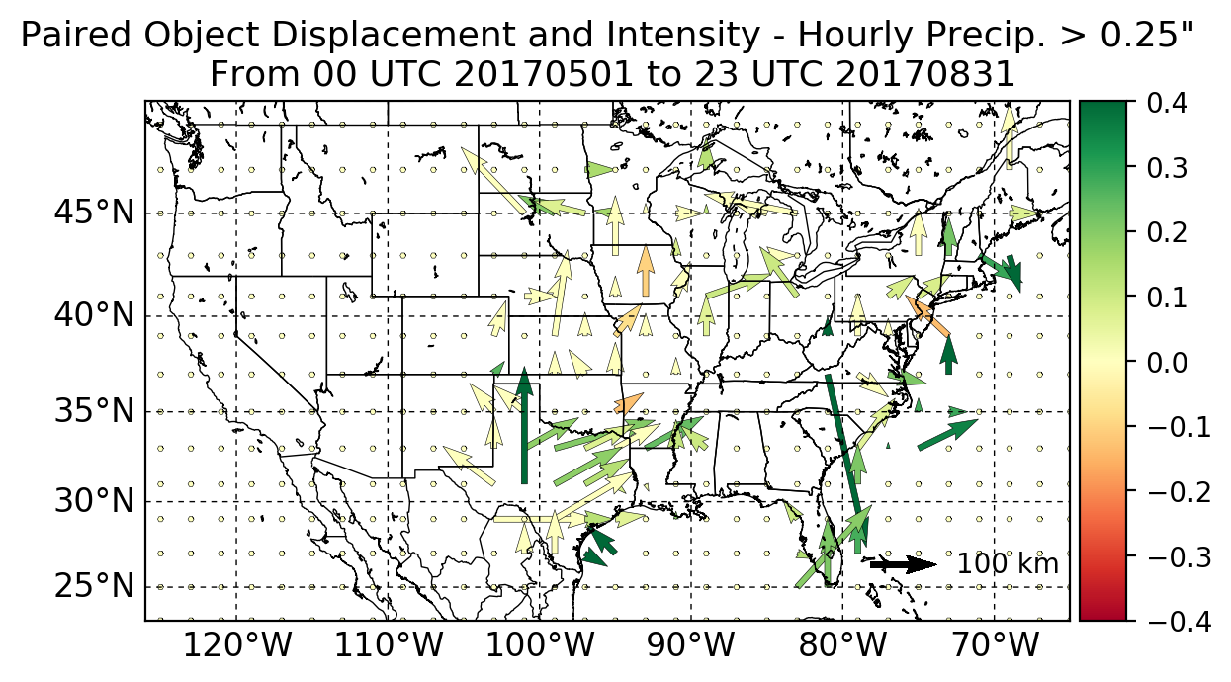
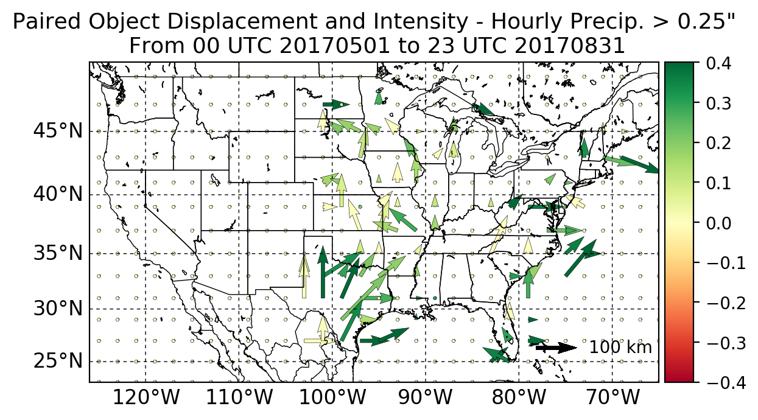
C) Paired Displacement and Intensity HRRRv2 and HRRRv3 at > 0.25”
Analyzing a higher threshold (> 0.25” per hour) reveal similar biases, with a north/northeastward displacement bias over the Central and Southern Plains.
The dry bias over the Central Plains becomes more apparent with a wet bias over Texas and most of the East Coast.
HRRRv2 - Intensity/Displacement
HRRRv3 - Intensity/Displacement

Slide 26
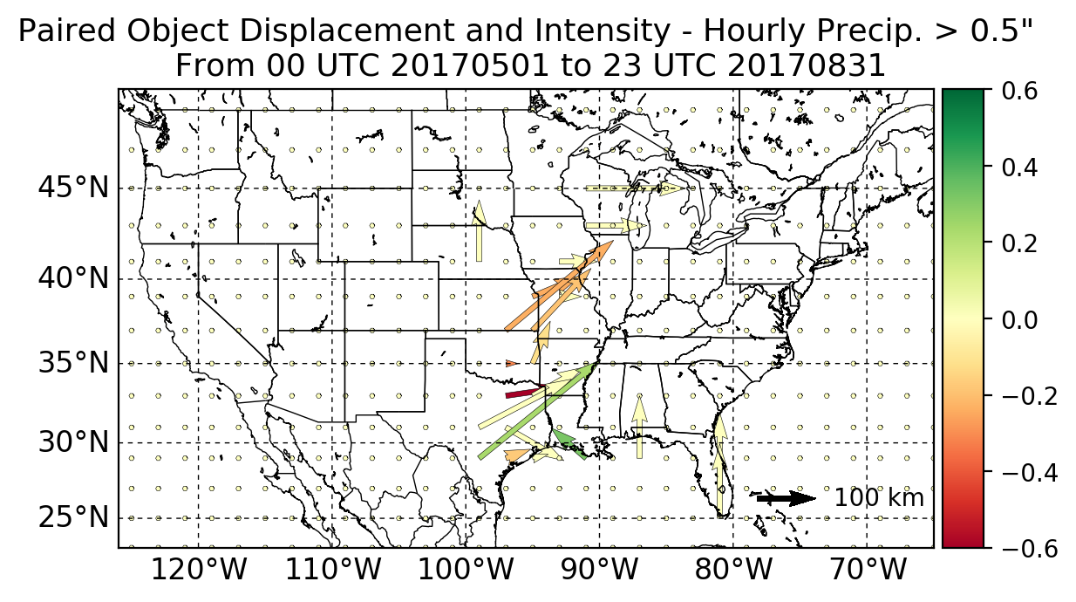
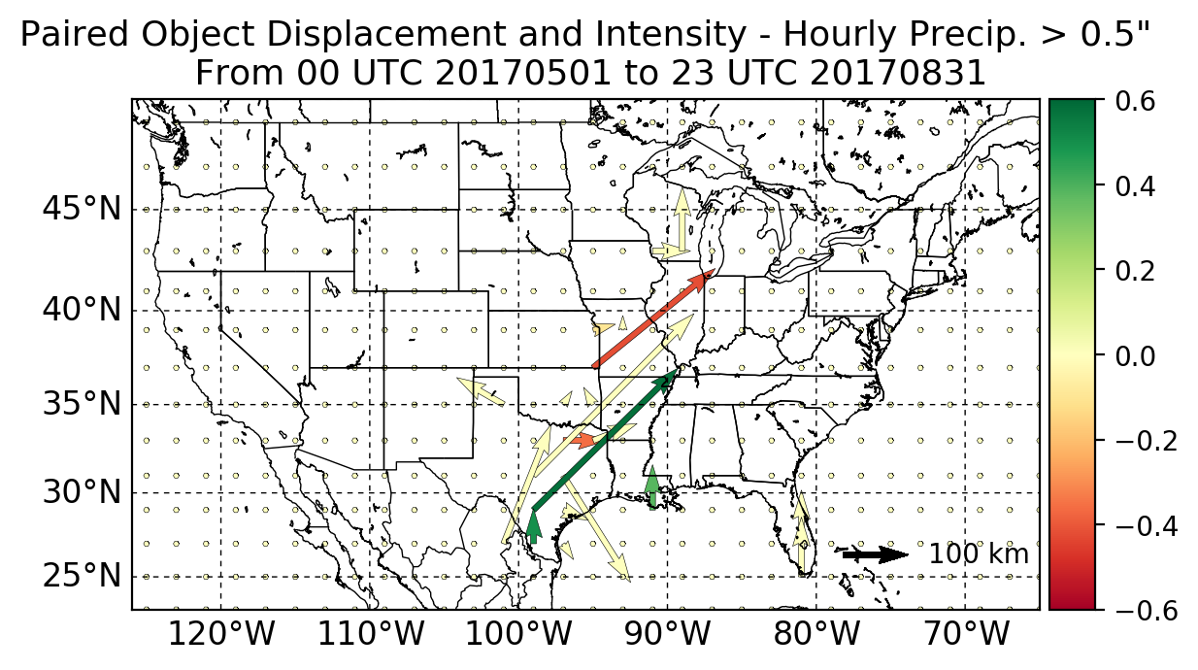
C) Paired Displacement and Intensity HRRRv2 and HRRRv3 at > 0.5”
Sample size is limited at the >0.5” threshold, with the only statistically significant displacement biases over the Central and Southern Plains.
For the majority of CONUS, the HRRR has a dry bias at the > 0.5” threshold.
HRRRv2 - Intensity/Displacement
HRRRv3 - Intensity/Displacement

Slide 27
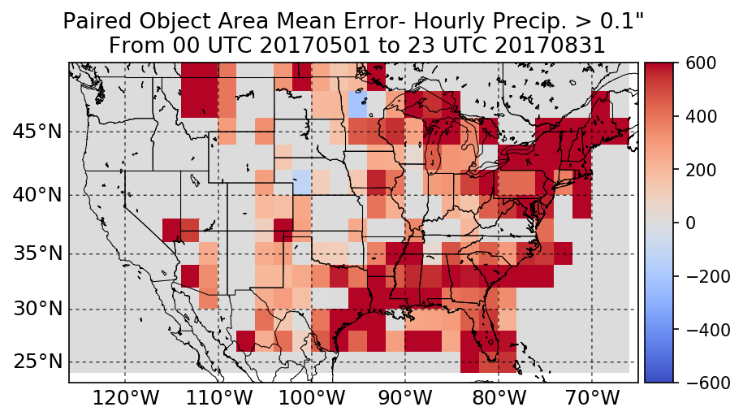
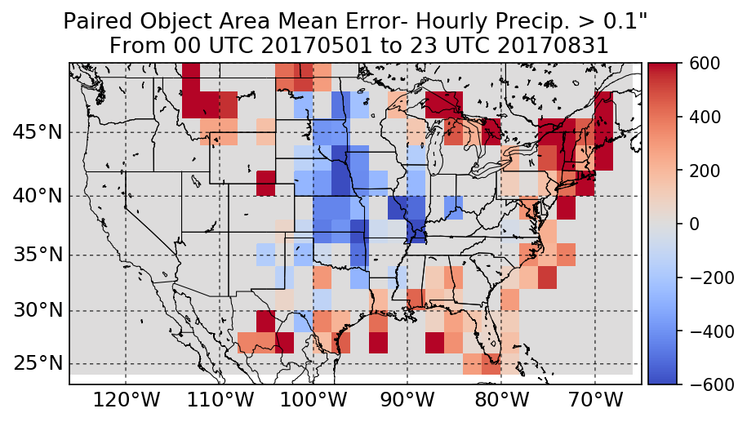
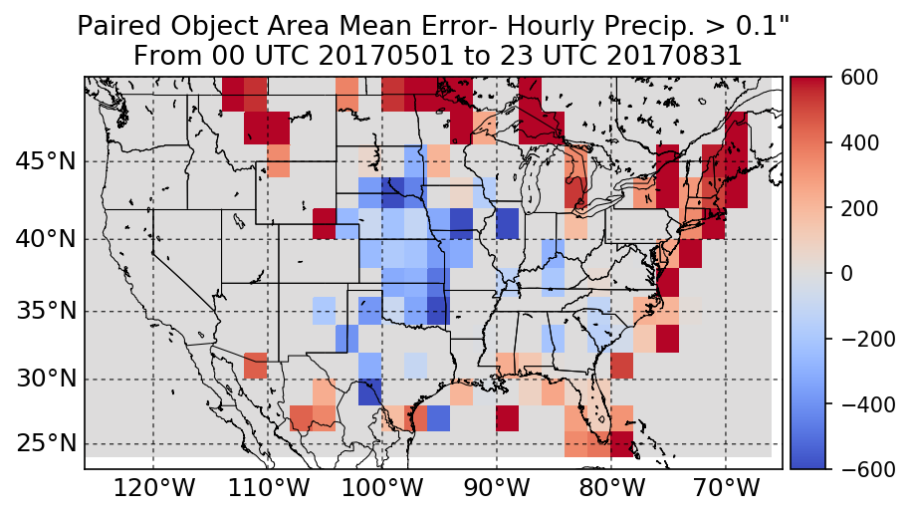
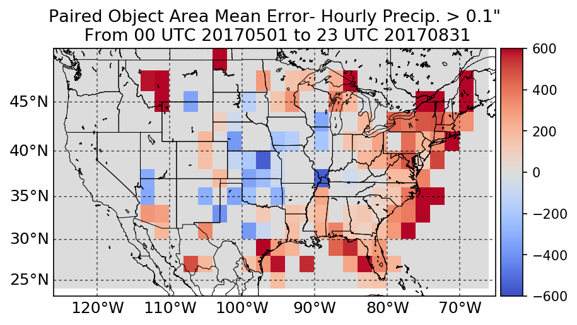
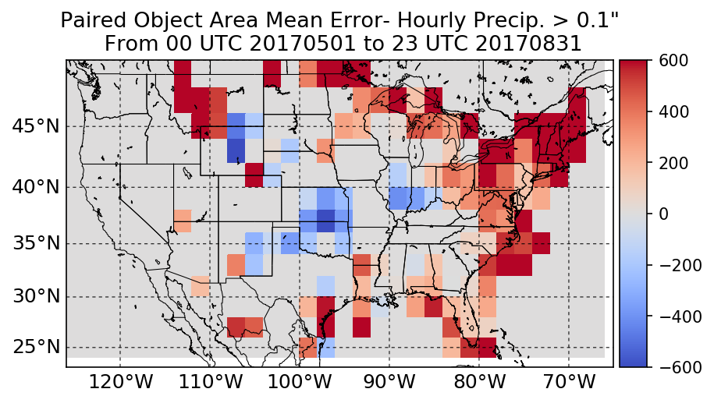
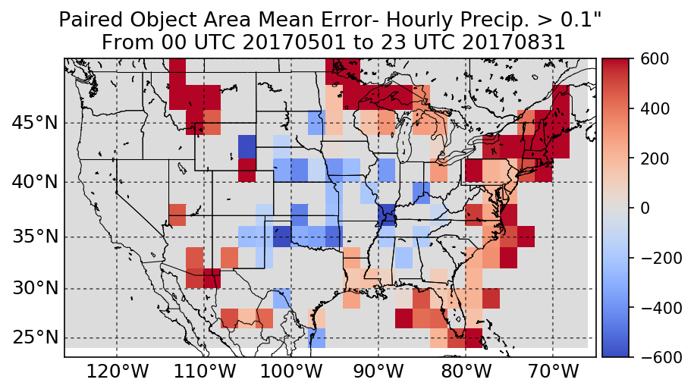
C) Paired Object Area By Forecast Hour HRRRv2 and HRRRv3 at > 0.1”
HRRRv2 Area Difference
Forecast Hours 1 to 6
HRRRv2 Area Difference
Forecast Hours 7 to 12
HRRRv2 Area Difference
Forecast Hours 13 to 18
HRRRv3 Area Difference
Forecast Hours 1 to 6
HRRRv3 Area Difference
Forecast Hours 7 to 12
HRRRv3 Area Difference
Forecast Hours 13 to 18
For earlier forecast hours, the HRRRv2 and HRRRv3 have a positive object area bias in the Eastern and Southern U.S.
The positive object bias lingers in the Northeast United States for later forecast hours.
The central Plains have a negative object area bias. This develops in the HRRRv2 after forecast hour 6 and exists for all forecast hours of the HRRRv3.

Slide 28
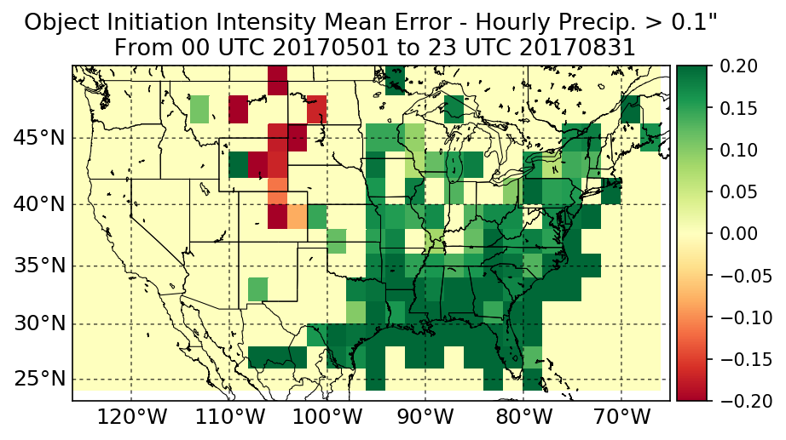
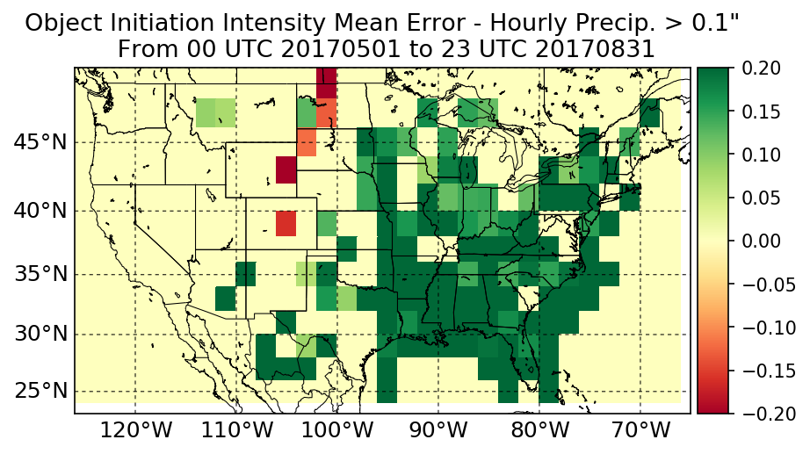
C) Paired Object Initiation Intensity Difference at > 0.1”
HRRRv2 Intensity Difference
HRRRv2 and HRRRv3 intensity biases during initiation are similar to the previous paired statistics, with a strong wet bias in the Southeast U.S. and a general wet bias east of the Mississippi River
HRRRv2 exhibits a slight but significant dry bias in a small region of the High Plains westward into Wyoming and Montana.
HRRRv3 Intensity Difference

Slide 29
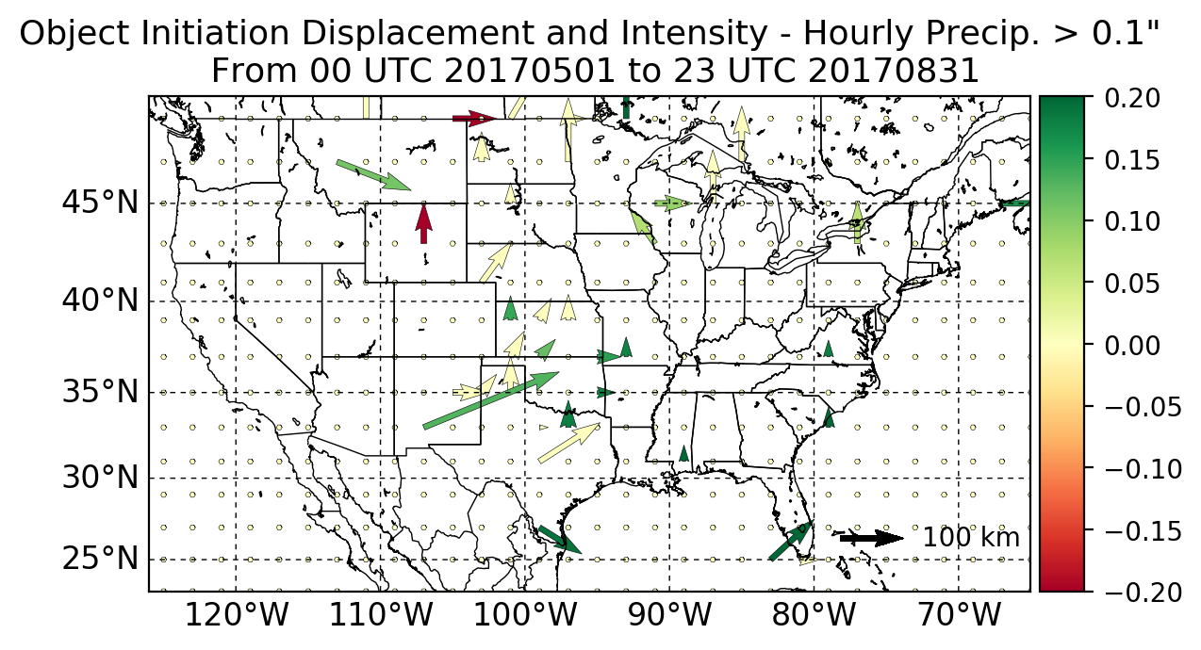
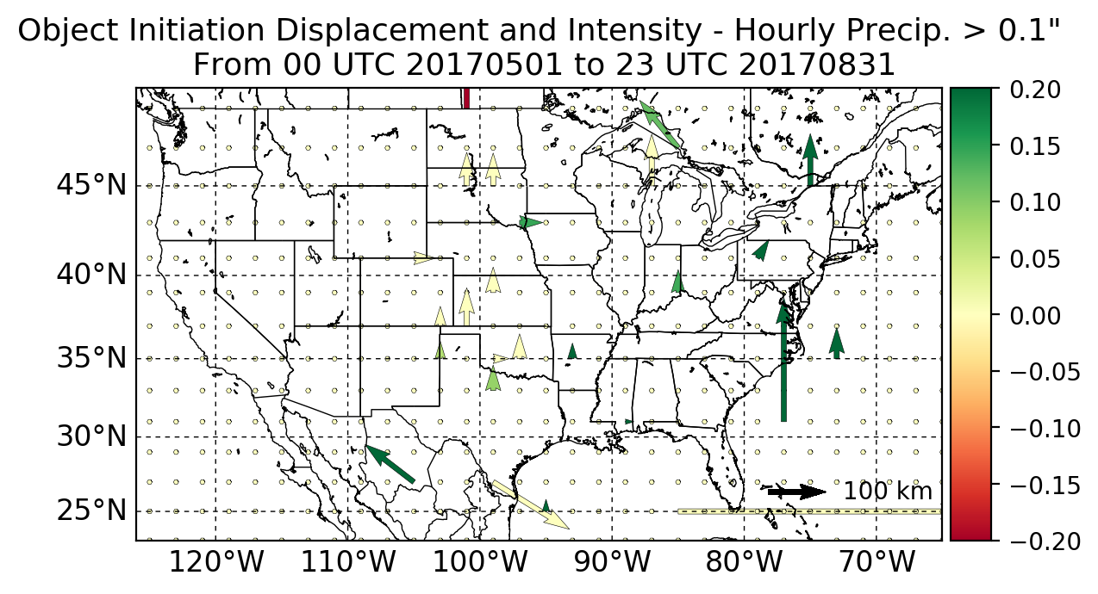
C) Paired Object Initiation Displacement at > 0.1”
HRRRv2 Displacement
HRRRv2 and HRRRv3 have a similar north/northeast displacement bias for the initiation of the precipitation objects.
Sample size is more limited for initiation compared to by-hour results, with most locations not having statistically significant displacement.
HRRRv3 Displacement

Slide 30
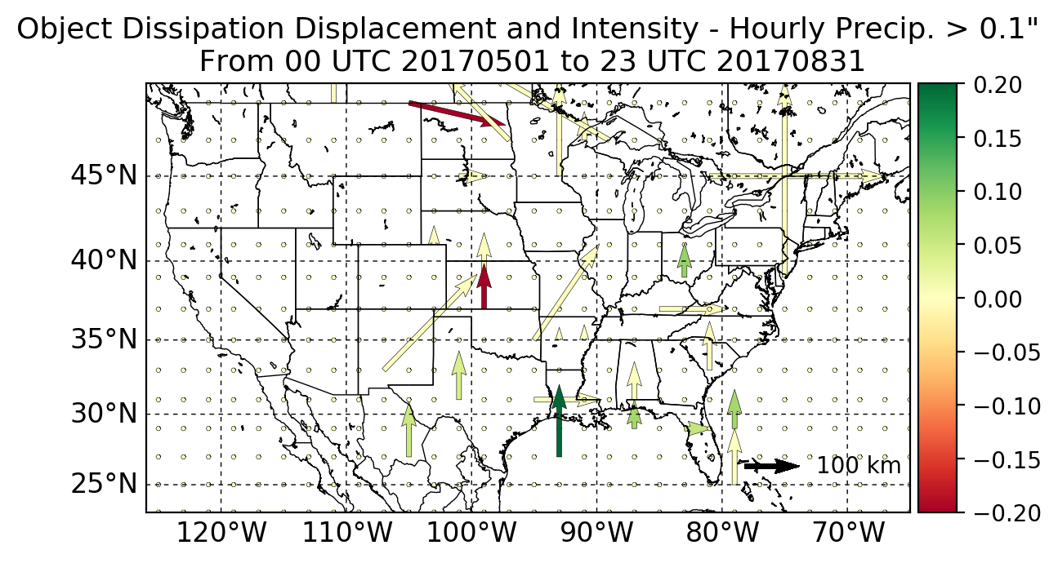
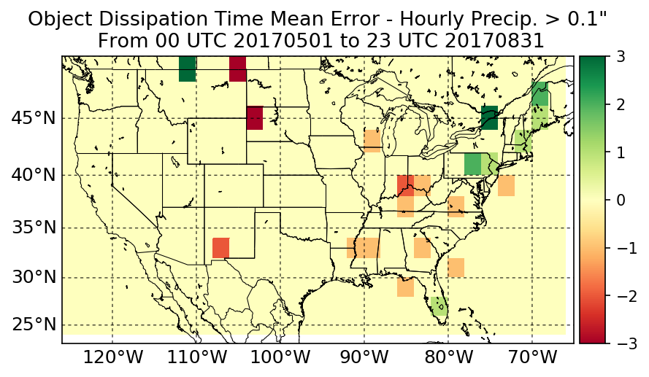
C) Paired Object Dissipation Timing and Displacement at 0.1”
Object Dissipation Timing Diff. – HRRRv2
Object Dissipation Displacement Diff. – HRRRv2
HRRRv2 objects dissipate too quickly compared to analysis in portions of the Southeast and too slowly over the Northeast United States.
In general, HRRRv2 and HRRRv3 objects dissipate too far north in the eastern two-thirds of CONUS.
Object Dissipation Timing Diff. – HRRRv3
Object Dissipation Displacement Diff. – HRRRv3

Slide 31
Conclusions
The Weather Prediction Center (WPC) is tracking heavy precipitation objects using the Model Evaluation Tools (MET). Object-oriented verification has been implemented on internal websites and within WPC’s Flash Flood and Intense Rainfall (FFaIR) experiment.
The MET tracker has been used to analyze object-oriented biases in the High Resolution Rapid Refresh (HRRR) versions 2 and 3. In general:
Over most of CONUS, the HRRR does not produce enough precipitation objects, but they are too intense and too large.
An exception is over portions of the Plains/Eastern Rockies, where the HRRR underdoes the frequency, intensity, and size of objects.
The HRRR produces precipitation objects too far north and northeast, particularly in the Central Plains.

Slide 32
Future Work: Post-processing and FLASH
Simulated Reflectivity Example
For WPC forecasters: Display object oriented biases to forecasters in real-time. For example, object 1 is more likely to be displaced to the northeast in the HRRR than object 2. Spread is likely as useful as the mean information.
In hydrological modeling: Use object oriented biases in QPF to inform a post-processing technique recently developed for Flooded Locations and Simulated Hydrographs (FLASH). The Neighboring Pixels Ensemble Technique (NPET), which uses a search radius to find relevant QPF forecasts, can be modified based on the mean/spread of object attributes.
Or
Object 2
Object 1
https://www.tropicaltidbits.com/analysis/models
HRRRv2 - Intensity/Displacement > 0.25”

