Slide 1


August 4th, 2018
High End EF1 Tornado Strikes Webster and Dudley MA During The Morning
NOAA/National Weather Service
Boston/Norton, MA
Tri-State Weather Conference
September 29th, 2018

Slide 2
Overview: High End EF-1 Tornado
A tropical environment was in place with 70+ dewpoints and low LCL/s.
A shortwave/cold front was approaching with a modest southerly low level jet of 25 to 30 knots.
Greatest concern was localized flash flooding given strong forcing and high Pwat atmosphere.
There was concern for the low risk of a tornado, given a tropical environment in place and some low level helicity.
Sunshine very early in the morning across eastern New England likely contributed to the tornado. This caused a 10 degree temperature differential across the region. The two tornadoes touched down on the differential heating/mesoscale boundary.
An initial EF-0 tornado touched down in Woodstock, CT at 936 am with a discontinuous path before lifting in Thompson, CT at 945 am. Maximum winds were 80 mph with some isolated tree damage.
A second touchdown occurred at 959 am in Dudley, MA and exited Webster, MA at 10 am. While only on the ground for a half mile, it was a high end EF-1 Tornado with maximum winds of 110 mph. It knocked down many trees/utility poles and damaged some buildings and homes.
Isolated flash flooding occurred into the early evening hours, but as often is the case with tropical tornadoes there were no other reports of severe weather.

Slide 3
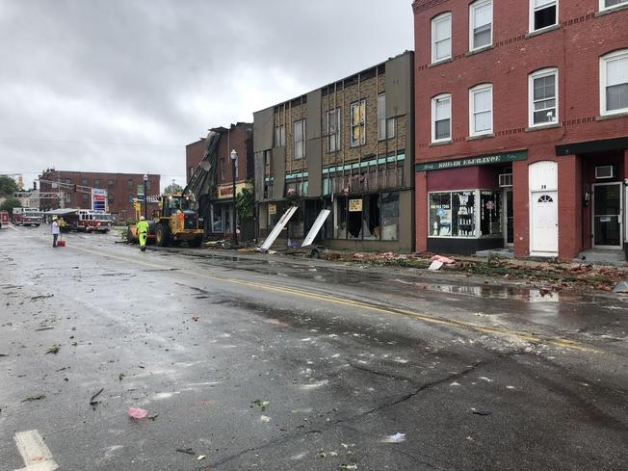
Webster, MA: High End EF1 Tornado Damage

Slide 4
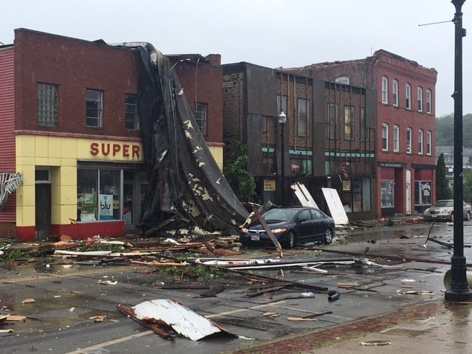
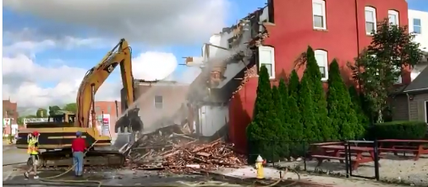
Webster, MA High End EF1 Tornado Damage

Slide 5
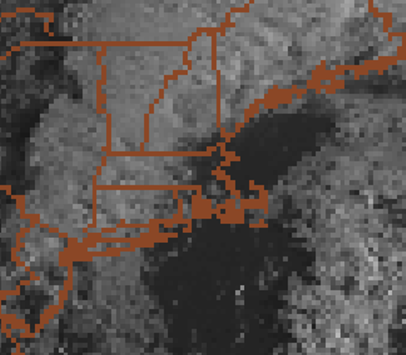

Visible Satellite Imagery: Valid 11z August 4th
Early morning sunshine allowed surface temperatures to climb into the lower 80s across eastern MA by mid morning.
Clouds and heavy showers kept western MA in the lower 70s.
This not only allowed for better instability to develop ahead of the showers and thunderstorms, but a differential heating boundary developed enhancing low level stretching/vorticity.

Slide 6
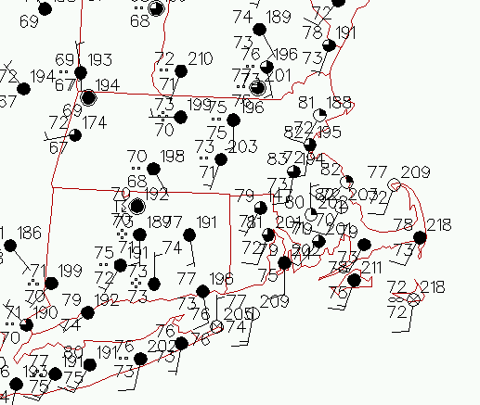
Surface Analysis: Valid 14z August 4th
Classic tropical tornado setup with low to mid 70 dewpoints in place along with low LCL/s.
Some partial sunshine occurred across eastern New England during the morning, setting up a differential heating boundary.
The two tornadoes touched down on the differential heating axis. Temps ranged from lower 70s west of axis with lower 80s east.
Differential Heating Boundary

Slide 7
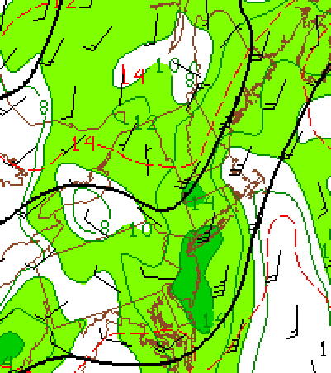
SPC: Meso- Analysis: Valid 14Z August 4th
850 MB Low Level Jet
Impressive 850 mb low level jet of 25 to 30 knots ahead of an approaching shortwave and cold front.
This was right around the time of the two tornado touchdowns.

Slide 8
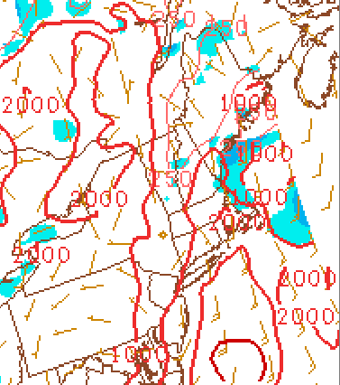
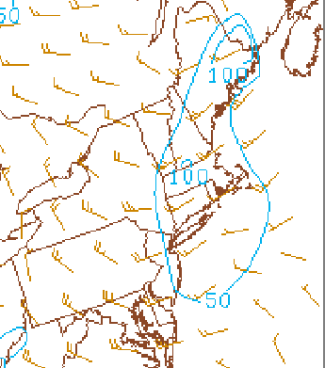
SPC: Meso- Analysis: Valid 13z Aug 4th
Surface Cape
0 to 1 KM Helicity
1500-2000 J/KG of surface cape, higher then most of our tropical tornadoes.
0-1 KM helicity depicted less than 100 units. Higher capes likely compensated.
Helicity may have been higher on the mesoscale given differential heating axis.

Slide 9
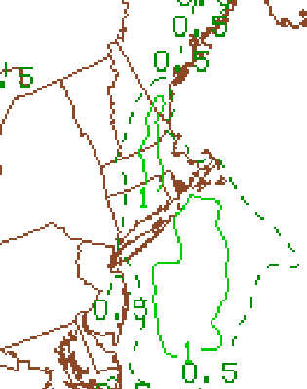
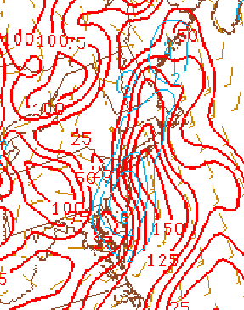
SPC: Meso- Analysis: Valid 14z August 4th
0 to 3 KM Cape
0 to 1 KM EHI
0 to 3 KM Cape near 125 J/KG: Quite high in low levels/stretches vorticity.
EHI values greater than 1 across northeast CT/central MA. Indicates where better cape/helicity overlap. That was certainly a clue on the tornadic potential.

Slide 10
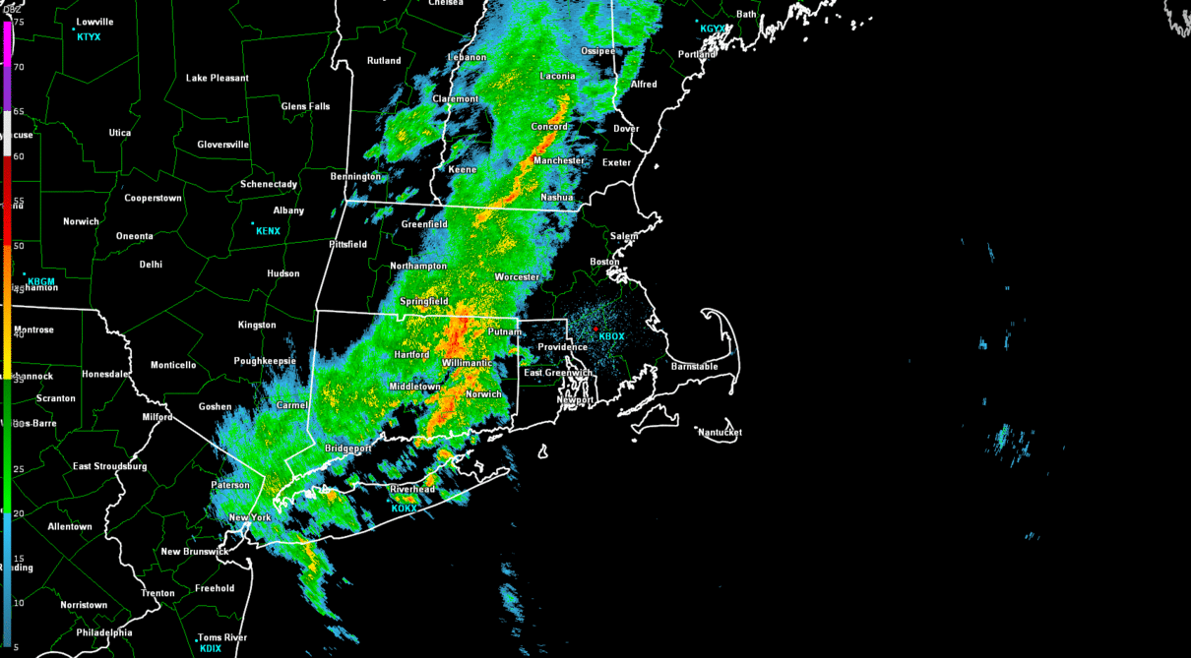
Radar Loop Between 1315 And 1415Z
Showers/thunderstorms lifting northeast across southern New England.
Two tornado touchdowns occurred on the differential heating boundary, which developed from morning sunshine across eastern New England.

Slide 11
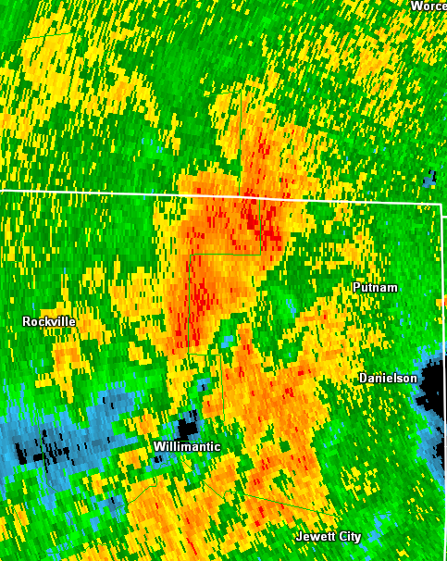
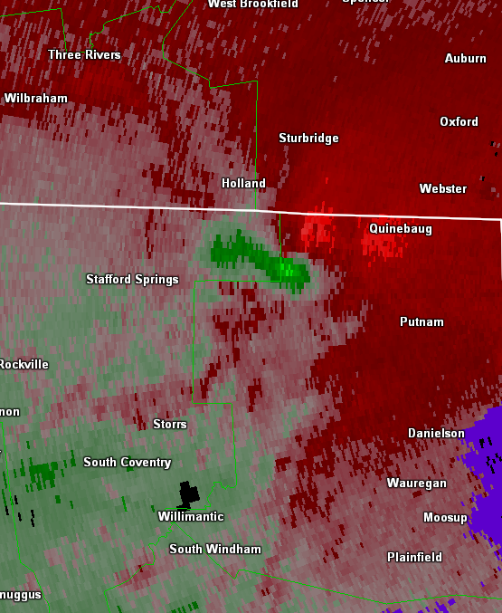
0.5 REF: 1331Z
0.5 SRM: 1331Z
Broad rotational velocity around 28 knots.
Approximately 5 minutes before tornado touchdown in Woodstock, CT.

Slide 12
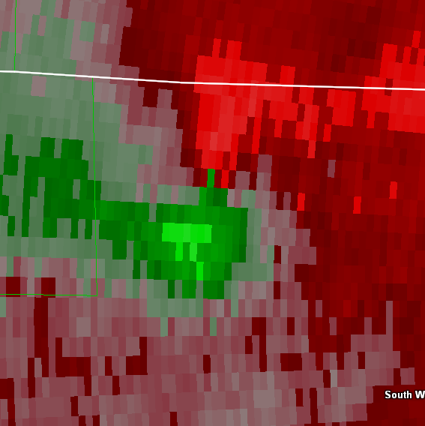
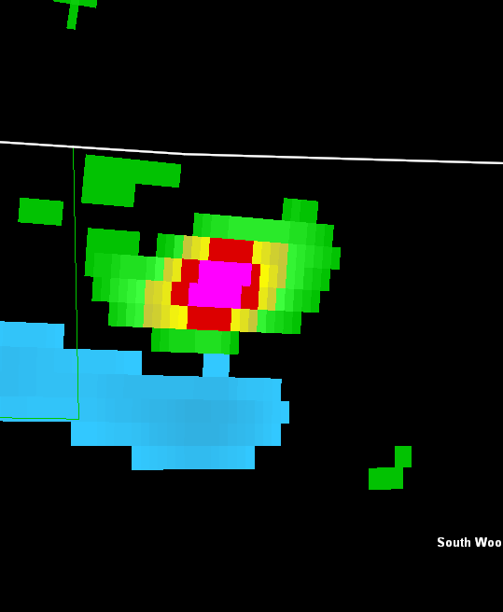
0.5 SRM: 1334Z
0.5 NROT: 1334Z
2 minutes before tornado touchdown in Woodstock, CT
Gate to gate shear of 49 knots with NROT of 1.2.
Given above parameters coupled with tropical environment, a tornado warning was certainly warranted.

Slide 13
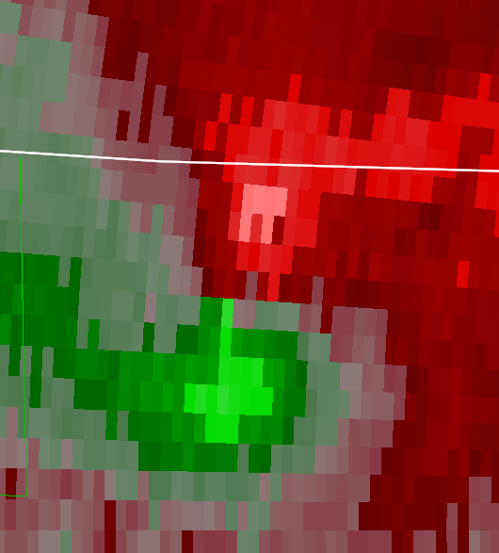
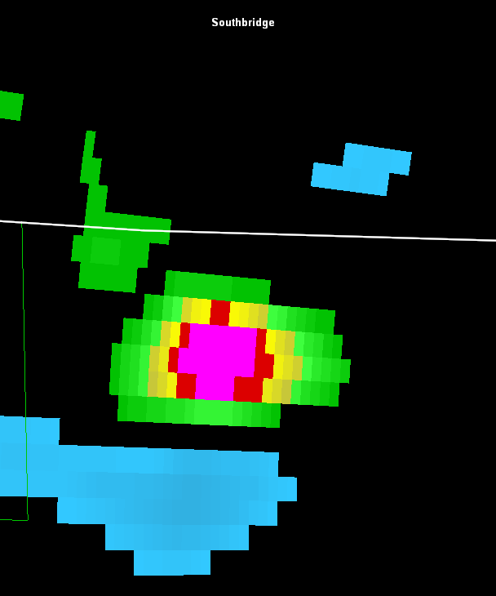
0.5 SRM: 1336Z
0.5 NROT: 1336Z
EF-0 Tornado touches down in Woodstock, CT
While not gate to gate, rotational velocity around 34 knots and symmetrical. NROT impressive for our region with values over 1.3!
NROT near 1 should strongly be considered for tornado warnings.

Slide 14
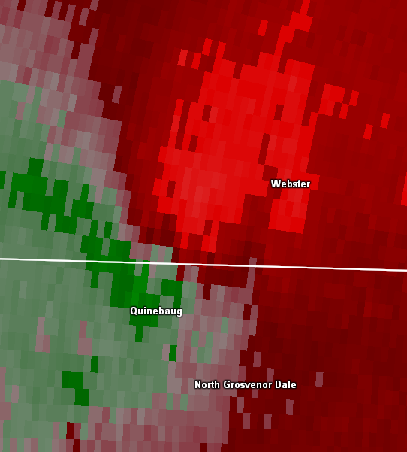
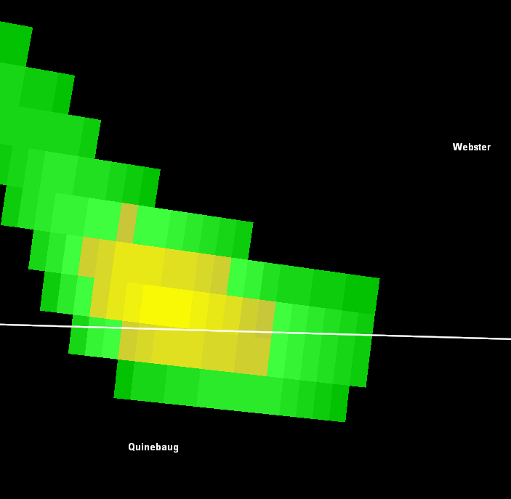
0.5 SRM: 1349Z
0.5 NROT: 1349Z
Rotational velocity weakened to 21 knots southwest of Webster and was fairly broad. NROT also dropped below 1.
While this imagery does not warrant an initial tornado warning, it is certainly worth continuing. These signatures often recycle and quickly can drop a new tornado in a tropical environment.

Slide 15
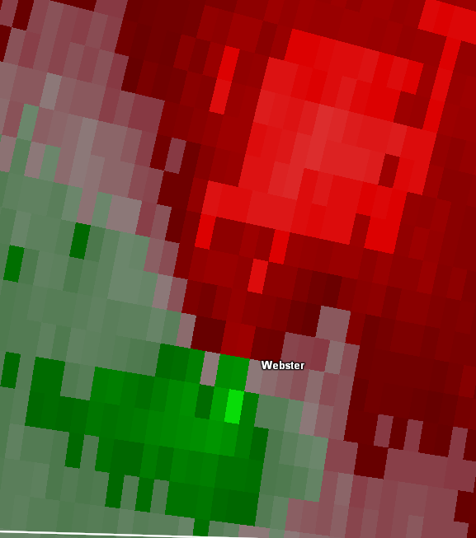
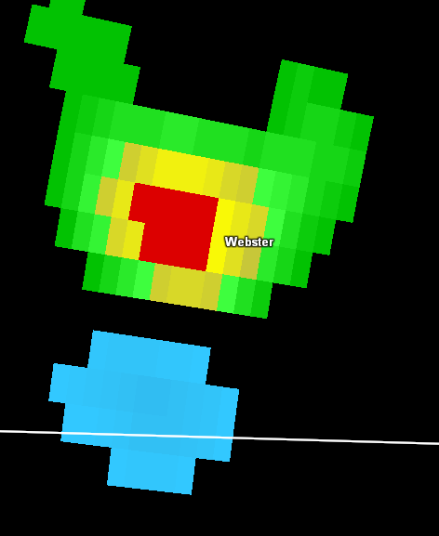
0.5 SRM: 1356Z
0.5 NROT: 1356Z
Rotational velocity broad but increased to about 29 knots. NROT back up to over 0.90. 3 minutes before high end EF1 Tornado touches down in Webster.
Criteria is right on the cusp of a what would warrant a tornado warning, but given the tropical environment better to error on side of caution. Low LCL/s with a tropical environment offer little opportunity for lead time.

Slide 16
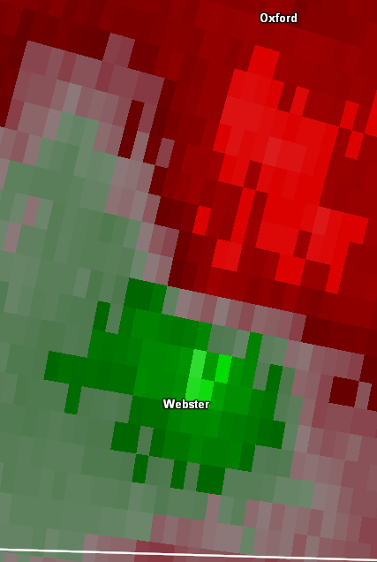
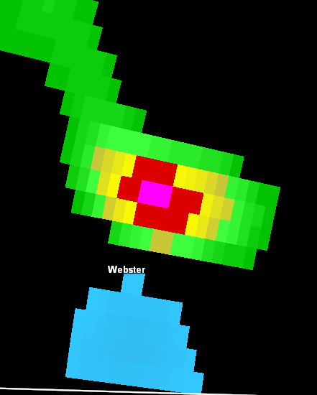
0.5 SRM: 1359Z
0.5 NROT: 1359Z
High End EF1 Tornado touches down in Webster, MA with 110 mph winds.
Rotational Velocity only 23 knots, but circulation very symmetrical. NROT also increased to over 1.
A good example on how the rotation does not need to be extreme to produce tropical tornadoes. This 2nd touchdown was much stronger than the initial one in CT. However, circulation was likely very shallow and not detected as well by radar.

Slide 17
Lessons Learned From This Event
Situational awareness is extremely important. While localized flash flooding was the higher risk, concern for a brief tornado existed given the tropical environment in place.
If there is any concern about tornadoes definitely utilize Sails 3.
The two touchdowns occurred along a differential heating axis as a result of early morning sunshine across eastern MA. Boundary likely helped stretch vorticity and enhance low level helicity.
The signature that produced the weak tornado across Woodstock, CT was much more impressive than what the radar depicted in Webster, MA which resulted in the high end EF-1 Tornado and much more damage.
Radar sampling often an issue especially with tropical tornadoes as the radar can over shoot the shallow/low level circulation. There is not a golden bullet for issuing tornado warnings, but lower thresholds are a very good idea in these type of environments.

