Slide 1
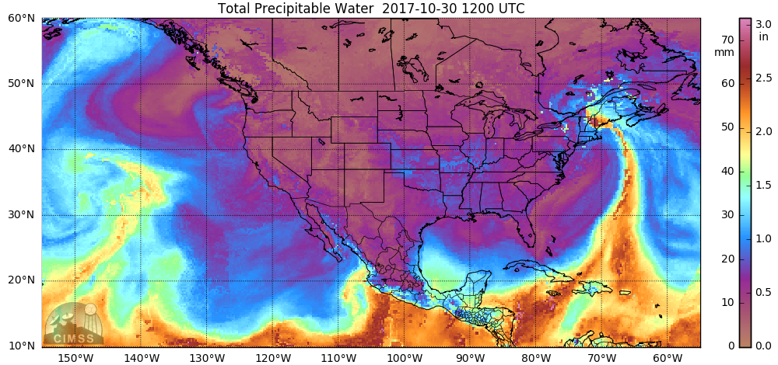
A Scale to Characterize the Strength and Impact of Atmospheric Rivers
Jason M. Cordeira
Meteorology Program, Plymouth State University
With contributions from F. Martin Ralph (UCSD/Scripps) and Jonathan R. Rutz (NWS/WRH)
Provided by University of Wisconsin; CIMSS
Saturday, 29 September 2018
Tri-State Weather Conference
Western Connecticut State University, Danbury, Connecticut

Slide 2
ATMOSPHERIC RIVER: A long, narrow and transient corridor of strong horizontal water vapor transport that is typically associated with a low-level jet stream ahead of the cold front of an extratropical cyclone. The water vapor in atmospheric rivers is supplied by tropical and/or extratropical moisture sources. Atmospheric rivers frequently lead to heavy precipitation where they are forced upward, e.g., by mountains or by ascent in the warm conveyor belt. Horizontal water vapor transport in the mid-latitudes occurs primarily in atmospheric rivers and is focused in the lower troposphere.
– Added to AMS Glossary of Meteorology May 2017 (as described by Ralph et al. 2018, BAMS)

Slide 3
Adapted from AMS Glossary definition of an “Atmospheric River”
L
Jay’s short definition:
Long (>2000 km) and narrow (<1000 km) corridors of enhanced integrated water vapor (IWV) and IWV Transport (IVT) located in the warm sector of their parent midlatitude cyclone along a low-level jet stream
IVT (kg m^{–1} s^{–1})
250–500
500–750
3.0
>750
2.0 cm IWV
2.5
3.0

Slide 4


Water vapor transport along AR & orographic precipitation
3 km
AR characteristics:
75% of water vapor flux below 2.25 km
Water vapor flux maximum at ~1 km
Forced saturated ascent (upslope/isentropic)
Orographic Precipitation
2 km
0°C
Upslope
1 km
Water Vapor Transport
Upslope
Atmospheric River
Coastal and/or interior mountains
0 km
Pacific Ocean
Stream flow
J. Cordeira

Slide 5
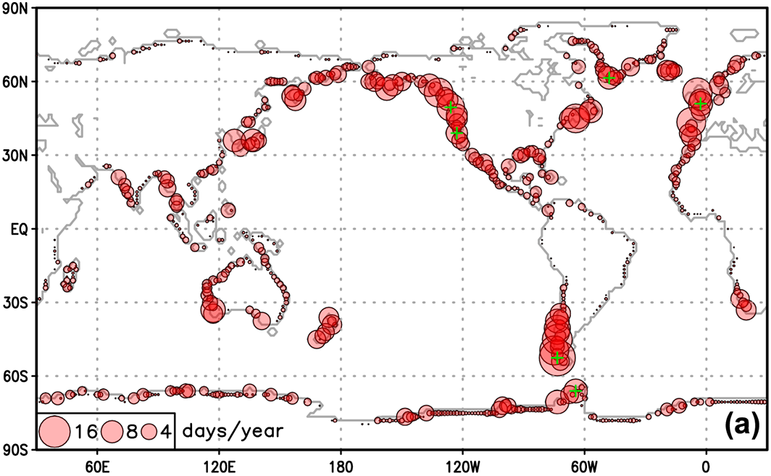
Global AR landfall frequency
Guan and Waliser (2015)

Slide 6
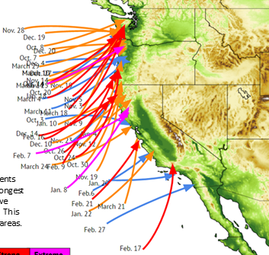
AR landfall along U.S. West Coast 2016–2017
CW3E: Ralph et al. (2017)
45+ AR landfalls
Northern Sierra wettest season on record
Large focus of AR research is on U.S. West Coast…
Landfalling ARs 1 October 2016 through 31 March 2017 (N=45)

Slide 7
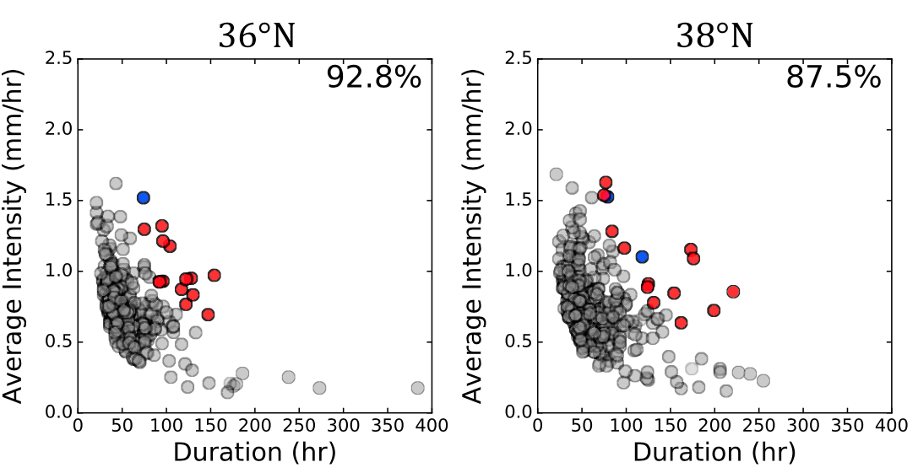
ARs and Precipiation
A large majority of most intense, longest duration precipitation events are associated with strong ARs along U.S. West Coast (e.g., California below)
~San Francisco Area
Fraction of 2-y storms that are ARs
Fraction of 2-y storms that are ARs
2-y storms that produce >25.4 mm
AR Storms
w/ return period >2y
AR Storms
w/ return period >2y
All storms that produce >25.4 mm
Lamjiri et al. (2017)

Slide 8
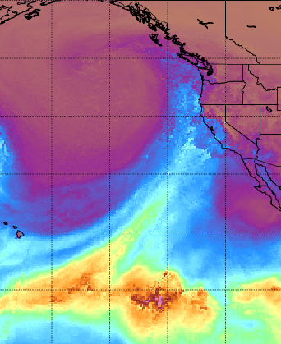
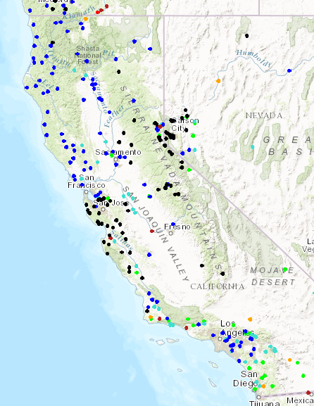
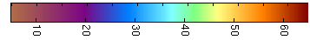
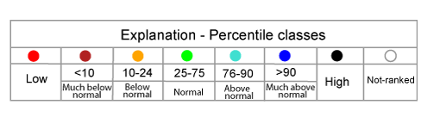
Example of an Extreme Event on 8–9 January 2017
1500 UTC 8 Jan 2017
Satellite-derived Precipitable Water
1500 UTC 9 Jan 2017
USGS streamflow Percentile
CIMSS
18–22”
of rain
Record Streamflow
AR
Total Precipitable Water (mm)

Slide 9
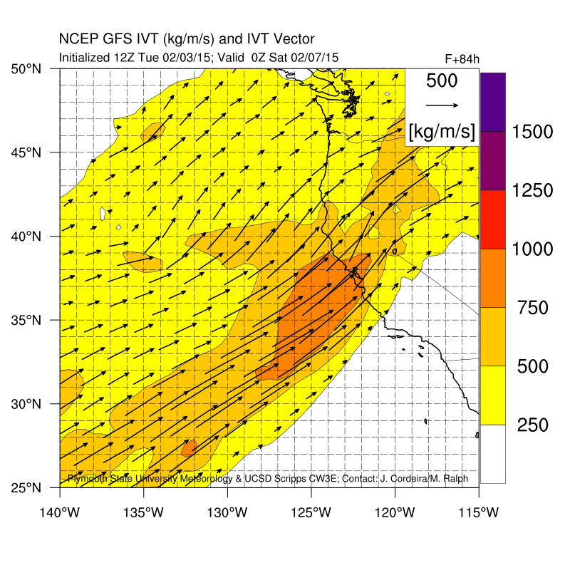
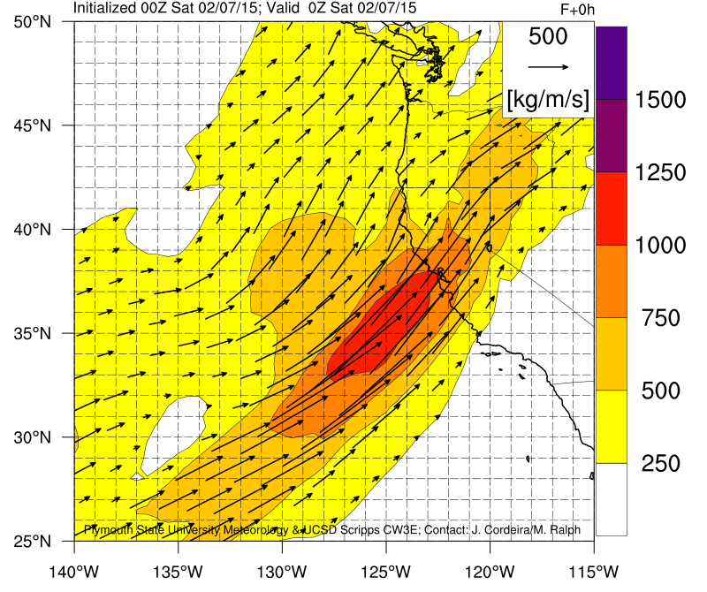
Development of an AR Scale
NCEP–GFS 84-h Forecast and Analysis valid 7 February 2015
Plot: Integrated Vapor Transport (IVT) magnitude (shaded) and direction (arrows)
“Common practice” during field campaigns to use 250 kg m^{–1} s^{–1} intervals of IVT to describe magnitude of forecasted and analyzed landfalling ARs along U.S. West Coast.
Nothing magical about minimum 250 kg m^{–1} s^{–1} → freq. ~10 events/year NorCal

Slide 10
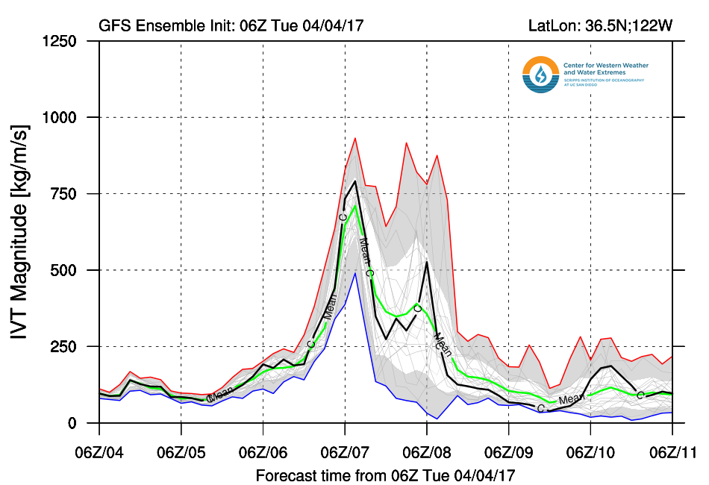
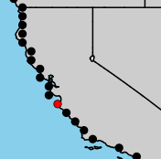
Development of an AR Scale
NCEP–GFS Ensemble IVT plume initialized 0600 UTC 4 April 2017

Slide 11
Development of an AR Scale – Intensity + Duration
NCEP–GFS Ensemble IVT plume initialized 0600 UTC 4 April 2017
Not an AR

Slide 12
Development of an AR Scale – Intensity + Duration
NCEP–GFS Ensemble IVT plume initialized 0600 UTC 4 April 2017
Extreme AR
Strong AR
Moderate AR
Weak AR
Not an AR

Slide 13
Development of an AR Scale – Intensity + Duration
>1250 kg m^{–1} s^{–1}
Exceptional AR
Extreme AR
Strong AR
Moderate AR
Weak AR
Not an AR

Slide 14
Development of an AR Scale – Intensity + Duration
The AR CAT level of an AR Event is based on its Duration and max Intensity
AR CAT (1–5)
(Denoted by color)
Determining AR Intensity and Category
From gridded analysis, forecast, or observational data
AR Intensity Name
4
5
5
Exceptional
Step 1: Pick a location
1250
3
4
5
Extreme
Step 2: Identify continuous past or forecast period when IVT mag. >250 kg m^{–1} s^{–1} in 3-h data in AR
1000
2
3
4
Strong
750
Step 3: Determine AR Intensity
Identify maximum IVT mag. during AR at location
Sets AR intensity & preliminary AR CAT
AR Intensity
Maximum IVT (kg m^{–1} s^{–1})
1
2
3
Moderate
500
X
1
2
Weak
250
Step 4: Determine final AR Cat:
If AR Duration ≥48 h, promote by 1 Category
If AR Duration <24 h, demote by 1 Category
Not an AR
24
48
AR Duration
(IVT>250 kg m^{–1} s^{–1}) (hours)

Slide 15
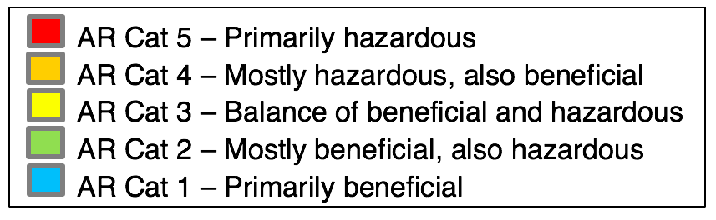
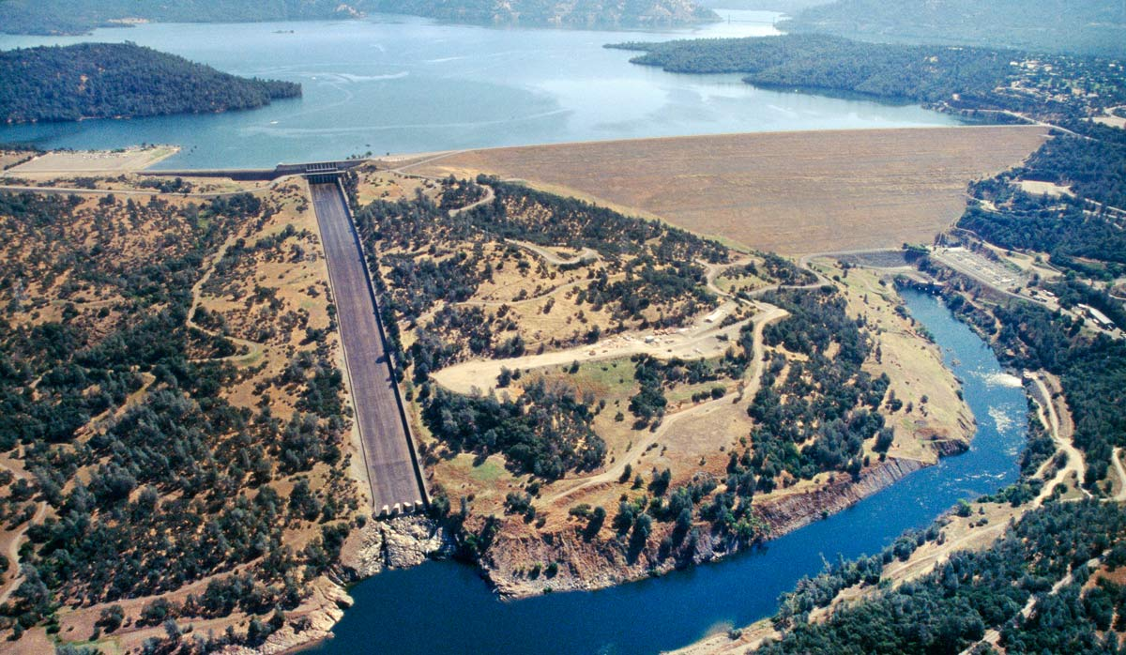
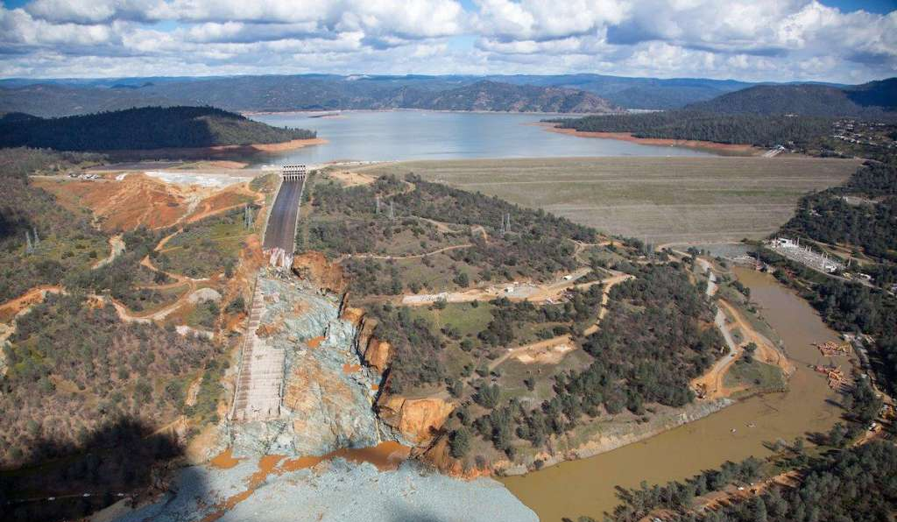
Development of an AR Scale – Intensity + Duration
The AR CAT level of an AR Event is based on its Duration and max Intensity
Lake Oroville Reservoir: Normal/full [23 June 2005]
Lake Oroville Reservoir: Damage [27 February 2017]

Slide 16
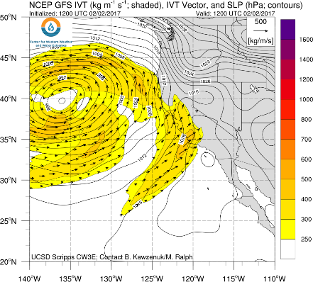
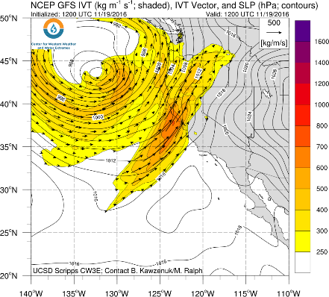
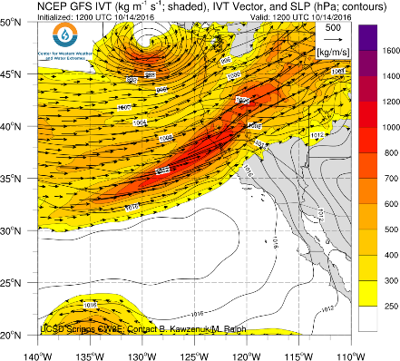
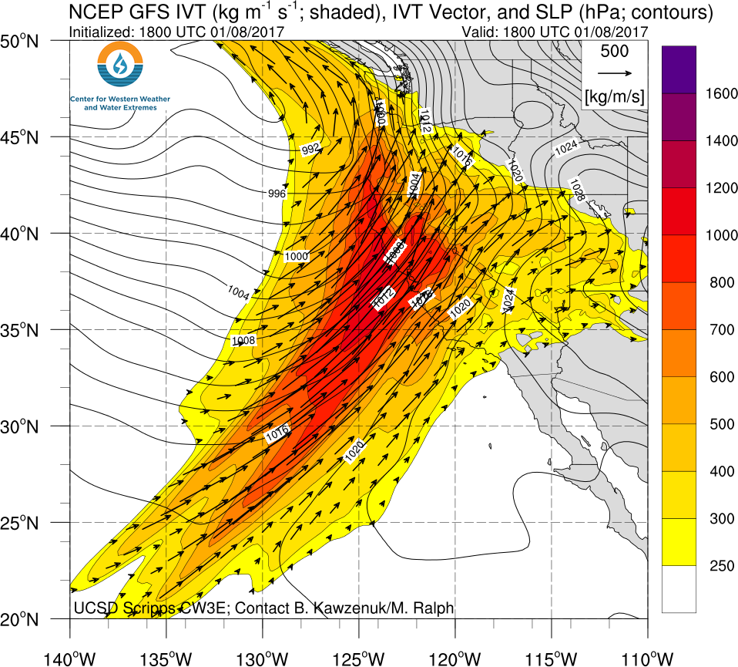
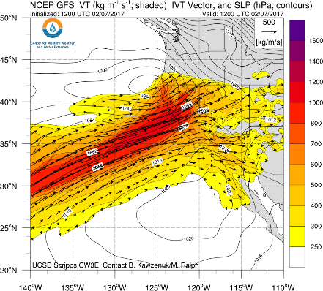
AR Scale Examples
1
2
3
4
5
Plot: IVT magnitude (shaded) & direction (arrows) with SLP (contours)

Slide 17
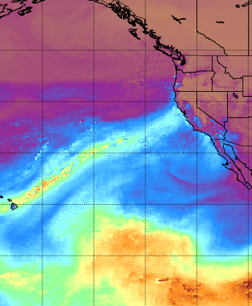

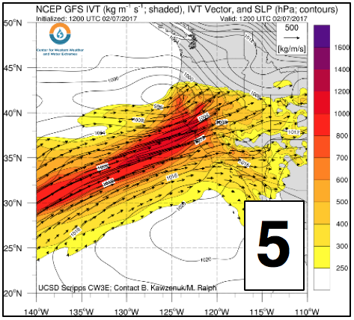
Examples of Extreme Events
1200 UTC 7 Feb 2017
Satellite-derived Precipitable Water
10 Feb 2017
Oroville Dam Spillway + Auxiliary Spillway Incident
CIMSS
AR
Total Precipitable Water (mm)
http://i.imgur.com/8Uj7Y7o.mp4

Slide 18
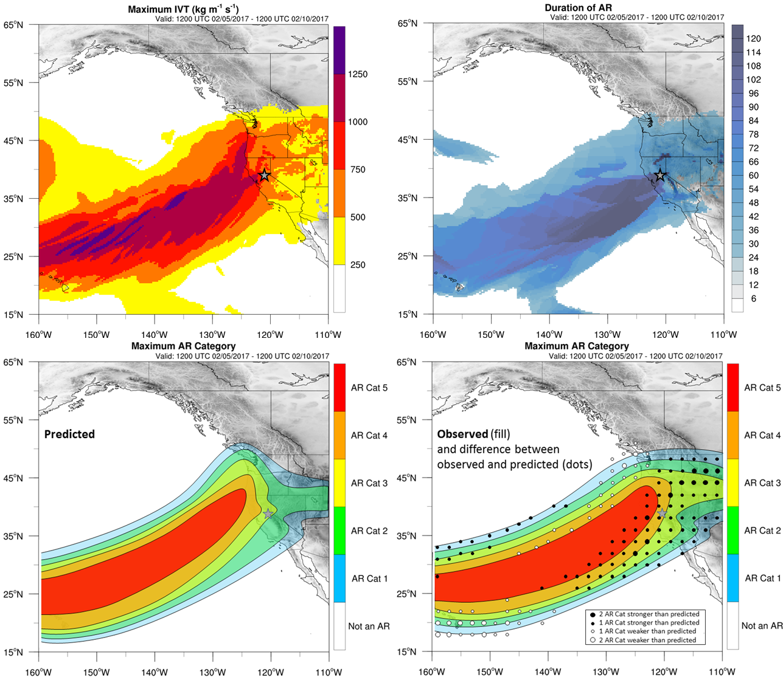
AR Scale Example: 5–10 February 2017
IVT >1000 kg m^{–1} s^{–1}
Duration >48 h
Max IVT during 120-h period
Duration of IVT>250 for 120-h period
Determining preliminary and final AR category:
Max IVT>1000 kg m^{–1} s^{–1} → Cat 4…
Duration >48 h → Promotes to Cat 5

Slide 19
AR Scale Example: 5–10 February 2017
Cat 3
Cat 4
AR Scale based on GFS forecasted maximum IVT and duration >250 kg m^{–1} s^{–1}
AR Scale based on GFS observed maximum IVT and duration >250 kg m^{–1} s^{–1} & anomaly (dots)

Slide 20
Seasonality of ARs at Bodega Bay, California
Seasonality of AR Cat events near Bodega Bay, California based on events from MERRA from Jan 1980–Apr 2017

Slide 21
Spatial Distribution: # ARs by Category per Year
1–2
3–5
5–10
10–15

Slide 22
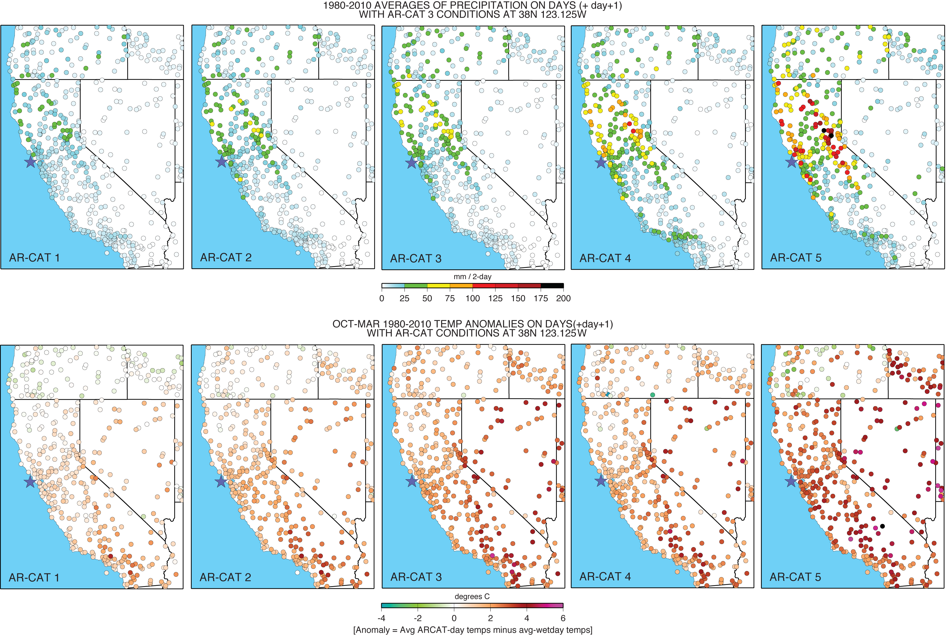
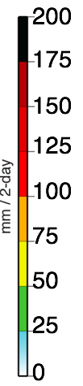
48-h Precipitation Associated with ARs by Category
<50 mm
25–75 mm
25–75 mm
50–100 mm
>100 mm

Slide 23
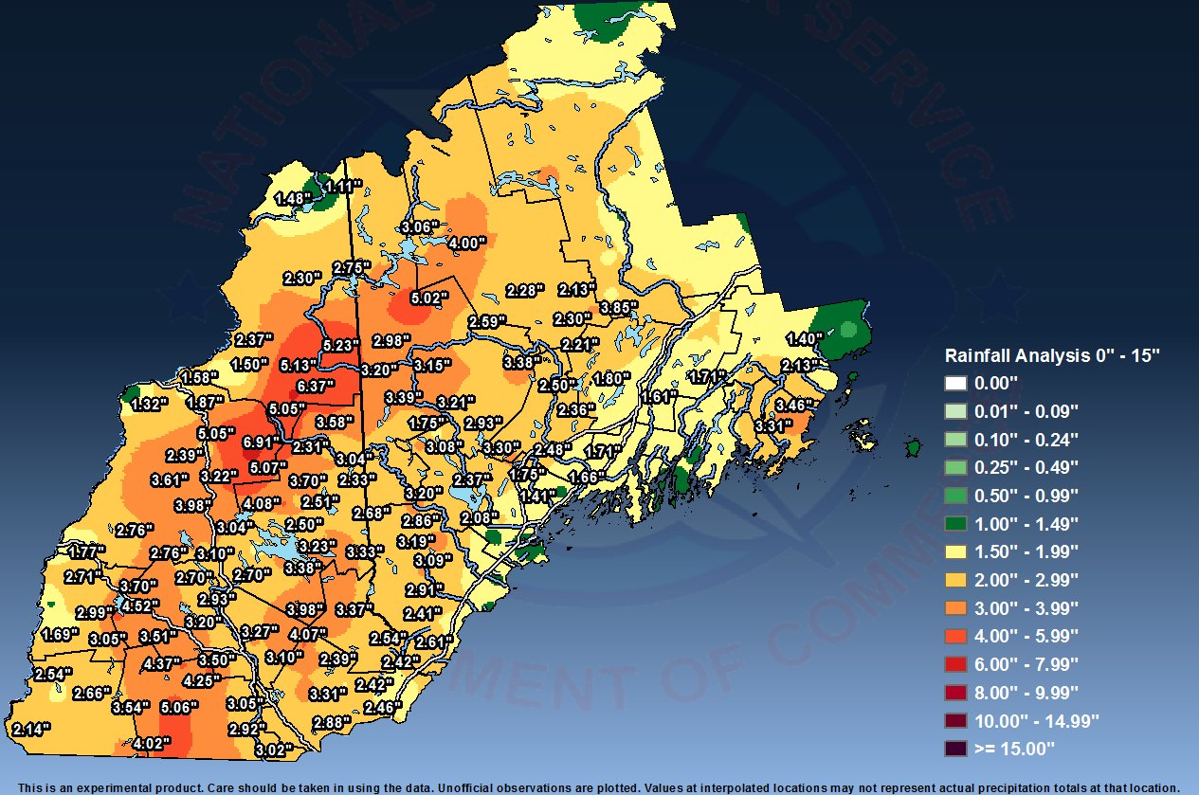
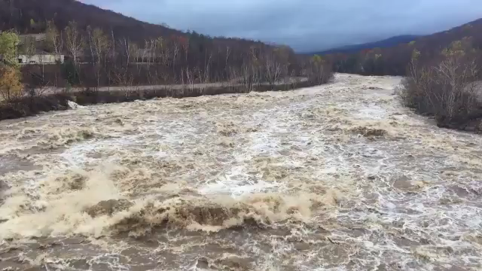
Examples of Extreme Events – An AR Cat 5 Event
1200 UTC 30 Oct 2017
Satellite-derived Precipitable Water
29–31 Oct 2017
NWS Gray, ME Precipitation Summary
CIMSS
Max IVT >1500 kg m^{–1} s^{–1}
Duration >250: 24–48 h
>5–7”
AR
Pemigewasset River at Loon Mountain
Total Precipitable Water (mm)
https://twitter.com/loonmtn/status/924974528945623040

Slide 24
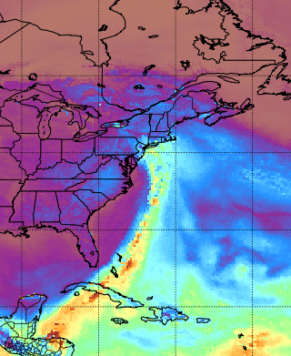
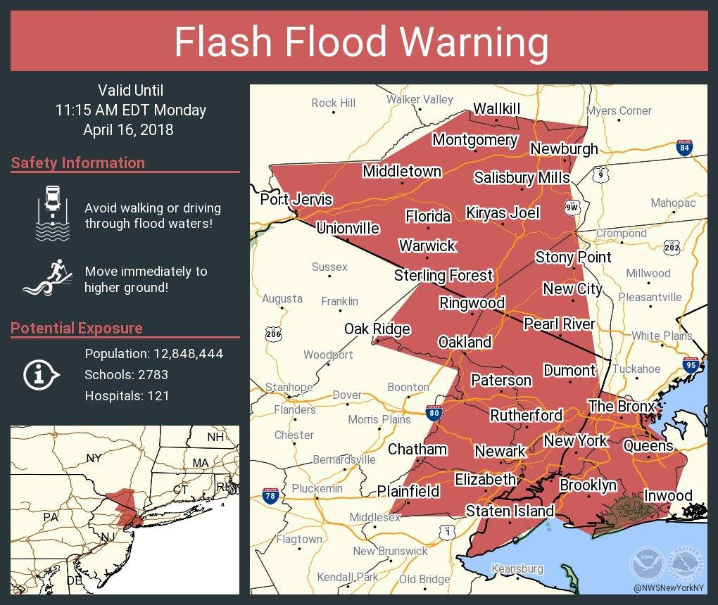

Examples of Extreme Events – An AR Cat 3/4 Event
1400 UTC 16 Apr 2018
Satellite-derived Precipitable Water
16 April 2018
NWS NY Social Media Post
CIMSS
Max IVT >1000 kg m^{–1} s^{–1}
Duration >250: ~24 h
AR
24-h rainfall amounts:
Westwood, NJ: 4.48”
Central Park: 3.29”
EWR: 2.99”
LGA: 2.50”
Total Precipitable Water (mm)
Flash Floods in NYC, 16 April 2018, Photo: NYPD 33rd Precinct

Slide 25
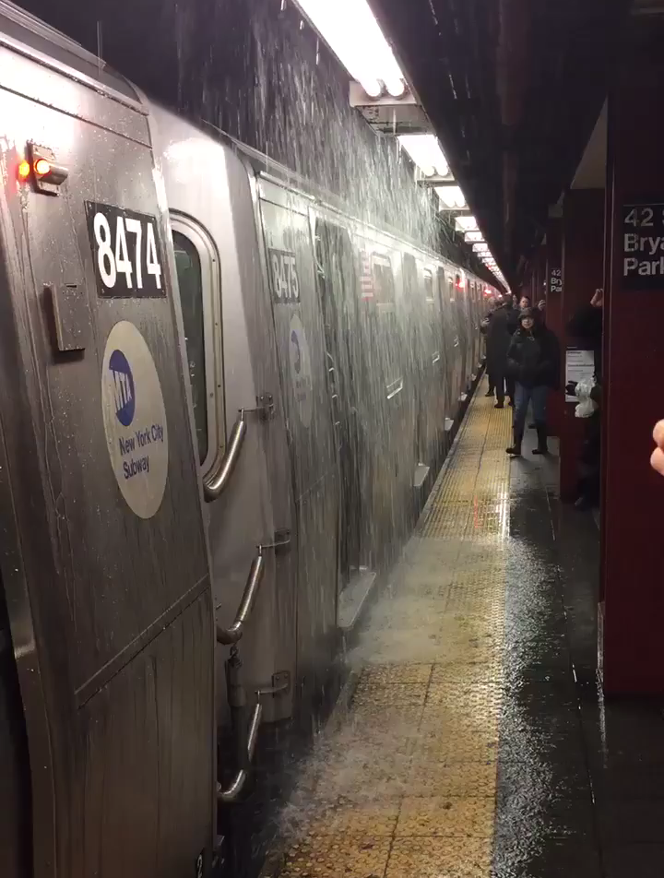

Examples of Extreme Events – An AR Cat 3/4 Event
1400 UTC 16 Apr 2018
Satellite-derived Precipitable Water
16 April 2018
@jeremymbarr – 9:51AM
CIMSS
Max IVT >1000 kg m^{–1} s^{–1}
Duration >250: ~24 h
AR
Total Precipitable Water (mm)

Slide 26
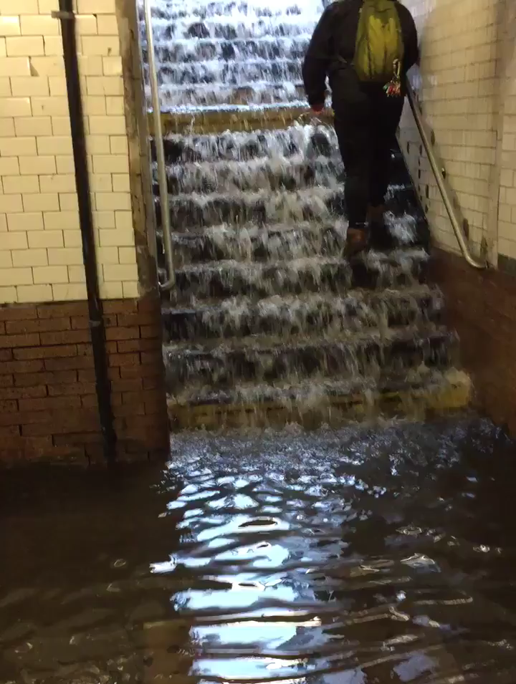

Examples of Extreme Events – An AR Cat 3/4 Event
1400 UTC 16 Apr 2018
Satellite-derived Precipitable Water
16 April 2018
@jbguild – 145th/Broadway 9:47AM
CIMSS
Max IVT >1000 kg m^{–1} s^{–1}
Duration >250: ~24 h
AR
Total Precipitable Water (mm)

Slide 27
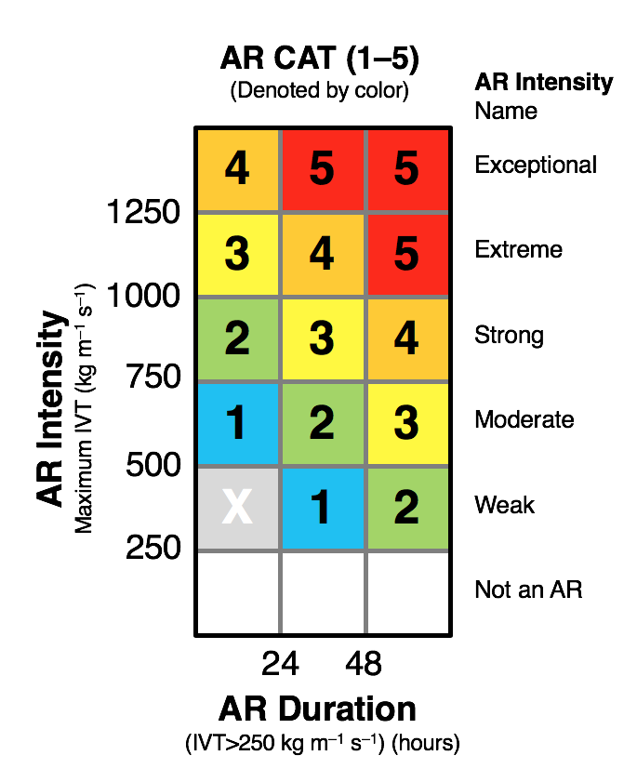
Closing Summary
A scale was developed to quantify strength and possible impacts of ARs [focused on West Coast of U.S.]
Scale has categories from 1 to 5 and is based on magnitude and duration of integrated vapor transport (IVT)
As categories increase, frequency of events decrease and possible impacts related to precipitation increase
**Categories may be a useful way to summarize potential impacts associated with ARs (but beware of their limitations!)

Slide 28
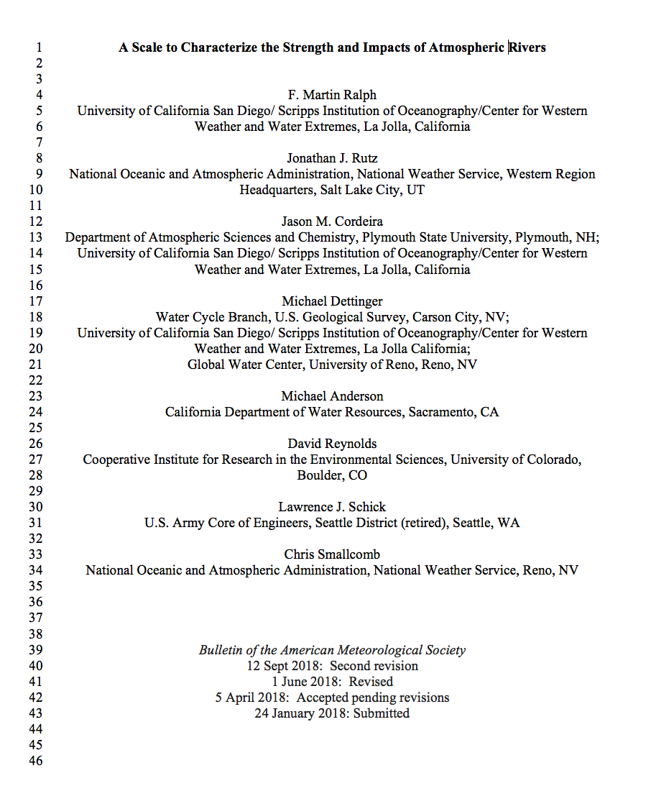
Closing Summary
Accepted for publication at BAMS on 9/18… look for it soon on BAMS Early Online Release
Note authors: Academic, NWS, Academic, USGS, California Dept. of Water Resources, NOAA, U.S. Army Corps, NWS…
ACCEPTED
Thank you!
j_cordeira@plymouth.edu
@jaycordeira
http://vortex.plymouth.edu
http://cw3e.ucsd.edu
AR

