Slide 1
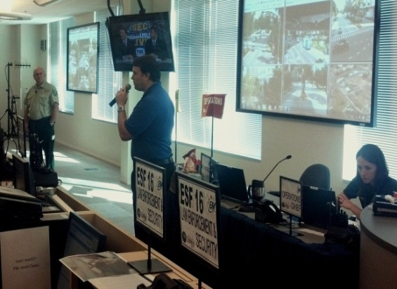
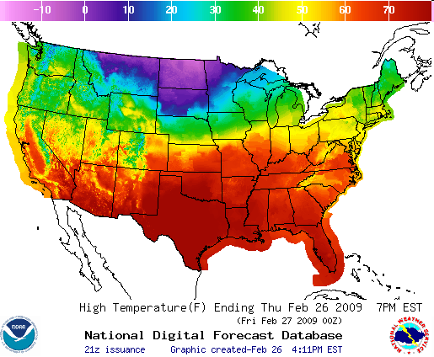
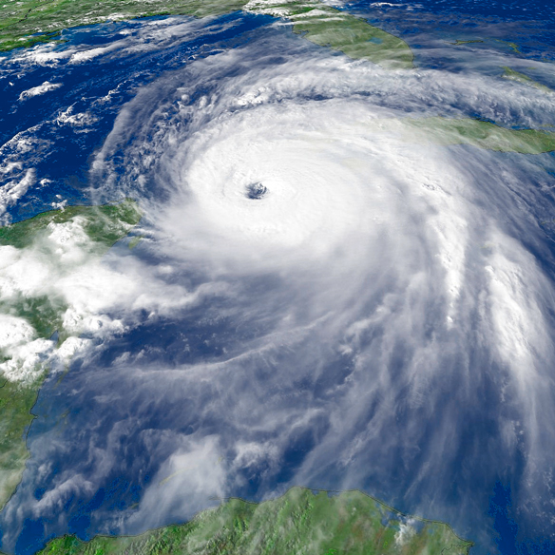
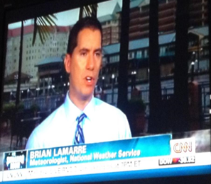


National Oceanic and Atmospheric Administration
Weather-Ready Nation:
Leading Public Resiliency and Reviewing Impacts from the 2017 Hurricane Season
Brian LaMarre
National Weather Service Meteorologist in Charge – Tampa Bay Area, FL
Notes:
A key part of the NWS strategic plan and campaign to Build a Weather-Ready Nation is impact-based decision support during all phases of weather events, from preparation to response to recovery.

Slide 2
“Meeting the evolving expectations of core partners and members of the weather enterprise and keeping pace with technology may require additional resources or shifts in how resources are aligned.”
Forecasts for the Future: Assuring the Capacity of the National Weather Service—NAPA, 2013

Slide 3
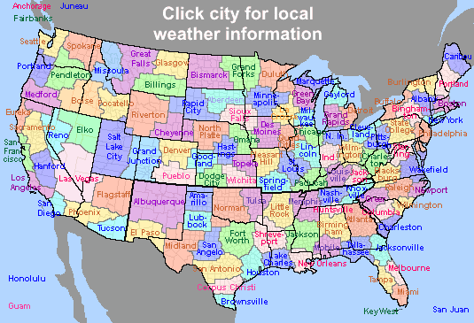
National Weather Service
Weather Forecast Offices
weather.gov
122 local offices

Slide 4
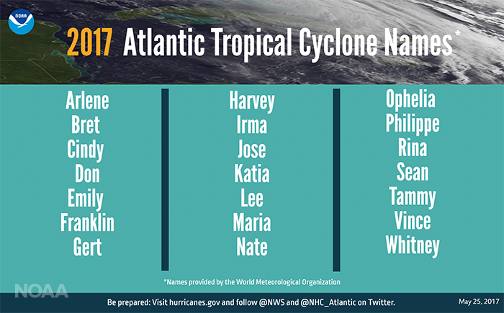

Slide 6
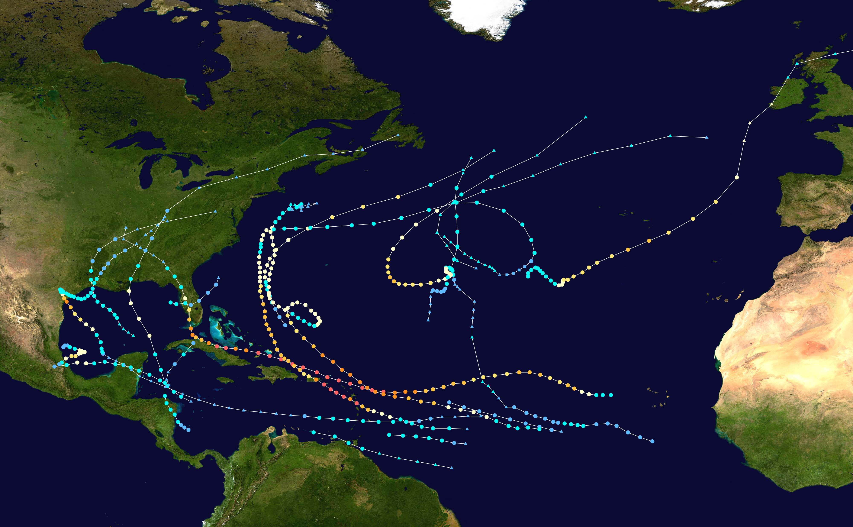
2017 Tropical Cyclone Season
Season total: 17/10/6
Average: 12/6/3
Record:
2005: 28/15/7
Hurricanes “Harvey”, “Irma”, and “Maria”
5th most active season – tied with 1936
The costliest season – $280+ B; nearly $100B over 2005

Slide 7
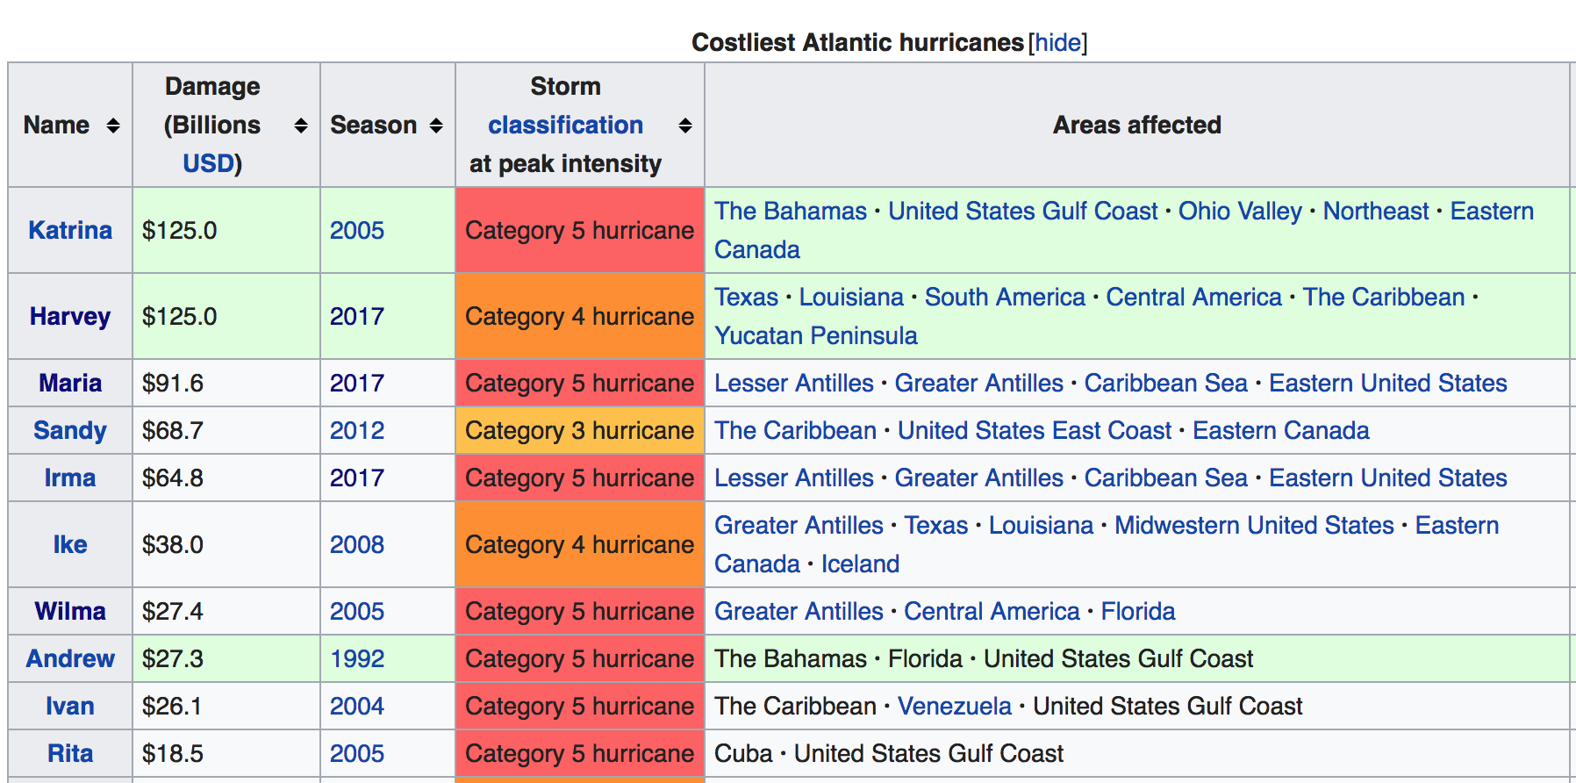

Slide 8
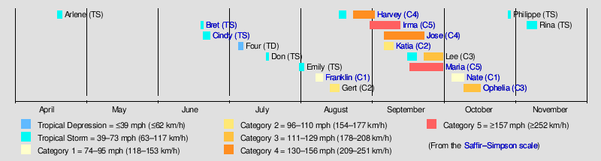

Slide 9
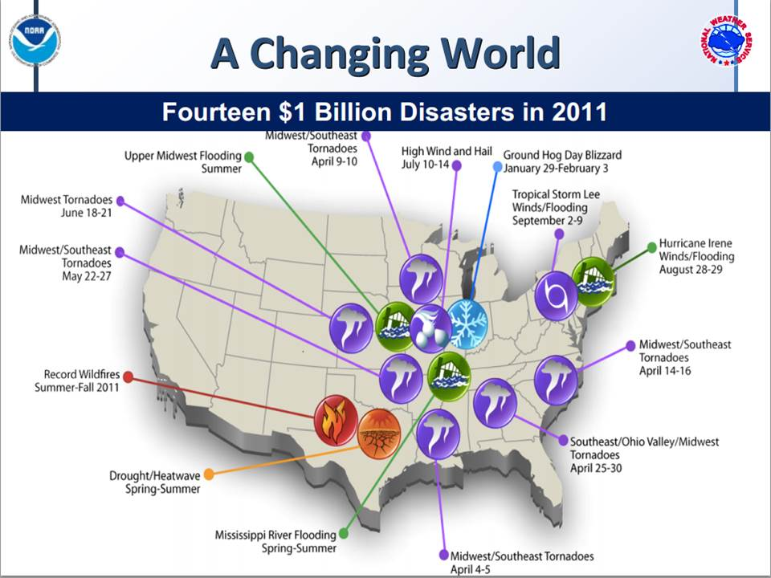
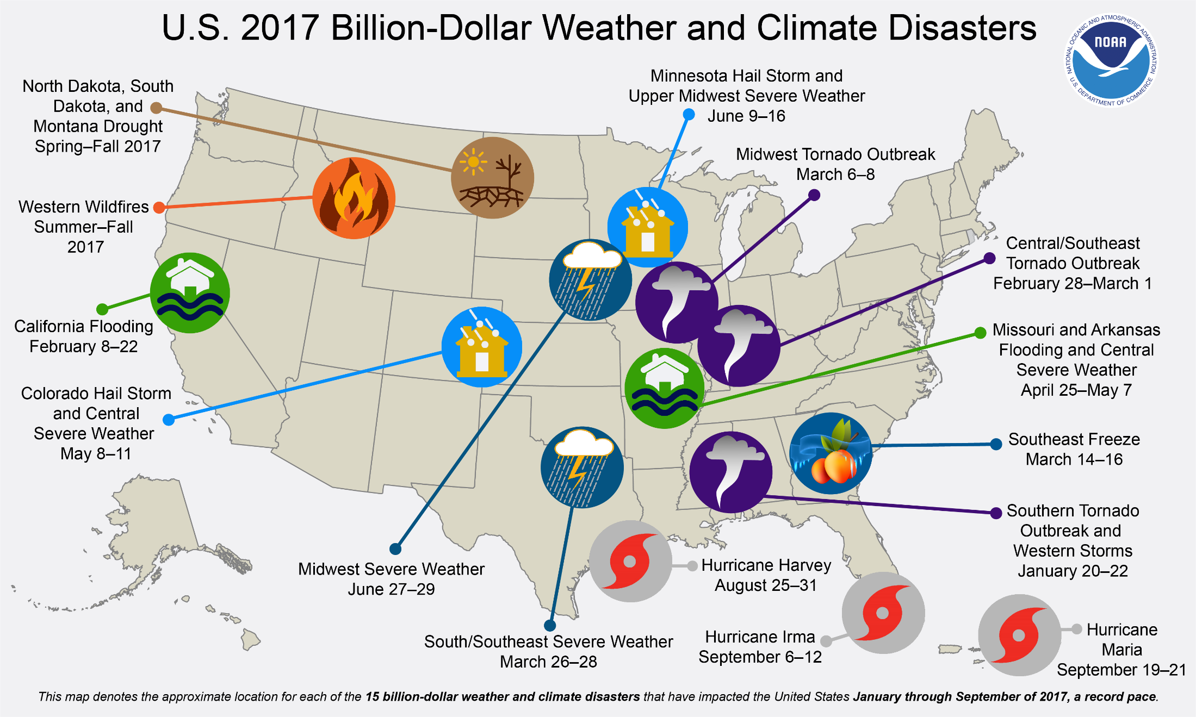
Sixteen $1 Billion Disasters in 2017

Slide 10
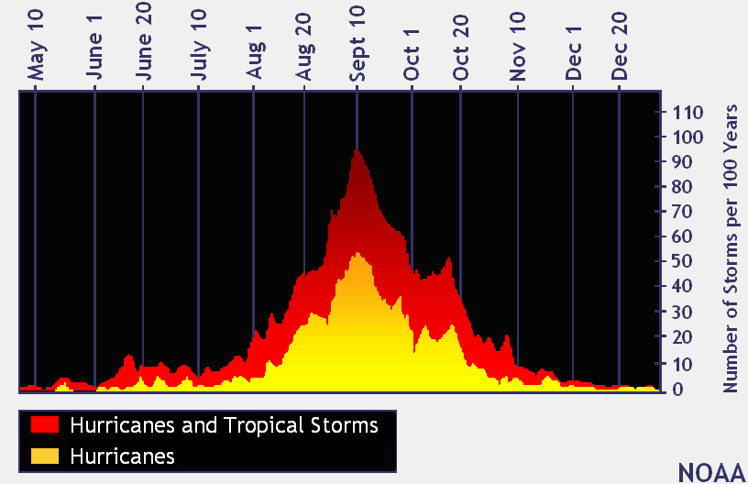
Hurricanes: When?

Slide 11
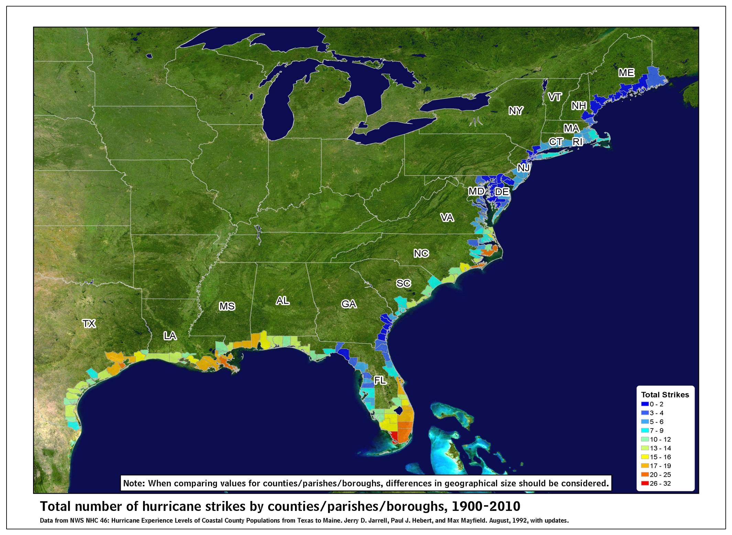

Slide 12
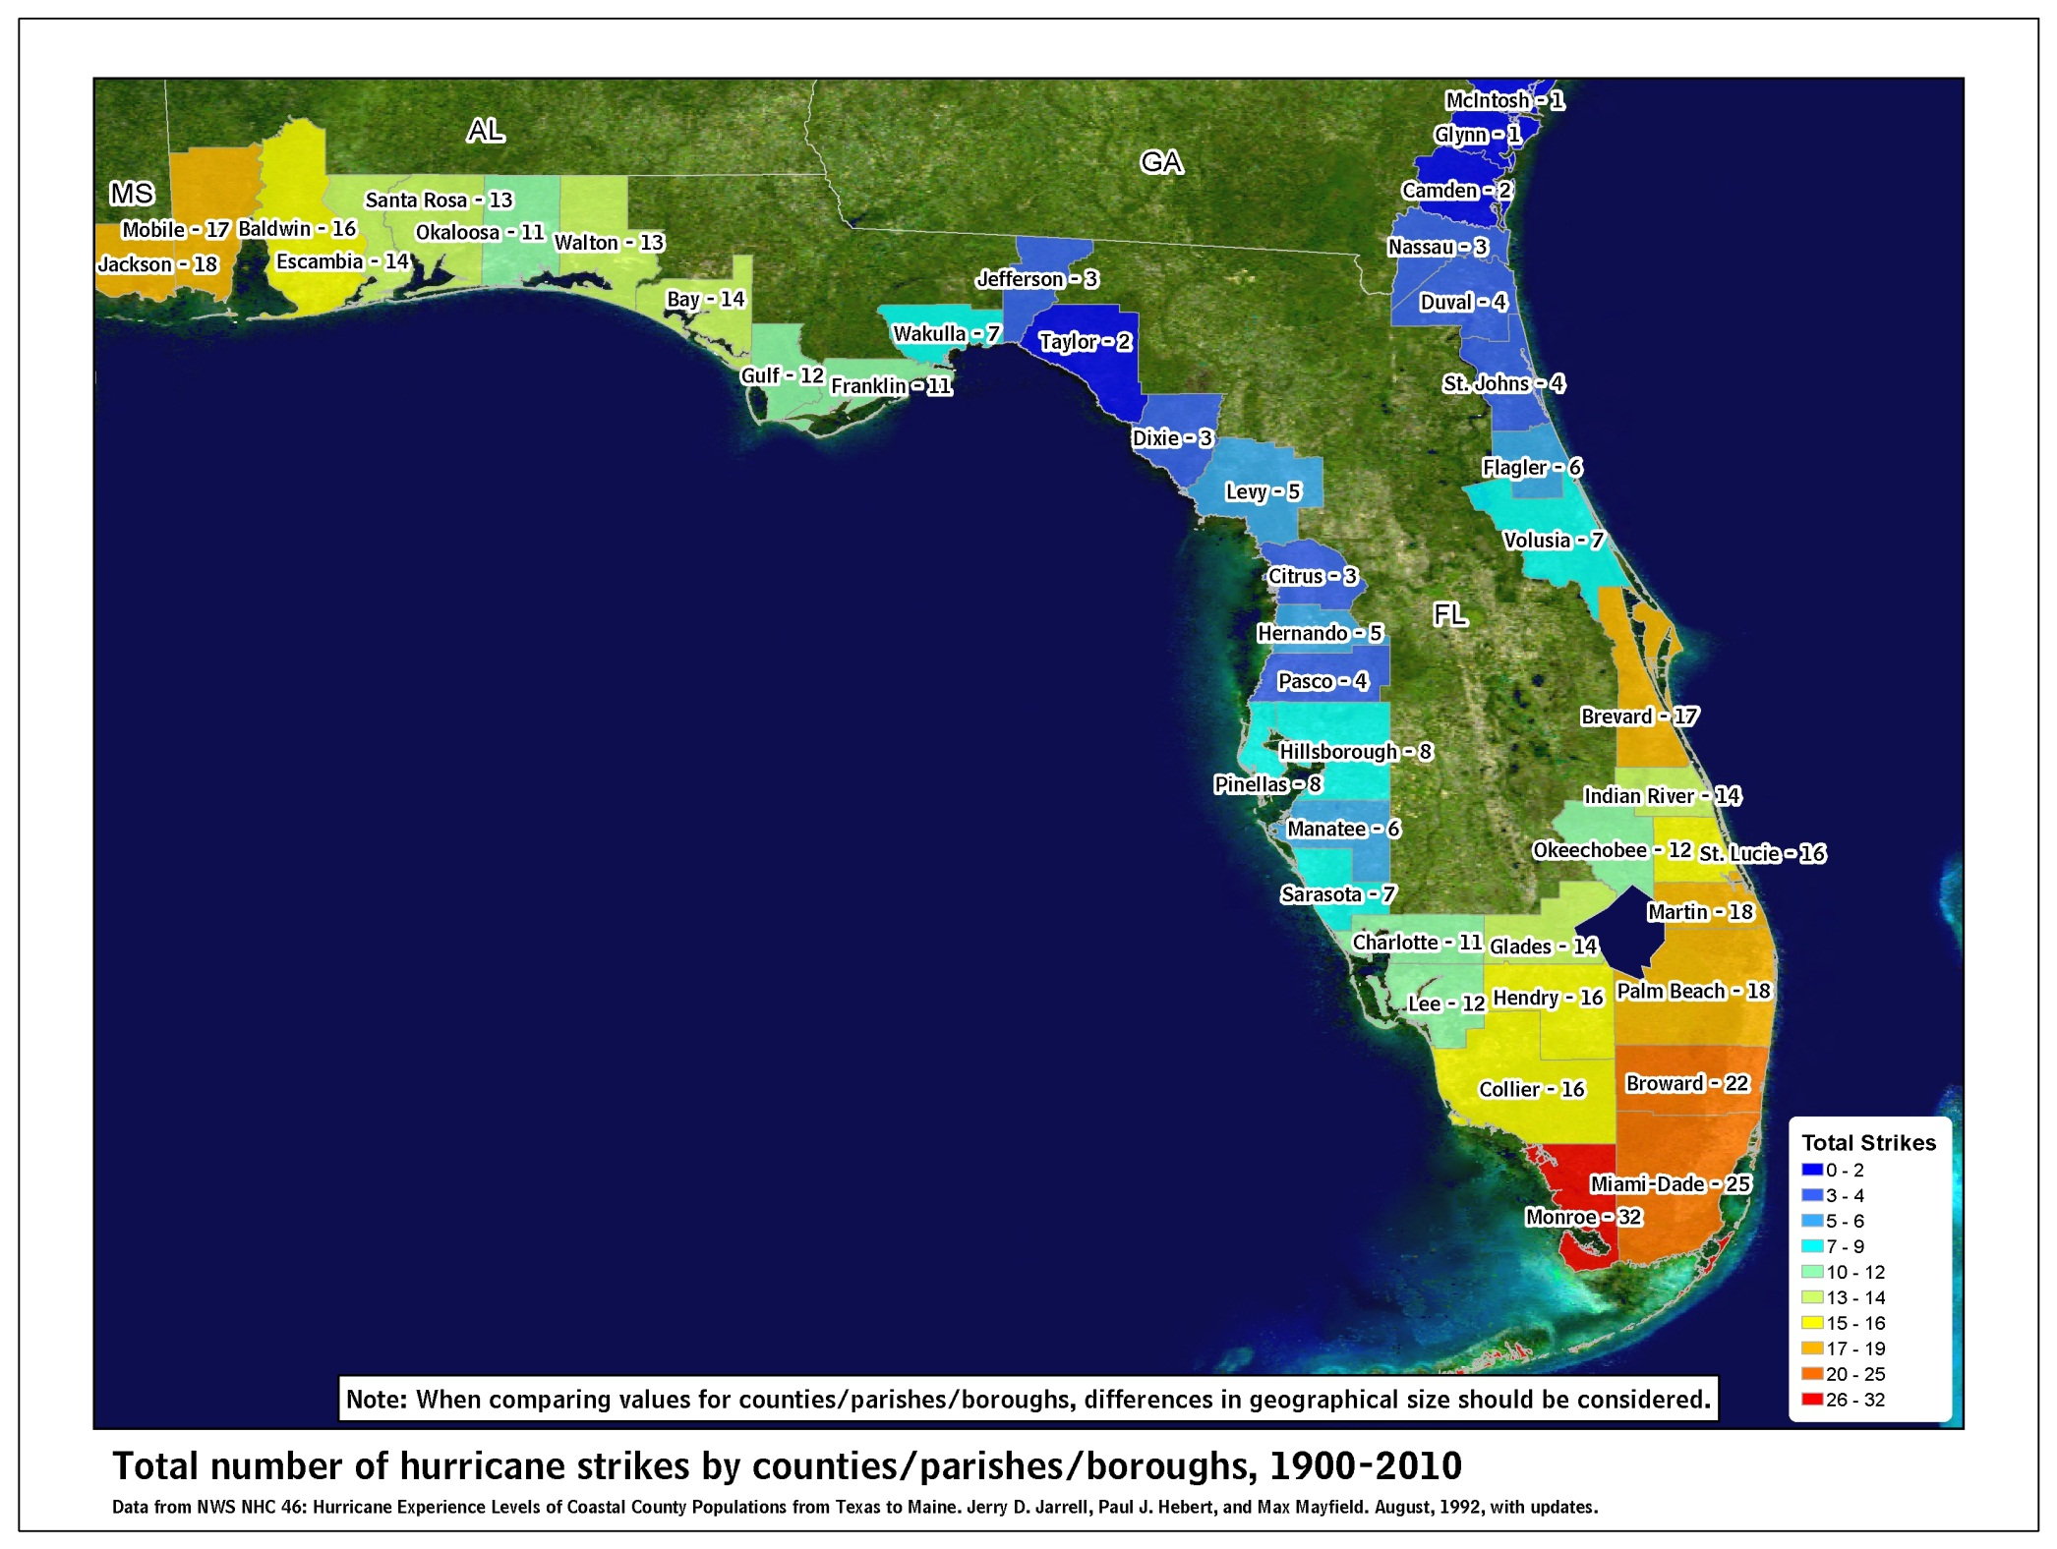

Slide 13
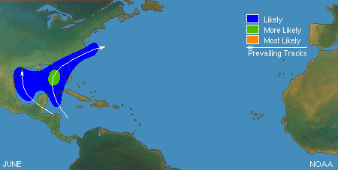
JUNE

Slide 14
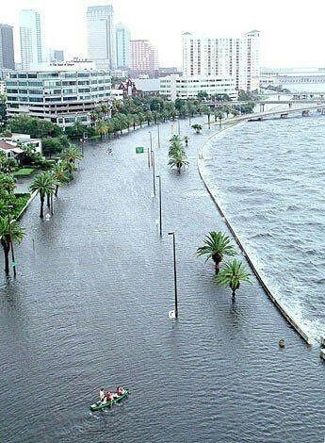
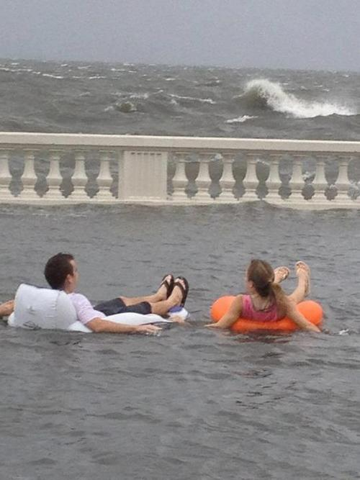
Tropical Storm Debby: June 2012
Tampa, Fla.

Slide 15
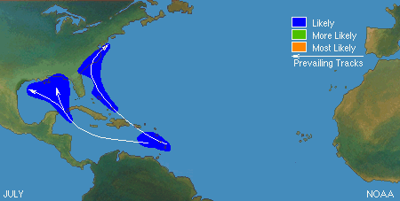
JULY

Slide 16
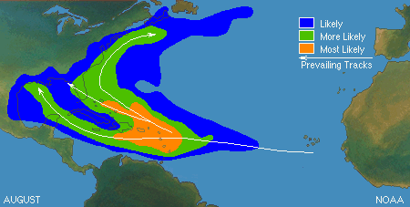
AUGUST

Slide 17
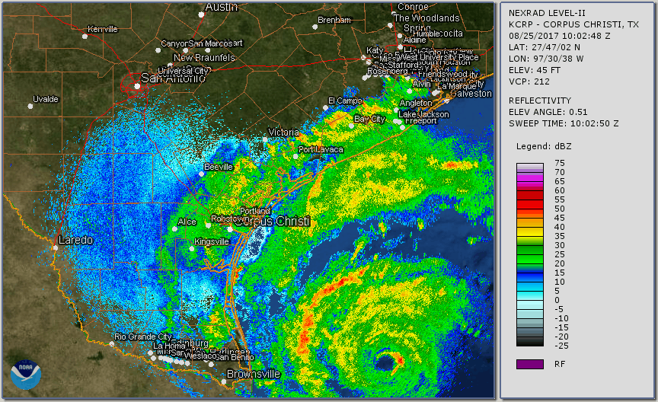
Radar Loop

Slide 18
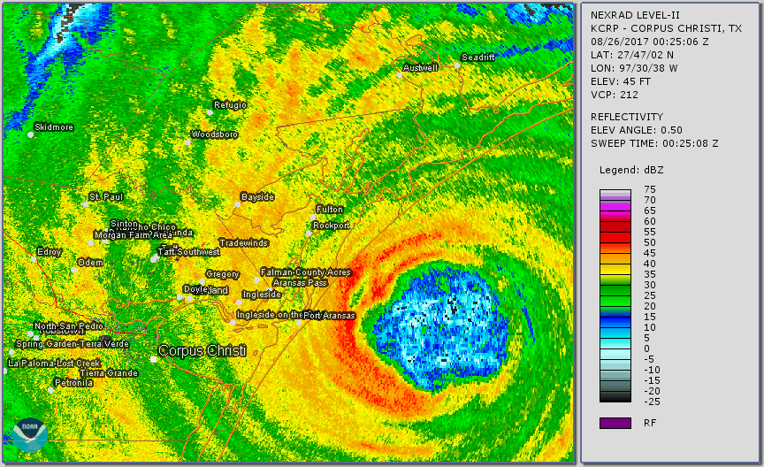
Harvey Impacts - Landfall

Slide 19
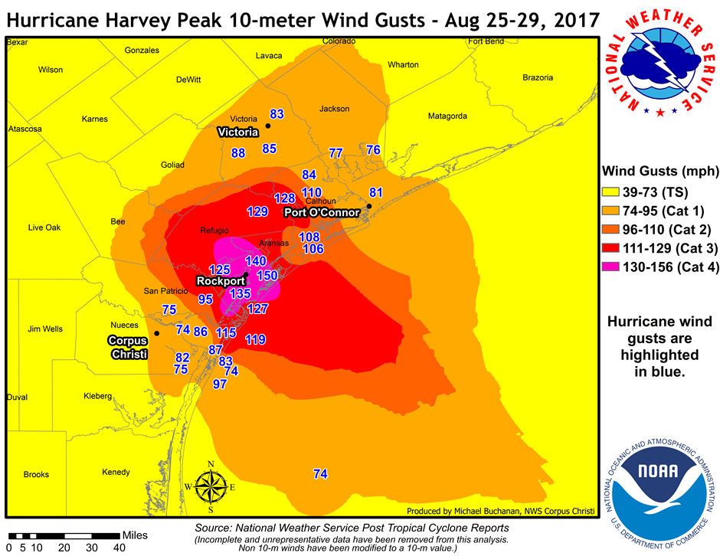
Harvey Impacts - Winds

Slide 20
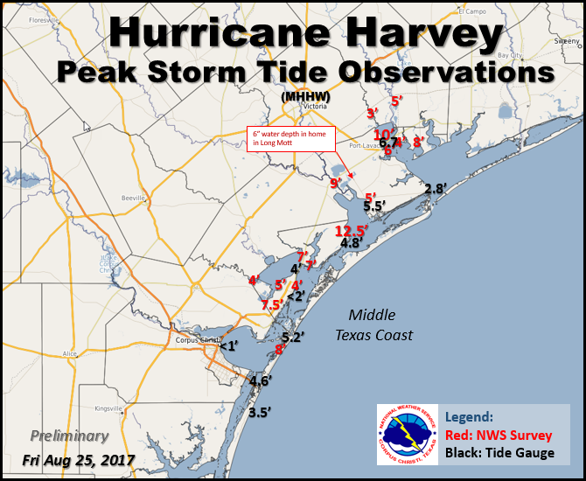
5-12 ft surge

Slide 21
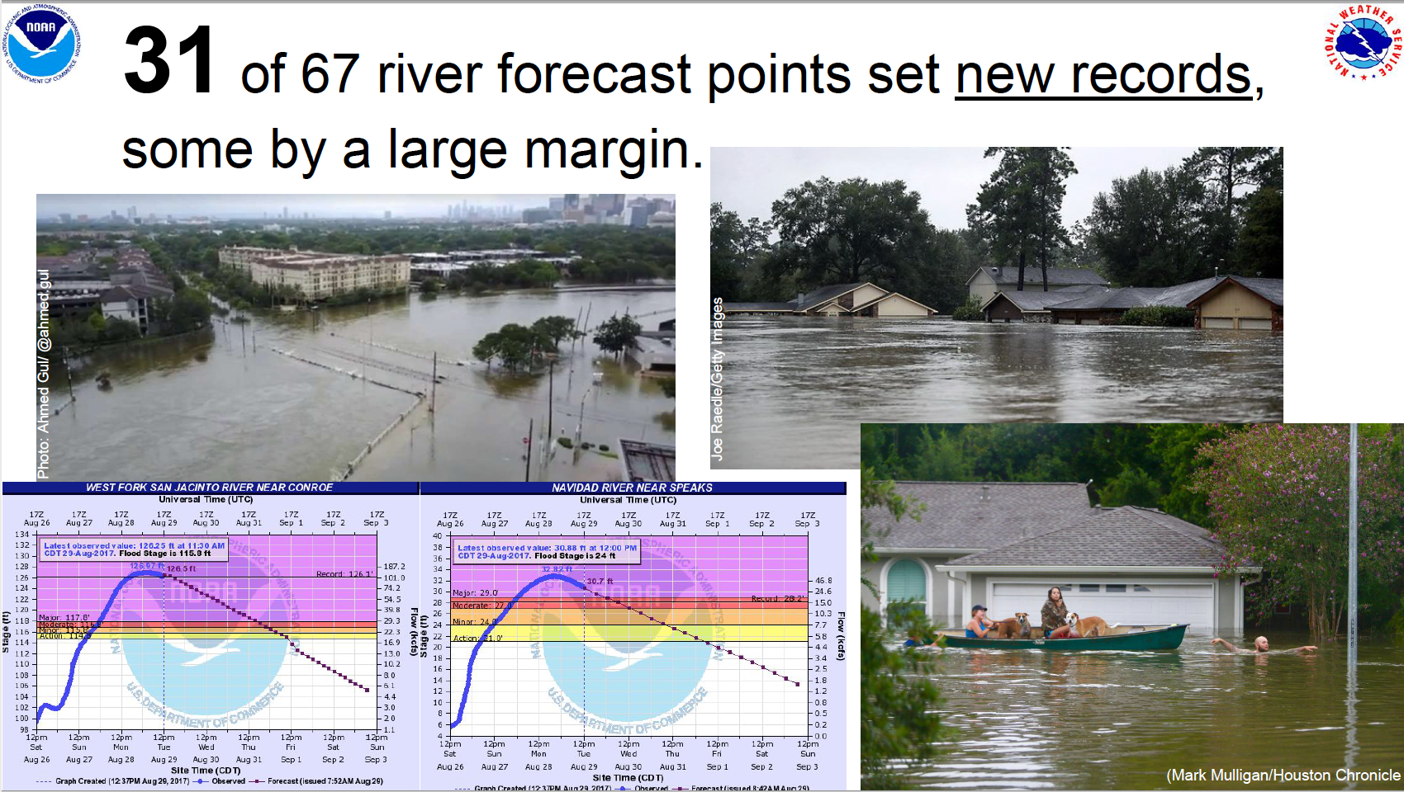

Slide 22
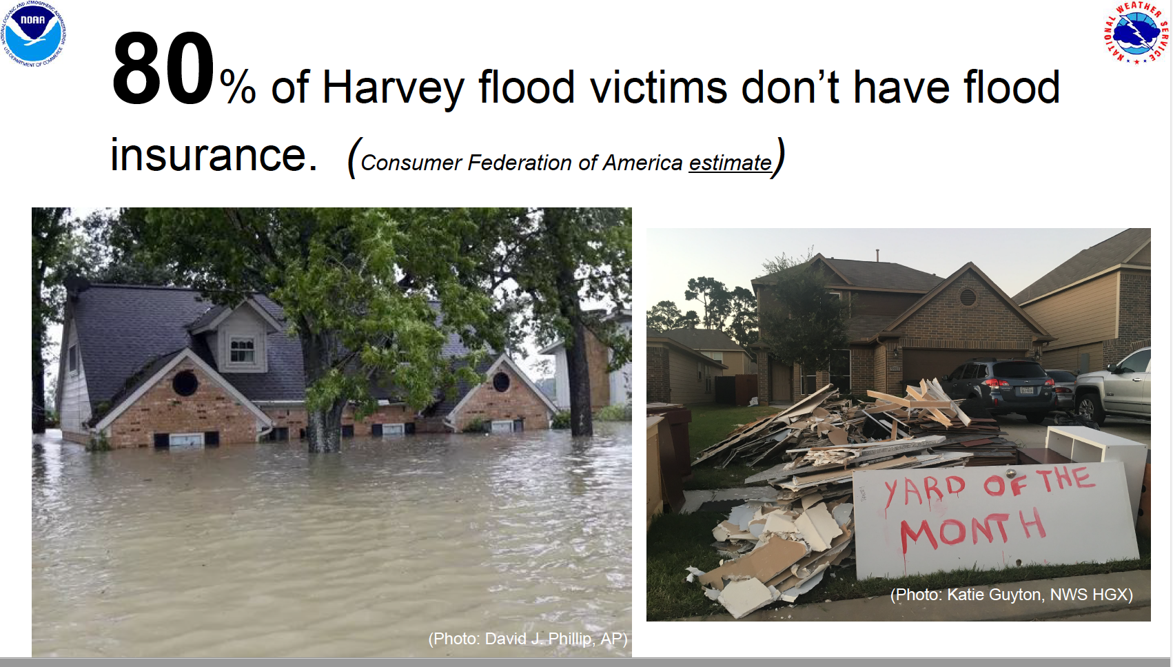

Slide 23
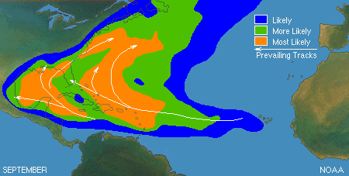
SEPTEMBER

Slide 24
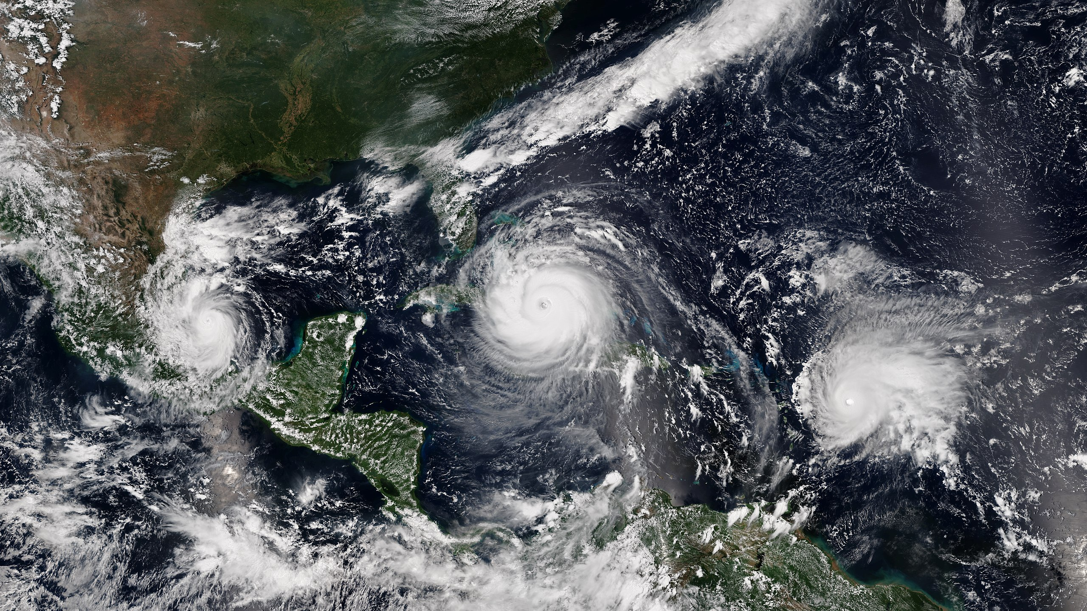
KATIA IRMA JOSE

Slide 25
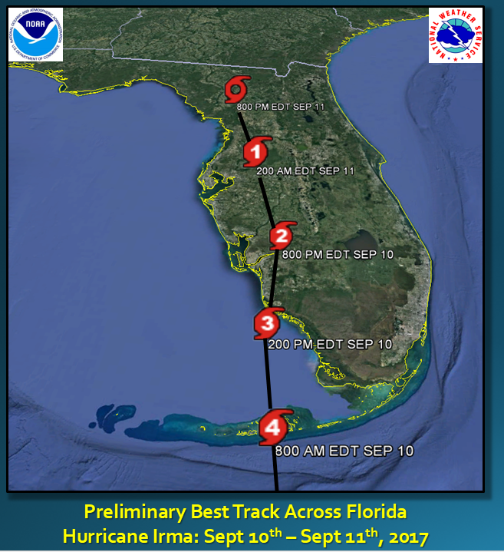
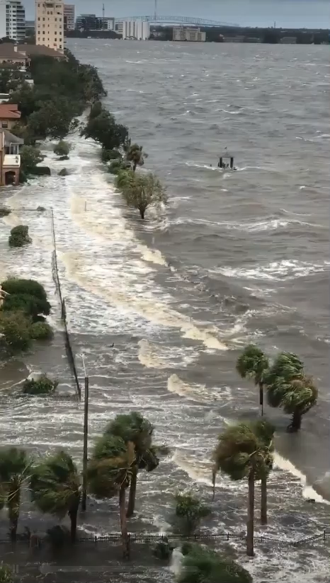
Jacksonville Storm Surge
Hurricane Irma
Notes:
Warning and Ongoing Phase:
Due to the fact that this briefing is likely taking place around or just after landfall, there is a shift in focus to more rapid-response type operations (search and rescue, etc)…but also needs to factor in recovery efforts that will be taking place in the next few days.

Slide 26
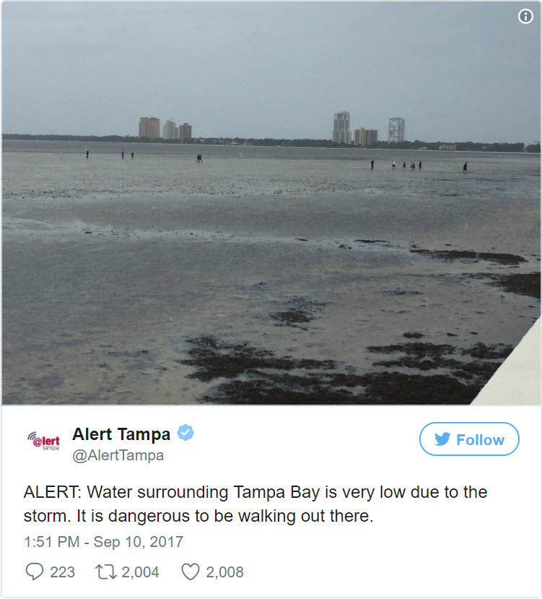
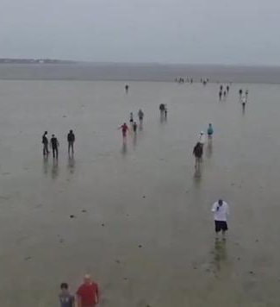
The Big Blowout – Tampa Bay
Hurricane Irma – 4-7 feet below normal tides
Notes:
Warning and Ongoing Phase:
Due to the fact that this briefing is likely taking place around or just after landfall, there is a shift in focus to more rapid-response type operations (search and rescue, etc)…but also needs to factor in recovery efforts that will be taking place in the next few days.

Slide 27
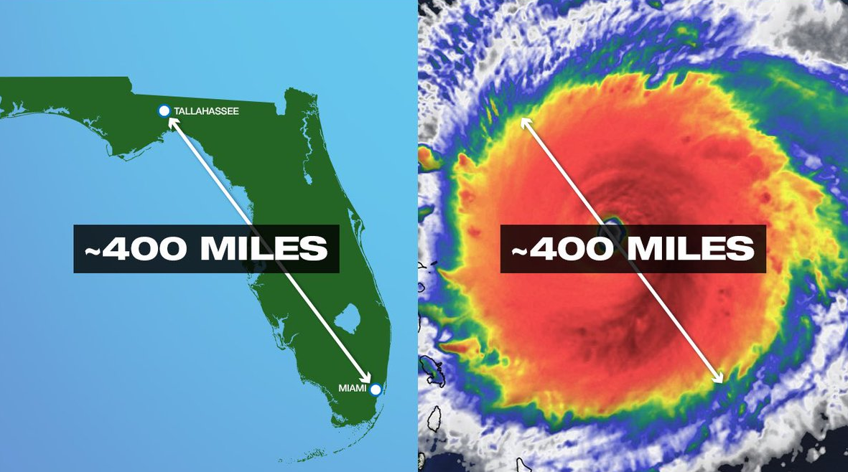
Current Radar View & Gusts
Hurricane Irma

Slide 28
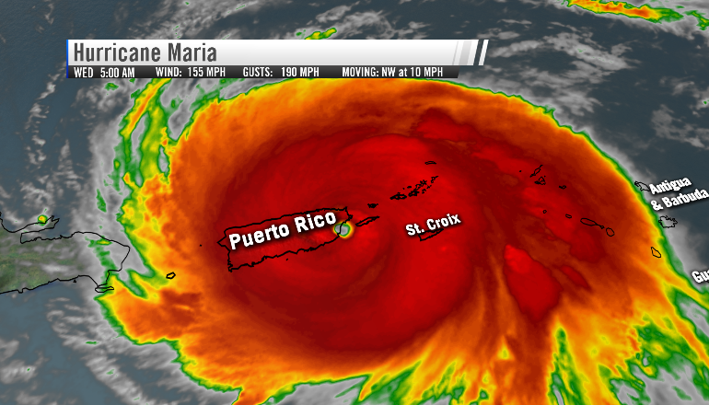

Slide 29
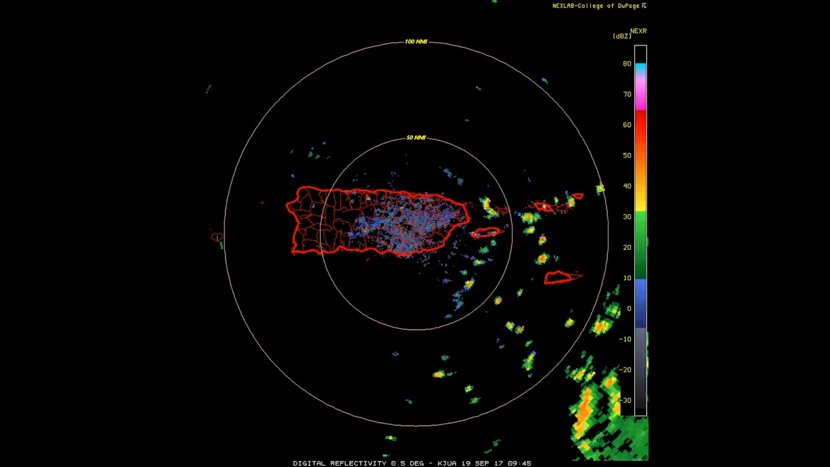

Slide 30
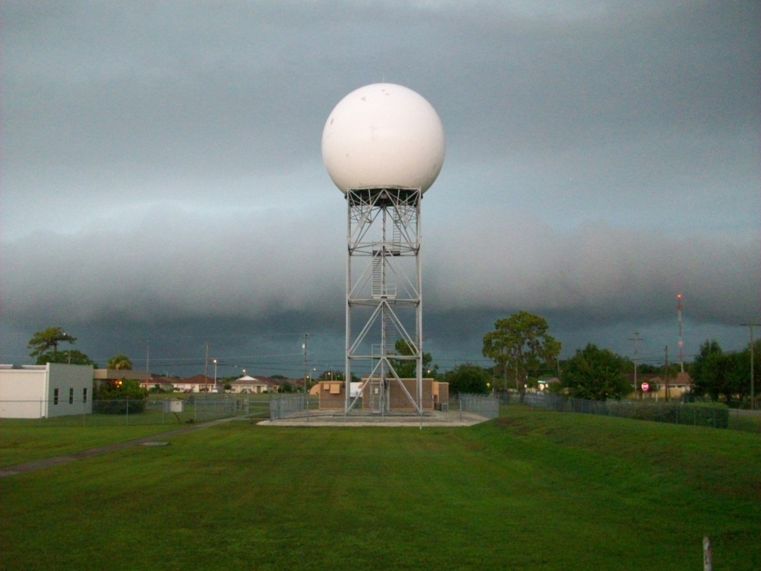

Slide 31
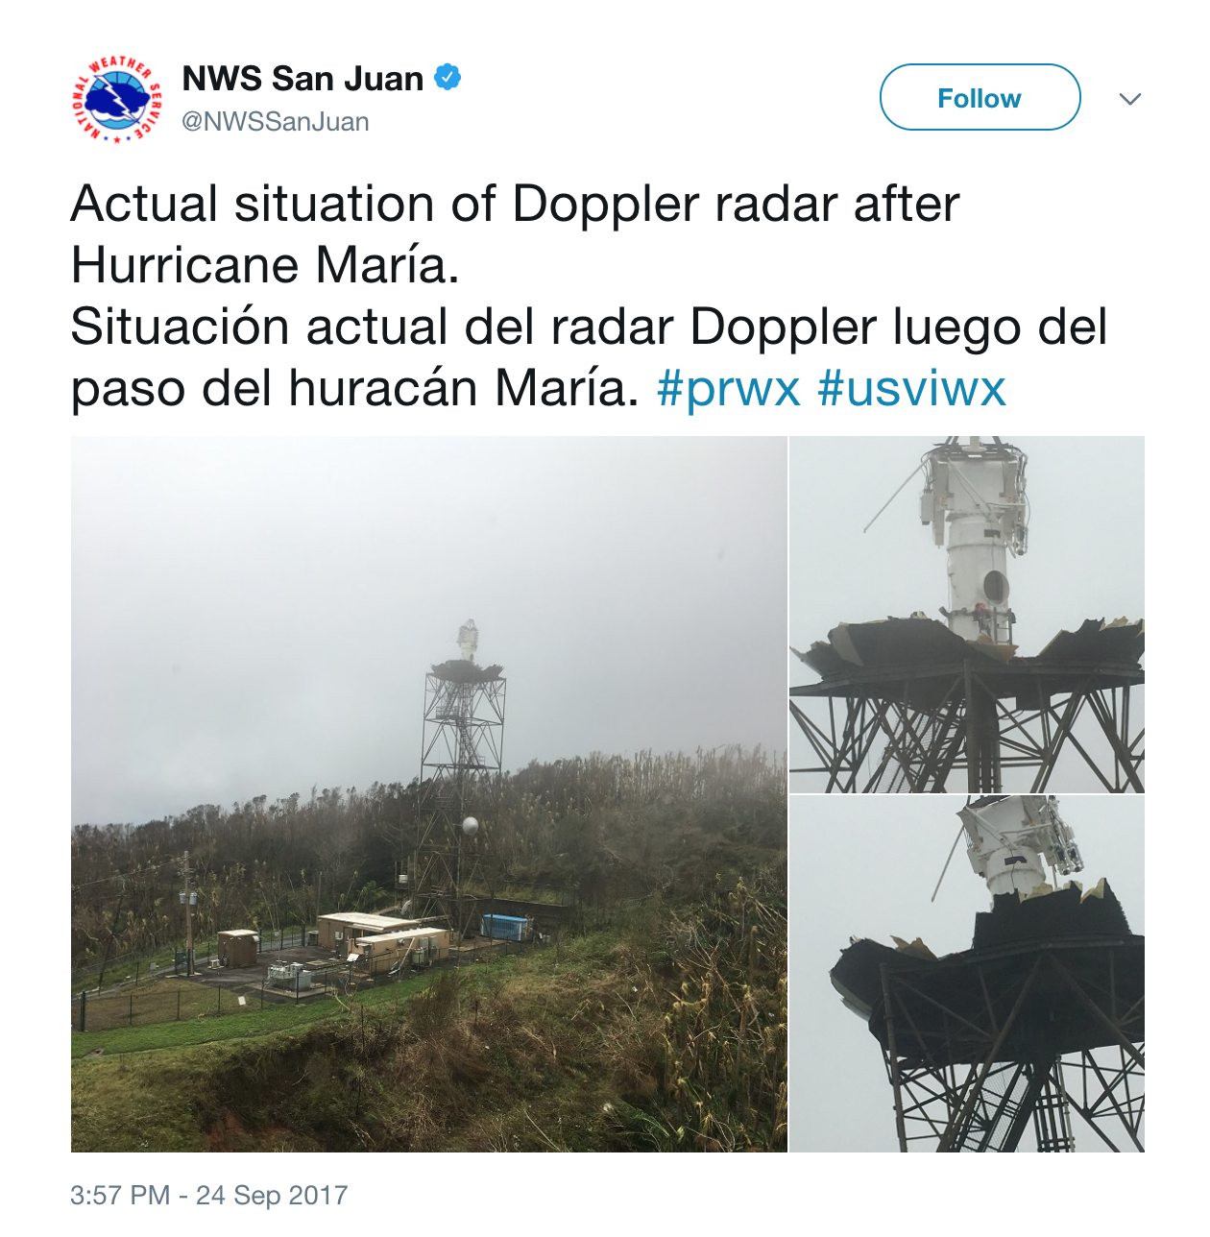

Slide 32
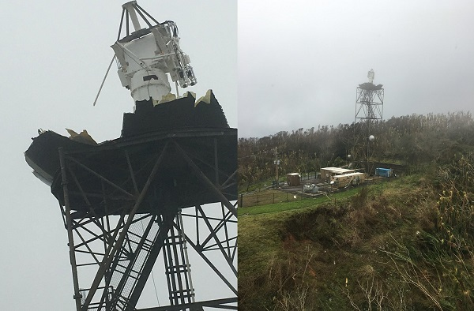

Slide 33
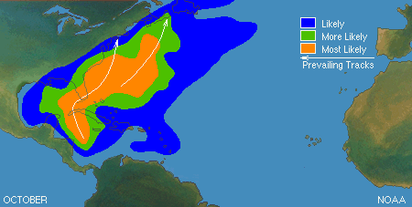
OCTOBER

Slide 34
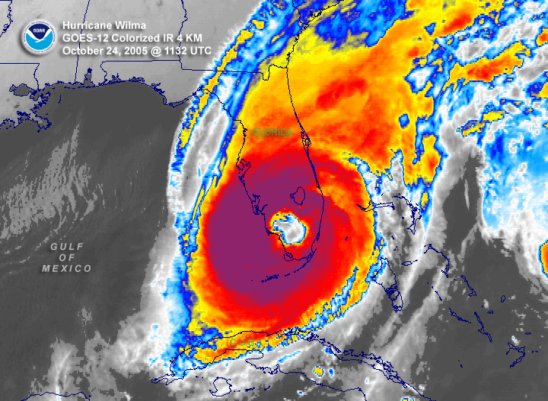

Slide 35
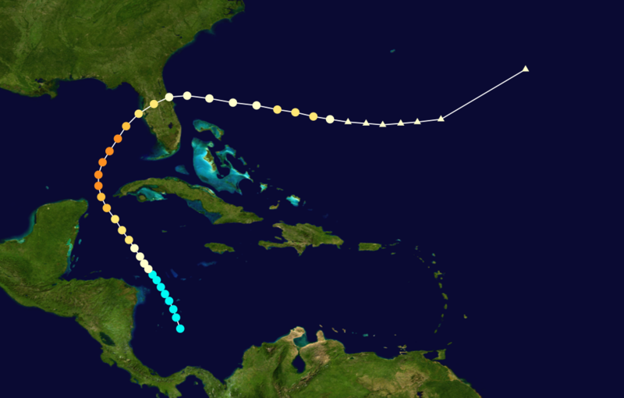
Tampa Bay Area “Tarpon Springs” Hurricane October 25, 1921 Category 3

Slide 36
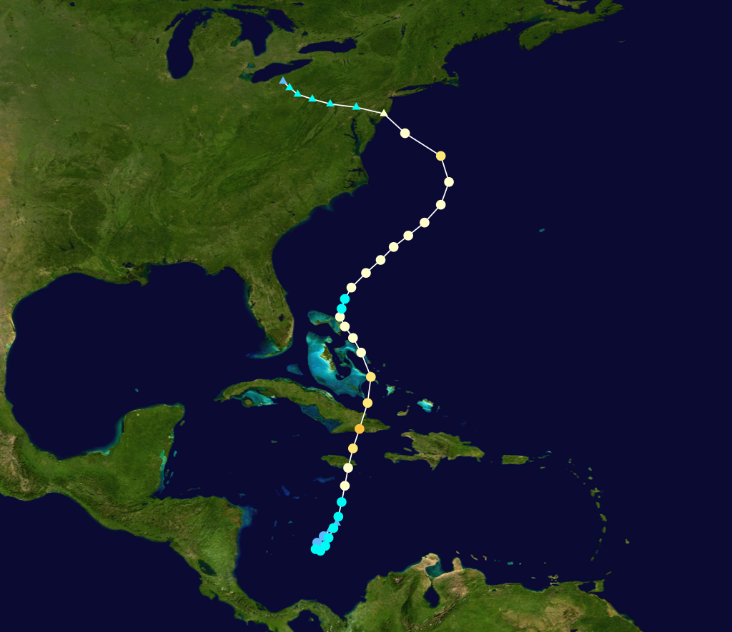
Hurricane Sandy
October 25, 2012 Category 3

Slide 37
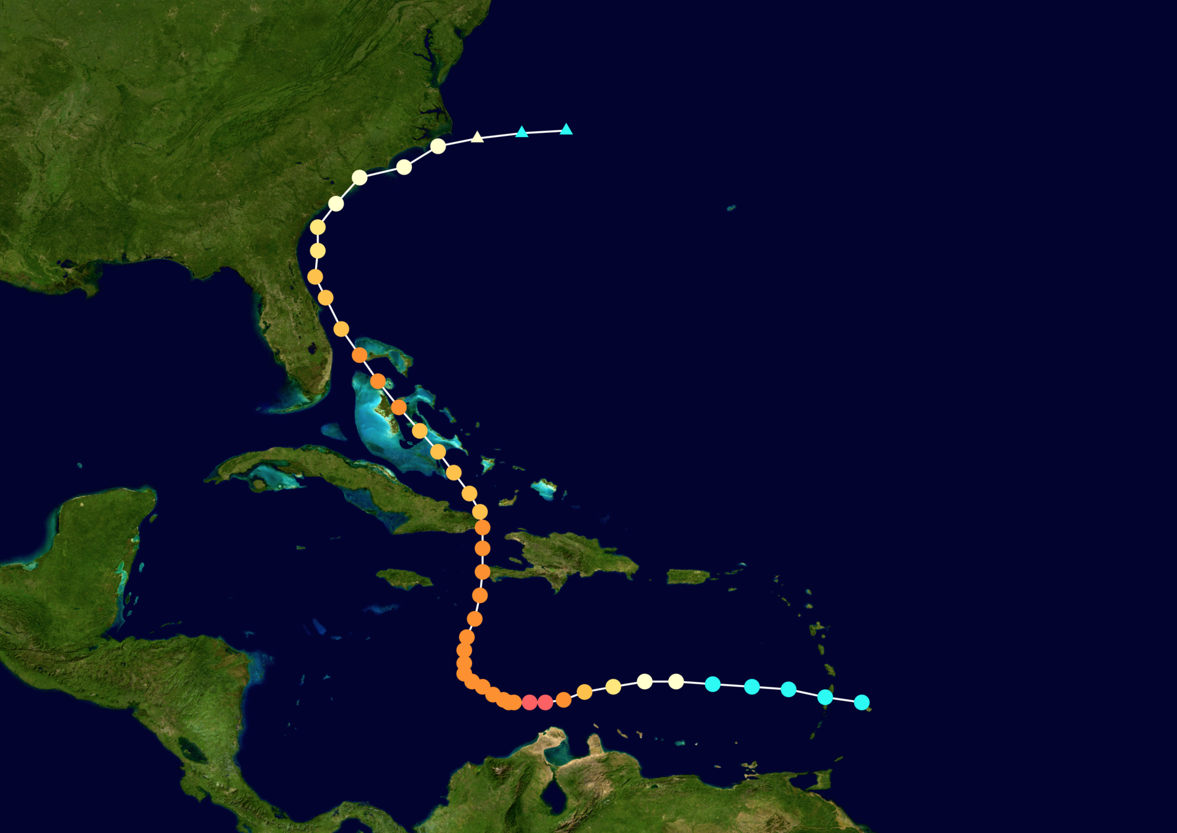
Hurricane MATTHEW: Sep/Oct 2016

Slide 38
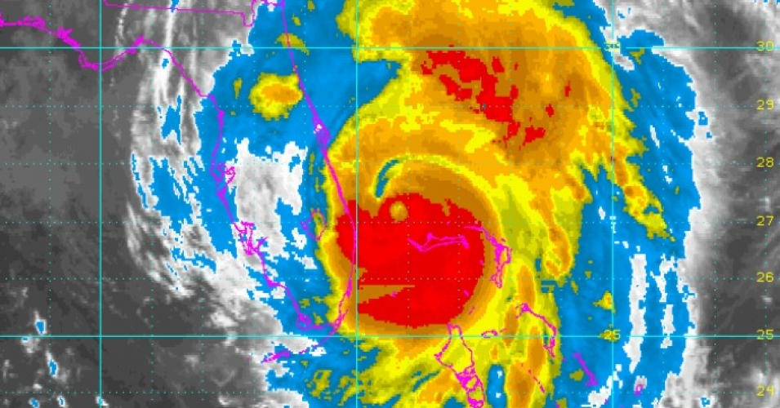
Hurricane MATTHEW: Oct 7, 2016

Slide 39
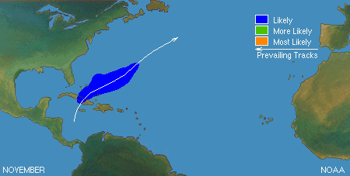
NOVEMBER

Slide 40
Question:
What year did Tropical Storm Debby form?
1994
2000
2006
2012

Slide 41
Answer:
What year did Tropical Storm Debby form?
1994
2000
2006
2012

Slide 42

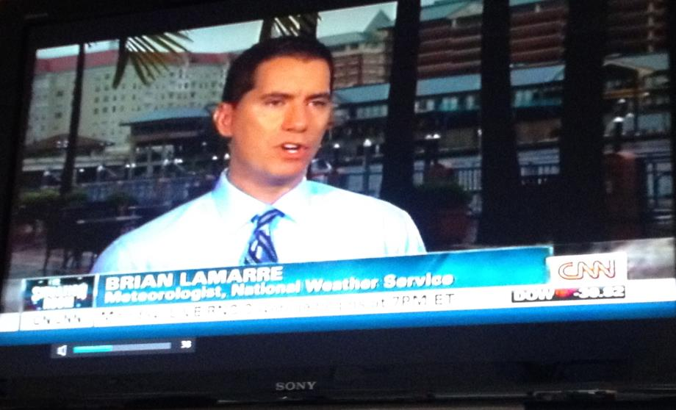
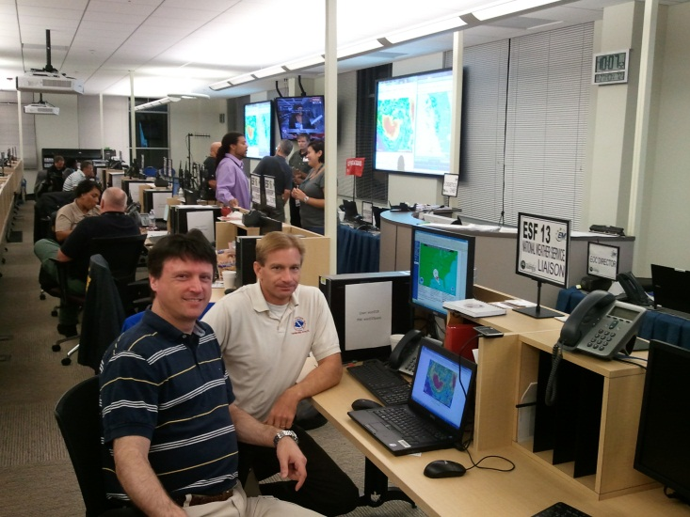
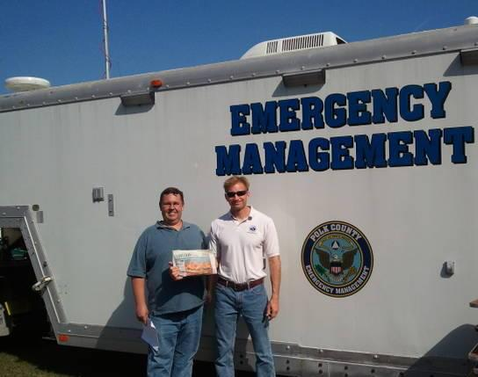
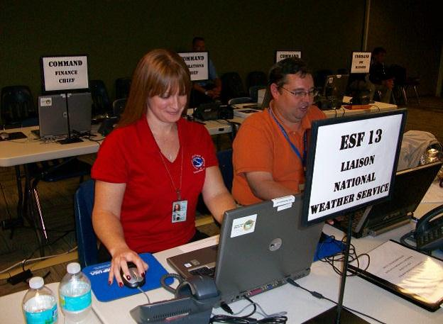
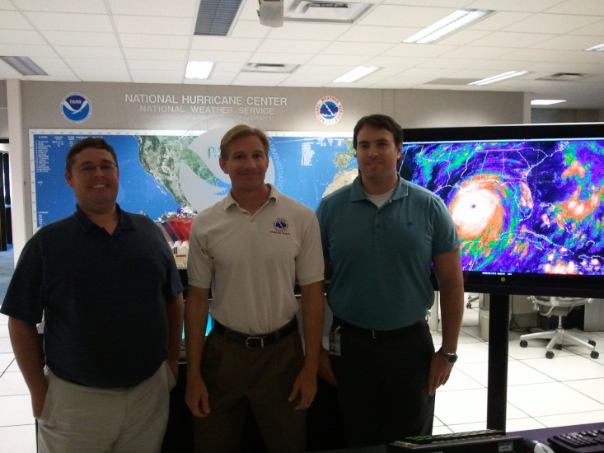
Building a Weather-Ready Nation
In action…
Notes:
42

Slide 43
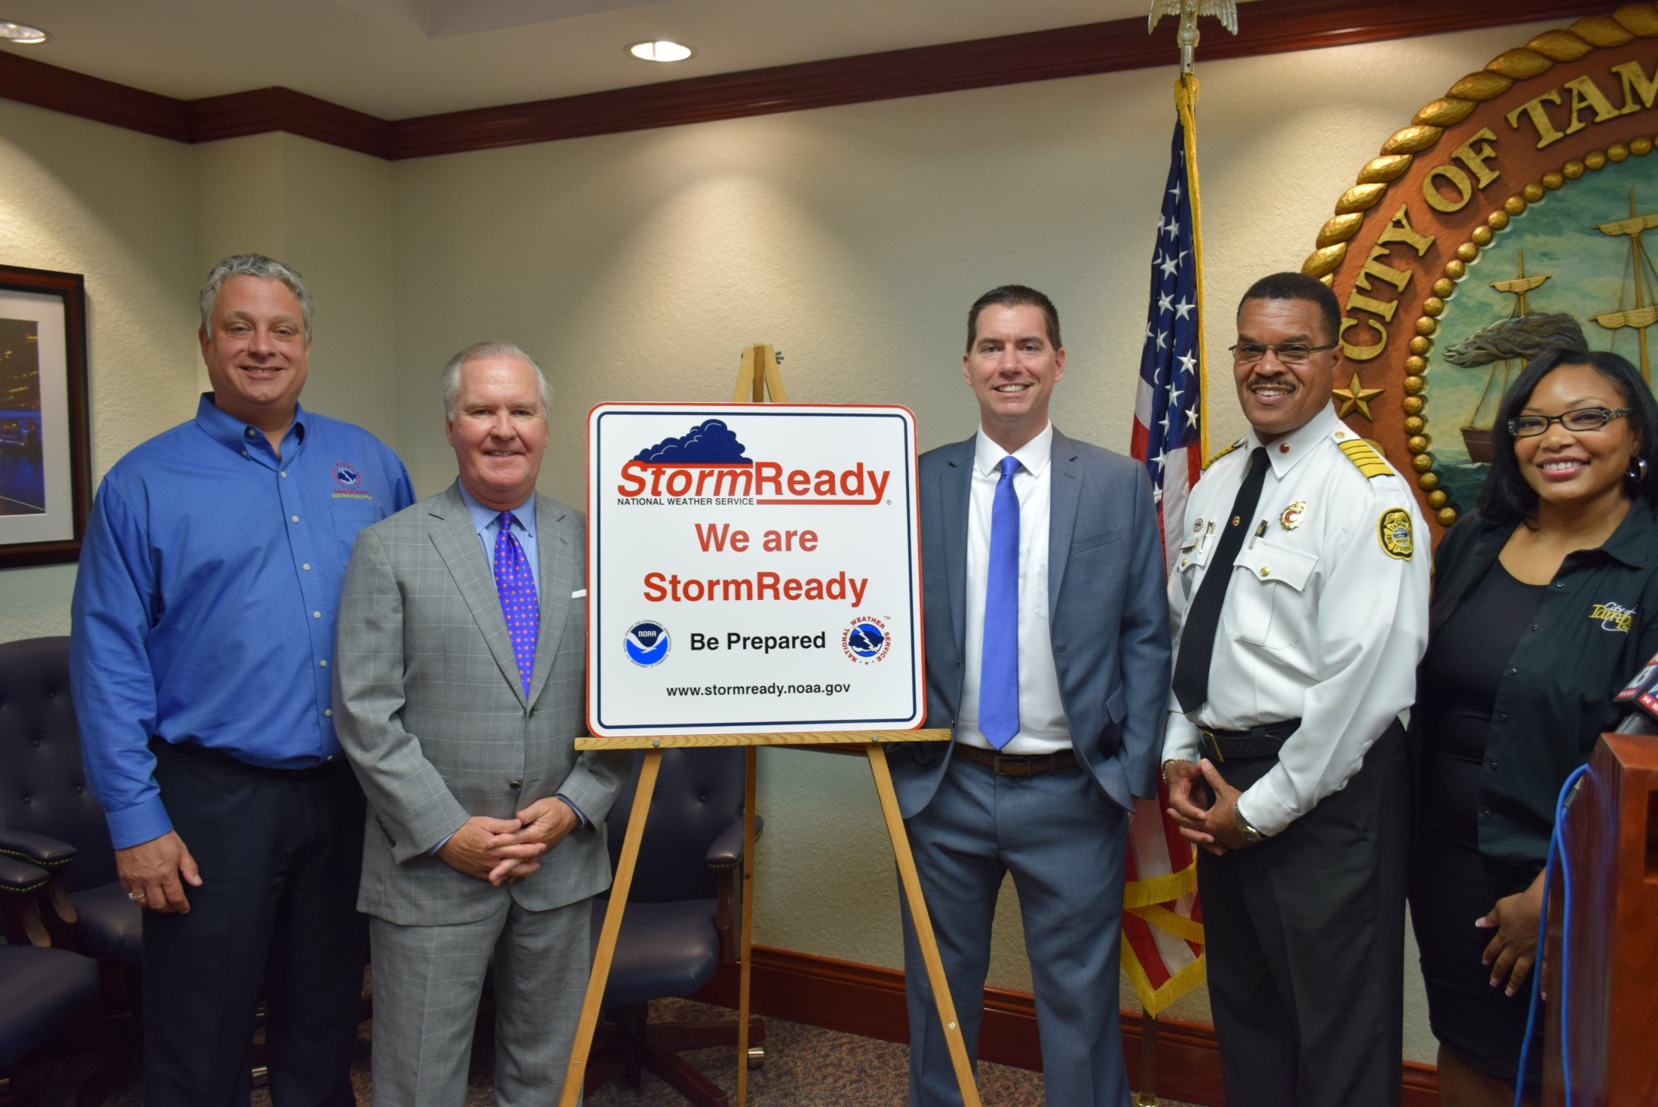
City of Tampa: StormReady Recognition – June 1, 2016

Slide 44







Technology →Awareness
Notes:
Less tolerance for community leaders not being aware of impending high impact events. They want access to weather expertise!
Partners are becoming increasingly mobile, need for information -- anytime, anywhere
Current NWS dissemination of information is not keeping pace with consumer technologies that are being adopted (for example, cell phones/PDA with Internet access is quickly becoming the new communication standard in the U.S.)
The personalized delivery of information, vice mass media, is the new communications model of the 21st century
44

Slide 45



Slide 46
“The entire weather enterprise would likely benefit from broader, more coordinated and consistent engagement that leverages all parties’ capabilities while also meeting their needs.”
Forecasts for the Future: Assuring the Capacity of the National Weather Service—NAPA, 2013

Slide 47



