Slide 1


Evaluating Impacts of Recent Major Storms and Non-Stationary Climate Conditions on
NOAA Atlas 14 Precipitation Frequency Estimates
Presenter: Sanja Perica, Ph.D.
Chief, Hydrometeorological Design Studies Center (HDSC),
Office of Water Prediction, National Weather Service, NOAA
Email: Sanja.perica@noaa.gov
Web: www.nws.noaa.gov/oh/hdsc
Authors: Sandra Pavlovic, Sanja Perica, Michael St Laurent, Carl Trypaluk,
Dale Unruh, Orlan Wilhite
Weather Conference
Western Connecticut State University, Danbury, CT
29 September 2018

Slide 2

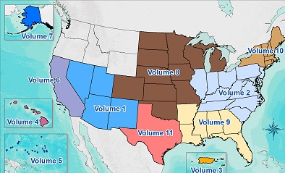
About HDSC and NOAA Atlas 14
    HDSC
    part of the NOAA/National Weather Service's Office of Water Prediction http://www.nws.noaa.gov/ohd/hdsc/
    Responsibility: preparing national standards and updating Precipitation Frequency (PF) estimates for various parts of the USA and affiliated territories.
NOAA Atlas 14
Since 2004, updates are published as Volumes of NOAA Atlas 14
S. Perica, NOAA/NWS/HDSC Weather Conference, Danbury, 29 September 2018 2

Slide 3
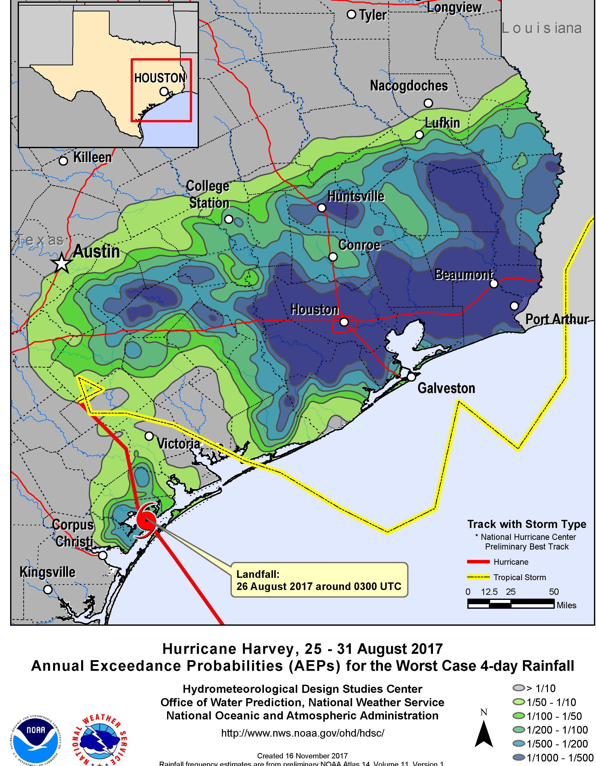
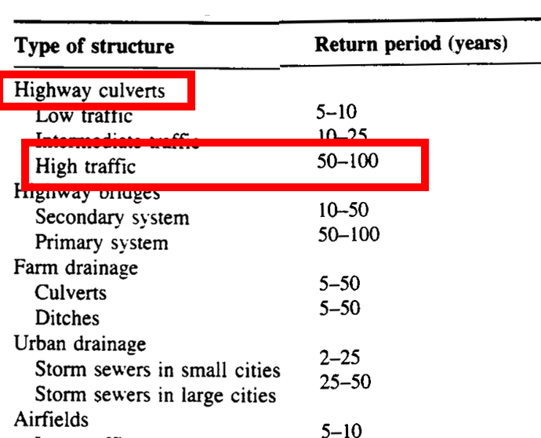
Applications
Variety of infrastructure design and planning activities under federal, state, and local regulations
    Storm water drainage
    FEMA’s National Flood Ins. Program
    Water-quality management
    Etc.
For monitoring observed and forecasted precipitation to indicate flooding threats
Estimating severity of historic events
Design criteria.
Frequency analysis of Hurricane Harvey.
S. Perica, NOAA/NWS/HDSC Weather Conference, Danbury, 29 September 2018 3

Slide 4
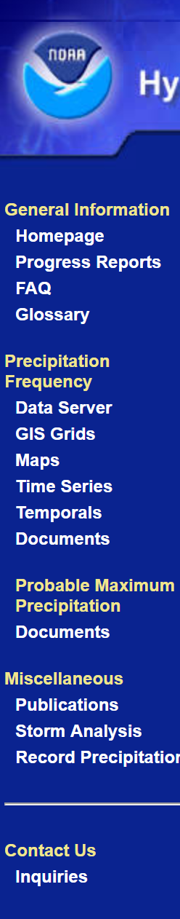
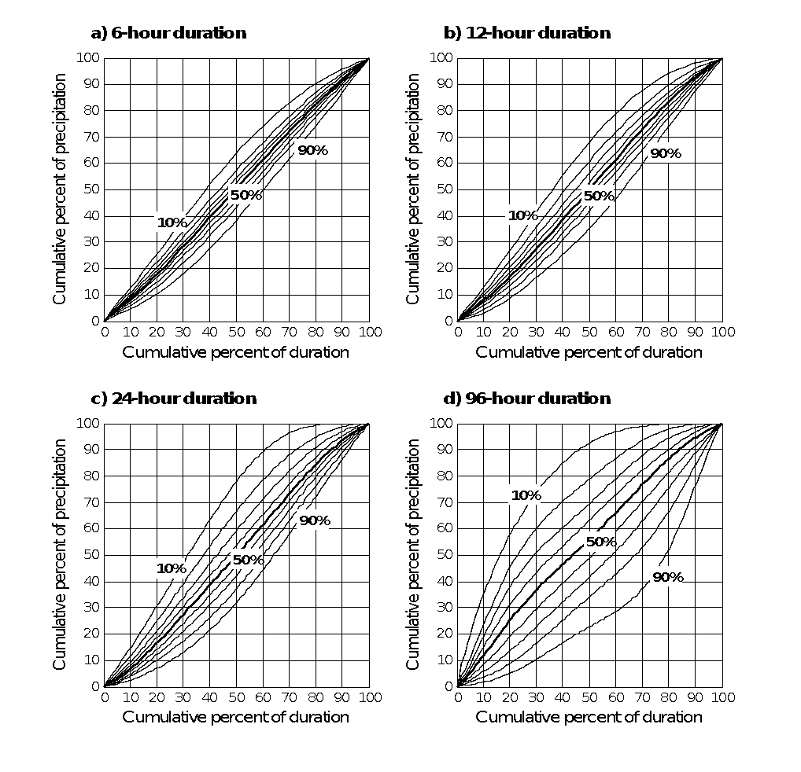
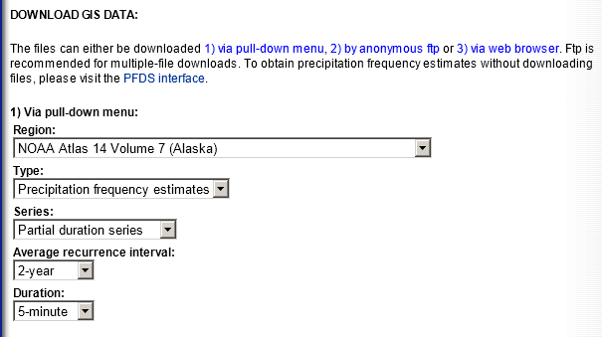
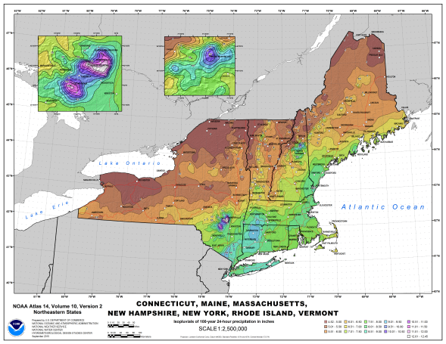
NOAA Atlas 14 products - project area
  30 arc-sec PF grids with confidence limits in GIS format for 5-min to 60-day; 1- to 1,000-year ARI
  Cartographic maps for selected durations and ARI
  Seasonality and Temporal Distributions
  AMS time series data
  Documentation, supplementary information
S. Perica, NOAA/NWS/HDSC Weather Conference, Danbury, 29 September 2018 4

Slide 5
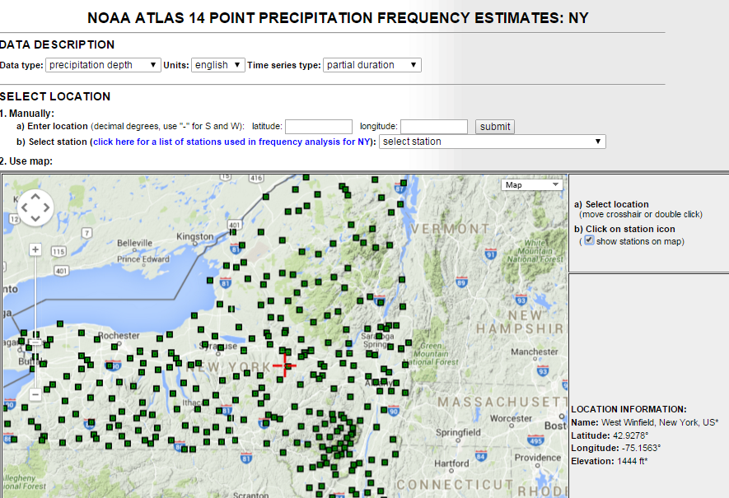
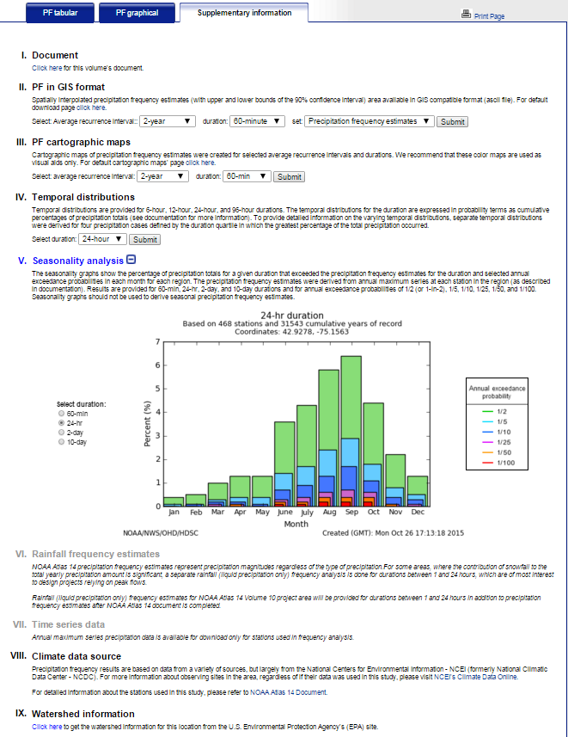
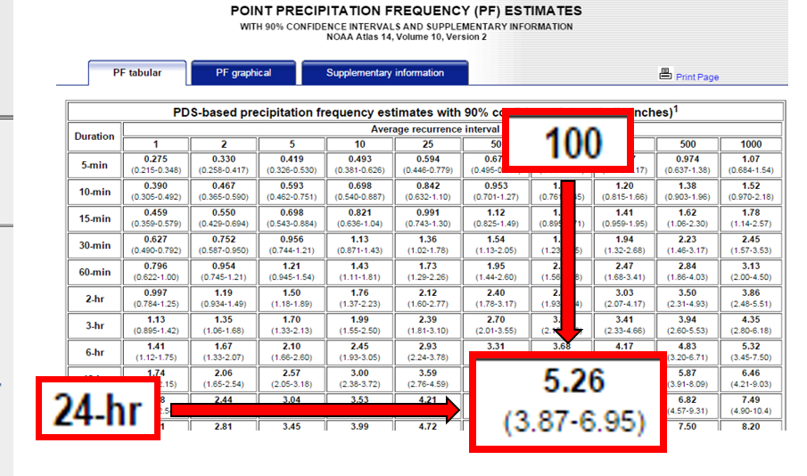
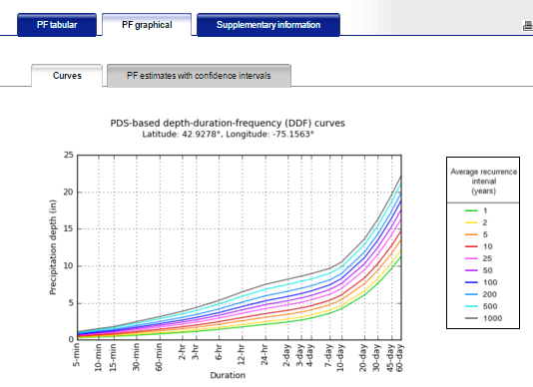
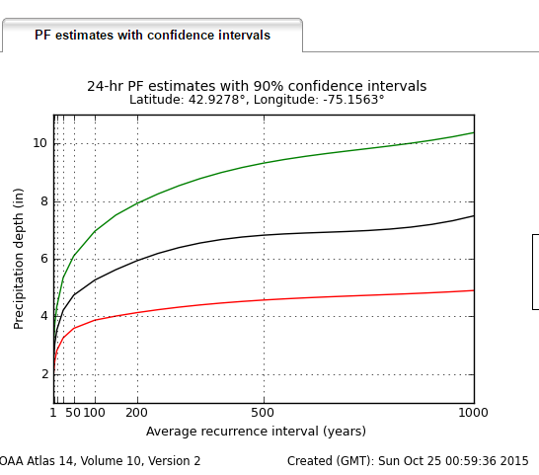
NOAA Atlas 14 products – selected location
Supplementary information
PF tabular
PF graphical
S. Perica, NOAA/NWS/HDSC Weather Conference, Danbury, 29 September 2018 5

Slide 6
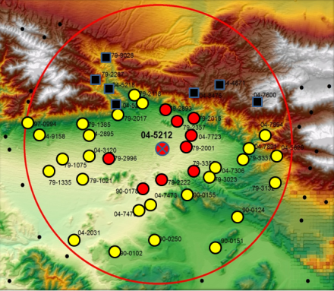
NOAA Atlas 14 process
Approach: Region-of-influence regional frequency analysis approach based on GEV distribution with parameters calculated based on L-moment statistics from annual maximum series (AMS).
Main steps:
1. Data collection, formatting
2. Examination of geospatial data, station cleanup
3. AMS extraction and quality control
4. Regionalization
5. Calculation of regional moments, distribution fitting
6. Derivation of DDF curves and confidence limits
7. Interpolation (30 arc-sec grid) using PRISM statistical-geographic approach
8. Peer review and revision
9. Development of supplementary products
10. Publication
AMS series
Regionalization
S. Perica, NOAA/NWS/HDSC Weather Conference, Danbury, 29 September 2018 6
Notes:
6

Slide 7
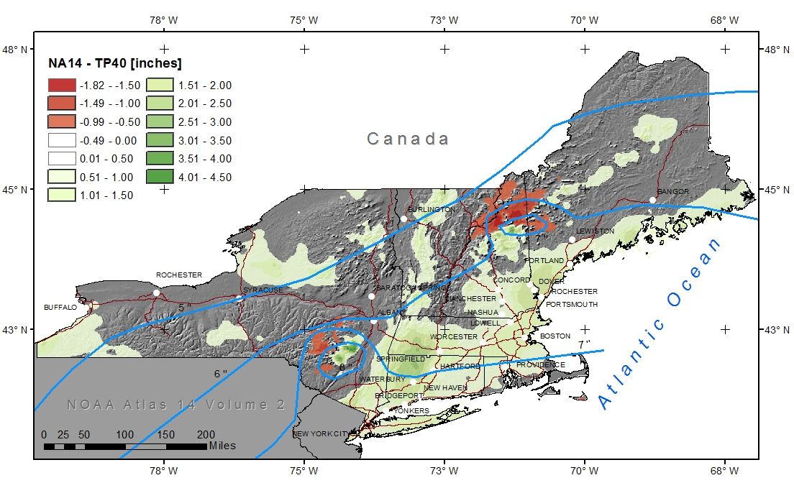
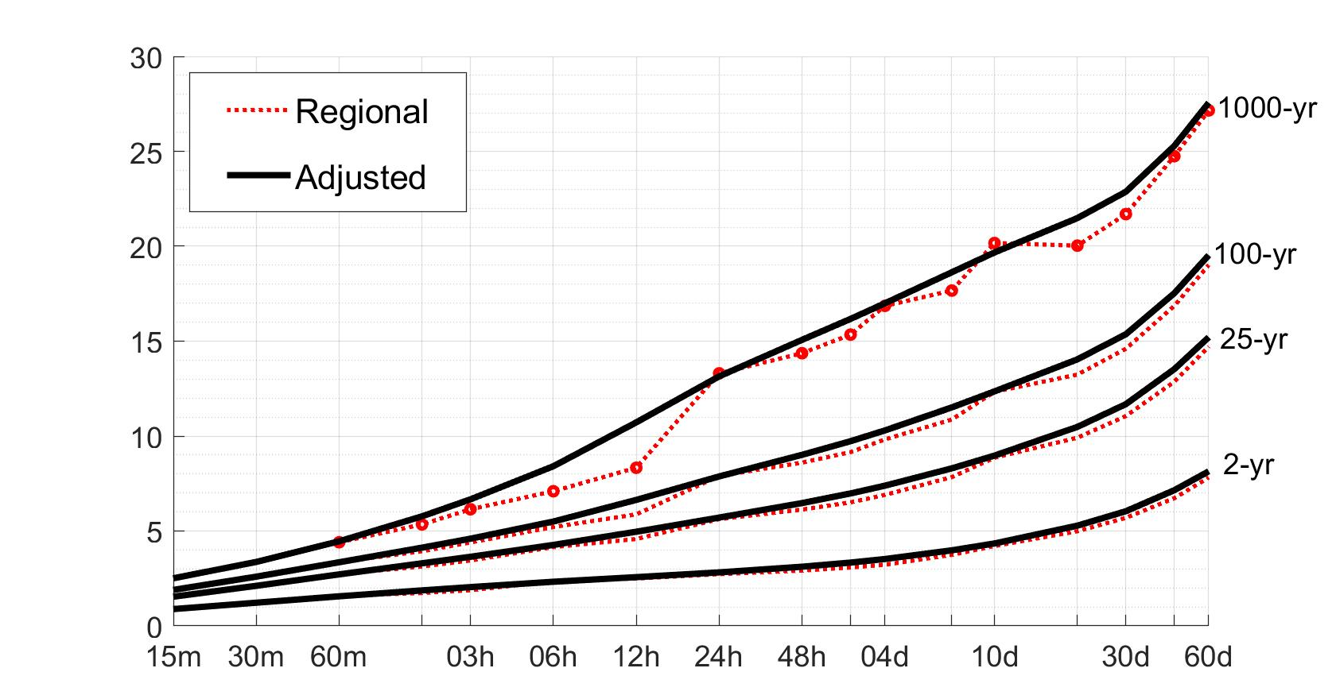
Major sources of errors - methods
Distribution fitting
Interpolation
ARI (years) | Potential PF range
100 | 11-13 in
1000 | 13 -22 in
NA14-TP40
Regionalization
Smoothing & consistency checks (spatially and across durations and frequencies)
S. Perica, NOAA/NWS/HDSC Weather Conference, Danbury, 29 September 2018 7

Slide 8
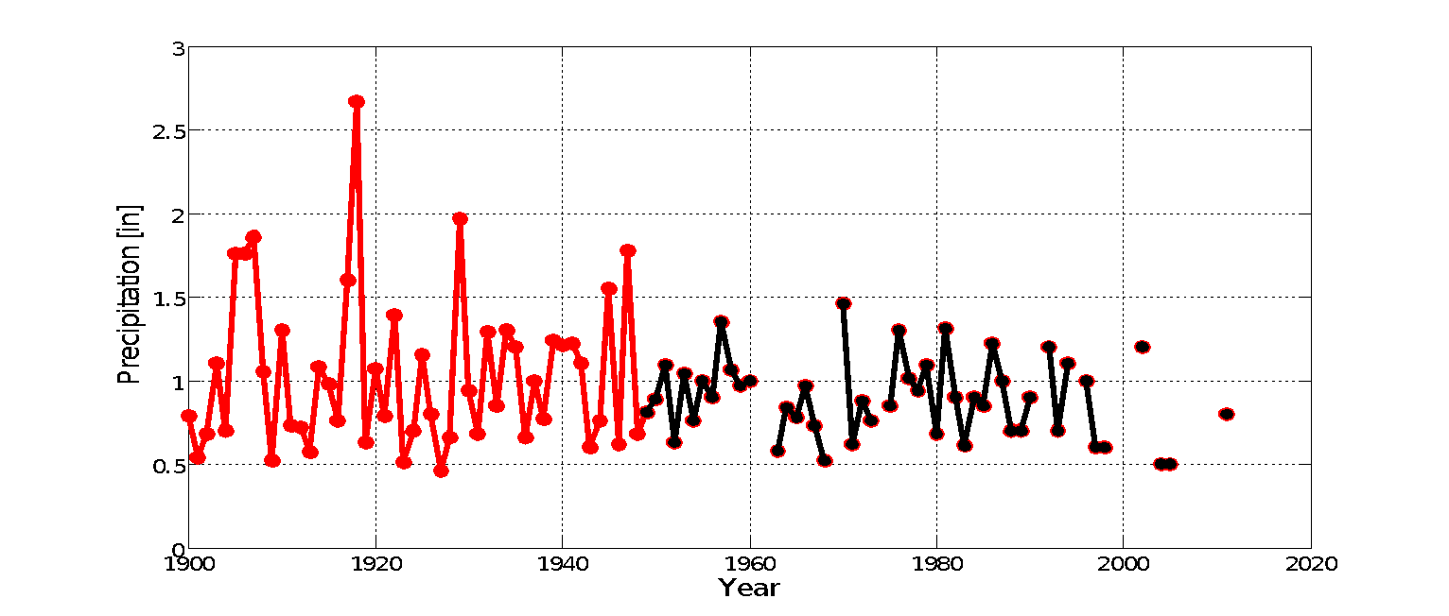
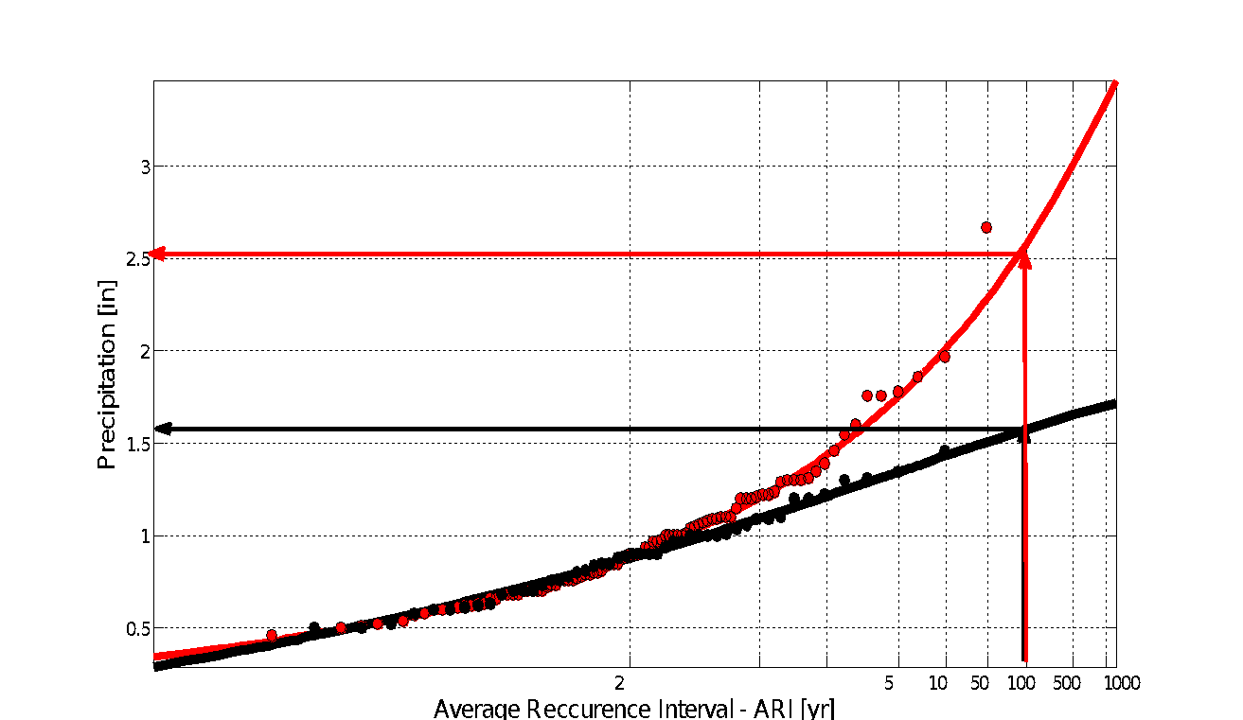
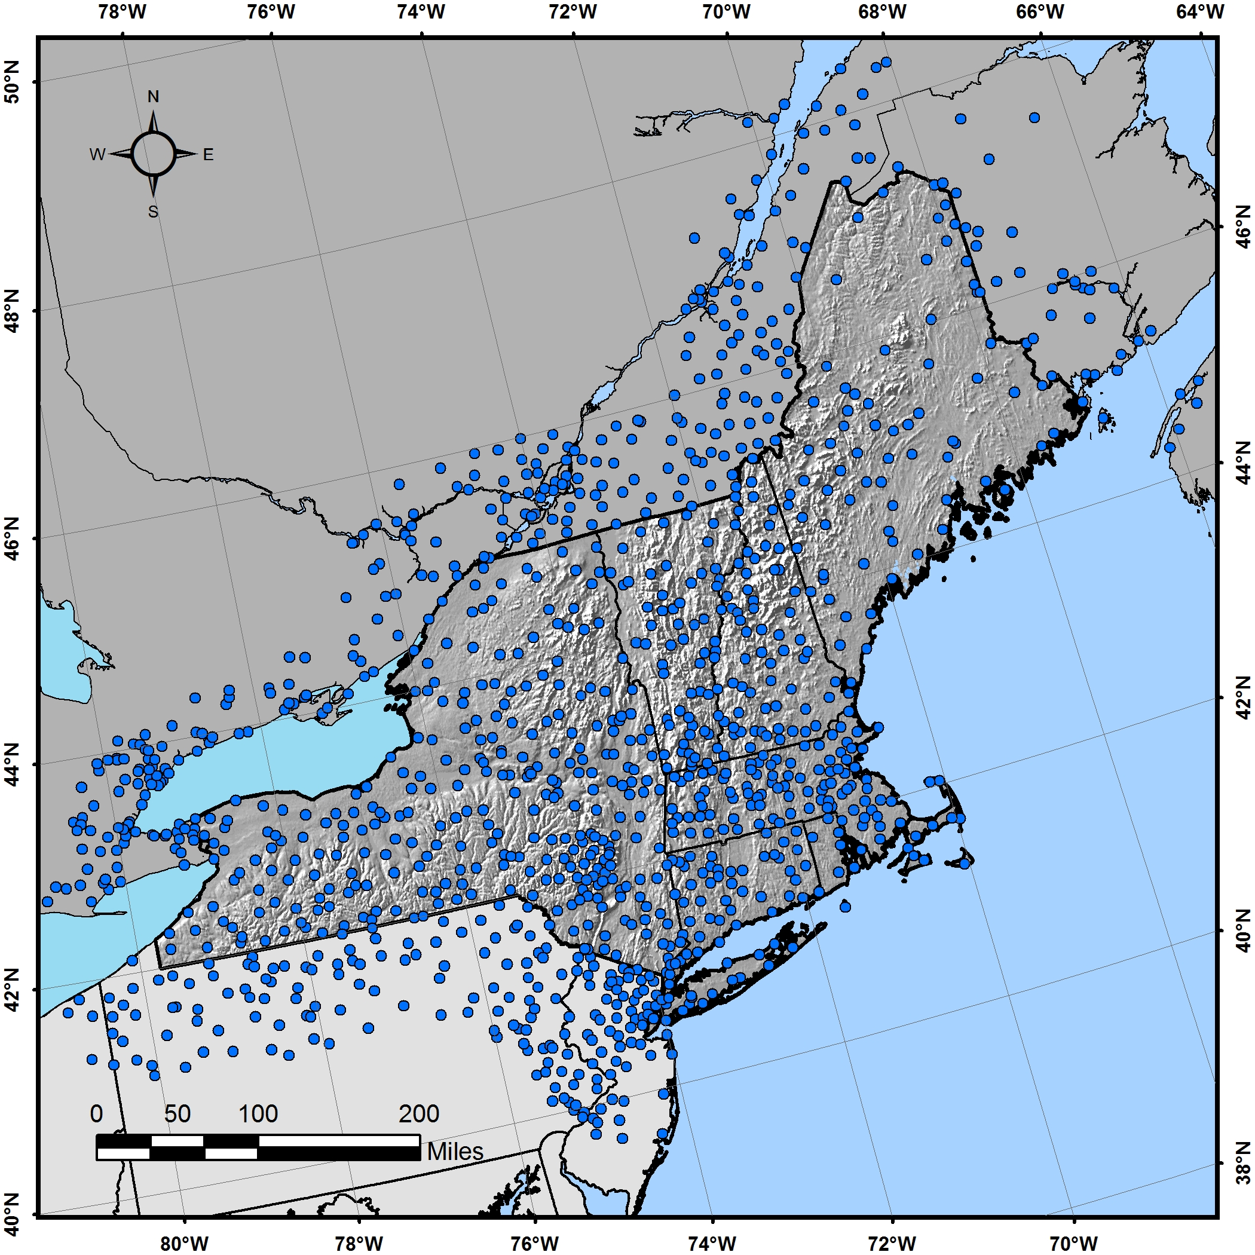
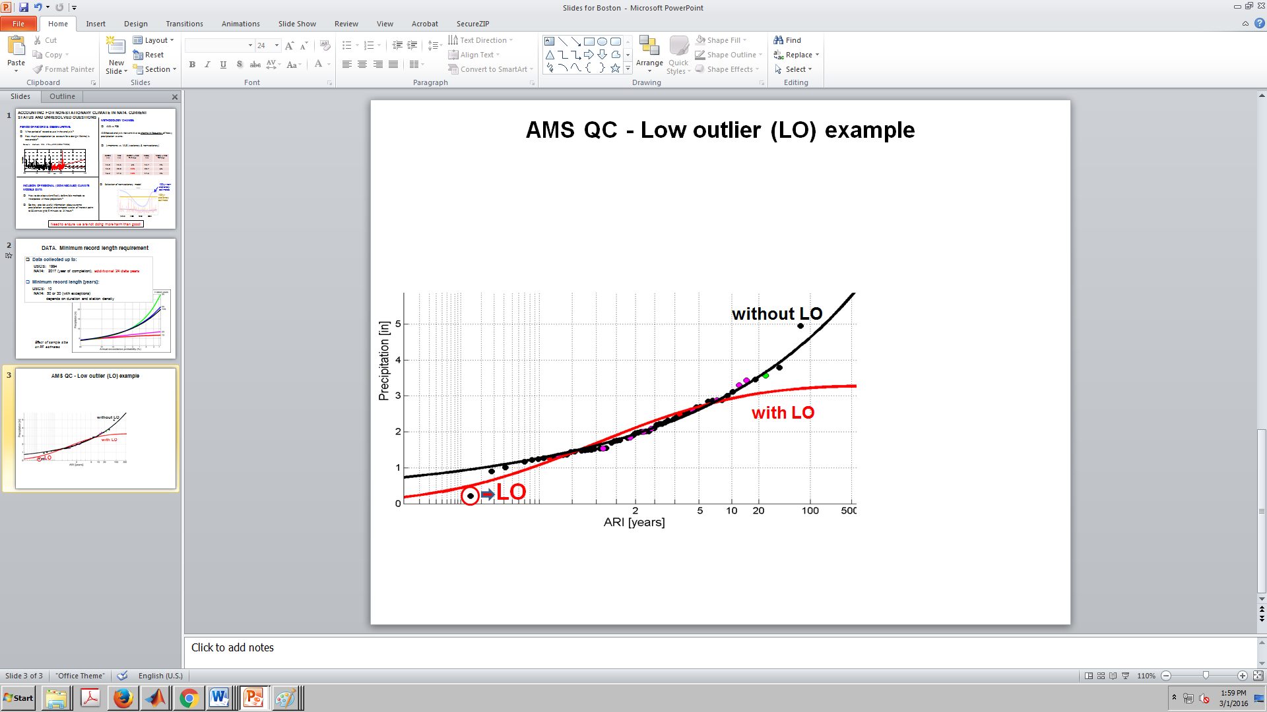
Major sources of errors - data
Record length
n latest years
100-yr range: 6.6 – 17 in
1hr AMS for ITHACA, NY. Hourly record extended 49 years through digitization; 100-yr estimate changed from 1.6 to 2.5 in.
Spatial coverage
Quality control
100-yr: 3.1 vs 4.8 in
Single low outlier reduced 100-year estimate ~35%.
S. Perica, NOAA/NWS/HDSC Weather Conference, Danbury, 29 September 2018 8

Slide 9
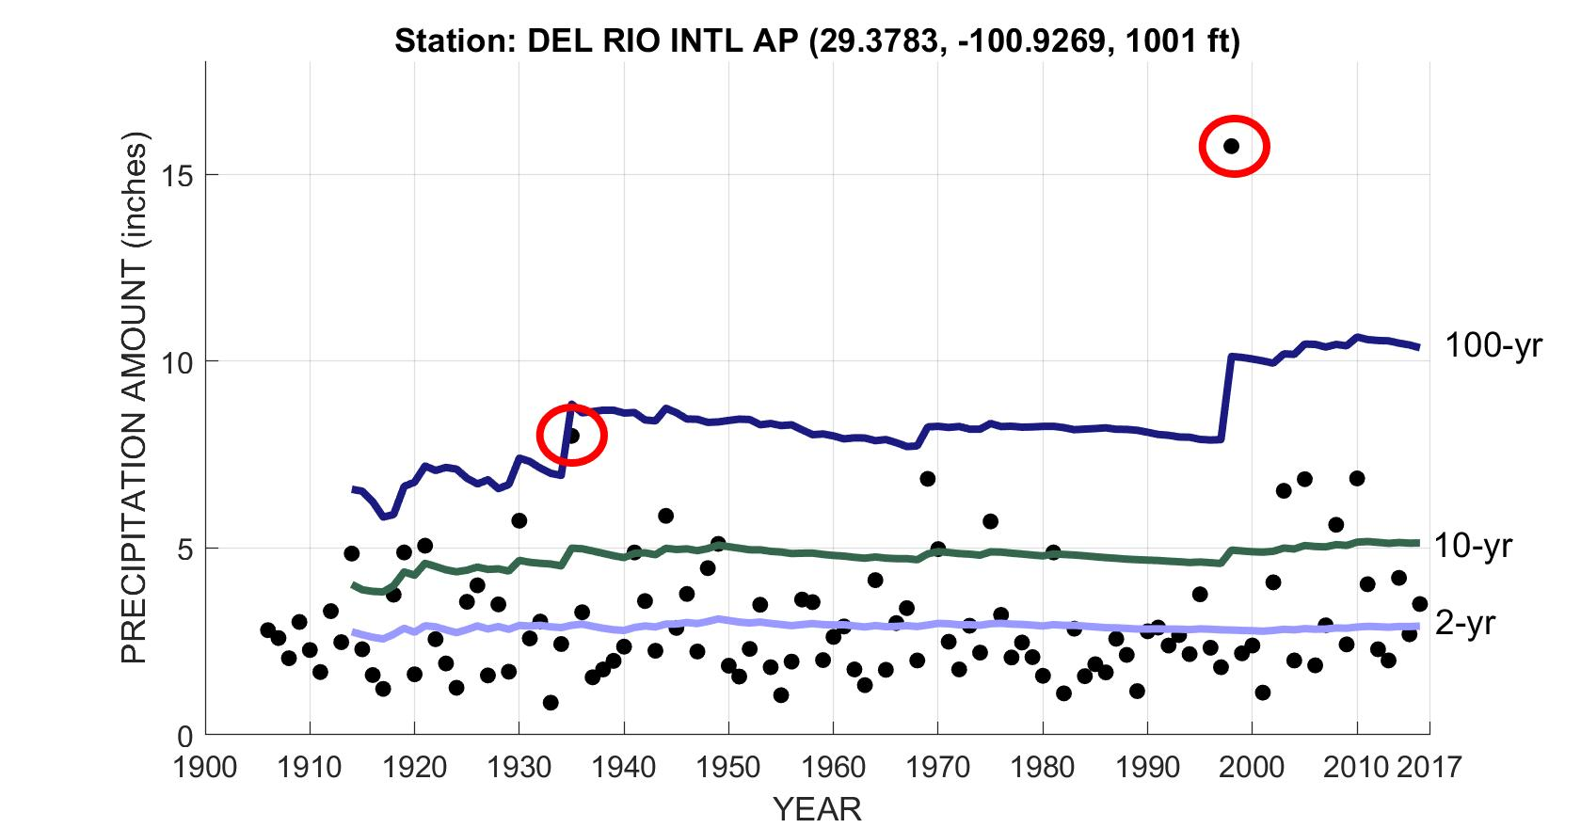
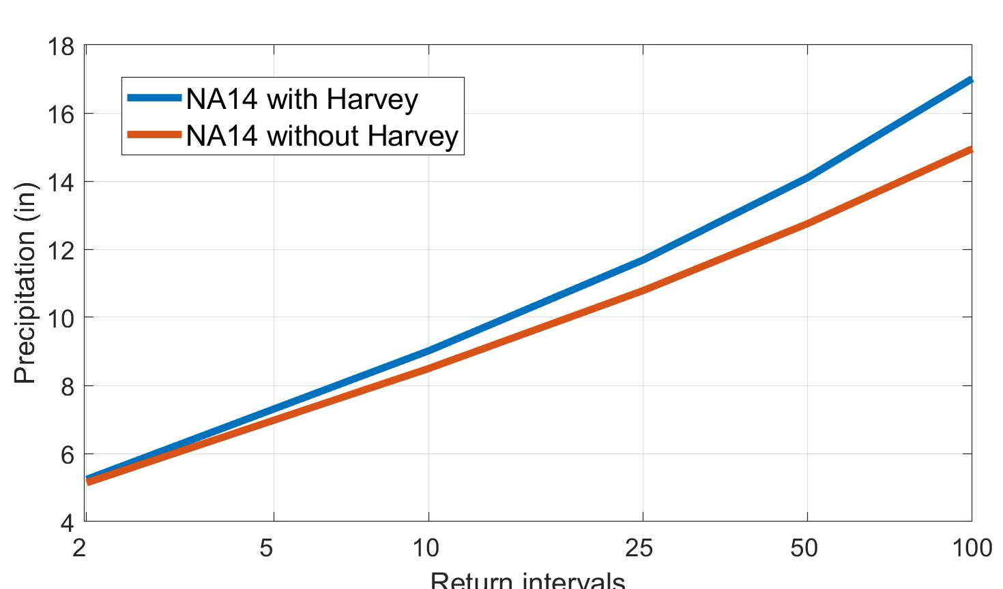
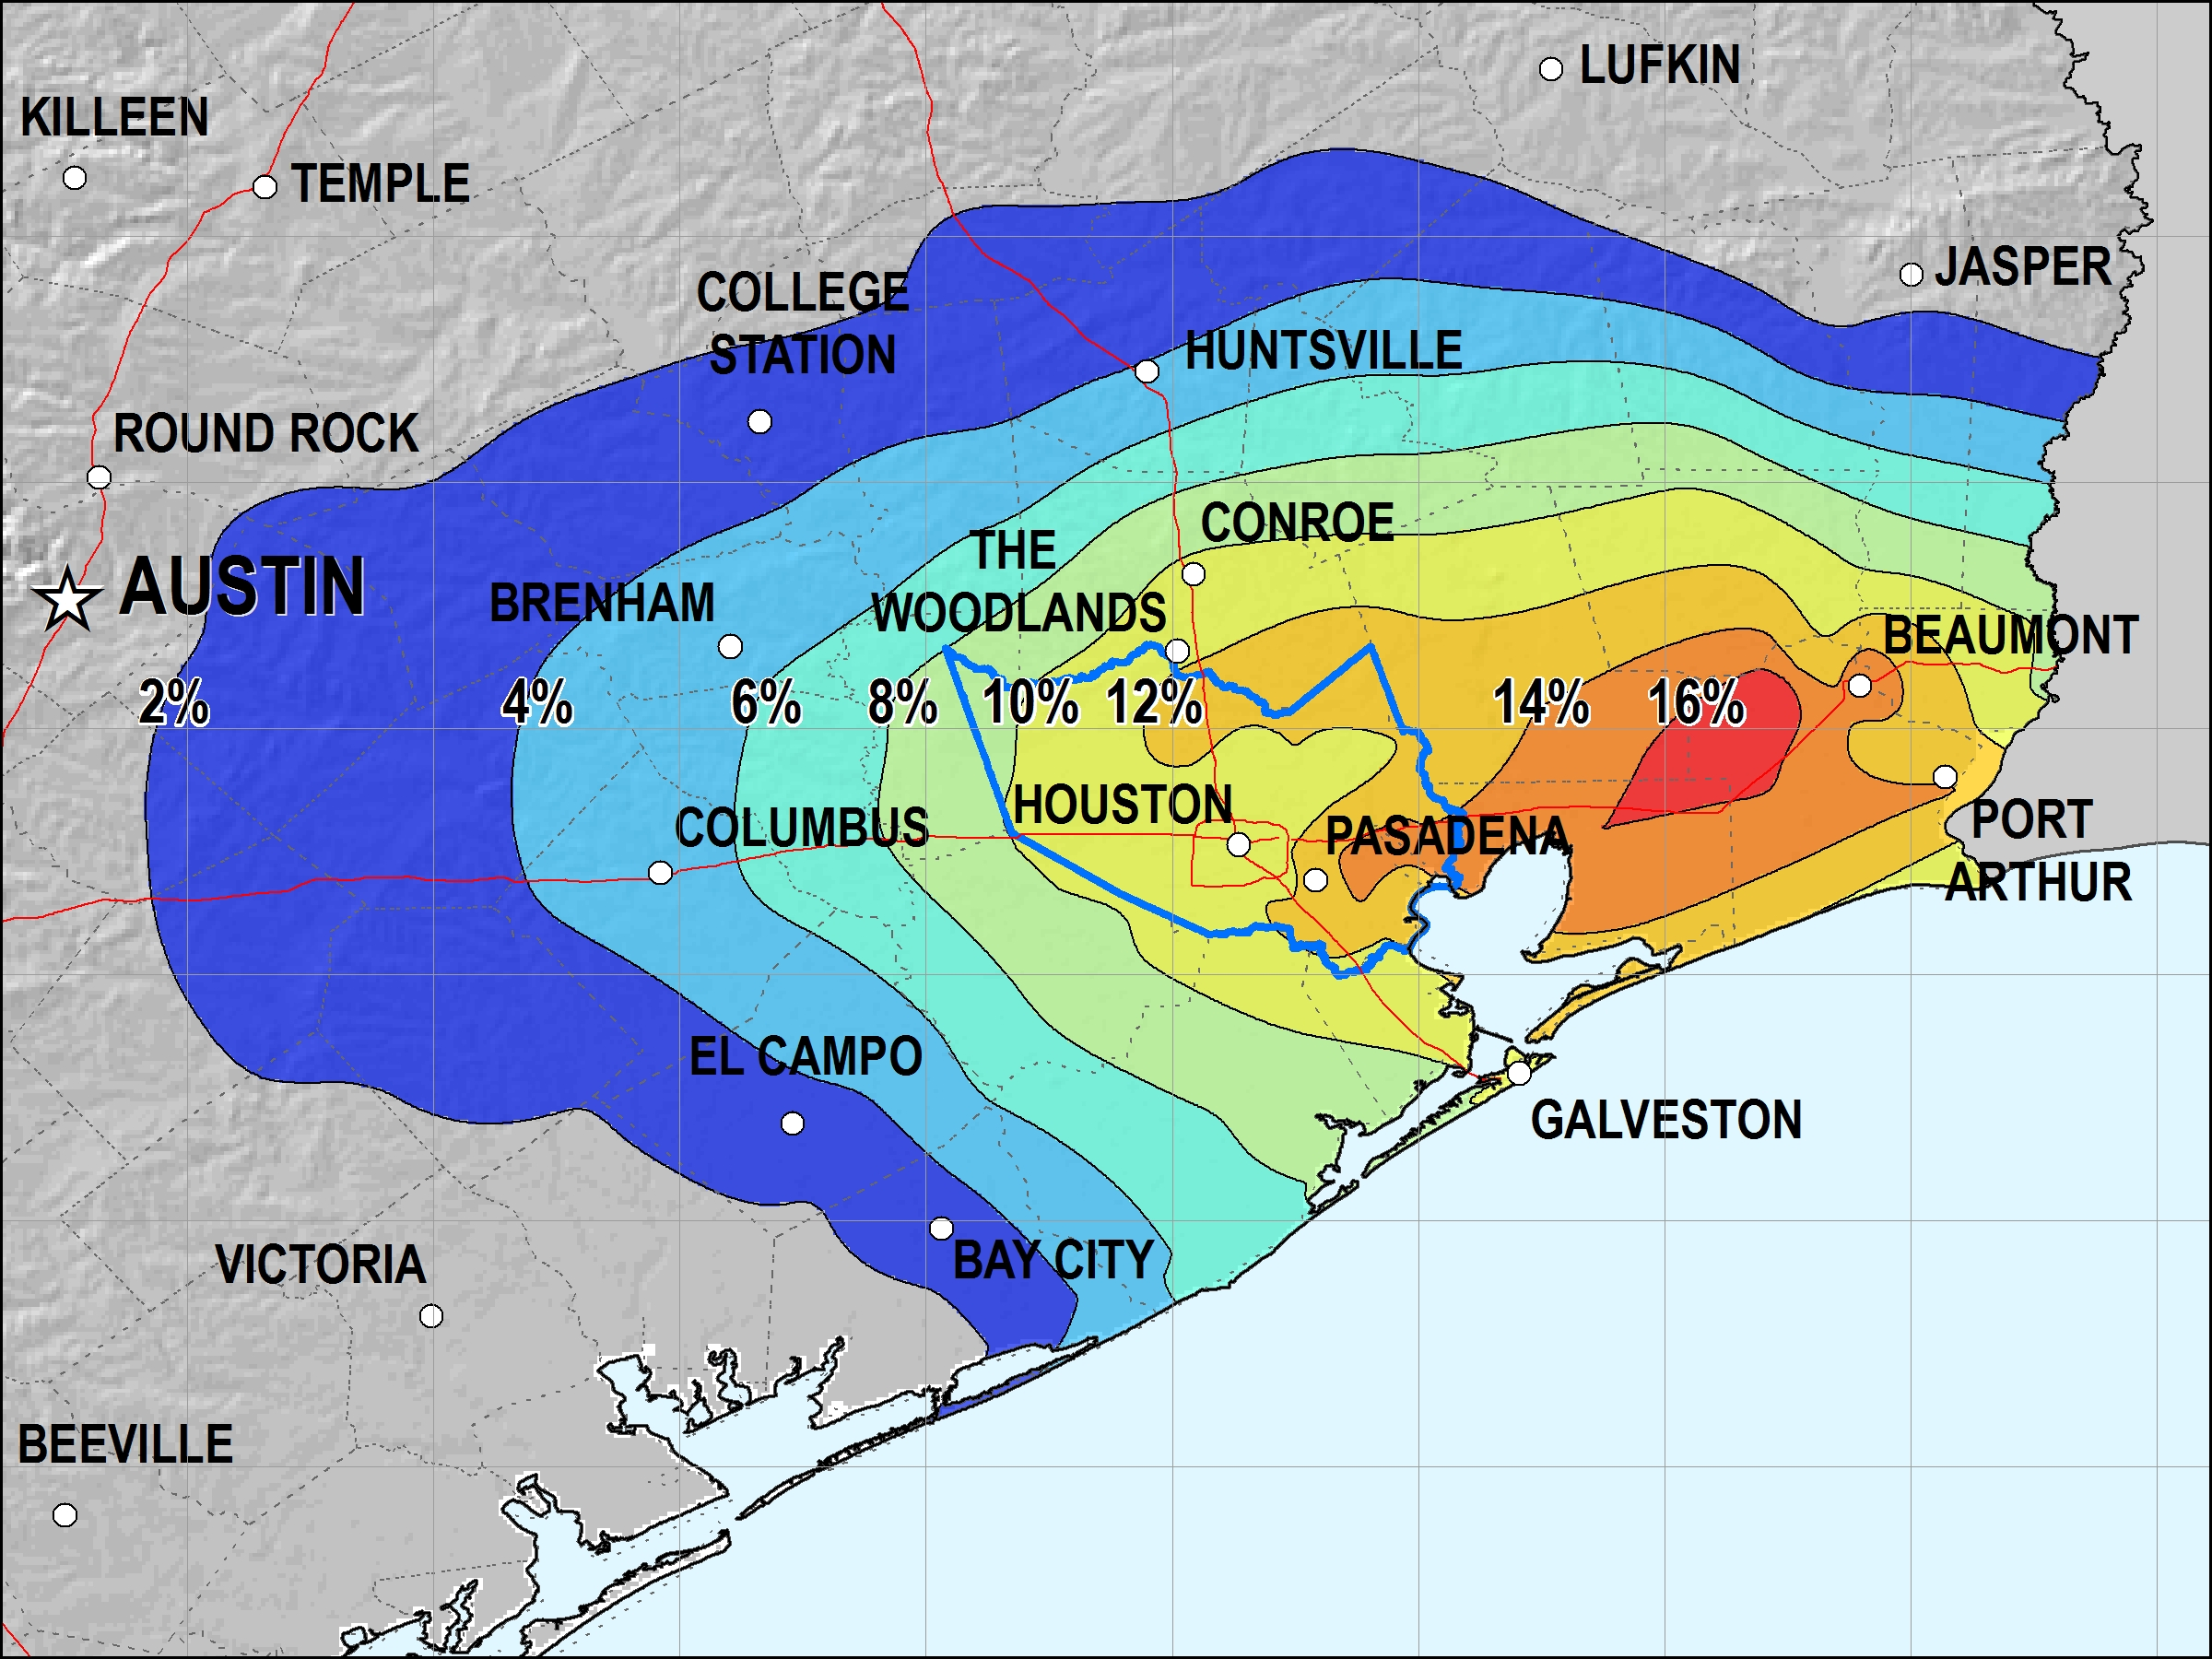
Impact of major storms on estimates
Tropical storm Charley, 1998
Progression over the years in 24-hour frequency estimates at Del Rio Intl Ap station.
24-hour frequency curves at Houston Hobby Airport.
Percent change in 100-year 24-hour estimates (ver 1) due to Hurricane Harvey.
S. Perica, NOAA/NWS/HDSC Weather Conference, Danbury, 29 September 2018 9

Slide 10
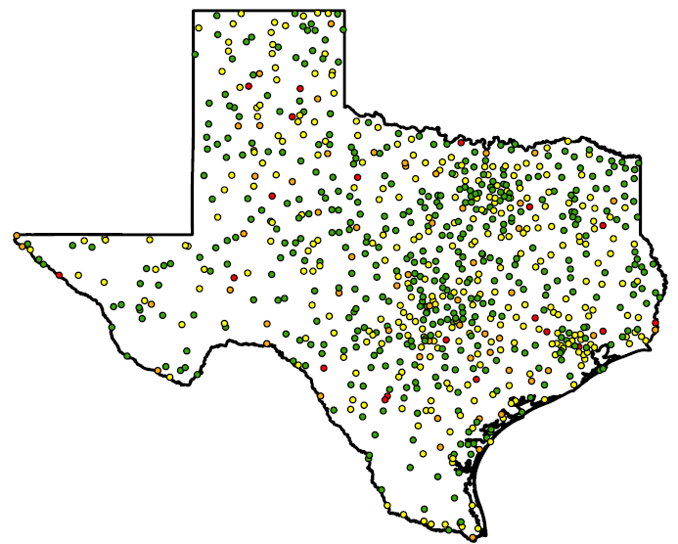
Why do 100-year (1000-year) events happen so often?
When talking about the frequency of extreme events, three elements should be specified: duration, location and area size.
Example: analysis of exceedances of NOAA Atlas 14 24-hour 100-year estimates at Texas stations.
Record length | # of stations | # of exceedances
 |  | 0 | 1 | 2 | 3
≤ 30 | 129 | 96 | 30 | 2 | 1
31- 50 | 296 | 202 | 78 | 12 | 4
51 - 70 | 356 | 204 | 125 | 25 | 2
71 - 90 | 224 | 104 | 97 | 18 | 5
> 90 | 223 | 89 | 89 | 32 | 13
Record length | # of stations | % of stations exceeding 100 year estimate actual (expected)
 |  | 0 times | ≥1 times
≤ 30 | 129 | 74 ( >73) | 26 ( <27)
31- 50 | 296 | 68 (61-73) | 32 (27-39)
51 - 70 | 356 | 57 (49-61) | 43 (39-51)
71 - 90 | 224 | 46 (40-49) | 54 (51-60)
> 90 | 223 | 40 (30-40) | 60 (60-70)
S. Perica, NOAA/NWS/HDSC Weather Conference, Danbury, 29 September 2018 10

Slide 11
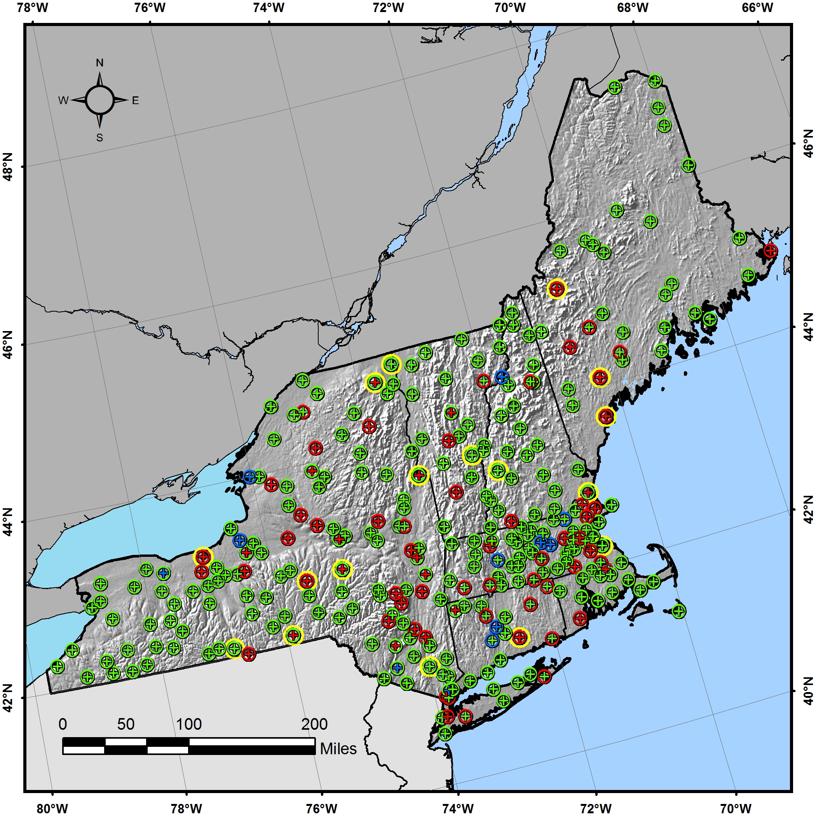
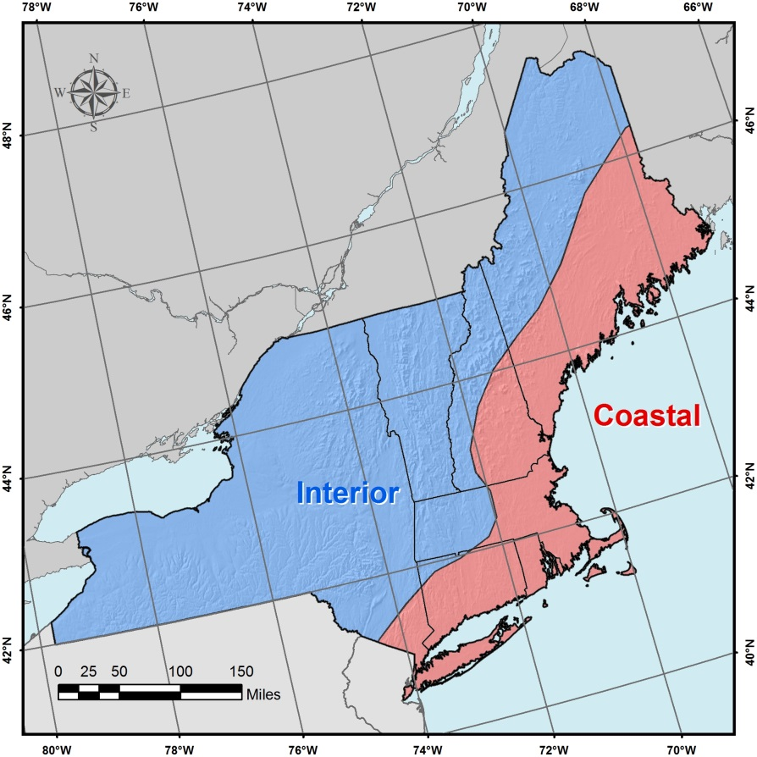
Analysis of non-stationary climate in NA14
DATA ANALYZED – AMS:
AT-STATION ANALYSIS:
1. Parametric and non-parametric statistical tests for trends in AMS mean and variance
2.Investigate spatial patterns in tests results
Vol 10, 24-hr
REGIONAL ANALYSIS:
H₀ : no correlation in normalized AMS regressed against time (5% level)
positive trend
negative trend
no trend
Volume 10 regions
S. Perica, NOAA/NWS/HDSC Weather Conference, Danbury, 29 September 2018 11

Slide 12
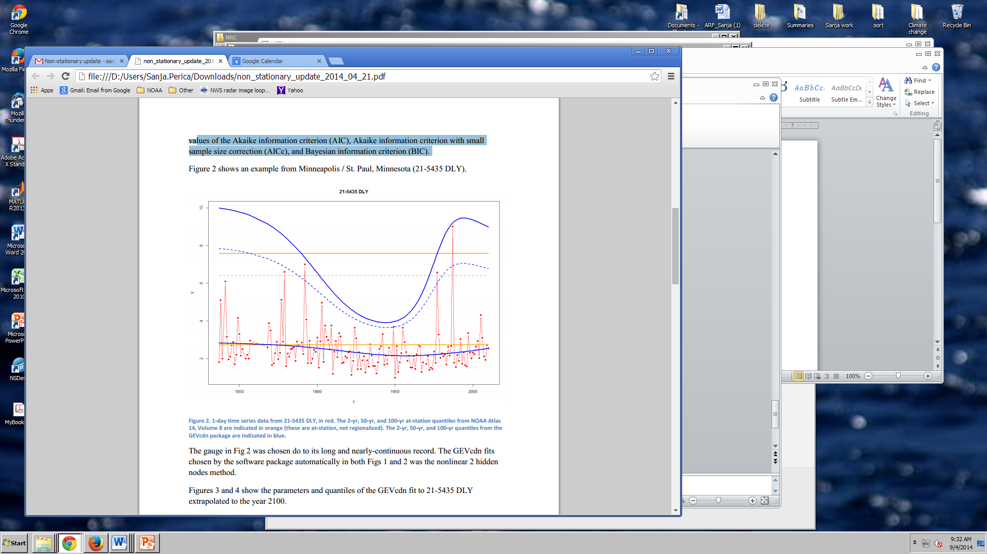
Non-stationary NA14 - current status, future work
METHODOLOGY CHANGE
  In partnership with the Penn State University developed non- stationary NOAA Atlas 14 methodology
  Challenges:
INCUSION OF (DOWNSCALED) CLIMATE PROJECTIONS DATA
In partnership with the University of Illinois, Urbana-Champaign & University of Wisconsin-Madison
Challenges
  How to develop scientifically defensible methods to incorporate climate projections?
  Can we extract useful information about extreme precipitation at spatial and temporal scales of interest (point, sub-daily)?
NA14 old | NA14 new | NA14(t) new
15.0 | 19.3 | 20.7
non-stationary
stationary
S. Perica, NOAA/NWS/HDSC Weather Conference, Danbury, 29 September 2018 12

