Slide 1
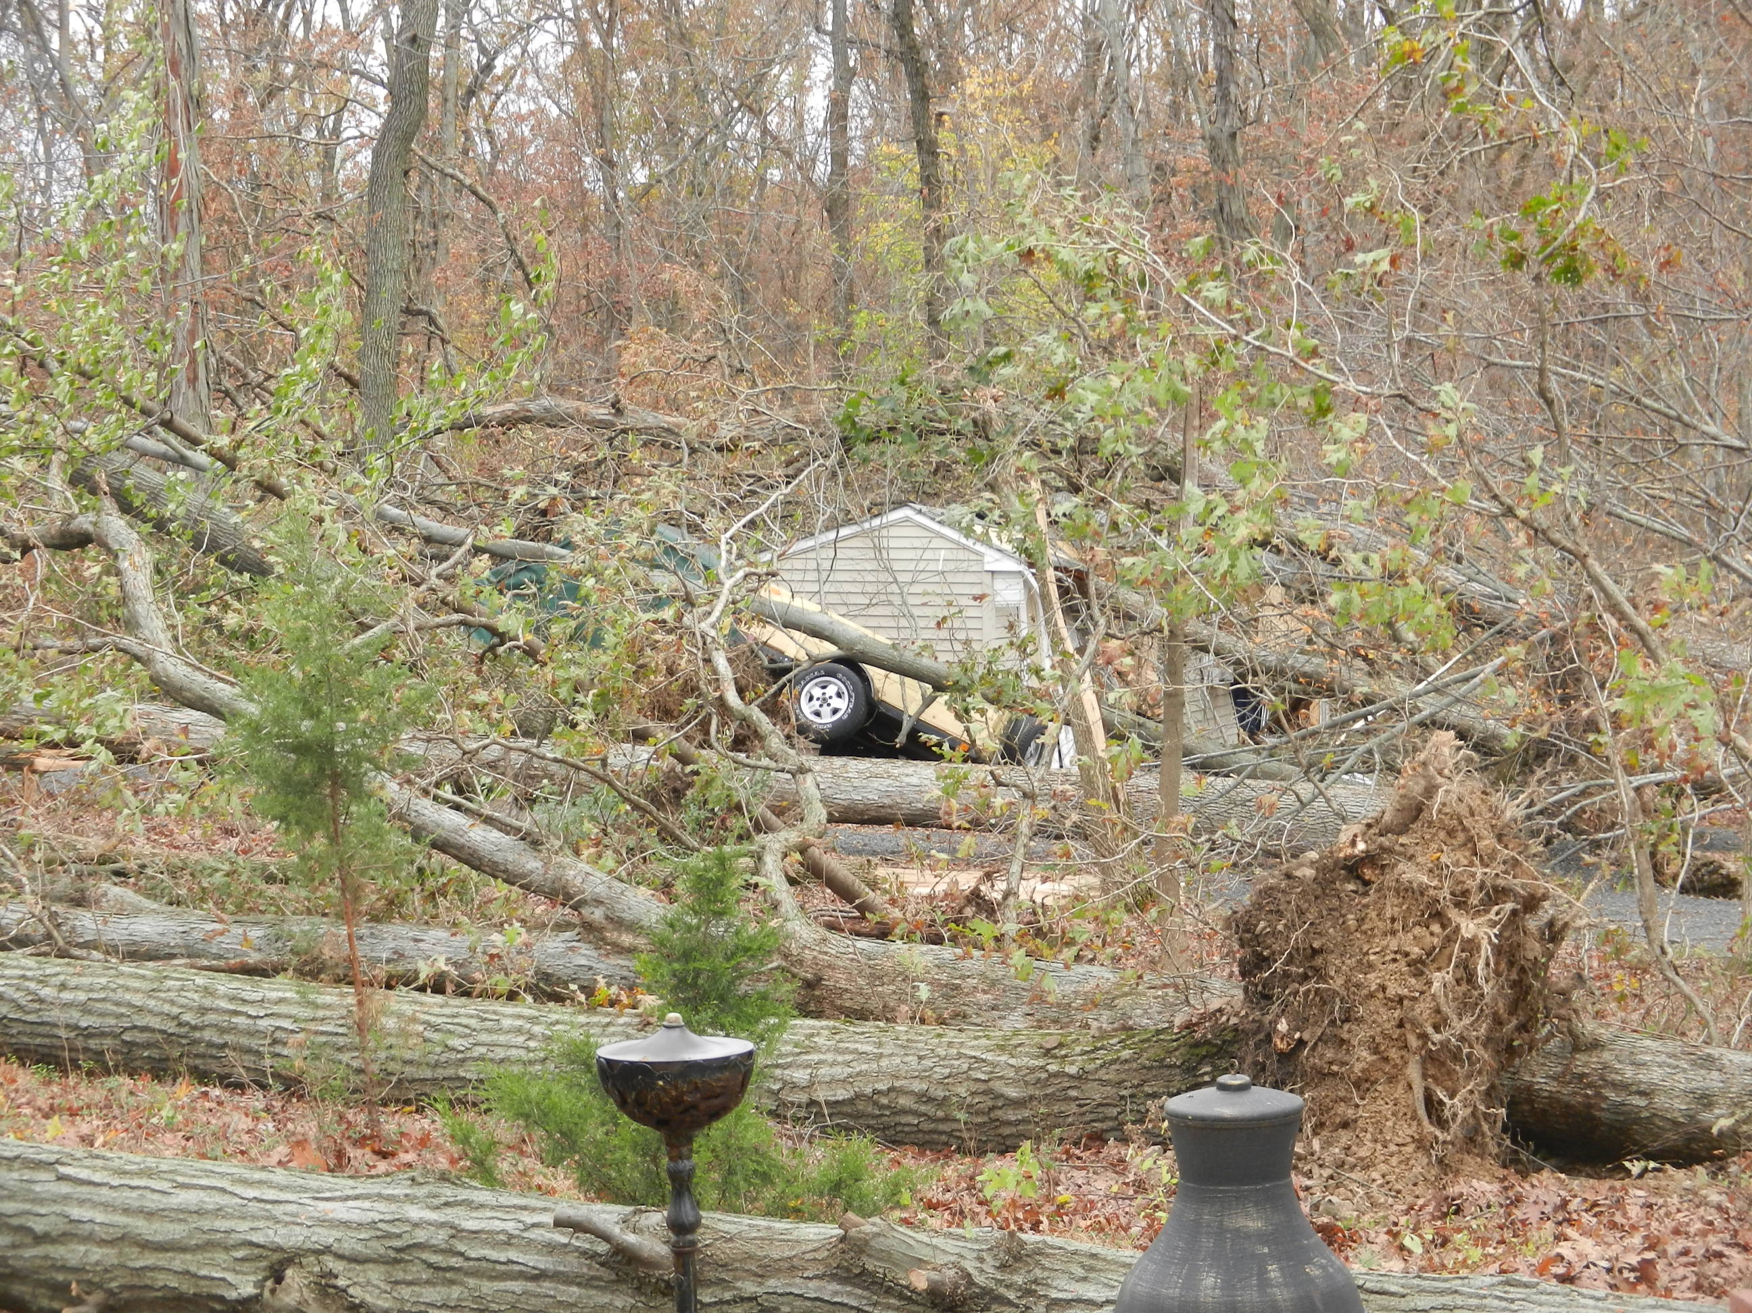
The role of roll vortices on damaging winds during Sandy’s landfall
James A. Schiavone, David A. Robinson, Peter Johnsen,
and Mathieu Gerbush
September 29, 2018
Notes:
Keep this picture in mind as we proceed.
Flooding, as we all know, caused most of the deaths and destruction by Sandy.
But wind-downed trees caused massive, long-duration power outages.
This work is about simulated and observed winds during Sandy.
And we’re in an LES session, so hopefully,
what I learn this afternoon will be a nice springboard for launching our own LES study.

Slide 2
Sandy’s Impacts
Sandy’s biggest impacts were:
  Devastating storm surge flooding
  Extended power outages caused by massive tree-fall
  72 direct deaths, 20 of them caused by fallen trees
Tree-fall was widespread but patchy – Why was it patchy?
  Hypothesize that patchiness was caused by roll vortices
Key resources are leveraged to provide evidence of rolls:
  Resilient New Jersey and Delaware state mesonets
  500-meter resolution Weather Research and Forecasting model
  NOAA radar, surface and rawinsonde observations
What I will cover:
  Data resources
  Boundary layer wind and roll vortex concepts
  Sandy overview
  Evidence of roll vortices – in observations and simulation
  What if Sandy tracked here
Notes:
Sandy’s impacts are all too well known to us.
Key impacts:
72 direct fatalities.
$70 B total economic damage.
8.5 M customers lost power, some for weeks.
650,000 homes damaged or destroyed.
12.5 feet maximum storm surge.

Slide 3








Work Made Possible By . . .
High resolution surface observations
  New Jersey Weather and Climate Network (NJWxNet) mesonet
  Delaware Environmental Observing System (DEOS) mesonet
  NOAA’s Automated Surface Observing Systems (ASOS) and National Data Buoy Center (NDBC)
High resolution WRF simulation of Sandy
  Run by Pete Johnsen, Mel Shapiro and
  Mark Straka on Cray XE6 at NCSA
  NCAR’s Dick Valent was instrumental in gaining access to the large 43 Terabyte data set
  NCAR’s Alan Norton provided invaluable help in using VAPOR Visualization and Analysis Platform
Notes:
This work is made possible by the hi-res mesonet observations,
and the hi-res WRF simulation of Sandy.
Fortunately, the NJ and DE mesonet stations continued to log winds throughout Sandy.
Fortunately also is that Mel Shapiro, Mark Straka, Pete Johnsen and Alan Norton
ran a 500-meter resolution WRF simulation of Sandy not long after Sandy struck –
and archived a lot of output – 43 Terabytes worth.
NCAR’s Dick Valent was instrumental in gaining access to this big data set for me.
And NCAR’s VAPOR visualization platform was vital for studying the hi-res WRF output.

Slide 4
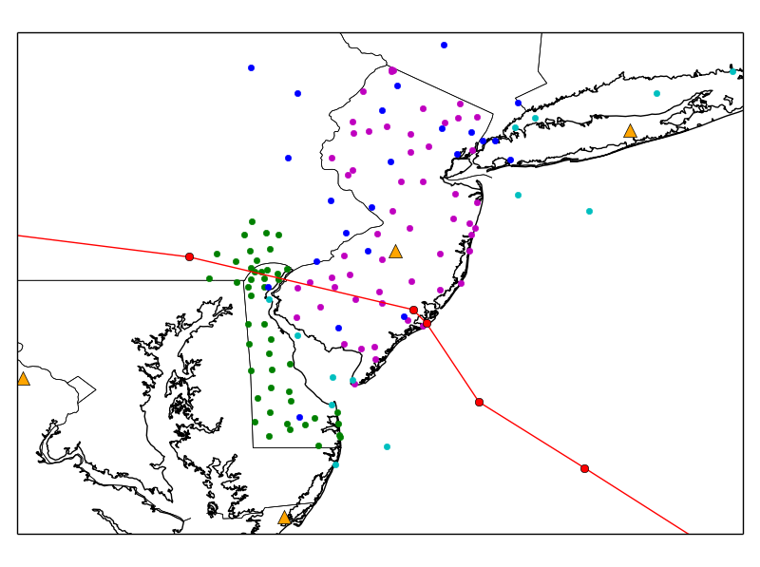
Stations
NJ Mesonet
DE Mesonet
ASOS
NDBC
Profiles
Observations
Mesonet winds
  5 min sampling interval
ASOS winds
  1 and 5 min sampling
KDIX Doppler radar
6 min image scan interval
RAOBs: OKX, WAL, IAD
3 to 12 hour interval
Notes:
This shows the geographical scope of observation stations.
Dots are surface observations,
the 4 triangles are profile observations, and
the red line is Sandy’s best track from NHC.
Mesonet observations are sampled at 5 minute intervals,
and WRF output was archived at 30 minute intervals.
Besides the surface observations, we also used rawinsonde observations, radar data,
reconnaissance observations, and satellite imagery.
NHC best track times are 2330, 0000, 0600 Z.
88% of stations were used in wind speed averages.

Slide 5
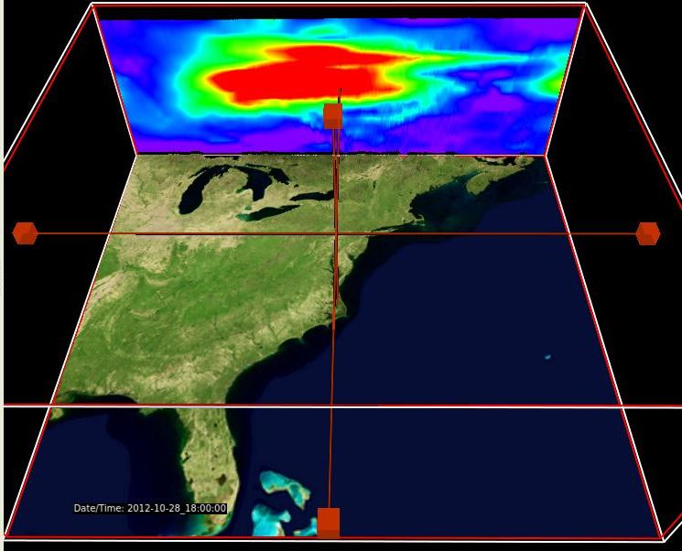
WRF Model Simulation
Model: Advanced Research WRF version 3.3.1
System: Cray XE6 “Blue Waters” at National Center for Supercomputing Applications (NCSA)
Grid: 500 meter spacing, 5320x5000x150 grid,
4 billion grid points
Initialization and boundary conditions: NOAA/NCEP GFS output
Simulation period: 96 hours,
beginning 12Z Oct 26, 2012
Output: 30 minute interval,
193 files, 224 GB each,
total of 43 Terabytes
Notes:
Here are a few specifics on the simulation . . .
Hardware specifics:
Simulation was run just after machine came online in March 2013
System uses AMD 2.3 GHz Interlagos processors
Peak performance is 13 petaFLOPS
WRF specifics:
1.25 second integration steps
Yonsei University (YSU) PBL
Full non-hydrostatic forecast with full moist physics
WSM6 6-class microphysics with graupel
RRTM/Dudhia long and shortwave radiation schemes
‘Noah’ land surface
Explicit cumulus
Cold start

Slide 6
Concepts – Boundary Layer and Winds
Sandy’s wind speeds measured by Fort Dix Doppler radar
Hurricane winds peak at low levels,
600-1,800 m for Sandy
Notes:
Boundary layer is the lowest layer of the atmosphere that is most affected by the earth’s surface.
It is usually about 1 km thick.
Winds in hurricanes always peak down low in the atmosphere, near the top of the boundary layer.

Slide 7
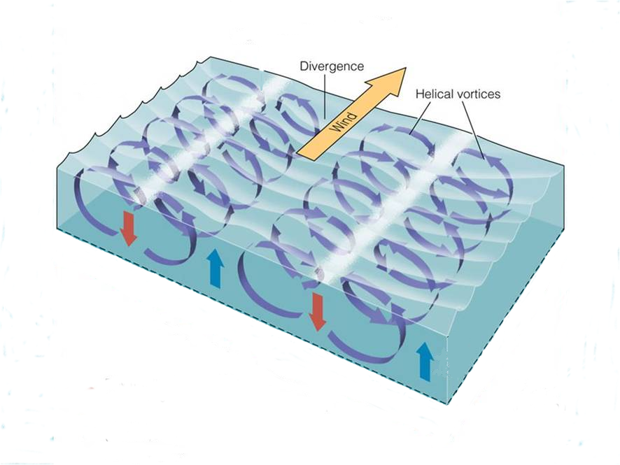
Concepts – What Are Roll Vortices?
Observed in 12 prior hurricanes but mostly over open waters
Slab depicts boundary
layer:
≈ 1 km
Lines of downward motion, higher surface winds, possible patchy treefall, and diminished precipitation
Often propagate sideways
Adapted from Brooks/Cole – Thomson (2005)
Notes:
When roll vortices are present in the boundary layer, air also spins slowly around horizontal axes.

Slide 8
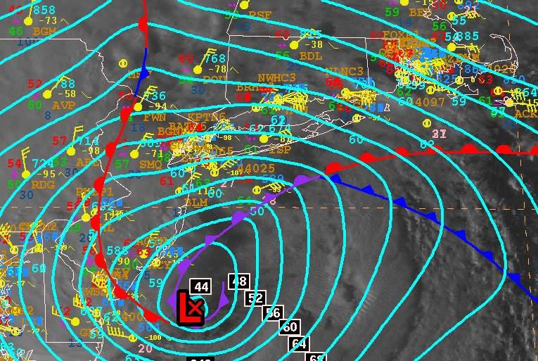
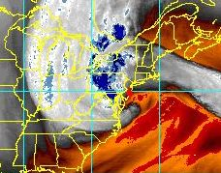
Sandy Overview – Observations
29 October 2012
Above:
NHC Analysis at 21Z
Right:
GOES water vapor
at 23:45Z
Notes:
Moist air is etched away by spiraling cold, dry intrusion.
On the left is NHC’s analysis at 21Z,
the time they considered Sandy to have become extratropical.
Note the inverted wave structure, with the warm front pushing westward,
and the cold and occluded fronts pushing northward.
On the right, in the GOES water vapor imagery,
we can pick out the classic extratropical cyclone airstreams:
the warm conveyor belt,
the cold conveyor belt,
and the descending dry air intrusion,
We’ll see these in our data shortly.

Slide 9
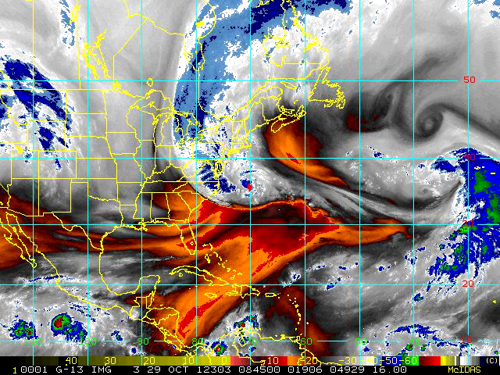

Slide 10
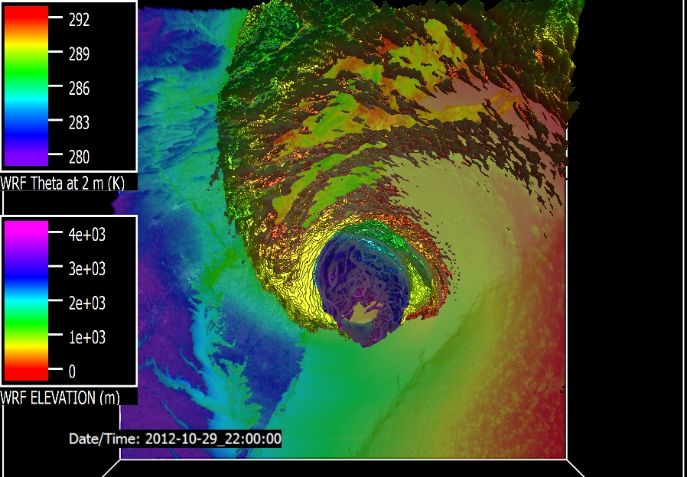
Sandy Overview – Model
Surface Temp. (°K)
Water Vapor Surface at 22Z
Notes:
Surface represents top of high water vapor concentration layer.
Moist layer is etched away by spiraling cold, dry air intrusion..
The ground image is WRF 2 meter potential temperature,
and the 3D iso-surface encloses higher-concentration water vapor.
Iso-surface colors denote elevation, with red and yellow below 1 km.
This shows etching of the warm, moist air from the east and also from above,
which you can appreciate even better on the animation.
Profile observations at Upton, LI, as shown on the plot,
confirm this cooling and drying from above, which destabilizes the boundary layer.
This destabilization, in turn,
may have played a role in transporting momentum downward from the LLJs,
contributing to the bursty and patchy high winds observed north of the storm center.
This destabilization has been mentioned before by Jeffrey Tongue,
and this will be yet another topic for more studies on our part.

Slide 11
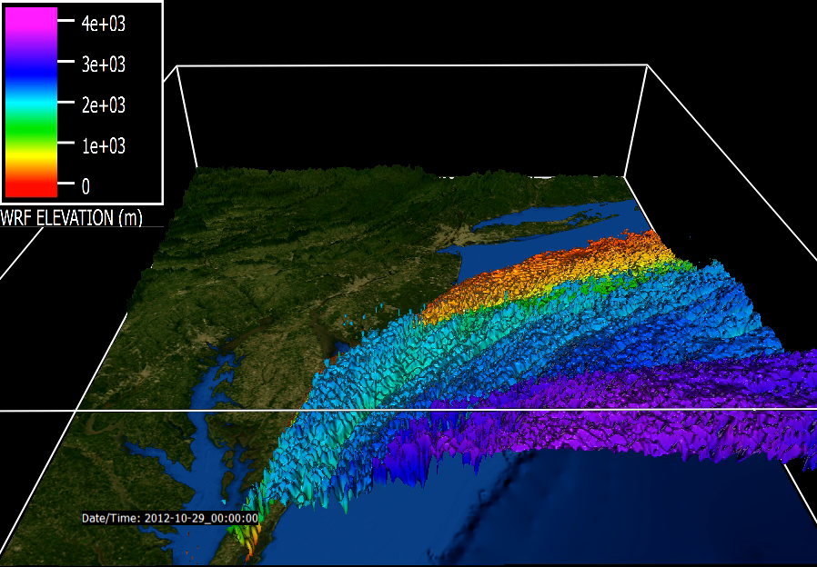

Slide 12
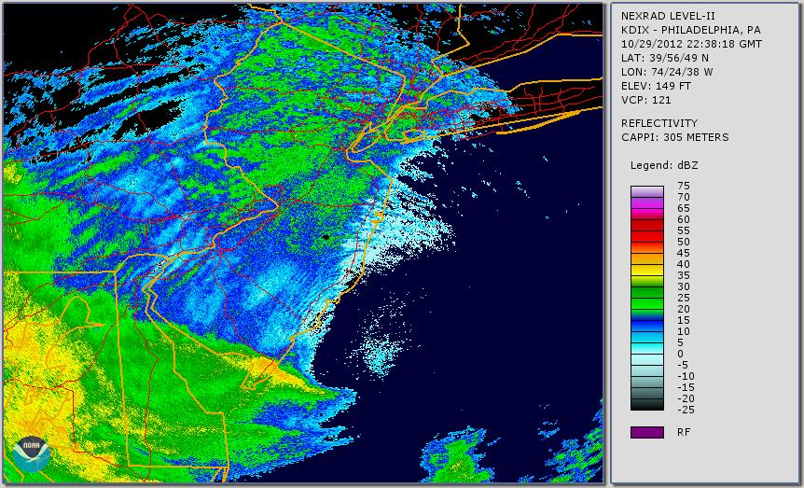
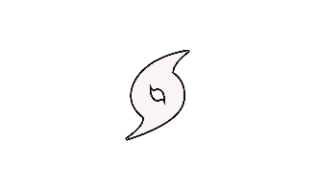
Roll Vortex Signatures in Radar Images
λ = 8.7 km
λ = 3.3 km
Notes:
Rolls are manifested in radar reflectivity images as alternating lines of enhanced and diminished rainfall intensity.
Rapid asymmetry loss is caused by storm entering region of cold water and air at 6 hours before landfall.
Details may differ, but similar structures exist in both.
The yellow and green arc in the SW quadrant is
deep convection ahead of the SW-ward moving warm front.
The blue and green swath in the center is
shallow precipitation within the warm, moist air.
The light blue arc in the left image along the coast is
the leading edge of the cool intrusion.
Note the near-linear bands.
Let’s look at these more closely in the radar base velocity imagery.

Slide 13
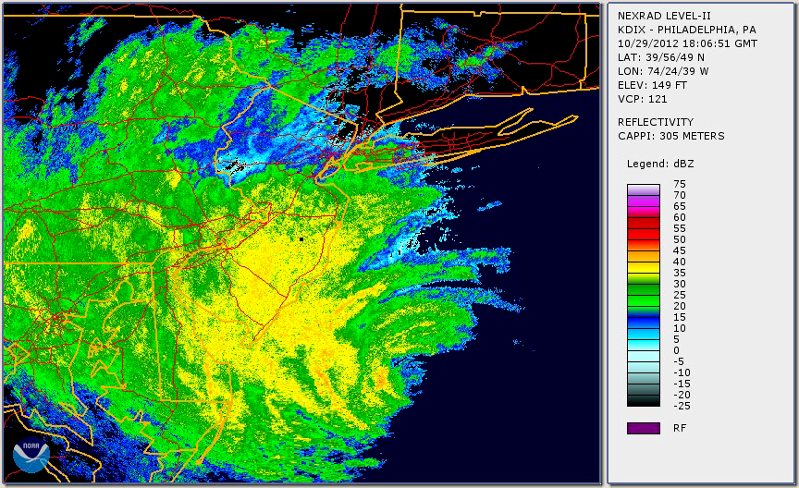

Slide 14
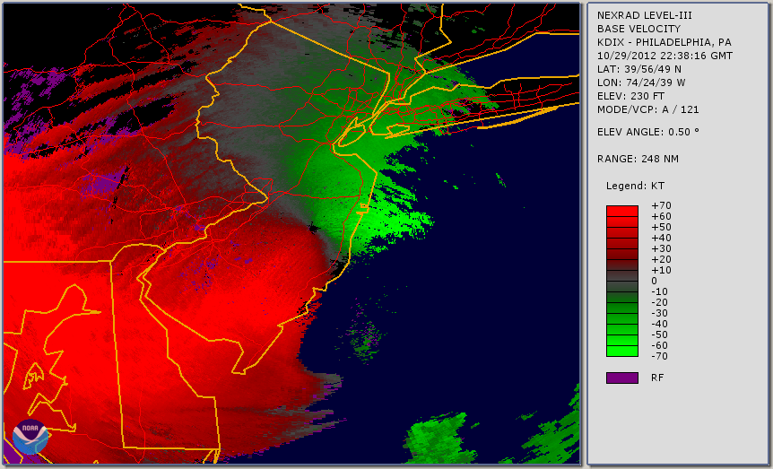
Roll Vortex Signatures in Radar Velocity
From
To
Notes:
Roll vortices vary in:
Spacing
Orientation
Propagation
Here’s a look at radar base velocity.
[play video]
Green is flow toward the radar and red is away from it.
These wind structures are similar to what we would expect from roll vortices.
Around 23Z there is an orientation change in the features over northern NJ.
We also see evidence of roll vortices in WRF – in its vertical velocity fields.
Vortices often propagate normal to their axis.

Slide 15
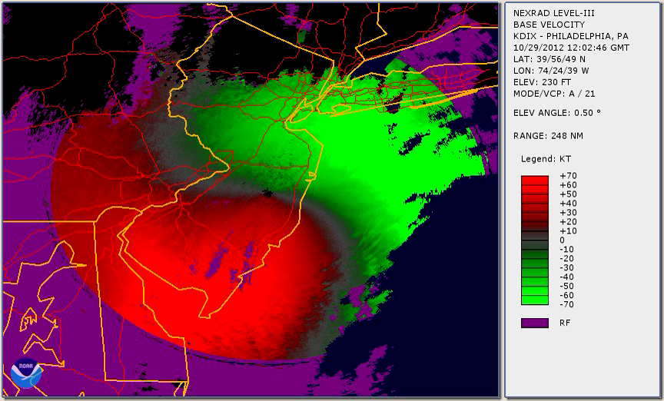

Slide 16
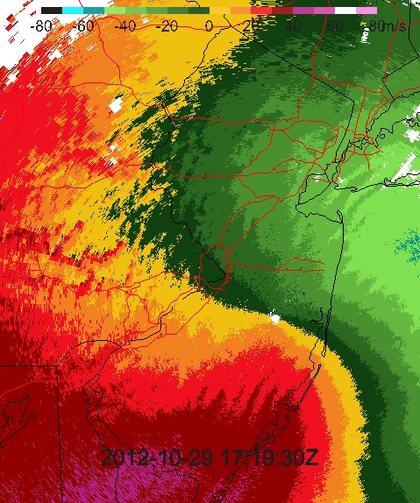
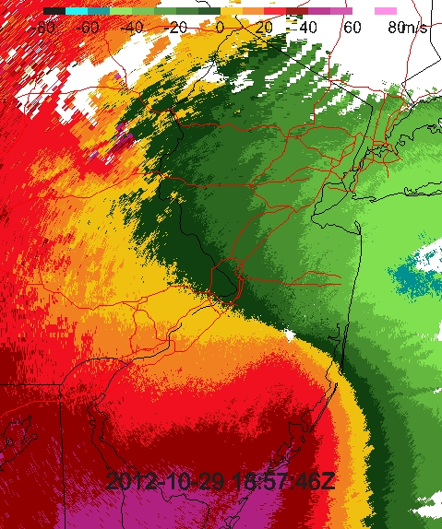
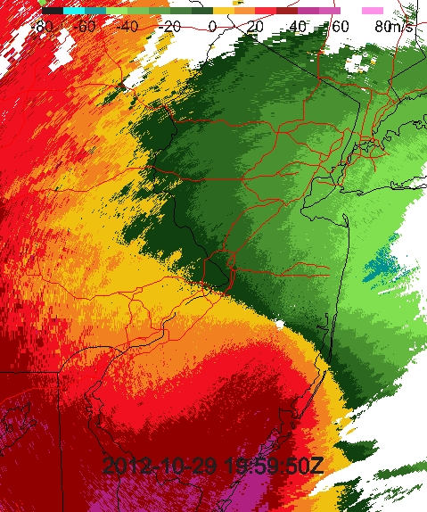
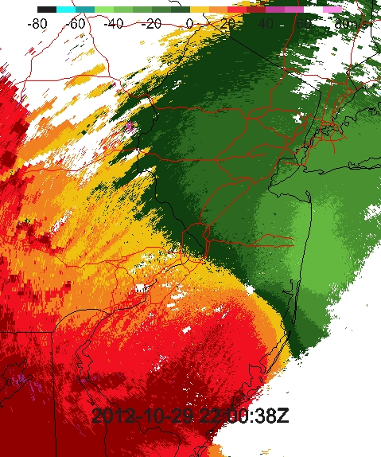
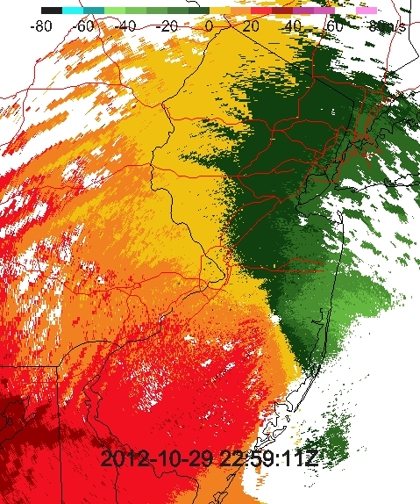
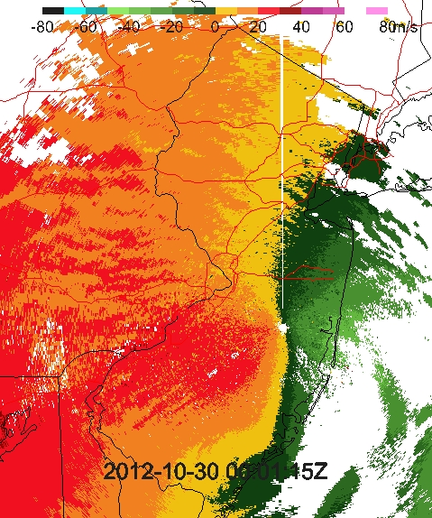
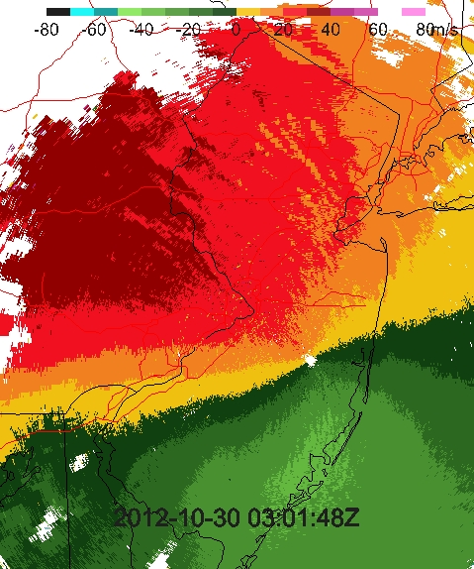
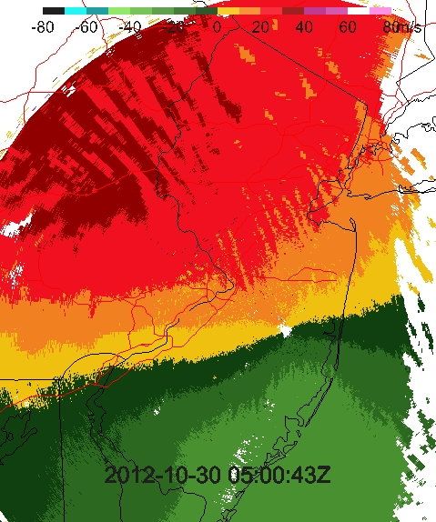
Roll Vortex Stages – Radial Velocity
1719Z
1857Z
1959Z
2200Z
2259Z
0001Z
0301Z
0500Z
Notes:
This shows the roll vortex stages in radial velocity imagery.
These are snapshots every few hours before and after landfall.
And they use a color scheme which resolves the roll features better.
They show how roll locations, sizes and orientation changes during landfall period.
We are now going to zoom into a series of rolls that overlie the Delaware River near Easton, PA to see what we can learn from the radial velocity images.

Slide 17
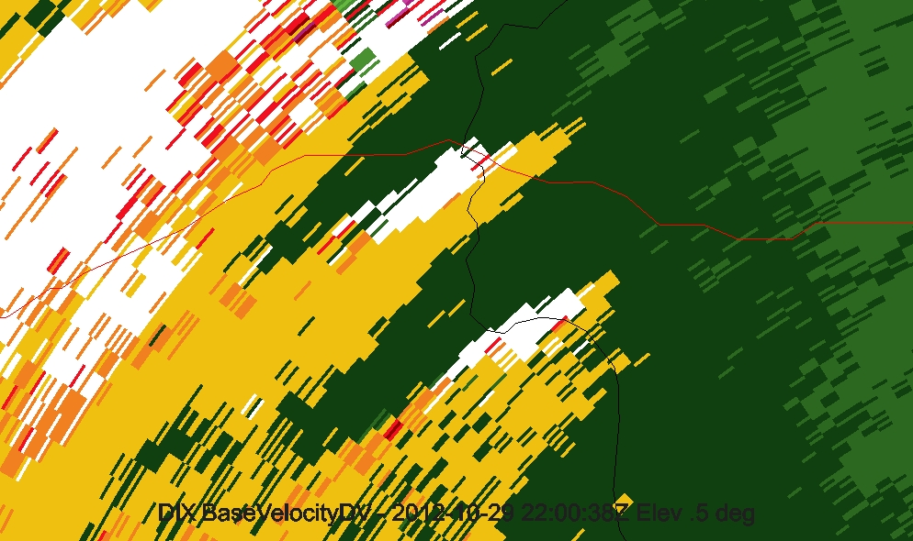
Radial Velocity Confluence Lines
Flow relative to KDIX radar:
Yellow: Away from
Green: Toward
Elevation ≈ 1,300 m
I-78

Slide 18
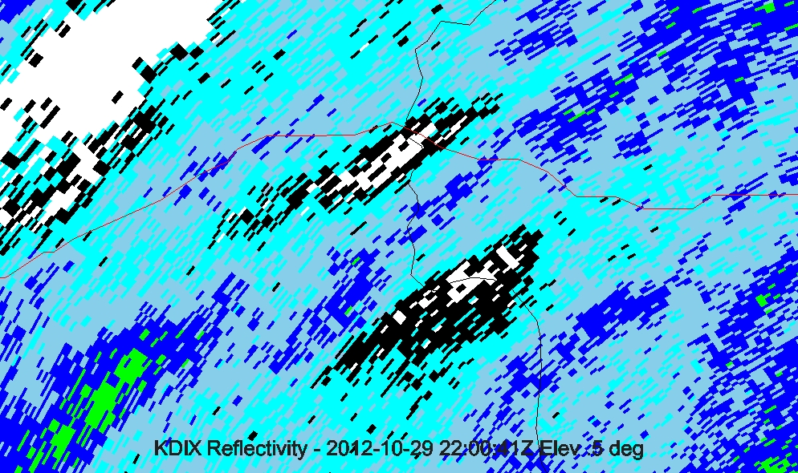
Reflectivity With Confluence Lines
I-78

Slide 19
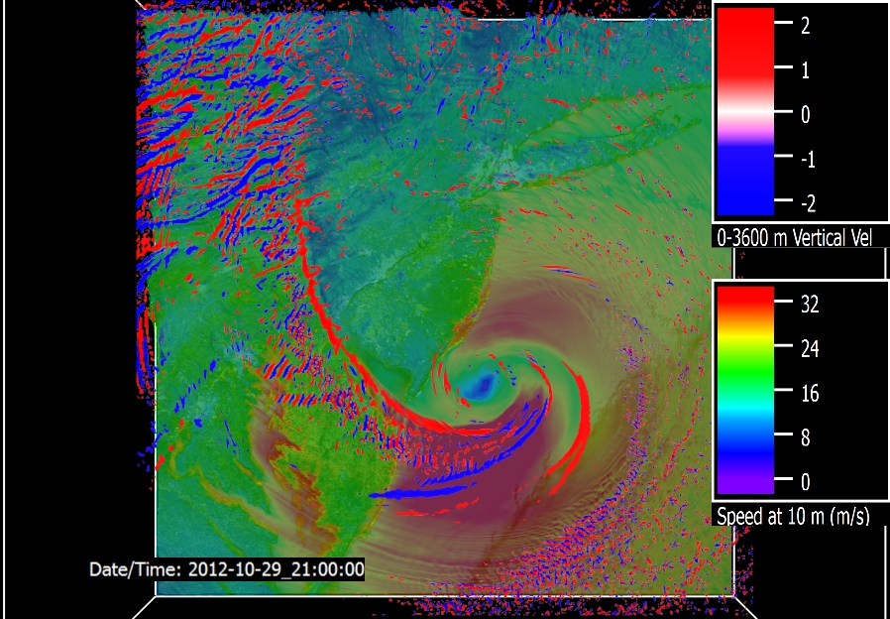
Roll Vortex Signatures in Model
Up
Dn
Vertical Velocity at 1 km and 21Z
Surface Speed (m/s)
Notes:
Roll vortices have different spacing and orientation.
Here is WRF vertical velocity at 1 km.
Red is upward motion and blue is downward.
These features have wavelengths of about 12 km,
which is about the same as those seen in the radar.
We also see signatures with shorter wavelengths,
which were not seen in radar imagery.
Elevations for wind speed are 200, 300, 400, 500, 600, 700, 1500, 2500 and 3500 m
Here is an upward sweep from 500 to 3500 meters.
[play video]
Note how the rolls reflect terrain shape at low elevations,
But become more regular at higher elevations.

Slide 20
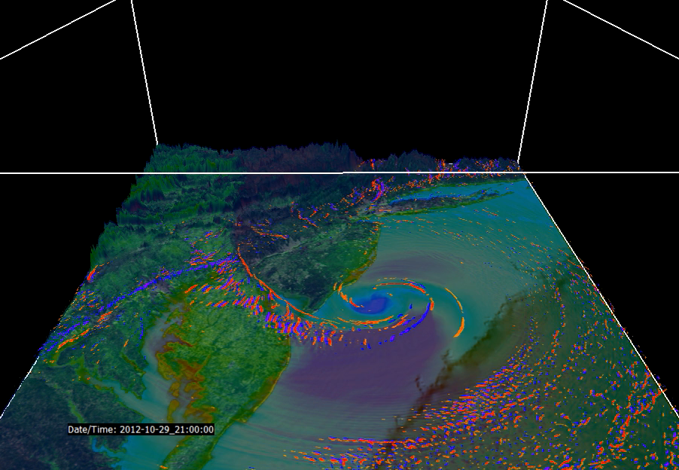

Slide 21
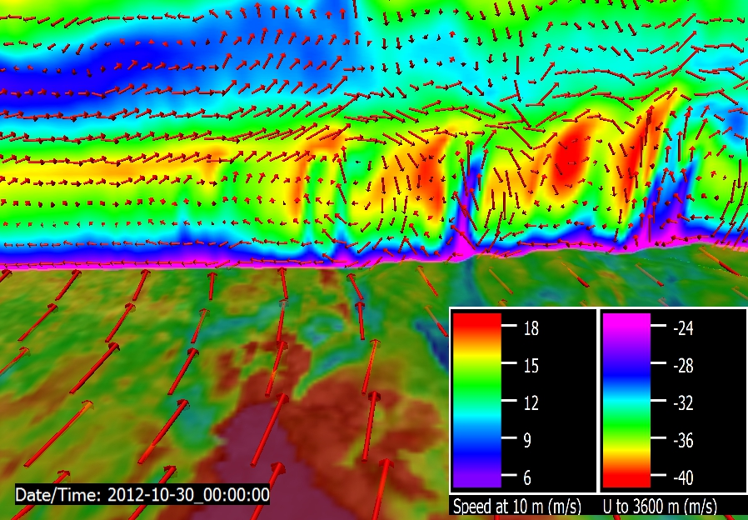
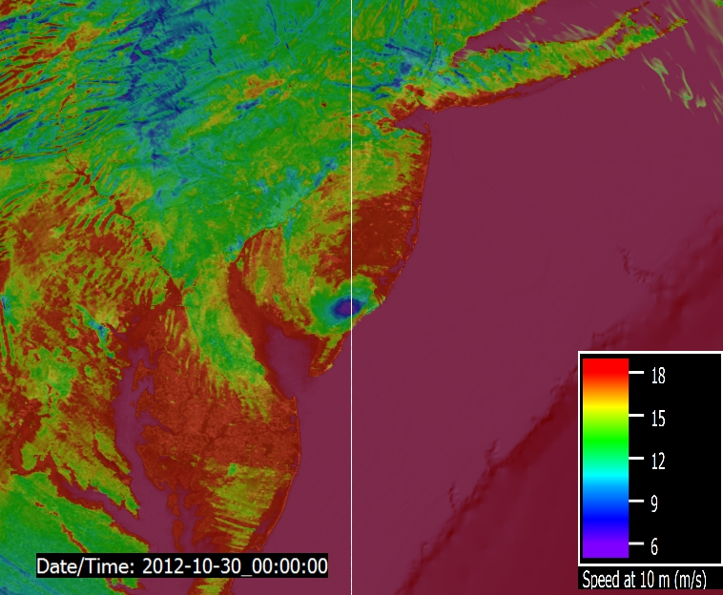
Wind Speed Vertical Section - Model
South
North
Winds on 0-4 km vertical section
Surface wind speed
Notes:
We saw evidence of roll-like motion in radar data, but what does model show?
Small arrows on cross section plane represent roll circulations.
Rolls themselves propagate horizontally.

Slide 22
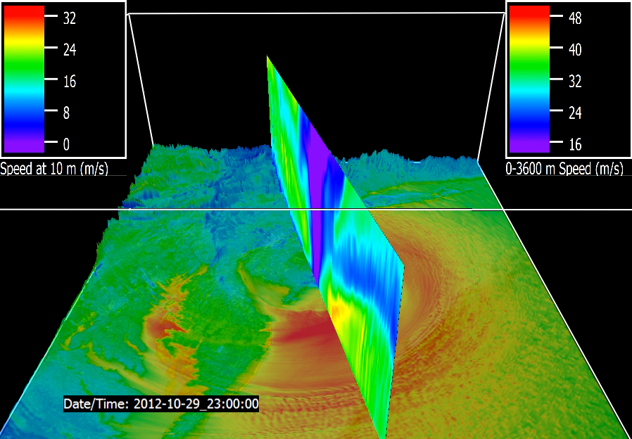

Slide 23
1-Minute Wind Speeds – 4 Sites
6-10 minutes interval
7-8 minutes
6 minutes
5 minutes
Radar shows that it takes ≈6 minutes for rolls to traverse sites
Notes:
Wind speed fluctuation period is 5-10 minutes, with largest variability at Allentown.

Slide 24
Periods of Propagating Roll Vortices
Wind Speed Observation Site | Measured Roll Vortex Period (minutes)
 | Radar Radial Velocity Imagery | Wind Speed Time Series | Wind Speed Auto-Correlation
ABE | 6 | 6.6 | 10
TEB | 6 | 7.9 | 7
TTN | 6 | 6.3 | 6
VAY | - | - | 5
In radar imagery, roll vortices often propagate normal to their axes
At VAY site:
  Roll signatures are difficult to discern on radar
  Evidence of periodicity is difficult to discern on wind speed time series
Autocorrelation is done for an 80-minute window during 1820-1940 UTC with lags of 1-60 minutes

Slide 25
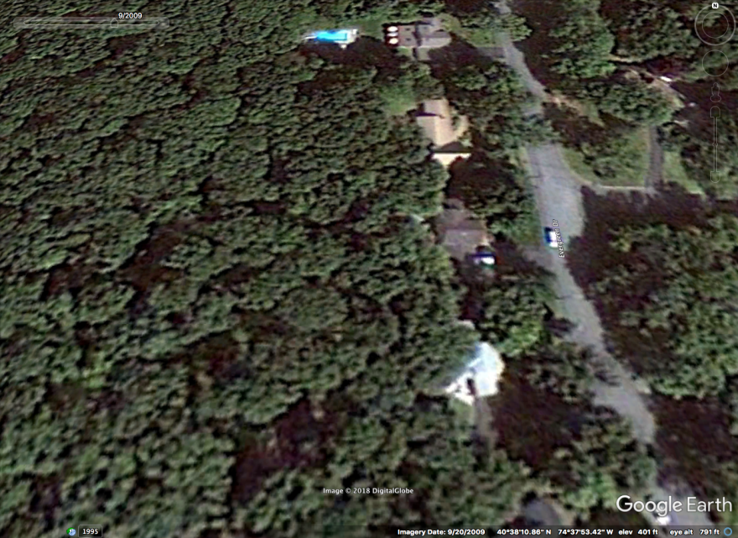
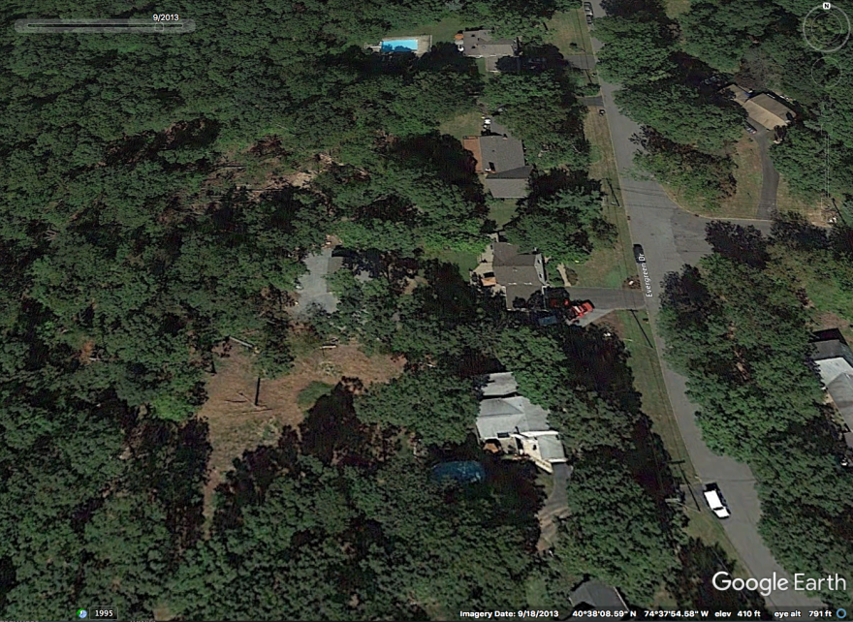
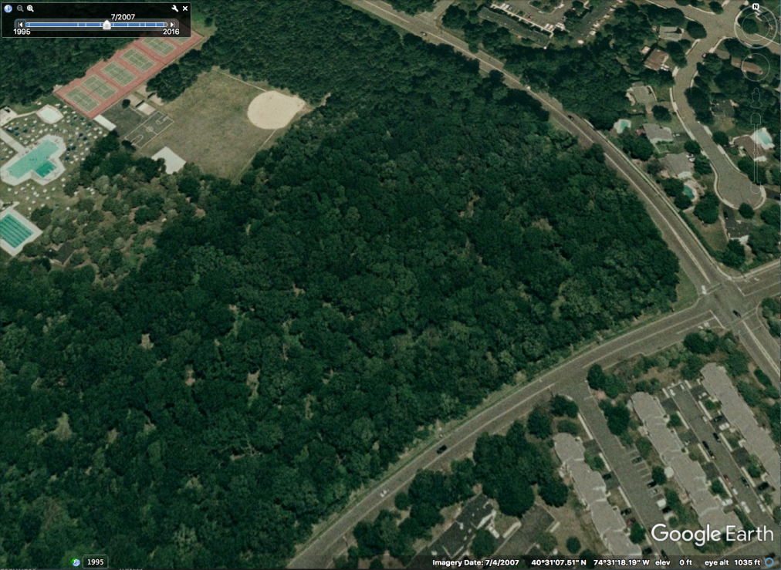
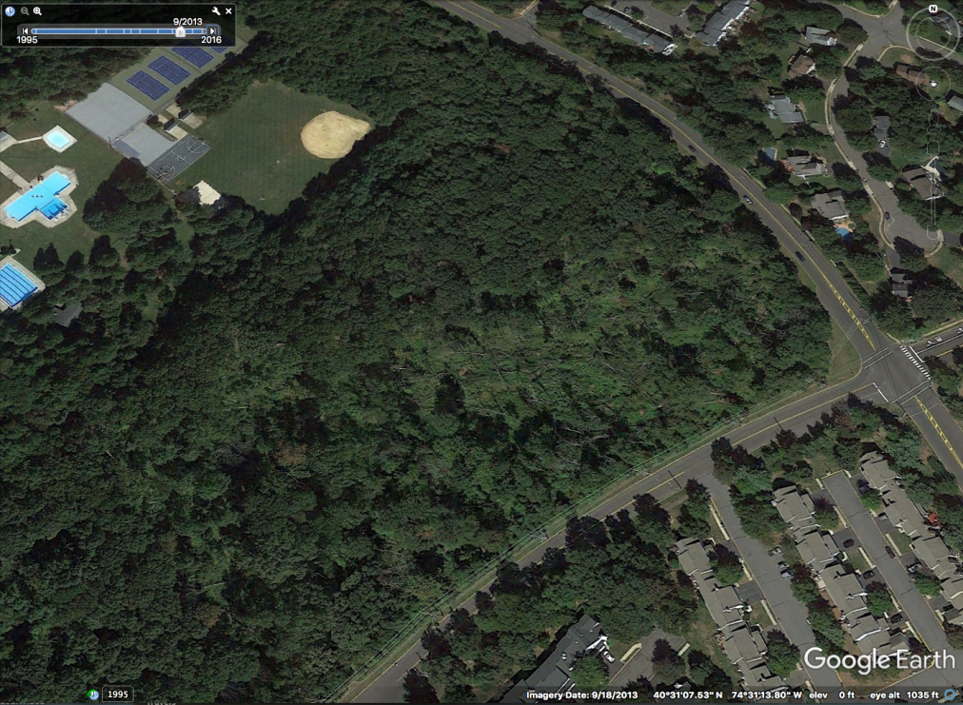
Before and After Tree-fall Images
Bridgewater, NJ ≈ 20 trees
Somerset, NJ ≈ 30 trees
Pre-Sandy
11 Months After
Notes:
Started by discussing treefall.
Then spent most of the time talking about roll vortices.
Now let’s wrap up by returning to treefall.
9/20/13 Google Earth images, 11 months after Sandy.

Slide 26
Summary
Data analyzed
  Radar imagery, surface wind speed observations, WRF simulation
Key findings
  Radar imagery exhibit elevated confluence lines aligned with precipitation voids, implying downward motion along these lines
  Linear radar signatures often propagate normal to their longitudinal axis
  Observed surface wind speed fluctuations have periods similar to propagation periods of linear radar signatures
  WRF simulation corroborates observations
Hypotheses appear to be supported
  Linear radar signatures appear to be caused by boundary layer roll vortices
  Elevated lines of confluence from radar imagery are coincident with downward motion, precipitation voids, and implied stronger surface winds
  Periodic fluctuations of surface wind speed appears to be caused by roll vortices propagating across an observing station
Yet to be done
  Can it be shown that tree-fall patches are indeed caused by roll vortices?

Slide 27
Plans
Compare tree-fall data with observed and model winds
  What are tree-fall patch dimensions, orientations and locations?
  Are footprints of observed and model wind speed maxima similar to tree-fall patches?
Quantify downward transport of momentum in WRF simulation
  Is downward transport strong enough to measurably enhance surface wind speeds?
  Does aerial extent of downward transport compare with that of radar signatures and tree-fall patches?
  Is downward transport organized in lines?
  Do lines of downward transport propagate partially normal to their axes?
  Do narrowest descent lines have highest surface speeds?

Slide 28
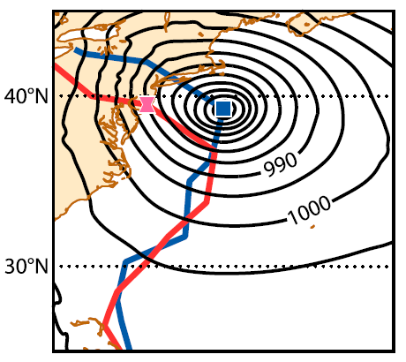
What If Sandy Tracked Here . . .
ECMWF 7-day forecast (blue line, Magnusson et al. 2014)
Isobars tell the story
NYC metro region spared severity
Western coastal Long Island Sound sites faced severe surge flooding
Long Island and Connecticut faced severe wind damage

Slide 29
Thank you!
More visualizations
  Mesoscale Analysis of Sandy’s Landfall Winds
  seedme.org/node/163591
  WRF Users' Workshop 2016 Visualizations
  seedme.org/node/70880
  Sandy WRF Discovery Paper
  seedme.org/node/47360
Papers online, but need ResearchGate login
  researchgate.net
Contact me for copy of paper
  jimschiavone@gmail.com

Slide 30
Prior TC Roll Vortex Studies
Wurman and Winslow, 1998: Intense Sub-Kilometer-Scale Boundary Layer Rolls Observed in Hurricane Fran (1996)
Gall et al., 1998: Small-Scale Spiral Bands Observed in Hurricanes Andrew (1992), Hugo (1989), and Erin (1995)
Katsaros et al., 2000: Wind Fields from SAR: Could They Improve Our Understanding of Storm Dynamics? [Bonnie, Danielle, Georges, and Mitch (1998)]
Katsaros et al., 2002: Microwave Remote Sensing of Tropical Cyclones from Space [Mitch (1998)]
Yao et al., 2004: A Multiscale Numerical Study of Hurricane Andrew (1992). Part VI: Small-Scale Inner-Core Structures and Wind Streaks
Foster, 2005: Why Rolls are Prevalent in the Hurricane Boundary Layer
Morrison et al., 2005: An Observational Case for the Prevalence of Roll Vortices in the Hurricane Boundary Layer [Fran (1996), Bonnie (1998), and Georges (1998)]
Zhang et al., 2008: Effects of Roll Vortices on Turbulent Fluxes in the Hurricane Boundary Layer
Lorsolo et al., 2008: An Observational Study of Hurricane Boundary Layer Small-Scale Coherent Structures [Isabel (2003) and Frances (2004)]
Nakanishi and Niino, 2012: Large-Eddy Simulation of Roll Vortices in a Hurricane Boundary Layer
Gao and Ginis, 2014: On the Generation of Roll Vortices due to the Inflection Point Instability of the Hurricane Boundary Layer Flow
Gao and Ginis, 2016: On the Equilibrium-State Roll Vortices and Their Effects in the Hurricane Boundary Layer
Wang and Jiang, 2017: Impact of vertical wind shear on roll structure in idealized hurricane boundary layers
Ito et al., 2017: Near-surface coherent structures explored by large eddy simulation of entire tropical cyclones
Wurman and Kosiba, 2018: The Role of Small-Scale Vortices in Enhancing Surface Winds and Damage in Hurricane Harvey (2017)
Gao and Ginis, 2018: On the Characteristics of Linear-Phase Roll Vortices under a Moving Hurricane Boundary Layer

Slide 31
Prior Observed Hurricane Roll Vortices
Hugo (1989)
Andrew (1992)
Erin (1995)
Fran (1996)
Bonnie (1998)
Danielle (1998)
Georges (1998)
Mitch (1998)
Isabel (2003)
Frances (2004)
Harvey (2017)
Irma (2017)

Slide 32
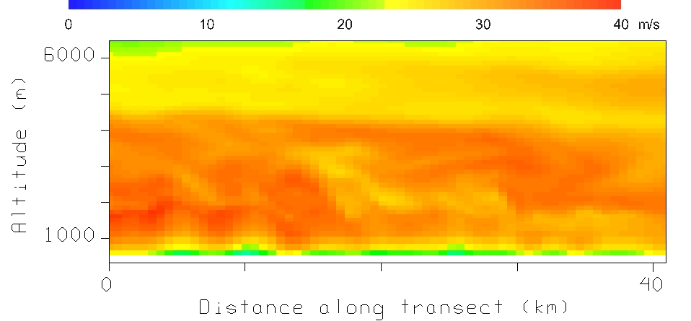
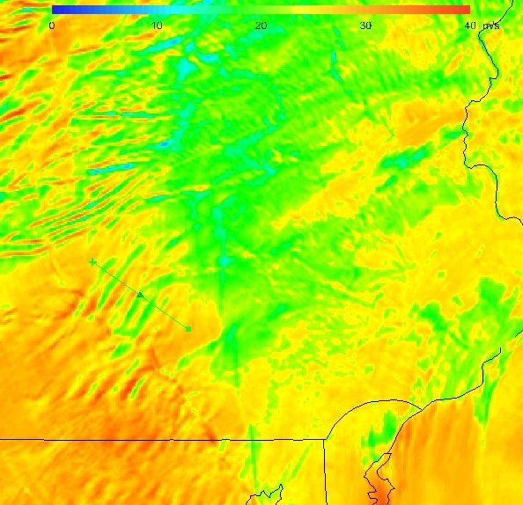
Wind Speed Vertical Section - Model

Slide 33
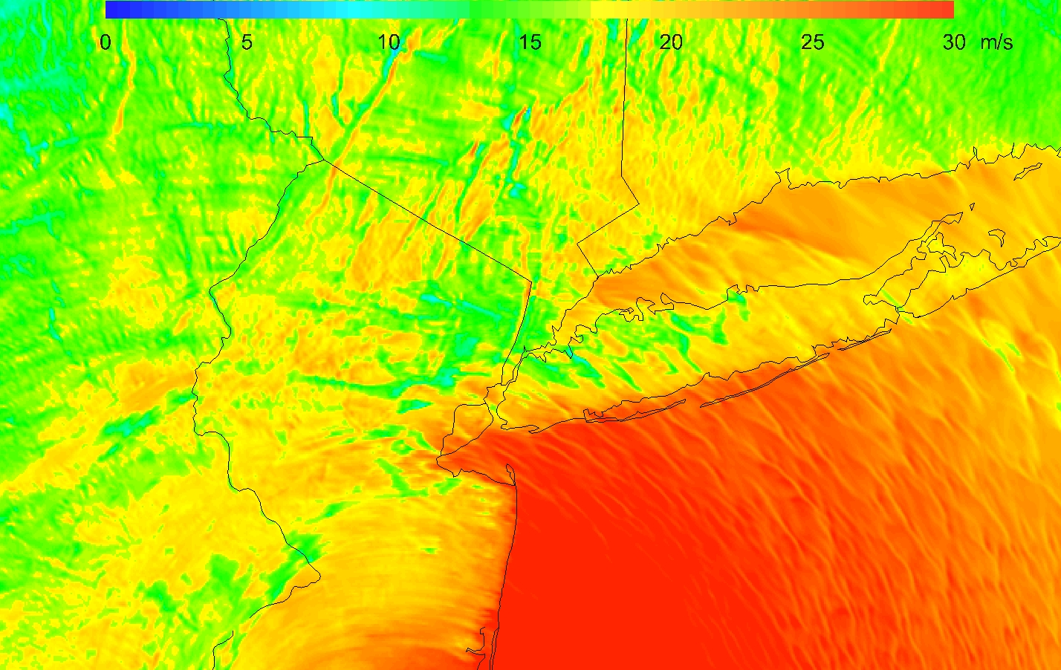
Wind Speed Patchiness - Model
Wind speed in lowest model layer at about 30 m above ground

Slide 34
Video List
8 TemprImages512.mp4
8 WaterVapor.mp4
9 Qiso0094hires.mp4 (was T2QisoPt0094.mp4)
10 S10+W200.mp4 seedme.org/node/163602
11 9hr1Kft.mp4 seedme.org/node/163592
12 Base Velocity 24hr.mp4 seedme.org/node/163600
16 S0100to3400m.mp4
16 S10SewRotate23z.mp4
18 Base Velocity 24hr.mp4
Rutgers\1Q14 Mesonet Data Update\Mesonet Paper Analyses\VAPOR Output

