Slide 1


Two Rare Southern New England Tornadoes
Presentation Overview
Review the first nocturnal tornado in Massachusetts since 1970, which occurred in Concord, MA on August 22, 2016.
Review the first known tornado to have occurred in Massachusetts
during the month of February, when and EF1 Tornado struck
Conway, MA on February 25, 2017.
Discuss model, radar data, and lessons learned from these two unusual southern New England Tornadoes.
Tri-State Weather Conference
September 29th, 2018

Slide 2
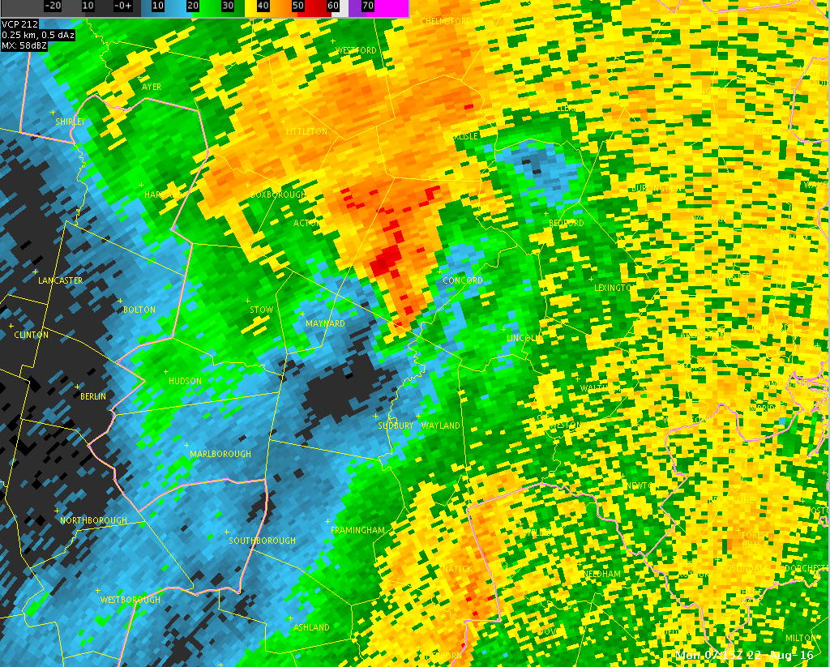
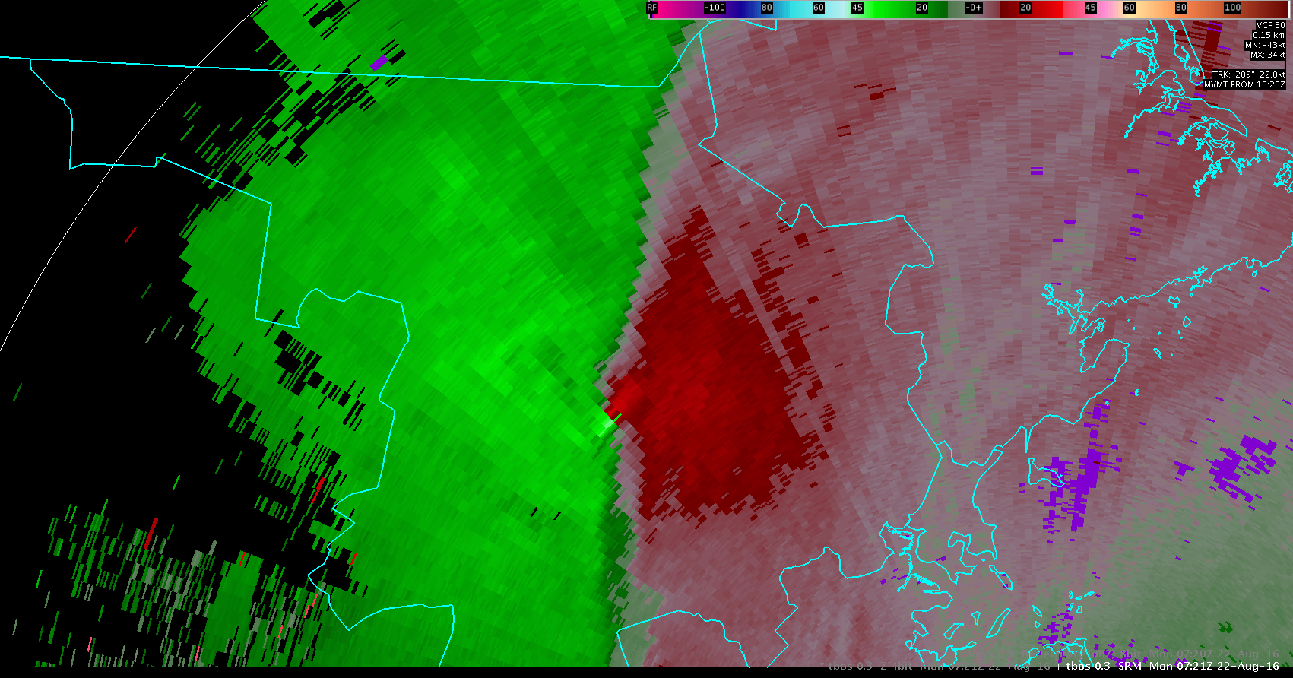
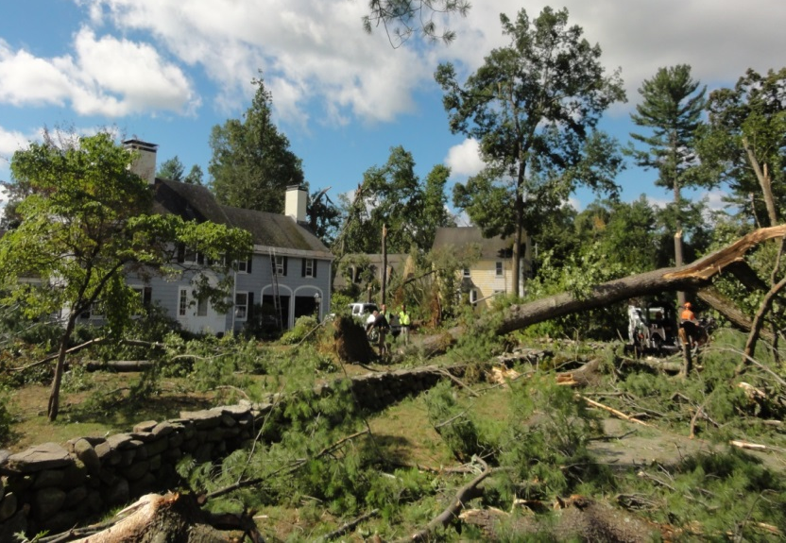


The Concord, MA EF-1
Early Morning Tornado of
22 August 2016
NOAA/NWS Boston, MA
Southern New England Weather Conference

Slide 3
Concord, MA Nocturnal EF-1 Tornado
      An EF-1 Tornado touched down in Concord, MA on August 22nd at 319 am. It was only on the ground for a few minutes, but packed winds of 100 mph.
      This was the first known nocturnal tornado to occur in Massachusetts since July 11th, 1970.
      Many trees were uprooted and 39 houses suffered minor structural damage, while 1 had significant damage.
      No other severe weather reports occurred in the region other than minor damage that occurred in Marlborough, MA from the initial storm.
      Instability was extremely limited and there was no lightning associated with the tornado.

Slide 4
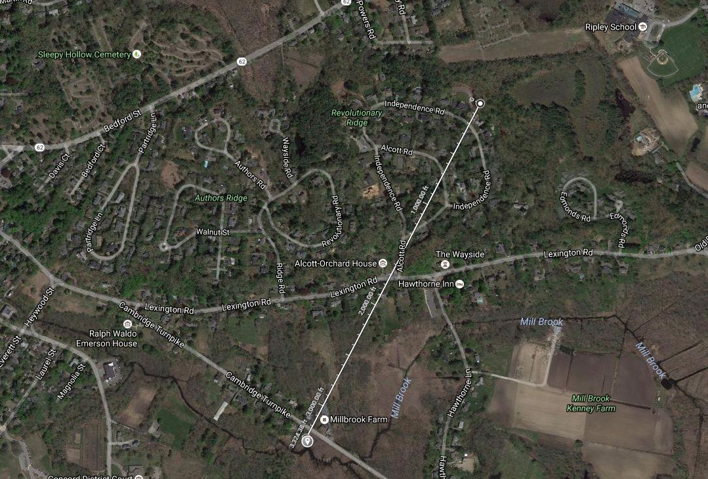
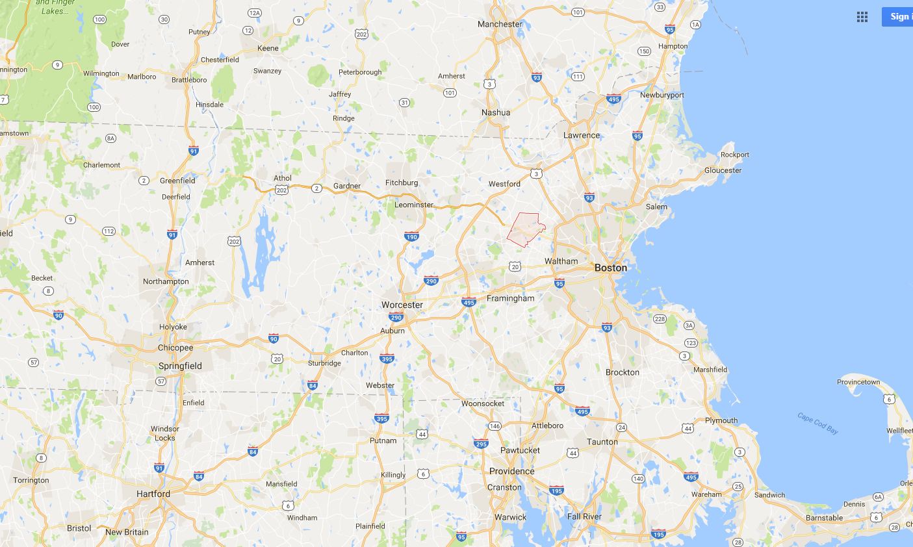
August 22, 2016 Concord, MA Tornado
Rated EF-1
Max Winds 100 mph
Length 0.5 mile
Width 400 yards
End
Tornado Warning issued 3:01 AM
Tornado touched down at 3:20 AM
5th tornado on record to have occurred in Massachusetts between midnight and 6 am (Last was in 1970)
Start

Slide 5
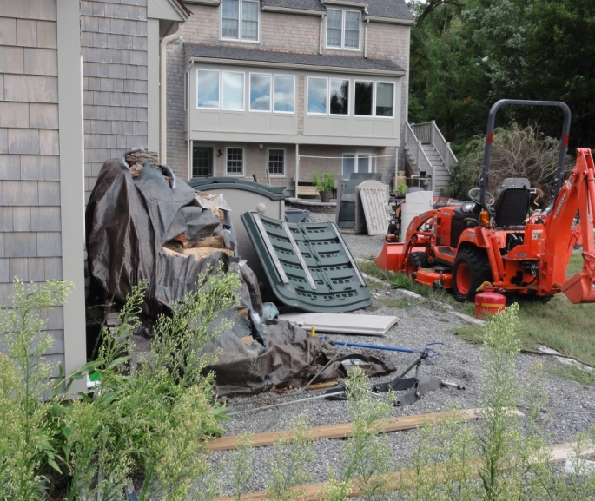
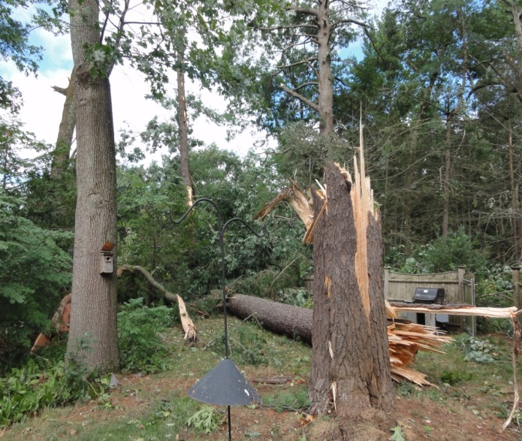
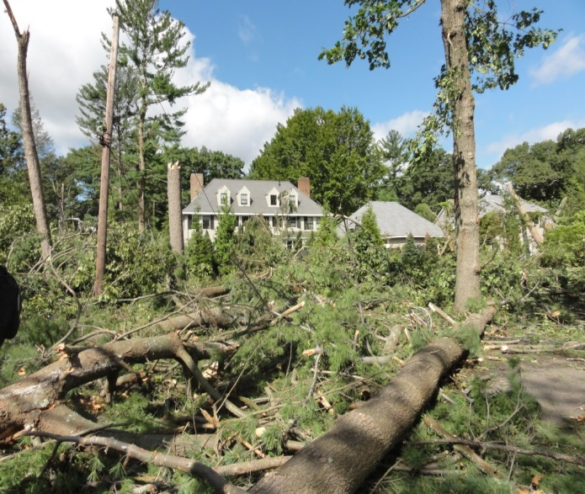
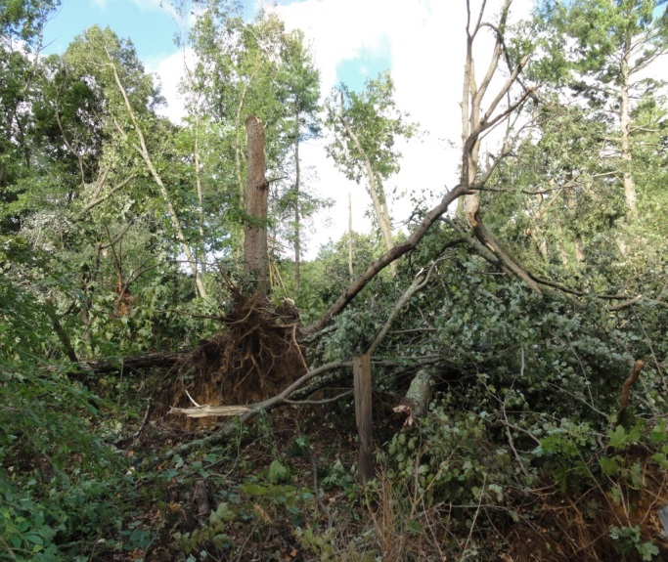
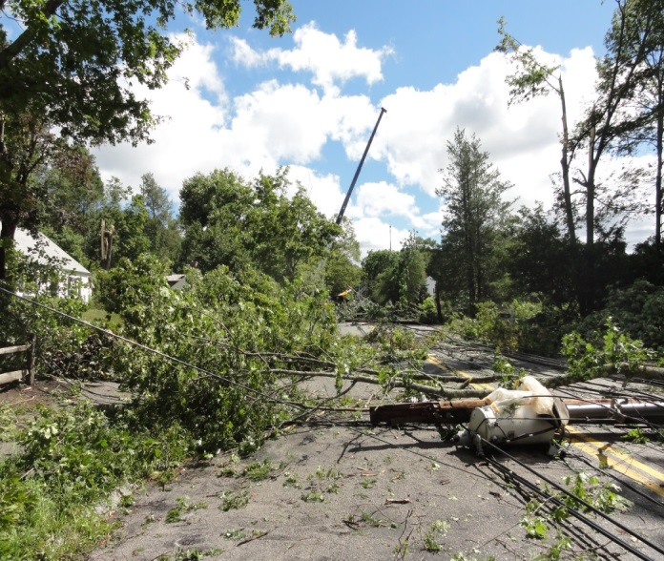
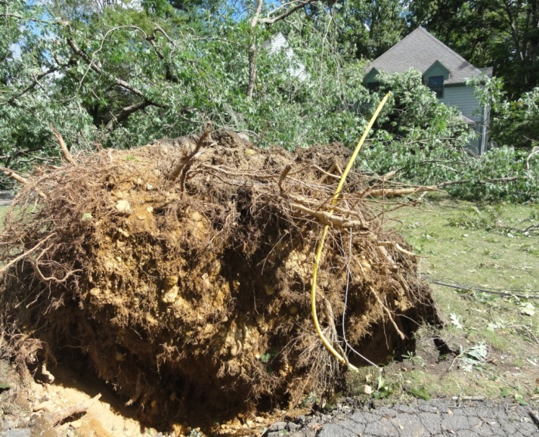
Storm Damage Photos from Concord, MA: August 22, 2016
Alan Dunham,
NWS Storm Survey

Slide 6
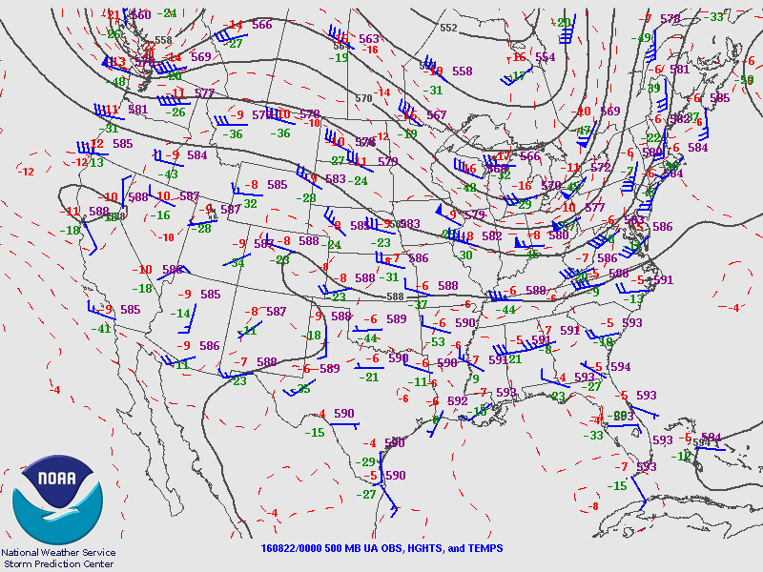
August 22nd 00z: 500 MB Height Analysis
Impressive Shortwave Trough Approaching From The West.

Slide 7
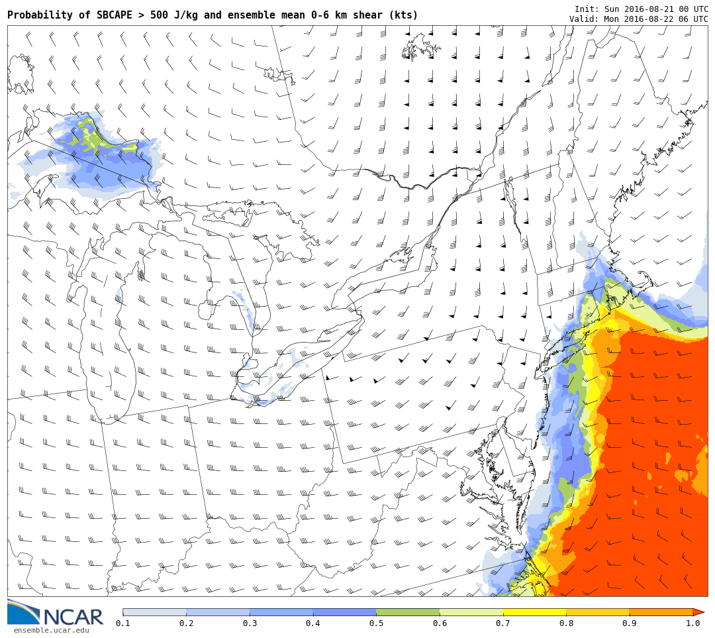
30 Hour NCAR Ensemble Probability of Surface Cape > 500 J/Kg: Valid 6z Aug 22nd
Note fairly
high probabilities of surface cape greater than 500 j/kg near the south coast.
Much lower risk across interior northeast MA, but note some small probs
Indicated.

Slide 8
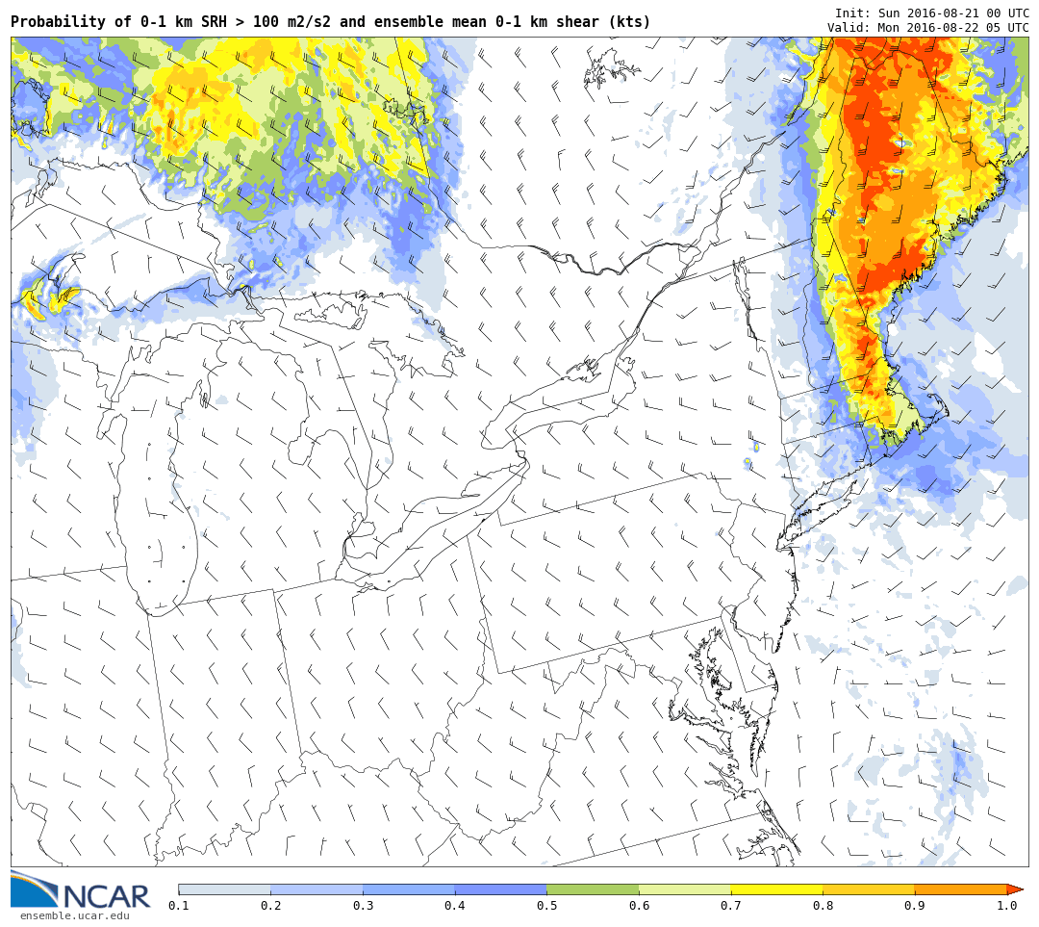
29 Hour NCAR Ensemble Probability of
0 To 1 KM SRH > 100: Valid 5z Aug 22nd
Highest probs of low level helicity > 100 was actually in northeast MA, despite better instability near the south coast

Slide 9
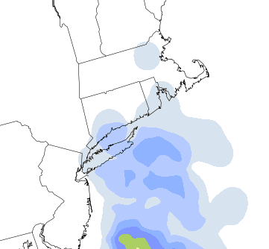
NCAR Ensemble Prob of Sig Tor Parmeter > 1
28 Hr Forecast Valid 4z
29 Hr Forecast Valid 5z
NCAR Ensembles Showed two pockets for low probs of Sig Tor > 1
Likely a result of the higher helicity expected across central/northeast MA

Slide 10


6z Surface Observations: 19 Minutes Before Tornado
70 to 75 dewpoints east of approaching cold front.
Impressive low level convergence likely resulted in stretching vorticity, allowing for the brief tornado on what appears to be a triple point.

Slide 11
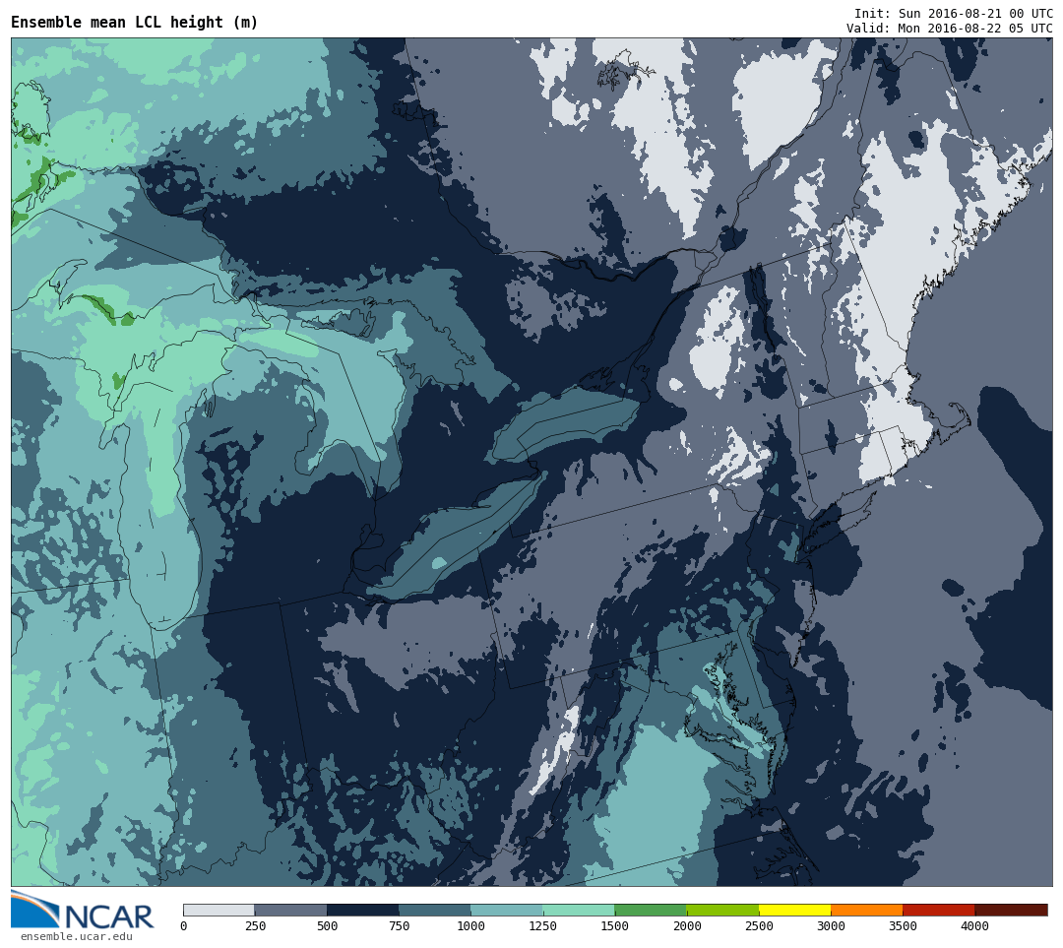
29 Hour NCAR Ensemble Mean LCL Height
Valid 5z August 22nd
LCL’s forecast to be extremely low, less than 250 meters across eastern MA

Slide 12
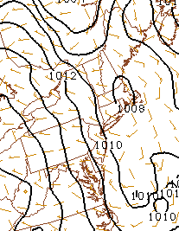
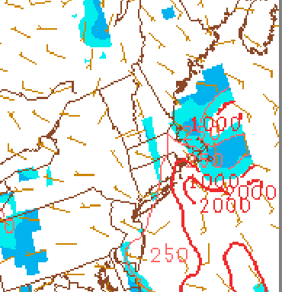
SPC Meso-Analysis
0-1 KM Shear Valid 7z
Surface Cape Valid 7z
Weak Surface Low/Triple point likely contributed to tornado.
Surface based cape on SPC Meso-Analysis showed 250 J/KG.

Slide 13
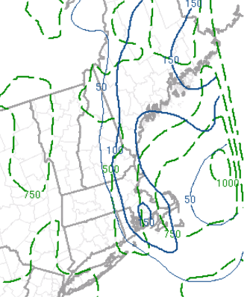
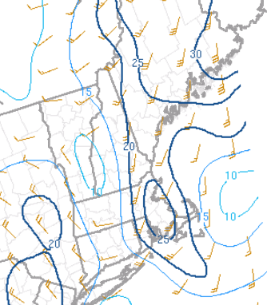
SPC Meso-Analysis Valid 7z
0-1 KM SRH Valid 7z
0-1 KM Shear Valid 7z
0-1 KM SRH > 100 Across Eastern MA
0-1 KM Shear > 25 knots

Slide 14
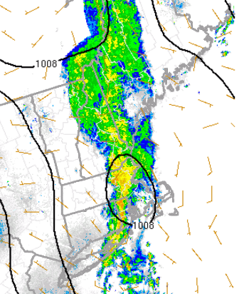
Actual Radar Imagery: 7z Aug 22nd
Weak Triple Point Likely Resulted in Even Higher 0-1 KM Helicity Than Depicted By SPC Meso-Analysis

Slide 15
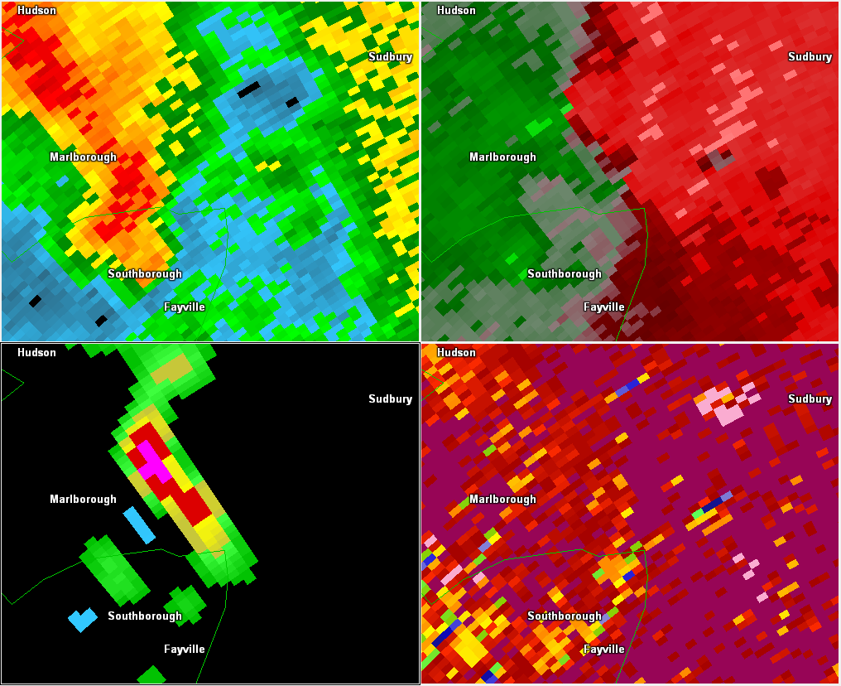
0657Z: First Sign Of Strong Rotation
Near Marlborough, MA
0.5 Reflectivity
0.5 Storm Relative Motion
G2G: 61 KTS
NROT
Correlation Coefficient
NROT 1.09

Slide 16
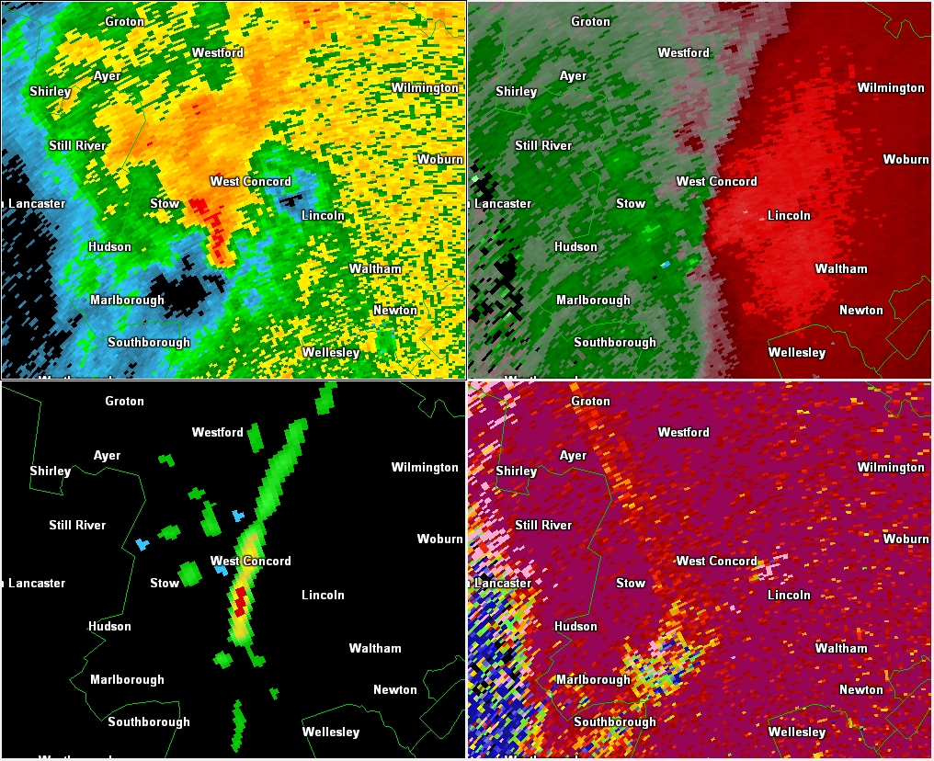
0710Z: Storm Weakens On Approach To Concord
Tornado Warning Continues Based on Cyclic Tendencies
0.5 Reflectivity
0.5 Storm Relative Motion
NROT
Correlation Coefficient

Slide 17
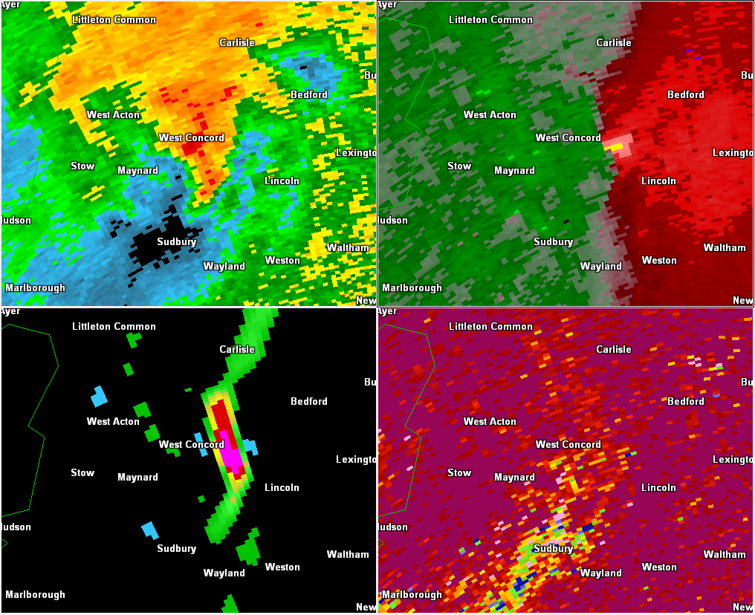
0717Z: Storm Rapidly Re-Strengthens
Brief EF1 Tornado Touches Down in Concord, MA
0.5 Reflectivity
0.5 Storm Relative Motion
G2G: 62 Kts
NROT
Correlation Coefficient
NROT 1.4

Slide 18
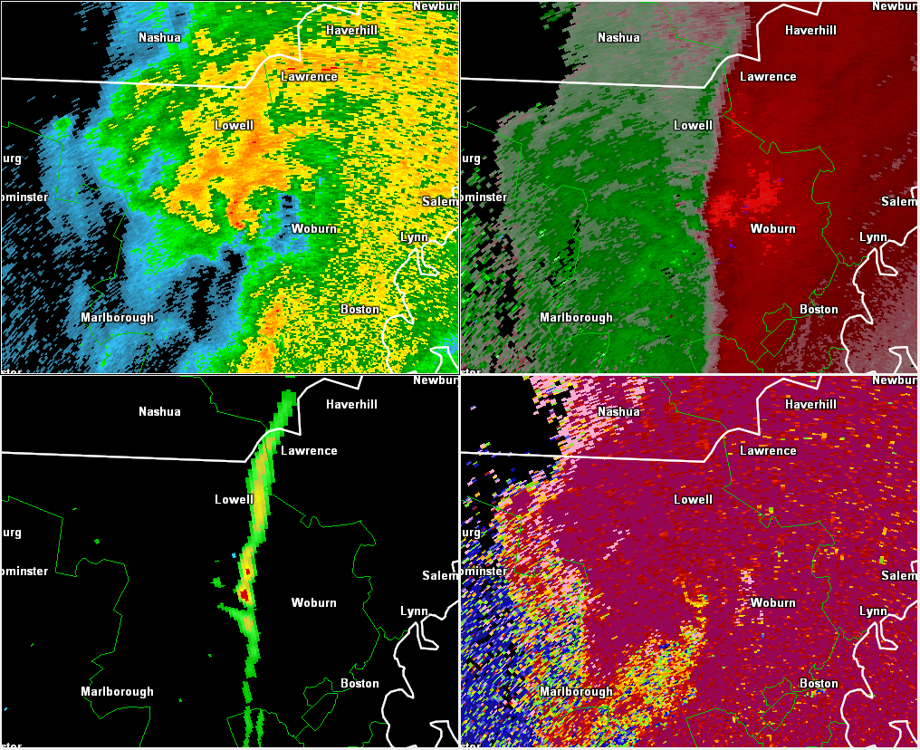
0724Z: Rotation And Tornado Threat Quickly Dissipate
As Activity Moves East of Concord, MA
0.5 Reflectivity
0.5 Storm Relative Motion
NROT
Correlation Coefficient

Slide 19
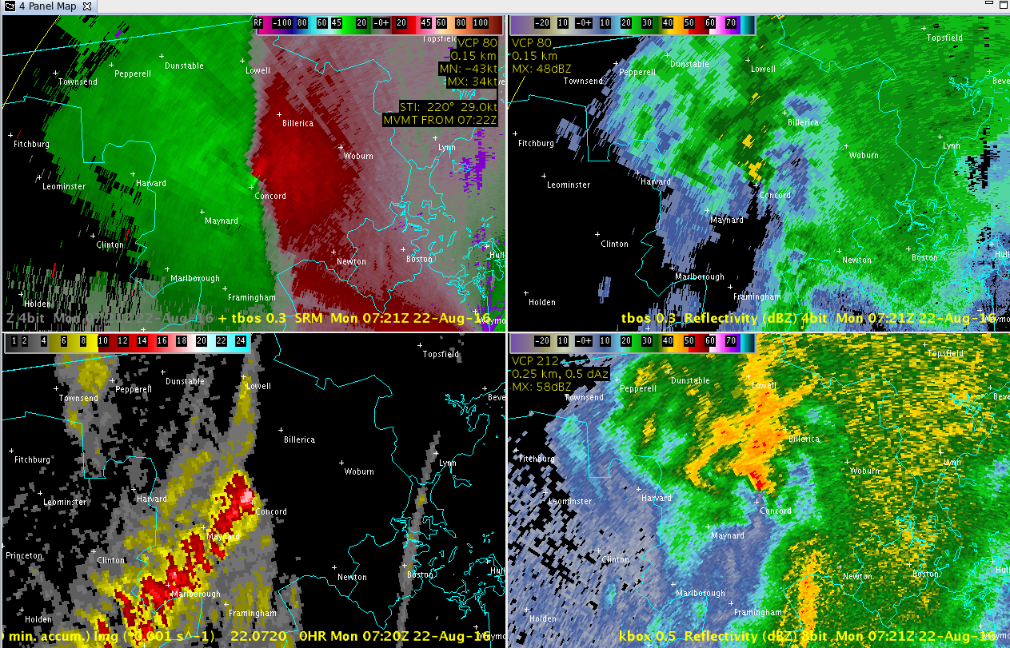
EF1 Tornado Radar Imagery From TBOS

Slide 20
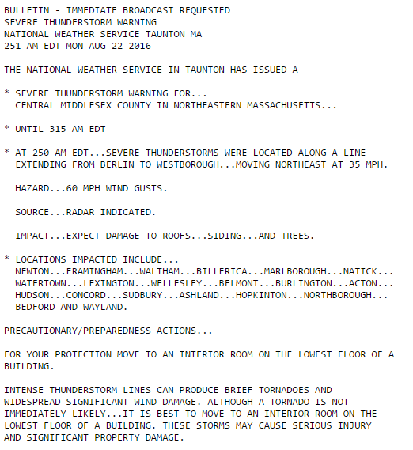
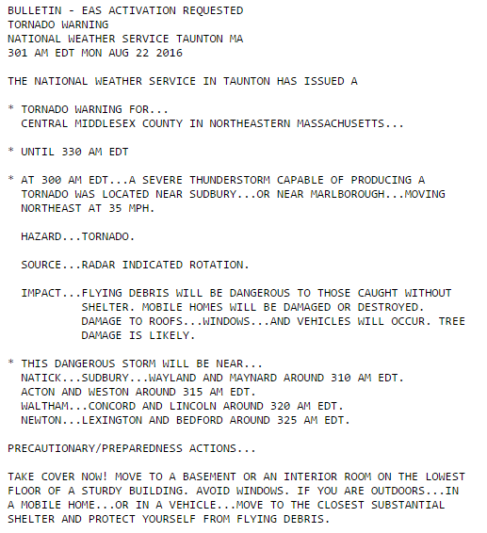
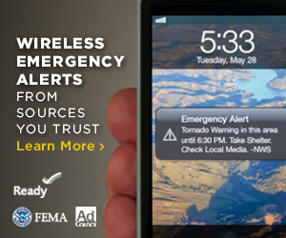
Taking Action Based Upon the Warning

Slide 21
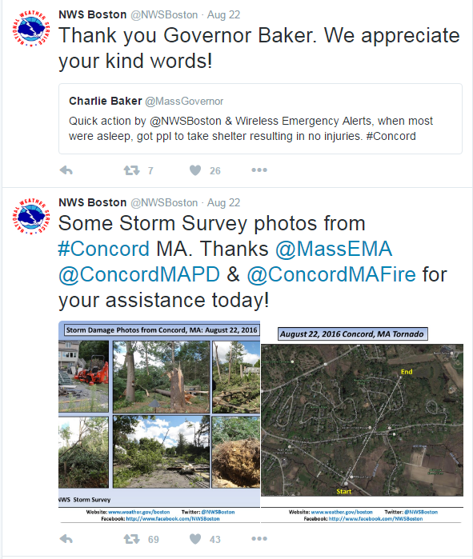
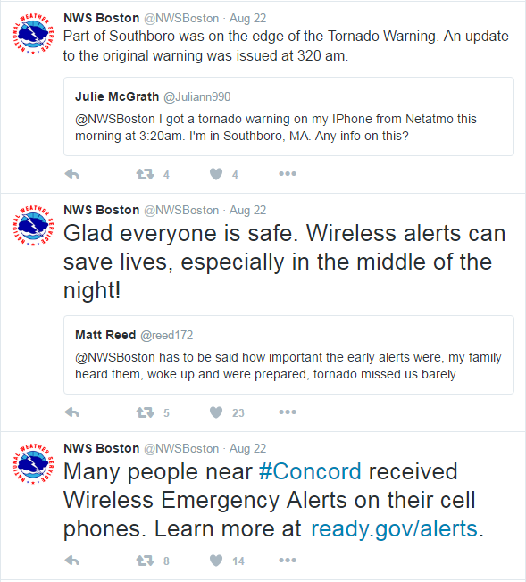
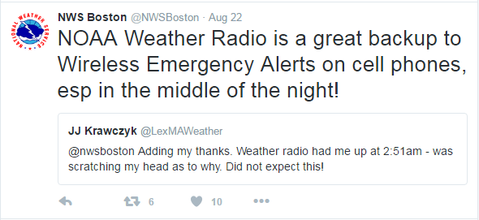
Social Media

Slide 22
Lessons Learned From Concord EF-1 Tornado
      0 to 1 KM helicity values of 100+ units coupled with just a bit of instability/low LCL heights will yield at least a very low risk for a brief spin-up if a trigger is available.
      Concern is heightened if there is a triple point/warm front to focus potential convection.
      Excluding rare high end EML tornadoes, the majority of our brief tornadoes occur with very marginal instability, 100+ units of 0 to 1 km helicity, along with low temperature/dewpoint spreads, and a triple point/warm front.
      Often severe weather is quite limited in these cases with perhaps the tornado being the only report of severe weather. Flash Flooding may also be a concern at times.
      Most of these setups will produce no severe weather at all! They are low probability events, so do not expect a Tornado Watch, Mesoscale Discussion Etc. Just have to keep a close eye to the radar and particularly the half degree SRM/NROT.

Slide 23
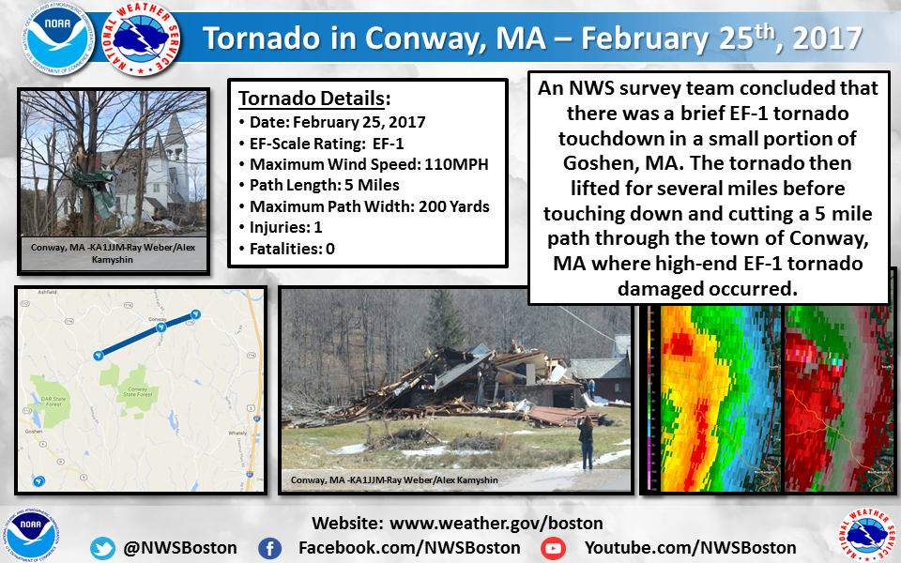

Slide 24
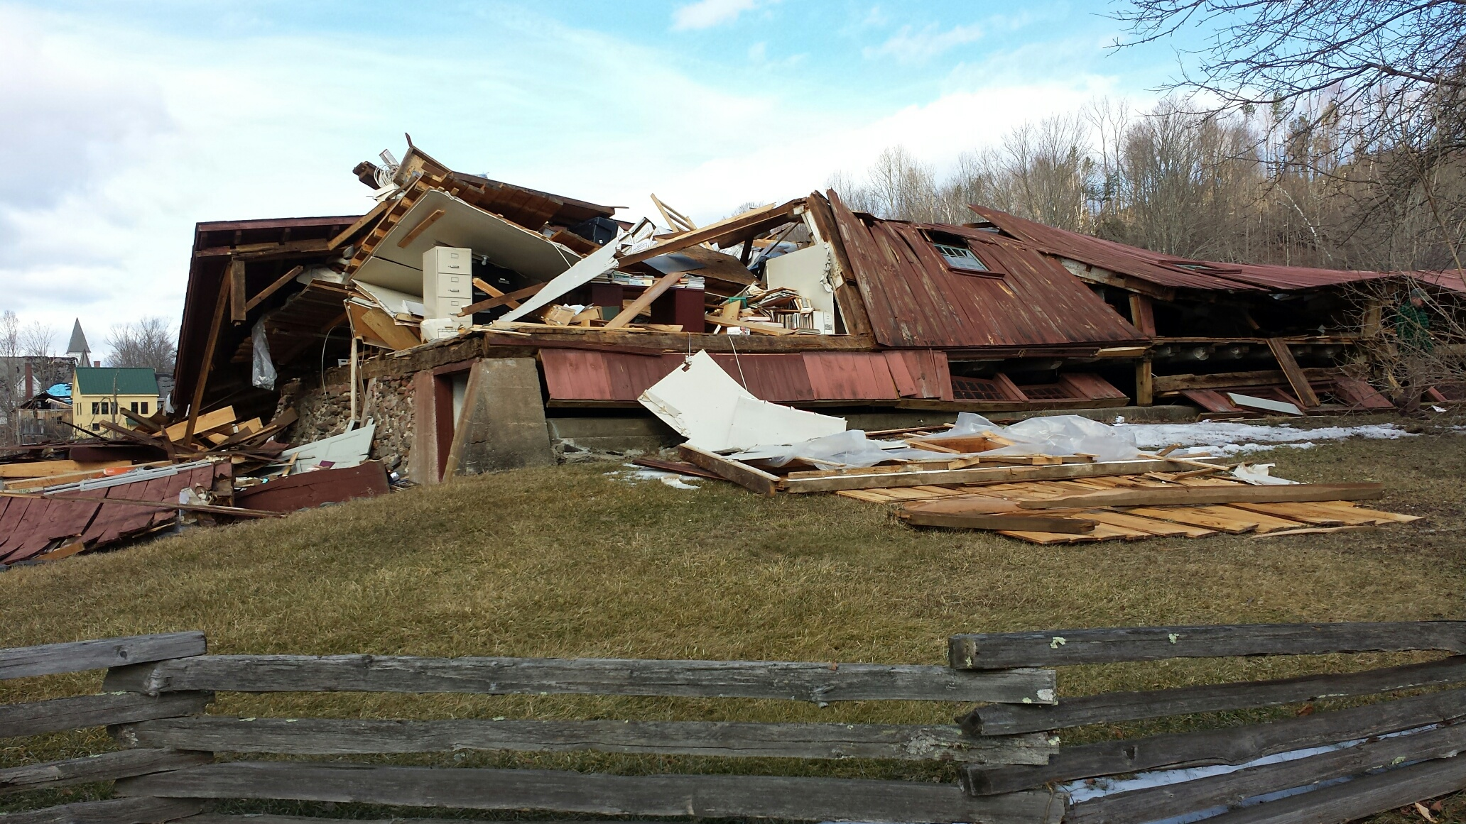
The Goshen/Conway EF1 Tornado
February 25, 2017
Pictures From Conway, MA Courtesy of Robert Thompson and Glenn Field

Slide 25
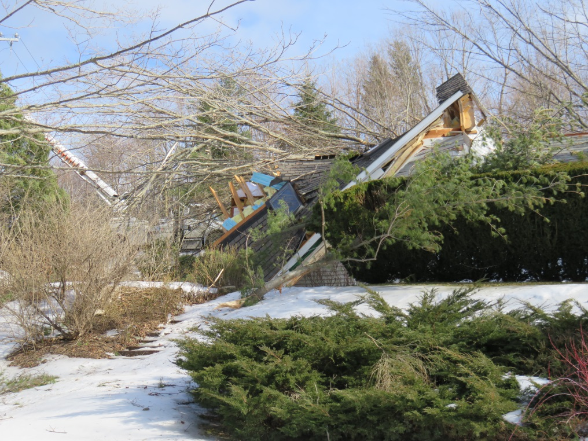
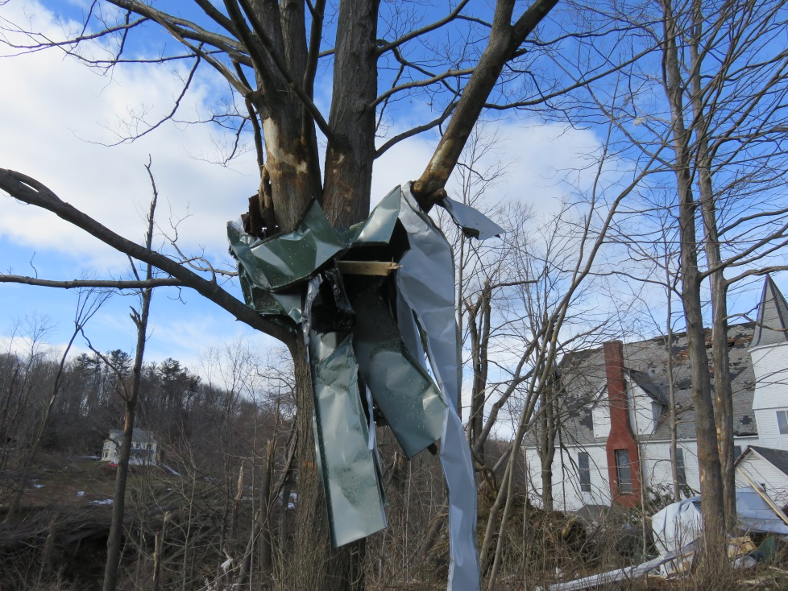
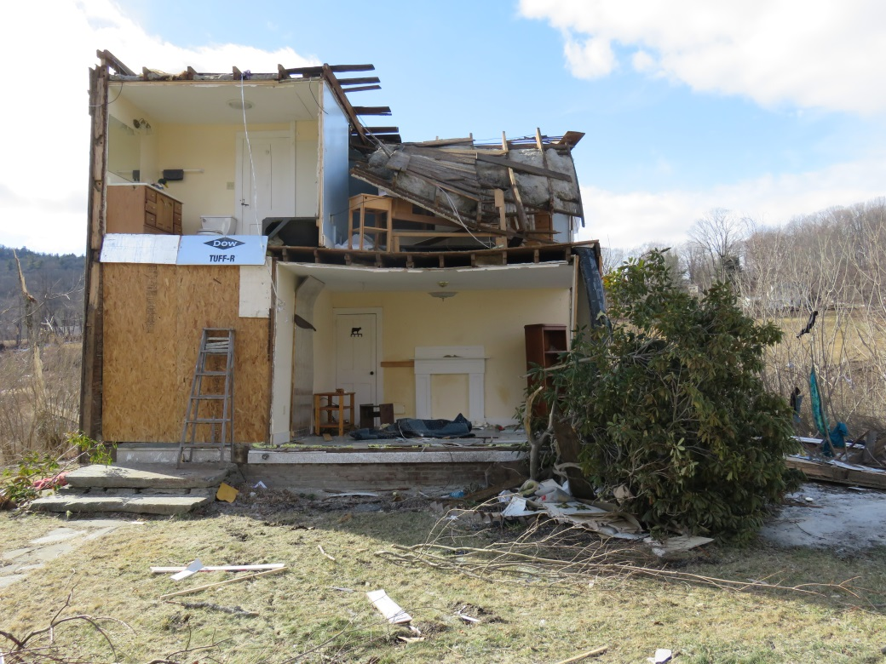
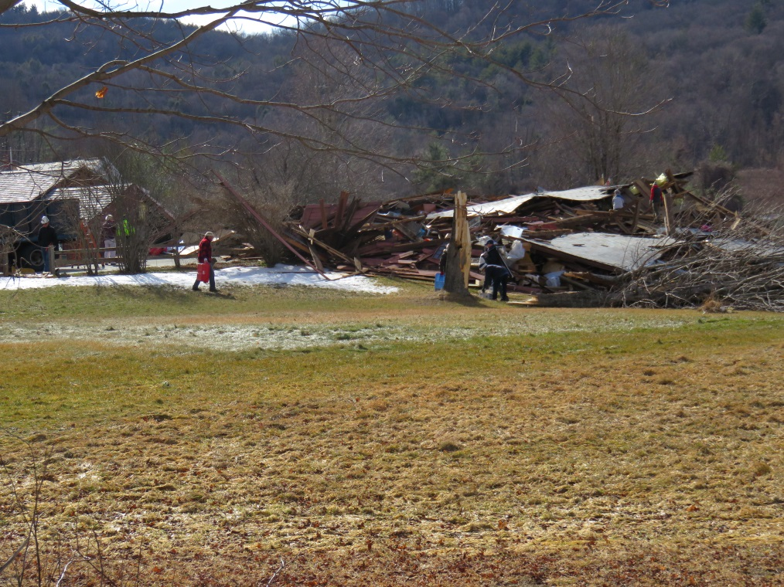
Pictures From Conway, MA Courtesy of Robert Thompson and Glenn Field

Slide 26
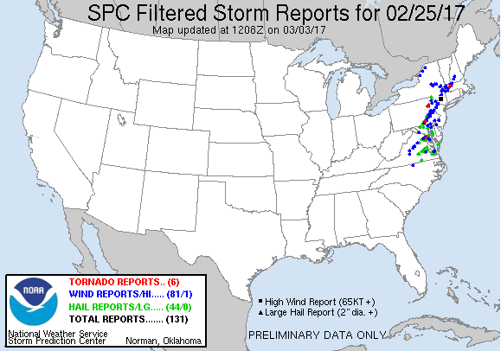
Severe Weather Reports
4 Tornadoes
southern MD (EF1)
southeast PA (EF1)
northeast PA (EF2)
Conway, MA (EF1)

Slide 27
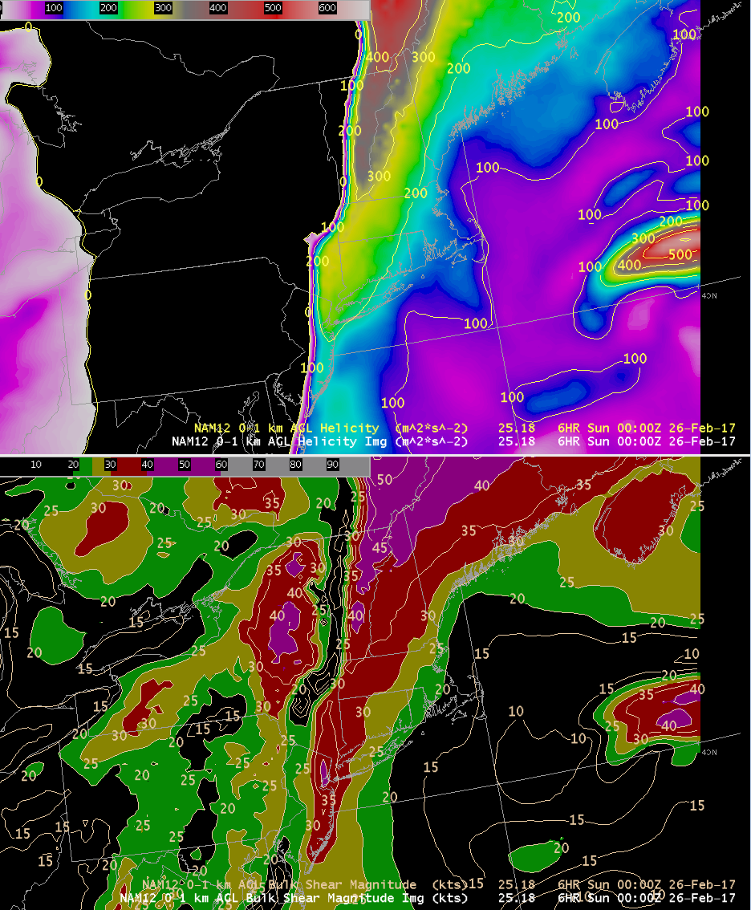
NAM 6h forecast 0-1km Helicity/shear: 00z Feb 26
0-1km Helicity
0-1km Shear
200-300 units of 0-1km Helicity
over western New England
0-1km Shear around 30 kt

Slide 28
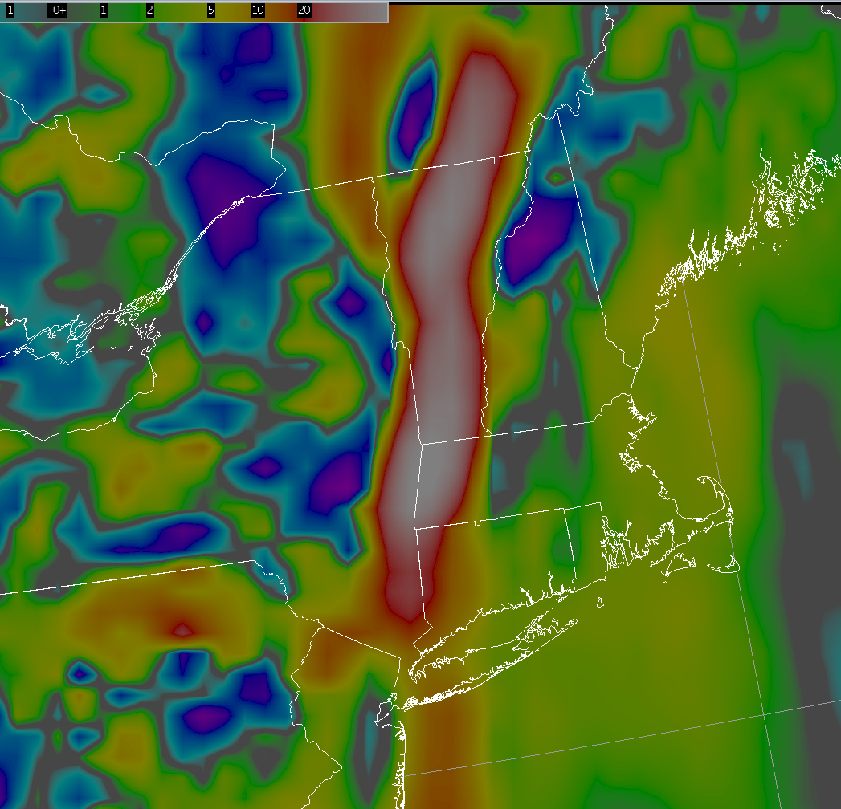
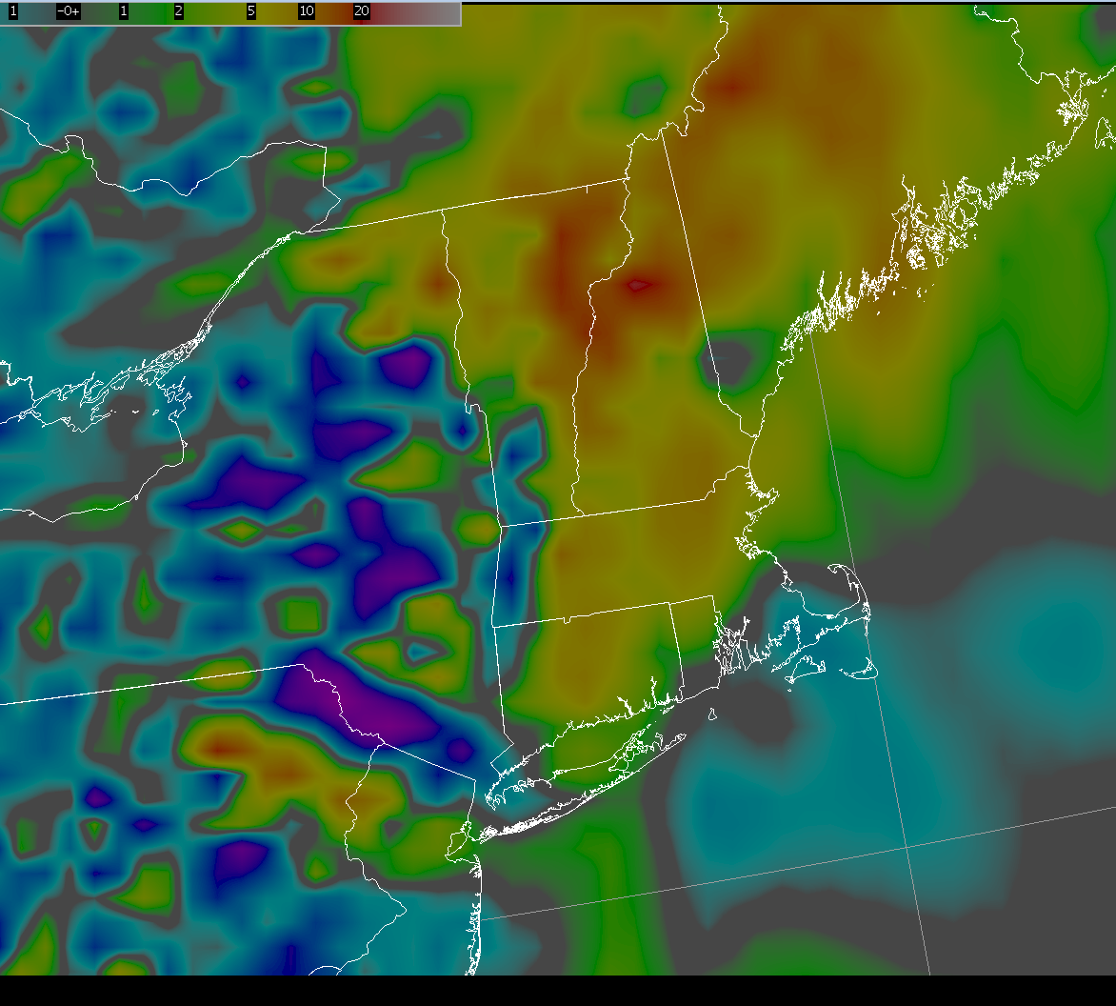
NAM forecast: 850-500 mb Omega
6h forecast valid 00z Feb 26
9h forecast valid 03z Feb 26
70+ ub/s omega
moving into
W MA
< 10 ub/s omega
850-500 mb omega
850-500 mb omega

Slide 29
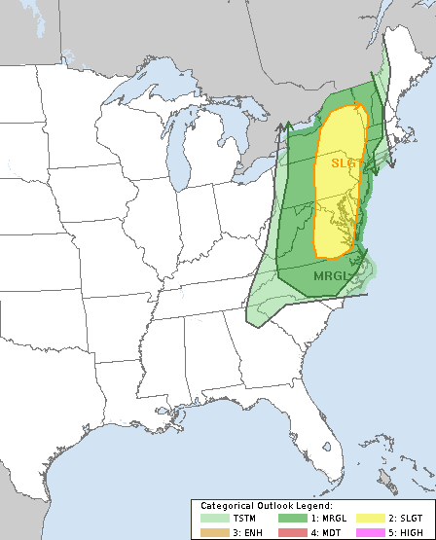
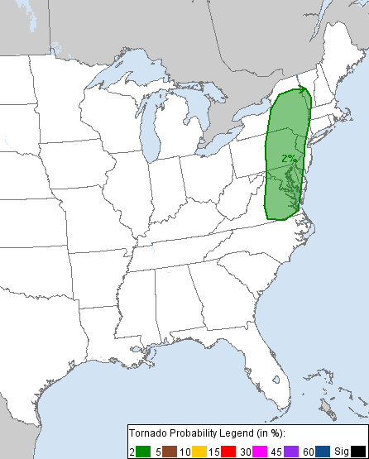
SPC Day 1 Outlook
Thunderstorm Category
Tornado probability

Slide 30
Forecast Summary
Strong cold front moving into western New England around 00Z
Tremendous forcing for ascent along the front
Low Cape/High shear environment
Forecast questions:
    Will there be enough instability for severe weather and possible tornado?
    Will strong forcing compensate for lack of instability?

Slide 31
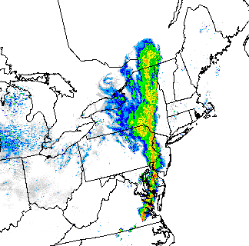
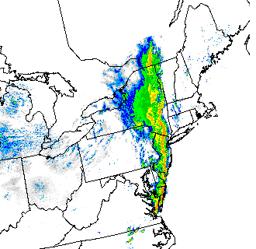
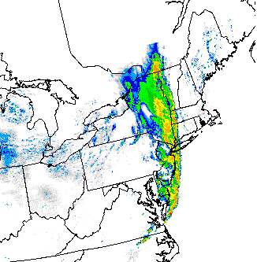
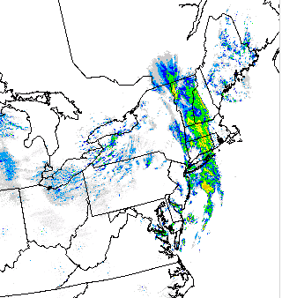
Radar Mosaic 22-02z
Fine line of convection
held together into
western MA, due to
very strong forcing
for ascent.
Convection weakened
further east as forcing
diminished.
22z
23z
00z
02z

Slide 32
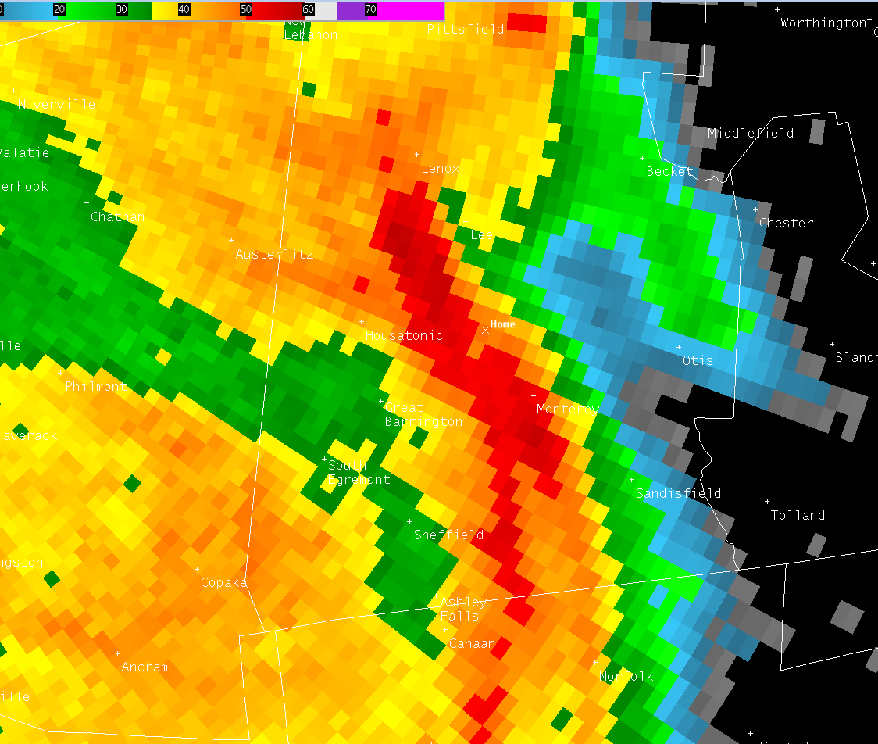
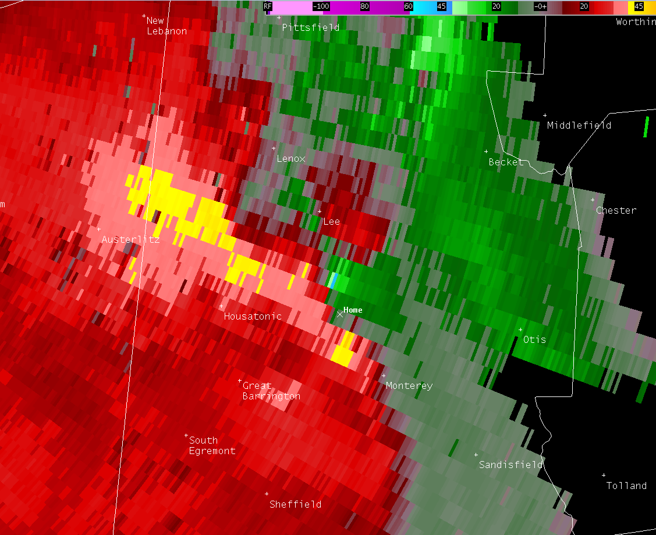

KENX 0.5 REF/SRM/NROT: 2351z Feb 25
REF
SRM
98 kt shear in southern Berkshire county
48 kt inbound, 50 kt outbound
NROT
NROT 1.4

Slide 33



KENX 0.5 REF/SRM/NROT: 2357z Feb 25
REF
SRM
88 kt gate-to-gate shear in central Berkshire county
41 kt inbound, 47 kt outbound
NROT
NROT 1.7

Slide 34



KENX 0.5 REF/SRM/NROT: 0001z Feb 26
REF
SRM
100 kt shear over Becket (Berkshire/Hampshire county line)
55 kt inbound, 45 kt outbound
NROT
NROT 1.7

Slide 35



KENX 0.5 REF/SRM/NROT: 0010z Feb 26
RIJ
REF
SRM
97 kt gate-to-gate shear over Worthington
52 kt inbound, 45 kt outbound
Located on cyclonic shear side of the apex of the bow
NROT 1.9
NROT

Slide 36



KENX 0.5 REF/SRM/NROT: 0018z Feb 26
RIJ
REF
SRM
101 kt gate-to-gate shear just north of Goshen
58 kt inbound, 43 kt outbound
Located on cyclonic shear side of the apex of the bow
NROT 1.8
NROT

Slide 37



KENX 0.5 REF/SRM/NROT: 0022z Feb 26
RIJ
REF
SRM
93 kt gate-to-gate shear approaching Conway
44 kt inbound, 49 kt outbound
NROT 1.0
Considerable weakening after this time
NROT

Slide 38
Summary / Lessons Learned
Very strong low level convergence and resulting forcing for ascent along the cold front was a key player in maintaining convection into New England.
Models and SPC meso-analysis likely underestimated amount of MUCAPE.
SPC meso-analysis based largely on the RAP so adjustments need to be made based on local observations.
Conway tornado and Concord tornado from August 2016 developed along a boundary in environments characterized by low CAPE, significant low level shear and low LCLs with anomalous dewpoints. We must be especially vigilant in these environments.
Tornado warning should be strongly considered with NROT greater than 1, especially in high shear (low level) environments.

