Slide 1
Severe Weather & the Role of TV media
Violeta Yas - Bilingual Meteorologist
NBC10/Telemundo62

Slide 2
the obvious goal
Get on television
Explain forecast & communicate impact
Save lives and protect property
Drink lots of coffee
Repeat

Slide 3
Expectation vs. reality

Slide 4
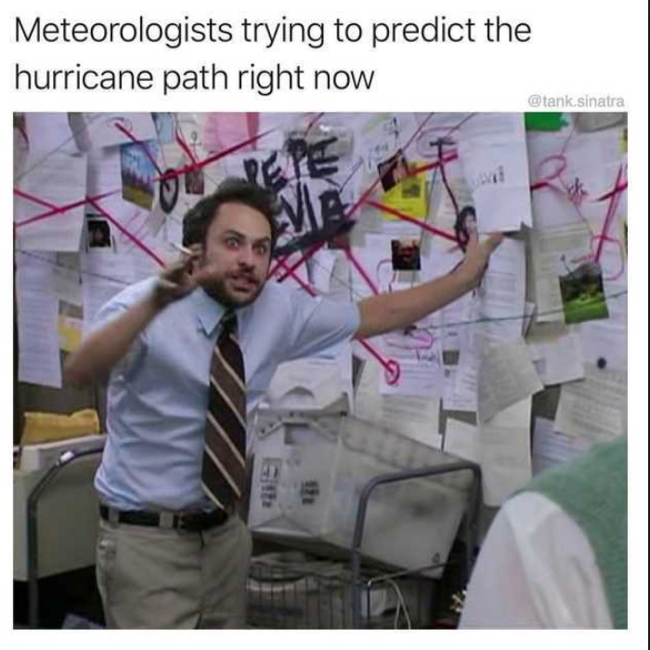
Expectation vs. reality

Slide 5
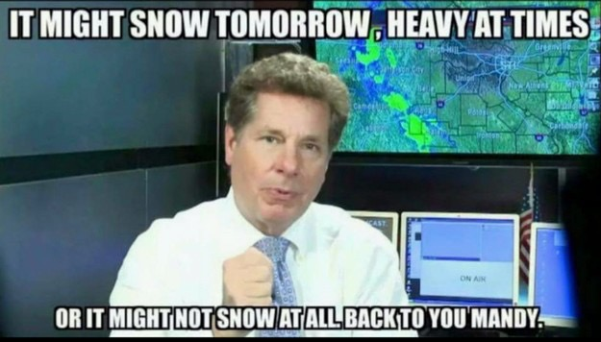
Expectation vs. reality

Slide 6
Reality…On an ordinary day
Open your 48498654640 browser tabs & analyze data for your DMA (and surrounding)
Brief your team (producers, reporters, management) on what can be expected in the short and long range
Slather on a full face of makeup and style hair (this alone can be 30 min-1hr)
Begin compiling forecast for the next 7-10 days (along with any individualized microclimate/neighborhood forecasts)
Record news topical to promote the upcoming newscast
Assist social media team in updating the station’s social account (Facebook, Facebook Live, Instagram, Instagram Live, Twitter, etc.)
Update your own social media accounts (some more Facebook, Facebook Live, Instagram, Instagram live, Twitter, etc.)
Update/tweak the weather info on station’s webpage
Begin building your show and working on relevant graphics for the day
Revise producer-written VOs/tosses for accuracy in weather info
START what the public thinks you do all day a.k.a the news

Slide 7
reality… during severe weather
Longer meetings, more questions
Triple the social media for the station
Triple the social media for yourself
More difficult forecast decisions to make
More graphics needed to explain impacts
Graphics need frequent updating for air
More on-air time
More opportunity for misinformation to make it on-air via tosses, VOs
Weather video/images coming into the station at warp speed thanks to social media (who is verifying?)

Slide 8
How do we not lose sight of our main goal DURING SEVERE?
Open dialogue about department goals (weather AND news), and regularly revisit the mission
Learn how to respectfully (but confidently) say no
YOU are the weather authority
“My app said _______”
COMMUNICATE PROACTIVELY
“As winter approaches…”
Hurricane pronunciations

Slide 9
Know your role
People know the gist of the forecast through other means. Push notification, Twitter.
Cell users know something is up, and then come to you for MORE
Important to communicate warnings, but don’t rip & read
Something serious is happening/going to happen. What now? What does this mean for me?
Guide your viewers on how & when to act– show them you care
Take that opportunity to build trust in the moment. Tell them the details they won’t see on their phone. Add VALUE
During severe, you may feel you’re being repetitive but it’s necessary (fire alarm example)
Need someone of authority to tell you multiple times
The more people who trust and believe you, the more they can sway others on the fence to ACT (find the shovel, plan for delays etc.)

Slide 10
*HOW* you communicate matters on tv
Words matter, very much. But words aren’t all we have
i.e. When Florence “downgraded”.
Technically true. But use your expertise to give this context and explain why it does/doesn’t matter for your viewers
Sometimes it still won’t be enough (see: Duckboat accident in Branson)
Words, context, tone, body language, graphics/colors. Use ALL the communication tools, and make sure they’ll all conveying the same message and sense of urgency.
Your forecast is for the general public— NOT for other meteorologists. Using overly technical terms usually adds nothing to your presentation This perpetuates the weather buzzword trend
#NeverForget: Polar vortex, quasi-linear convective system, and most recently BOMBCYCLONE/BOMBOGENESIS

Slide 11
Informal education by the media in advance of severe weather occurrences helps prepare the public to respond properly during an emergency situation
-AMS

Slide 12
Staying ahead of Severe
Operative word: AHEAD
You only get a certain amount of time, even during severe
Explaining complex weather terms does not help viewer prepare or act
Utilize less active days to give more in-depth explanations
BLOGGING: All the stuff you don’t have time to explain on-air
Explainer graphics are getting more and more life-like (hello, Weather Channel!)
Not every station has endless resources, but make sure you’re using all tools at your disposal (WSI Select OnDemand, etc). ASK for more

Slide 13
The BilingUal effect
Challenges unique to Spanish-speaking meteorologists

Slide 14
Minutiae Matters
Even as a native speaker, most weather terms were new to me when starting in the business. It was like learning a new language
English: Fog or dense fog
Spanish: Neblina (reduced visibility) vs. niebla (vis. <1/4 mi.)
Words are longer/things take more time to explain
Partly sunny vs. Parcialmente soleado
Dew point vs. punto de condensación/punto de rocío
High pressure system vs. sistema de alta presión

Slide 15
Knowing your audience
Audience native to countries with virtually no winter weather (Puerto Rico, Mexico, Dominican Republic)
Snow/sleet/hail are foreign. Clearly communicating impact is paramount
You must give them the information they didn’t know they needed
Must cover hyperlocal AND international (audience may physically be local, but entire family may be at risk elsewhere— i.e. Maria)
Many do not know the difference between weather & climate
Despite the demographic being highly vulnerable to both, due to where we live and work (National Resources Defense Council)

Slide 16
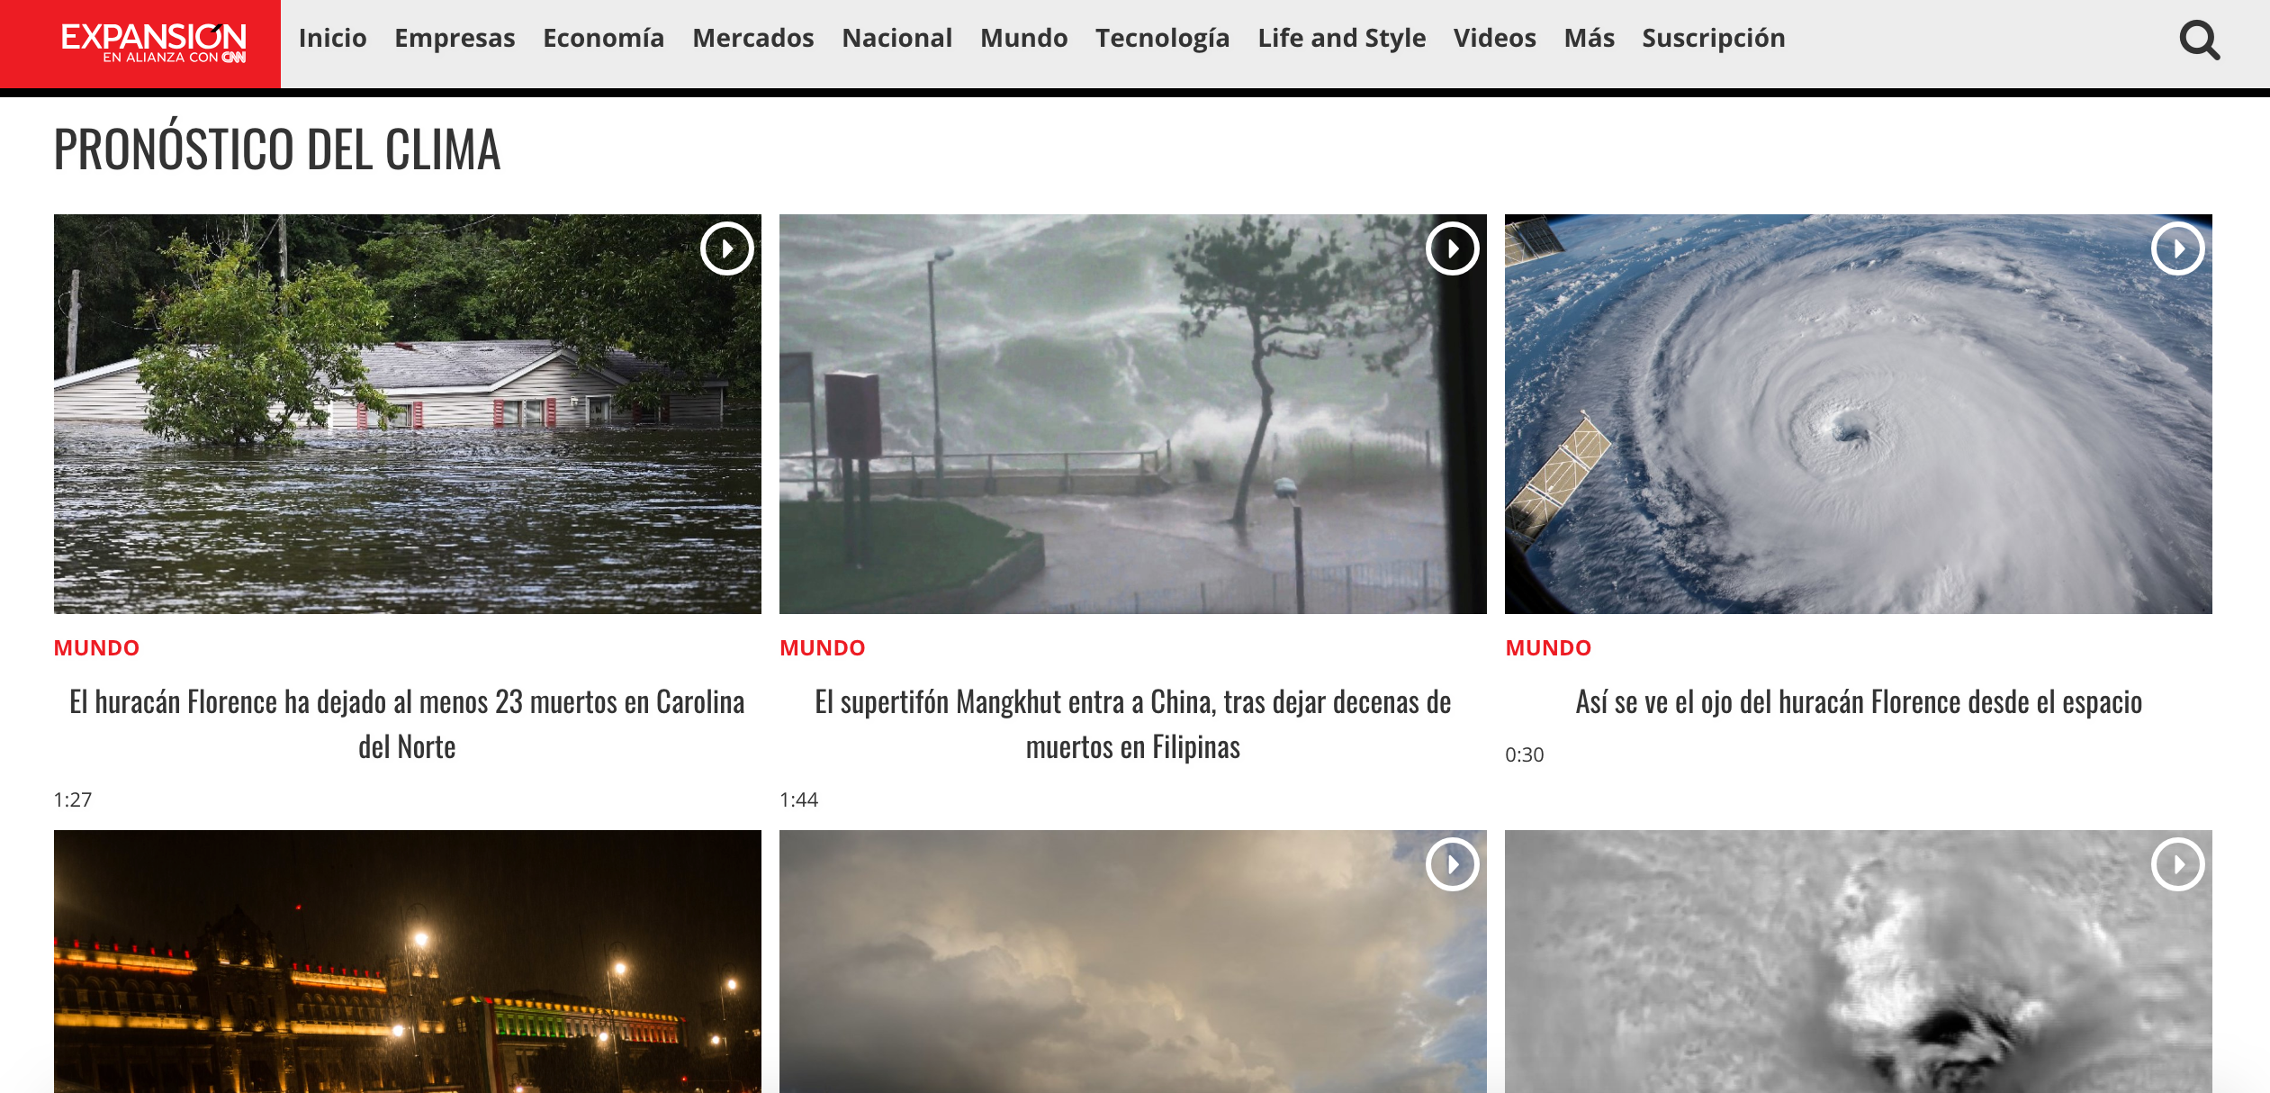
Joint website between Expansión & CNN (Mexico)

Slide 17
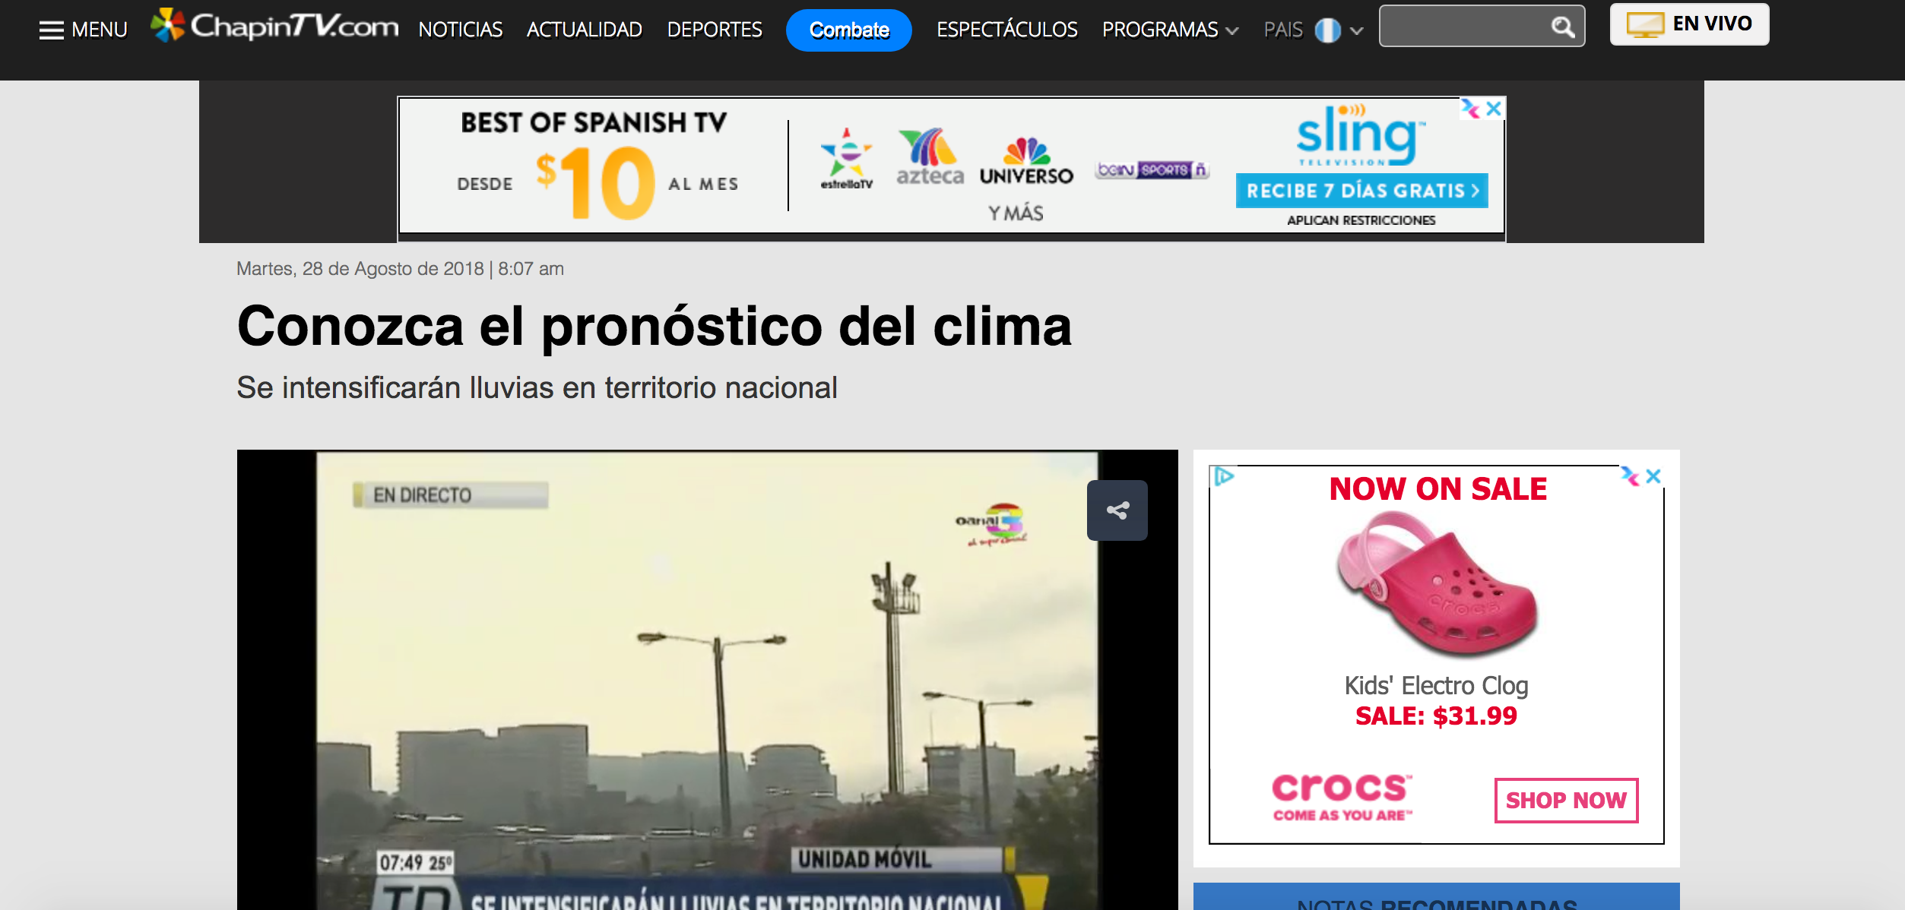
Chapin tv (radio & TV) Guatemala

Slide 18
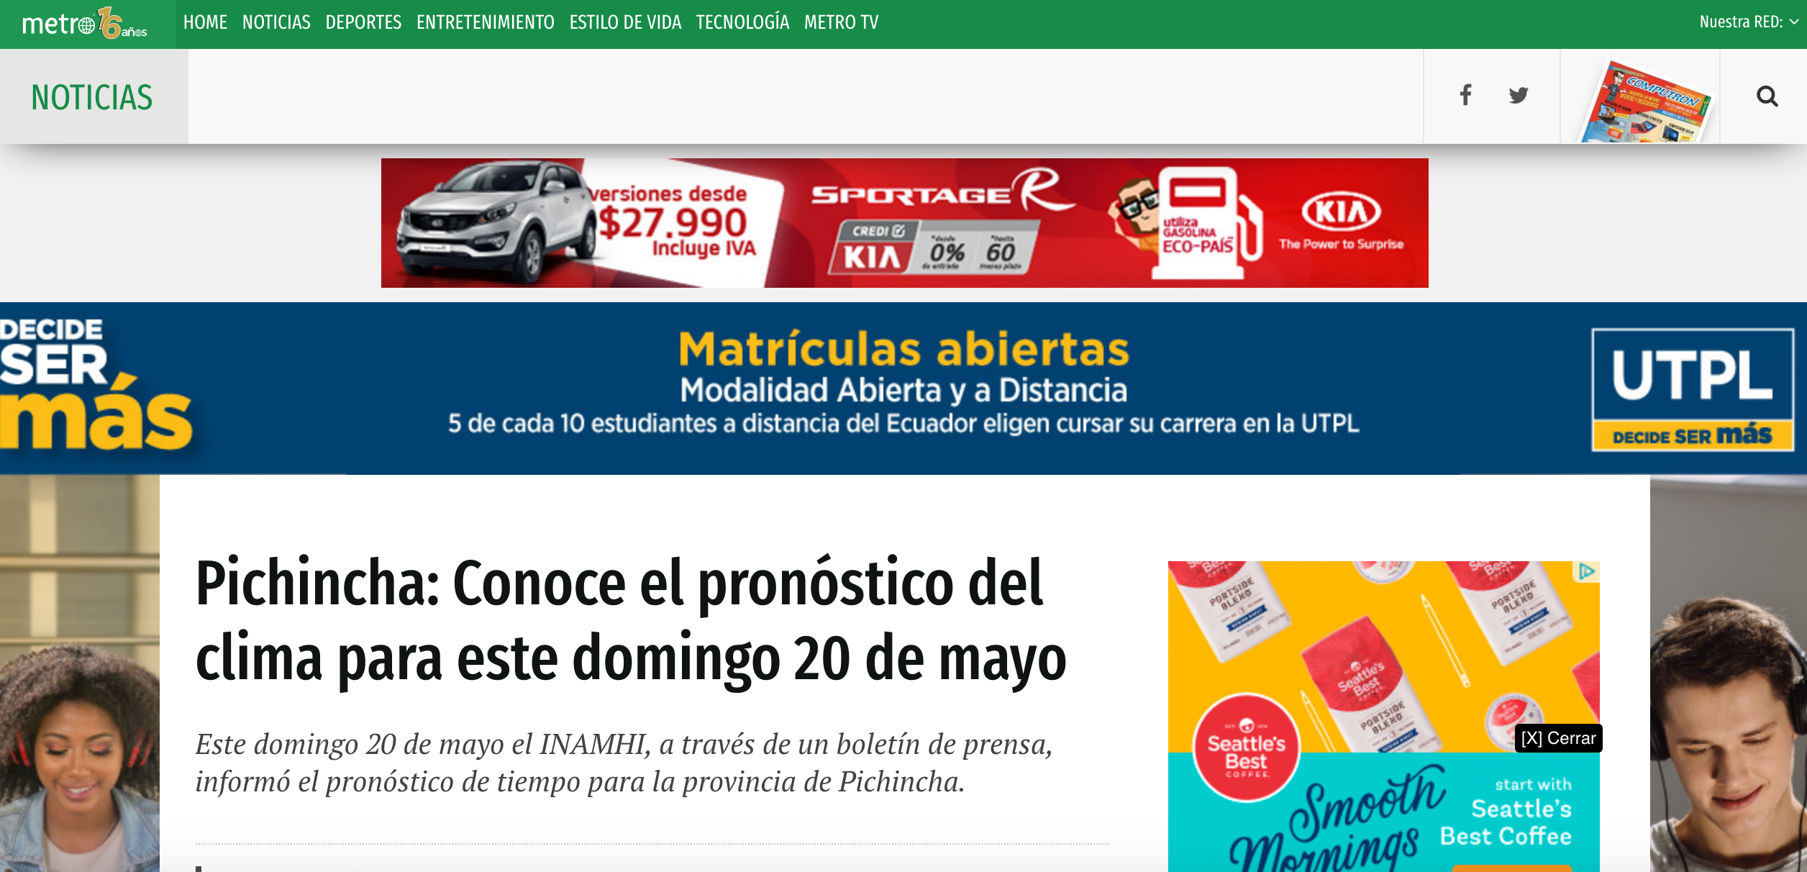
Metro Ecuador

Slide 19
National Resources Defense Council, 2016
“‘Nuestro Futuro,’ a comprehensive review of dozens of the latest studies and reports in the United States lays out the array of health and economic impacts that Latinos face as a result of climate change”
“A majority live in California, Texas, Florida and New York, states that are among the most affected by extreme heat, air pollution, and flooding.”
“Latinos are heavily represented in crop and livestock production and construction, where they’re at elevated risk from climate-change-boosted extreme heat. They are three times more likely to die on the job from excessive heat than non-Latinos.”

Slide 20
the power of Representation
Underrepresented in STEM related professions
“If you don’t see people like you in the media you consume, you must somehow be unimportant.” (Nicole Martins - Indiana Univ./HuffPost)
“If you are a black, Asian or Latino, etc. who always sees an inauthentic or one-dimensional version of yourself you may wonder if that is all that is expected of you in society.” (HuffPost)

Slide 21
taking weather/science more seriously
Many of their home countries, weather presented generically by people with no training (expectation from TV “experts” is low)
Fighting Latina stereotypes
Heavy severe weather coverage might not be what they are used to (a 20 minute interruption of their favorite show)
Our job to show and tell them why they should care (because it impacts them in ways they might not be aware of)
Large gap between the weather info Spanish-speaking communities need, and what they are getting
Local weather matters (even more so during severe)
Making yourself a part of viewers daily routine/decision-making builds trust/relationship
Social media now allows us regular access to community (can talk, explain, educate in casual environment– AHEAD of severe events)

Slide 22
The Tide is turning
Hispanics going to college more, and studying science more. A LOT more
American Institute of Physics, 2014
64% increase in the number of Latinos graduating with bachelor’s degrees in engineering (aerospace, mechanical, and chemical engineering)
78% increase from 2002 to 2012, in the number of hispanics graduating with degrees in physical sciences (chemistry, physics, atmospheric sciences and astronomy)
Hispanics earned more than 175,000 bachelor’s degrees during 2011-2012 academic year. (85% increase since 2002)

Slide 23
¡Muchisimas gracias!
violetay@gmail.com
@YasT62 (Twitter)
@VioletaYas (Instagram)

