Slide 1
May 15th’s Destructive Connecticut Tornadoes/ Macro and Microburst
Bill Goodman
Carlie Buccola
National Weather Service
New York NY

Slide 2
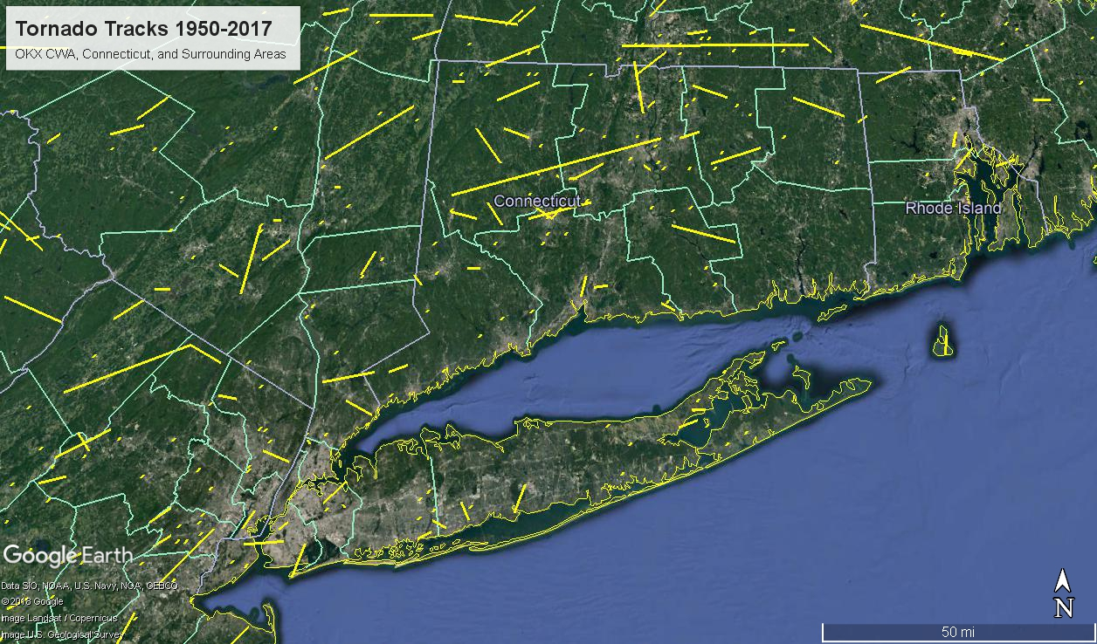
Climatology

Slide 3
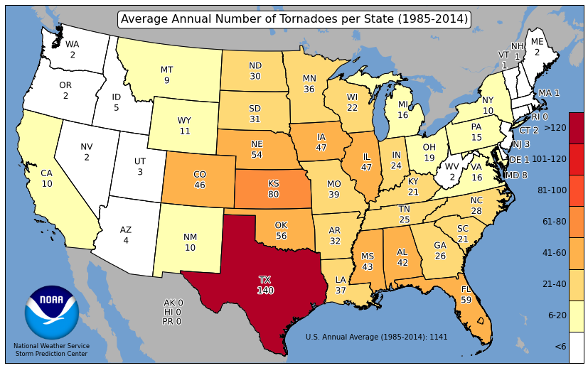
Climatology

Slide 4
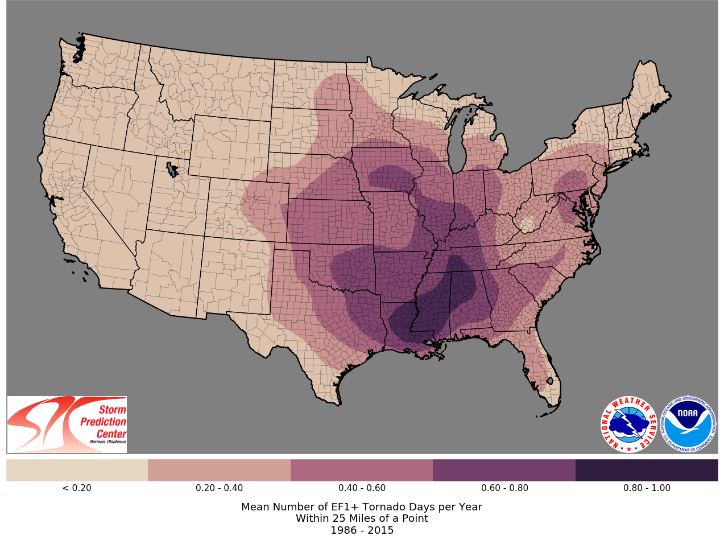
EF1+ Tornado Days per Year

Slide 5
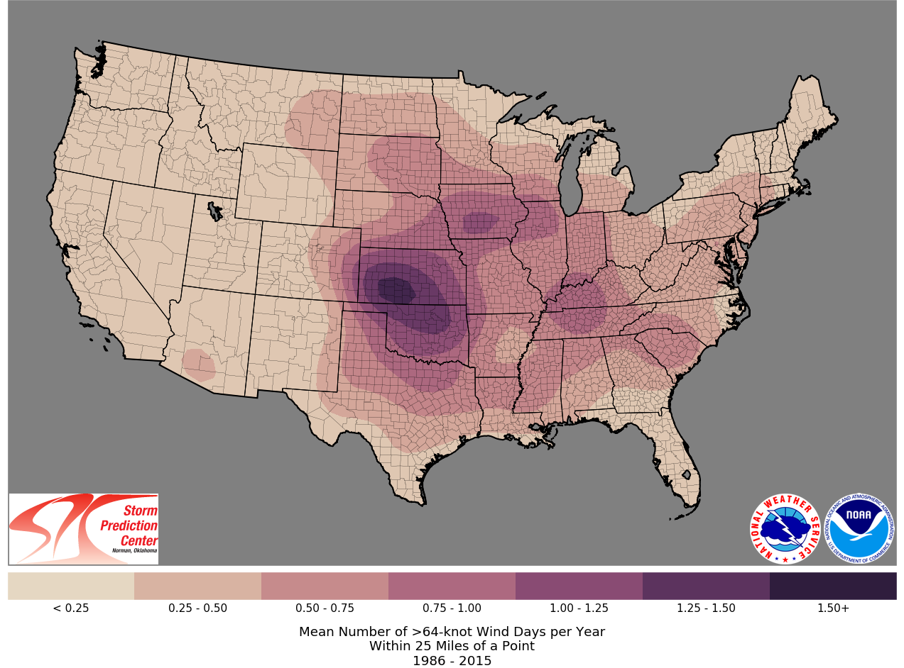
>64-kt Wind Days per Year

Slide 6
Save life and property by providing critical environmental intelligence, including weather forecasts and warnings, to our partners and the general public.
NOAA wants everyone, from communities across the country, businesses, and the public at large to be ready, responsive, and resilient to extreme weather, water, and climate events.

Slide 7
Outlook Phase Messaging
WFO Area Forecast Discussion / Hazardous Weather Outlook
SPC Outlooks
WFO/SPC Web/Social Media Posts
E-mail to Emergency Management/Broadcast Media/Other partners

Slide 8
OKX Area Forecast Discussion 408 PM EDT Sun May 13 2018
“A strong polar shortwave and associated low pressure system moving through Quebec on Tue/Tue Night, will have a trailing cold front approaching the region Tuesday, and sagging through Tuesday night. Ahead of this, a very warm and unstable airmass will advect into the region on Tuesday, with evidence of an elevated mixed layer between 700 and 500mb advecting in from the high plains of the Central US. With high instability across NYC/NJ metro and interior and strong unidirectional deep layer shear 40-50 kt, potential is there for severe weather along/ahead of the approaching cold front on Tues afternoon/evening.”

Slide 9
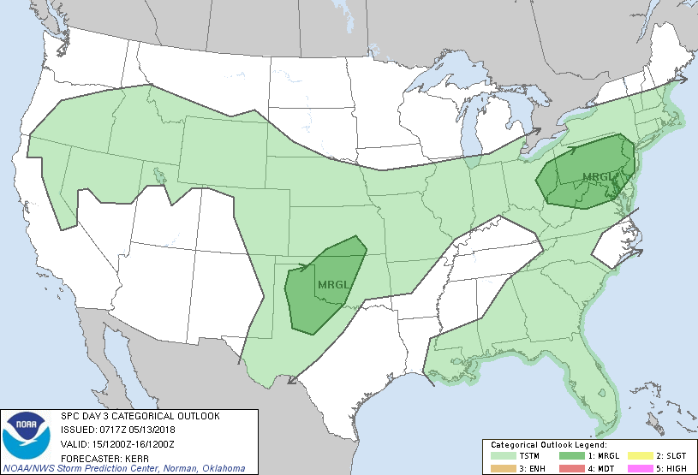
SPC Day 3 Outlook 13/0717Z

Slide 10
OKX Area Forecast Discussion 409 AM EDT Mon May 14 2018
“The main story…will be the passage of a cold front Tuesday afternoon/evening, associated with a passing 700-500 hPa northern stream trough axis. Ahead of the front, CAPE across NE NJ/Western Lower Hudson Valley/interior SW CT is progged to 2000-3000 J/kg with up to 1000 J/kg forecast into NYC. In addition have 40-50 kt of bulk shear and that area under the low level theta-e ridge. Are progged to have around 1000 J/kg of downdraft CAPE in that region as well as Energy helicity Indices over 1. With Bulk Richardson Numbers initially progged in the 15-25kt range could see some discrete supercells ahead of the squall line which should eventually develop later in the day. As a result, there is the risk for severe thunderstorms over NE NJ/Lower Hudson Valley/SW CT and NYC Tuesday afternoon and evening. The main threat is for damaging wind gusts, with possibly some large hail. The LCL is generally progged to be above 1000m, so this significantly limits the tornadic threat, even with the veering low level wind profile.”

Slide 11
Social Media Post on Mon, May 14
Scattered severe thunderstorms possible with the main threat being damaging wind gusts tomorrow afternoon and evening.
Flash Flooding is possible with average rainfall amounts of 0.5”-1.00” expected.
There is moderate/high confidence in showers and thunderstorms developing, but it is uncertain how widespread the threat for severe storms or flash flooding will be.
WEATHER.GOV/NYC | @NWSNEWYORKNY

Slide 12
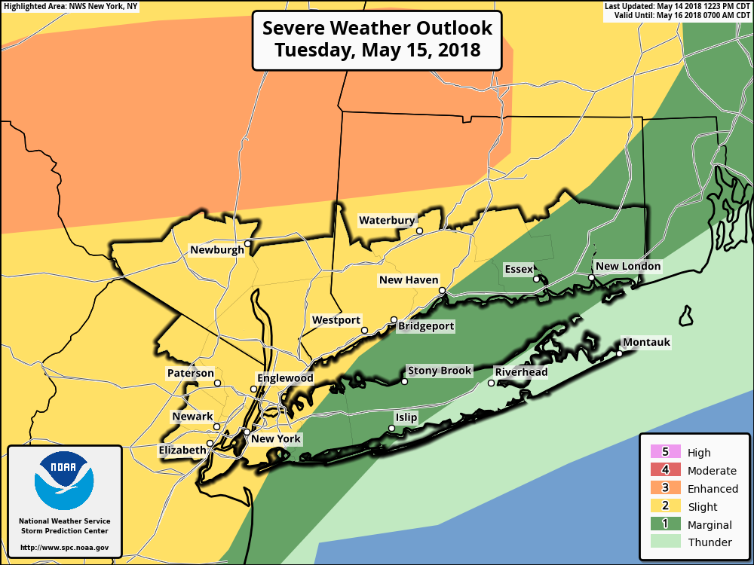
Tuesday, May 15
Thunder
Marginal
Slight
Enhanced
No severe* thunderstorms expected.
Isolated severe thunderstorms possible.
Scattered severe storms possible.
Numerous severe storms possible.
WEATHER.GOV/NYC | @NWSNEWYORKNY

Slide 13
OKX Area Forecast Discussion 417 AM EDT Tue May 15 2018
“A 700-500 hPa shortwave trough approaches by late afternoon and crosses the area this evening, along with its associated surface cold front. Ahead of the front the atmosphere will rapidly destabilize this afternoon with solar heating and dewpoints increasing to the lower to mid 60s. As a result, have the potential for 1000-2500 J/kg or CAPE across NE NJ/Lower Hudson Valley/SW CT, most of NYC and parts of SE CT and Long Island. The high CAPE coupled with 45-55 kt of 0-6km Bulk Shear, an Elevated Mixed Layer (EML) passing over, and a veering wind profile with height (more pronounced in areas after the seabreeze front moves through and locally backs the wind), will produce the threat for severe weather across the Tri-State this afternoon and evening.
The main threat across the entire area is damaging wind gusts - mainly with the passing of the main squall line ahead of the cold front. There is also a smaller chance of large hail.
Over northern portions of NE NJ, most of the Lower Hudson Valley, interior portions of SW CT and NW Middlesex County - this area should see the highest CAPE (1500-2500 J/kg) and is under the core of the low level theta-e ridge axis and the EML (700-500 hPa lapse rates around 8C), so has been placed under an Enhanced Risk for Severe Thunderstorms by the Storm Prediction Center (SPC)…Across the Enhanced Risk area, Bulk Richardson numbers are 15 to 25 indicating the potential for isolated supercells ahead of the main line of storms. Given high Energy Helicity Indices and Significant Tornado Parameter (both greater than 1) there is the potential for isolated tornadoes, especially in any isolated supercells that form ahead of the main squall line. ”

Slide 14
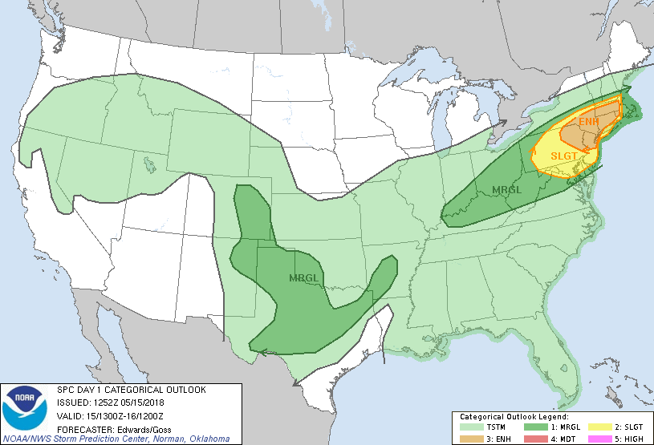
SPC Day 1 Outlook 15/13Z

Slide 15
Storm Prediction Center Day 1 Outlook 752 AM CDT Tue May 15 2018
“Thunderstorms are expected to develop and grow upscale from midday through afternoon, sweeping eastward across the region with the main risk being severe wind. The potential for a well-organized swath of damaging wind -- including a few gusts around hurricane force -- appears greatest over the enhanced-risk area. Large hail also is possible, especially in the first few hours of the convective cycle when storm modes can be more favorably discrete or semi-discrete. A few tornadoes also may occur, whether from supercells or QLCS-embedded vortices.
Whether the resulting convective wind event qualifies as a derecho may be a semantic exercise; impacts could be of that caliber in the area affected.”

Slide 16
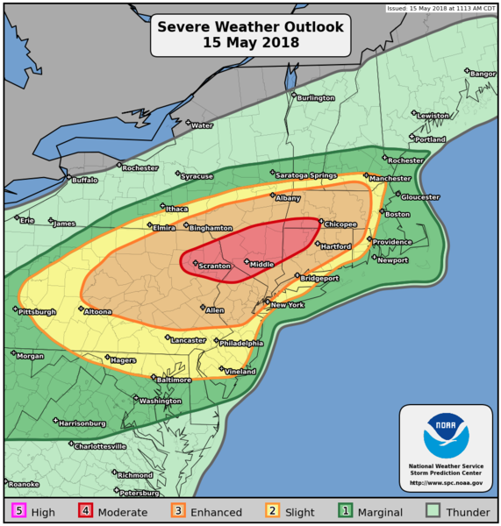
SPC Day 1 Outlook 15/1613Z

Slide 17
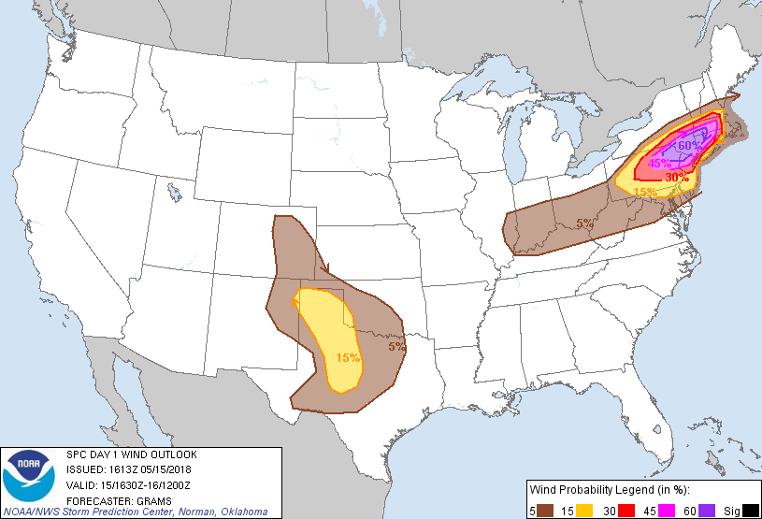
SPC Day 1 Outlook 15/1613Z

Slide 18
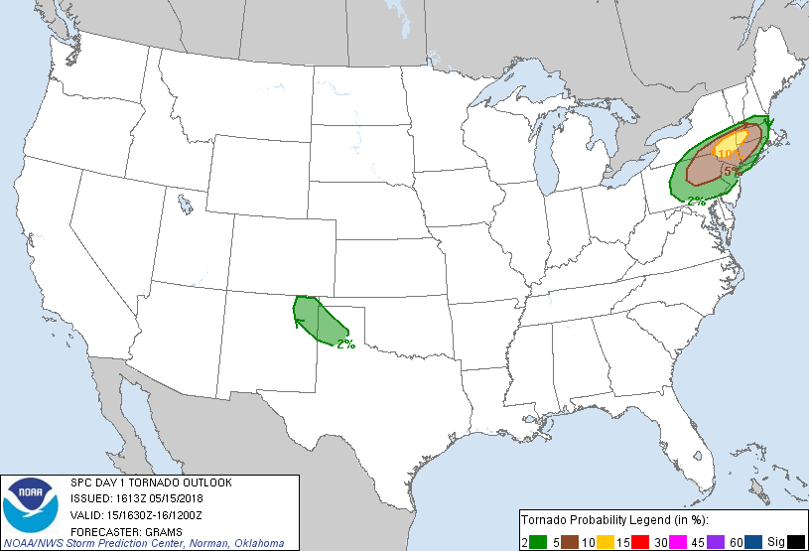
SPC Day 1 Outlook 15/1613Z

Slide 19
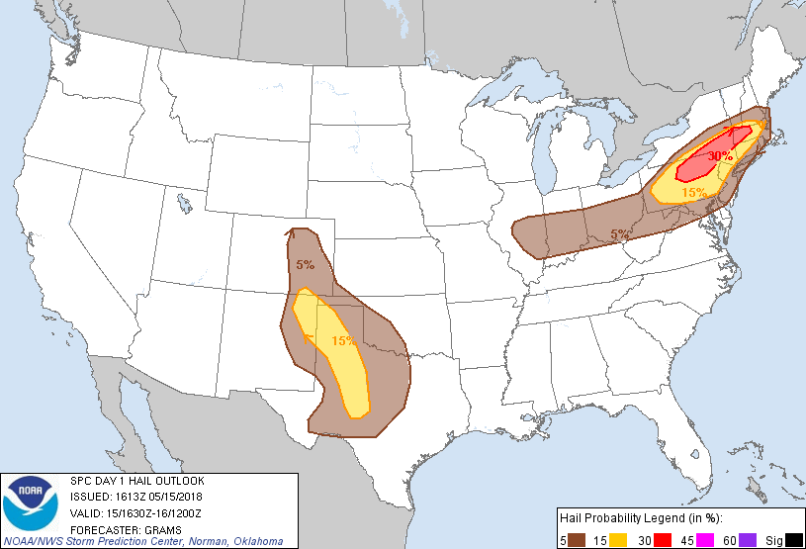
SPC Day 1 Outlook 15/1613Z

Slide 20
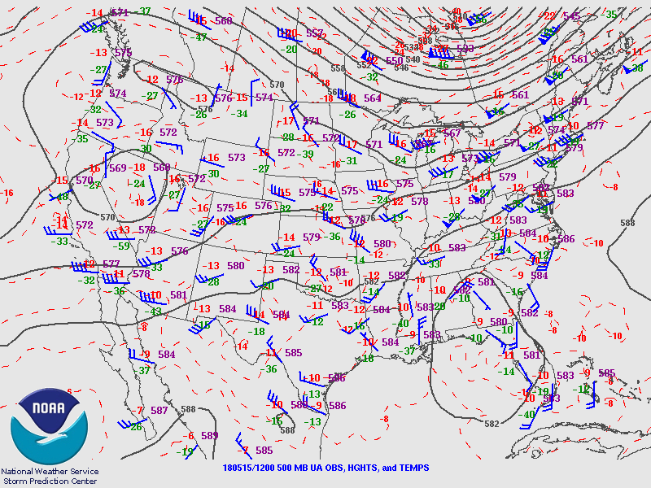
2018/05/15 12Z 500 mb

Slide 21
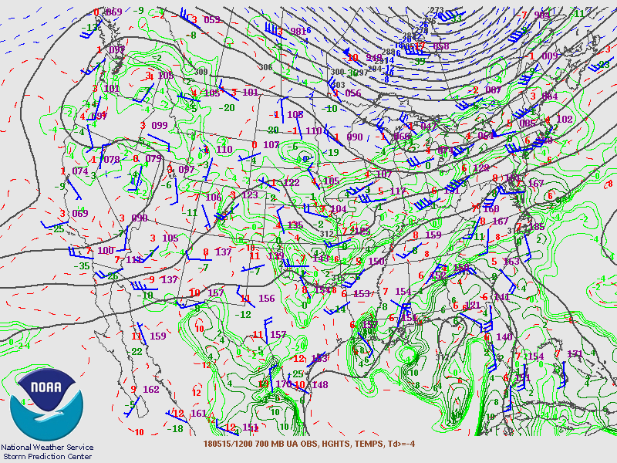
2018/05/15 12Z 700 mb

Slide 22
2018/05/15 12Z KPIT Sounding
Elevated Mixed Layer
500-700 mb lapse rate 7.6C/km near climatological max
Significant rear-inflow elevated instability feed; storms may survive marine layer excursion
Fcst SBCAPE 2000 J/kg
DCAPE 1000 J/kg
Strong 0-1 km veering wind profiles

Slide 23
2018/05/15 12Z EML Source
Central High Plains
Initial surge likely fueled Mid Atlantic outbreak 5/14

Slide 24
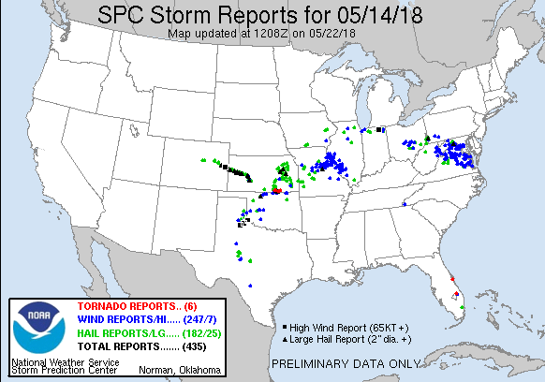

Slide 25
2018/05/15 12Z EML Source
DDC 13/12Z
EML 500-800 mb with dry adiabatic lapse rates

Slide 26
2018/05/15 12Z KPIT Hodograph
0-1 km shear 35 kt
0-1 km SRH 133 m^2/s^2
Avg storm motion 251/42
RM supercell motion 272/41

Slide 27
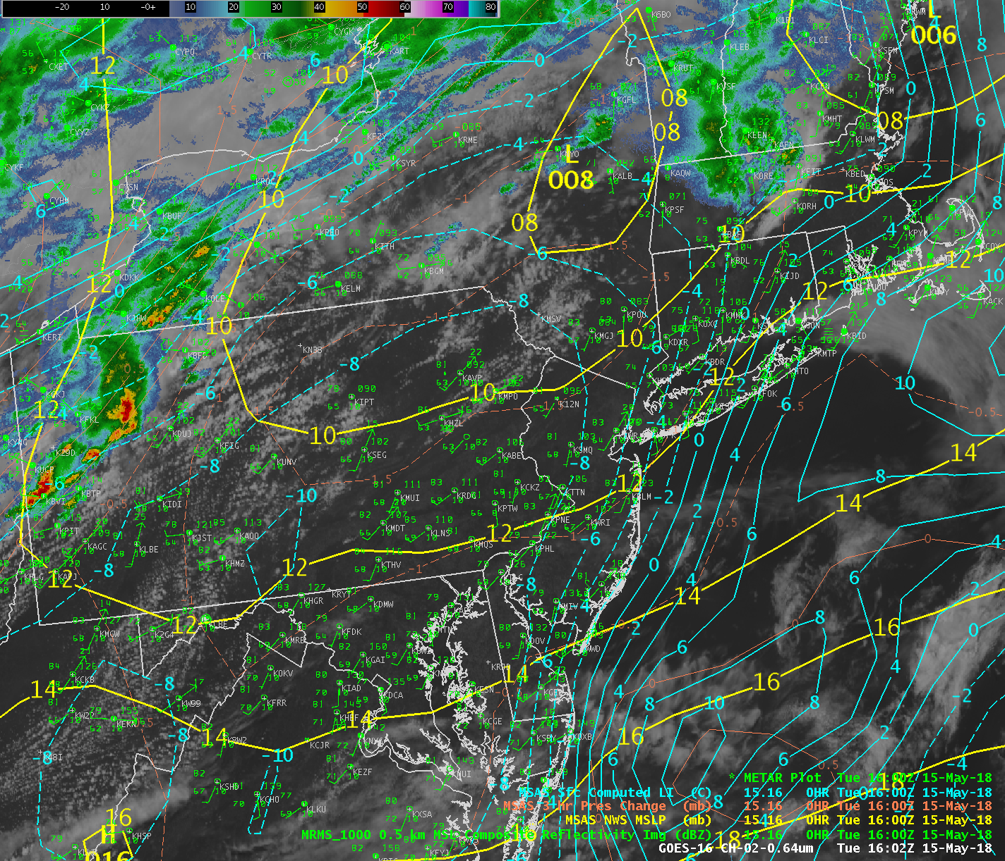
Surface 15/16Z

Slide 28
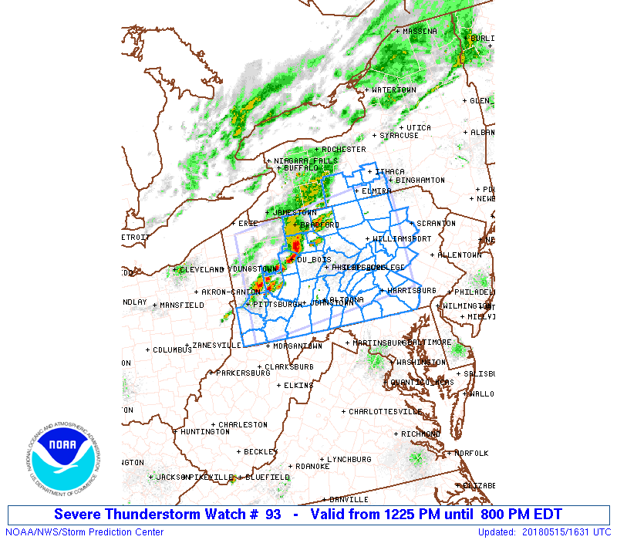
SPC Watches

Slide 29
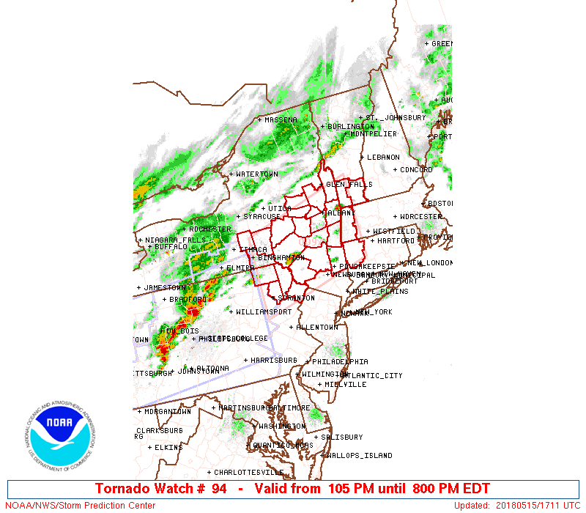
SPC Watches

Slide 30
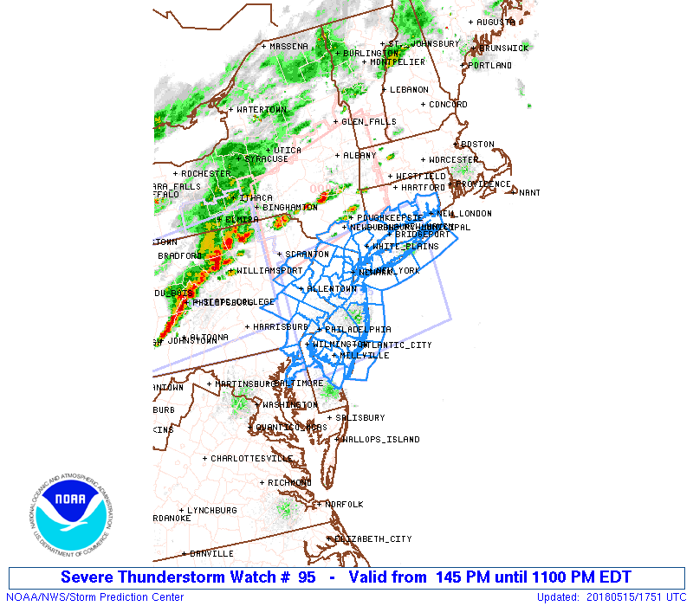
SPC Watches

Slide 31
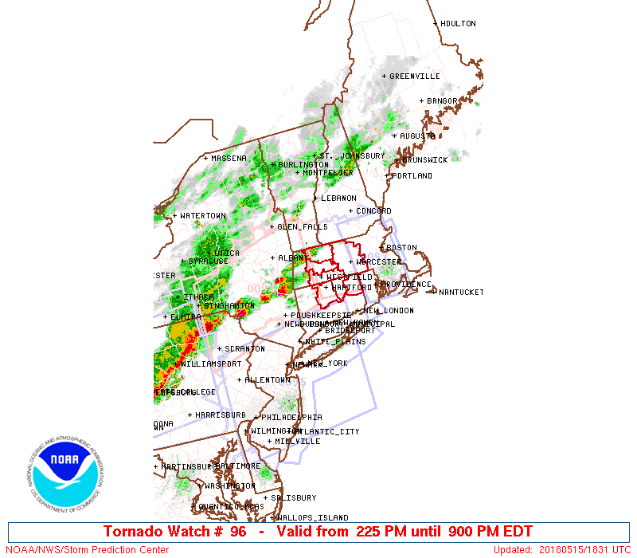
SPC Watches

Slide 32
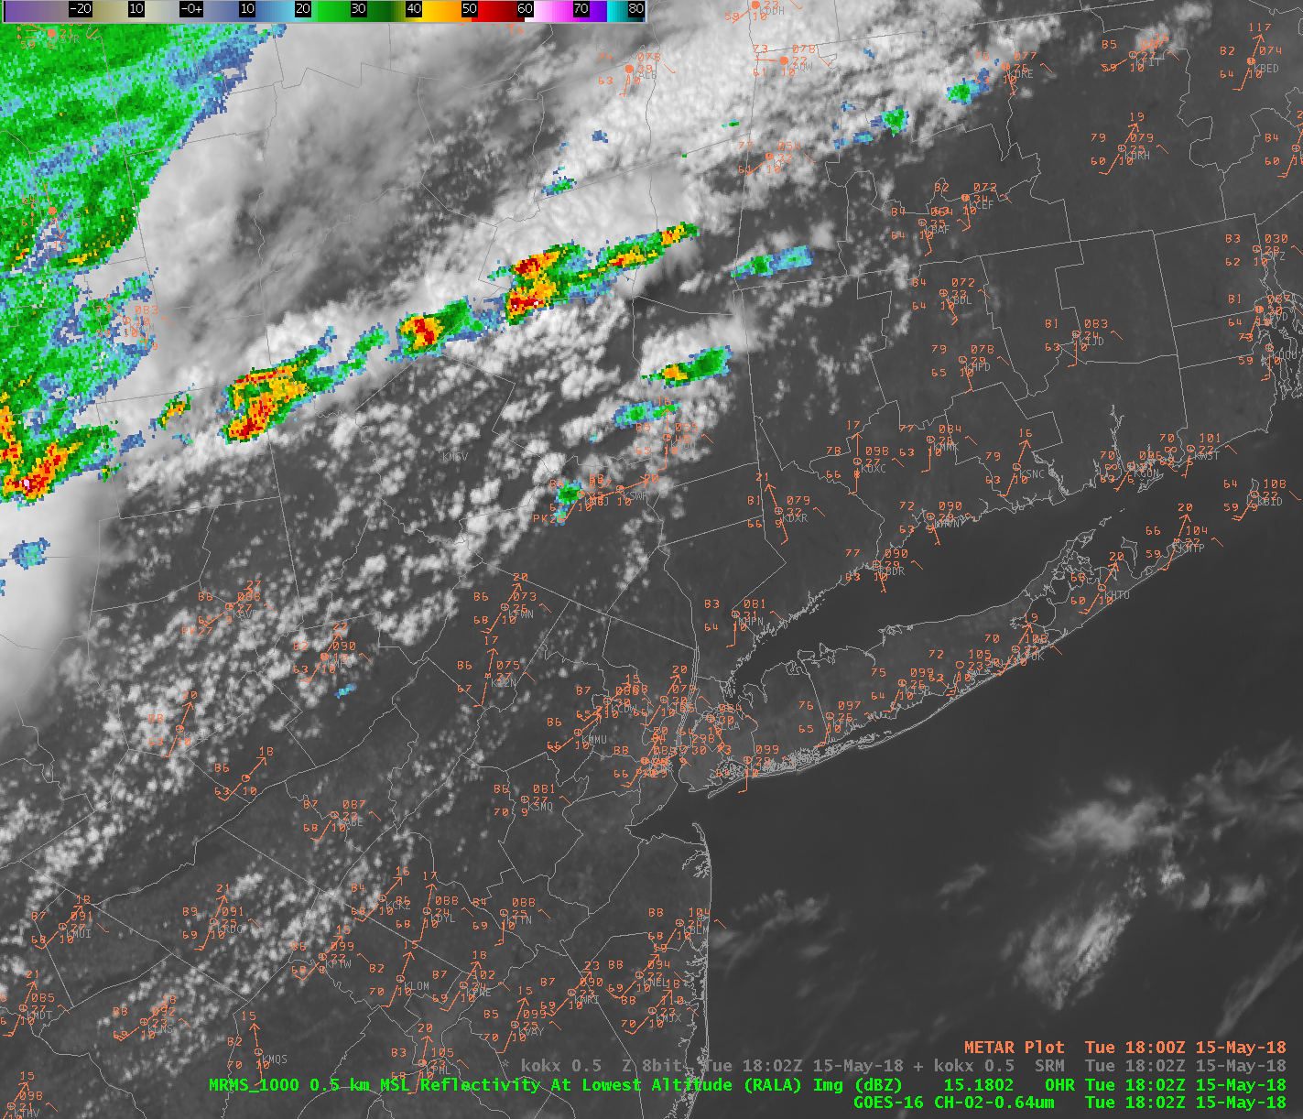
Surface 15/18Z
Supercells forming along cold front near Catskills
Showers to south in hills and along old outflow
Outflow boundary from earlier storms across N Litchfield CT
Cu field expanding in Lower Hudson Valley

Slide 33
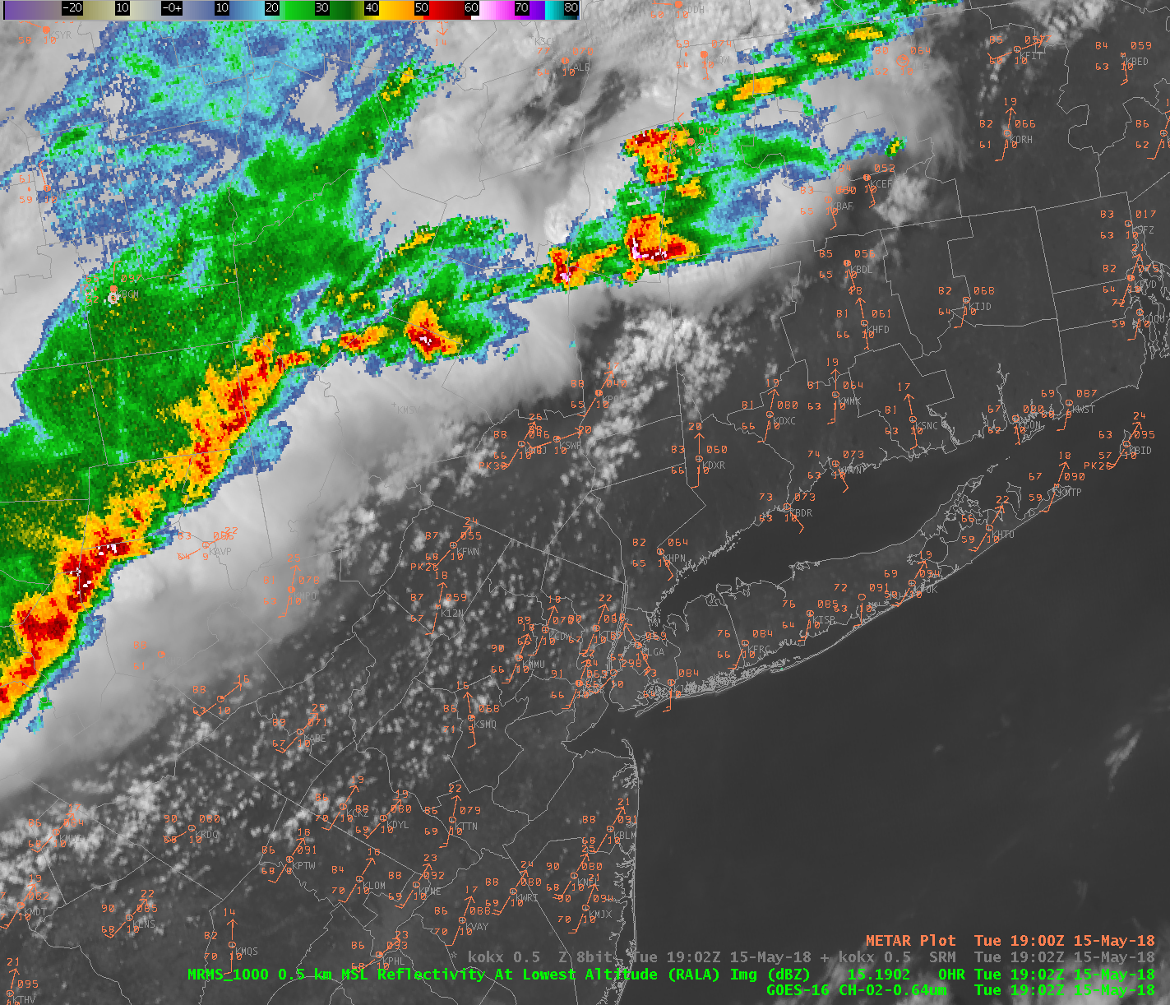
Surface 15/19Z
Supercell drops baseball-sized hail in Columbia County NY
Moving into Litchfield Hills where multiple boundaries seen (low level cloud field, anvil shadow)

Slide 34
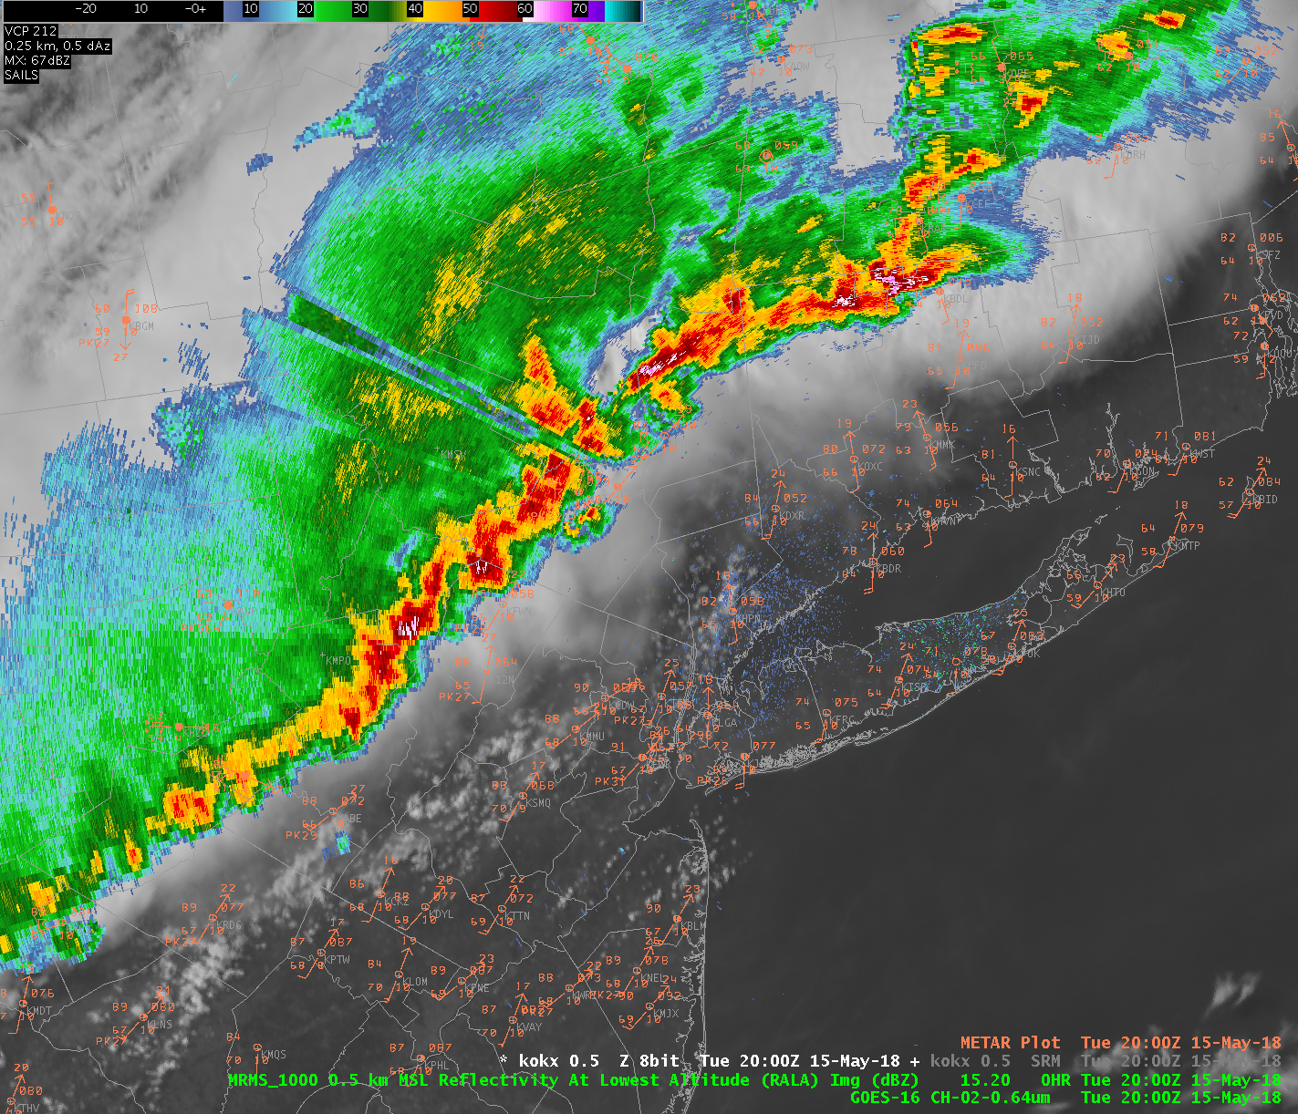
Surface 15/20Z
Tennis-ball sized hail in East Hartland
1-inch hail covering ground in Granby
Crops destroyed, homes damaged, windshields smashed
EF-1 Tornado in Winsted

Slide 35
Surface 15/20Z
Line moving into Lower Hudson Valley toward southern CT
Surge of southerly wind across southern CT
Anvil shadow and sea breeze front become very important boundaries for focusing storm movement and low-level horizontal vorticity

Slide 36
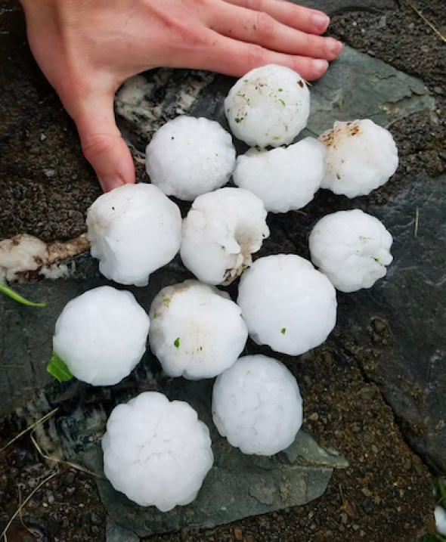
Columbia County NY Hail

Slide 37
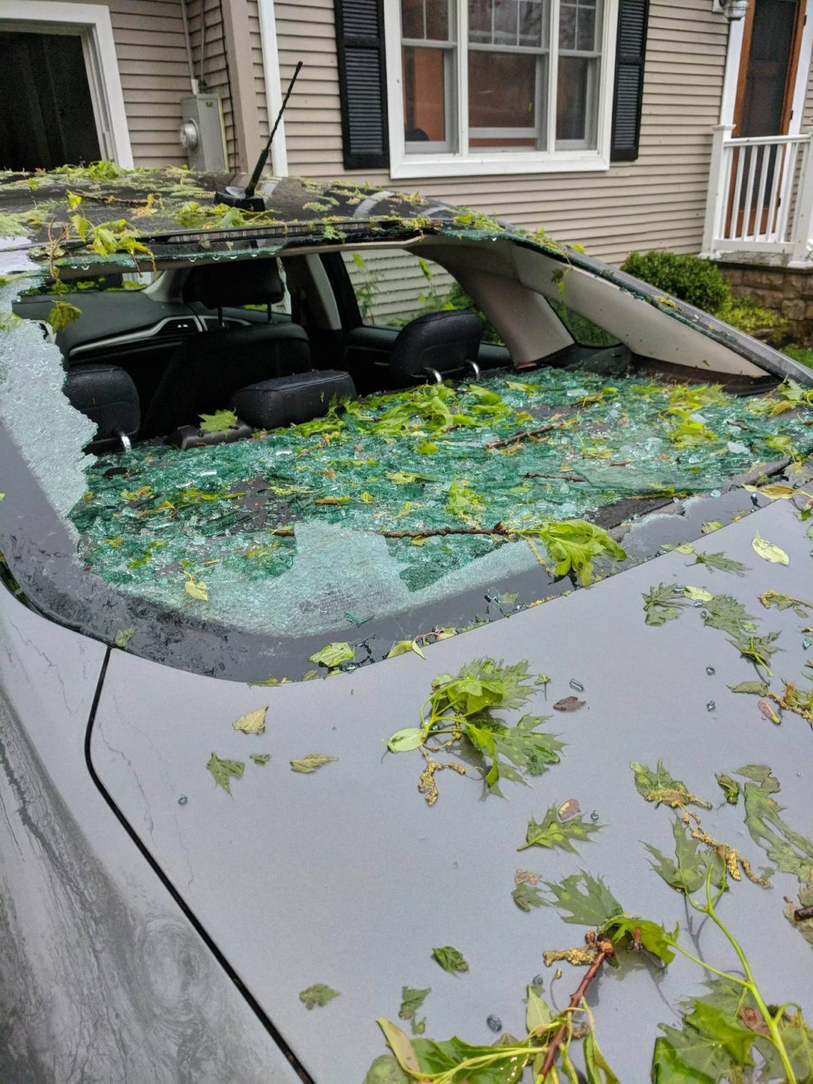
Hartland Hail Damage

Slide 38
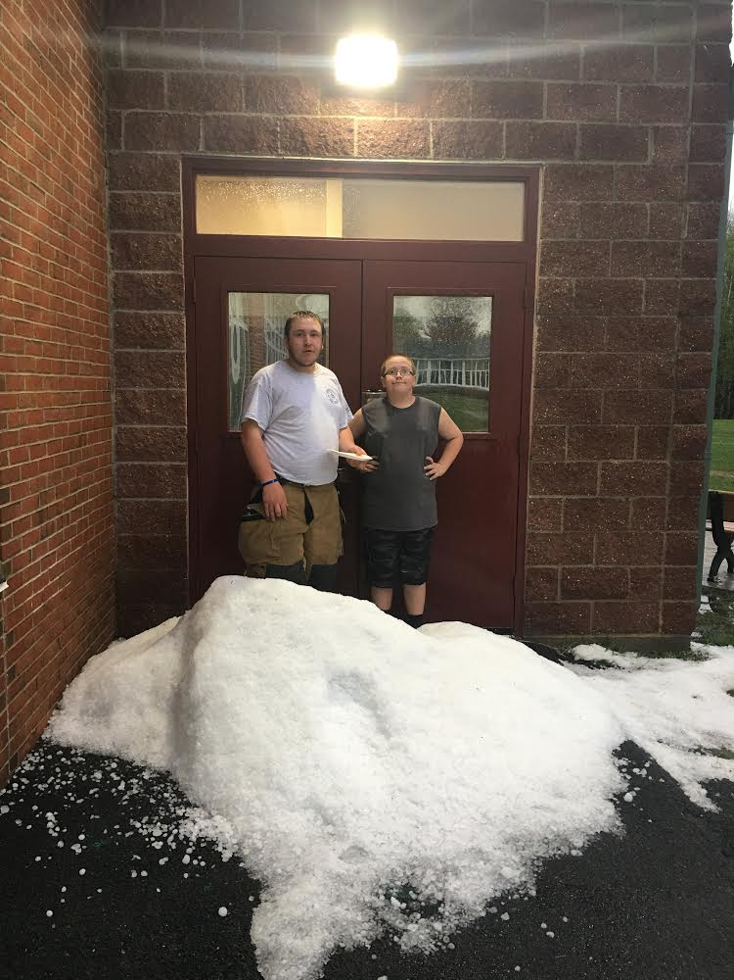
Granby

Slide 39
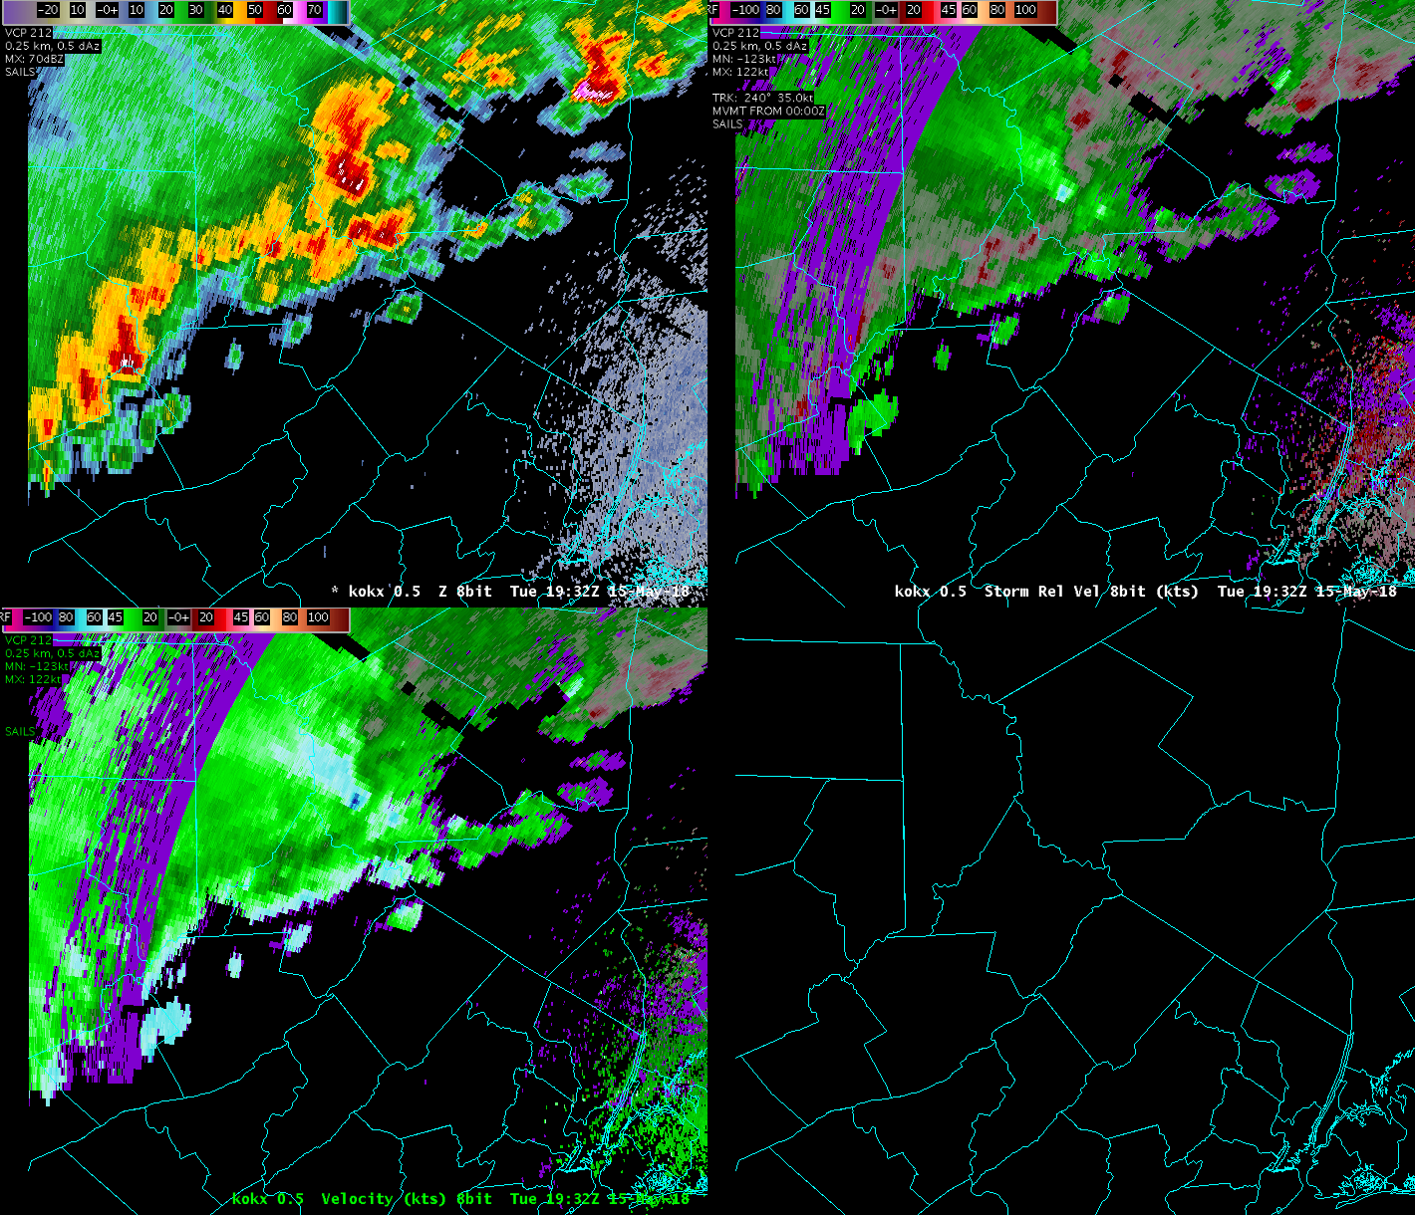
OKX Radar 1932Z
Line of intense cells in EML environment
Mid level flow 60+ kt on leading edge
Prior history of wind damage
Tornadic storm in Sullivan County NY passing to north…for now

Slide 40
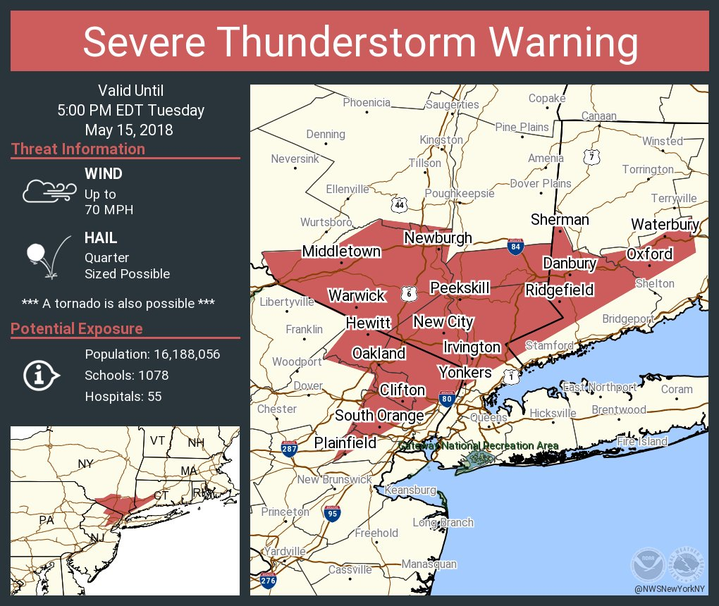
Social Media Post for SVR #0003

Slide 41
Severe Weather Statement 438 PM EDT Tue May 15 2018
At 437 PM EDT, severe thunderstorms were located along a line extending from Lake Carmel to near West Point to Victory Gardens to Washington to near Coffeetown, moving east at 45 mph.
These are very dangerous storms.
HAZARD...80 mph wind gusts and penny size hail.
SOURCE...The New York State Mesonet site at Beacon reported winds of 78 mph at 420 PM.
IMPACT...Flying debris will be dangerous to those caught without shelter. Mobile homes will be heavily damaged. Expect considerable damage to roofs, windows, and vehicles. Extensive tree damage and power outages are likely.
PRECAUTIONARY/PREPAREDNESS ACTIONS...
This is an EXTREMELY DANGEROUS SITUATION with tornado like wind speeds expected. Mobile homes and high profile vehicles are especially susceptible to winds of this magnitude and may be overturned. For your protection move to an interior room on the lowest floor of a building. These storms have the potential to cause serious injury and significant property damage.
&&
TORNADO...POSSIBLE
HAIL...0.75IN
WIND...80MPH

Slide 42
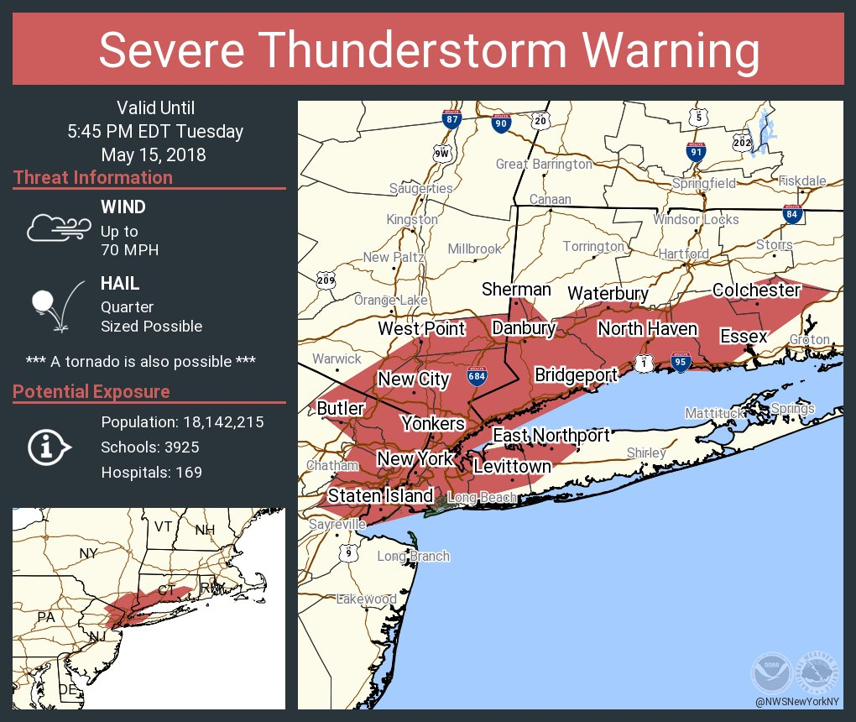
Social Media Post for SVR #0004

Slide 43
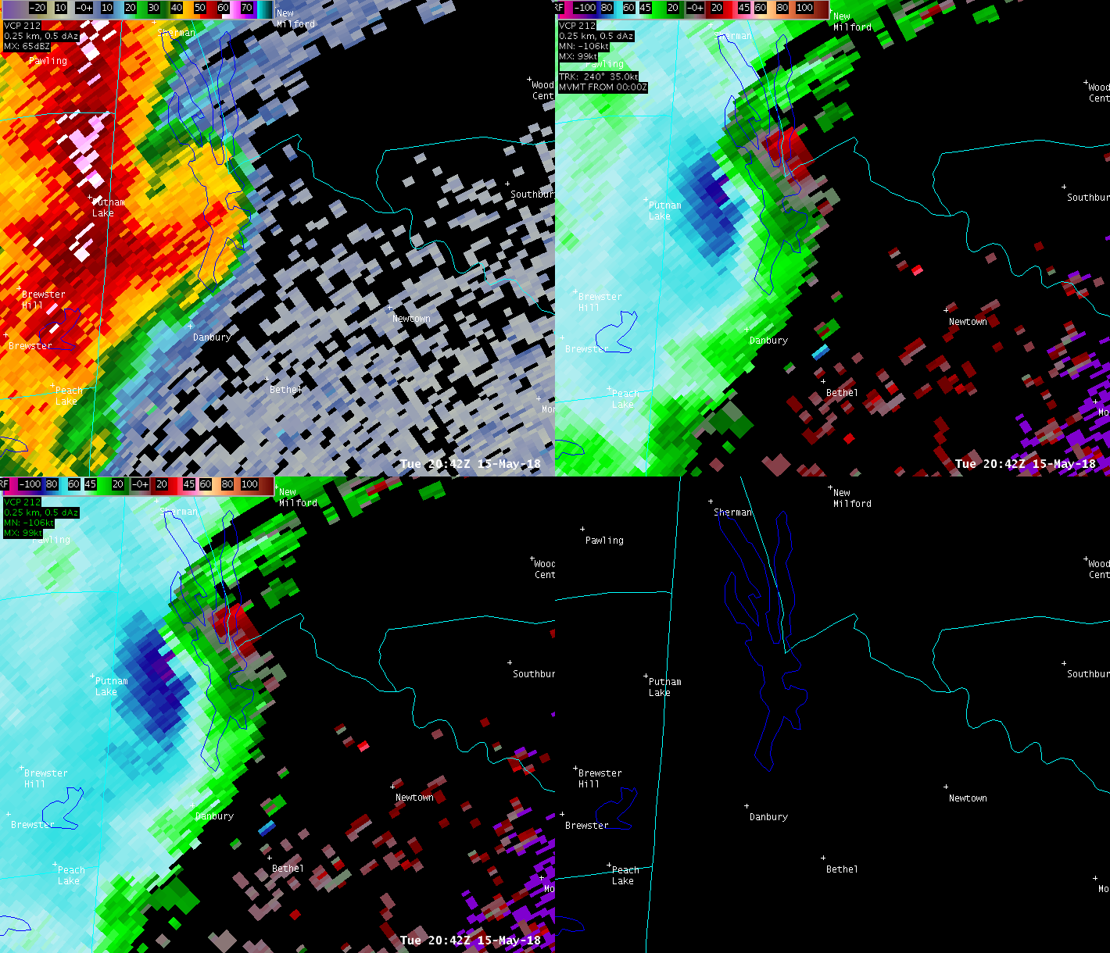
New Fairfield-Brookfield Macroburst
TOR #0002 also issued given large rotating hook/inflow notch
0.5-degree Base Velocity inbound wind maximum: 94.1 kt == 108 mph!!
Concentrated damage path 9 miles long/3 miles wide

Slide 44
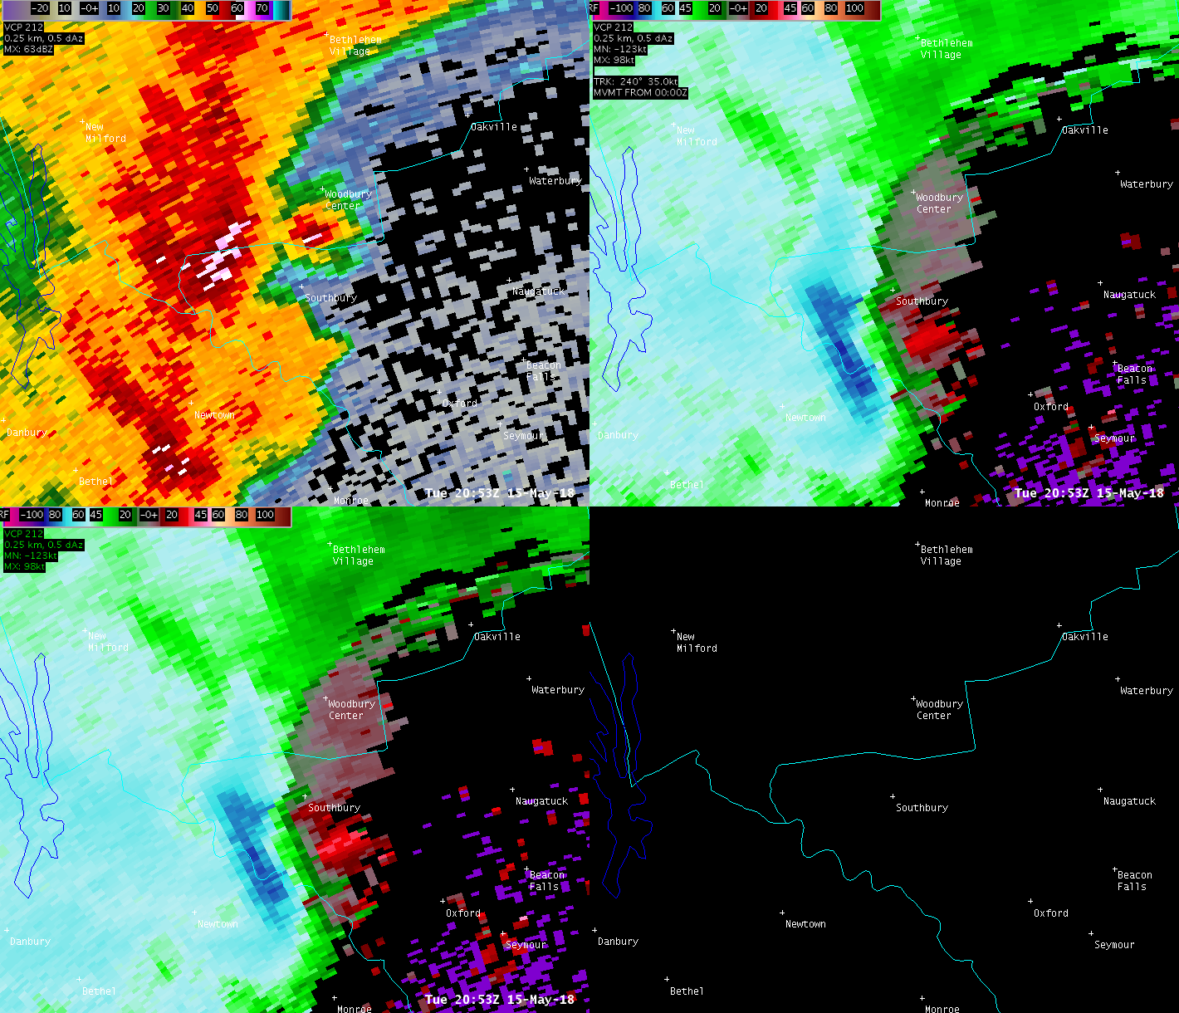
OKX Radar 2053Z
Persistent strong mesocyclone
Inflow notch
Leading appendage

Slide 45
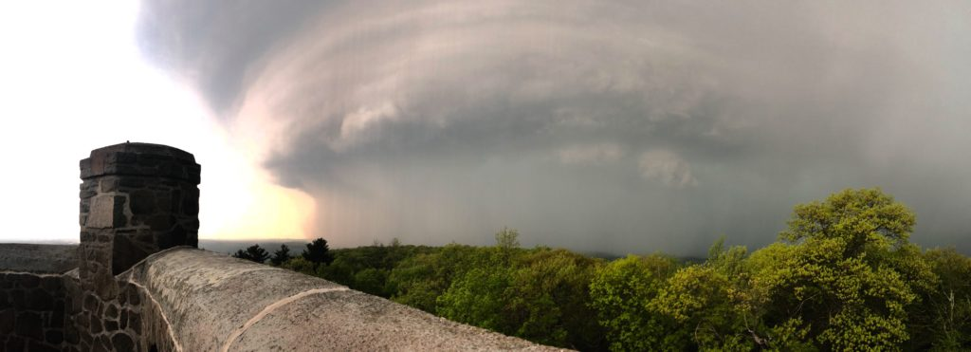
View from the East at Sleeping Giant State Park

Slide 46
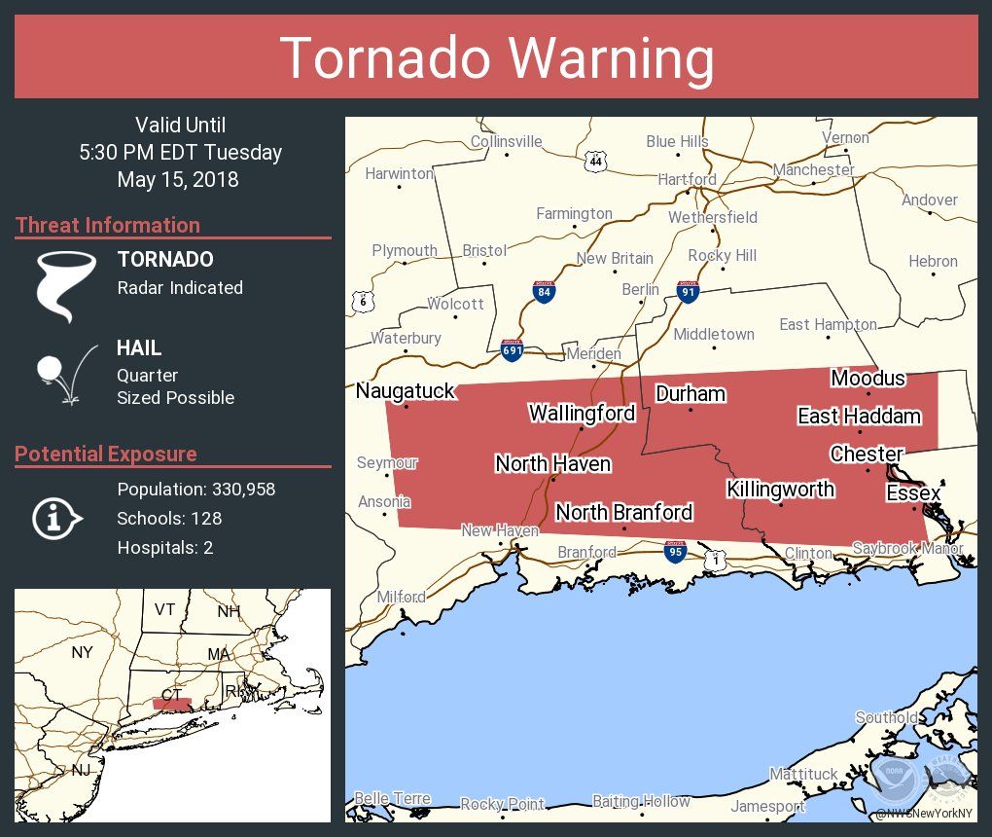
Social Media Post for TOR #0003

Slide 47
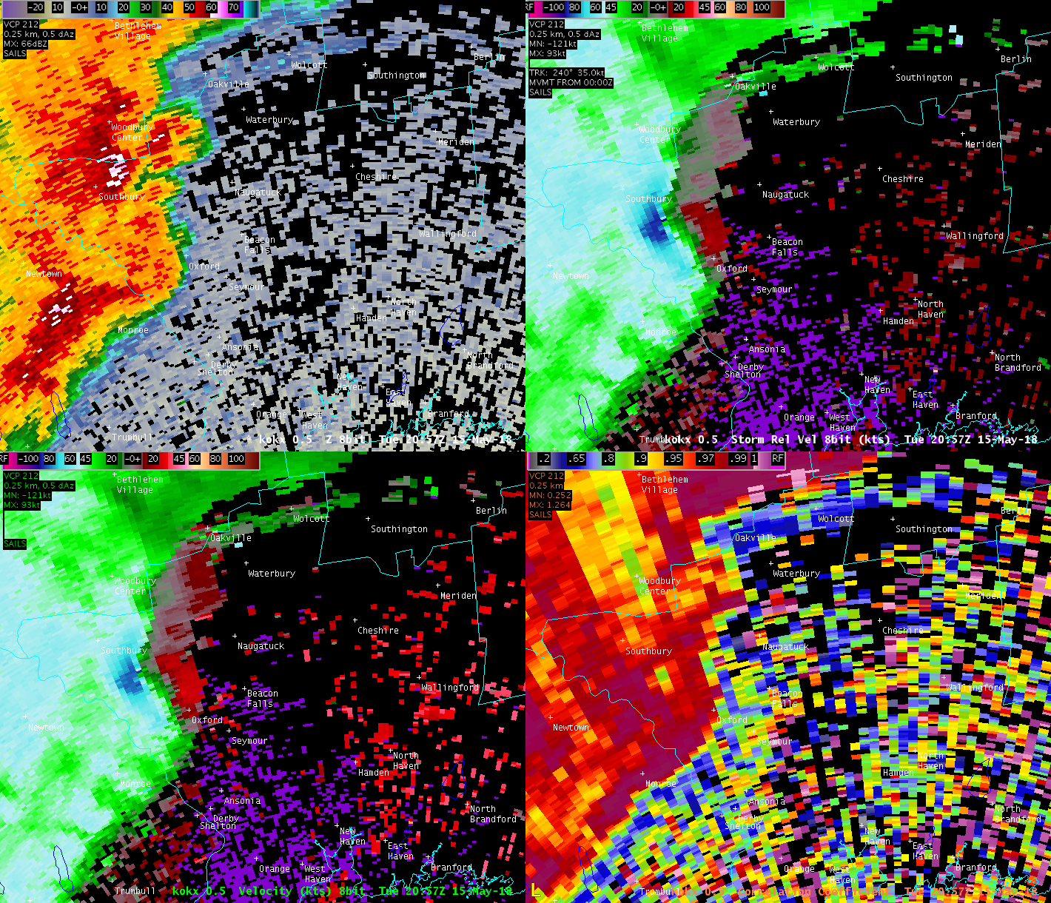
OKX Radar 2057-2112Z
Tornadic Debris Signature (TDS) as indicated by low Dual-Pol Correlation Coefficient (CC) co-located with circulation

Slide 48
OKX Radar 2057-2112Z

Slide 50
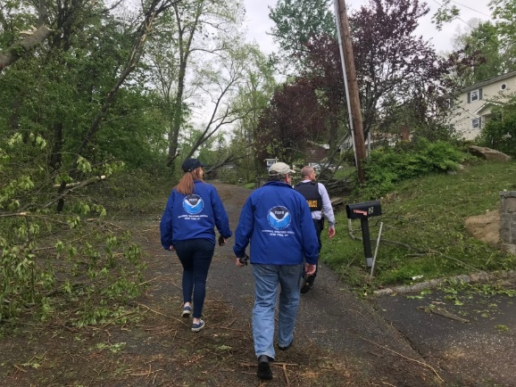
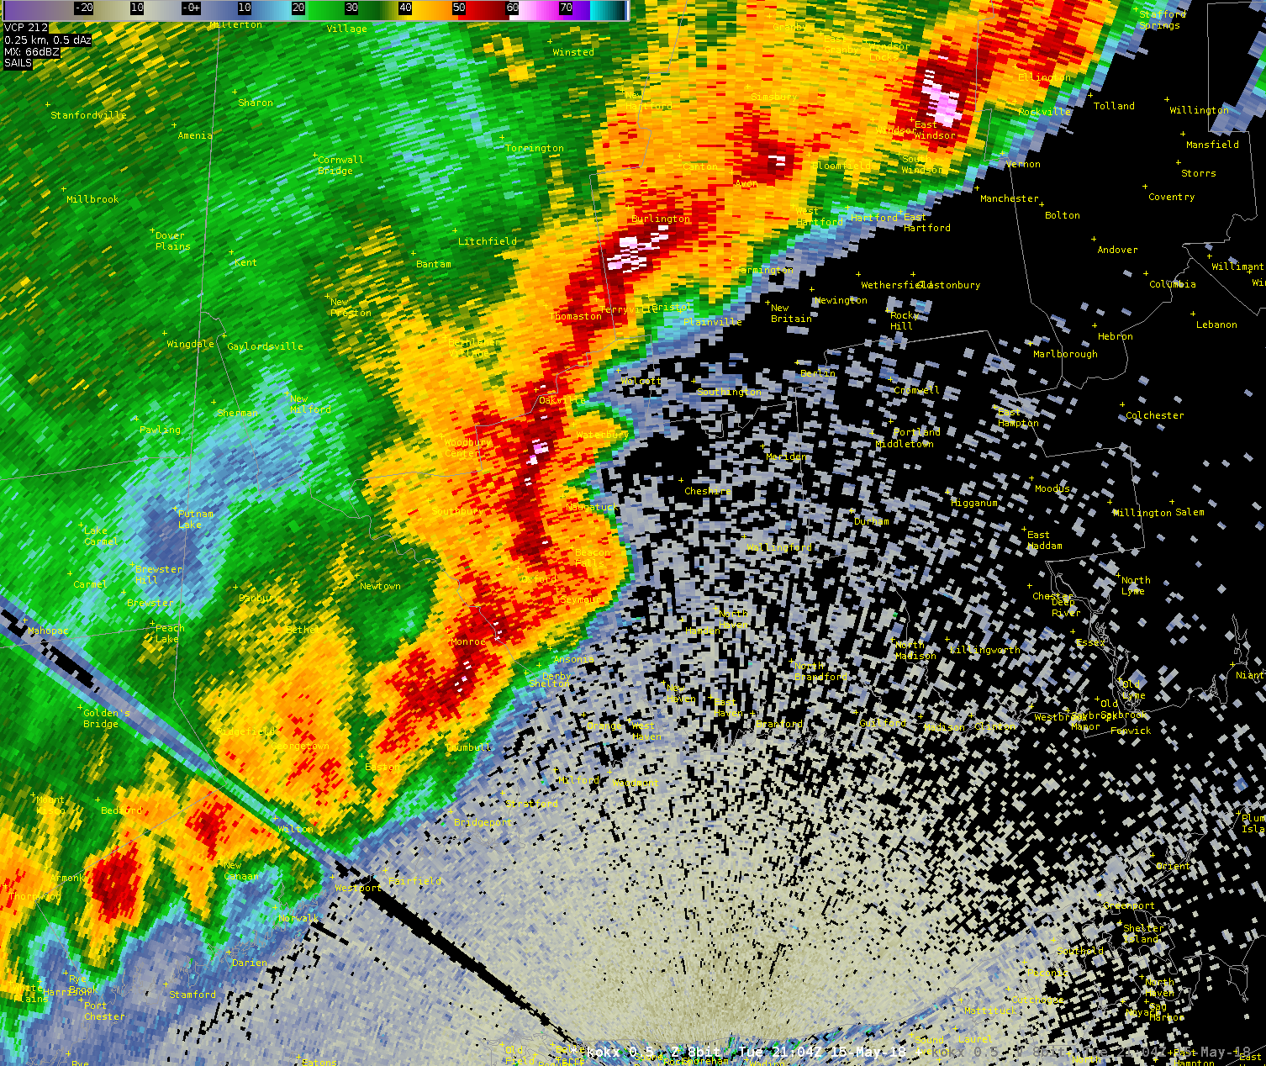
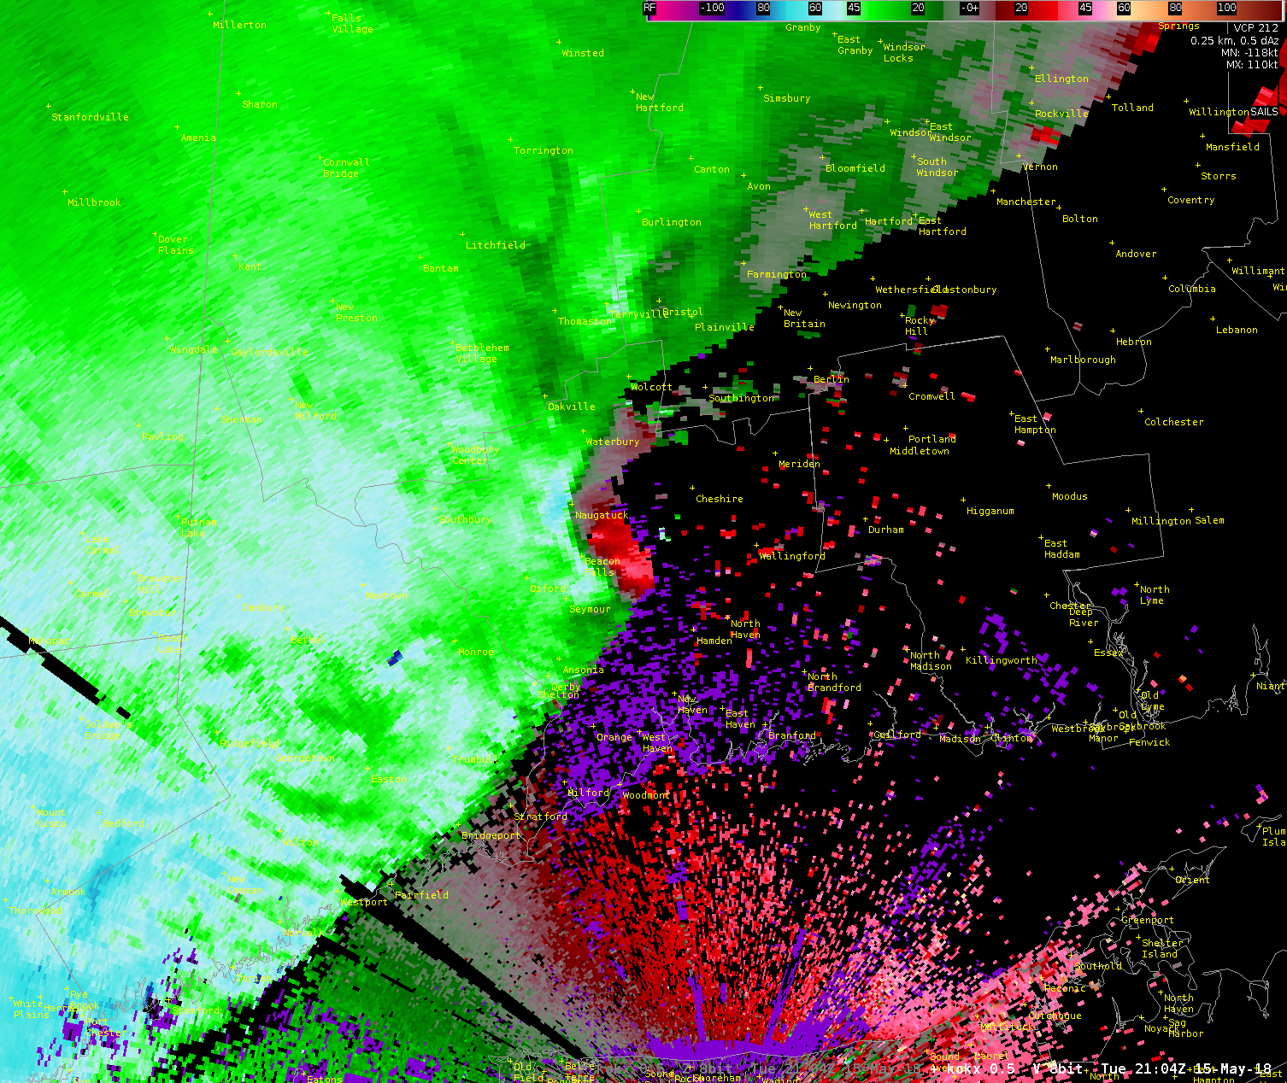
NEW HAVEN COUNTY, CT TORNADOES
Brookfield, CT
May 15, 2018
Radar Velocities
Radar Velocities
tornado
tornado
Southbury-Oxford, CT
Beacon Falls-Hamden, CT
Rating: EF1
Estimated Peak Winds: 100 mph
Path Length: 4.5 miles
Path Width: 400 yards
Start Time: 4:53pm EDT
Location: Moved SE from Route 67 & Burma Road in Southbury before lifting after damaging the roof of the Great Oak School in Oxford.
Rating: EF1
Estimated Peak Winds: 110 mph
Path Length: 9.5 miles
Path Width: 600 yards
Start Time: 5:03pm EDT
Location: Moved SE from Bethany Street in Beacon Falls to Sleeping Giant State Park in Hamden.
HOW:
WEATHER.GOV/NYC | @NWSNEWYORKNY

Slide 51
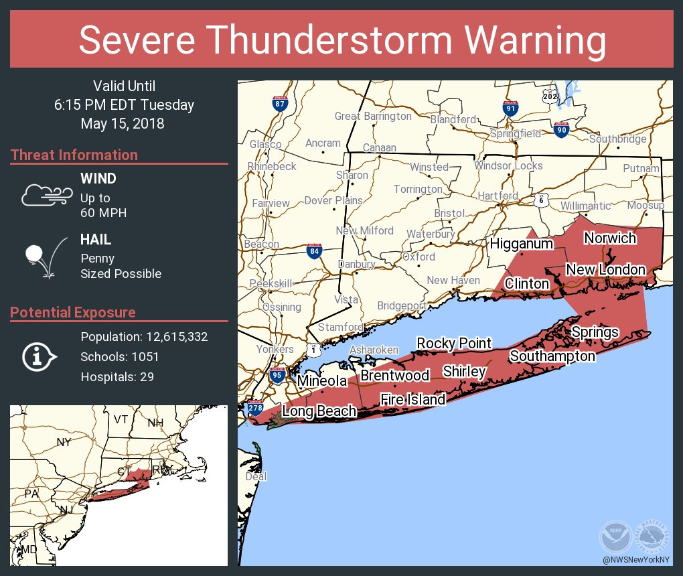
Social Media Post for SVR #0005
Line weakening over marine layer
Still producing damaging wind gusts

Slide 52
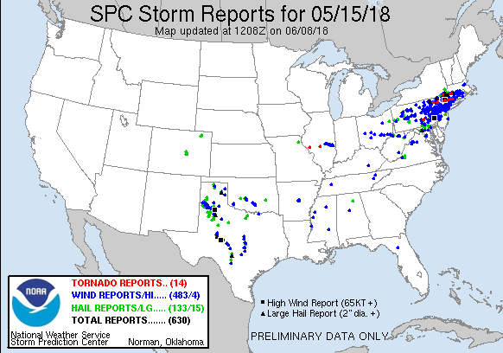

Slide 53
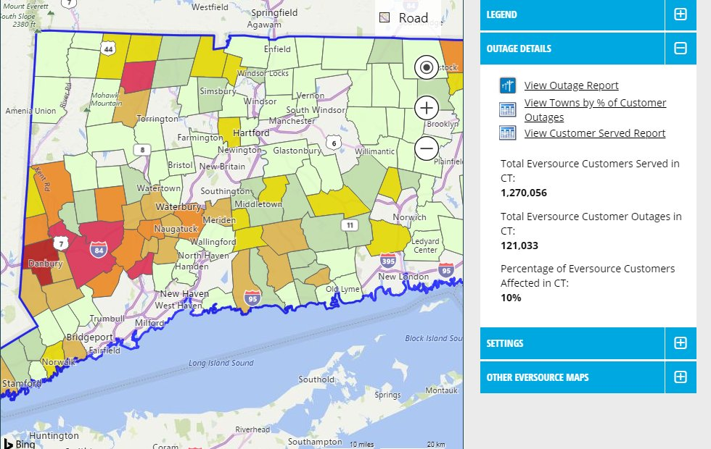
Power Outages
Eversource said this event was more damaging than Hurricane Sandy: 1800 broken utility poles, 288 miles of power lines downed.

Slide 54
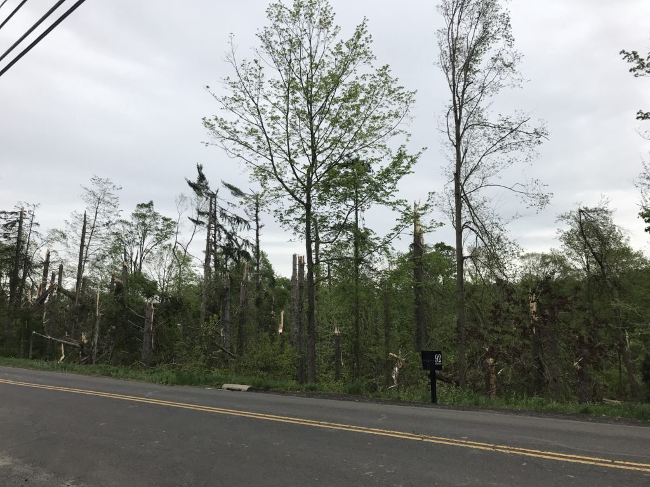
Brookfield

Slide 55
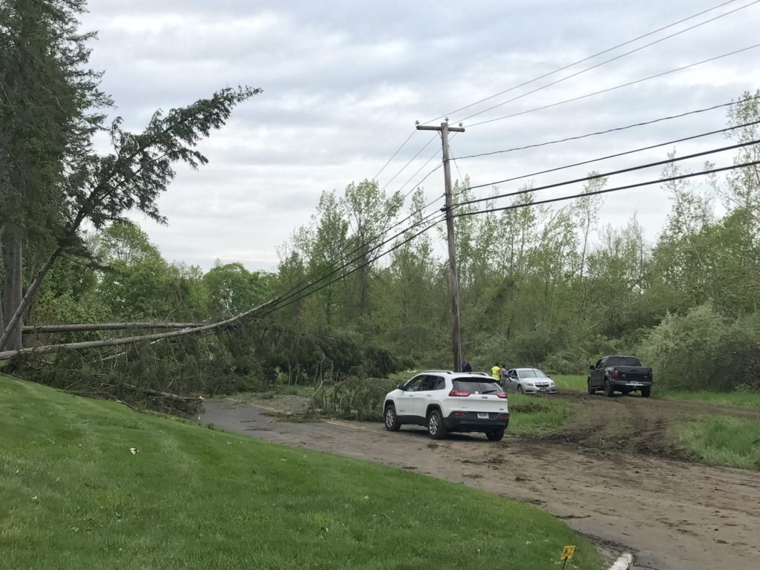
Brookfield

Slide 56
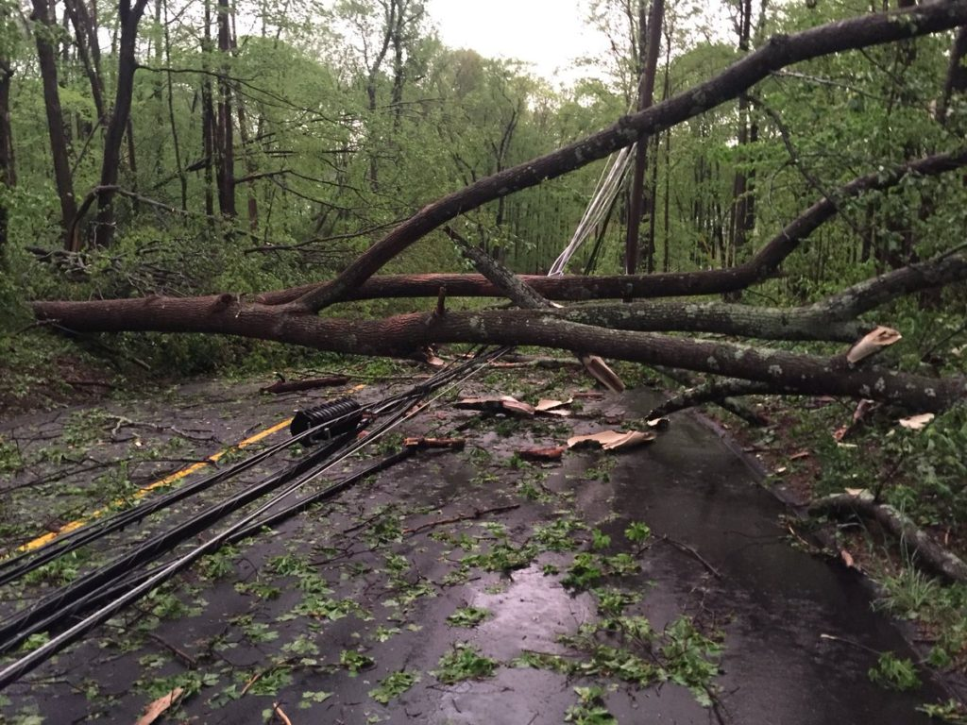
Oxford

Slide 57
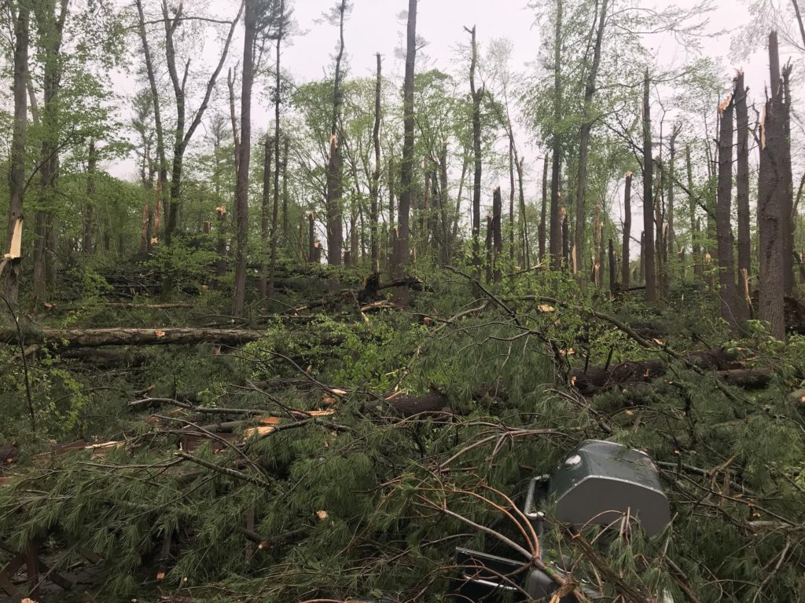
Bethany

Slide 58
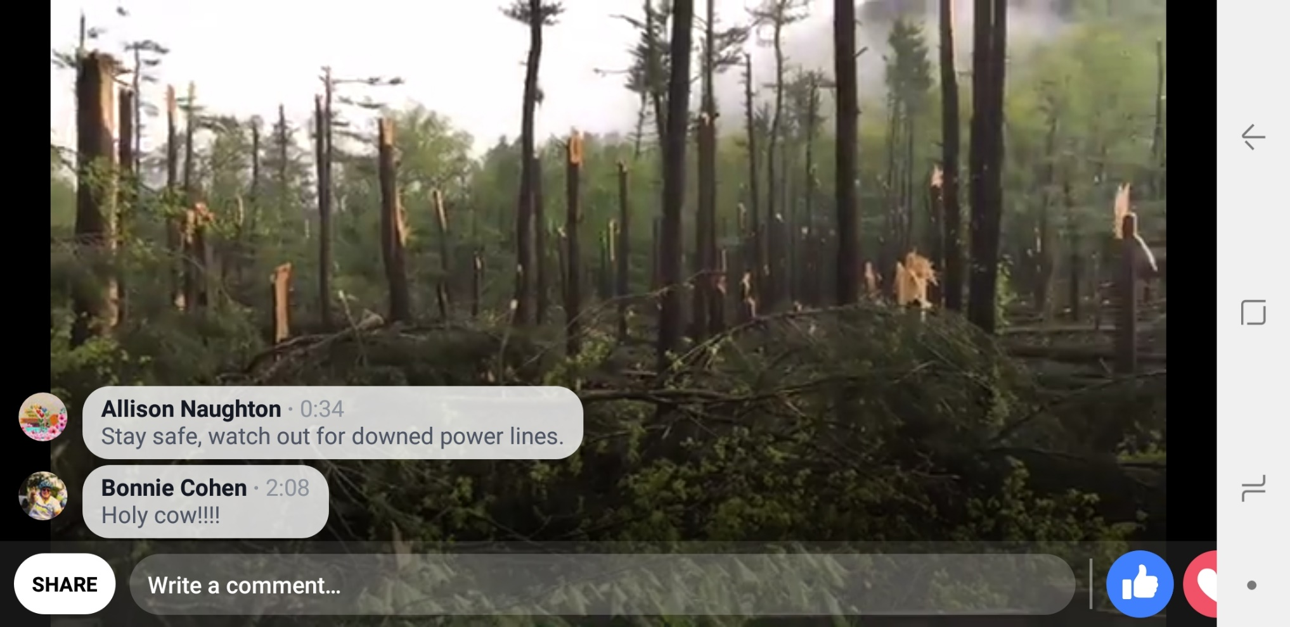
Sleeping Giant State Park

Slide 59
Photo Credits
Hail Damage: Chris Davis
Other Damage photos: Ryan Hanrahan @ NBC Connecticut
Storm photo from tower at Sleeping Giant State Park: Hailey Wilson

Slide 60
Closing Thoughts
Model performance for this event excellent, especially 15/00Z NSSL WRF timing, and HRRR explicit forecast of bowing segments and the CT tornadic storms
Human forecasters added value to the above by adjusting based on actual timing per radar, recognition of boundaries that would alter placement of most intense storms.

Slide 61
Closing Thoughts
Many people heeded WEA’s for Tornado Warnings and took shelter.
Despite excellent forecasts and messaging, including long lead time severe thunderstorm warnings and social media, 6 fatalities still occurred. What if this had happened on a summer weekend?

Slide 62
Closing Thoughts
Should this have been upgraded to a High Risk in the Day 1 Outlook? Perhaps societal impacts ought to be given more consideration for convective watches, a la the NWS Prototype Winter Storm Severity Index.
No Wireless Emergency Alert (WEA) activation for intense severe thunderstorms?
Does WEA alert people after the fact if they are driving into warned areas?
Other ways to help the people of CT become more “Weather Ready?”

