Slide 1
HUMANIZING THE SCIENCE OF WEATHER
chief meteorologist gil simmons
Wtnh-news8
SEPTEMBER 21, 2024

Slide 2
Agenda
Conveying the weather message with more than just numbers
What does the expected weather forecast mean?
How can the forecast information help your daily planning
Questions & answers-Weather discussion

Slide 3
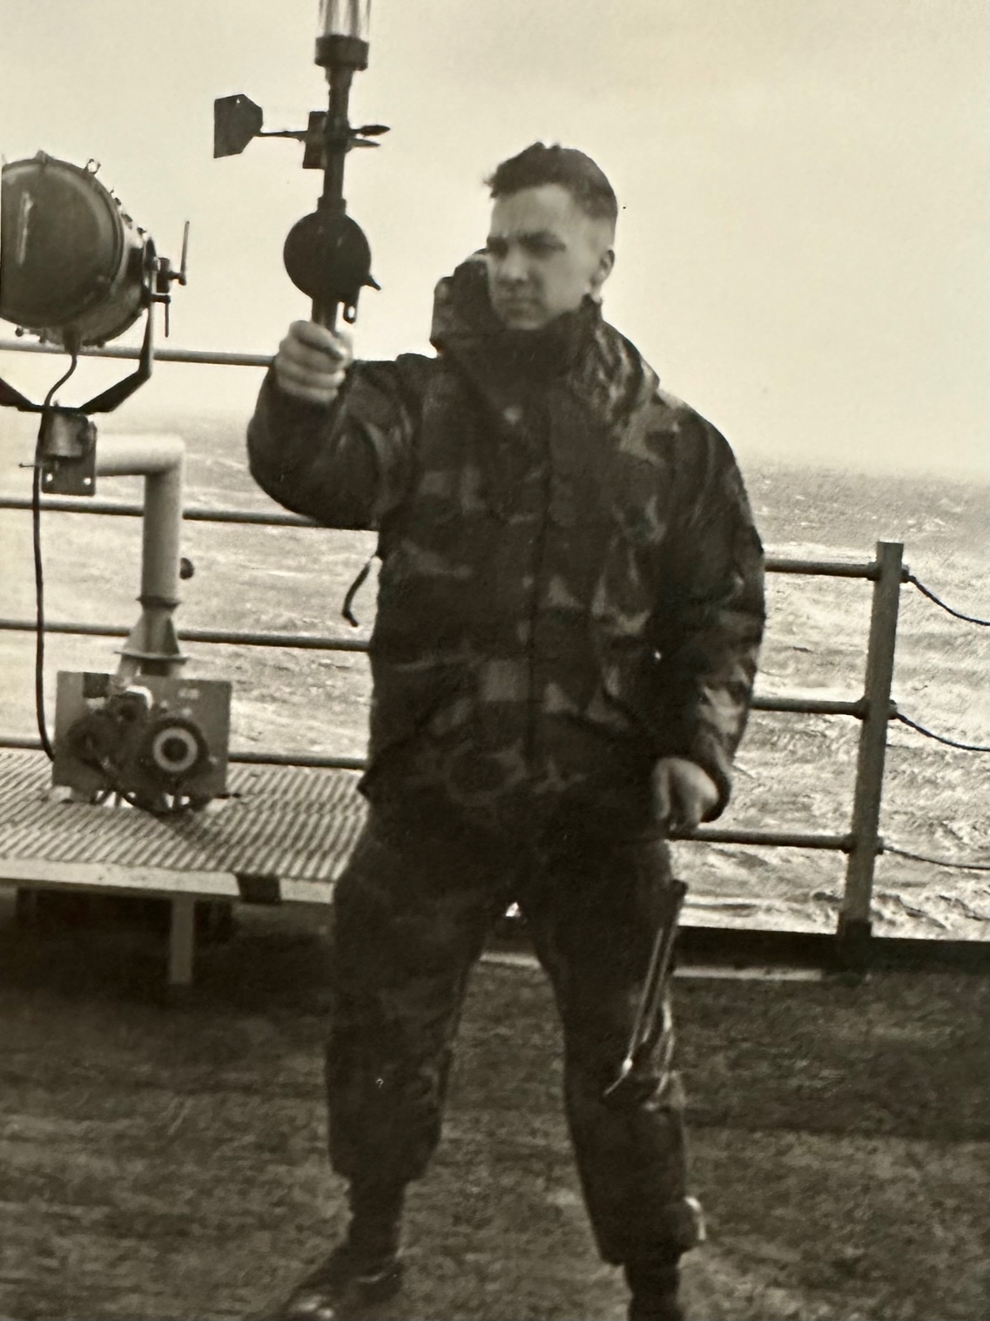
USS NASSAU 1992

Slide 4
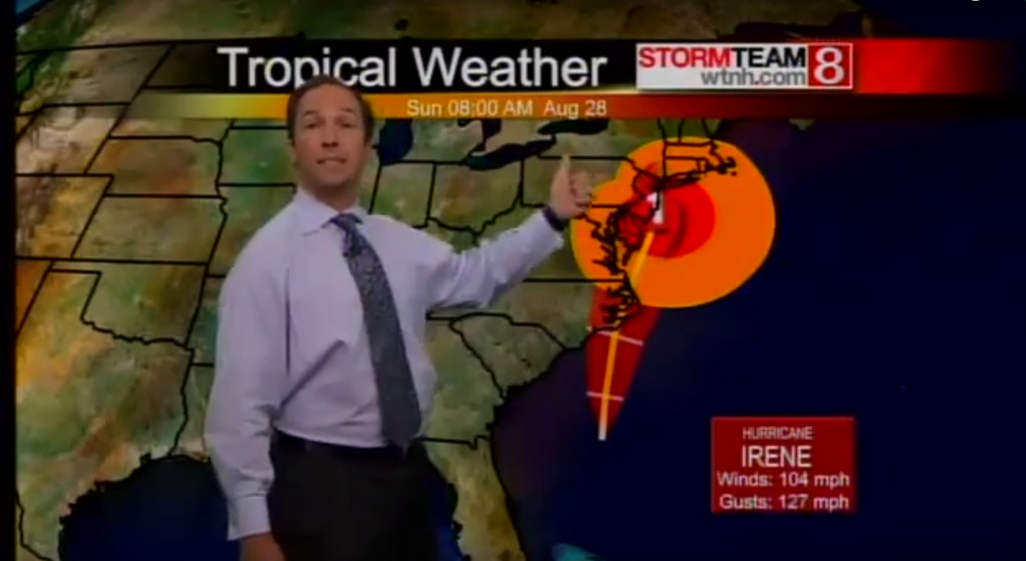
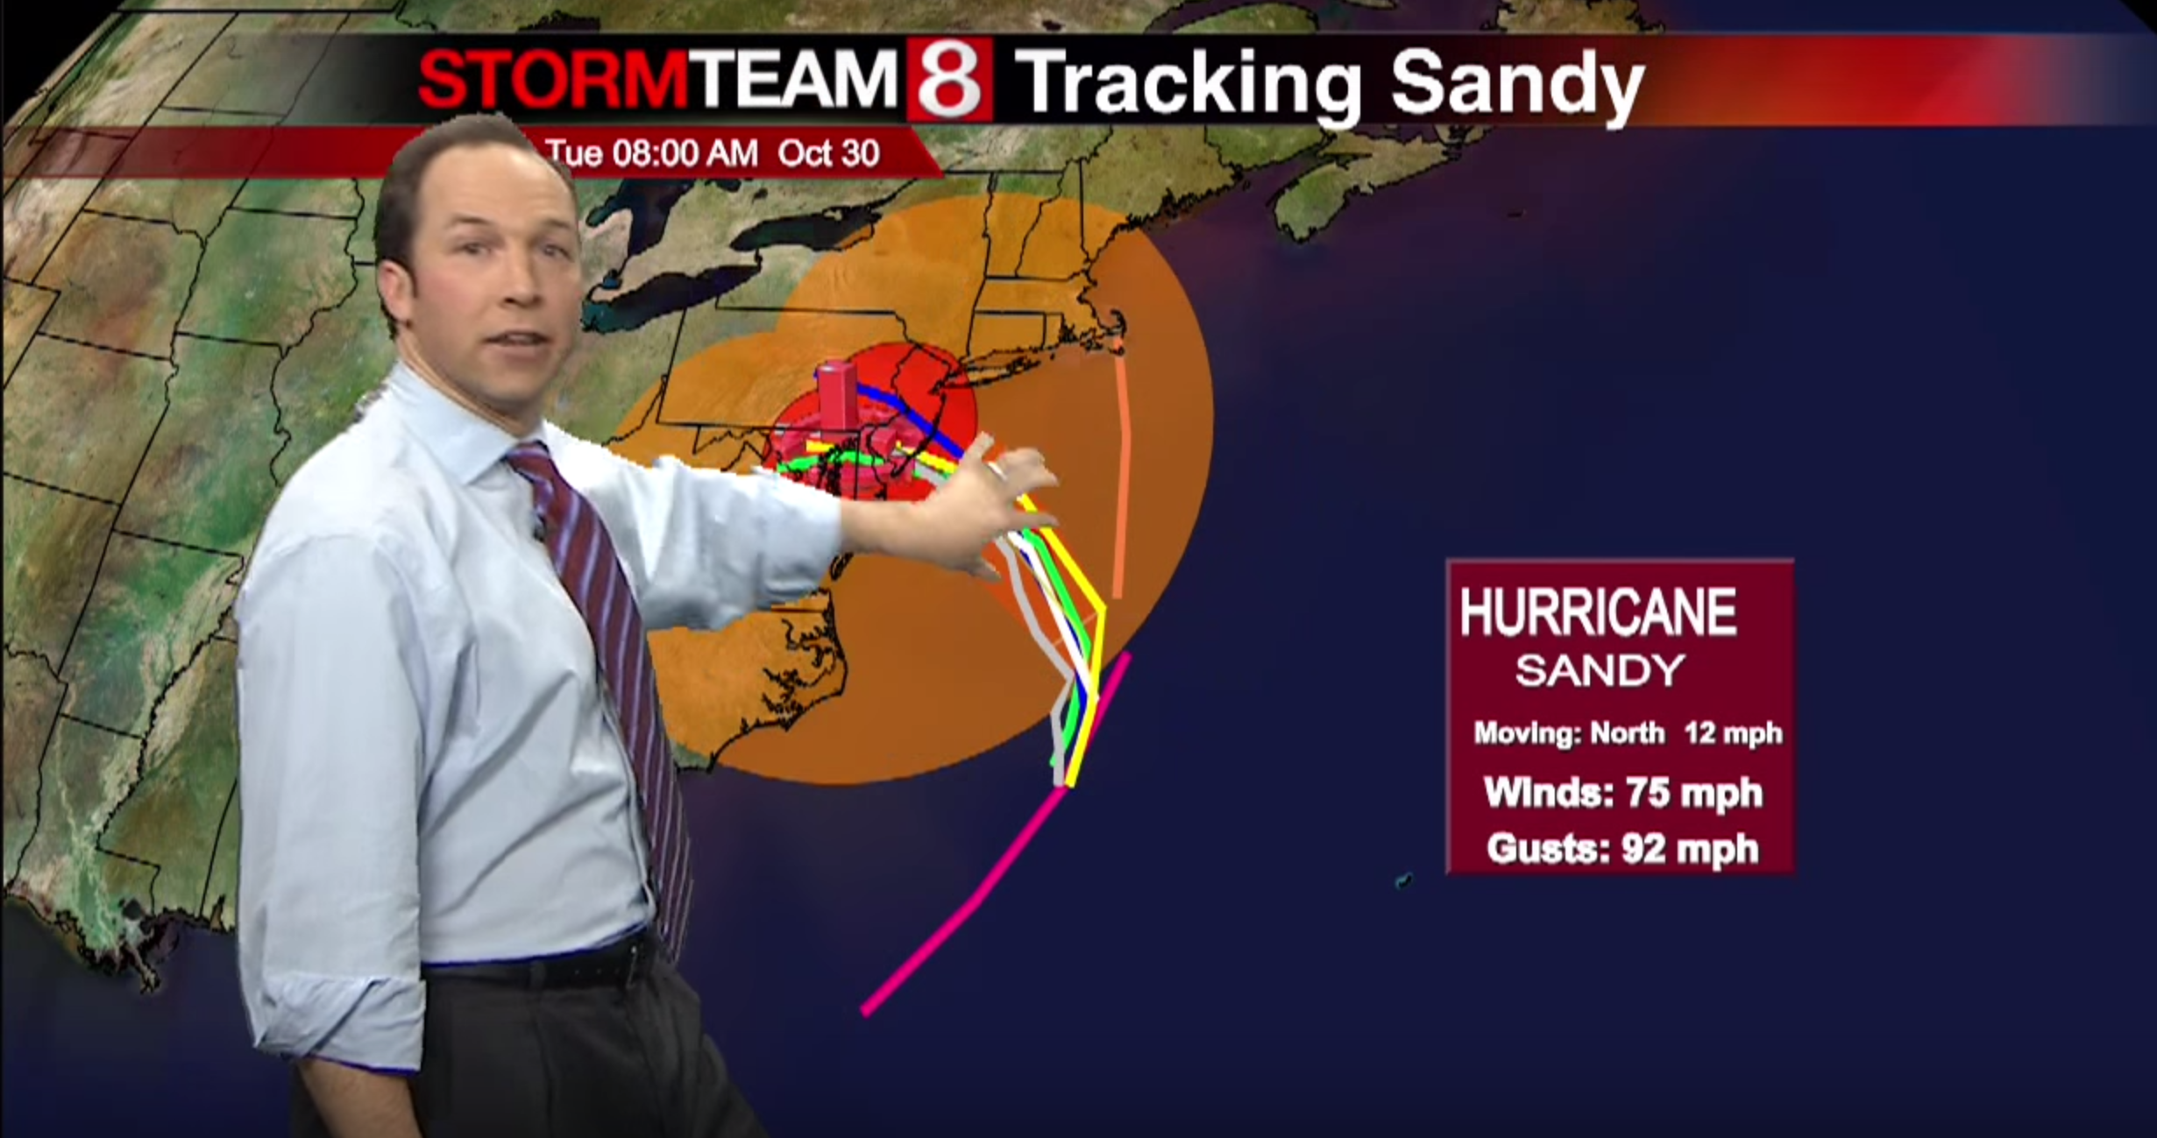
Tracking Irene & Sandy

Slide 5
APPLYING WEATHER FORECASTS TO HUMANS
What good is a forecast if it doesn’t apply to me?
I call it humanizing the weather
Phone & online forecasts just spit out numbers
Example: 40 degrees with or without wind
What about pollen?
Air pollution forecasts becoming more important

Slide 6
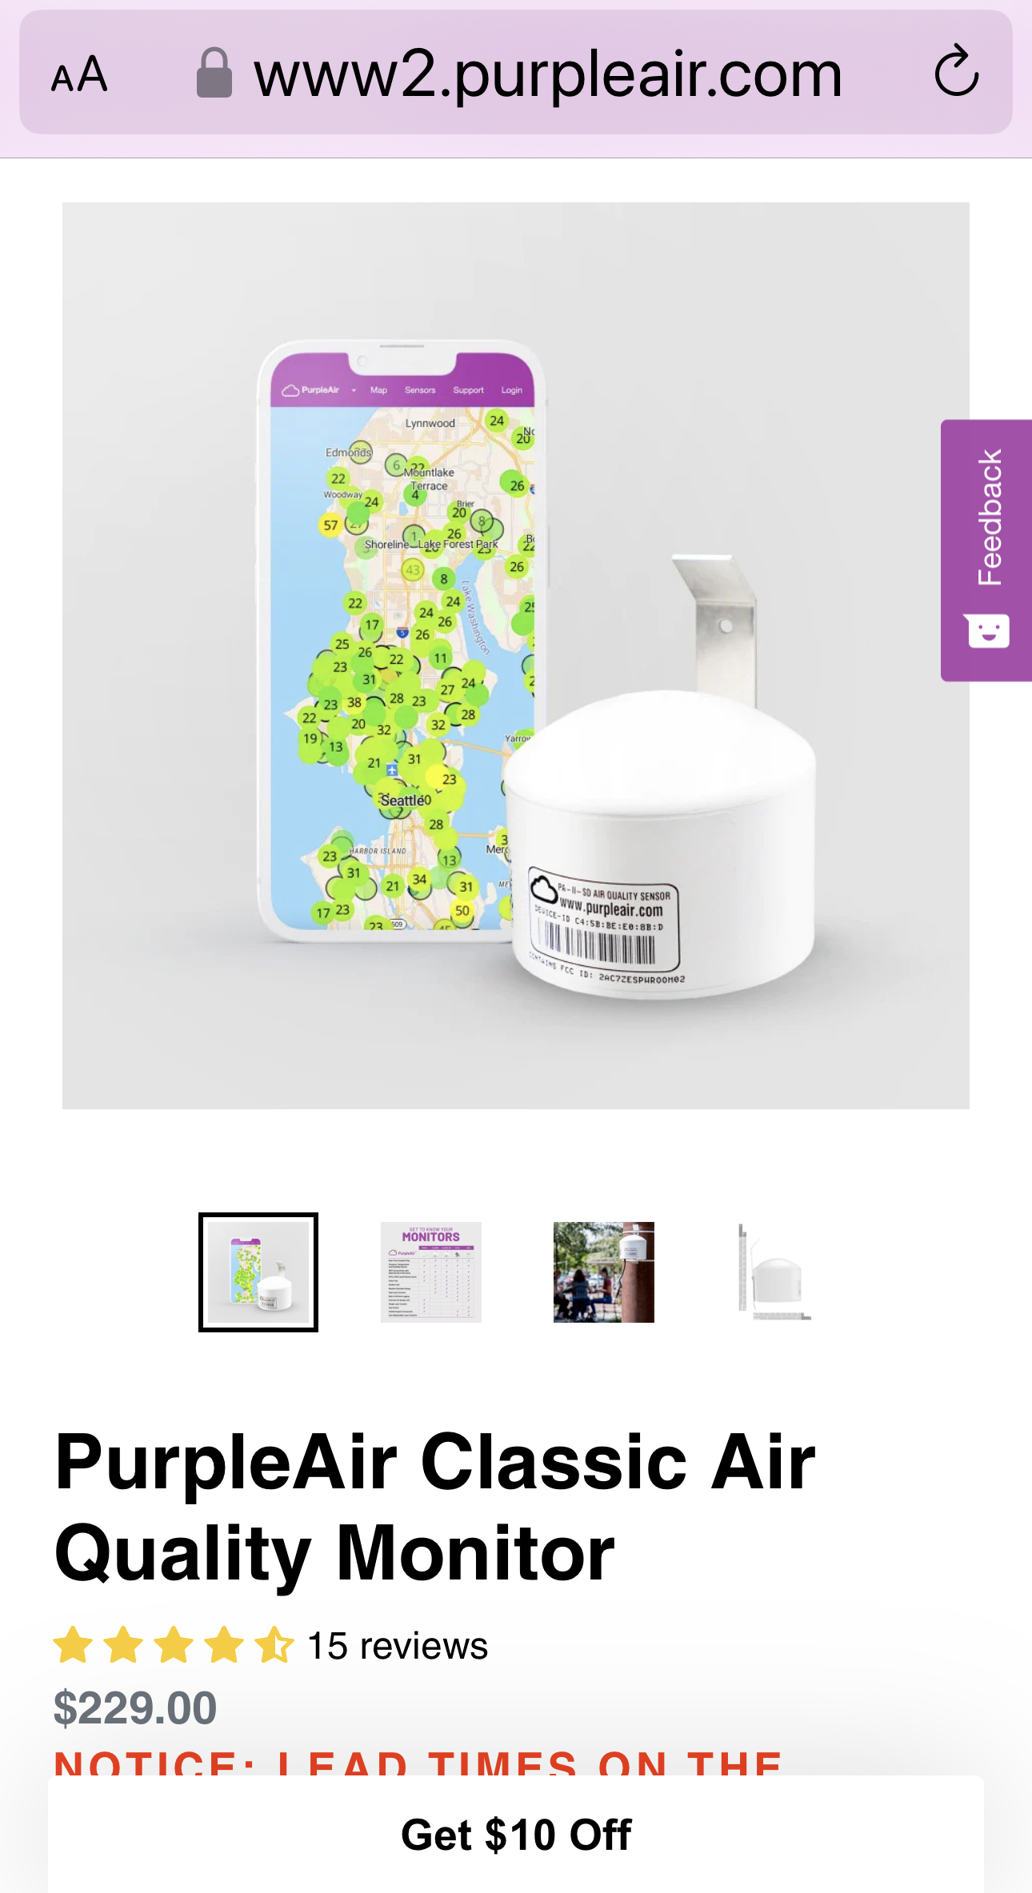
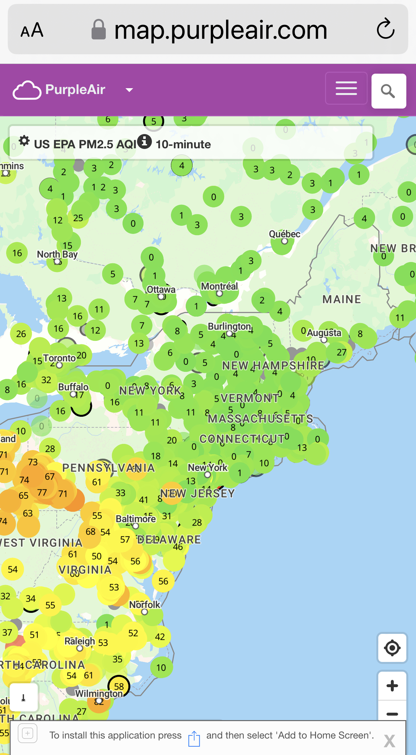
PURPLEAIR SENSOR & DATA DISPLAY

Slide 7
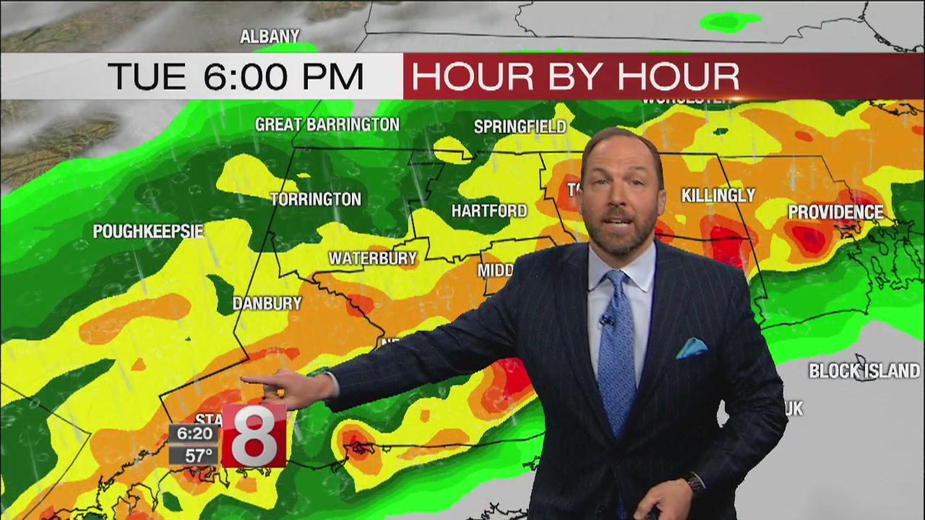
HRRR Weather Model May 15, 2018
*

Slide 8

Fall Forecast Considerations

Slide 9
Fall
Large temperature ranges-what to wear
Leaf raking conditions-wind speeds & wetness of leaves
Allergies & air quality
First frost & plant impacts
When to take window air conditioners out
Outdoor painting & driveway sealcoat applications
Lawn treatment & over-seeding

Slide 10
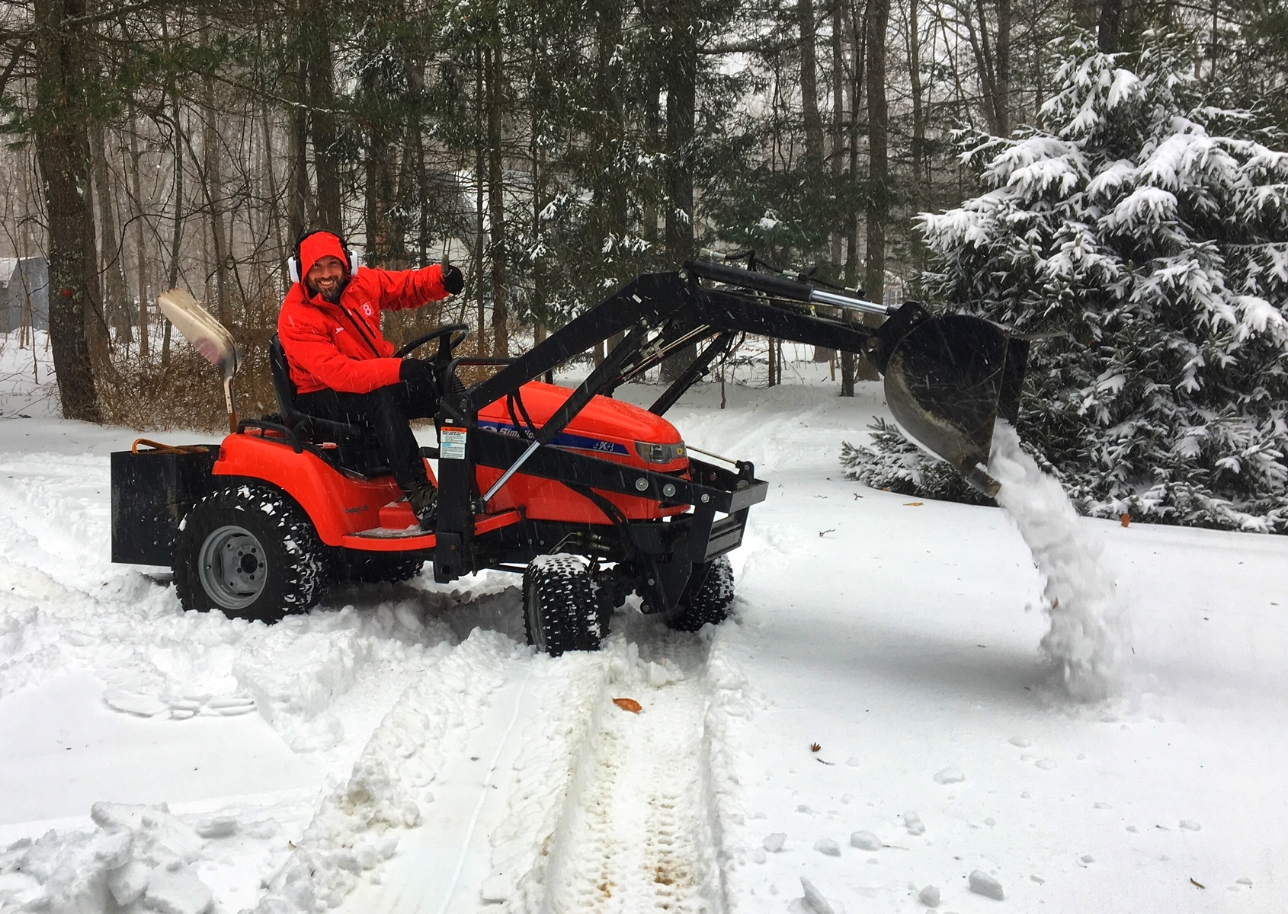
Winter Forecast Considerations

Slide 11
Winter
Which cold weather outfit & how many layers
Snow & driving conditions
Driveway snow removal timing
Will the snow be wet & heavy or dry & fluffy?
Wind & wind chill for outdoor workers
Cold snaps to thaws & frozen pipes/bursts
When to open urban warming centers

Slide 12

Spring Forecast Considerations

Slide 13
Spring
Choosing outfits for large temperature fluctuations
Rain gear for what days of the forecast
Chances of late season snow & freeze conditions for plants
Pollen levels with the first trees to produce
Wind & wind chill at times even with 40s & 50s
Thunderstorm threats to outdoor activities

Slide 14
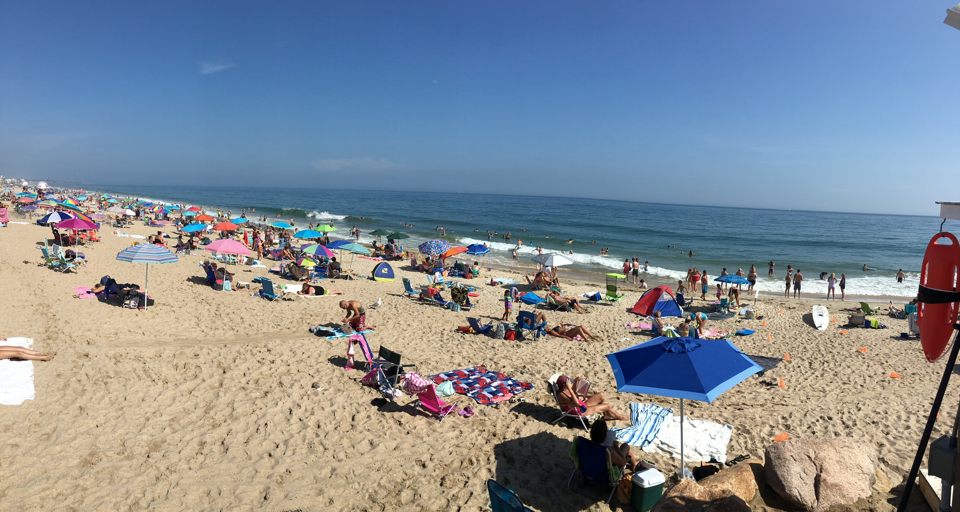
Summer Forecast Considerations

Slide 15
Summer
Heat index & influence to outdoor workers
Community cooling center demands
Pollen levels with grass, weed & mold levels
Thunderstorm risk for community events
Boating & beach specifics/safety

Slide 16
CHALLENGES
More computer model data-not always a good thing
Long Range: CFS & Euro Weeklies
Medium Range: Euro, GFS & Canadian
Short Range: NAM, HRRR & SREF
In the works: AI influenced model data
Limited time for on-air preparation & forecasts

Slide 17
CHALLENGES
Feed the social media machine
Social media supports unchecked forecasts
Sharing of the most dramatic scenarios is common
A problem now & will likely continue

Slide 18
THANK YOU!
QUESTIONS & let’s discuss

