Slide 1
Approaching the 30th Anniversary of the 1995 Great Barrington F4 tornado and July (Super)derecho.
Meteorologist Paul Taschereau, Jr.

Slide 2
What is a Derecho?
An Intense, long-lived line of thunderstorms.
Criteria
Swath of wind damage ≥ 400 miles (as of 01.11.2022).
Previously, ≥ 250 miles.
≥ 60 miles wide.
Wind gusts ≥ 58 mph along much of its path with several 75+ mph gusts.
Specific radar features (distinct bowing structure and rear-inflow jet).

Slide 3
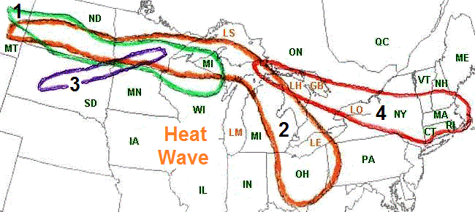
July 11-15, 1995
A series of 4 derechos impacted the northern Plains, upper-Midwest, Great Lakes, and Northeast.
Photo Credit: Storm Prediction Center

Slide 4
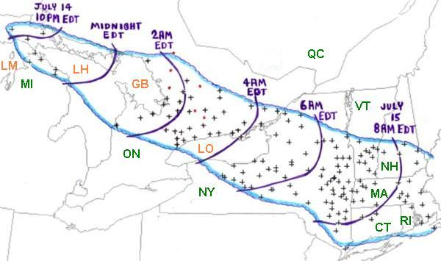
Photo Credit: Storm Prediction Center

Slide 5
Summary
One of the costliest severe thunderstorm events to impact the Northeastern United States during the 20th century.
Estimated 100+ mph wind gusts at several points along the storms path within the Adirondacks.
Several measured gusts ranging between 70 mph – 90 mph.
Syracuse airport: 76 mph at 5:30 AM EDT
Albany airport: 77 mph
Otis, MA: 92 mph
Upton, MA 85 mph
Estimated $500 million in damage (1995 U.S. dollars).
900,000 acres of forest damaged in New York per New York Department of Conservation ($200 million of timber loss – 1995 U.S. dollars).
Several hundred thousand power outages.
Covered 800 miles in 12-hours (avg. forward speed of 67 mph).
Organized ~10:00 PM EDT across Upper-Peninsula of Michigan.
Exited off Cape Cod ~9:30 AM EDT.
Window from 2:00 AM – 8:00 AM produced most extensive damage.
7 deaths and several dozen injured.
Data Obtained from NWS

Slide 6
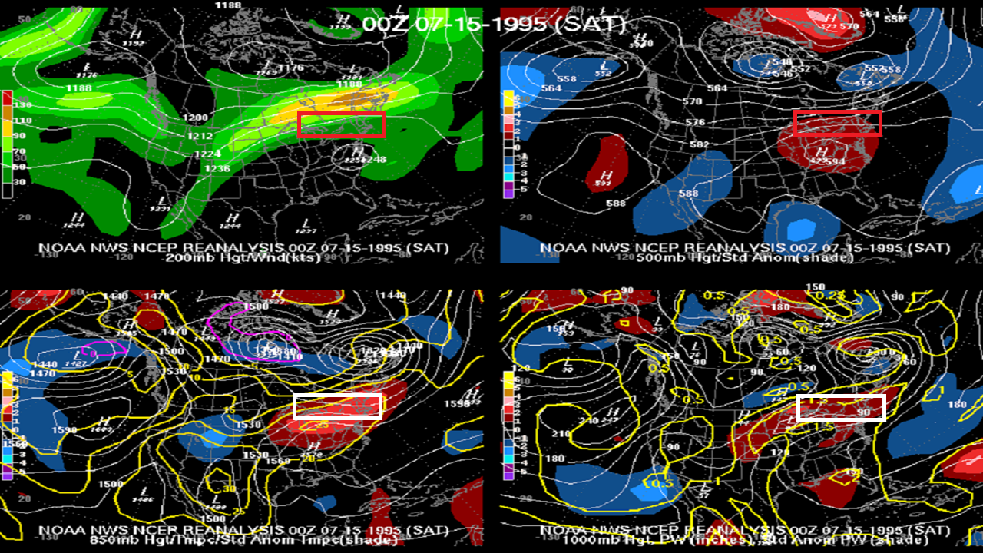
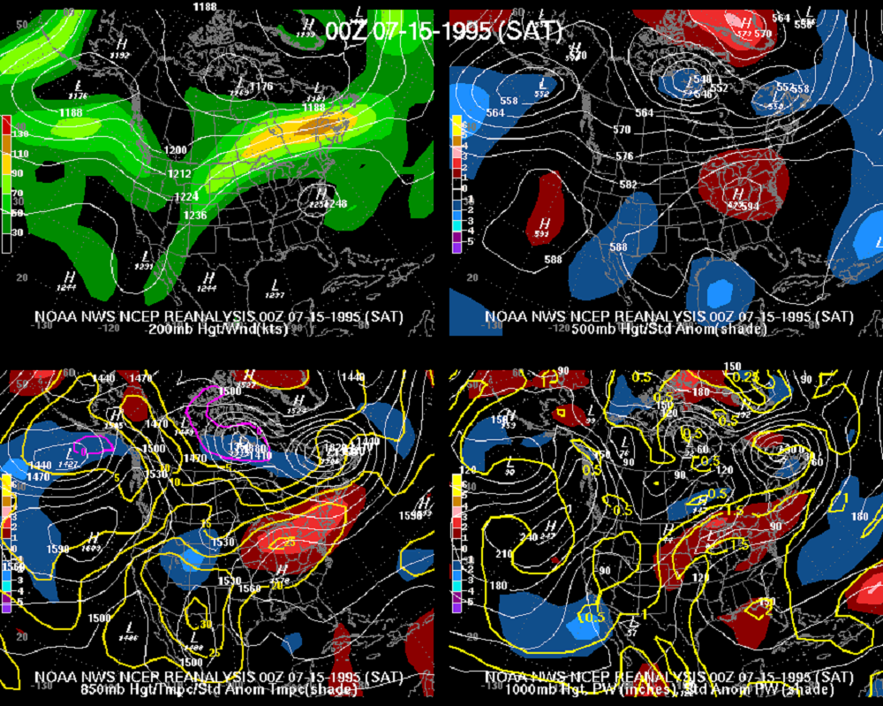

Slide 7
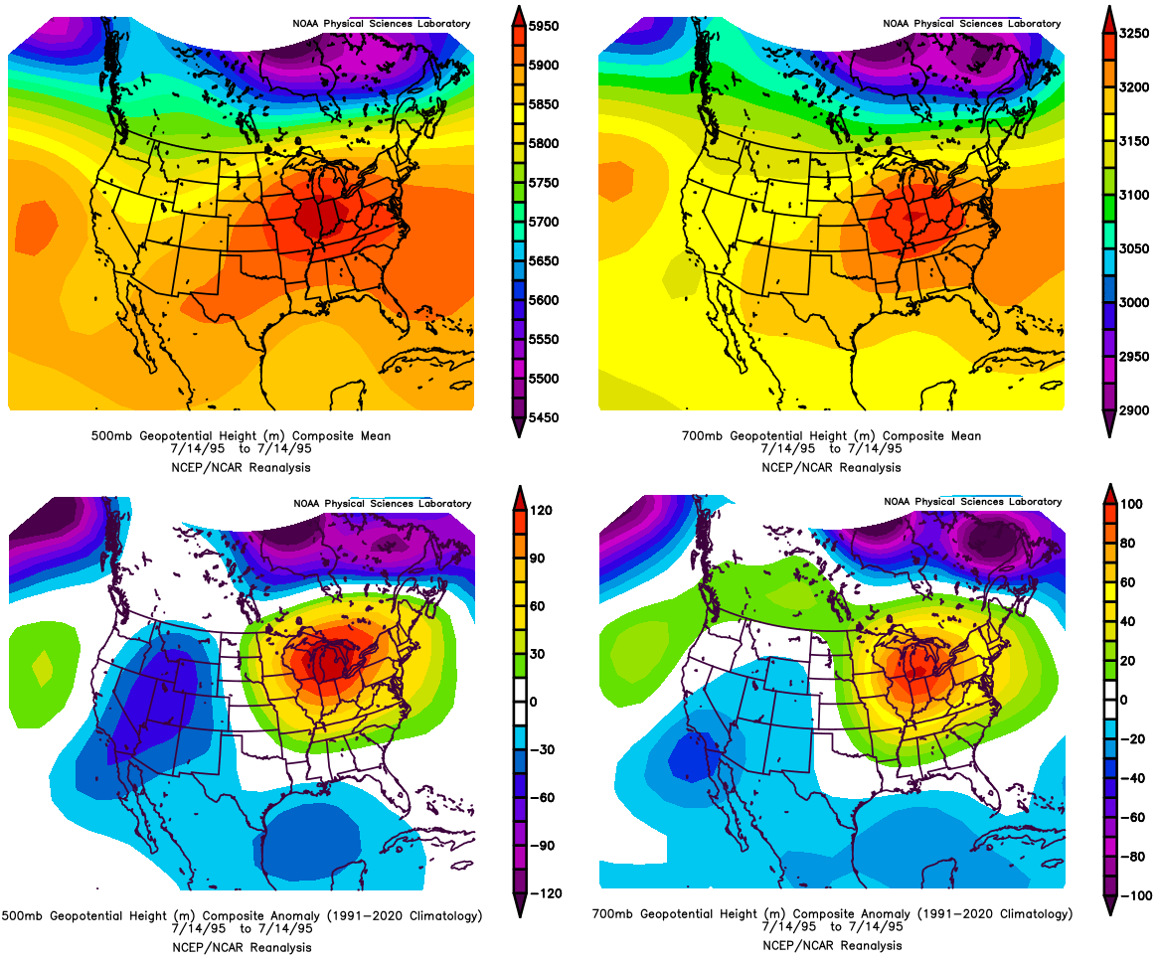
TROUGH
RIDGE

Slide 8
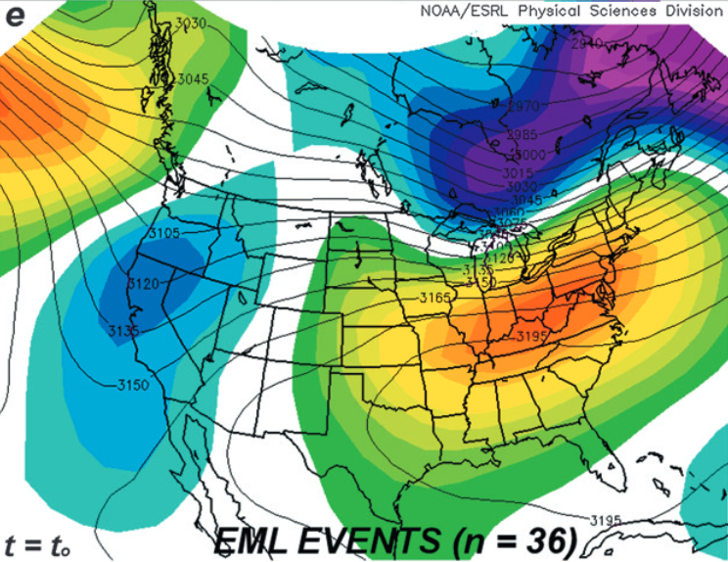
Peter Banacos and Michael Ekster: The Association of the Elevated Mixed-Layer with Significant Severe Weather Events in the Northeastern United States.

Slide 9
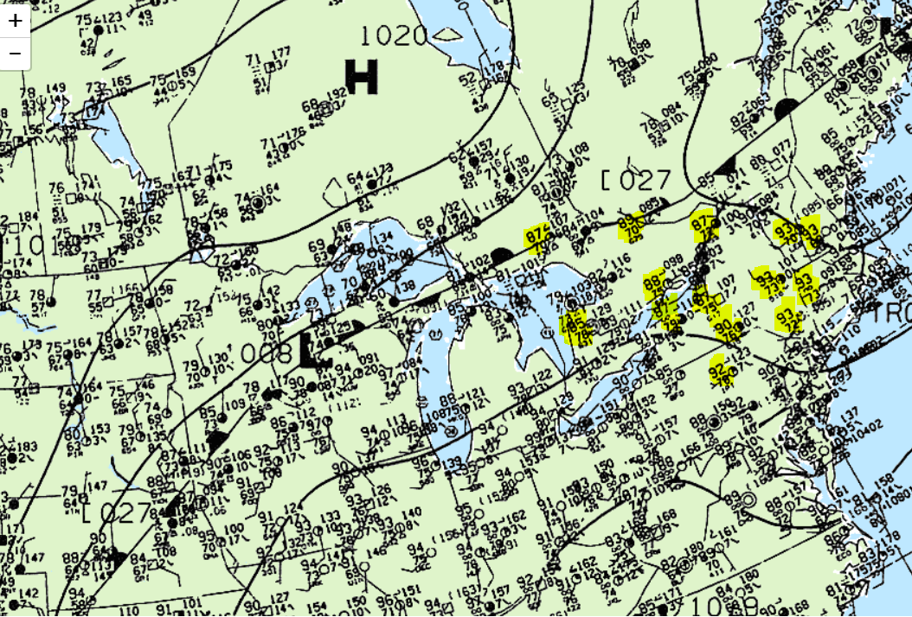
Surface Observations – 0z July 15

Slide 10
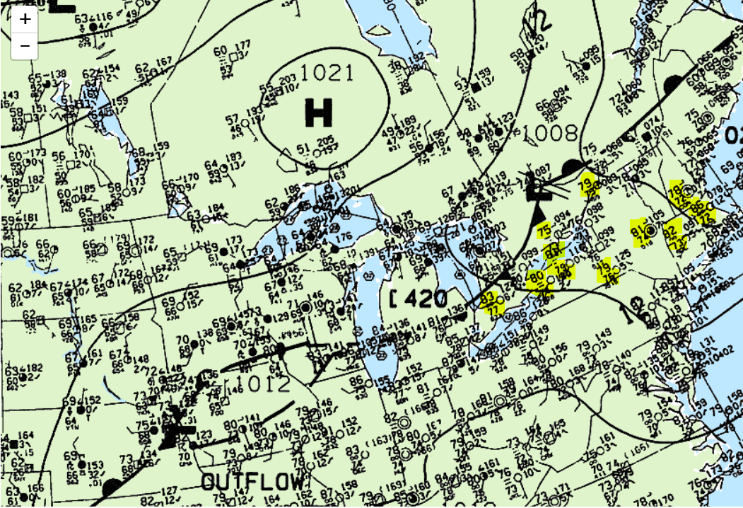
Surface Observations – 6z July 15

Slide 11
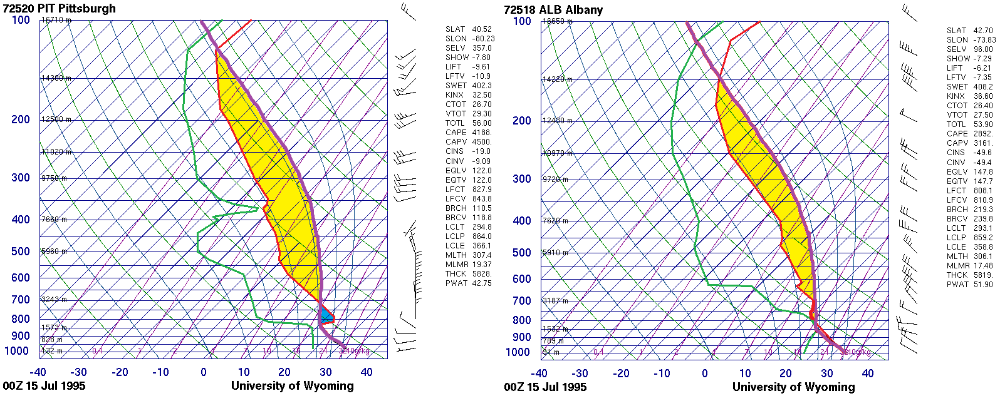
CAPE
CAPE

Slide 12
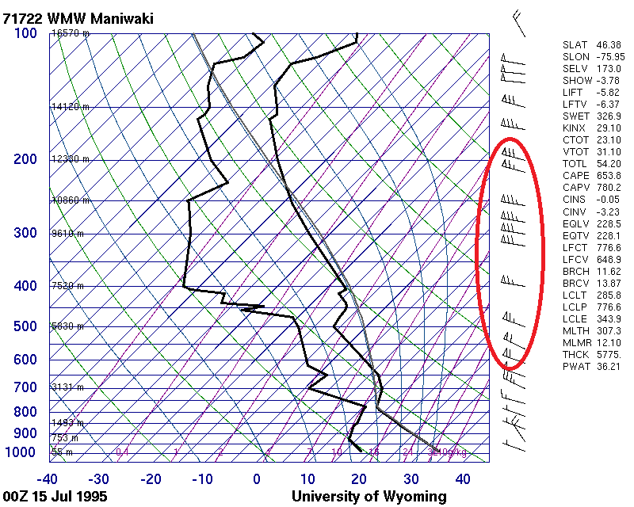

Slide 13
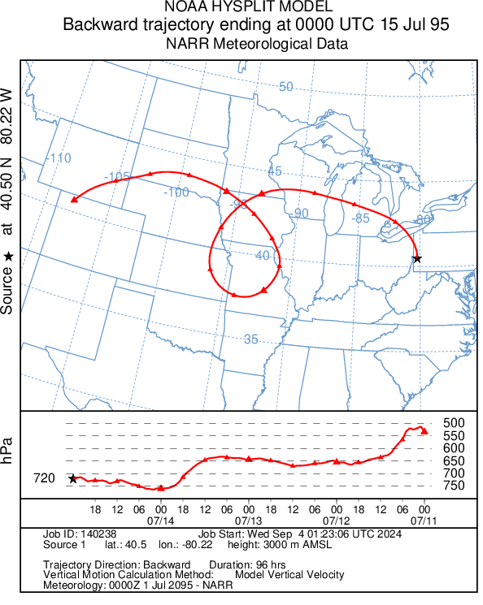

Slide 14
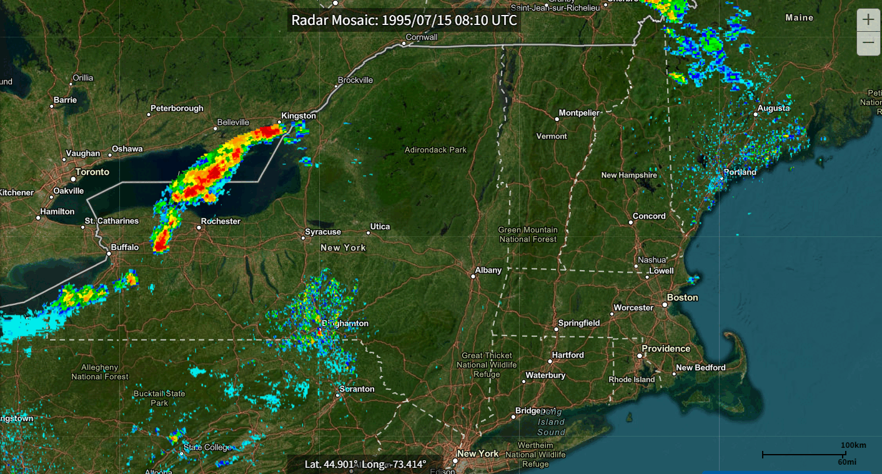

Slide 15
Meteorological Setup Summary
Northeastern U.S. located on the northern periphery of an anomalously strong upper-level ridge.
Favorable location for enhanced jet stream and strong shortwave energy.
Mid-level trough digging into the West aided in the advection of an elevated-mixed layer into the Northeast.
High low-level theta-e air and rich PWATs across the Northeast, combined with the elevated-mixed layer, yielded extreme instability.
Stationary front and shortwave energy across Great Lakes region provided lifting mechanism for thunderstorms to develop and the front progressed east as a cold front continuing to aid in lift.

