Slide 1
Empowering a Weather, Water, and Climate-Ready Nation
NWS
TRANSFORMATION
Tri-State Weather Conference
Jason Tuell, Director, NWS Eastern Region

Slide 2
To best meet
our mission,
alongside our partners,
we must be…
NWS Mission
To provide weather, water and climate data, forecasts, warnings, and impact-based decision support services for the protection of life and property and enhancement of the national economy.
located where those
decision-makers need us.
available when they need us.
deliver products and services in
the manner in which they are needed.
Those needs are constantly changing,
and we must too…
Notes:
NWS Mission:
The core mission of the National Weather Service is to provide accurate and timely weather, water, and climate data, forecasts, warnings, and impact-based decision support services.
These services are crucial for protecting of life and property and enhancing the national economy
To Best Meet Our Mission, We Must:
Be Present Where Decision-Makers Need Us:
Location is key. Our experts and resources need to be strategically placed to support decision-makers on the ground.
Be Available When They Need Us:
Timeliness is vital. Our services must be accessible and responsive around the clock, especially during critical moments.
Deliver Products and Services in the Manner Needed:
Flexibility in delivery is essential. We must be able to adapt to the unique needs of those we serve.

Slide 3
Weather, water, and climate events are becoming more severe and thus more impactful.
Population and infrastructure has dramatically increased, putting more people and property in weather's way.
Communication frequency and channels have accelerated and grown as landlines evolved to mobile devices.
Adapting
To Change
"Clouds” became a form of data storage, allowing for increased capacity, improved accessibility, and greater workforce mobility.
Virtual and untethered working environments have expanded and set the stage for stronger collaborations outside traditional office settings.
Notes:
Increased Severity and Impact:
Weather, water, and climate events are becoming more severe, which means their impact on communities, infrastructure, and the environment is growing.
These intensified events require more robust and timely responses to mitigate damage and protect lives and property.
Population and Infrastructure Growth:
The rapid increase in population and infrastructure means that more people and property are exposed to weather-related risks.
Our strategies and services must scale to address these expanded vulnerabilities and ensure effective protection.
Evolving Communication Channels:
The way we communicate has evolved significantly from traditional landlines to mobile devices.
The frequency and variety of communication channels now require us to adapt our methods for delivering critical information quickly and effectively.
Advancements in Data Storage:
The shift to "cloud" storage has revolutionized how we manage and access data.
This technological advancement allows us to handle larger volumes of data with improved accessibility, enhancing our ability to analyze and respond to weather-related information and allowing us to access that data from nearly anywhere.
Expansion of Virtual and Collaborative Work:
The rise of virtual and untethered working environments has changed how we collaborate.
These developments present opportunities for stronger partnerships and more flexible, innovative approaches to address weather and climate challenges beyond traditional office settings.

Slide 4
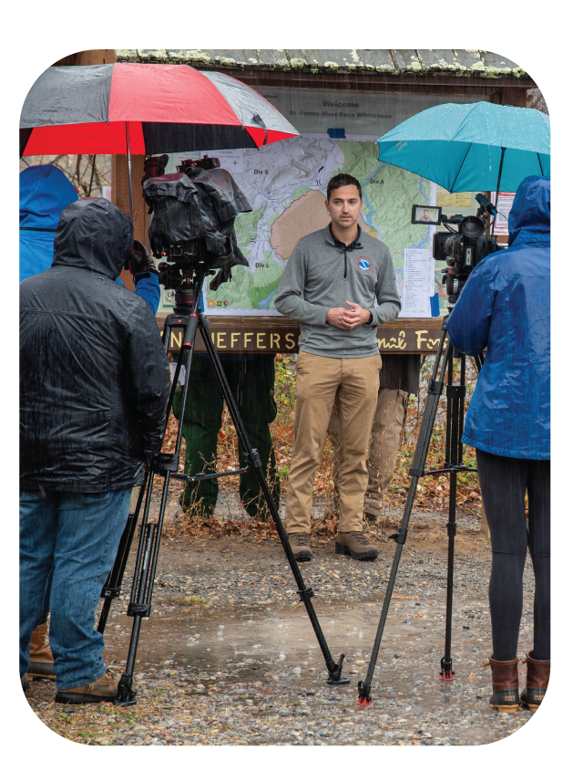
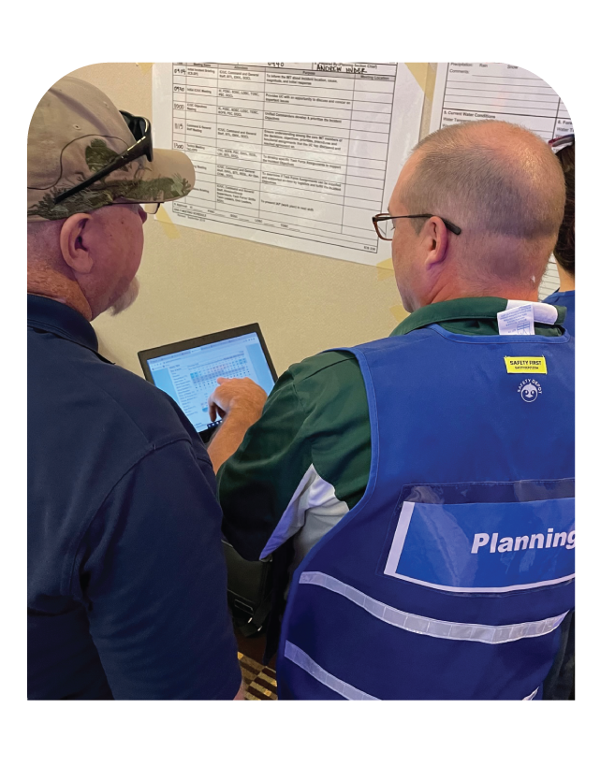
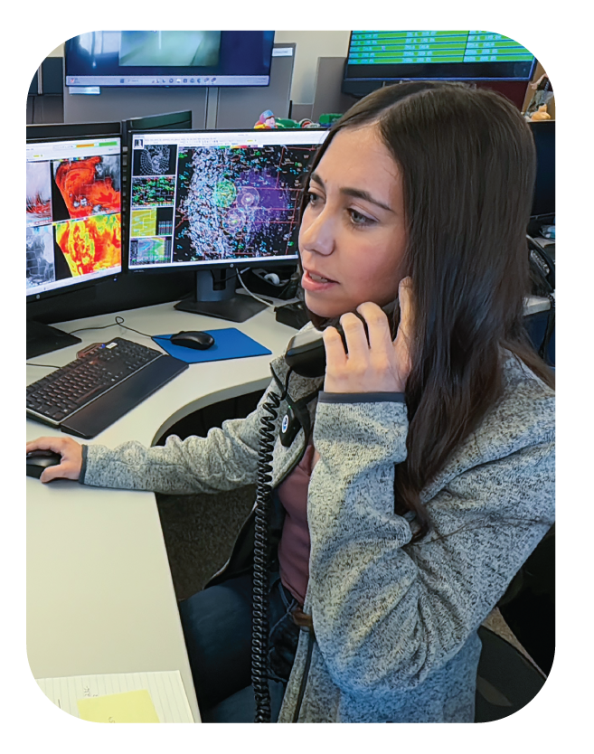
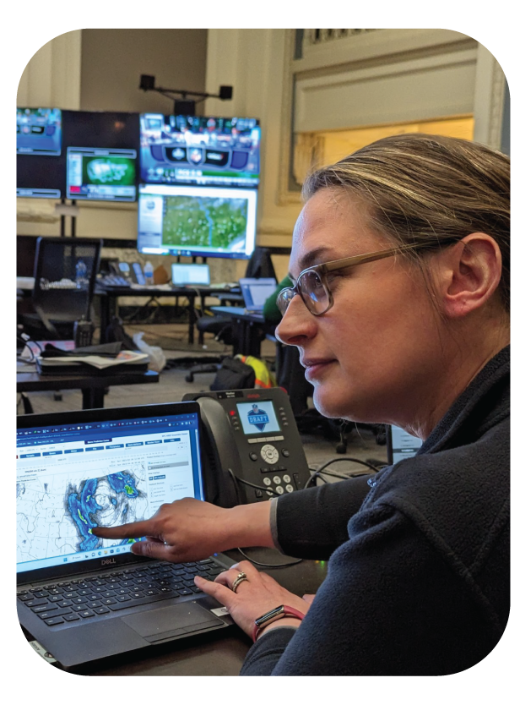
The NWS of Tomorrow
We’re transforming how we operate so we can serve you…
Where you need us, when you need us, how you need us
More efficiently & effectively
From nearly anywhere
With greater adaptability
Impact-based decision support services
Community-Centric Warnings
A weather.gov built for you
Improve processes
Take care of
our people
Untethered Technology
Cloud-Based Data & Services
Train our leaders
Streamline decision-making
NIMBLE
Mobile
FLEXIBLE
EYE-TO-EYE
Notes:
We’re transforming our operations so we can:
1. Work from Nearly Anywhere (Mobile)
Our technology will become less tethered to desks and desktops
Localized data storage and services will move to the cloud
By moving from traditional, localized systems to flexible, cloud-based solutions, our team to work seamlessly from any location, enhancing mobility and responsiveness.
Example Transformation Initiatives: AWIPS in the Cloud, NAWIPS/AWIPS
2. Enhance Efficiency and Effectiveness (Nimble)
We’re focusing on refining our processes to streamline operations and ensure they’re as efficient as possible. (Examples: 10 Things, Days 4-7, Tsunami)
Prioritizing the well-being and development of our team members to maintain a nimble, adaptable workforce. (Examples: DEIA, Hiring, Shift Work)
3. Update and Adapt Easily (Flexible)
Investing in leadership training to equip our team with the skills needed to navigate evolving challenges. (Example: Outward Mindset Training)
Simplifying decision-making processes to enhance agility and ensure timely responses (Examples: Governance, HQ Restructuring, IT A&G)
By becoming more mobile, nimble, and flexible, we can…
4. Be Where You Need Us, When You Need Us, How You Need Us (eye-to-eye)
Examples:
Impact-Based Decision Support Services and Community-Centric Warnings:
Providing tailored, impact-based decision support services that address specific community needs.
Offering community-centric warnings that are relevant and actionable.
A Weather.gov Built for you:
Redesigning weather.gov to improve user experience, making it more intuitive and accessible for everyone

Slide 5
Creating the NWS of Tomorrow
People
Infrastructure
Future
Putting people at the center of our transformation and our work.
Becoming a more nimble, mobile, and flexible agency.
Building an agency that can continuously transform to ensure its longevity.
Notes:
While we’re transforming dozens of aspects of our agency at once, at the center of NWS transformation is our work to create a new operating model.
We’re looking at three key themes as we update our operating model:
People: To be where we’re needed when we’re needed by our people, our partners, and the public, we must build and support a resilient workforce that reflects the communities we serve
Infrastructure: To allow for more flexibility and mobility in where and how we work, we’re taking another look at the technology, tools, and organizing principles behind our work
Future: To ensure we never end up with another 30-year-old operating model, we’re creating an agency that can continuously adapt to our future needs

Slide 6
People
Infrastructure
Future
DEIA: Recruitment & Retention
Hiring Tiger Team
Shift Flexibility
Service Equity
ESA Career Progression
IT Architecture & Governance
AWIPS in the Cloud
Weather.gov 2.0
Radar Next
GIS in the NWS
NWS Connect
Slack/NWS Chat
Tsunami Unification
Governance
Outward Mindset Leadership Training
Probabilistic IDSS
Community Centric Warnings
Notes:
Nearly all the other transformation initiatives underway at NWS can be grouped into one of the three key themes that we’re using to create our next operating model

Slide 7
NWS Shift Flexibility
Our People are a top priority:
Improve flexibility in offices to increase the health and well-being of NWS shift-working employees.
Benefits:
Better Health and wellness
Improve retention of talented employees
Better work/life balance

Slide 8
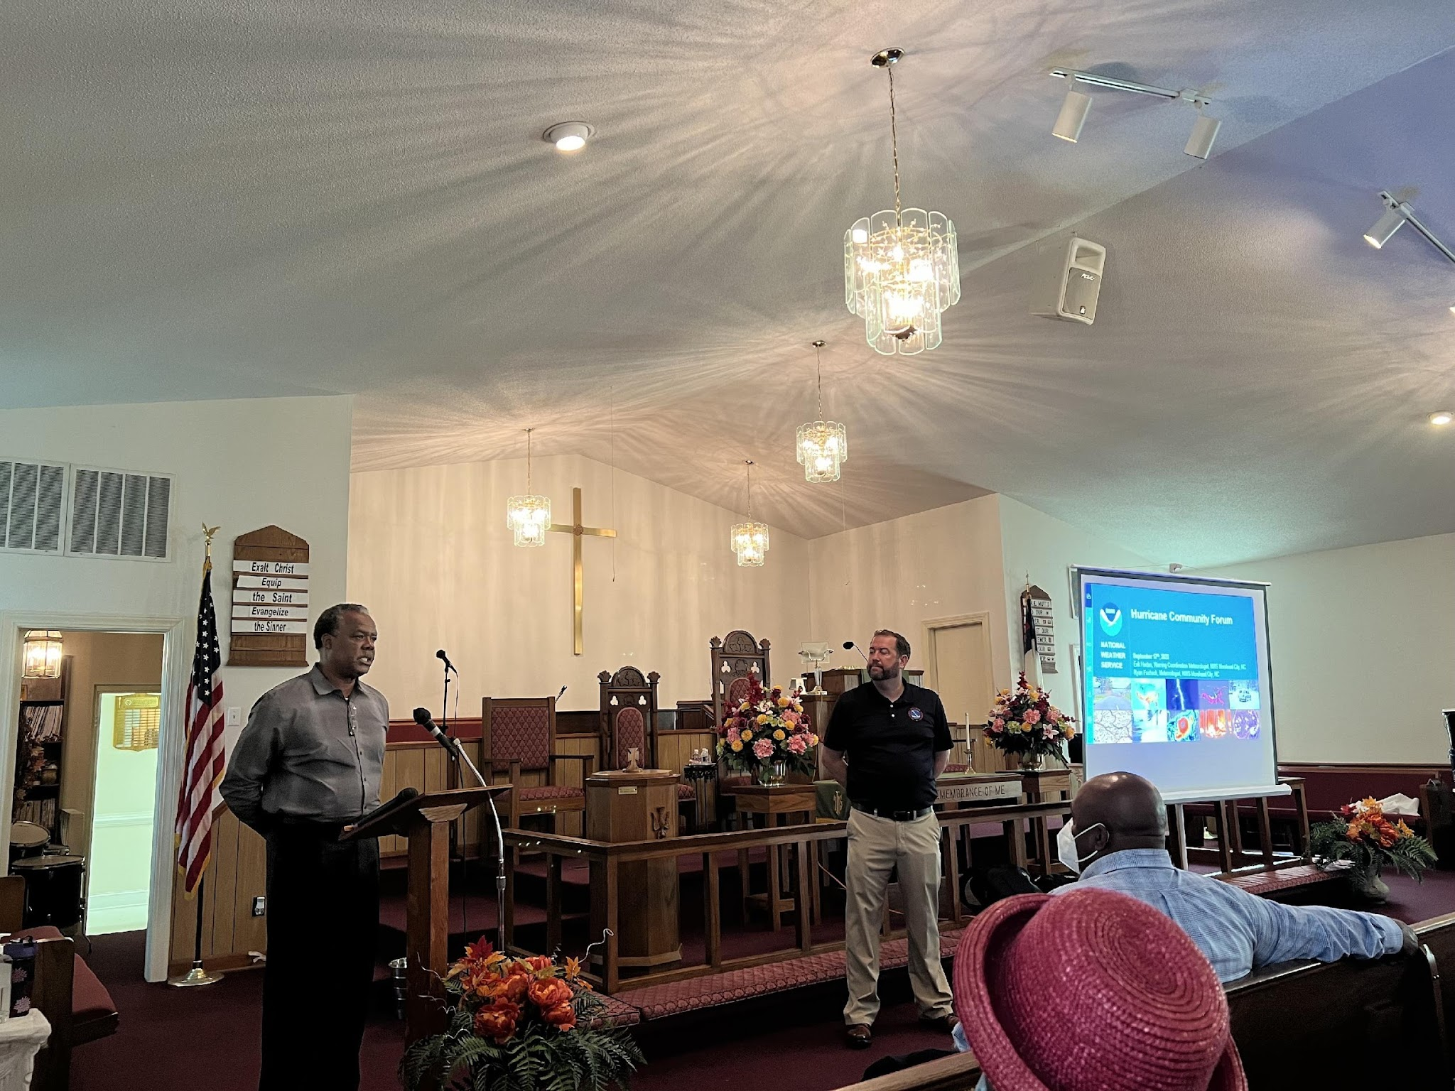
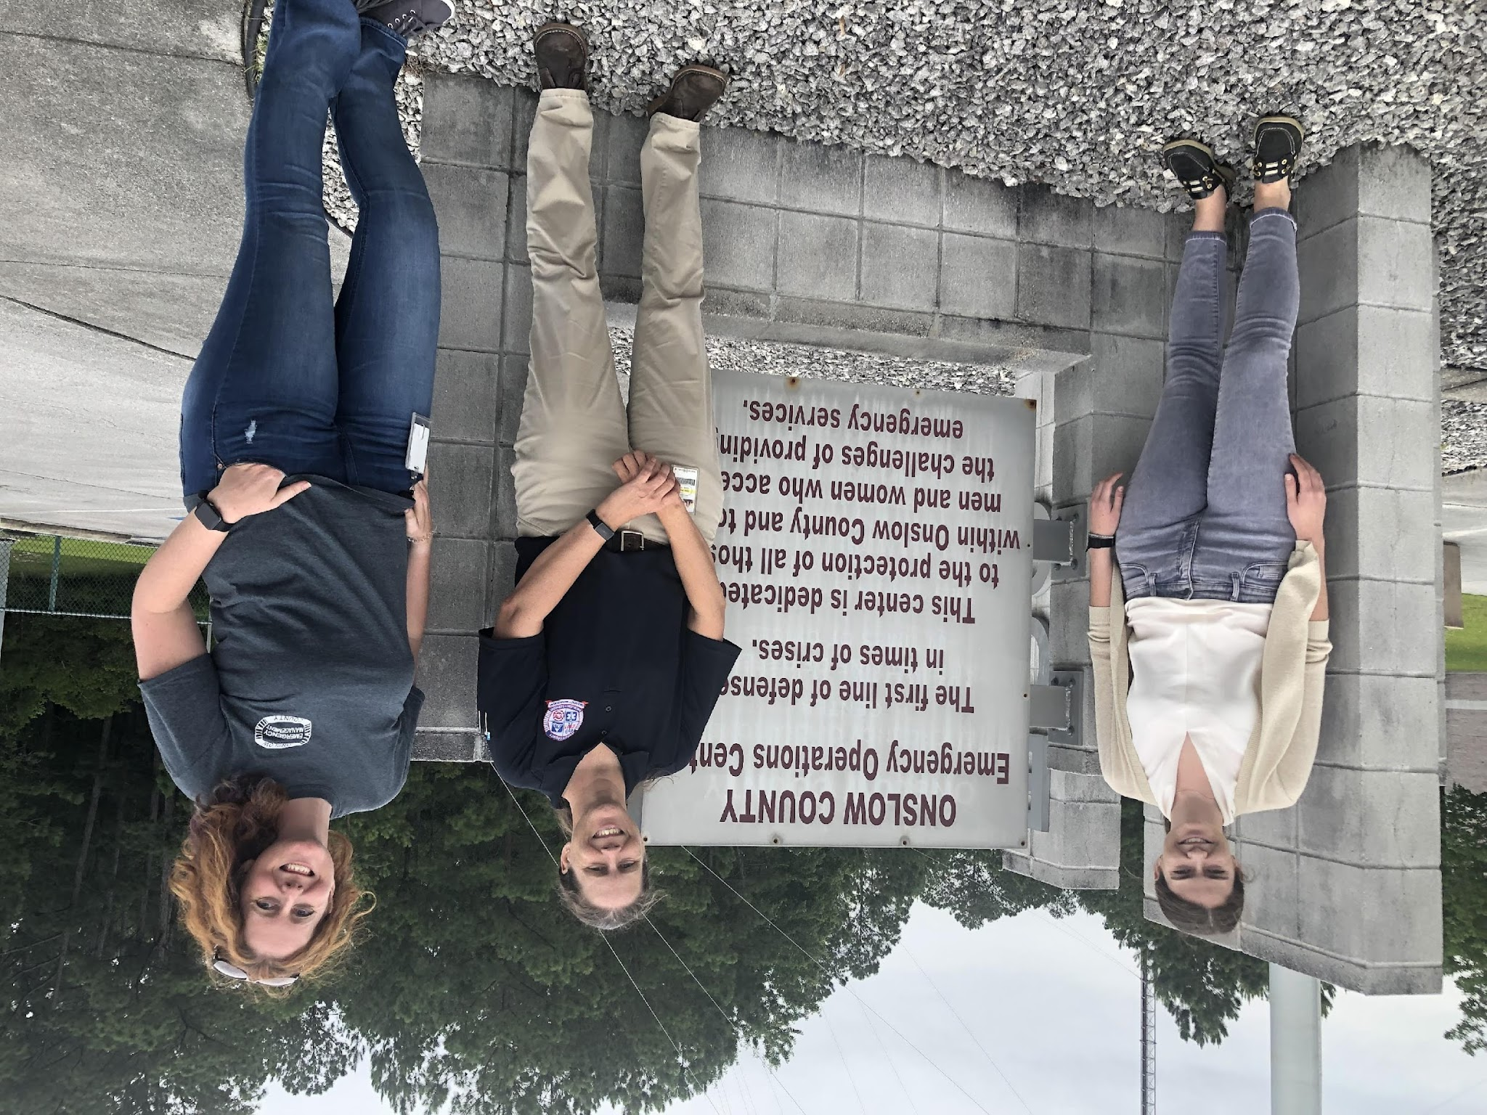
NWS Service Equity
Delivering equitable services across the country to protect our most vulnerable populations
Initiatives
GIS tracking tool mapping engagement against the CDC Social Vulnerability Index
Language translation – getting our warnings and services to people in language they understand
DEIA hiring – making NWS look like the communities we support

Slide 9
Becoming a more Nimble, Mobile, and Flexible Agency
Objectives:
Reorient our operating model for better community and decision-maker engagement.
Implement mobile technology.
Upgrade online support services.
Streamline administrative processes.
Infrastructure
Notes:
Our workforce needs to reach decision-makers quickly and provide information effectively so those decision-makers can put plans into action. To maximize the speed and efficacy of our interactions with decision-makers, we need to become more nimble, mobile, and flexible.
If we want to serve our partners and the public to the best of our ability, our technology and infrastructure need to advance just as quickly to ensure our agency provides consistent, reliable, and accurate weather, water, and climate information when and how decision-makers need it.
Highlight 1-2 examples of progress or recent success in the infrastructure category

Slide 10
IT Architecture

Slide 11
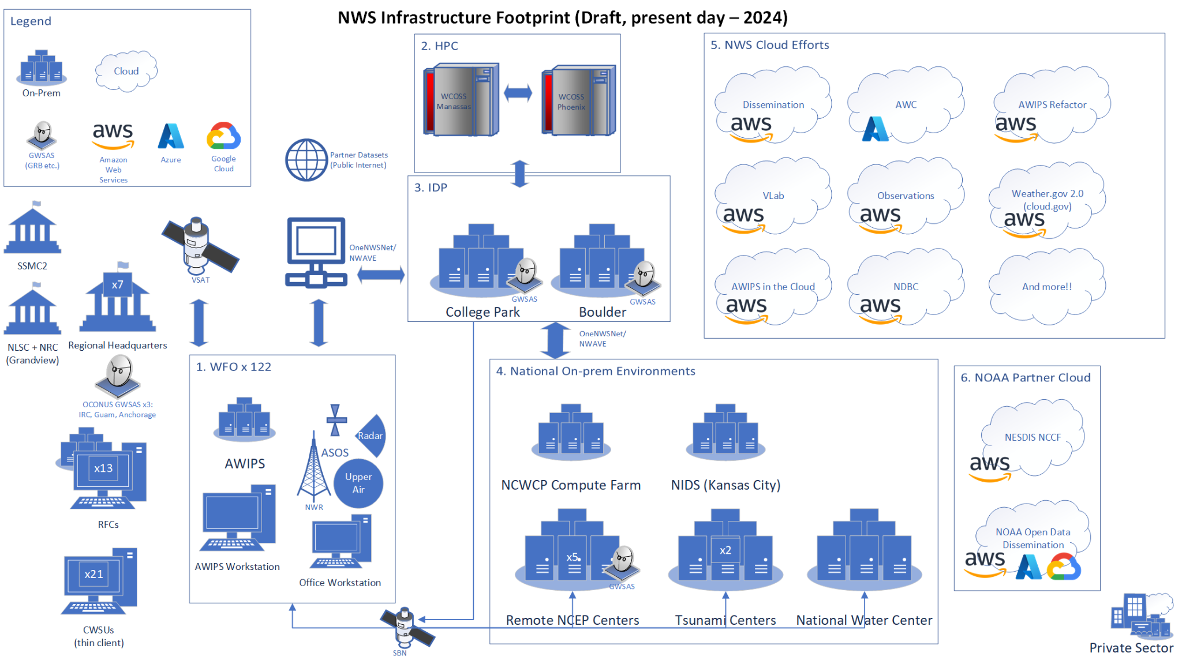

Slide 12
Modernize Architecture, Support Transformation
Ops Model: Decouple tools and data for our “Science First Responders” from traditional office and organization boundaries.
AWIPS in the Cloud: Decouple AWIPS from physical hardware and communications at 122 WFOs, 7 NCs and 13 RFCs. Improve access, resilience, and the pace of delivery.
ProbIDSS: Scale our workforce’s partner interactions through robust, cloud hosted modern tools and data.
Weather.gov 2.0: Modernize how we deliver our flagship web presence with Cloud enabled DevOps.

Slide 13
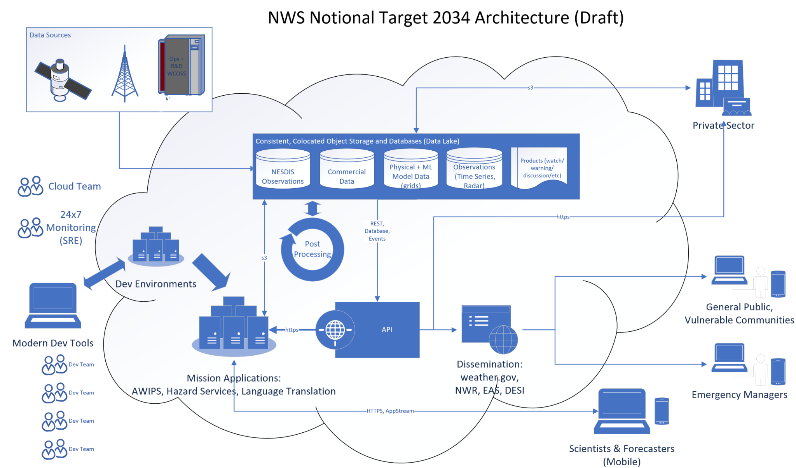
Science First Responders

Slide 14
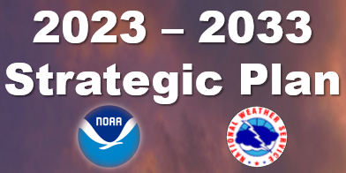
Transforming Challenges into Opportunities
Present Challenges
Focus Areas
Future
Duplicative, siloed, inconsistent, inaccessible data in the field | Data | Cloud Data Lake
Poor software quality, rigid platform dependency, and slow dev-to-ops hamper operational resilience and efficiency | Software | Enable DevOps and cloud-native architecture
Fragile, duplicative, segregated systems. Slow and intermittent network | System and Network | Improved network, unified Identity and Access Management, and consistent endpoint devices
Difficulty incorporating new science/tech into operations and 3rd party apps at a leading science agency pace Inadequate and inconsistent dev environment HPC: need 10x > WCOSS ops system Non-HPC: cloud, VLab, AWIPS, etc | Application Integration and Development | Mission Application Space, Expedited integration, streamlined development
Inability to bring external applications or field innovators to our data | Scalability | Enhanced Scalability

Slide 15
Radar Next

Slide 16
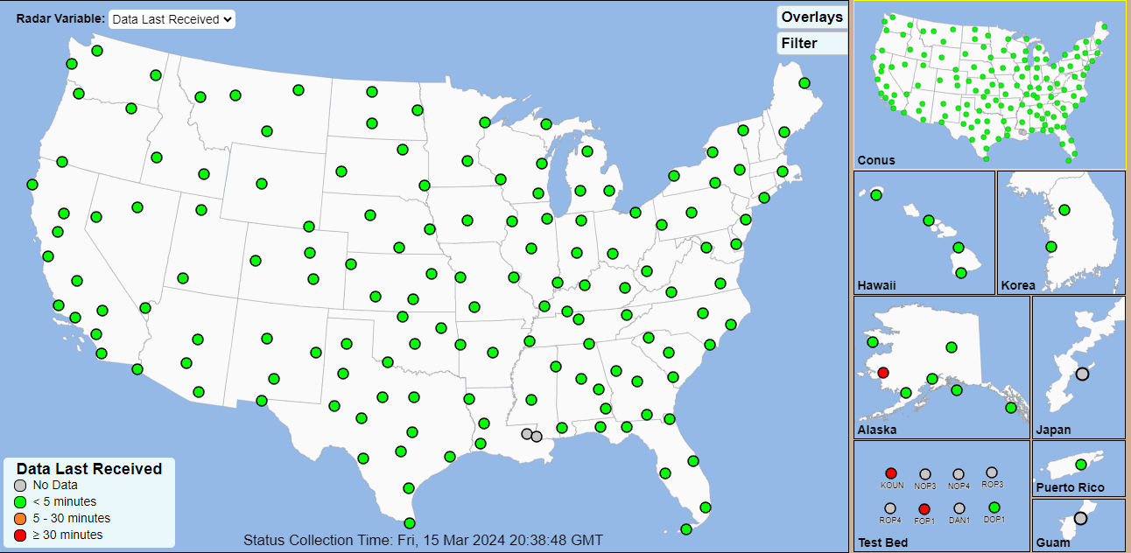
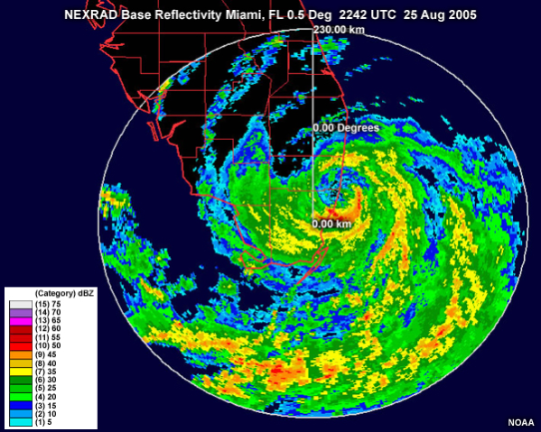
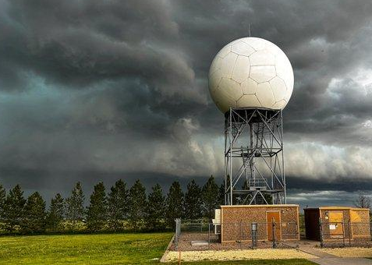
NEXRAD Program: NOAA’s Current Operational Weather Radar
Network of 159 S-band Doppler weather radars jointly operated by NWS, USAF, FAA
Provides mosaic coverage of most of the Continental United States
Most impactful NOAA observational asset supporting severe weather, flash floods, and air traffic management. The radar network provides high national societal impact
Installed in the 1990s with a 20-year expected design life
Dual Polarization Upgrade in the 2013 and Service Life Extension Program in the late 2015 - 2024
KAMX - Hurricane Katrina
25 AUG 2005 - 2242 UTC
KGLD - Goodland, KS

Slide 17
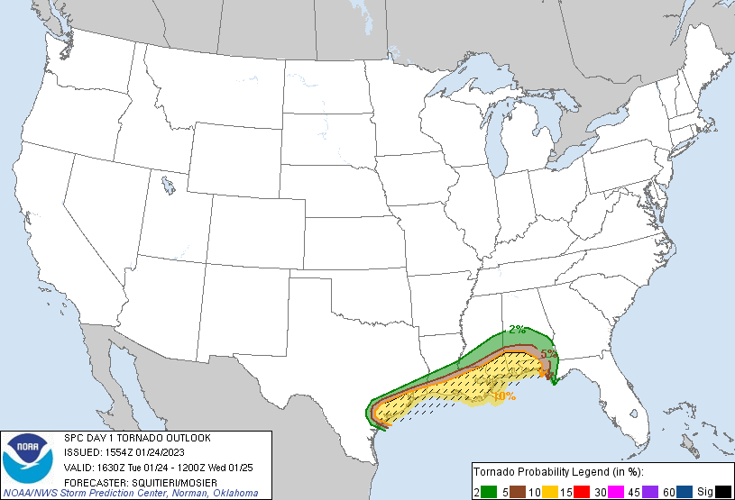
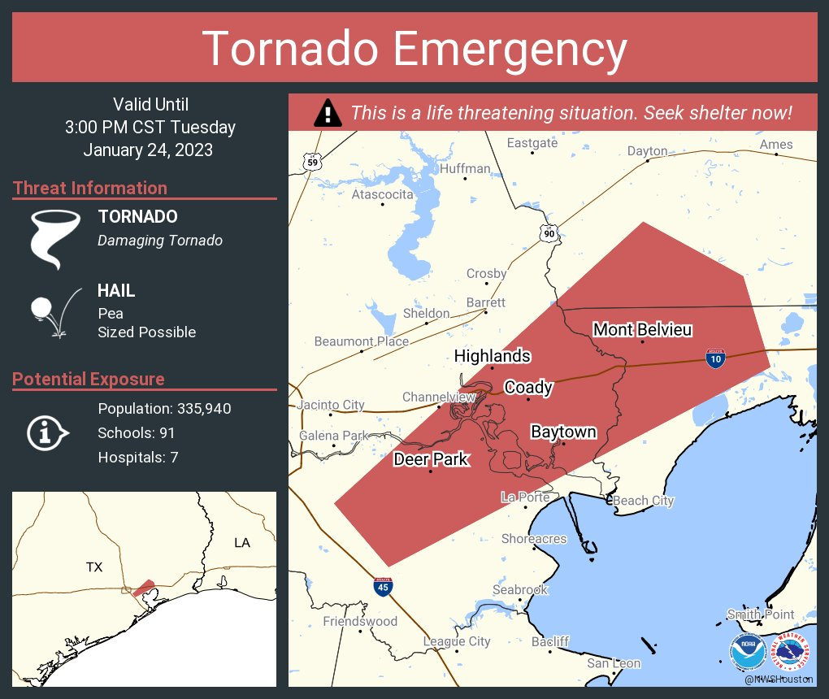
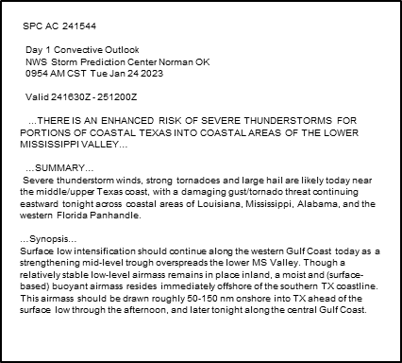
Example: January 24, 2023 Southeast Houston Tornado
SPC Convective Outlook and Probabilistic Tornado Graphic
Radar
Warning
Tornado
Deer Park, TX
Storm Relative Velocity / Correlation Coefficient
Tornado in major populated area
EF3 tornado (140 mph winds); 18.8 miles long track; 1,000 yards width
Minor injuries, no fatalities
Tornado rain-wrapped, no visual cue to persistence, strength, or size
Radar data (debris signature) vital to informing forecasters and media partners that tornado remained in progress and was large, damaging
WFO issued Tornado Emergency based solely on radar data
Aftermath

Slide 18
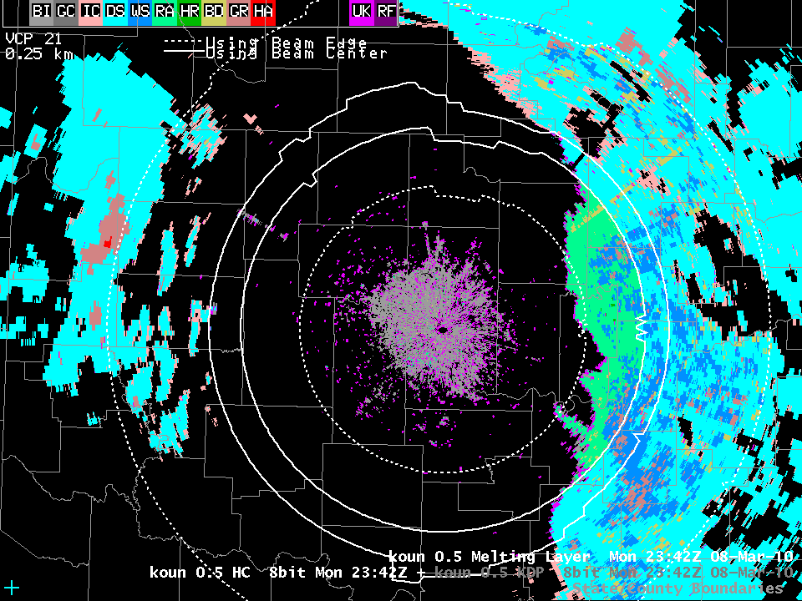
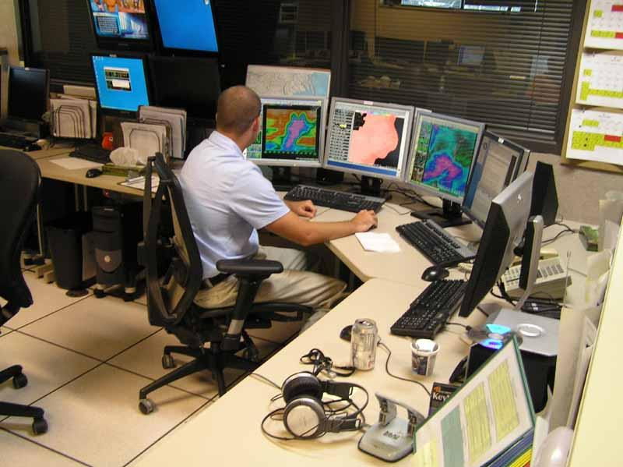
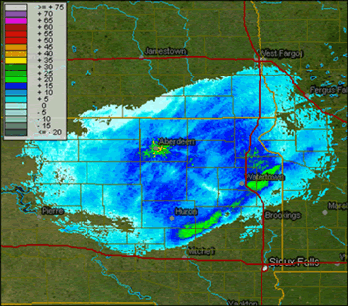
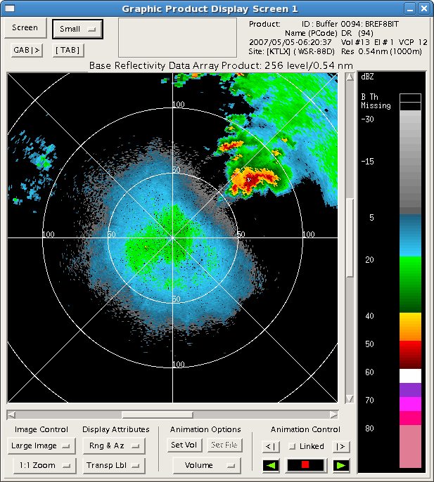
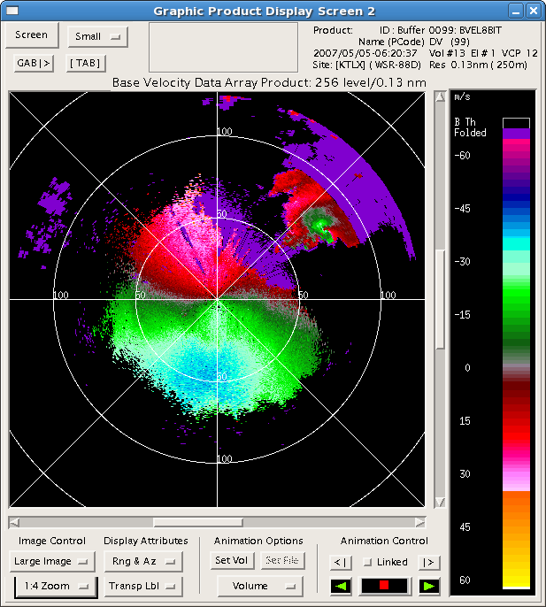
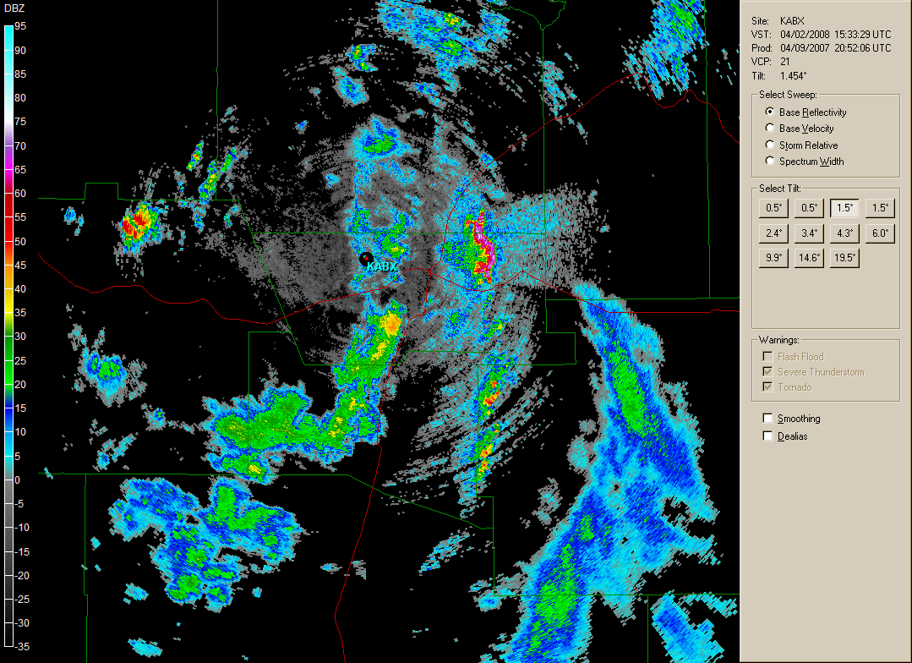
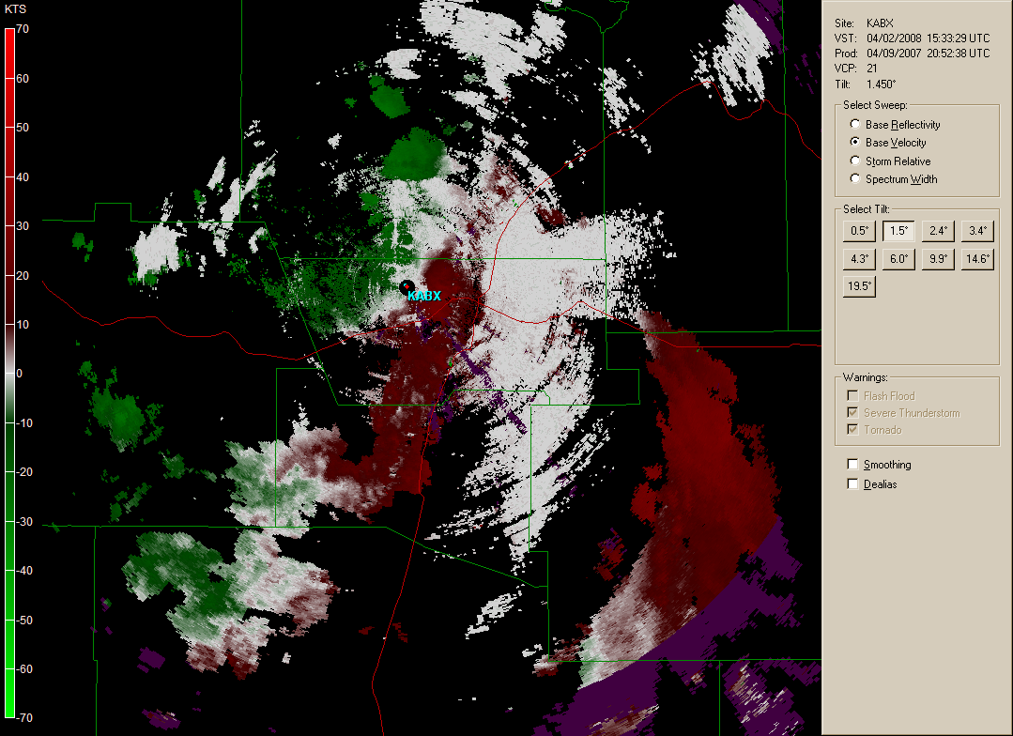
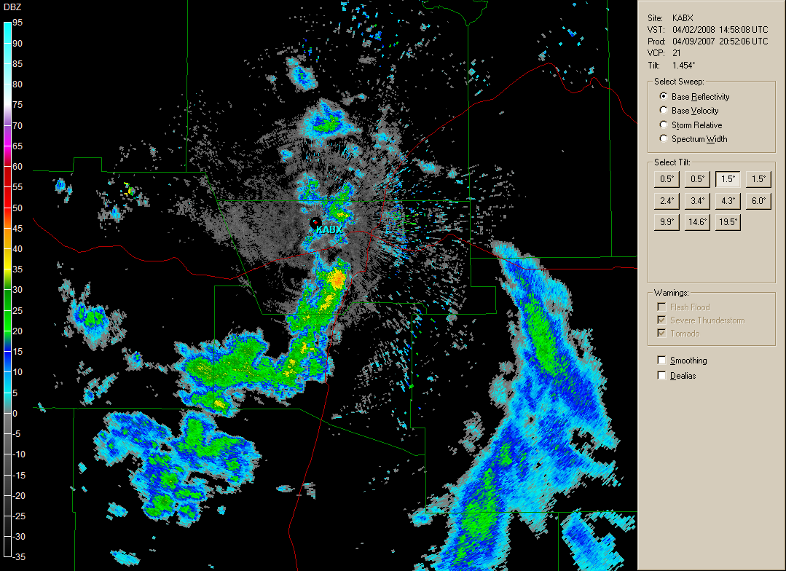
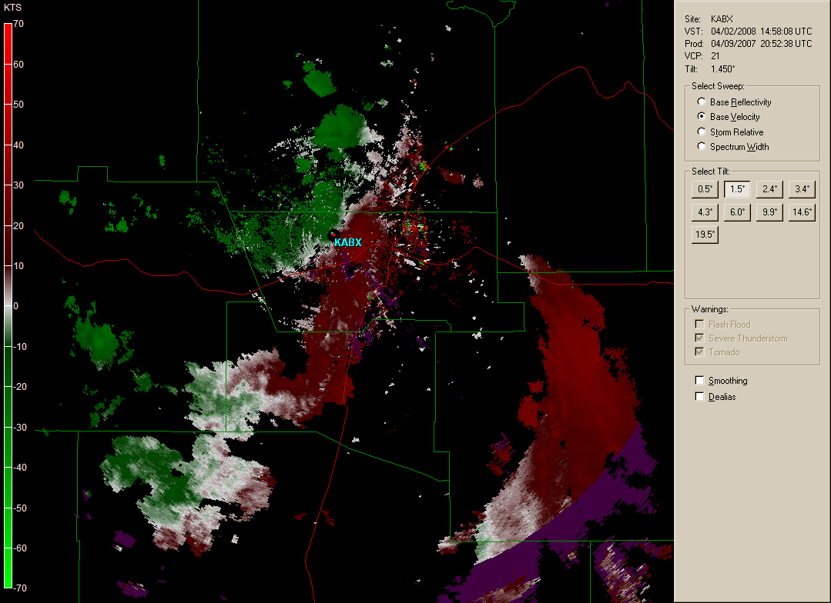
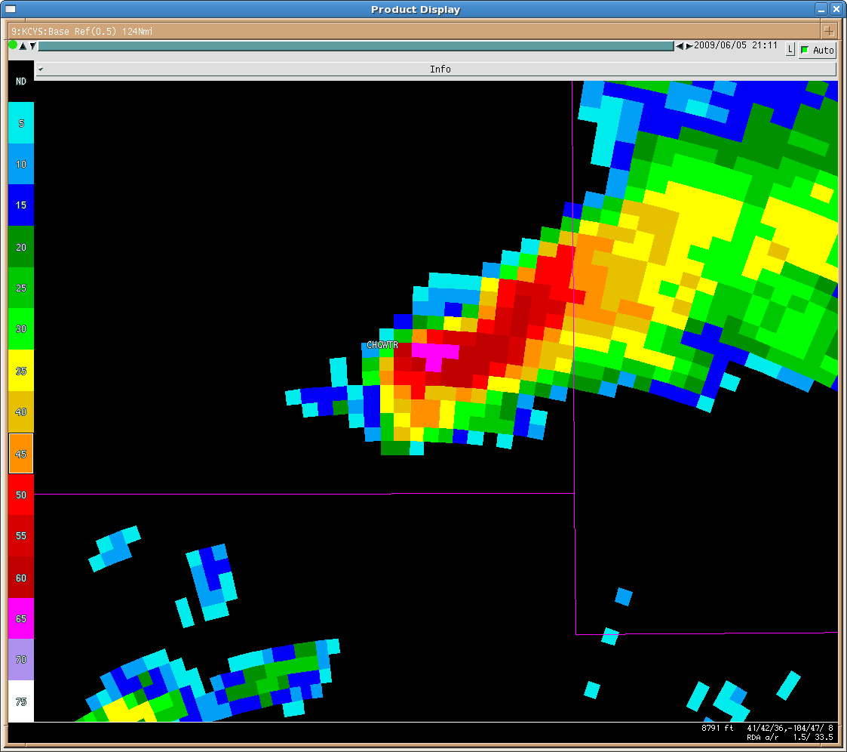
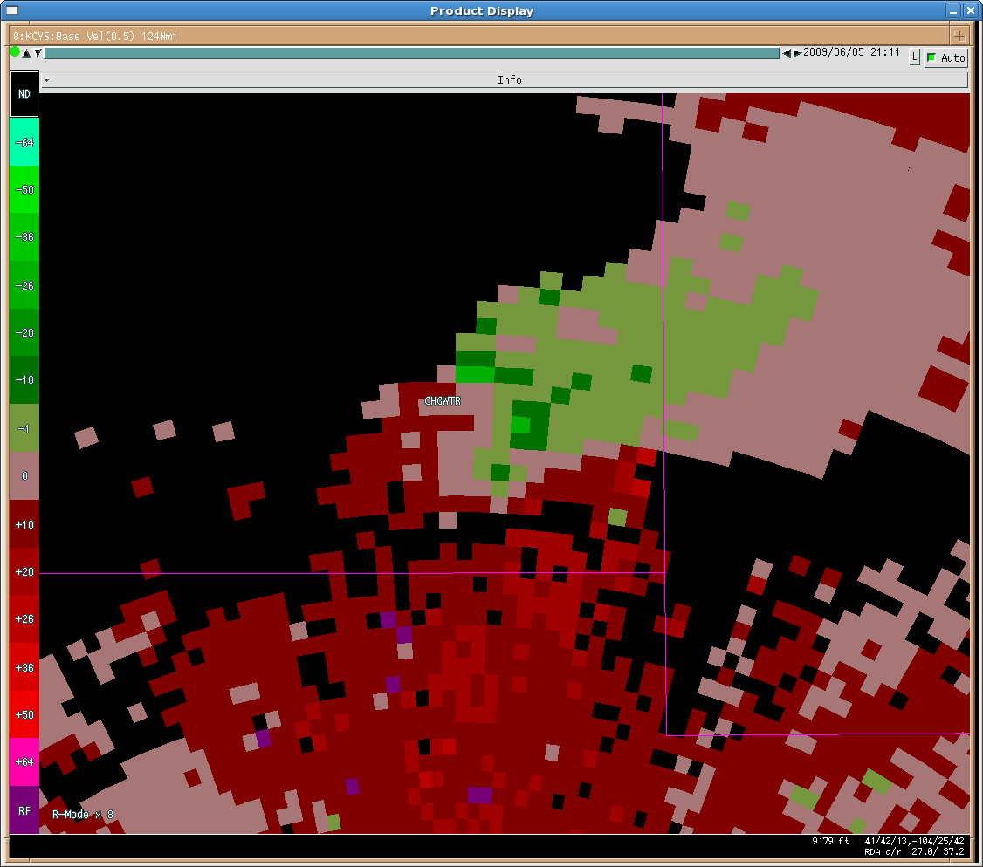
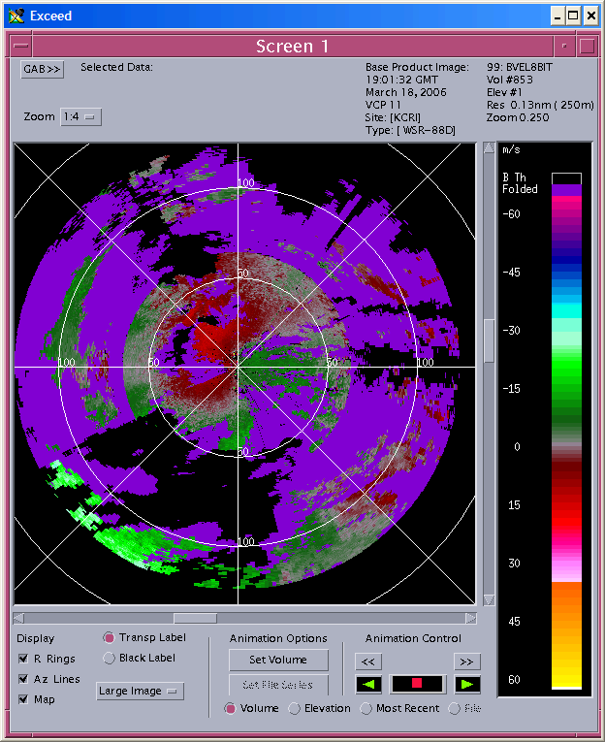
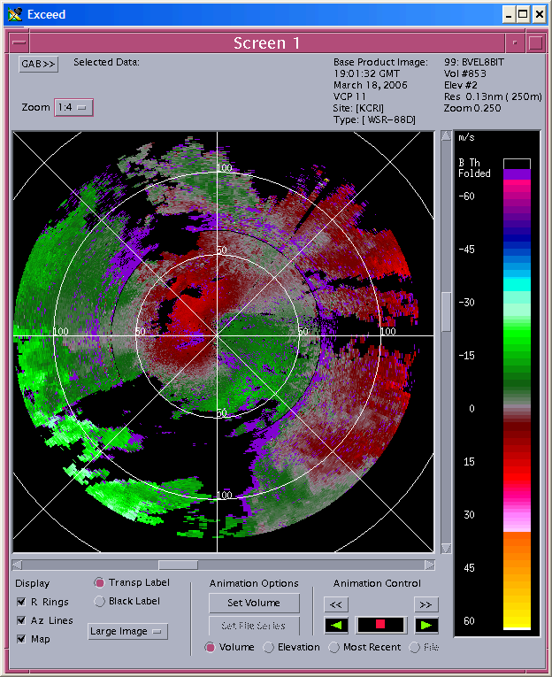
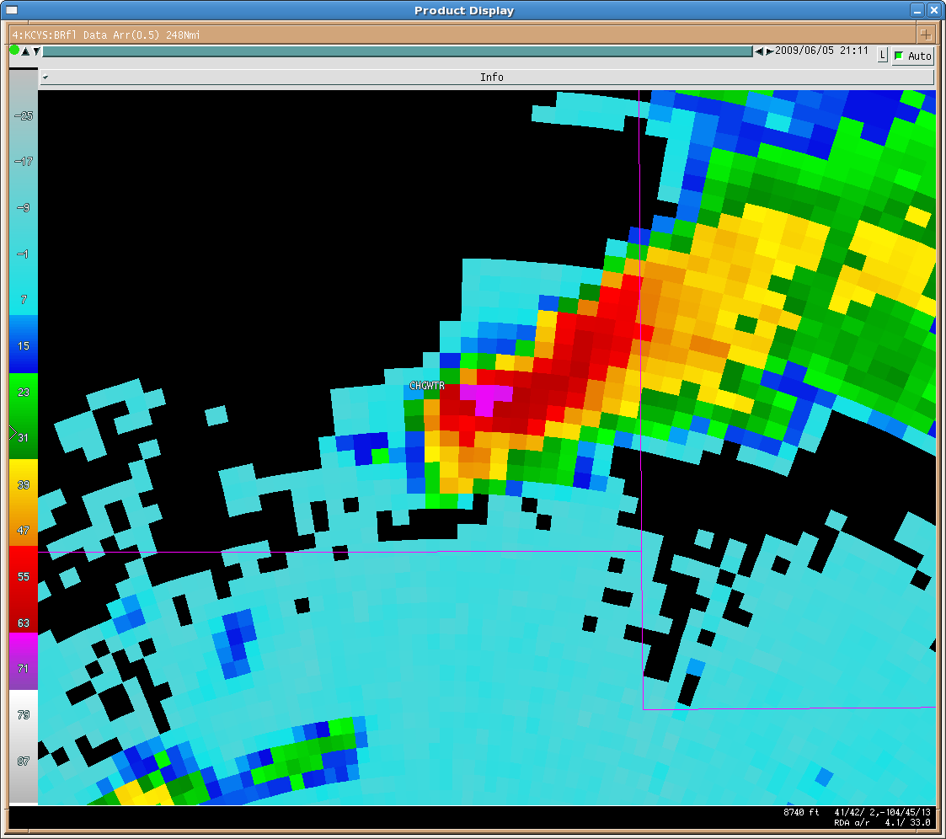
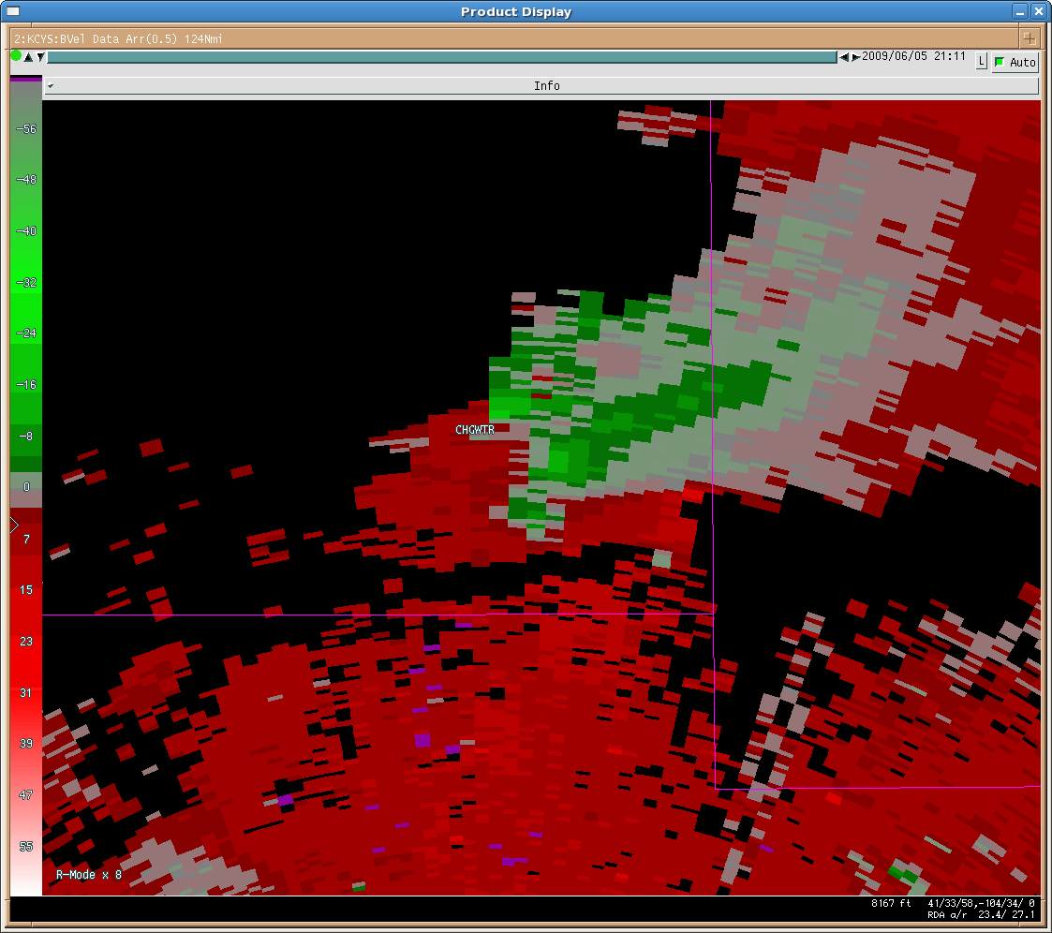
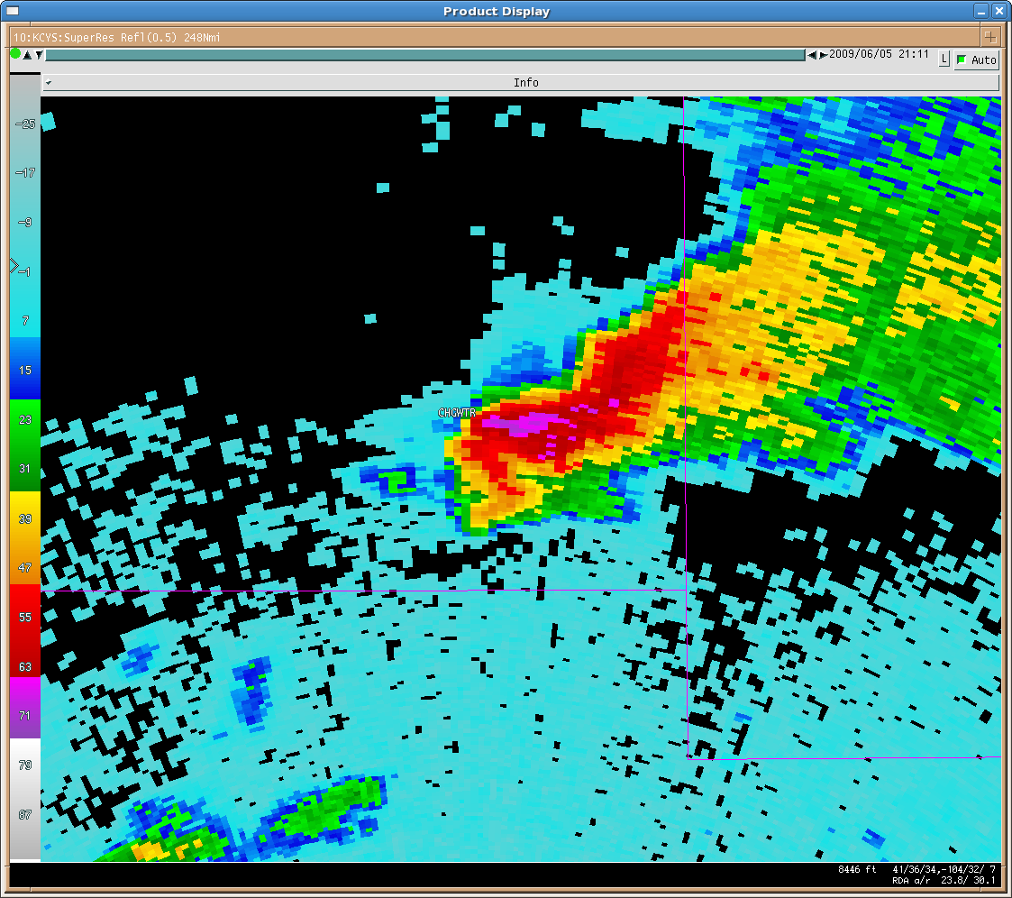
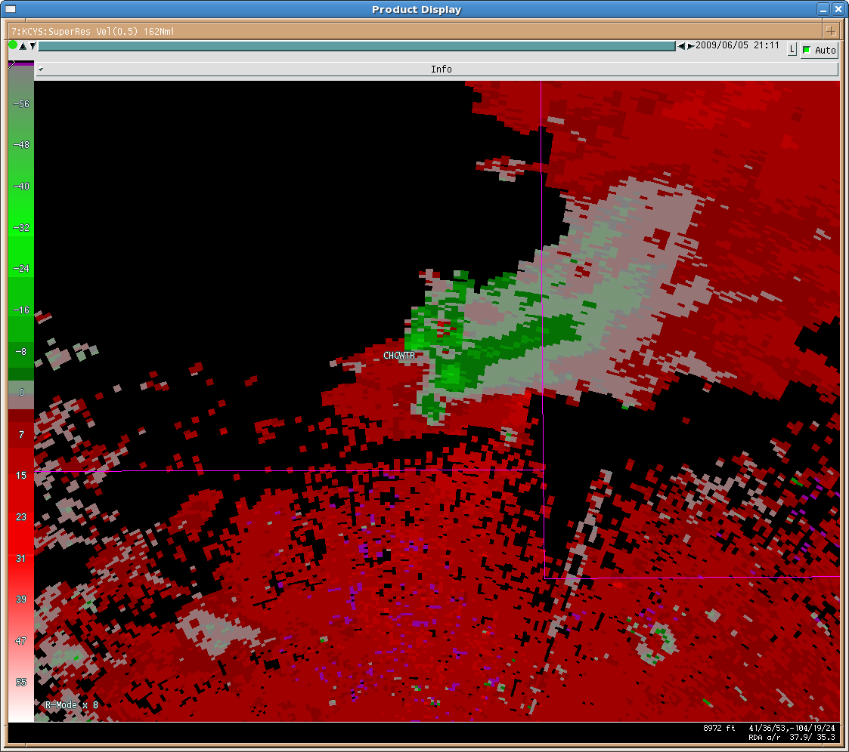
NEXRAD Evolution
Upgraded Algorithms and Products (e.g,, Snow Accumulation)
SLEP
2025
Digital Communications
Digital Signal Processors
Transmitters
Pedestals
High Resolution Products
Dual Polarization
Equipment Shelters
Generator/Engine
Automatic Transfer Switches
2015
Clutter Mitigation
Open Systems RPG
2005
20 Year Design
Lifetime
Open Systems RDA
1995
Legacy Resolution
First Test Bed WSR-88D Installed
WSR-88D Deployment
High Resolution
1985
SZ2 Velocity
Super Resolution
UNISYS Contract Award
RDA: Radar Data Acquisition
RPG: Radar Product Generator
SLEP: Service Life Extension Program

Slide 19
Technology Solution (Analysis of Alternatives)
Radar Next Program will identify and assess various alternatives, comparing strengths and weaknesses, and select the best option(s) based on the analysis.
Examples of Alternatives:
Replace NEXRAD with new rotating reflector dish (Rip and Replace)
Replace WSR-88D with new technology, including various electronically steerable (e.g., phased array radar - PAR) concepts
Hybrid solutions encompassing different technologies (and frequencies) which may include the purchasing of commercial data, rotating parabolic dish, rotating PAR, stationary PAR, other electronically steering technology, and mobile radars
A replacement architecture for NEXRAD has not been selected!

Slide 20
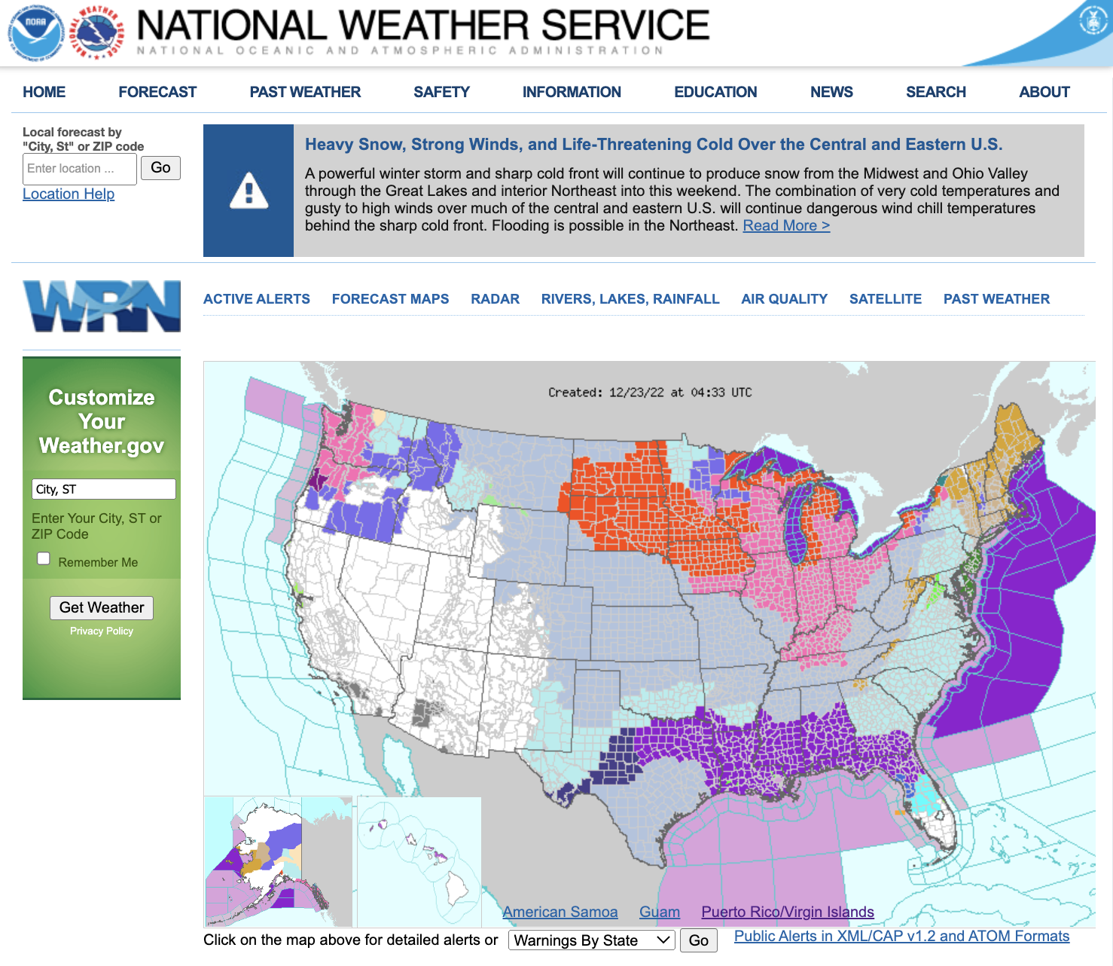
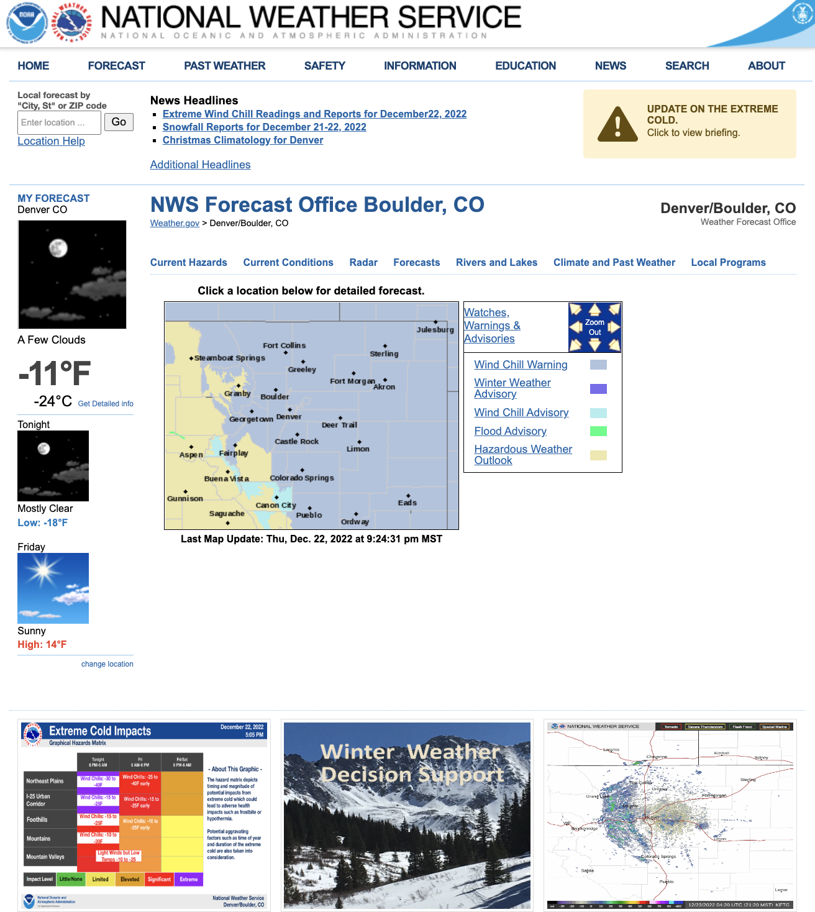
Weather.gov 2.0 Flexible, Nimble, and Mobile
Vision
An improved weather.gov that better supports core users in making weather, water, and climate related decisions and serves as the NWS foundational website that is more Nimble, Flexible, and Mobile.
Benefits
Meets the needs of decision makers who depend on NWS web-based services when they are needed the most and wherever they are
Easily accessible and delivered effectively and efficiently
Utilizes Cloud-based and COTS technologies for increased robustness and flexibility
Mobile Friendly
Provides impact-based key messages, data, forecasts, and warnings for the National, State, and Local-level decision makers
Notes:
Weather.gov is frequently in the Top-10 list of most visited federal websites with 1.5 billion visits per year. Despite this .. the site has not had any major public-facing upgrade in over a decade. The Content Management System (CMS) was building in-house and requires significant modernization.

Slide 21
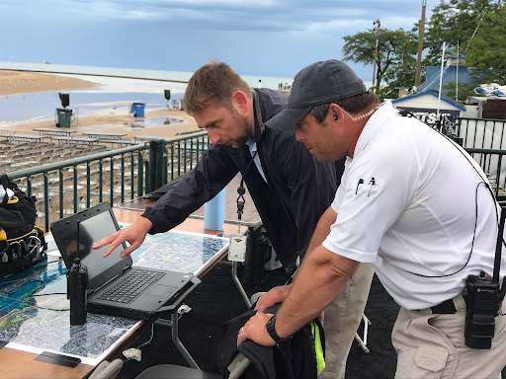
AWIPS - Cutting the Cord
Vision
Unleash AWIPS capabilities in an office through cloud technologies to serve as the technical foundation for a more Nimble, Flexible, and Mobile NWS eye to eye with decision makers.
Benefits
Forecaster mobility
Greater access to data
Rapid infusion of innovation into operations
More robust service backup

Slide 22
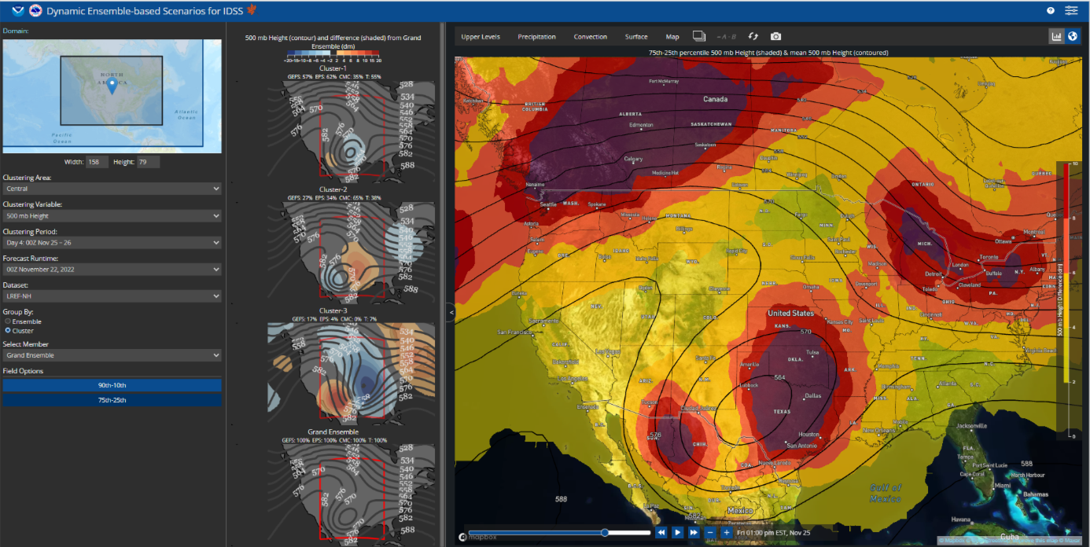
Probabilistic IDSS
Vision
If we fully leverage probabilistic information, focus on the things that humans do well and learn what questions our partners really need answers to, we can revolutionize our ability to protect life and property
Prototype Example Only
Benefit
A probabilistic forecast conveys the uncertainty in the prediction and maximizes decision-making value for NWS partners and the public in a consistent and scientific manner
Ensemble clusters with the grand ensemble 500 mb pattern with 25-75th interquartile range of height differences
“…people make better decisions, have higher trust in information, and/or display a greater understanding of forecast information when shown a [tailored] probabilistic forecast instead of a deterministic one.”
Source: https://crcm.shinyapps.io/probcom/#section-practical-recommendations and Ripberger et al (2022)
Notes:
Image: DESI example: High impact cut off low scenario Nov 2022 in the south central US. Shows the various ensemble clusters (center row) along with the grand ensemble 500 mb pattern with 25-75th interquartile range of height differences.

Slide 23
Learn
More
Or visit
noaa.gov/NWStransformation

Slide 24
Historic Flooding
Northeast Minnesota - June 2024
NWS Flood survey and visit to the City of Cook, MN where the Little Fork River was rising fast.
NWS Duluth documented the flooding and provided updates to local officials at the onsite Command Post.
NWS Duluth provided guidance for the timing and extent of maximum flooding to help local officials prioritize their actions to protect infrastructure, homes, and businesses
Notes:
On June 18, 2024, heavy rainfall fell across northeast Minnesota leading to historic flooding
While on a survey of flooding the next day, NWS meteorologists were invited by St Louis County Emergency Manager Josh Brinkman to visit the City of Cook MN where the Little Fork river was rising fast
NWS Duluth stayed on-scene for hours, and then returned the following two days to document the flooding and provide updates to local officials at the makeshift Emergency Operations Center
NWS Duluth coordinated with North Central River Forecast Center on providing guidance for the timing and extent of maximum flooding to help local officials prioritize their actions to protect infrastructure, homes, and businesses from the rapidly rising water. While not a river forecast point, NWS Duluth management coordinated to request an experimental Flood Inundation Map (FIM) from the National Water Center, despite not yet being part of FIM!
NWS Duluth has since been invited to flood mitigation meetings hosted by the Iron Range Rehabilitation and Resources Board (a State of Minnesota agency) which included the EM, Army Corps of Engineers, DNR, Pollution Control Agency, FEMA, and representatives from the offices of both MN state Senators and the Congressional Representative for this region.

Slide 25
“Weather support has been absolutely critical for coordinating well over 30 aircraft flights, keeping our crews safe (and dry), and making short and long term planning decisions based on the hydrology and long term forecast reports.”
-St. Louis County EM
Critical Support to
Remote Wilderness
Search & Rescue
Efforts on the
International Border
(May 2024)
“Special mention goes to the NWS Duluth, who literally set up a table next to us to provide minute by minute atmospheric data and weather forecasts. We could not accomplish our mission without all of you!”
Notes:
May 2024) WFO Duluth MN Provides Critical Support to Remote Wilderness Search & Rescue Efforts on International Border
While providing on-site support for public safety at the Duluth Air Show with St Louis County Emergency Management, forecasters provided weather support for what evolved into a significant federal, state, and local agency Search and Rescue mission in the Boundary Water Canoe Area Wilderness on the international border lasting almost two weeks.
Services provided included twice-daily SPOT forecasts, with aviation forecasts for aviation operations (planes, helicopters, and drones), 24/7 heads up for thunderstorms, and water level forecasts from our Canadian partners (*Lake of the Woods Control Board) for Lac La Croix/Curtain Falls where rescuers were searching for two missing canoeists. Emergency Management responded, "I don't know what we would do without you guys."
An email St Louis County Emergency Manager Josh Brinkman sent to NWS Duluth staff: “Weather support has been absolutely critical for coordinating well over 30 aircraft flights, keeping our crews safe (and dry), and making short and long term planning decisions based on the hydrology and long term forecast reports.” … “Please pass on to everyone how thankful we are for your crews timely, accurate information, and for keeping an eye on us.” … “The search continues and water levels will directly impact our efforts.”

Slide 26
2023
Spring
Flood
NWS Bismarck staff briefs state officials on March 24, 2023, at the North Dakota SEOC about flood expectations. Adjutant General Dohrmann said that NWS’s weather and water intelligence “enabled a unified approach for flood preparedness and response and recovery efforts by state agencies”.
Areas where snowmelt flooding was expected to commence were highlighted to the NDDOT. This intelligence enabled NDDOT to strategically place mobile cameras in anticipation of possible road impacts.
NWS support is critical in helping officials decide whether or not evacuations need to take place. Based on NWS forecasts the information being relayed to the public had a higher “mode of confidence”.
-Morton County, ND Emergency Management
Ice jam on the Heart River at Mandan, ND. NWS took a wire weight measurement to verify the automated gauge reading. They then briefed officials at the Morton County EOC.
Notes:
1. SH briefs state officials on March 24, 2023, at the ND SEOC about flood expectations for the spring snowmelt. Adjutant General Dohrmann said that NWS’s weather and water intelligence “enabled a unified approach for flood preparedness and response and recovery efforts by state agencies”. Representatives from NDDES, NDHP, NDDOT, NDHHS, NDDEQ, NDDA, ND ParkRec and NDCAP were at the meeting.
2. Through ND Pathfinder, from April into May 2023, areas where snowmelt flooding was expected to commence were highlighted to the NDDOT. This intelligence enabled NDDOT to strategically place mobile cameras in anticipation of possible road impacts.
3. Ice jam on the Heart River at Mandan, ND. SH, SOO and two forecasters viewed the jam on April 14, 2023 and took a wire weight measurement to verify the automated gauge reading. They then briefed officials at the Morton County EOC. EM Cody Mattson said NWS support is critical in helping officials decide whether or not evacuations need to take place, and especially in this case where the automated gauge was erroneously reporting higher stages than reality. Based on NWS forecasts the information being relayed to the public had a higher “mode of confidence”.

Slide 27
Coordination with City of Chicago Ahead of Winter Storms
Based on information provided by the NWS Chicago, numerous city agencies enact their response plans to ensure vulnerable populations such as the elderly and homeless receive the support they need to remain safe and healthy during the period of extreme cold.
NWS Chicago delivers a weather briefing at the December, 21 2022 press conference.
Notes:
NWS Chicago and the City of Chicago collaborate closely ahead of severe winter weather, including most recently in December 2022 when wind chills dropped to -40 F.
The city often responds with a press conference which NWS Chicago is asked to open with a forecast summary.
Based on information provided by the NWS, numerous city agencies enact their response plans to ensure vulnerable populations such as the elderly and homeless receive the support they need to remain safe and healthy during the period of extreme cold.
City actions include welfare checks, warming shelters, outreach to homeless encampments, enhanced transportation services, and a 311 hotline providing information regarding all of these resources.
During any given storm, tens of thousands of residents will utilize these services.

Slide 28
Putting People at the Center
Our people are the foundation of our agency. Without them, we fail.
Objectives:
Increase diversity to reflect the communities we serve.
Foster inclusive, respectful, flexible workplaces to improve burnout and our culture.
Transforming employee engagement to support a thriving workforce.
Build an indispensable workforce.
Develop leadership skills at all levels.
Work hand-in-hand with our union stewards.
People
Notes:
By supporting our people, we prepare them to provide our partners and the public with the best possible service.
Highlight 1-2 examples of progress or recent success in the people category

