Slide 1
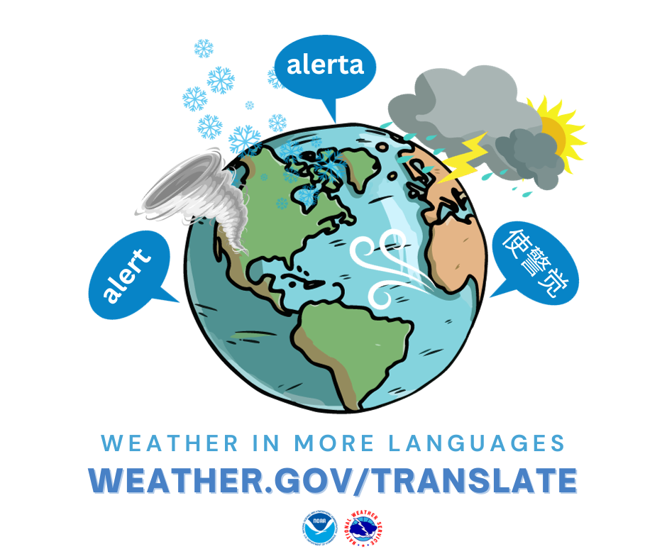
Using AI-Powered Translations to Expand Access to Weather Information Across the Tri-State
Faye Morrone
Meteorologist & Information Technology Officer
NWS New York, NY
Tri-State Weather Conference
September 21, 2024

Slide 2
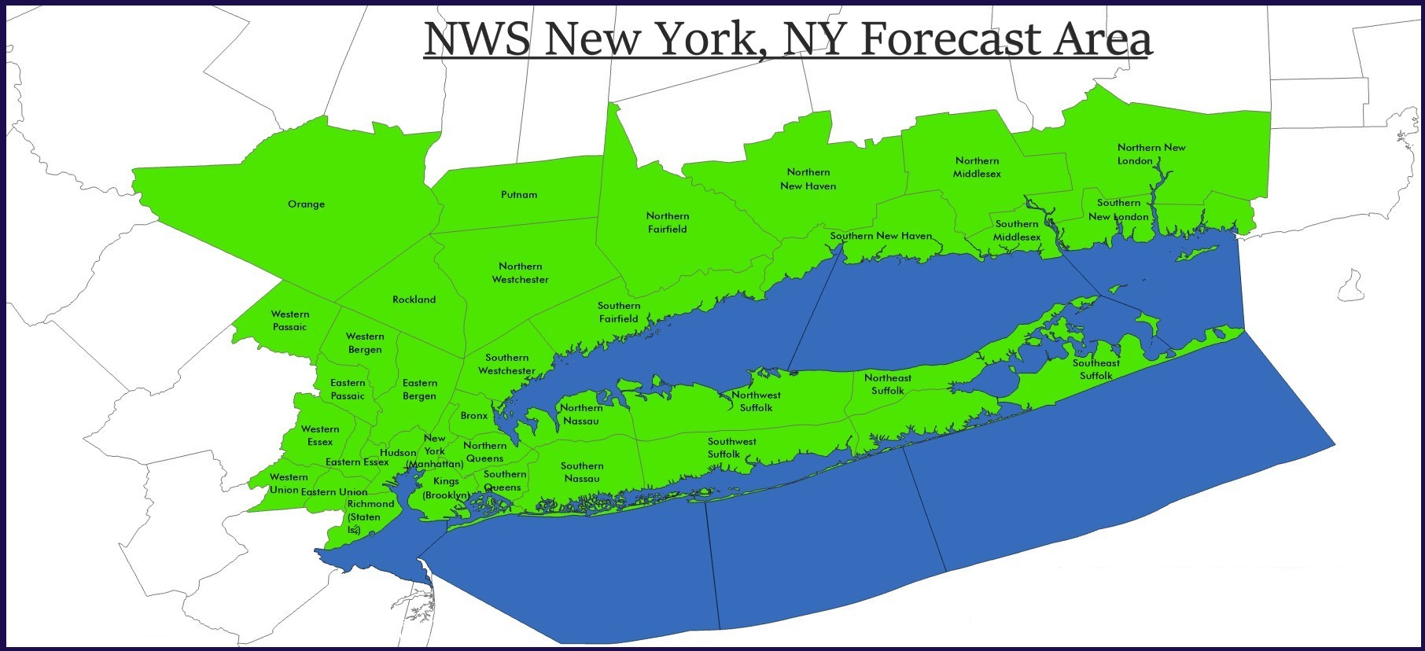
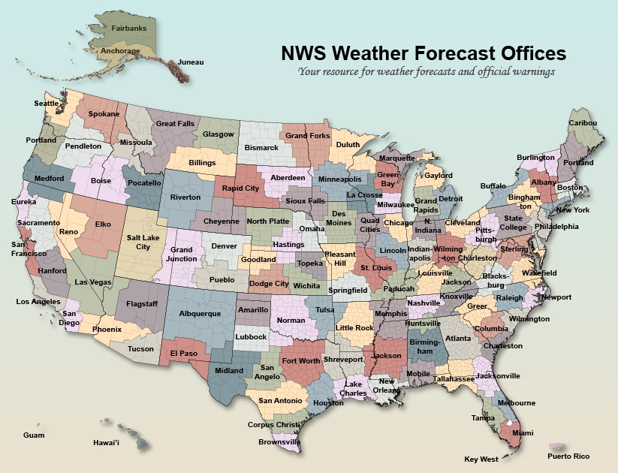
National Weather Service New York, NY
📡
Including ocean waters out 20 NM, Long Island Sound, NY Harbor, and Long Island Bays
Located in Upton, NY on the grounds of Brookhaven National Laboratory
Serve 20 counties across southeast New York, northeast New Jersey, and southern Connecticut as well as the surrounding coastal waters
19.4 million people (6% of the U.S. population)
National Weather Service
WFO New York, NY

Slide 3
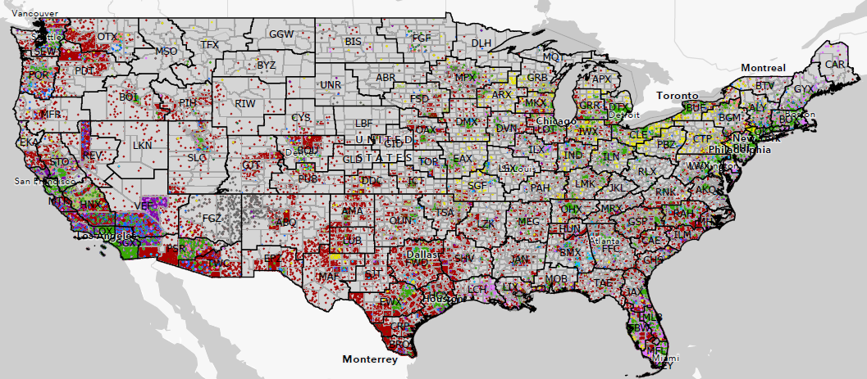
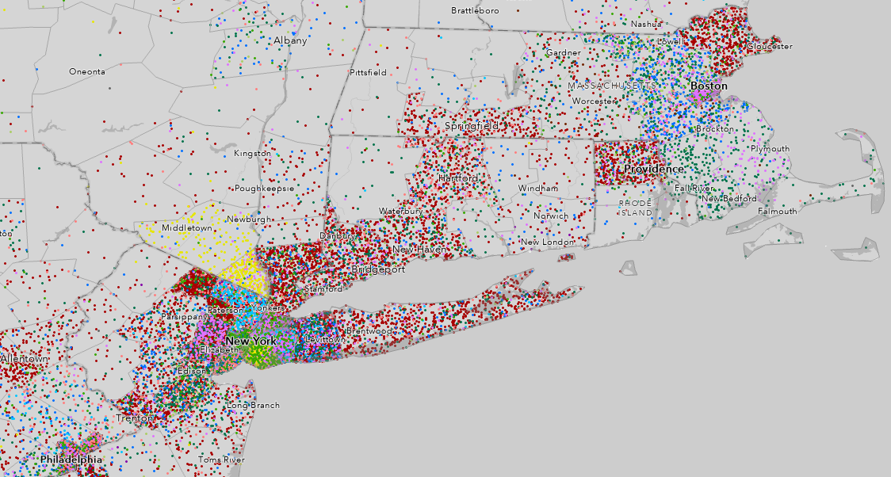
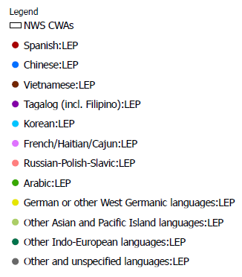
Weather Ready Nation
NWS Vision
A Weather-Ready Nation: Society is prepared for and responds to weather, water, and climate-dependent events.
Nationwide: ~25 million people are considered LEP
Locally (OKX CWA): ~3,000,000
Top languages:
Spanish
Chinese
Other Indo-European
Russian/Slavic
French/Haitian/Cajun
1 dot = 150 LEP people
1 dot = 100 LEP people
National Weather Service
WFO New York, NY

Slide 4
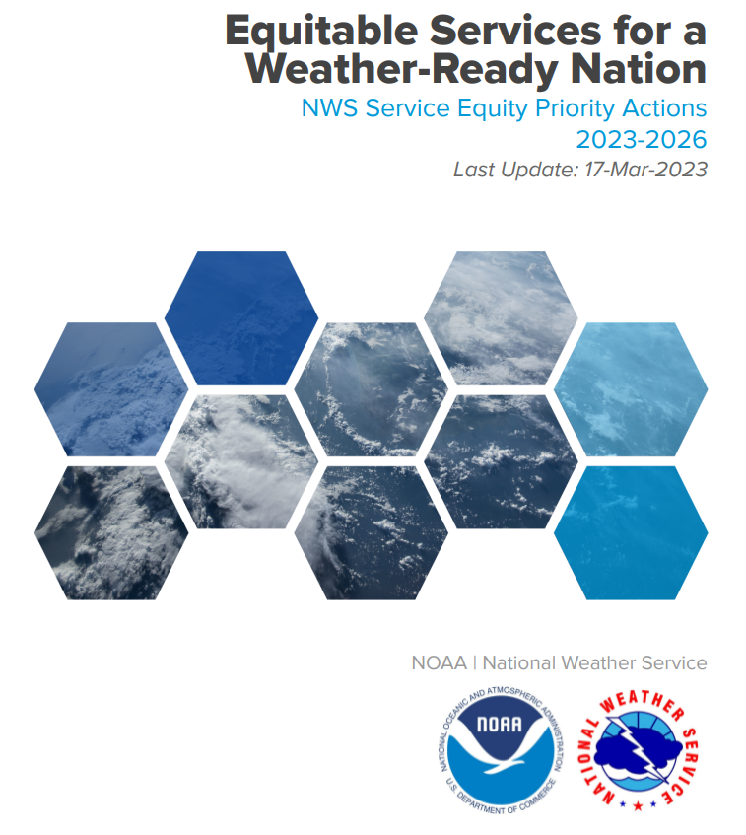
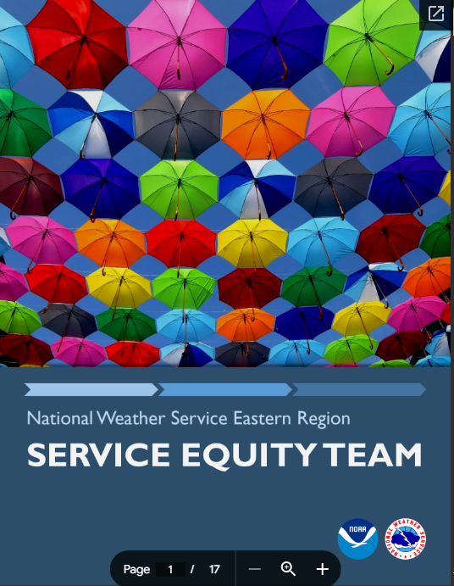
Service Equity
CHALLENGE: How do we build a Weather-Ready Nation when many people either can’t access or can’t understand the information we provide?
Accurate forecasts are only a starting point. If the forecast isn’t received AND understood, we are falling short of meeting our mission.
National Weather Service
WFO New York, NY
Notes:
Doesn’t apply only to language, but that is focus of this talk

Slide 5
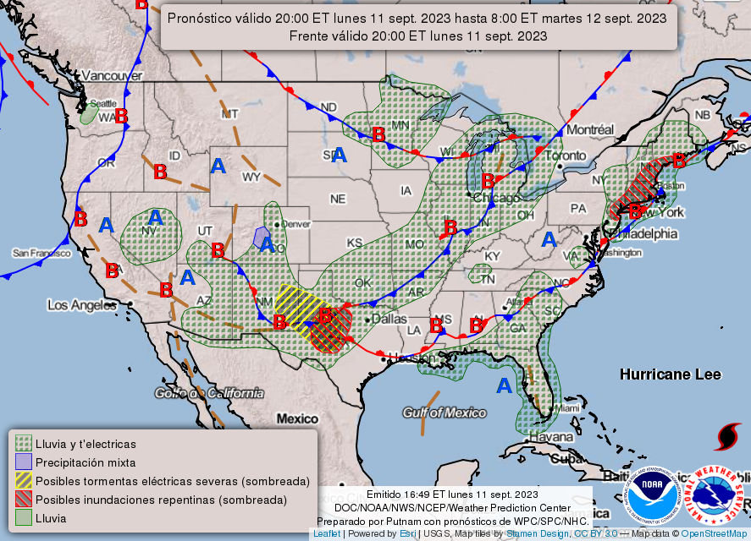
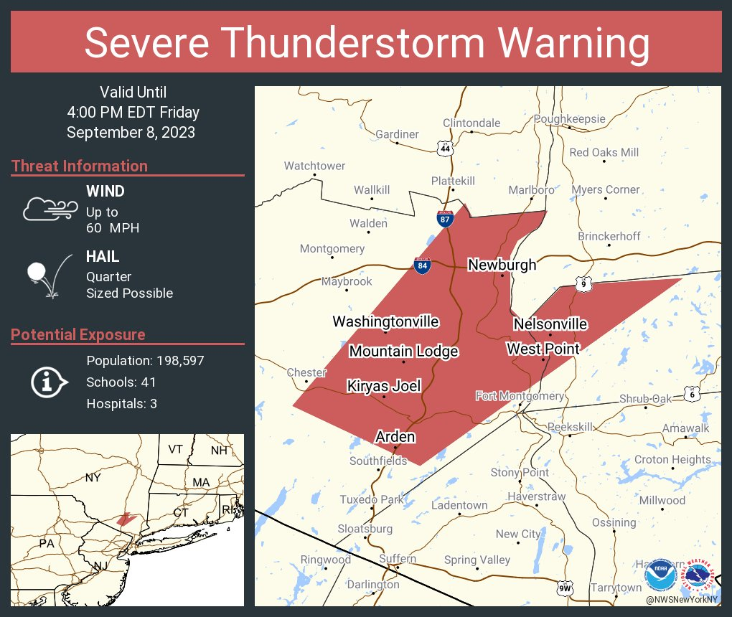
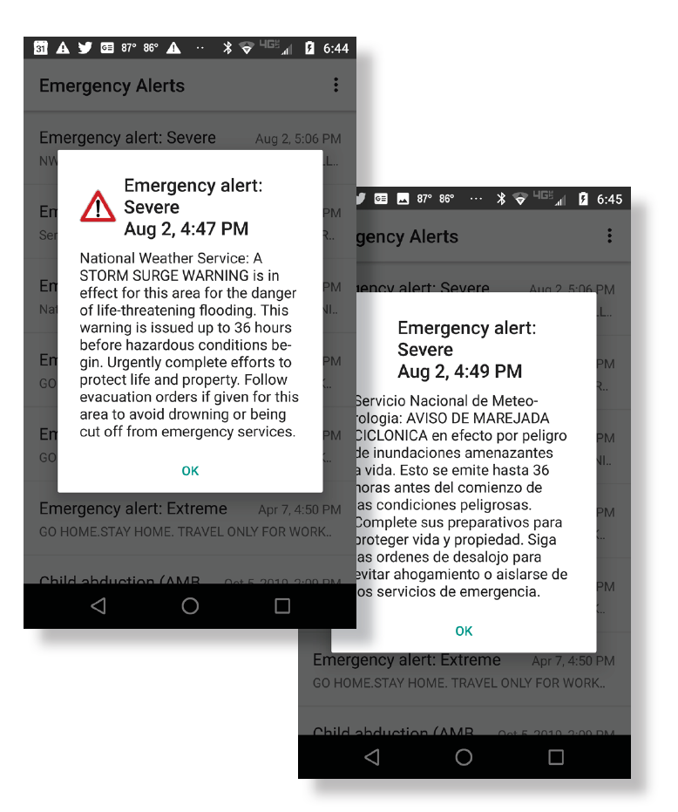
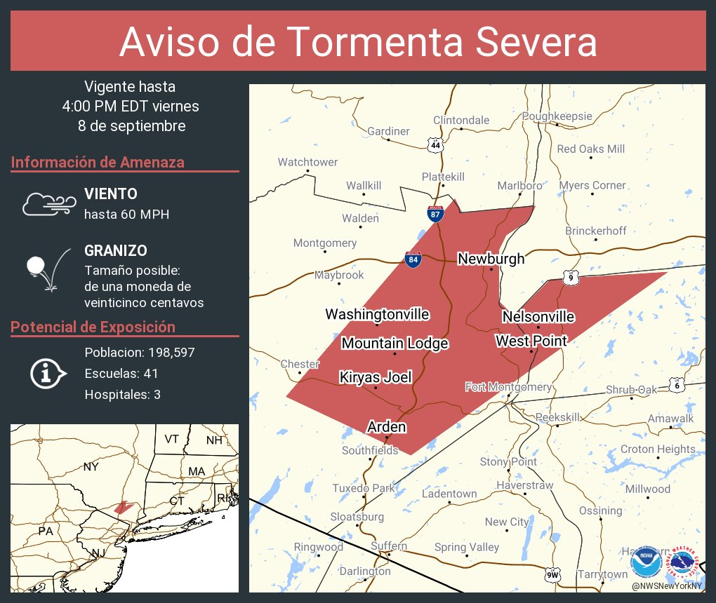
NWS Translation Efforts
WFO San Juan and WSO Pago Pago
Manual translations of some forecast information into Spanish (San Juan) and Samoan (Pago Pago)
National Forecast Chart
Template-based automatic translations into Spanish since 2011
Severe Thunderstorm/Tornado/Flash Flood warning tweets
Template-based automatic translations into Spanish since 2016
Multimedia Assistance in Spanish Team
Developed in 2017 to provide on demand translation services for media interviews and other messaging
Wireless Emergency Alerts
Template-based automatic translations into Spanish since 2020
National Weather Service
WFO New York, NY

Slide 6
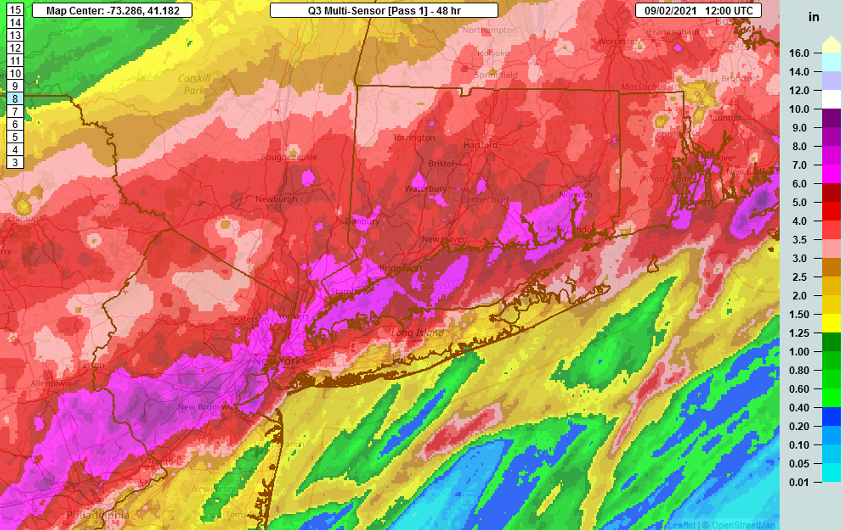
NWS Translation Expansion
September 2021 – 13 fatalities in NYC as a result of catastrophic flooding from the remnants of Hurricane Ida
Majority were of Asian descent and either did not speak or had limited proficiency in both English AND Spanish
However….
NWS does not have language expertise
Manual translations are time consuming
Template-based translations lack flexibility
https://ag.ny.gov/press-release/2022/attorney-general-james-calls-national-weather-service-increase-language
MRMS Multisensor QPE ending 12Z 9/2/21
Solution: Leverage Artificial Intelligence (AI) to expand translations to reach more LEP people
National Weather Service
WFO New York, NY

Slide 7
NWS AI Translation Project
Project Objectives
Optimize Accuracy
Reduce Forecaster Burden
Unresourced Languages
High accuracy needed to minimize risk from mistranslation
Easier checking/editing for forecasters
Build a process that easily scales into additional languages
Adaptive NMT
NWS
Domain Specific
Lilt
Patented
First-guess translation suggestion
As the model learns NWS terms and language, the model becomes more specialized
Translator Platform:
Software + Human
Model
Retraining
Instant Translate:
Software only
Human Translator
National Weather Service
WFO New York, NY

Slide 8
NWS Translations
www.weather.gov/translate
Translations available from NWS New York on an experimental basis since Spring 2023
26 offices + NHC as of September 2024
Translations are completely hands off for forecasters
Disseminate English Product
Text Sent to Lilt
Lilt Automatically Translates Product
Translation(s) Posts to Website
National Weather Service
WFO New York, NY

Slide 9
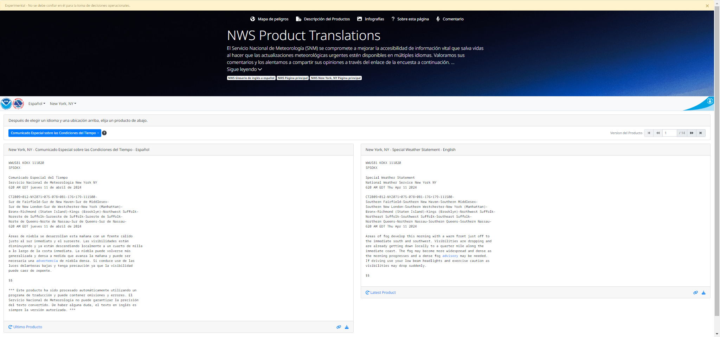
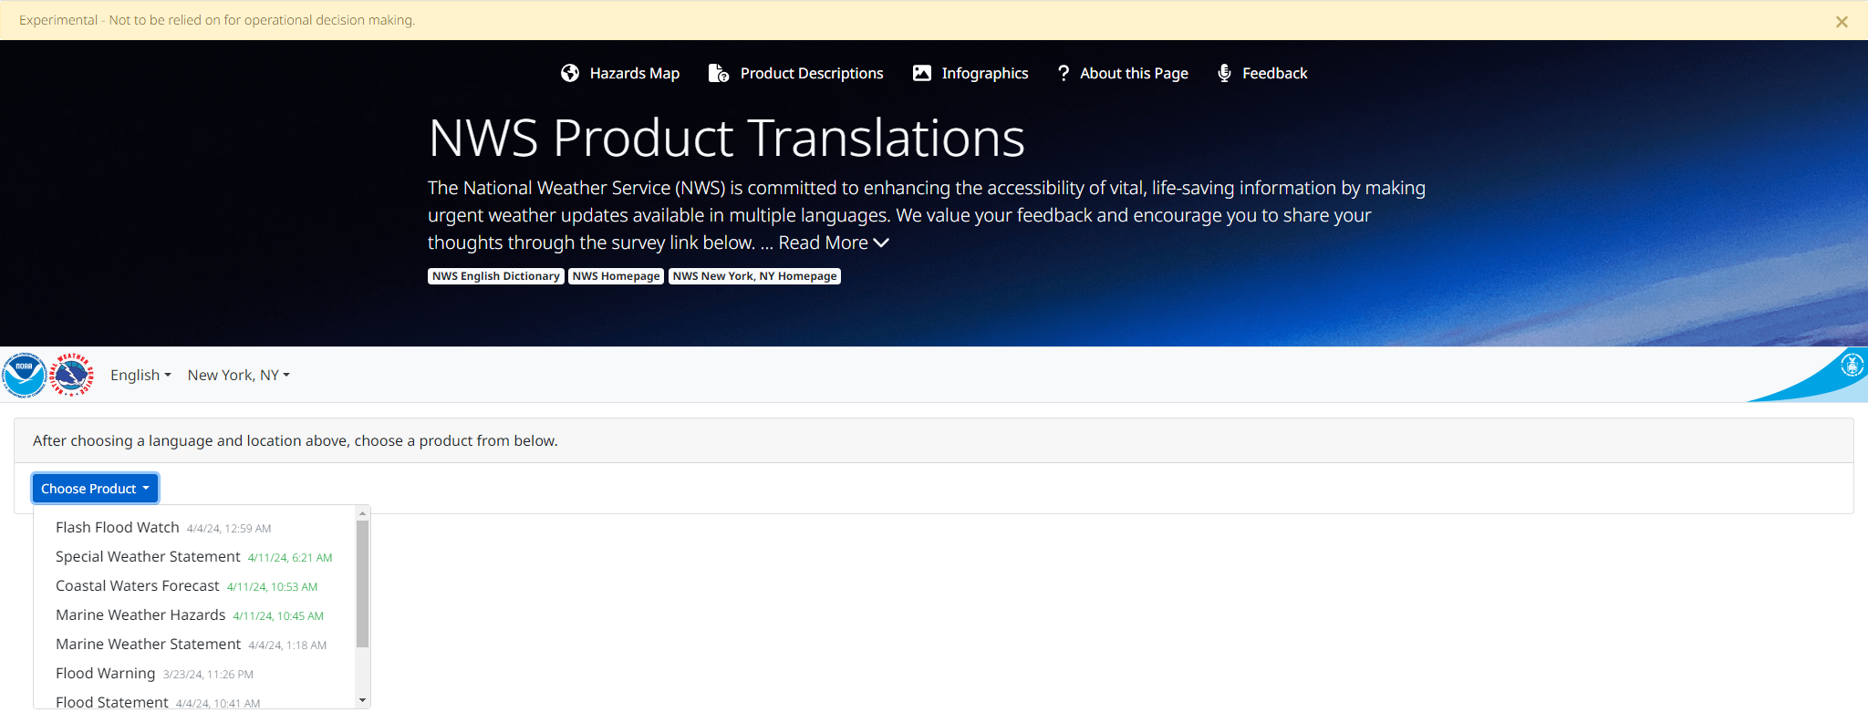
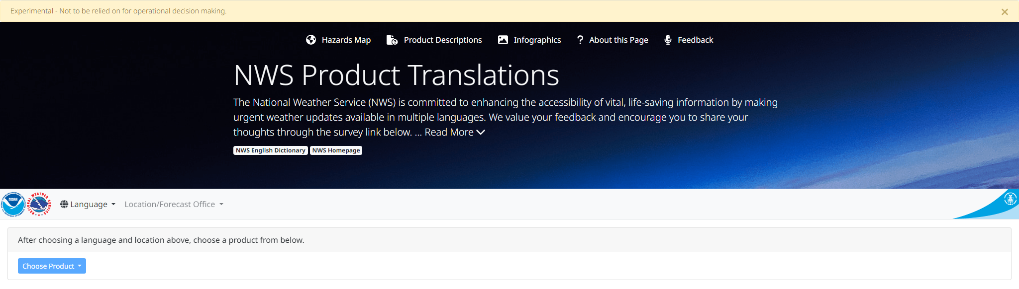
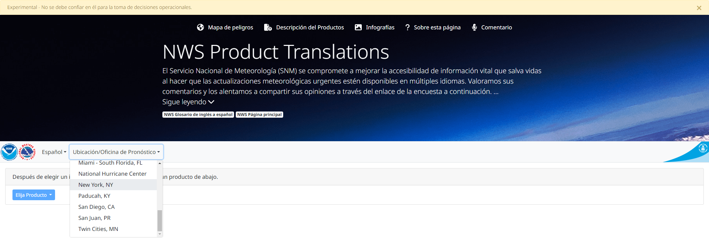
Translation Website
www.weather.gov/translate
National Weather Service
WFO New York, NY

Slide 10
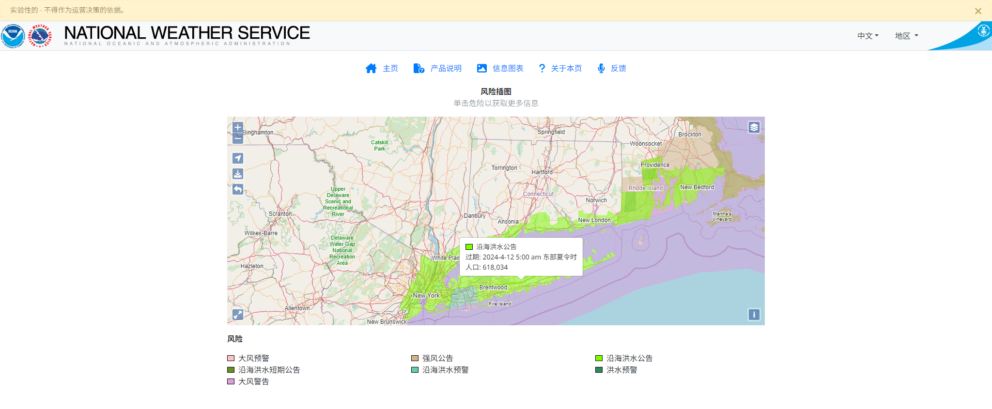
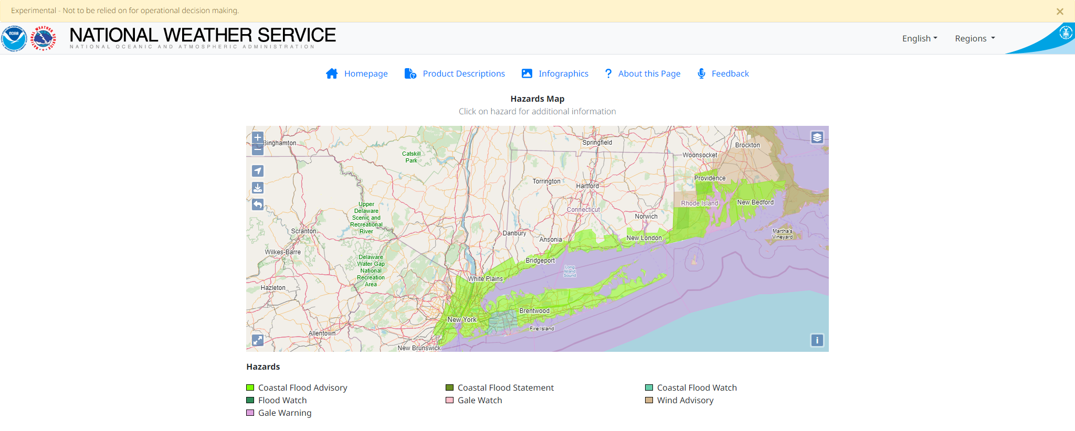
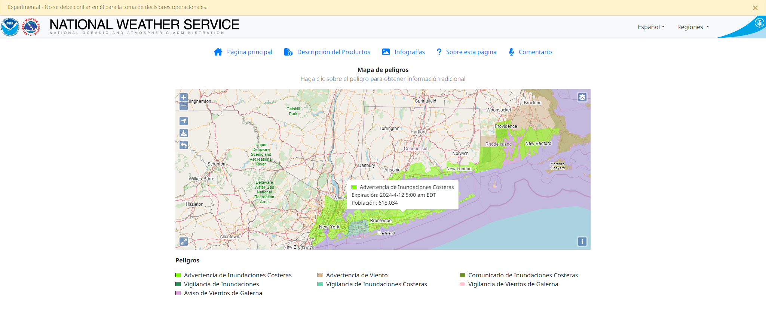
Translation Website
www.weather.gov/translate
National Weather Service
WFO New York, NY

Slide 11
Spreading the Word
Raising awareness about weather hazards in LEP communities is hard!
No single agency/group to serve as a contact
Groups often exist at the sub-county level
Distrust of government
Everyone is busy
NWS – outreach attempts need to be sustainable (not one-and-done)
Emergency Management – other issues may take priority
Hard to advertise www.weather.gov/translate to those who need it most
National Weather Service
WFO New York, NY

Slide 12
Social Media
@NWSNewYorkNY
National Weather Service
WFO New York, NY

Slide 13
Social Media
@NWSNewYorkNY
National Weather Service
WFO New York, NY

Slide 14
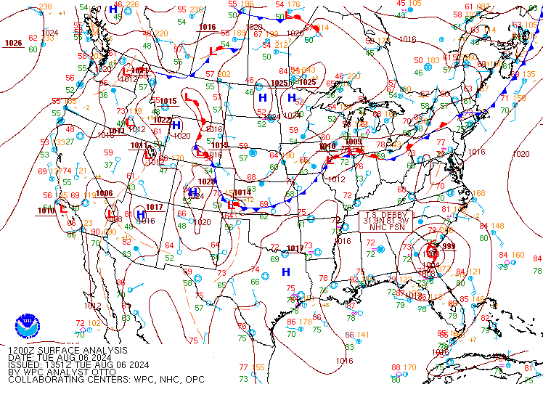
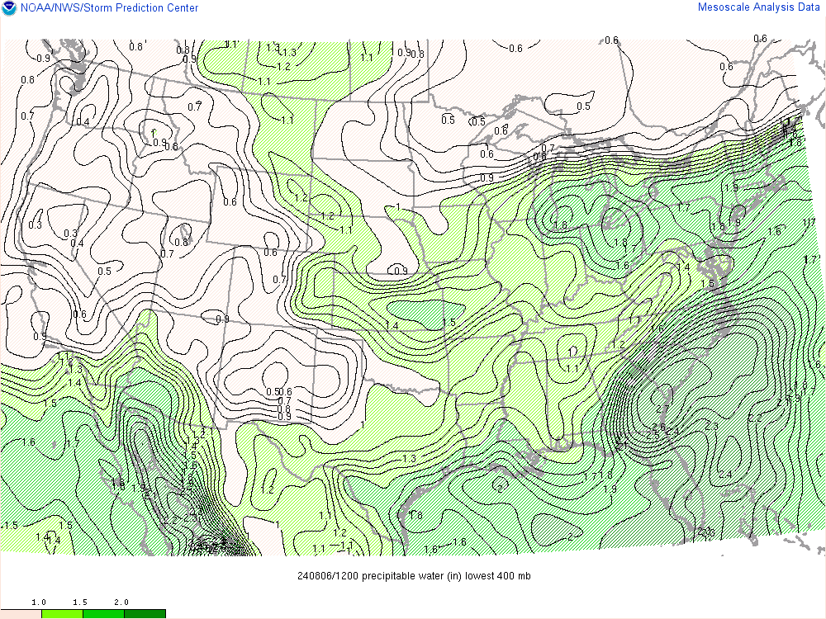
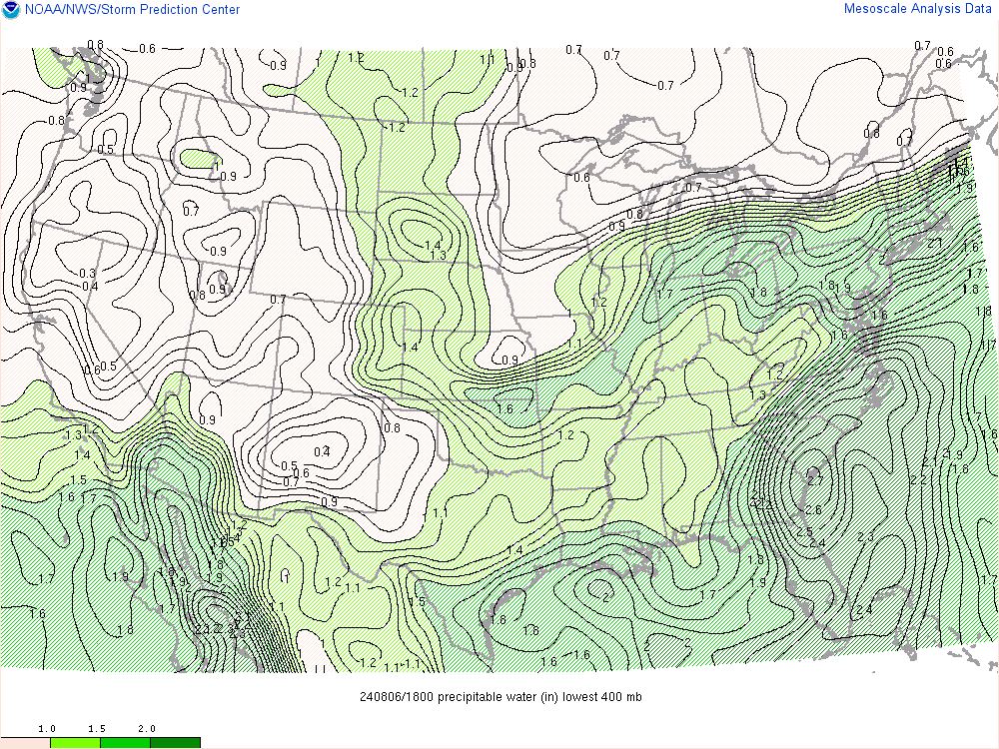
Along came the first week of August…
Potential for two consecutive heavy rainfall events August 6-9
Event #1: Slow moving cold front with tropical moisture feed (Tuesday-Wednesday)
Event #2: Remnants of Tropical Storm Debby (Thursday-Friday)
12Z 8/6/24 Surface Analysis
12Z 8/6/24 Precipitable Water
18Z 8/6/24 Precipitable Water
National Weather Service
WFO New York, NY

Slide 15
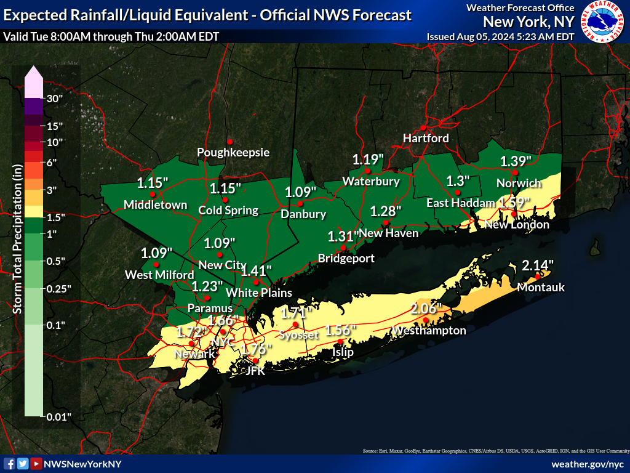
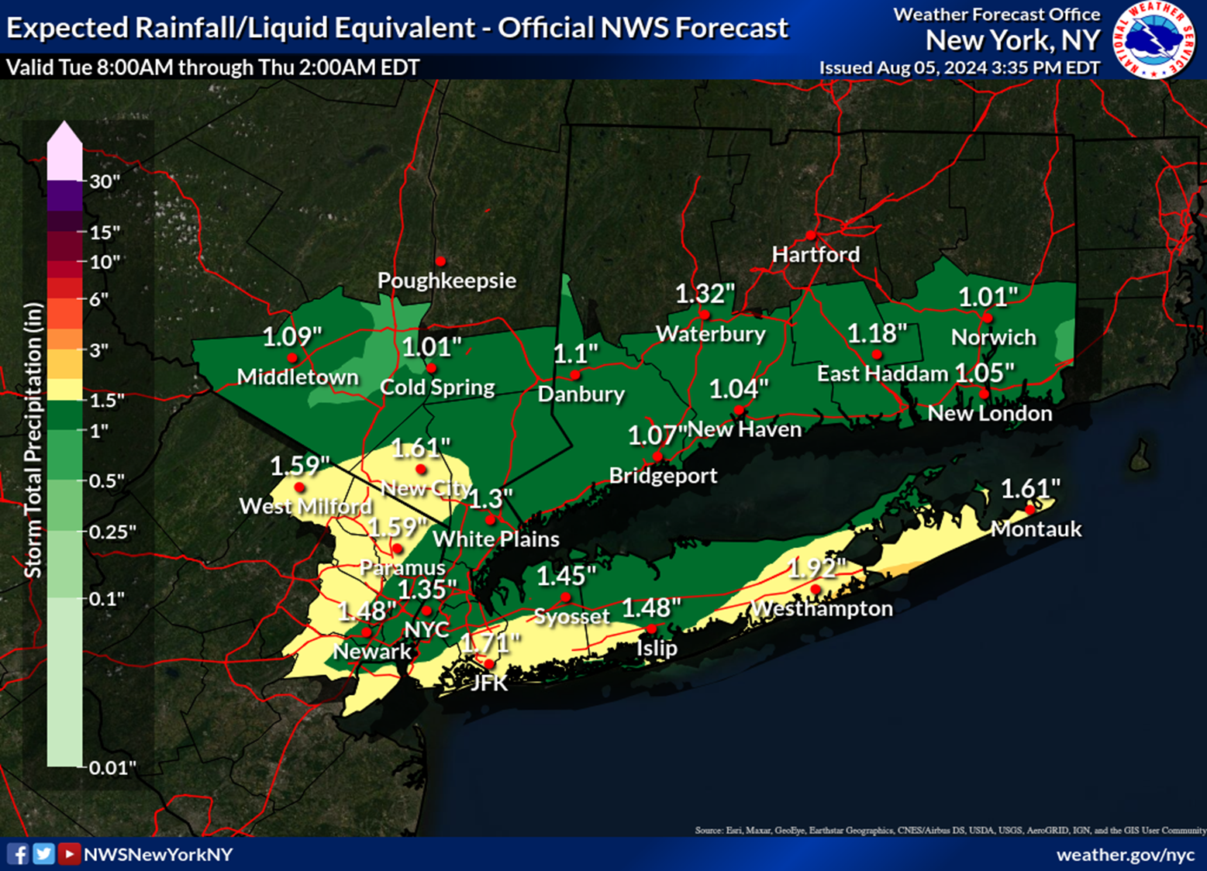
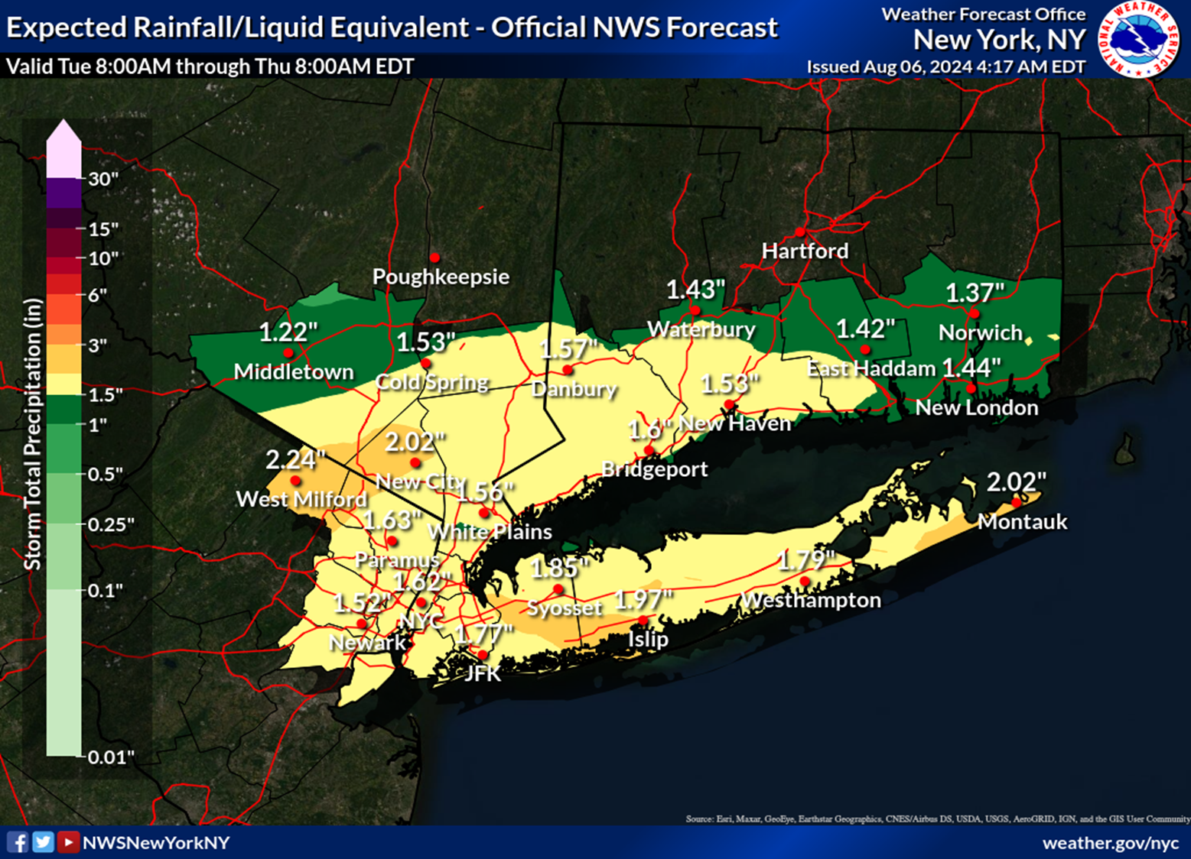
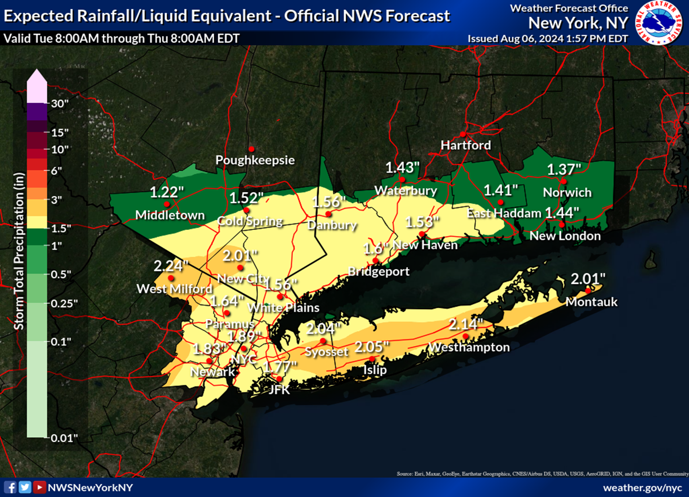
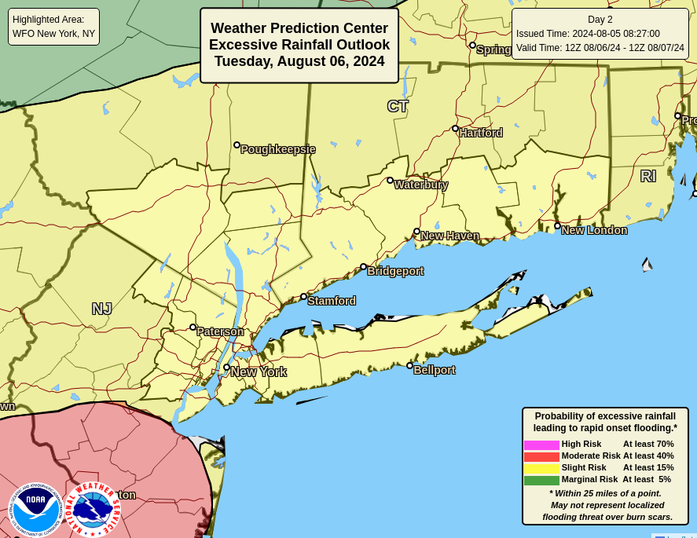
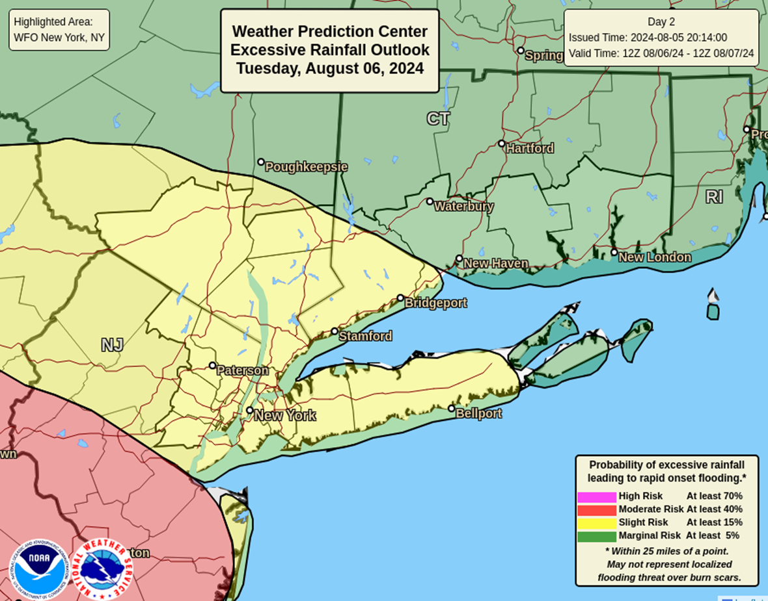
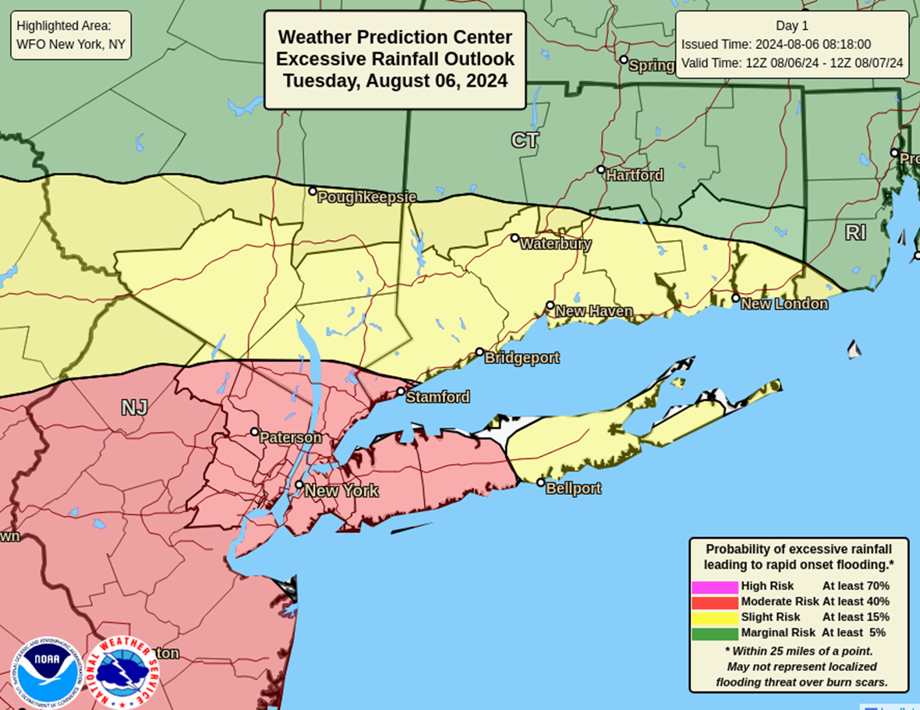
Event #1
Cold front + tropical moisture
Monday morning
Monday afternoon
Tuesday morning
Tuesday afternoon
National Weather Service
WFO New York, NY

Slide 16
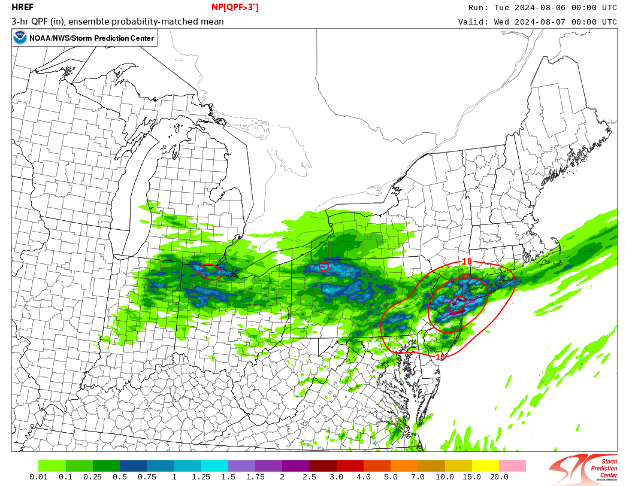
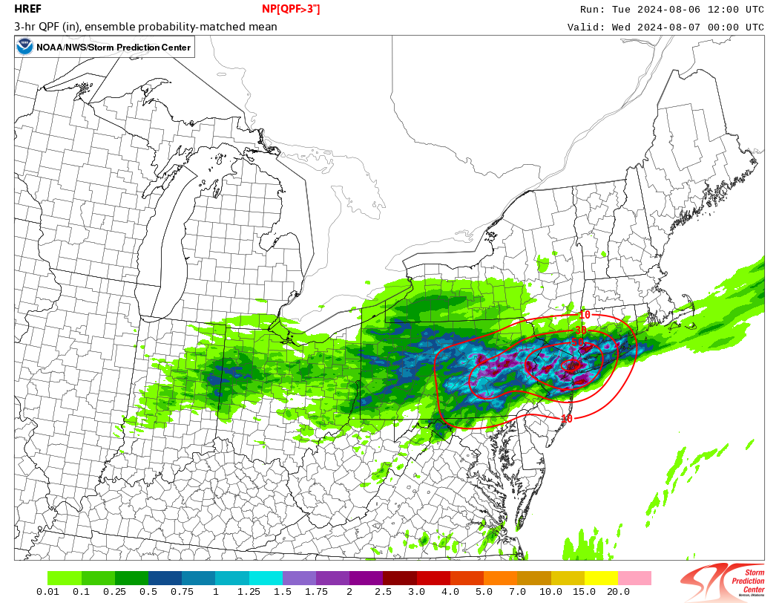
Event #1
Cold front + tropical moisture
What tools do we have available now to communicate the risk of a potentially significant rainfall/flooding event that we did not have in 2021?
00Z 8/6 HREF
Valid 00Z 8/7
12Z 8/6 HREF
Valid 00Z 8/7
National Weather Service
WFO New York, NY

Slide 17
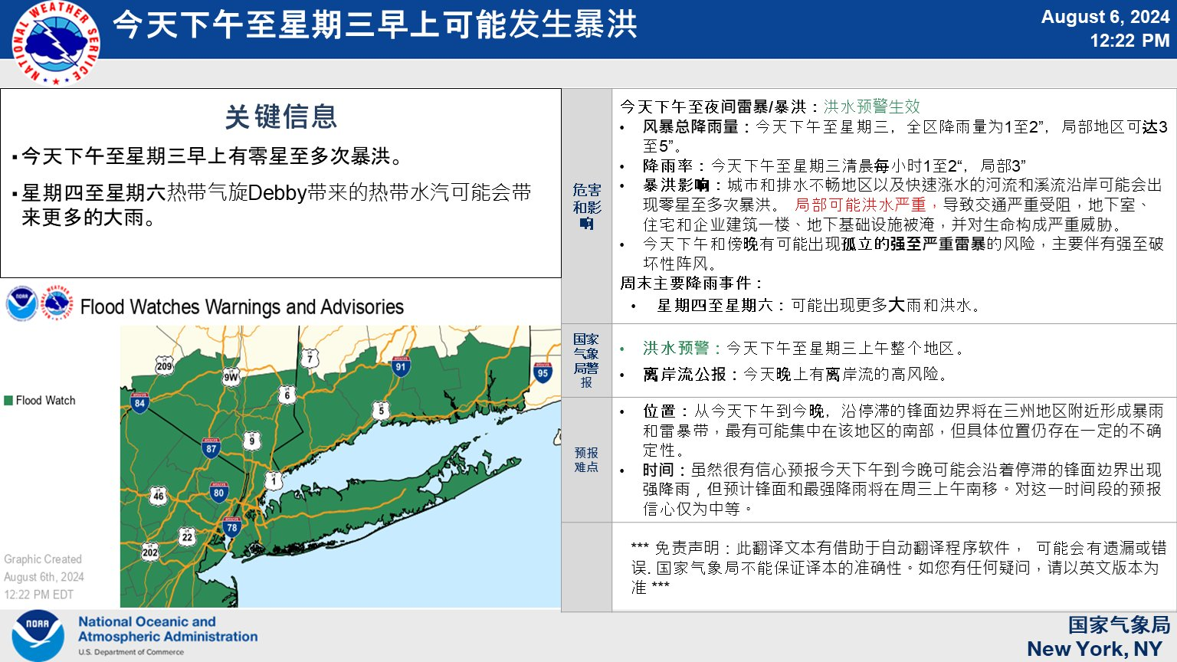
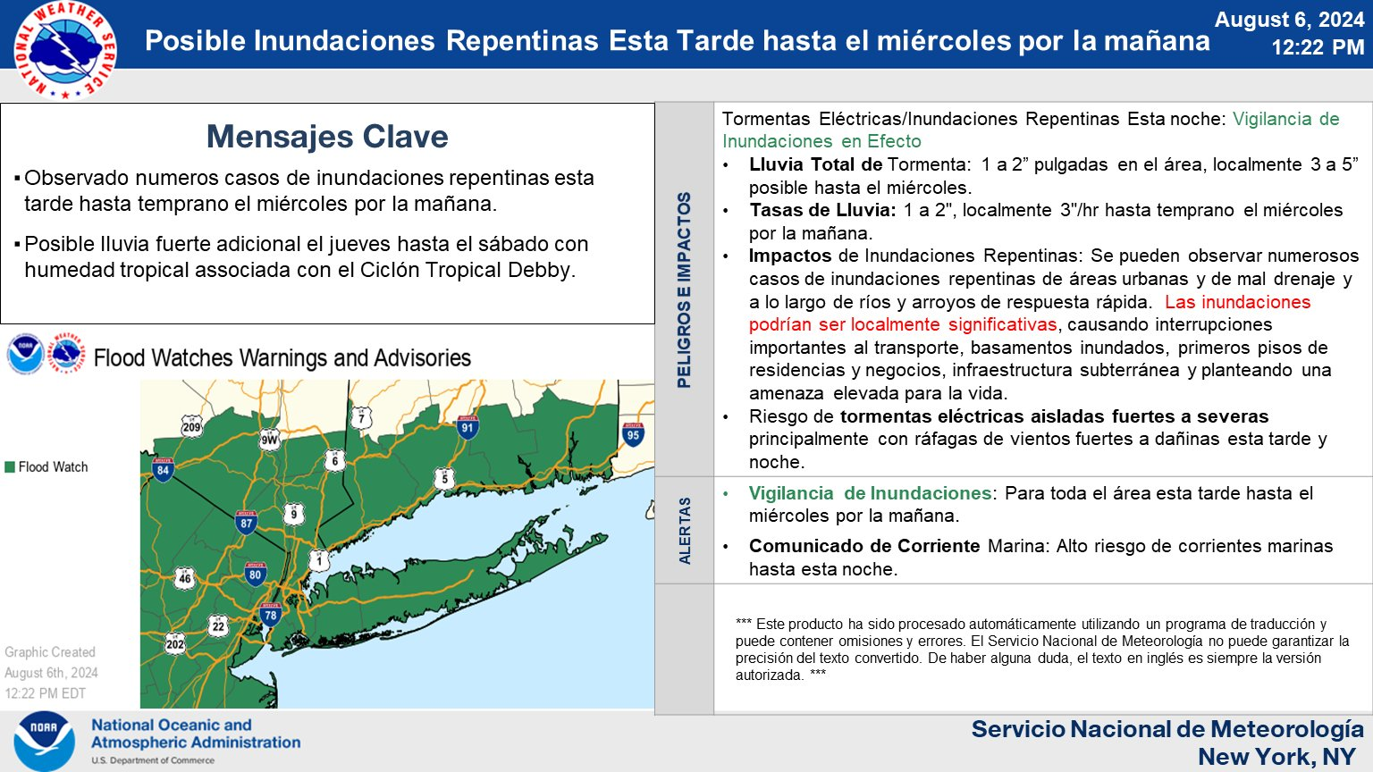
Social Media
@NWSNewYorkNY
National Weather Service
WFO New York, NY

Slide 18
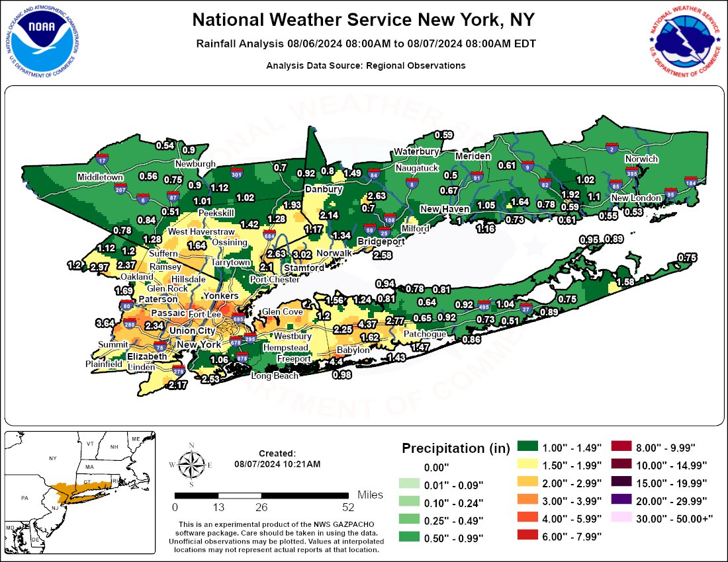
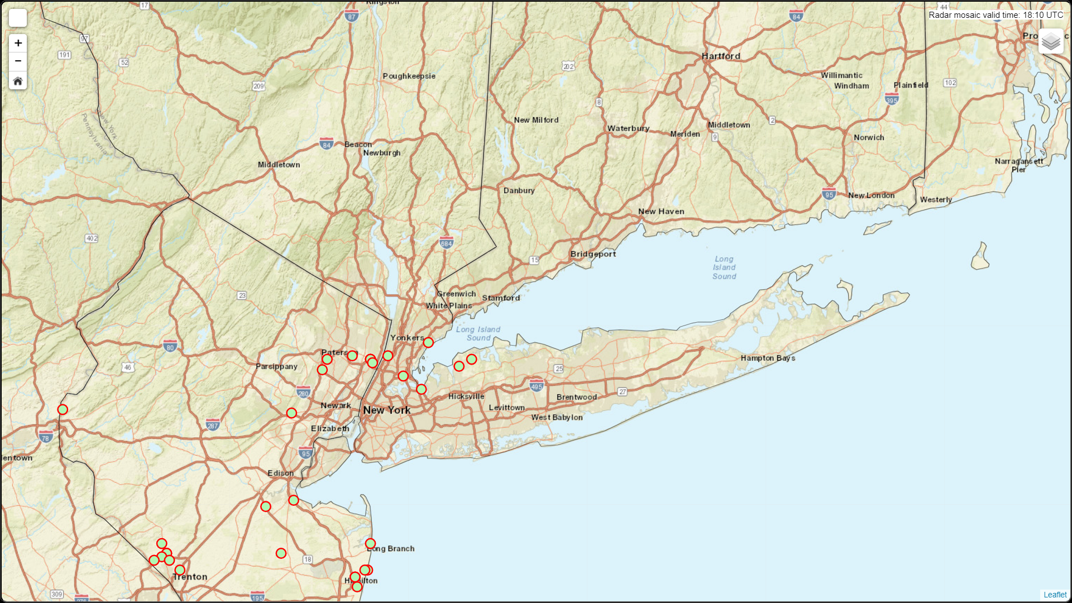
Event Wrap Up
@NWSNewYorkNY
National Weather Service
WFO New York, NY

Slide 19
NWS Translations – Future Plans
Locally:
Developing a social media strategy for translated content
Best practices
Triggers for posting product links vs. full translations
Developing a library of pre-translated content – simple phrases that can be reused
Nationally:
Incorporate translated text into NOAA Weather Radio broadcasts
Expand automated Twitter/X posts to additional languages
Integrate translations directly into a new and improved weather.gov
GOAL: Every office will have the ability to automatically translate products into Spanish and select other languages based on local need
(Languages: Arabic, Chinese, French, Haitian Creole, Korean, Portuguese, Russian, Samoan, Somali, Spanish, Vietnamese)
National Weather Service
WFO New York, NY

